Slide 1
Leveraging Implementation Strategies to Promote Healthy Mental, Emotional, and Behavioral Development Byron J. Powell, PhD, LCSW University of North Carolina at Chapel Hill March 6, 2018 | National Academies of Sciences, Engineering, and Medicine Presented to the Committee on Fostering Healthy Mental, Emotional, and Behavioral Development Among Children and Youth

Slide 2
Each aspect of the implementation context that the CFIR highlights is potentially amenable to the application of targeted and tailored implementation strategies.
Powell et al., 2012

Slide 3
Overview
Identifying and Selecting Implementation Strategies
Assessing the Evidence
Priorities and Recommendations

Slide 4
Leveraging Implementation Strategies
1
2
3
Identifying and Selecting Implementation Strategies

Slide 5
Methods or techniques used to enhance the adoption, implementation, sustainment, and scale-up of a program or practice.
Proctor, Powell, & McMillen, 2013; Powell, Garcia, & Fernandez, In Press

Slide 6
Types of Strategies
Discrete – Single action or process (e.g., reminders, audit and feedback, supervision)
Multifaceted – Combination of multiple discrete strategies (e.g., training + consultation)
Blended – Multifaceted strategies that have been protocolized and (often) branded (e.g., Glisson’s ARC, Aarons’ LOCI)
Powell et al., 2012

Slide 7
Initial Question
What strategies can be used to implement effective programs and practices?
Powell et al., 2012

Slide 8


Literature Reveals Problems
“Tower of Babel”
Limited “Menu”
Poor Reporting
McKibbon et al., 2010; Michie et al., 2009; Powell et al., 2012; Proctor et al., 2013

Slide 9
Developing Initial Compilation
Structured Review
Taxonomies & reviews (n = 41)
Blended strategies (n = 15)
Empirical, descriptive, & conceptual articles (n = 149)
Powell et al., 2012

Slide 10
Initial Compilation
Plan strategies
Assess readiness
Identify champions
Educate strategies
Educational meetings
Shadow clinicians
Finance strategies
Alter incentives
Place on formulary
Restructure strategies
Change systems
Revise roles
Quality mgmt. strategies
Audit and feedback
Clinical supervision
Policy context strategies
Change requirements
Change liability laws
Powell et al., 2012

Slide 11
Establishing Consensus & Ratings

Slide 12
Methods
Expert Panel:
71 experts in implementation science and practice
3 Round Delphi:
Rounds 1 & 2 (n = 57 & 43): survey to refine original compilation
Round 3 (n = 40): live polling and consensus process
Concept Mapping:
35 participants sorted & rated strategies
Analysis: multidimensional scaling & hierarchical cluster analysis

Slide 13
Updated Strategies Compilation
*See Additional File 6 for most comprehensive version of the compilation

Slide 14
Waltz et al., 2015

Slide 15
Waltz et al., 2015

Slide 16
Waltz et al., 2015

Slide 17
Concept Mapping Findings

Slide 18
Utility of Compilation
Identifying “building blocks” of multi-level, multi-faceted strategies for research and practice
Specifying “active ingredients” of strategies
Tracking strategy use
Assessing fidelity to strategies
Improving reporting of implementation strategy use
Promoting a common language for strategies
Highlighting under-researched strategies

Slide 19
Visibility and Application

Slide 20
Helpful Extensions
Adapted for school mental health settings (Cook et al., Under Review; Lyon et al., Under Review)
Planned adaptation for child maltreatment prevention programs in LMICs (Martin, In Prep)

Slide 21

Now what?
How do we select and tailor strategies?

Slide 22

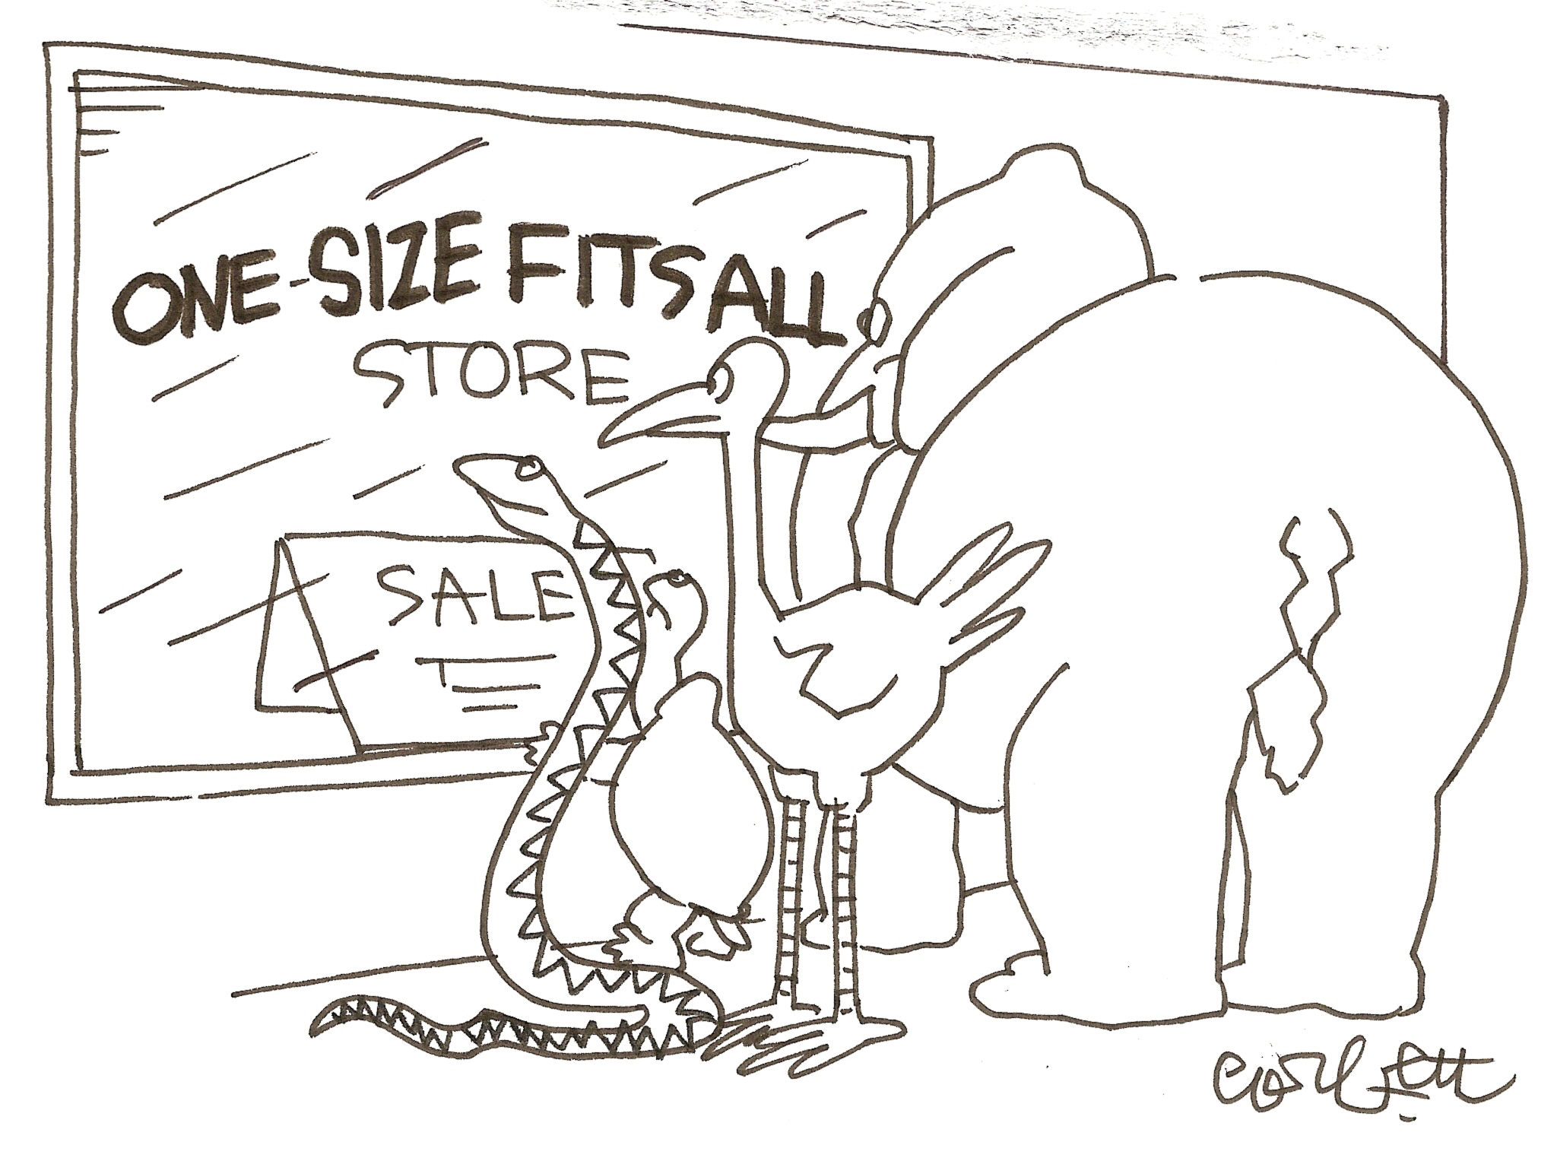
The Status Quo
Most frequently used model of change: ISLAGIATT
Martin Eccles
“It seemed like a good idea at the time!”

Slide 23
The Ideal
Participation
Evidence
Context
Theory
Colquhoun et al., 2017; Powell et al., 2017

Slide 24
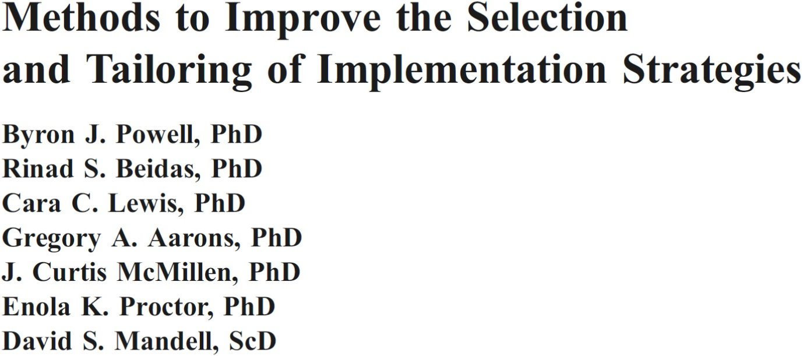
Methods for Selecting & Tailoring
Colquhoun et al., 2017; Powell et al., 2017

Slide 25
Strong Barrier-Strategy Linkages
Identified barrier | Relevant implementation strategies
Lack of knowledge | Interactive education sessions
Perception/reality mismatch | Audit and feedback
Lack of motivation | Incentives/sanctions
Beliefs/attitudes | Peer influence/opinion leaders
Systems of care | Process redesign

Slide 26
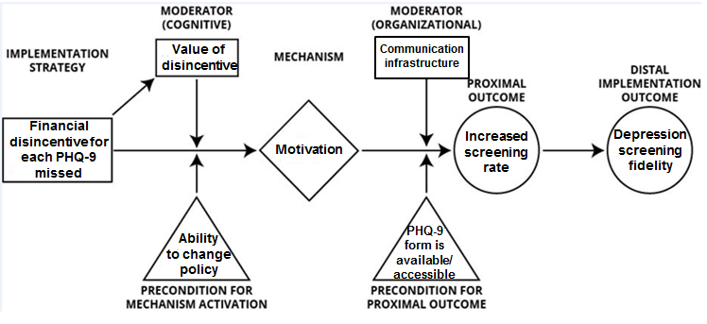
Elucidating Causal Pathways
Lewis et al., Under Review

Slide 27
Name it, Define it, Specify it!
Proctor, Powell, & McMillen, 2013

Slide 28
Applied Example
TF-CBT Learning Collaborative (11 component strategies*)
Prepare change package
Commitment
Learning sessions
PDSA cycles
Conference calls
Web support
Quality improvement technique training
Metrics reporting
Coaching calls
Onsite visits
Rostering
*Each specified according to Proctor et al. (2013) standards
Bunger et al., 2014

Slide 29
Bunger et al., 2014

Slide 30
Leveraging Implementation Strategies
1
2
3
Assessing the Evidence

Slide 31
Evidence-Base for ERIC
Some ERIC strategies have systematic reviews assessing their effectiveness (e.g., audit and feedback, opinion leaders, facilitation), whereas others are unlikely to be tested as stand-alone strategies (e.g., obtain formal commitments, shadowing clinicians)
Increasingly, focus is not on whether or not they work, but how does it work? Why Where? For whom? How can we enhance effectiveness?

Slide 32
Strategy Review | Number of Trials | Effect Sizes
Printed Educational Materials | 14 Randomized Trials 31 ITS | Median absolute improvement 2.0% (range 0% to 11%)
Educational Meetings | 81 Randomized Trials | Median absolute improvement 6% (IQR 1.8% to 15.3%)
Educational Outreach | 69 Randomized Trials | Median absolute improvement in prescribing behaviors 4.8% (IQR 3% to 6.6%), other behaviors 6% (IQR 3.6% to 16%)
Local Opinion Leaders | 18 Randomized Trials | Median absolute improvement 12% (6% to 14.5%)
Audit and Feedback | 140 Randomized Trials | Median absolute improvement 4.3% (IQR .5 to 16%)
Computerized Reminders | 28 Randomized Trials | Median absolute improvement 4.2% (IQR .8 to 18.8%)
Tailored Interventions | 26 Randomized Trials | Meta-Regression using 15 trials. Pooled odds ratio of 1.56 (95% CI, 1.27 to 1.93, p < .001)
Examples of Cochrane EPOC reviews updated from Grimshaw et al., 2012

Slide 33
Multi-faceted Strategies
Mixed evidence regarding the effectiveness of multifaceted strategies. Two plausible explanations:
Lack of a priori rationale for selection of components (could be “kitchen sink” approach)
Some multifaceted strategies may focus on only one type of barrier; some single component strategies may address multiple barriers
Grimshaw et al., 2012; Lau et al., 2015; Squires et al., 2014; Wensing et al., 2017

Slide 34
Tailored Strategies
Some evidence that supports effectiveness
Need to get better at identifying and prioritizing barriers
Often a mismatch between barriers and strategies
May require ongoing tailoring throughout implementation process, which can pose threats to trials
Need systematic methods for tailoring and more head-to-head comparisons of tailored vs. non-tailored strategies
Little evidence on cost
Baker et al., 2015; Bosch et al., 2007; Wensing, 2017

Slide 35
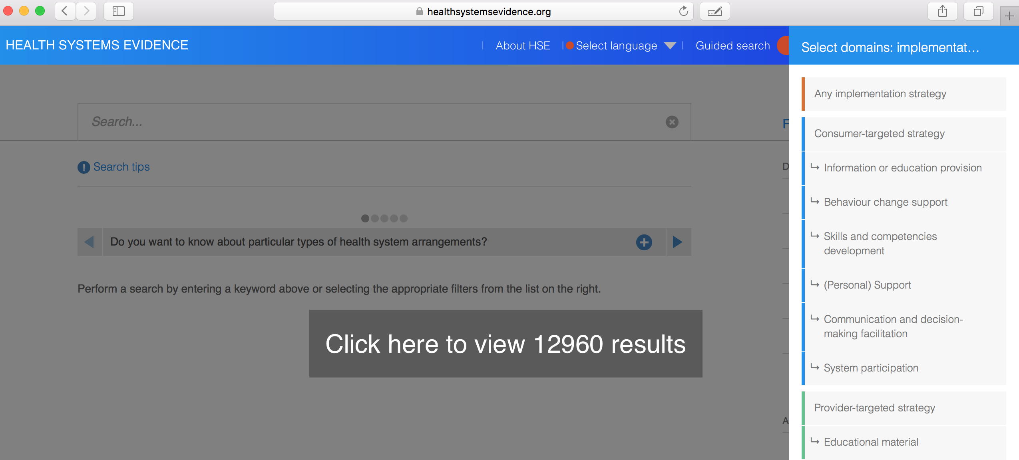
Resources to Assess Evidence
Cochrane EPOC (epoc.cochrane.org)
Campbell Collaboration (campbellcollaboration.org)
Health Systems Evidence (healthsystemsevidence.org)

Slide 36
Leveraging Implementation Strategies
1
2
3
Priorities and Recommendations

Slide 37
Enhance Methods for Designing and Tailoring
1
Need “systematic and rigorous methods…to enhance the linkage between identified barriers and strategies”
Numerous candidate methods have been identified, though few have been evaluated formally
Baker et al., 2015; Bosch et al., 2007; Colquhoun et al., 2017; Grol et al., 2013; Powell et al., 2017

Slide 38
Specify Mechanisms
2
Focus on establishing mechanisms of change
Identify mediators, moderators, and pre-conditions
Increase use of causal theory and model proposed causal pathways
Improve design and analysis of multilevel mediation models in trials
Lewis et al., Under Review; National Institutes of Health, 2016; Weiner et al., 2012; Williams et al., 2016

Slide 39
Conduct more comparative effectiveness research
3
Diversify the strategies tested
Need for more comparative studies of discrete, multifaceted, and tailored strategies
Utilize a wider range of designs and methods
Brown et al., 2017; Institute of Medicine, 2009; Lau et al., 2015; Mazucca et al., 2018; Powell et al., 2014;

Slide 40
Increase Economic Evaluations
4
In a review of 235 implementation studies, only 10% provided information about implementation costs
Severely inhibits decision making regarding strategies
Practical tools have been developed (e.g., COINS)
Common framework facilitating comparability is needed
Raghavan et al., 2018; Saldana et al., 2014; Vale et al., 2007

Slide 41
Improve Description, Tracking, and Reporting
5
Poor description, tracking, and reporting:
Limits replication in science and practice
Precludes answers to how and why strategies work
Numerous reporting guidelines exist
Need pragmatic approaches for tracking strategies
Albrecht et al., 2013; Boyd et al., 2018; Bunger et al., 2017; Hoffman et al., 2014; Proctor et al., 2013

Slide 42
Acknowledgments
National Institutes of Health
NIMH K01MH113806 (Powell, PI)
NIMH LRP (Powell, PI)
NIMH R25MH080916 (Proctor, PI)
NIMH R01MH106510 (Lewis, PI)
NIMH R01MH103310 (Lewis, PI)
NIH UL1TR001111 (Buse, PI)
NIAID P30A1050410 (Golin, PI)
Department of Veterans Affairs
Mental Health QUERI QLP 55-025
Expert Recommendations for Implementing Change Team
National Child Traumatic Stress Network
North Carolina Child Treatment Program
Society for Implementation Research Collaboration

Slide 43
Contact Information
Byron J. Powell, PhD, LCSW
Department of Health Policy and Management | Gillings School of Global Public Health
Cecil G. Sheps Center for Health Services Research
Frank Porter Graham Child Development Institute
University of North Carolina at Chapel Hill
bjpowell@unc.edu | 919-843-2576 | http://sph.unc.edu/adv_profile/byron-powell

