Slide 1
Environmental Monitoring, Safety & Emergency
April 2011

Slide 2
Concerns
Detection of Fires
Electrical Equipment behind panels
Cabling Systems
Components of thermal subsytems
Response
Rapid detection
Acceptable correction
Limit risk
Fire suppression without damage

Slide 3
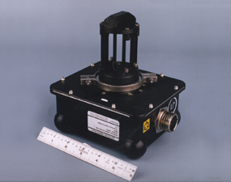
Smoke Detection (SD)
Smoke Detectors
  Obscuration and scatter technology
  Power 1.48 W
  Weight 2.76/ 3.66 Max
  Duct or Area detection
  1.9 x10E7 – 15.2 PSIA
  10 -100 ft/min
  0.09cuft max
  36 – 120 F temp
  One on-orbit failure

Slide 4
Other Sensors
Detection of Safety Concerns
Sensors
  Carbon Dioxide
  Pressure
  Temperature
  Gas Analyzers
Characteristics
  Accurate
  Miniature
  Low Power
  Smart Sensor

Slide 5
ECLSS Challenges

