Slide 1
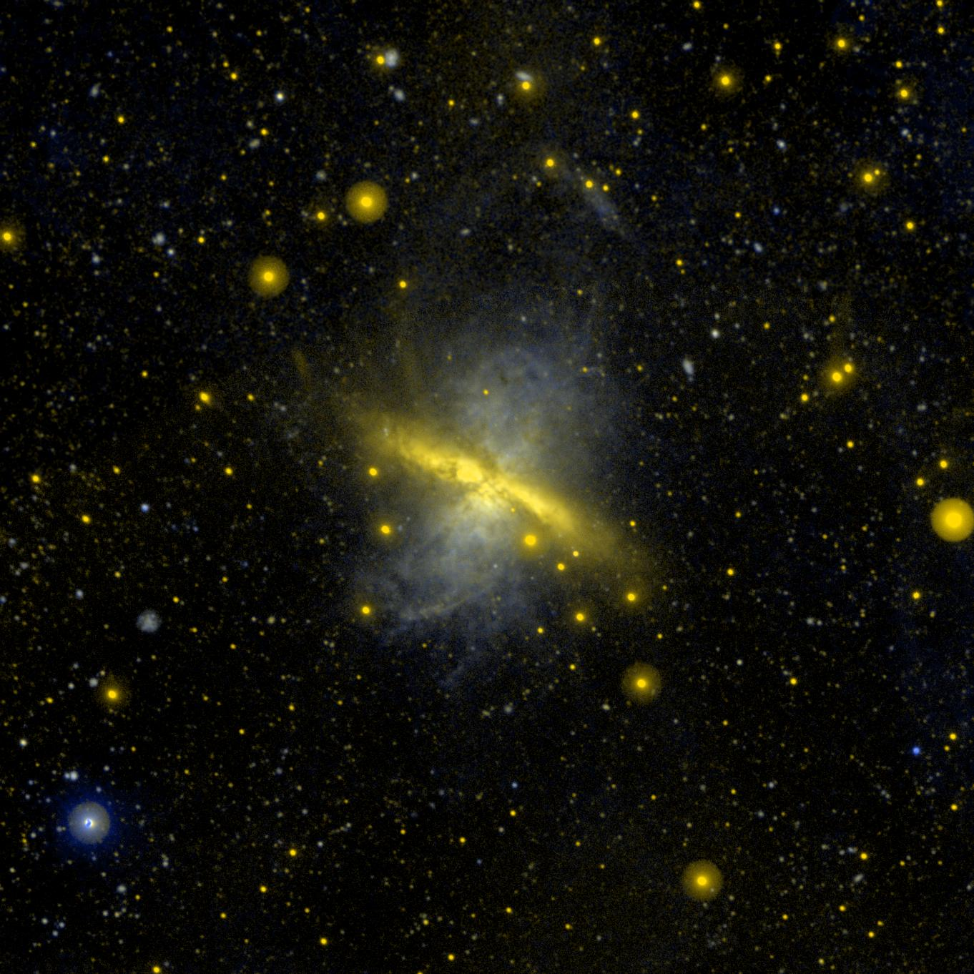
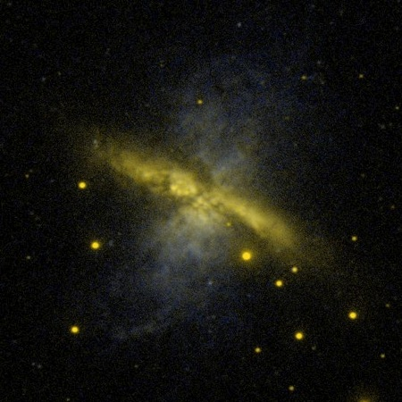
Potential Impacts of UV/Optical Photon-Counting DetectorTechnology Developments
Christopher Martin
California Institute of Technology
NRC Technology Roadmap Panel Workshop on
Instruments and Sensors, U.C. Irvine, 29 March 2011

Slide 2
Representing
Developer: UV Detectors
User: UV experimental astrophysics mission builder/user (GALEX, FIREBALL, future missions)
Community Rep: Cosmic Origins Program Analysis Group (COPAG), Executive Chair
  Future 4-m class UV/optical mission target
  Future Far IR instruments (SOFIA, Spica)

Slide 3
Assessment Criteria
Criterion | UV photon-counting (high QE, low noise) (0.1-0.3 μm) | Visible photon-counting (0.3-1.0 μm) | Near IR photon-counting (1-5 μm)
1. Benefit
2. NASA Alignment
3. non-NASA aerospace alignment
4. Alignment with National goals
5. Technical risk & reasonableness
6. Sequence & timing
7. Time & effort

Slide 4
UV photon-counting detectors
Quantum Efficiency

Slide 5
Observatory/Instrument Trends
Imaging: Low Spectral
Resolution R
High Spectral
Resolution R
Low Spatial
Resolution Δθ
High Spatial
Resolution Δθ
Low Temporal
Resolution Δt
High Temporal
Resolution Δt
Low Pixel
Count N²
High Pixel
Count N²
Low Dynamic
Range I_{max}/I_{min}
High Dynamic
Range I_{max}/I_{min}
Diff limited
Sensitivity
Time~D⁻⁴
Sky Background QE * Δt
Pixel R * Δθ²
✓✓Astrophysics
✓Heliophysics
✓Planetary
~

Slide 6
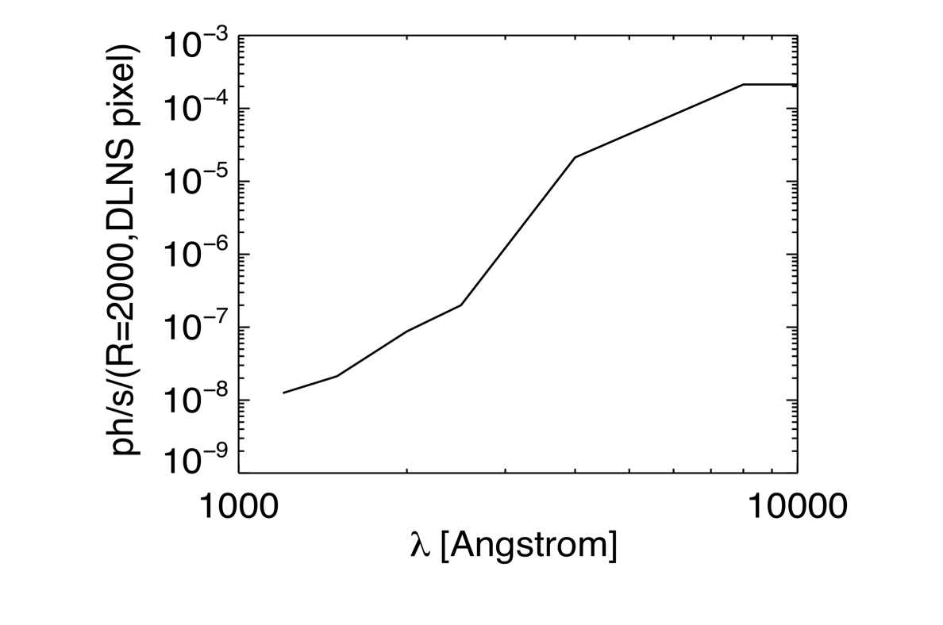
UV/Optical photon-counting detectors
Need for photon-counting
Photon background [ph s⁻¹ pixel⁻¹]
Space UV
Optical

Slide 7
Why UV? Dark UV Sky!

Slide 8
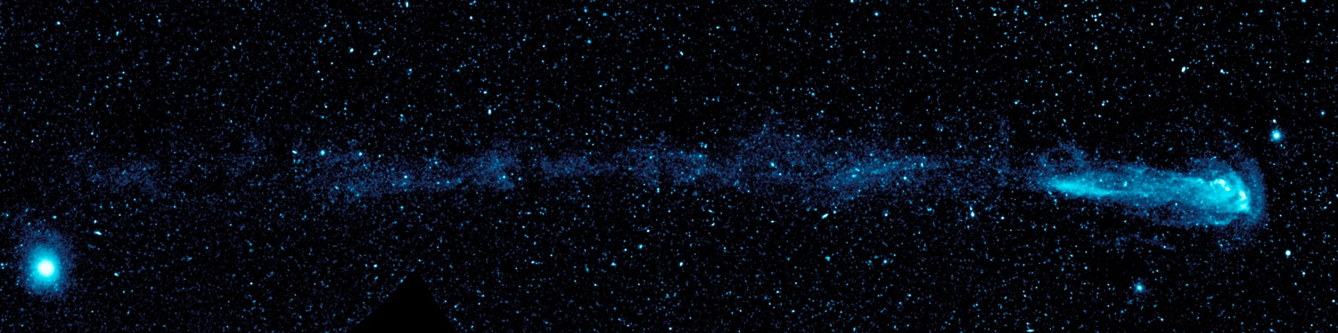
Mira

Slide 9
UV/Optical photon-counting detectors
Need for photon-counting – Sky background in Diffraction-limited spectrally dispersed pixel
Photon background [ph s⁻¹ pixel⁻¹]

Slide 10
UV/Optical Photon-Counting Detector
Key Requirements
Requirement | Detector Requirements
(1) High Sensitivity | High QE Sky-limited → Photon-counting Low internal background
(2) Large formats imaging spectroscopy highly-multiplexed spectroscopy wide field imaging large surveys spectral resolution spatial resolution | Large formats; Lots of pixels; scalability
(3) Large spectral coverage | UV/Optical (0.1-1 μm) Large formats; Lots of pixels
(4) Time resolution variability (<1 hr timescales) jitter reconstruction | Photon counting
(5) Dynamic Range | Photon counting + integrating

Slide 11
UV/Optical Photon-Counting Detector
Other Requirements
Scalability & Modularity
  Scalability to large and unique formats
  Flexibility to combine different features in new ways
Flight implementation
  Support equipment requirements (HV, coolers)
  Durability/Robustness
  Radiation tolerance
Stability, Hysteresis, Linearity
Band isolation – low red leak
  Accomplished by detector bandpass, spectrometer, filters, or coatings

Slide 12
Assessment Criteria
Criterion | UV photon-counting (high QE, low noise) (0.1-0.3 μm) | Visible photon-counting (0.3-1.0 μm) | Near IR photon-counting (1-5 μm)
1. Benefit
2. NASA Alignment
3. non-NASA aerospace alignment
4. Alignment with National goals
5. Technical risk & reasonableness
6. Sequence & timing
7. Time & effort

Slide 13
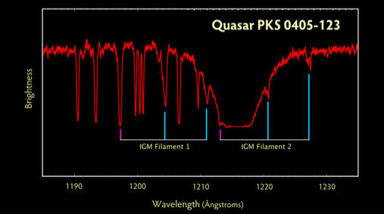
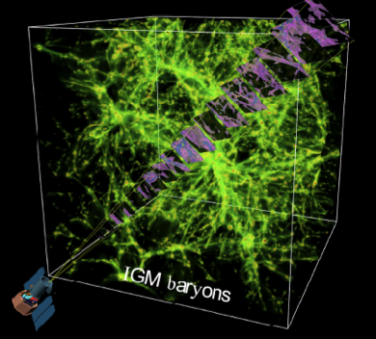
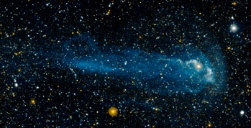
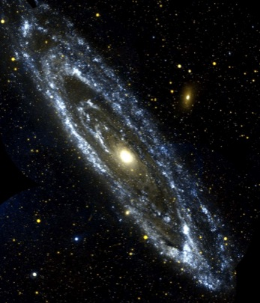
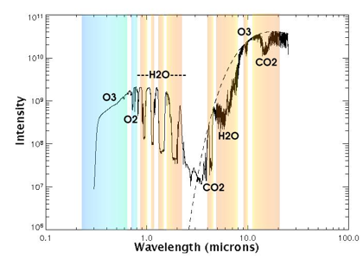
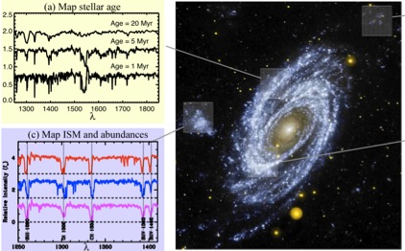
Applications for UV Photon Counting Detectors
UV Imaging
Spectroscopy of IGM
IGM UV absorption spectroscopy
UV Imaging
HST/COS/StScI
Exoplanet Emission &
Transmission spectroscopy
UV Imaging
Spectroscopy
Allard+ 2004

Slide 14
UV/Optical Photon-Counting Detectors: NASA Astrophysics Applications

Slide 15
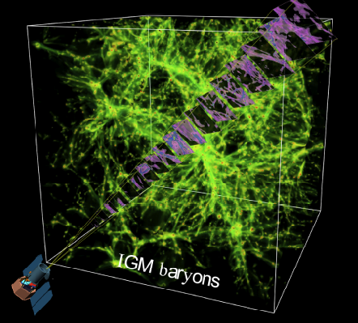
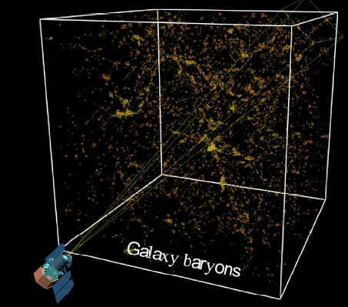
Applications for UV Photon Counting Detectors
Cosmic Web Baryon Mapping: Balloon, Explorer, 4-m UV/optical Mission

Slide 16
Applications for UV Photon-counting Detectors
Example: Cosmic Web Mapping: SNR Calculation
SNR w/ MCP, 10% QE, 1 ct/cm²/sec
  10⁶ sec, 1600Å, 200LU, 10” x 10”, S/N=1.4
SNR w/ 2 e⁻ CCD
  10⁶ sec, 1600Å, 200LU, 10” x 10”, S/N=0.4
SNR w/ photon-counting CCD, 70% QE
  10⁶ sec, 1600Å, 200LU, 10” x 10”, S/N=6
 | MCP | UV PC-CCD (2 e-) | UV PC-CCD (0 e-)
Telescope Diameter | 2.3 | 8 m | 0.5 m
Mission Cost | 1.2B | 9B | 0.1B
➔ Transformational (Game-changing) Capability

Slide 17
Assessment Criteria
Criterion | UV photon-counting (high QE, low noise) (0.1-0.3 μm) | Visible photon-counting (0.3-1.0 μm) | Near IR photon-counting (1-5 μm)
1. Benefit | Game-changing | Major improvement | Minor-Major improvement
2. NASA Alignment | Impacts multiple missions, areas | Impacts multiple missions in 1 area | Impacts at least 1 mission (WFIRST?)
3. non-NASA aerospace alignment | Remote sensing situational awareness | Remote sensing situational awareness | Remote sensing situational awareness
4. Alignment with National goals | Non-line-of-sight communication Biomolecule sensing Medical imaging (cancer cell detection) | Biotech applications
5. Technical risk & reasonableness
6. Sequence & timing
7. Time & effort

Slide 18
Assessment Criteria
Criterion | UV photon-counting (high QE, low noise) (0.1-0.3 μm) | Visible photon-counting (0.3-1.0 μm) | Near IR photon-counting (1-5 μm)
1. Benefit | Game-changing | Major improvement | Minor-Major improvement
2. NASA Alignment | Impacts multiple missions, areas | Impacts multiple missions in 1 area | Impacts at least 1 mission (WFIRST?)
3. non-NASA aerospace alignment | Remote sensing situational awareness | Remote sensing situational awareness | Remote sensing situational awareness
4. Alignment with National goals | Non-line-of-sight communication Biomolecule sensing Medical imaging (cancer cell detection) | Biotech applications
5. Technical risk & reasonableness
6. Sequence & timing
7. Time & effort

Slide 19
UV/optical Photon-counting Detectors
Potential Implementations

Slide 20
UV/optical Photon-counting Detectors
Potential Implementations
Back-Illuminated, Delta-Doped, AR-coated Electron Multiplying CCDs
Nikzad+2011

Slide 21
Assessment Criteria
Criterion | UV photon-counting (high QE, low noise) (0.1-0.3 μm) | Visible photon-counting (0.3-1.0 μm) | Near IR photon-counting (1-5 μm)
1. Benefit | Game-changing | Major improvement | Minor-Major improvement
2. NASA Alignment | Impacts multiple missions, areas | Impacts multiple missions | Impacts at least several missions
3. non-NASA aerospace alignment | Remote sensing/situational awareness | Remote sensing/situational awareness | Remote sensing/situational awareness
4. Alignment with National goals | Non-line-of-sight communication Biomolecule sensing Medical imaging (cancer cell detection) | Biotech applications
5. Technical risk & reasonableness | Moderate-to-high Good fit | Moderate-to-high Good fit | Moderate-to-high Good fit
6. Sequence & timing | Clear plan Joint user funding | Clear plan Joint user funding
7. Time & effort | Minimal to moderate effort | Minimal to moderate effort | Moderate effort

