Slide 1
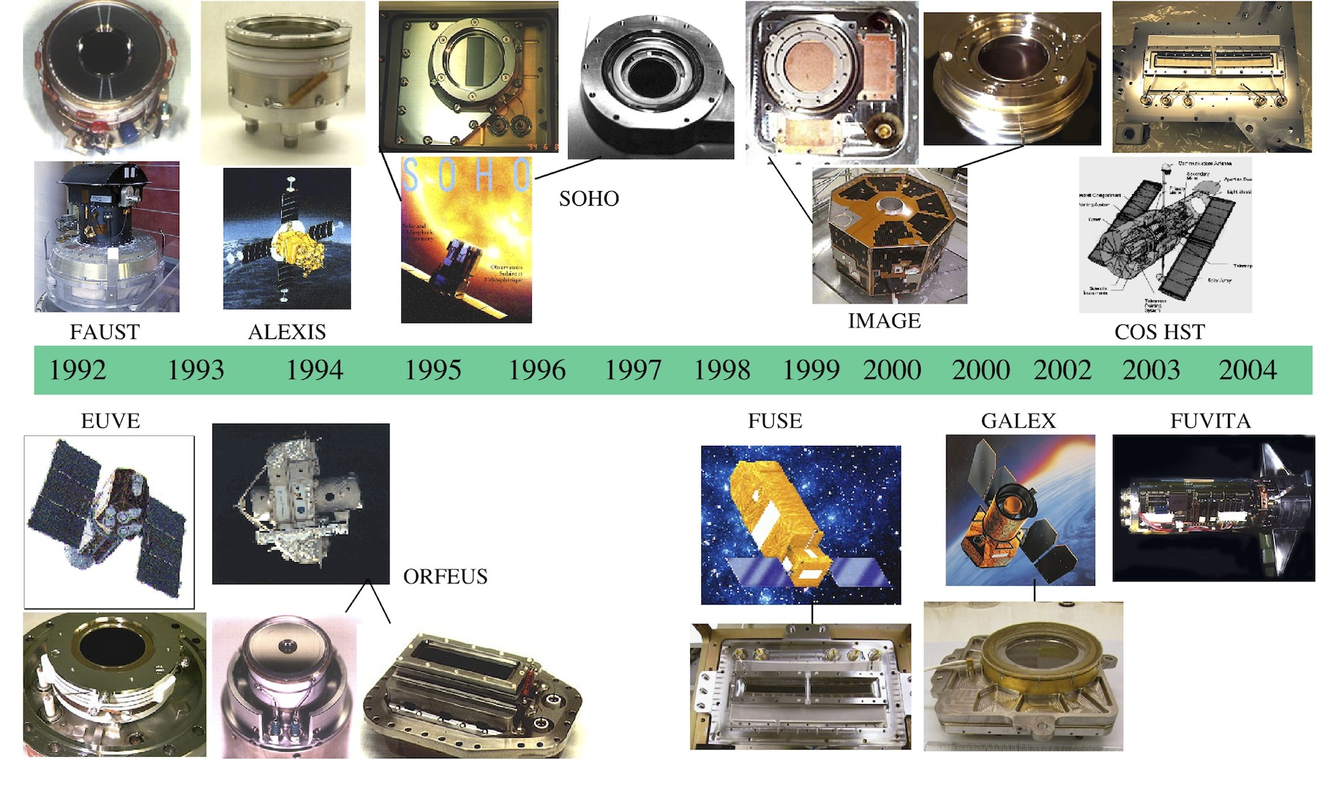
Microchannel plates have been a workhorse detector for NASA (+ESA) space-based UV missions
Continue to be proposed for future Explorer and sounding rocket instruments (Astronomy, Solar and Space physics)
Notes:
1

Slide 2
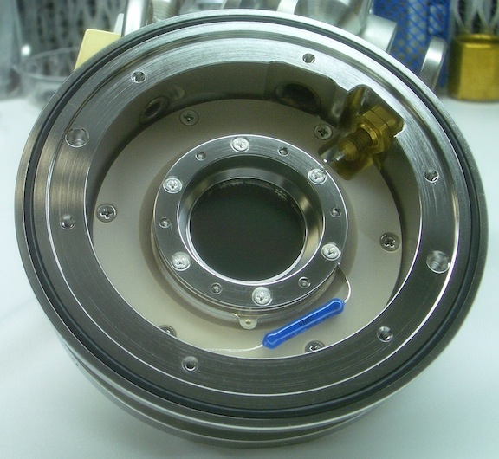
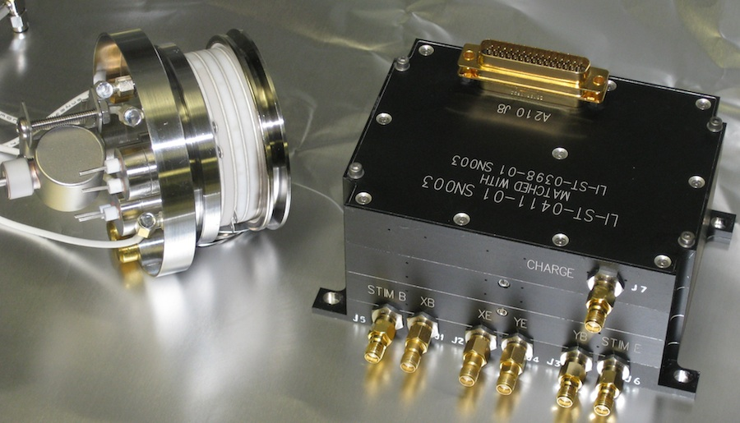
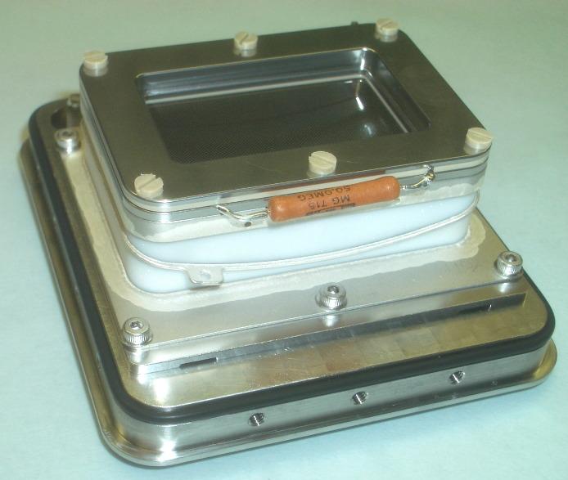
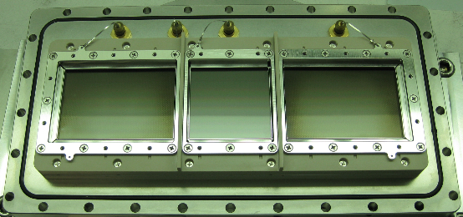
MCP Detectors Have been Used in a Wide Range of Formats
Shapes, Power, Weight, Volume, for Different Applications
JPEX (NRL) 25mm cross strip, 2008
SSULI, 40mm cross delay line, 2009
~1 Kg, 1 Watt (Pluto), 7cm R curved MCP
2003-2011
FORTIS (JHU) 60/40/60 x 40mm cross delay line, ~2012
45 x 30 mm delay line. Pluto
Persi-ALICE, LRO-LAMP,
JUNO-UVS, ROSETTA-ALICE

Slide 3
  Laboratory MCP detector development at Berkeley is examining three topics for future application:
  Cross strip readouts capable of large formats (>4k x 4k)
    Flexible formats (from small <20mm to >10cm)
    High spatial resolution at low gain (typical 10⁶ gain or less)
    High dynamic range (10 MHz with modern electronics)
    Needs implementation of modern ASIC for full performance benefit
  Improvements in photocathode QE to >50%
    III-V and Gallium Nitride FUV photocathodes
    GaAsP optical (up to 700nm)
  Borosilicate Glass MCPs with large areas
    Functionalize with atomic layer deposited coatings
    Long lifetime, low outgassing
    Very low background and low cosmic ray cross-section (no lead)
    Very affordable, with very large formats (20cm +)
    High melting point – (GaN opaque photocathode depositions)
Notes:
3

Slide 4
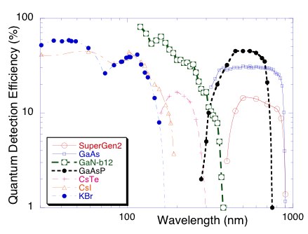
Photocathodes, 30nm - 1000nm
Standards;
CsI, KBr, 40% - 50% up to 130nm. CsTe <300nm, multi-alkali 300 – 900nm
Prospects; to cover the gaps
GaN “Solar blind” cathode for 100nm-400nm, high efficiency,
GaAsP, optical band 350 – 700nm, 50% peak QE.

Slide 5
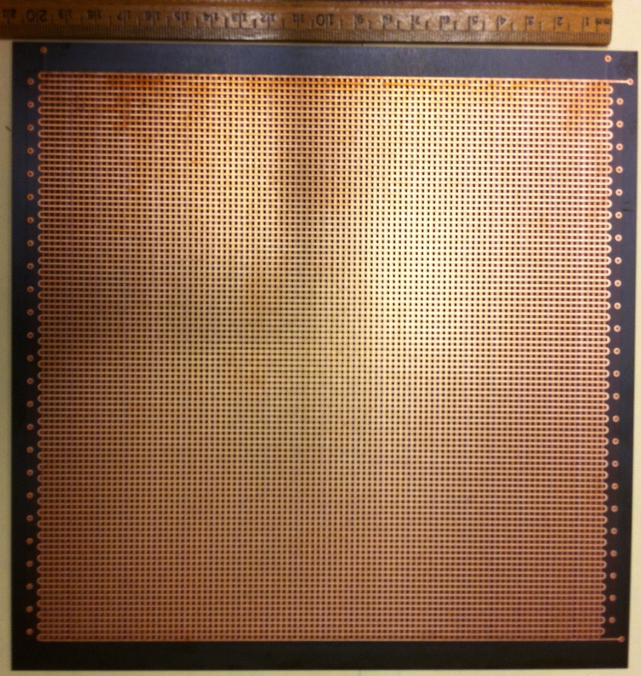
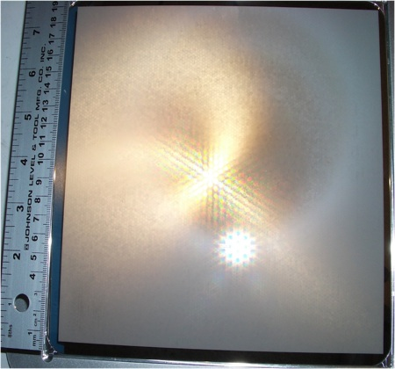
Borosilicate MCPs – Very Large Areas
Large area (8”x8”) MCP’s have been made with 20µm pores
Atomic Layer Deposited coatings for resistive/emissive layers.
Still at very early stages, but offer much larger areas than conventional MCPs at a fraction of the cost (<10%).
20cm cross delay line anode
20cm” square borosilicate MCP with 20µm pores

Slide 6
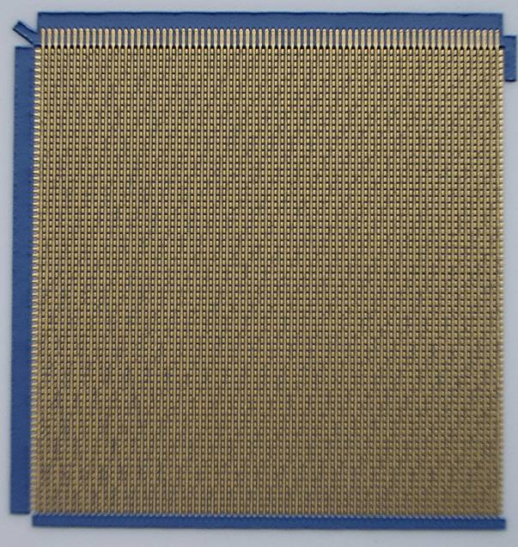
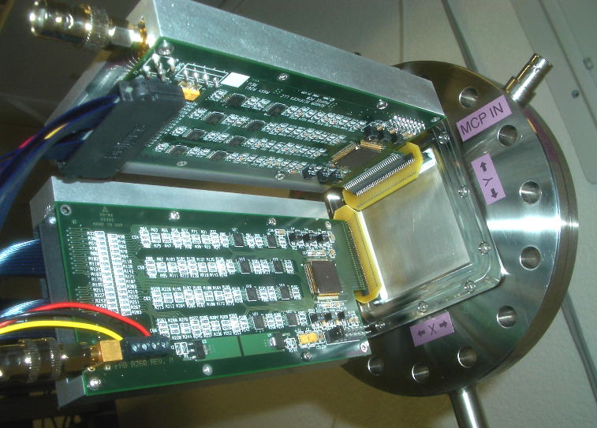
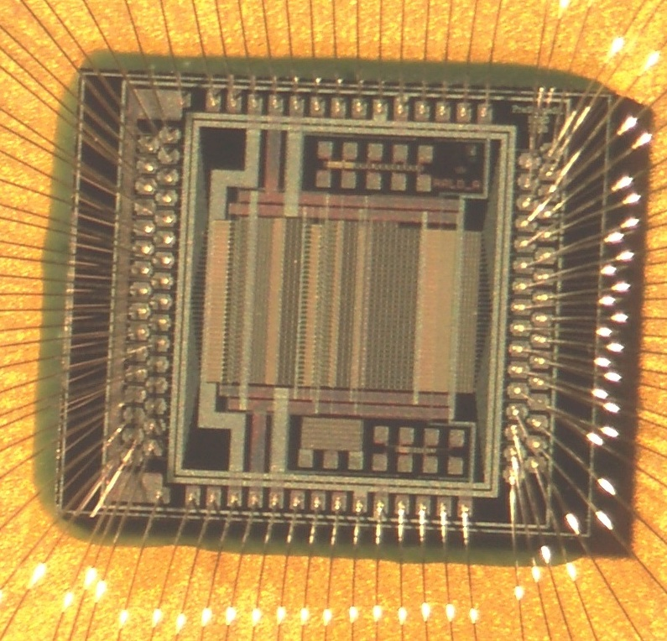
Cross Strip Readout Anode Detectors
ASIC amps on 40mm cross strip
50mm square Cross Strip Anode
with 0.6mm finger period.
Spatial resolution of <15µm on 50mm format, >3k x 3k
Lower gain, longer lifetimes, than existing devices
Can be extended to large sizes, but needs modern ASIC
electronics to fully implement performance capabilities
with >10MHz rates and large formats
32 Amplifier chip used is 1993 RAL/CERN

