Slide 1
Training Students to do Good with Data Data Science for Social Good Fellowship
Rayid Ghani
University of Chicago

Slide 2
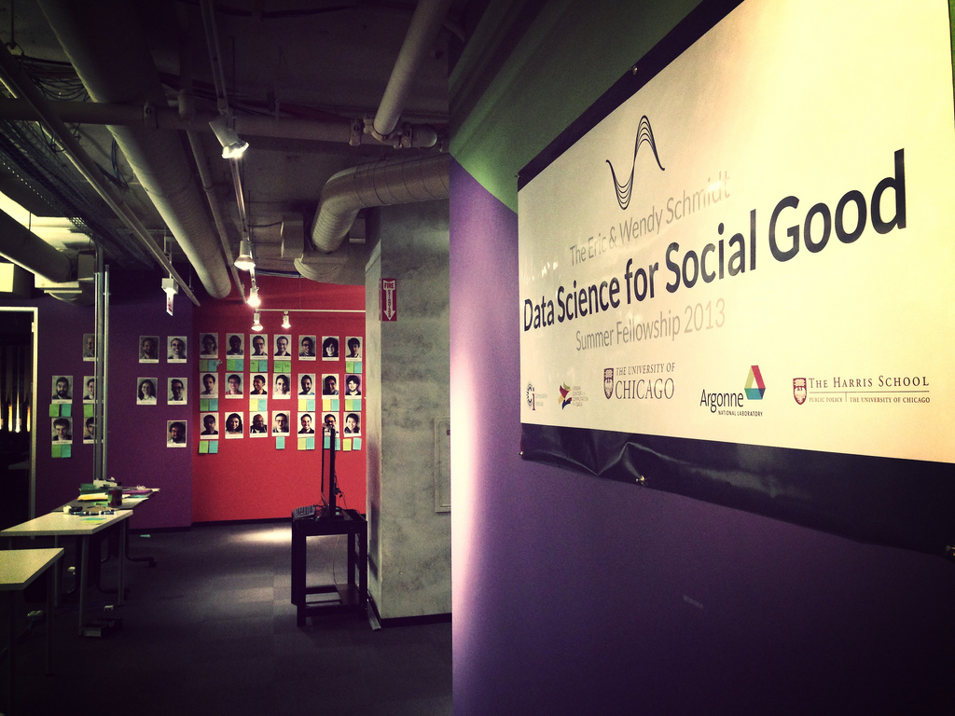

Slide 3
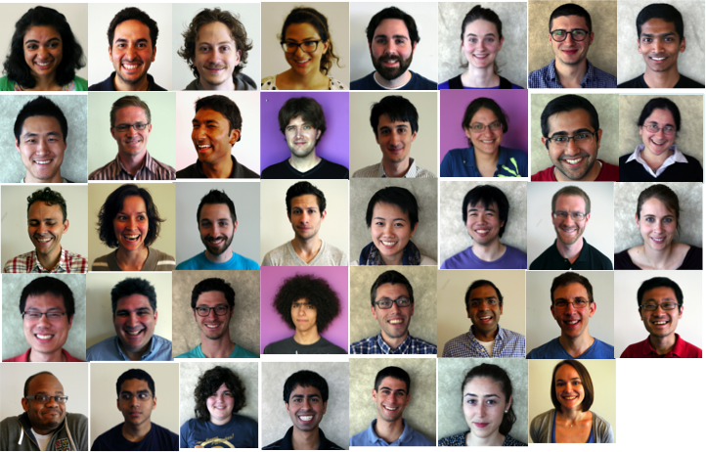

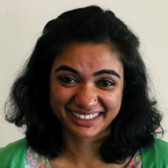
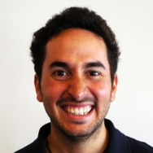
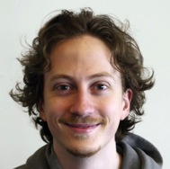
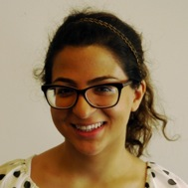
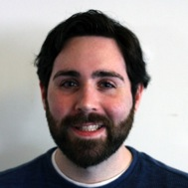
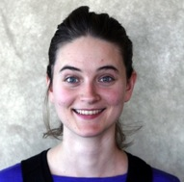
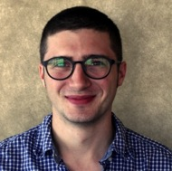
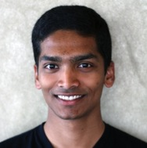
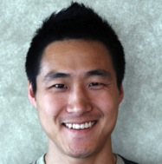
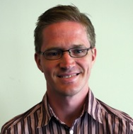
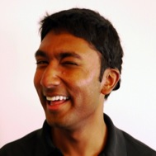
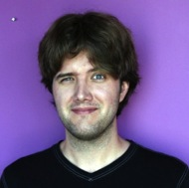
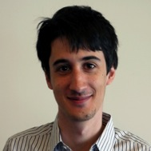
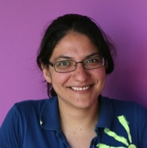
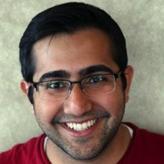
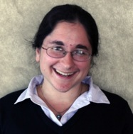
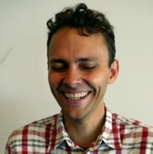
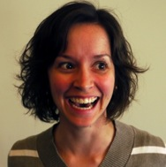
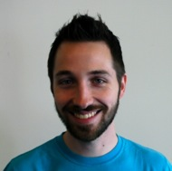
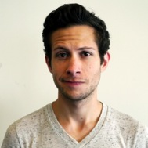
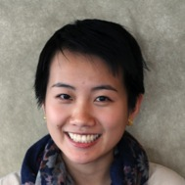
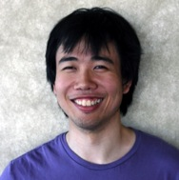
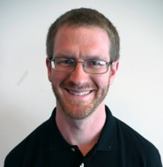
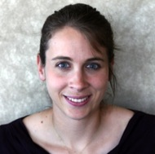
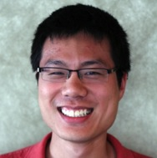
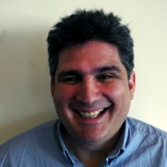
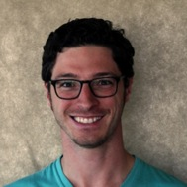
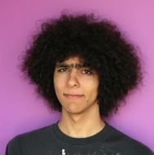
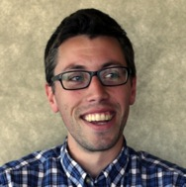
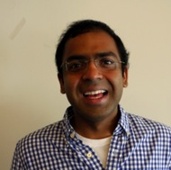
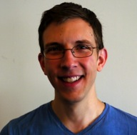
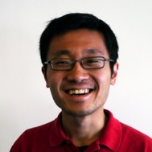
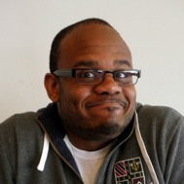
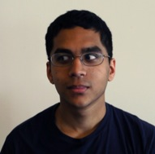
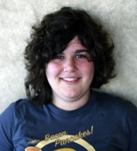
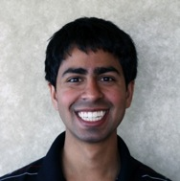
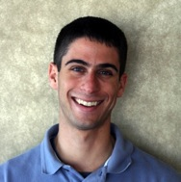
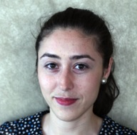
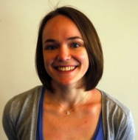
The Eric & Wendy Schmidt
Data Science for Social Good
Summer Fellowship 2013
550 Applicants from 34 countries ~200 Universities
36 fellows
Computer Scientists
Statisticians
Economists
Public Policy
(and other computational and quantitative fields)
CMU
U. of Chicago
Harvard
U. Of Wisconsin Madison
UT Austin
MIT
Yale
ITAM
Columbia
Northwestern
UIC
Stanford
Technion
U of Alabama
Georgia Tech
Cambridge
UC Irvine
U of Maryland
U of Michigan
Stanford
WPI

Slide 4

By the Numbers
38 Fellows
6 Mentors
12 Projects
12 Weeks

Slide 5
The Ideal Student
Making an Impact with Data
Computer Science & Programming
Statistics & Machine Learning
Econometrics & Social Science Methods
Databases
Experimental Design
Communication
Common Sense

Slide 6
Problem Solving Skills
Methods
Tools
Python
R
DBs
MapReduce
Statistics
Econometrics
Experimental Design
Mapping
What do they need training in?
Tableau, D3, ggplot
Machine Learning
Social Sciences
SQL
Understanding
Evaluation Metrics

Slide 7
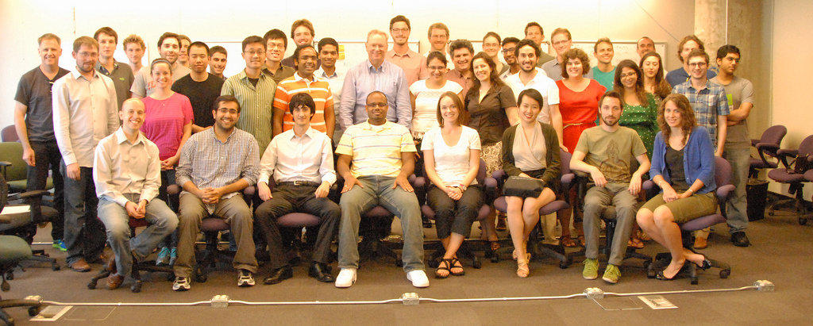


Slide 8
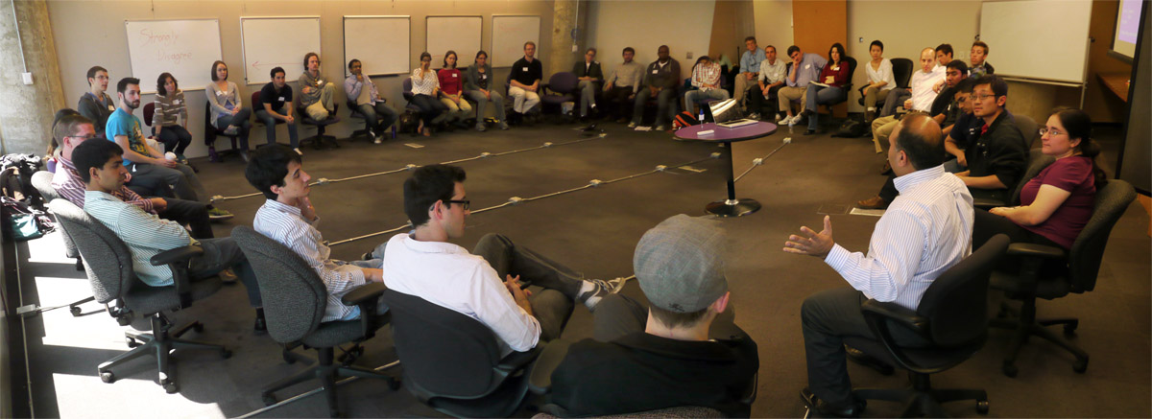
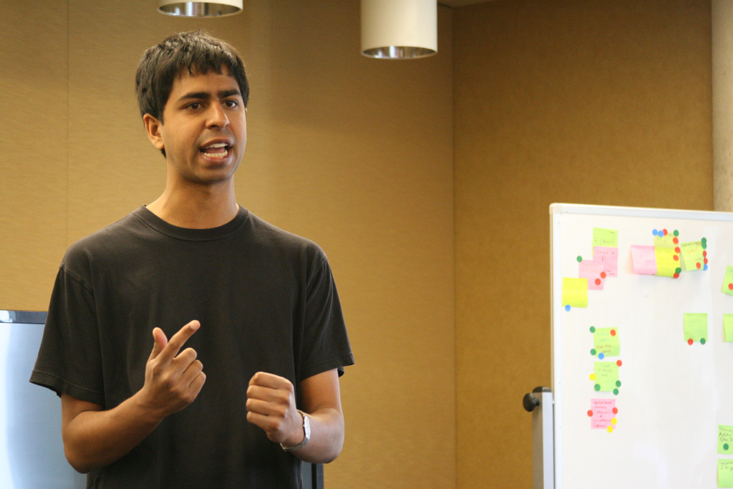
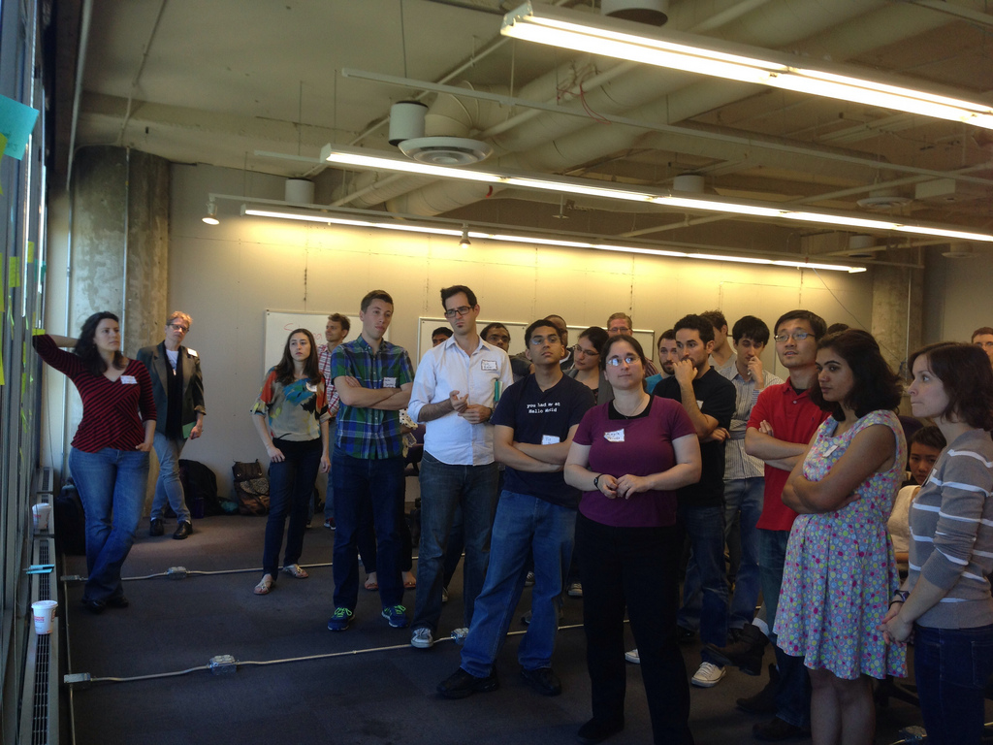

Slide 9
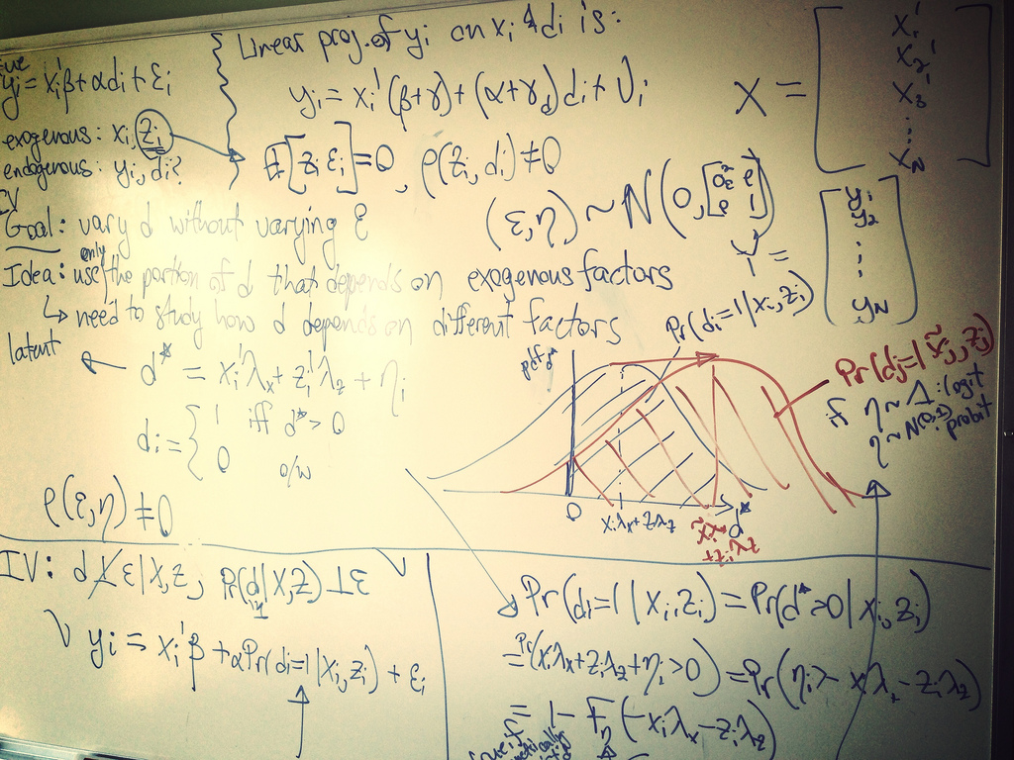
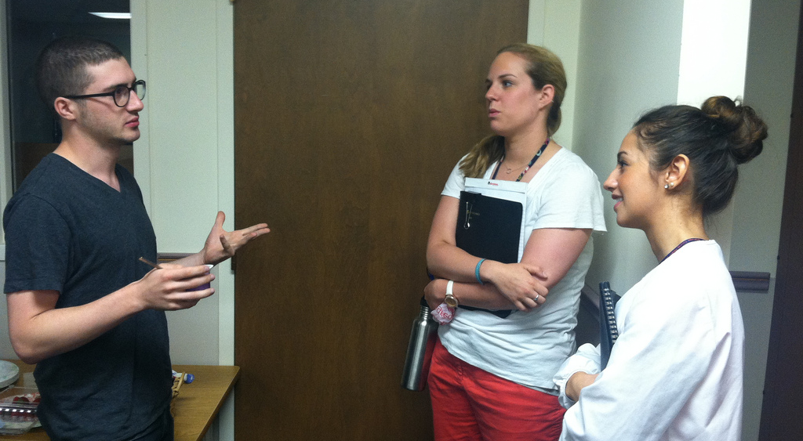
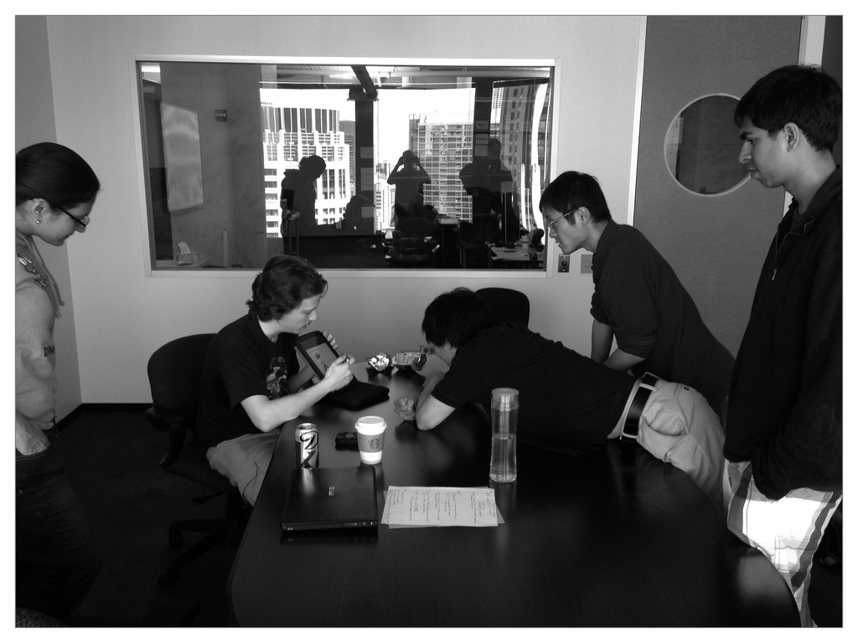
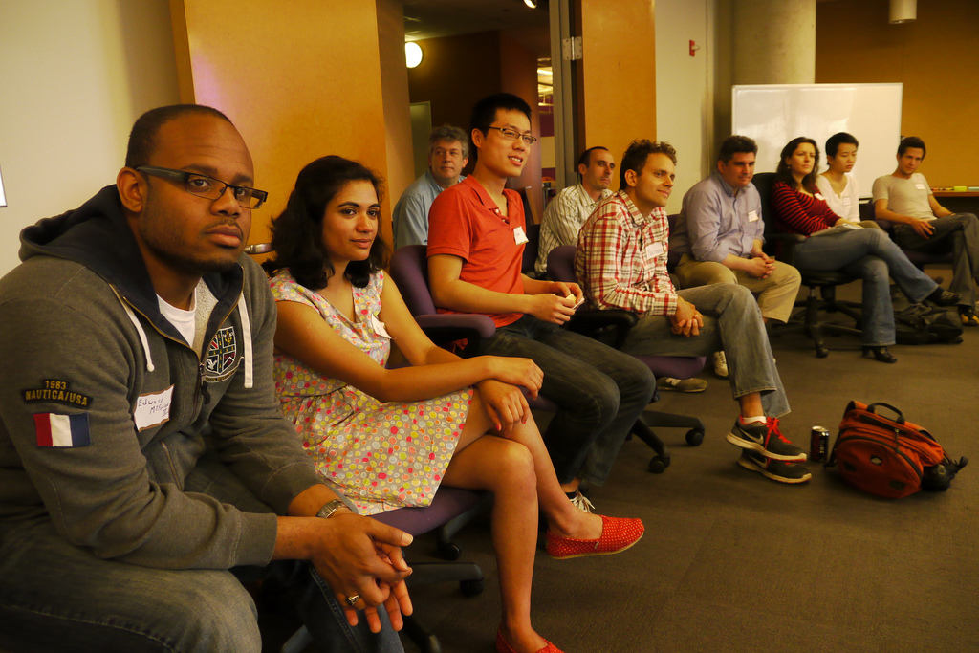
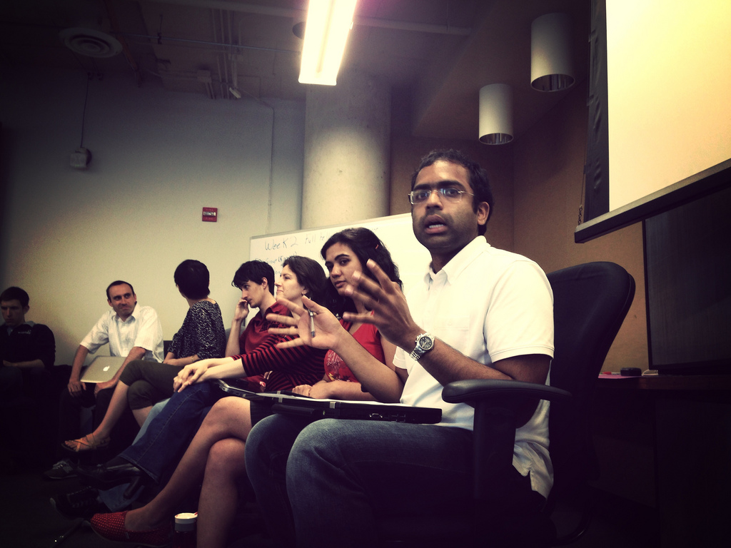

Slide 10



















The Eric & Wendy Schmidt
Data Science for Social Good
Summer Fellowship 2013

Slide 11

Related Programs

Slide 12




Cook County Land Bank
A Zillow for Vacant & Abandoned Properties

Slide 13





Improving Public Transit Planning
A Step Forward in Solving the Crowding Problem
Brandon Willard
Research Consultant
Booth School of Business
Walter Dempsey
Statistics
University of Chicago
Andrés Akle Carranza
Applied Math
Instituto Tecnológico Autónomo de México
Jordan Bates
Computer Science
Arizona State University
David Sekora
Computer Science
University of Chicago

Slide 14




Evaluating Home
Visitation Programs
Measuring Impacts on Children’s Health and Development

Slide 15

Code Blue Prediction
Using EMR Data

Slide 16

Smarter Crisis Crowdsourcing
Machine Suggestions for Report Reviewing

Slide 17

Targeting students at risk of not going to college

Slide 18
Contact Information
Rayid Ghani
rayid@uchicago.edu
For more information on the summer fellowship
http://dssg.uchicago.edu

