Slide 1



Michael F. Bloom | U.S. GSA
Office of Governmentwide Policy
Office of Federal High-Performance Green Buildings
FFC Presentation, November 12, 2014
B Building sustainable practices one decision at a time

Slide 2


Slide 3
GSA’s OFHPGB & SFTool
  GSA’s Office of Federal High-Performance Green Buildings works at the intersection of buildings and people. We created SFTool to help our partners Build and Buy Green. Free, robust and easy-to-use, SFTool:
  Identifies cost-effective green building and procurement strategies to improve environmental performance and occupant health.
  Models an inclusive approach to sustainable practices that moves beyond large mechanical systems & expert-led construction projects.
  Clarifies the relationship between sustainability guidance and the physical, financial and human resources we seek to conserve.
  Engages and empowers people to ask questions, persuade others and make informed decisions -- regardless of previous knowledge level or role.

Slide 4

Focusing on engagement and retention
Average retention rates by teaching method
5%
Lecture
10%
Reading
20%
Audio/Visual
Passive
30%
Demonstration
Immersive
50%
Discussion
75%
Practice Doing
90%
Teach Others
Adapted from the National Teaching Laboratories, Bethel, ME
Notes:
Online training is a difficult concept to get right

Slide 5
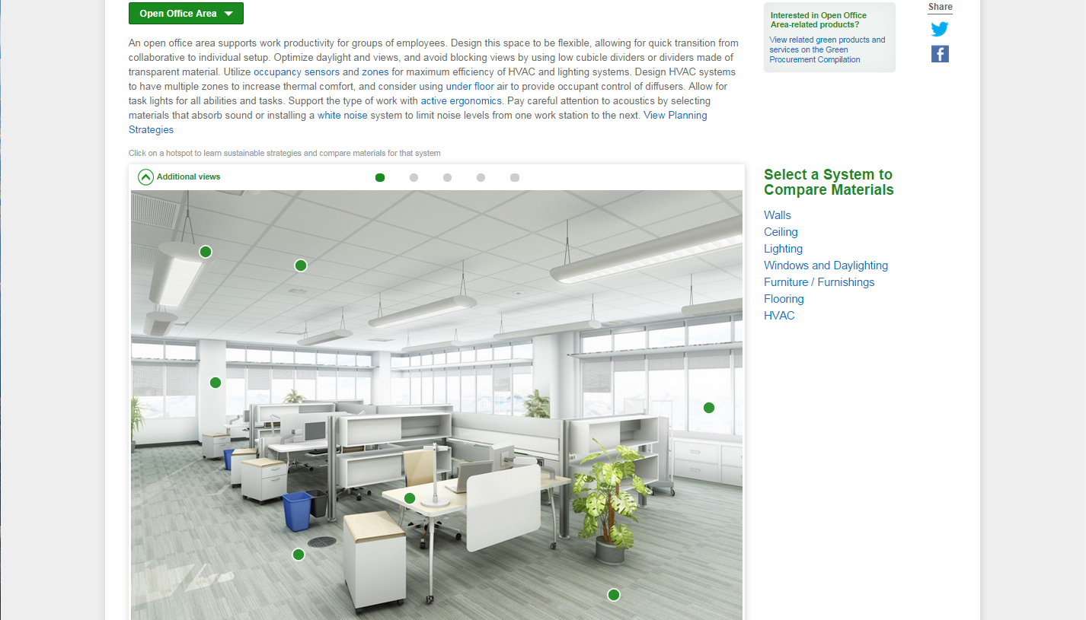
2) Users click on hotspots to compare materials, read design guidance & regulations

Slide 6
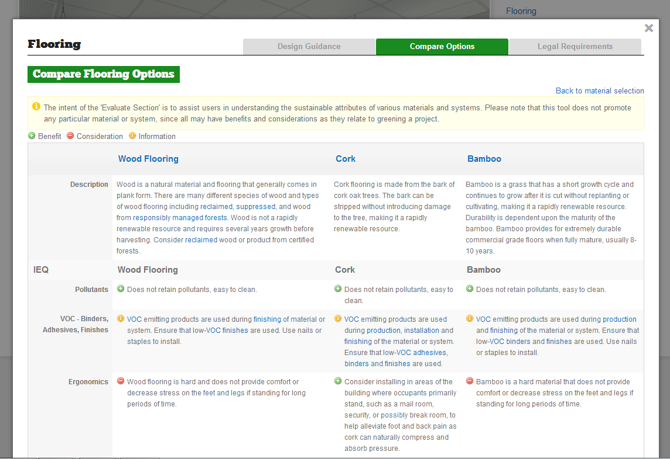

Slide 7


Slide 8
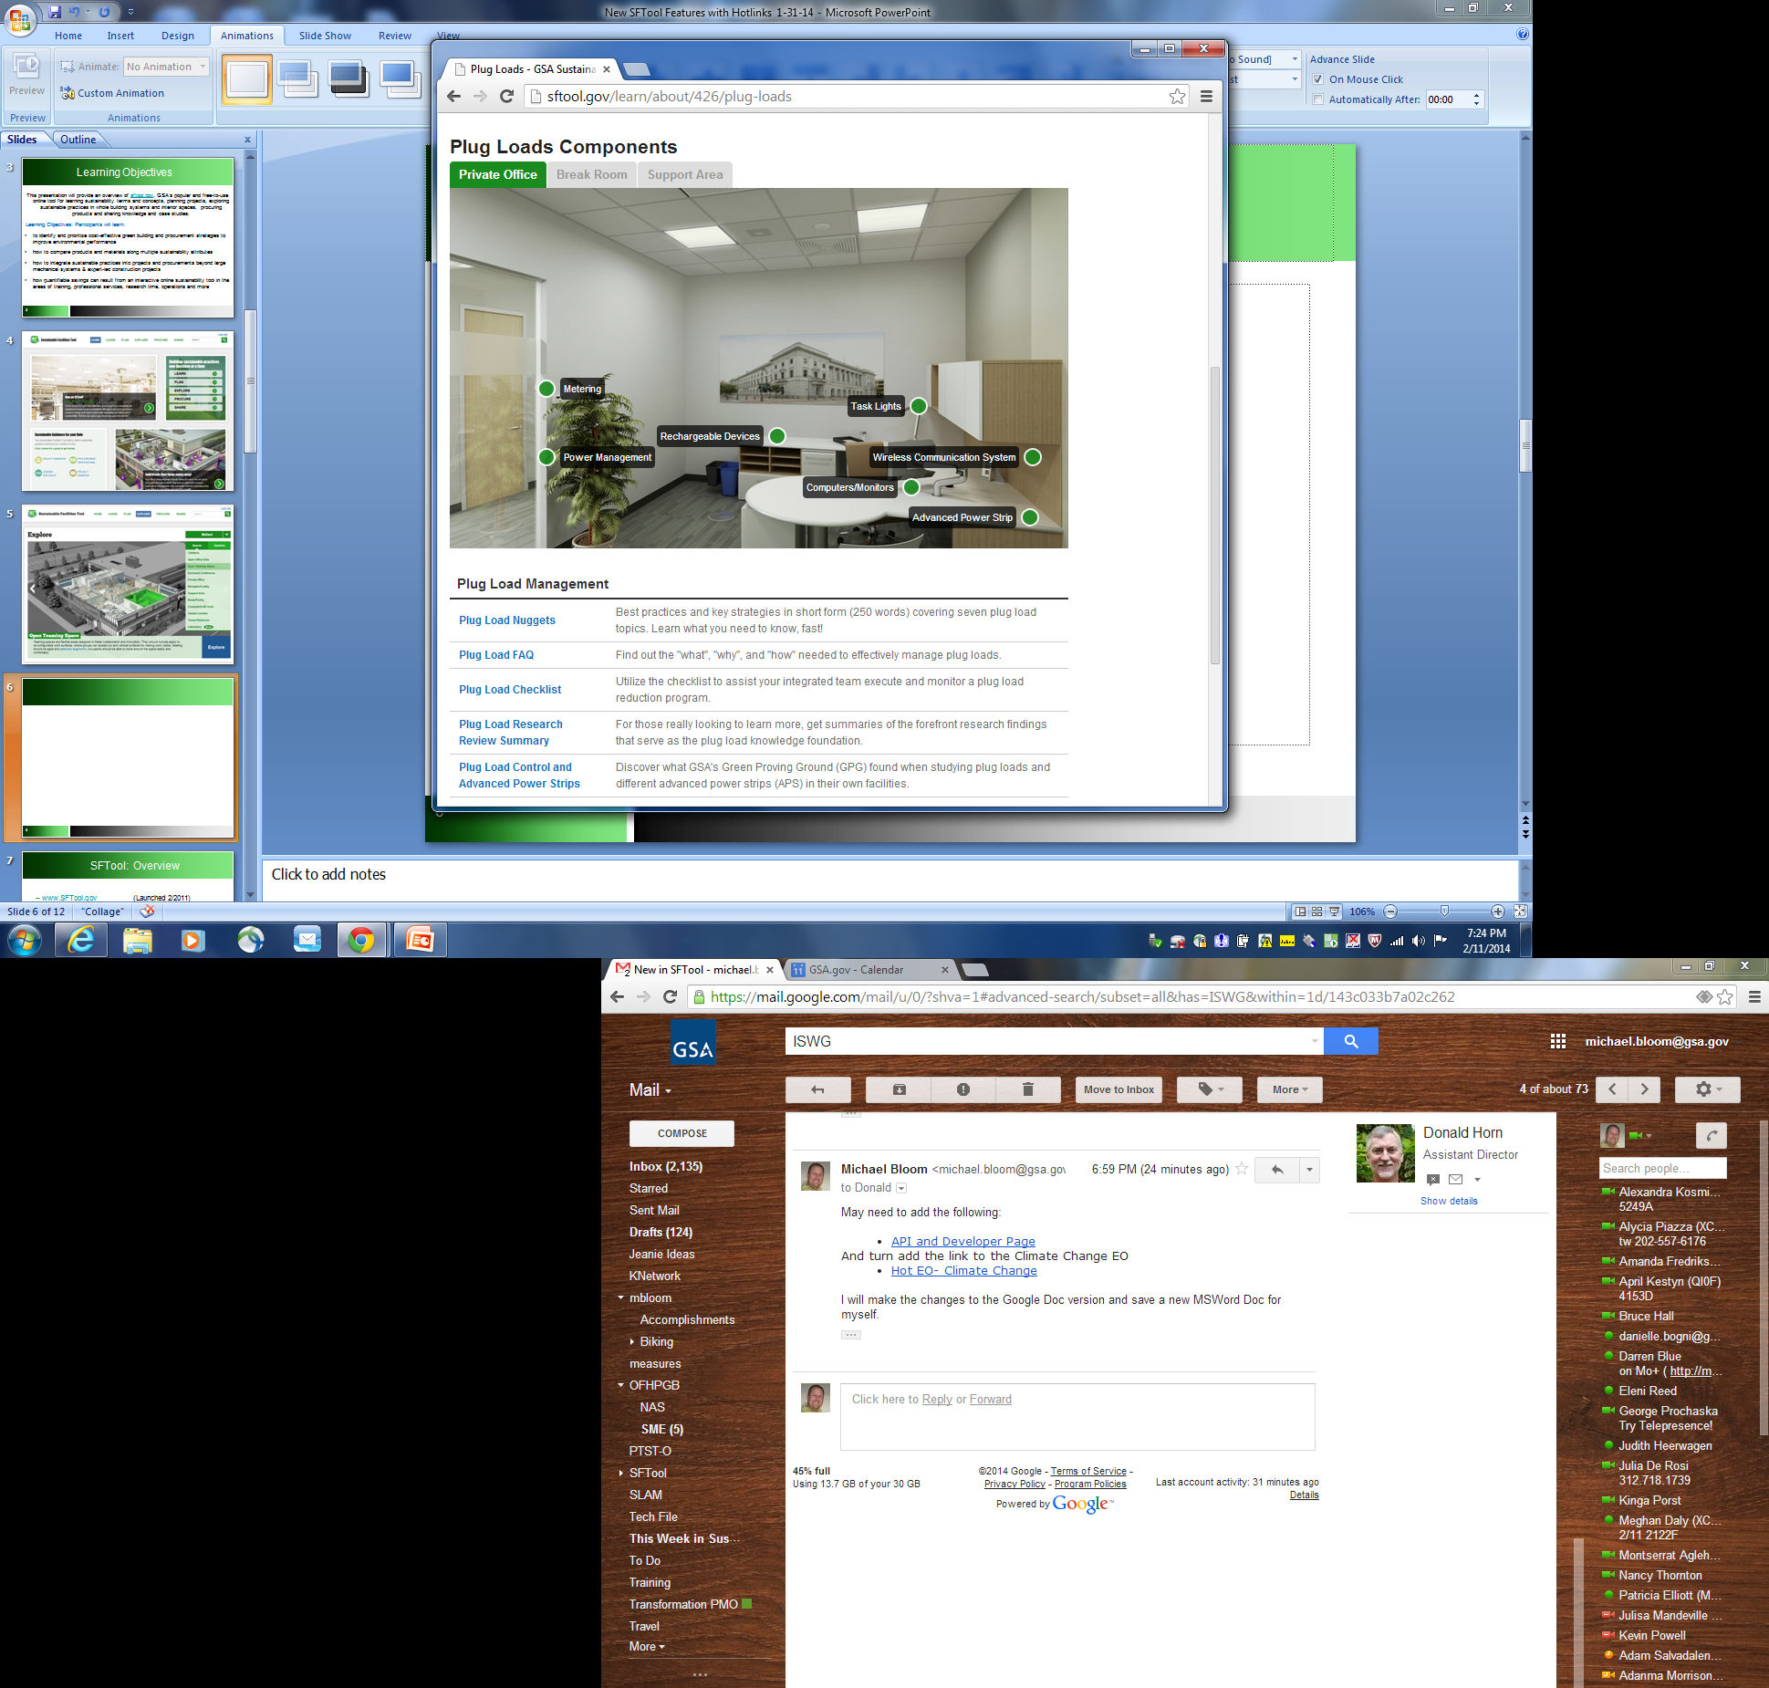
https://sftool.gov/learn/about/426/plug-loads

Slide 9
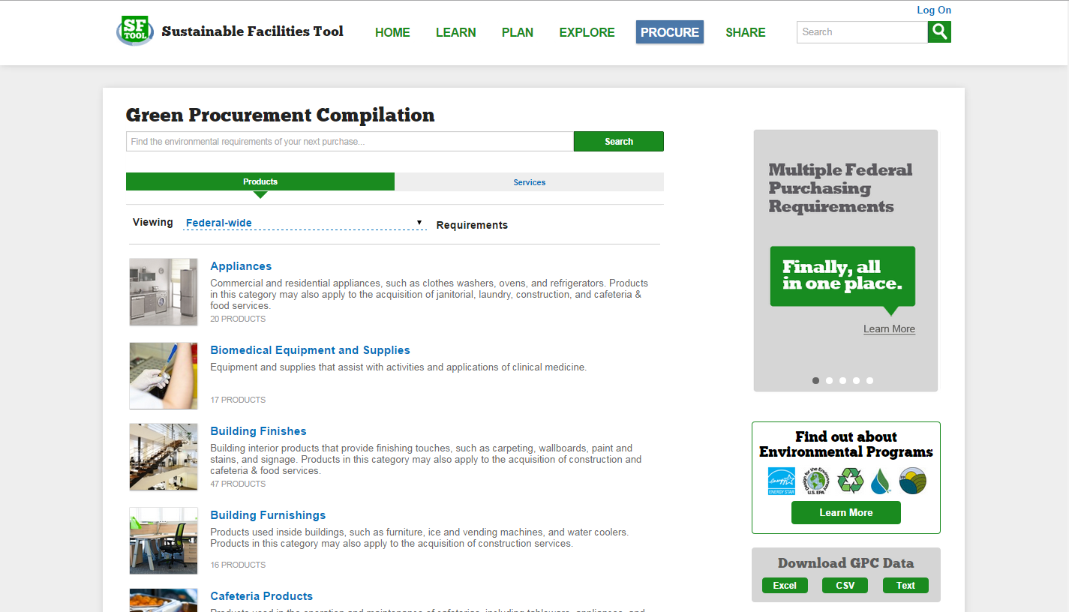

Slide 10
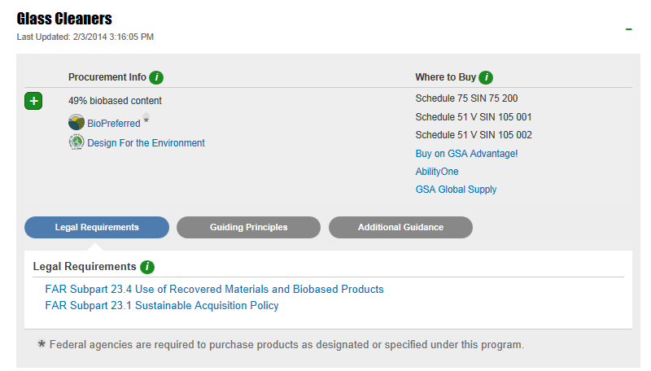

Slide 11
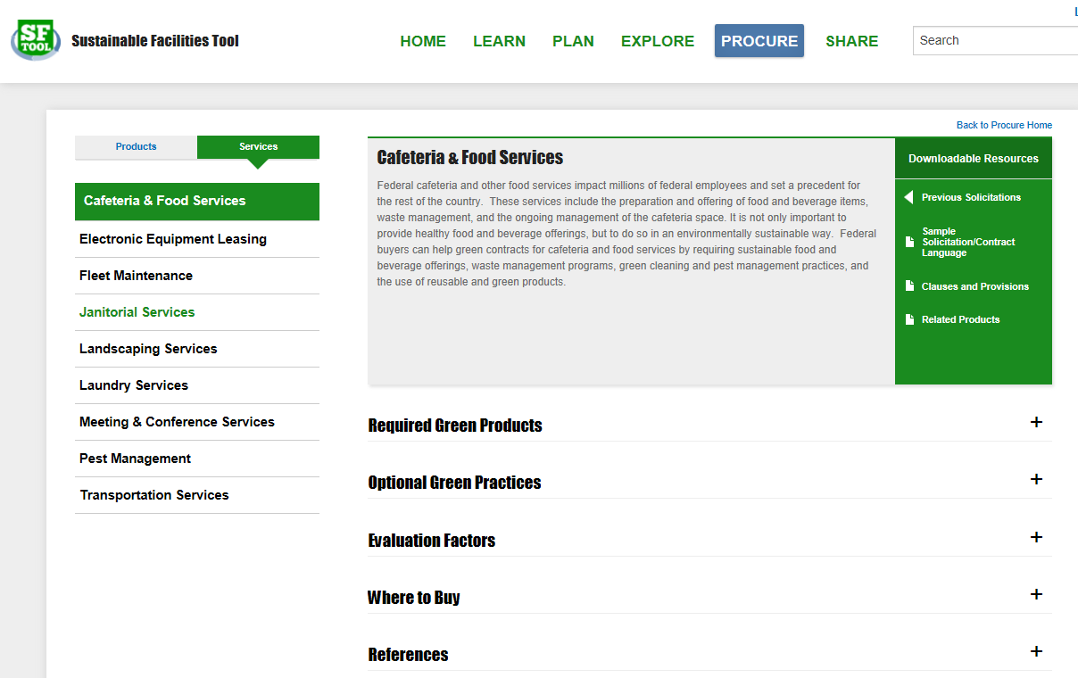
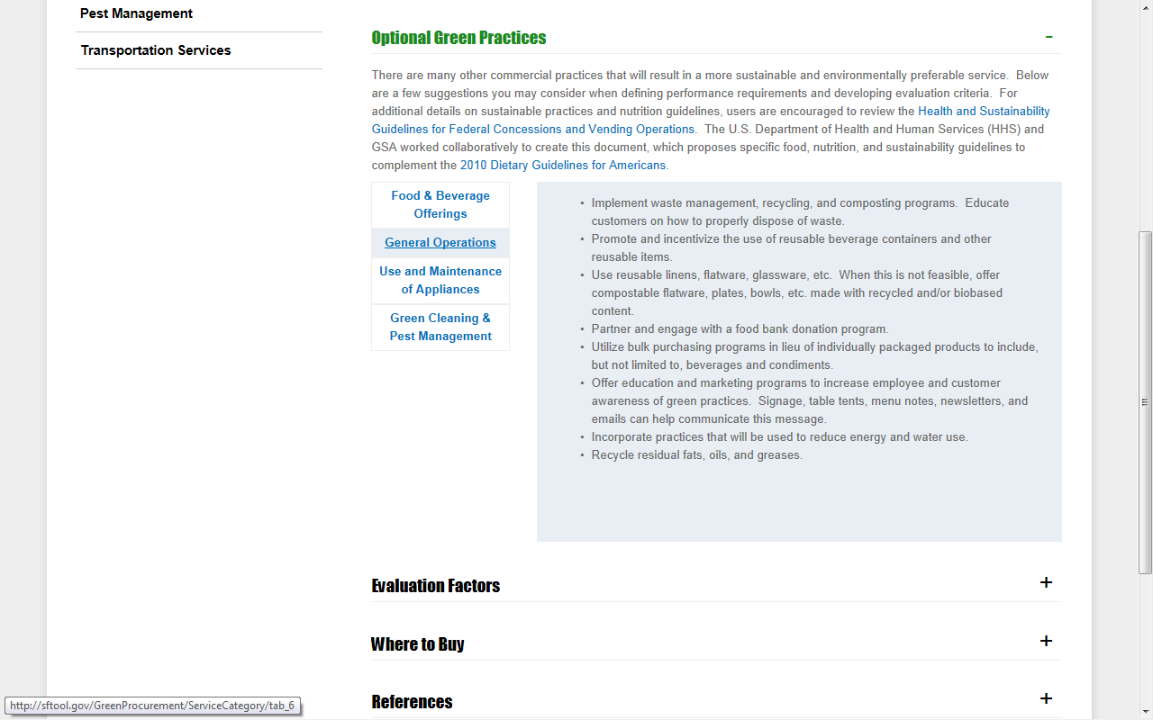

Slide 12
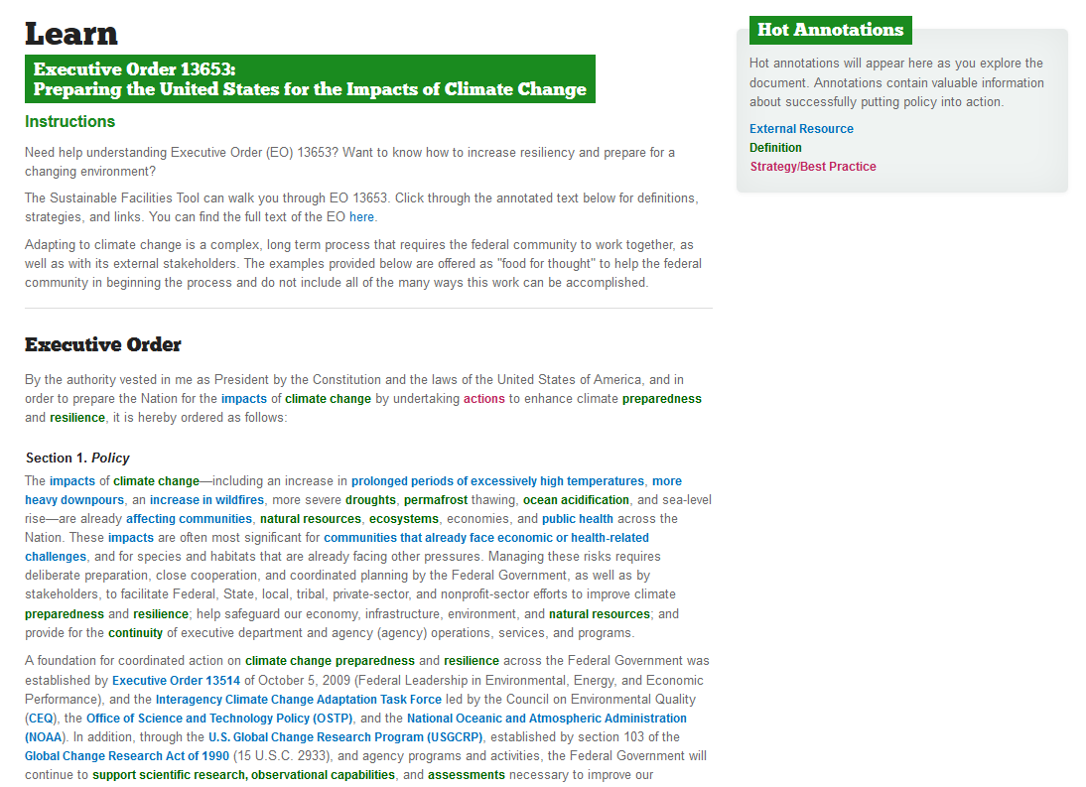
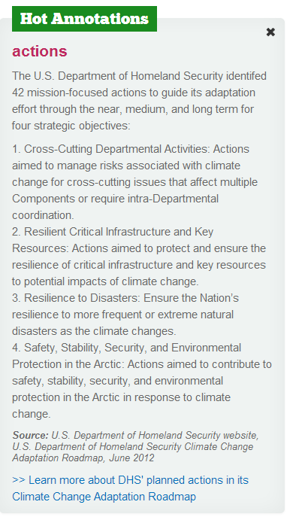

Slide 13


Slide 14



Slide 15

Water Conservation Tips

Slide 16


Slide 17


Slide 18
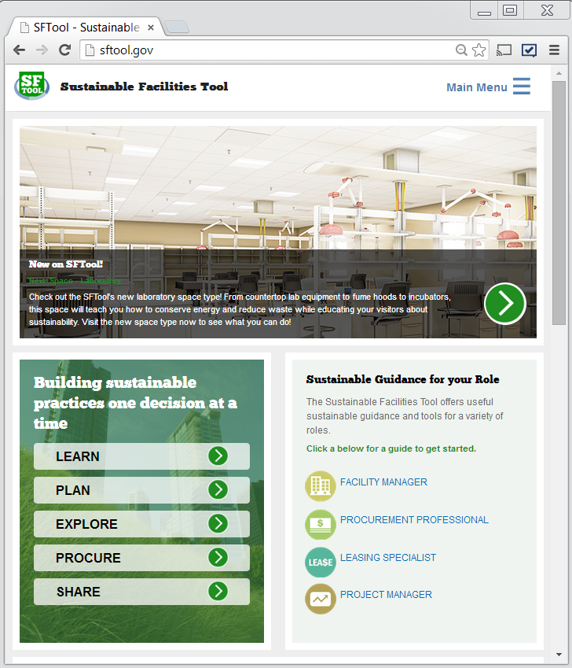
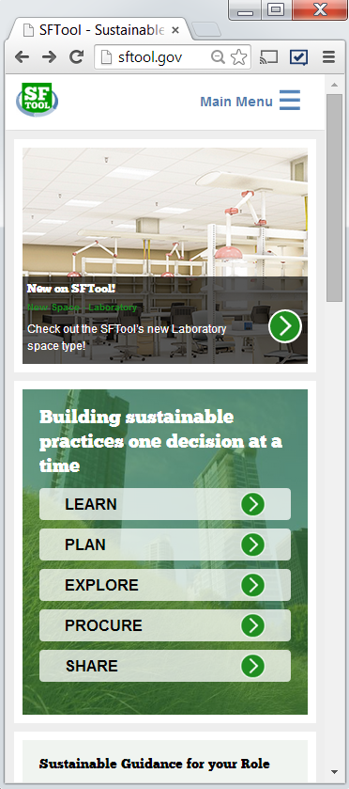
Tablet size
Phone size

Slide 19
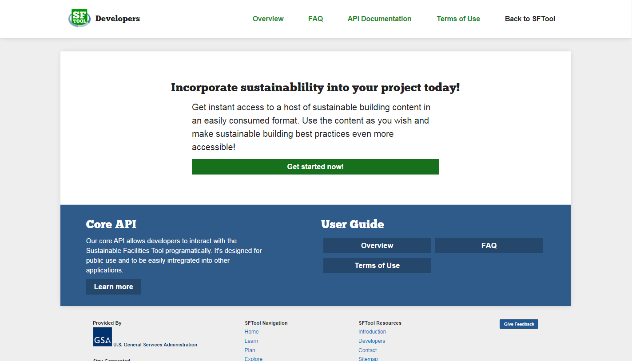

Slide 20

SFTool Delivers Value
SFTool.gov is GSA’s popular and free-to-use online tool to build and buy green.
  LEARN sustainability terms, concepts and relationships
  PLAN projects
  EXPLORE sustainable practices in whole building systems & interior spaces
  PROCURE products and services
  SHARE knowledge, case studies and API-enabled data
https://sftool.gov

Slide 21
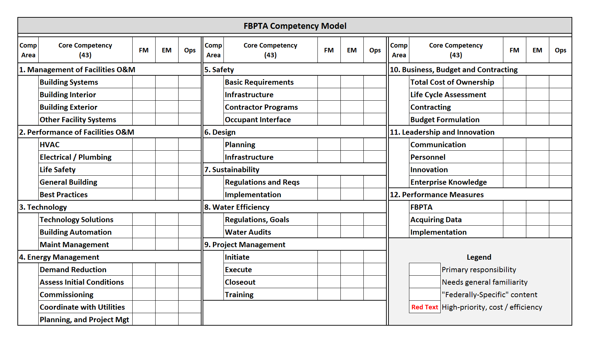
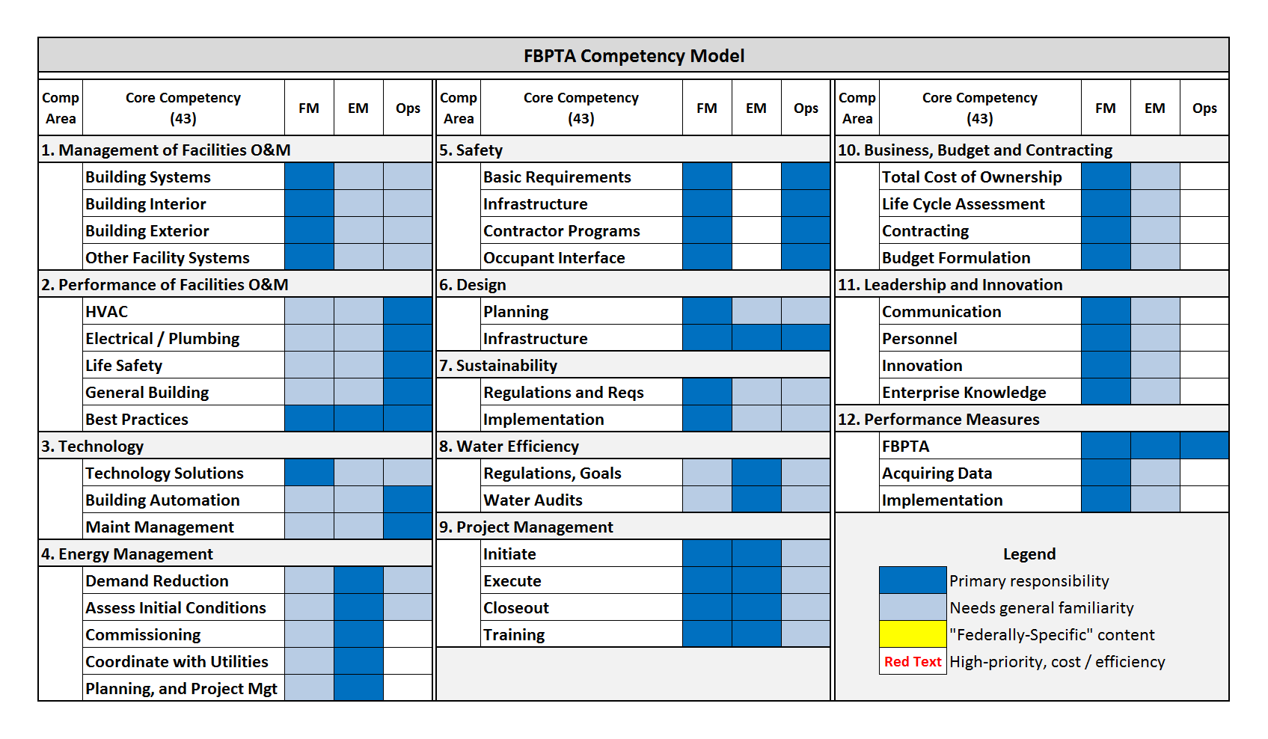
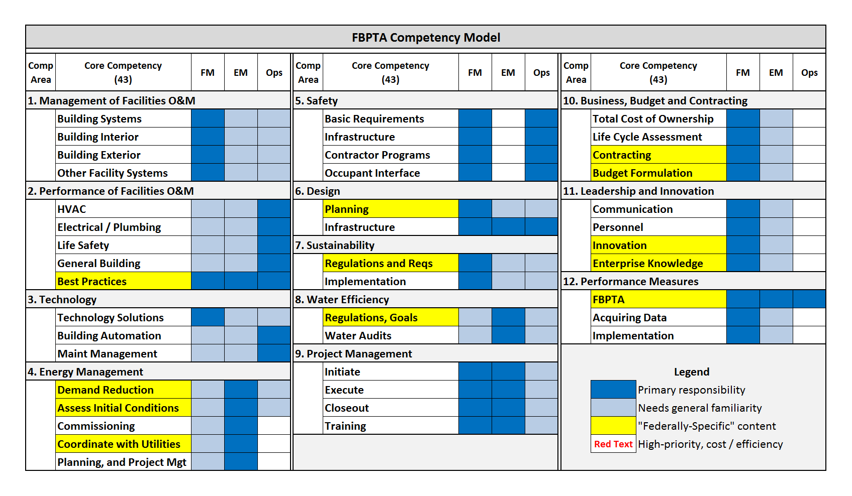
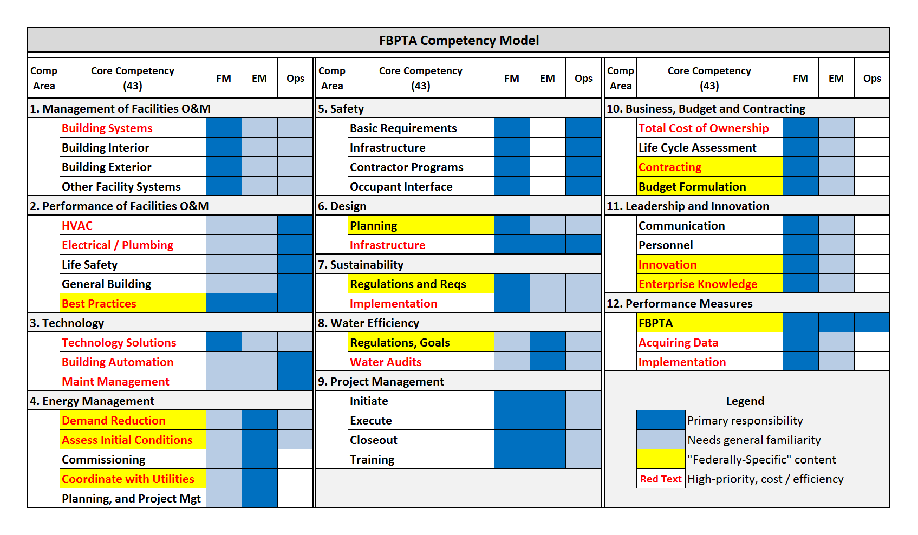
The FBPTA Core Competencies
www.fmi.gov
Notes:
This is our competency model or set of core competencies. It is divided into 12 big buckets called competency areas, 43 core competencies and not show here 232 “performances” or granular things you need to know.
No one person would need to know all this information, an entire organization should cover these. Though each organization is different we have divided this into three categories of personnel, facility managers, energy managers and building operators. Dark blue shows the group should have a deep knowledge, light blue and familiarity, white no requirement.
There are a number of competencies in yellow highlight which are federally specific and might not be included in a course intended for a broader audience. In the case of O&M Best Practices this is content developed by FEMP; in other cases these are federally specific rules and regulations or agency specific policy.
Recently a group of 15 facility managers from across government met to prioritize these competencies for early career facility managers. The identified the items in red text as having the most potential impact on cost and quality of operations. Their work was later validated by a survey of nearly 800 feds. We are placing a focus on these high-priority competencies.

Slide 22
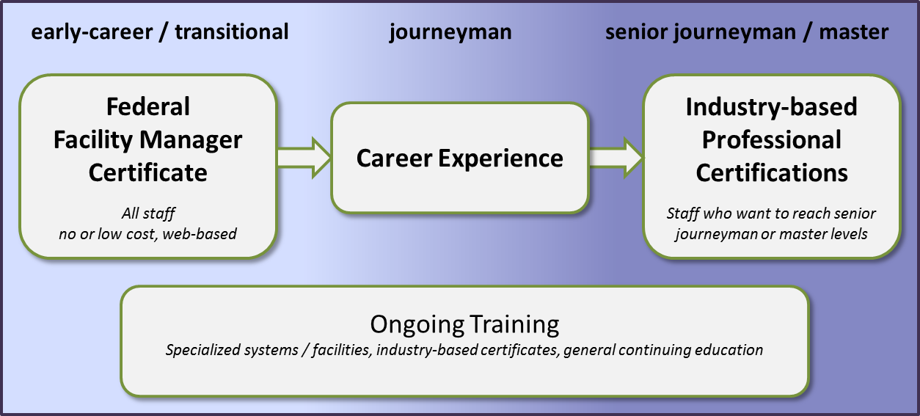
Addressing barriers to implementation
Cost – no new funding
Complexity – options, but unclear path
Notes:
The Tool we have developed is simple, elegant way to understand the requirements of the Act and identify training resources aligned with them. It does not, however, address two key concerns that agencies have expressed. Cost and complexity. The competencies provide guidance by do not come with funding to send people to training. The tool provides options but not a specific path to compliance. At GSA we have identified a number of courses and structured on the job training tasks we want our property managers to pursue.
In the long term, however we are pursuing a career progression that starts with a free, online certificate issued by GSA that will represent basic compliance with the requirements of the Act. The certificate will test the competencies identified as high-priority. If a person passes a test question they get credit, if not, they are routed to free online content. Our intent is to ensure all facility managers have a basic level of competence. Over the course of their careers, we expect individuals to seek specialized training and industry-based credentials appropriate to their agency and facility type. Those who wish to advance will have an incentive to do this and agencies can budget for and select those to send.

Slide 23
FMI Integration
FMI.gov is a resource for Facility Managers
  Skills Assessment Tool – guidance for implementing the FBPTA
  Look for Update to Competencies and Curriculum, Nov 2014
Clear pathways to professional development
  Entry / Transitional: Basic FM Certificate issued by SFTool.gov
  Advanced: Industry certifications and degrees
Contact information:
  Brian Gilligan (FMI / FBPTA) – brian.gilligan@gsa.gov
  Michael Bloom (SF Tool) – michael.bloom@gsa.gov

Slide 24

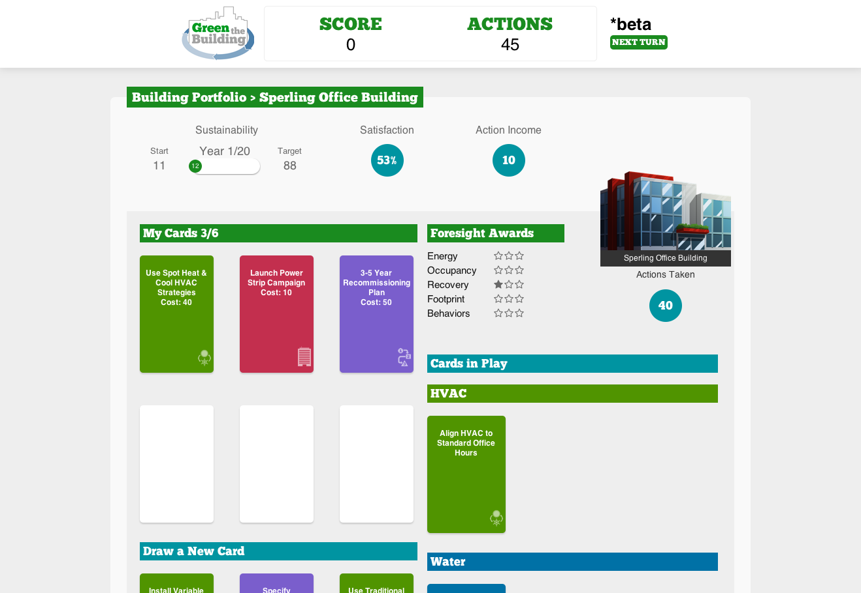
Introducing…
… the Sustainable Renovation Simulation.

Slide 25
Michael F. Bloom
GSA Sustainability and Green Buildings Program Advisor
Michael.Bloom@gsa.gov
SFTool Feedback Survey

