Slide 1

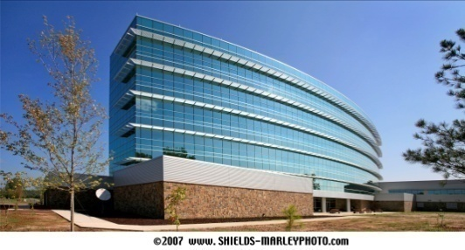
ADEQ Headquarters, North Little Rock, Arkansas
New Construction/Major Renovation
and
Existing Buildings
Erin Shaffer
VP of National Affairs
Green Building Initiative
Notes:
1

Slide 2

Agenda
The Green Building Initiative (GBI)
Green Globes® Assessment & Certification System Review
  New Construction/Major Renovation
  Existing Buildings
  Existing Buildings Healthcare
  Sustainable Interiors
Guiding Principles Compliance Assessment & Certification System
Green Globes and Guiding Principles Personnel Certifications

Slide 3

The Green Building Initiative
Nonprofit corporation – HQ in Portland, OR
  Mission: Accelerate the adoption of building practices that result in energy efficient, healthier & environmentally sustainable buildings
Founded in 2004
Exclusive U.S. provider of the Green Globes® and Guiding Principles Compliance assessment & certification programs
Notes:
Note for the last bullet: Guiding Principles Compliance is the first program to assess and certify existing buildings owned by the U.S. Federal Government according to the sustainability requirements of EO 13514.

Slide 4
Product Review
Web-based, interactive, design, assessment and rating system for commercial buildings;
Green Globes for New Construction-updated June 2013 -incorporates key components of the “ANSI/GBI 01-2010: Green Building Assessment Protocol for Commercial Buildings.”
ANSI Standard update--expected end of 2015

Slide 5
Green Globes Assessment Tools
Green Globes NC
  Guides the integrated design process at each stage of the project
Green Globes CIEB
  Establishes a baseline and guides improvement
Green Globes CIEB for Healthcare
  Specialized for healthcare buildings with licensed in-patient beds
Green Globes Sustainable Interiors
  Designed for tenant improvement projects, fit-outs and remodels
Notes:
GBI offers four products under the Green Globes family for assessing & certifying new construction, existing buildings and healthcare facilities.

Slide 6

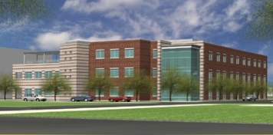
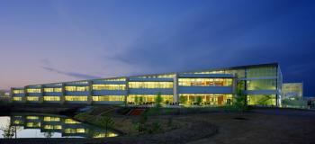


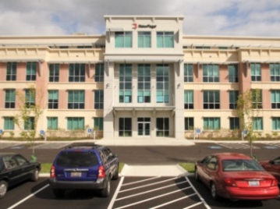



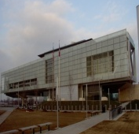
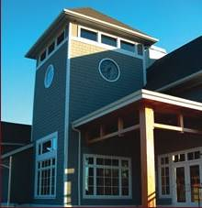
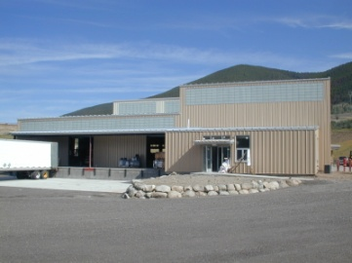



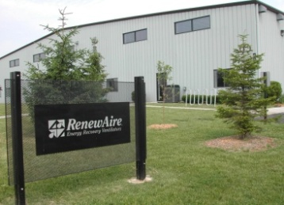



Used Across Government & Industry
Notes:
Green Globes is used across government & industry. It is also used to assess & certify specialty building types that LEED does not consider such as recreational centers, transit centers, parking garages, and historical buildings.

Slide 7
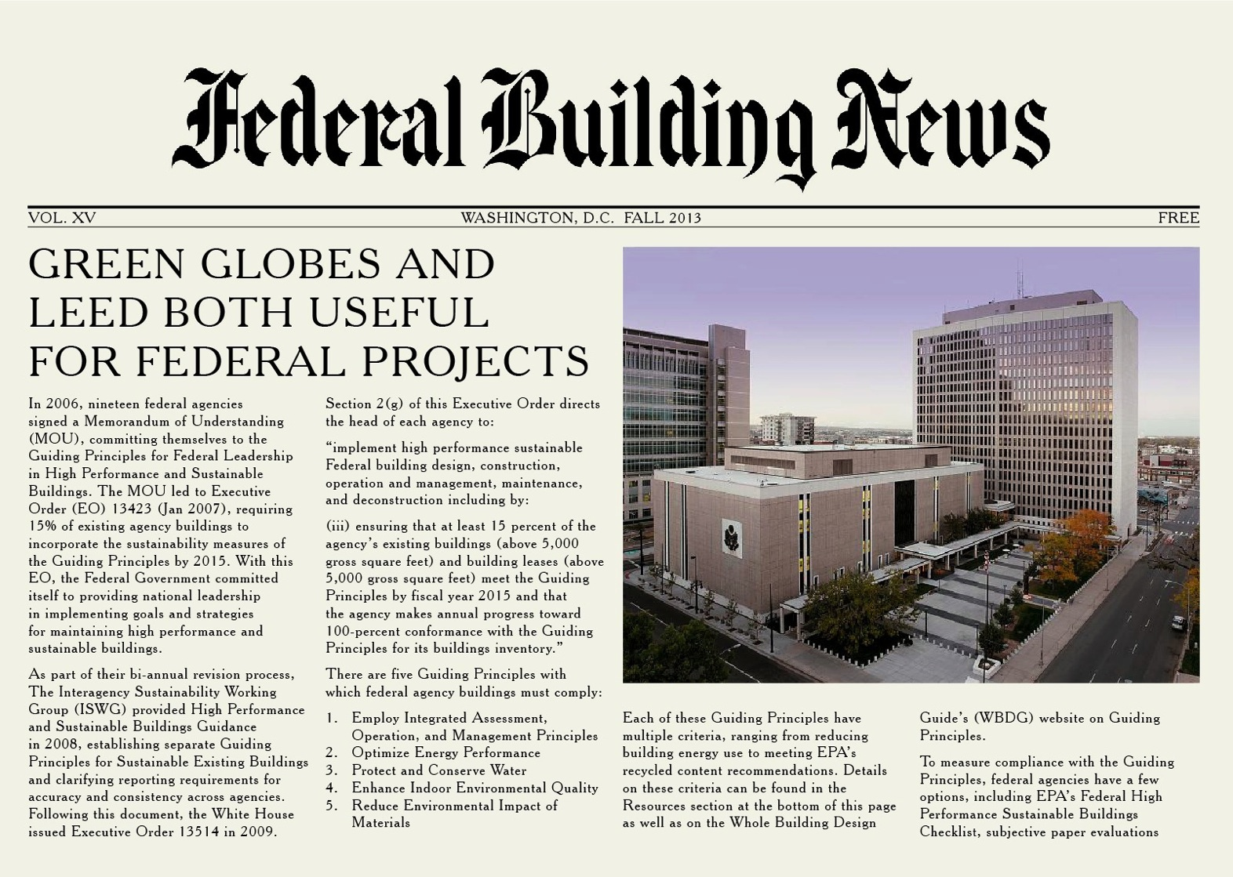
Federally Recognized Rating System
Notes:
IMPLICATION: GREEN GLOBES IS ACCEPTED AS EQUAL TO LEED BY NATIONAL AUTHORITIES
Green Globes has achieved recognition by the U.S. federal government. In 2012 a report commissioned every 5 years by the GSA found that GBI’s ANSI Standard version of Green Globes for New Construction met more of the requirements of the federal government than any other program. In 2013, recognition came in a letter to the Secretary of Energy in October 2013 where the GSA recommended agencies use Green Globes and LEED certification systems. In 2014, the Department of Energy adopted a RULE for all Federal agencies that if they want to use a green building rating system for new construction, it has to be either Green Globes or LEED.

Slide 8
Green Globes® Attributes
Transparent, interactive process
Web-based survey
1000 point scale
Weighted criteria/partial credit
No prerequisites
Site visit by third-party assessor for certification
Provides recommendations for improvement
NC Crosswalk in NIBS Whole Building Design Guide
Notes:
Green Globes is implemented through a transparent, interactive process with feedback so the user always know where they stand.
The process starts by entering project data through a web-based survey.
3 & 4) The process includes assignment of a third-party assessor who provided feedback and recommendations throughout the process including a final report following an on-site assessment.
8

Slide 9
Green Globes New Construction
New Construction module introduces major updates including:
  Complete coverage of the federal government’s Guiding Principles for New Construction with a report detailing level of compliance
  Criteria developed by an ANSI-approved consensus body
  Increased focus on Energy… 4 paths for energy performance
  Increased focus on Materials & Resources
    Emphasis on life cycle assessment
    A new approach assessing building assemblies, furnishings, finishes and fit-outs utilizing multi-attribute certifications, and/or third-party assessments by approved standards development organizations

Slide 10


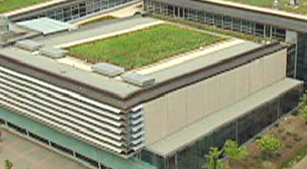
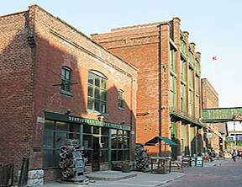

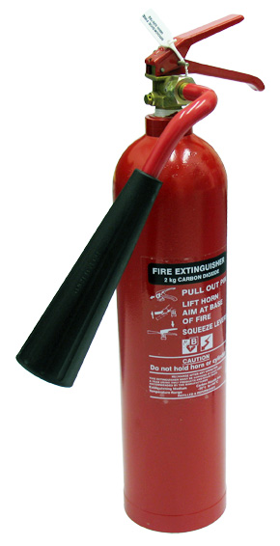
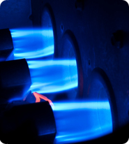

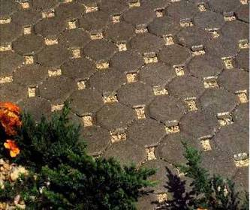
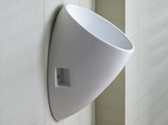
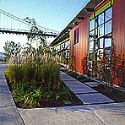

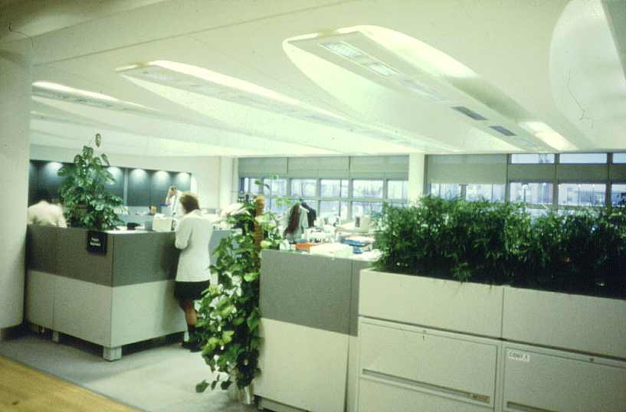
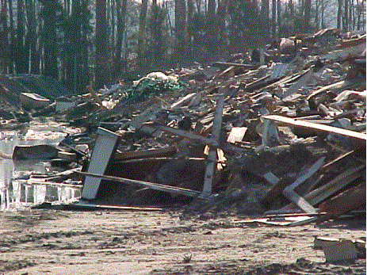

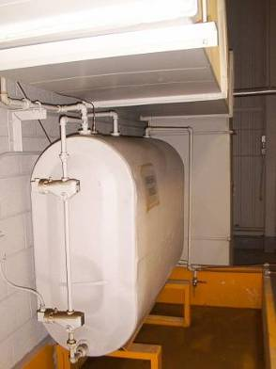

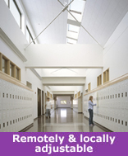

Environmental Assessment Areas
%
5
11.5
39
11
12.5
5
16
1 Management
2 Site
3 Energy
4 Water
5 Materials & Resources
6 Emissions
7 Indoor Environment
Notes:
10
1 - Integrated design process, Environmental purchasing, Commissioning, Emergency response plan
2 - Development area, Ecological impacts (erosion, heat island, light pollution), Watershed features, Site ecology enhancement
3 - Energy performance (ASHRAE), Reduced demand, Energy efficiency features, Renewable energy, Transportation
4 - Water performance, Water conserving features, On-site treatment (stormwater, greywater, blackwater)
5 - Low-impact systems and materials (LCA), Minimal use of non-renewables, Reuse of existing buildings, Building adaptability, Building disassembly, Demolition waste, Recycling & composting facilities
6 - Air emissions (boilers), Ozone depletion, Sewer & waterway protection, Pollution control (procedures, compliance)
7 - Ventilation system, Indoor pollution control, Lighting (daylighting & electric), Thermal comfort, Acoustic comfort

Slide 11

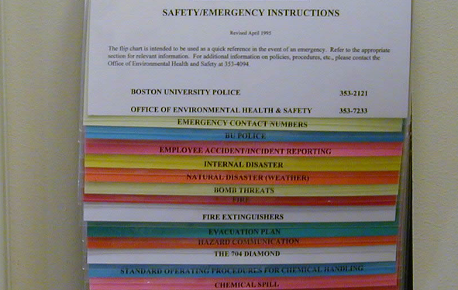
1 Management
      11 11
New Construction
Existing Building
Integrated Design and Management
Environmental Purchasing
Whole Building Commissioning
Environmental Mgt. – During & Post Construction
Emergency response plan
EMS Documentation (policy, goals, targets, action plans)
Purchasing Policy (including energy efficient products)
Emergency Response
Stakeholder Awareness (communication, stakeholder satisfaction)
Notes:
11
Green Globes has always addressed management topics as critical aspects of assessment, incorporating them under a major topical section, rather than as innovative or extra credit. Sound management practices inevitably lead to positive outcomes. Note the ‘umbrella’ management approaches – Integrated Design and Delivery (IDP) for new construction and the Environmental Management System (EMS) protocol for existing buildings. GG NC enhances management concepts by incorporating IDP in segments based on project phases; best practices such as Clean Diesel approaches, enhanced/whole building commissioning and comprehensive environmental management during and post construction.

Slide 12
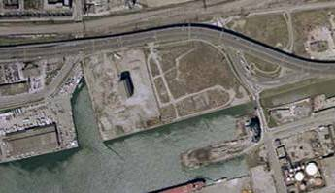


2 Site
New Construction
Existing Building
Development area
Ecological Impacts (erosion, heat island, light pollution)
Watershed Features and Onsite Water Management
Site Ecology Enhancement and Landscaping
Site Construction Best Practices
Site Assessment
Site Enhancement
Notes:
12
The Site section under GG NC incorporates onsite and stormwater management, currently in the Emissions section. Other enhancements include criteria addressing vegetated roofs and landscape design.

Slide 13
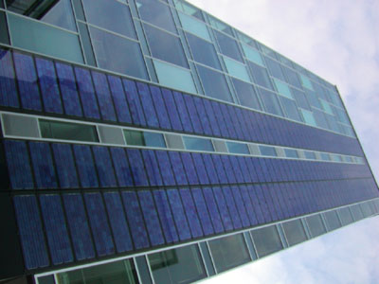
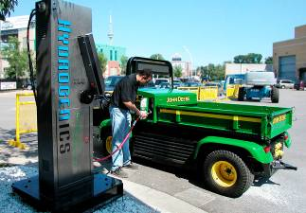
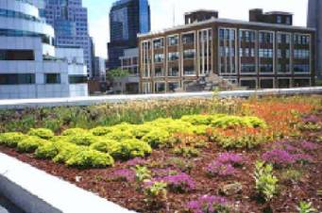
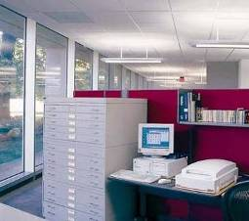
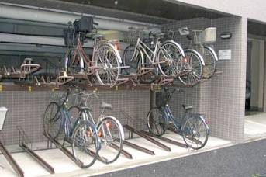
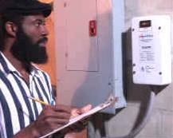
3 Energy
New Construction
Existing Building
Energy Performance - 4 paths… ANSI Path A, Energy Star, ASHRAE 90.1, Building Energy Quotient
Reduced Demand (space optimization, microclimatic design, day-lighting, envelope design, metering, peak demand response)
Energy Efficiency Features (lighting, heating & cooling equipment)
Renewable Energy (including ground source)
Transportation
Energy Audits (monitoring and performance improvement)
Operation and Maintenance (preventive maintenance and equipment management)
Energy Performance and CO₂ Emissions
Energy Efficiency Features (lighting, heating & cooling equipment, controls, building envelope, green energy (solar, wind, biomass)
Energy Management (energy policy, audits, targets, metering, operating manual, schedules, preventive maintenance)
Transportation (access to public transport, bicycles, carpooling)
Solar panels
Notes:
13
The Energy section under GG NC is greatly enhanced to accommodate the widest possible range of building occupancy types, sizes and complexities, regional considerations and owner/organizational requirements. These include:
Four optional paths for assessing design energy performance, including 2 known industry standards (Energy Star and ASHRAE 90.1); a recently introduced program (ASHRAE bEQ), and the GBI ANSI Standard Path A protocol, which allows the designer to derive a projected energy performance in units of CO2e emissions.
Energy demand/Peak load criteria
Enhanced building feature and equipment energy efficiency
Renewable Energy will include Ground Source and Renewable Energy Credits

Slide 14
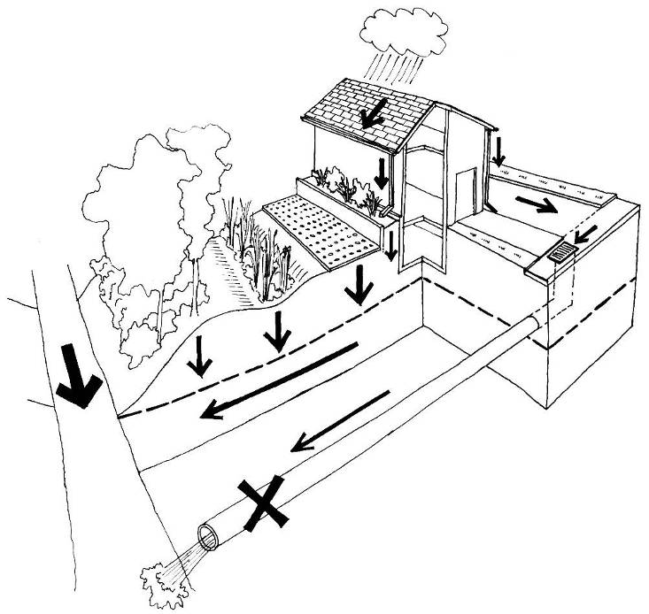
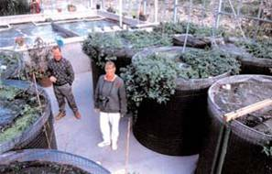
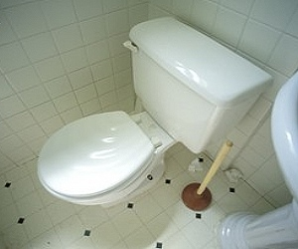
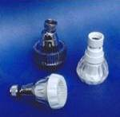
4 Water
      Seven As
New Construction
Existing Building
Planters
Impermeable Paving
Water Performance – GBI Water Calculator
Water Conserving Features (Plumbing, fixtures, fittings, appliances, and equipment, incl. medical, food service, laundry, cooling towers, boilers, water heaters, special water features and water treatment)
Alternate Water Sources
Metering and Submetering
Irrigation Design
Water Performance
Water Conserving Features (equipment faucets, toilets, urinals, showers, cooling towers, irrigation, stormwater systems)
Water Management (policy, monitoring, water audit, fix leaks)
Permeable Paving
Bioswale
Riparian Zone
Water Table
Storm Sewer
Stream
Desirable and undesirable stormwater management practices
Notes:
14
The Water section addresses:
Water Performance
Water conserving features (equipment and features, metering and sub-metering, irrigation system design)

Slide 15
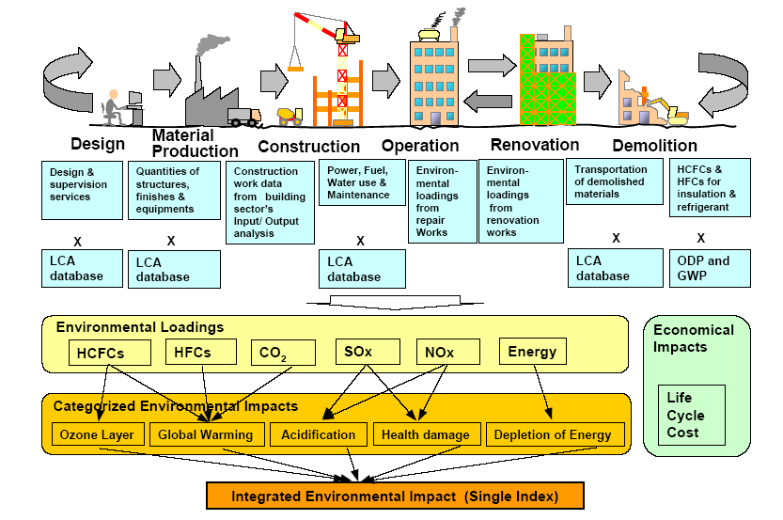

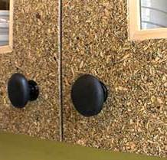
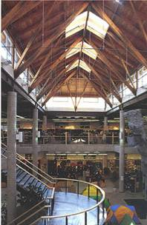
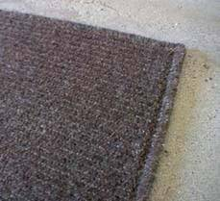
5 Materials & Resources (100 pts.)
New Construction
Existing Building
Assemblies, Furnishings and Fit-Ups
Performance Path – Life Cycle Assessment
Prescriptive Path - Environmental Product Declarations (EPD) or 3rd Party Certification
Wood certification – 4 options
Reuse of Existing Buildings:
Whole Building Life Cycle – Building Life Service Plan, durability, adaptability and
disassembly
Construction Waste Management
Design & Construction of Waste Management Space
Waste Reduction and Recycling (collection/ storage/ handling facilities, composting)
Waste Reduction Workplan (waste audit, diversion rate, construction, renovation and demolition waste)
Notes:
15
The next slide details the assessment paths for Assemblies, and Furnishings and Fit-ups
Also includes:
Enhanced building structural protection criteria
Detailed construction waste management best practices

Slide 16
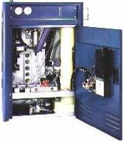
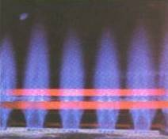
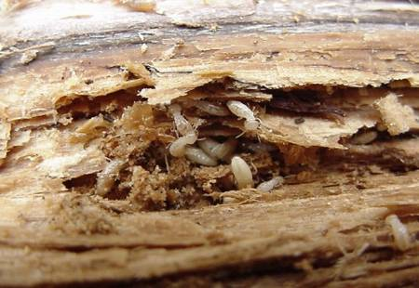
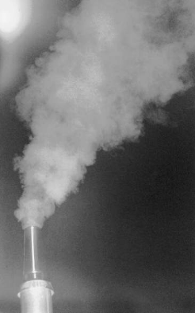
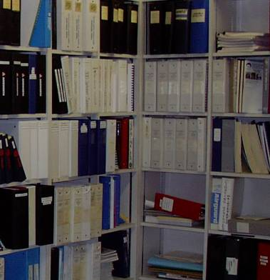
6 Emissions & Other Impacts
New Construction
Existing Building
Air Emissions – (Heating equipment, including District Heating)
Refrigerants – ODP and GWP; GreenChill best design practices
Pollution Control (procedures, compliance with standards)
Radon Mitigation/Asbestos (major renovations)
Air Emissions (boilers)
Water Effluents (floor drains, roof drains, landscaping practices, glycol discharges)
Hazardous Materials (asbestos, radon, PCBs, refrigerants, storage tanks, drinking water)
Hazardous Products, HCS, Health & Safety (MSDS, health and safety, management, pesticides)
Recuperative boiler
Notes:
16
The Emissions section enhanced GG NC features
Air emissions for both single building plants and district heating plants
Comprehensive refrigerant management with increased emphasis on GWP and best practices, through incorporation of EPA GreenChill criteria

Slide 17
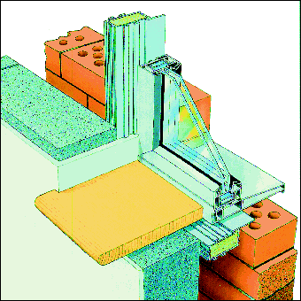

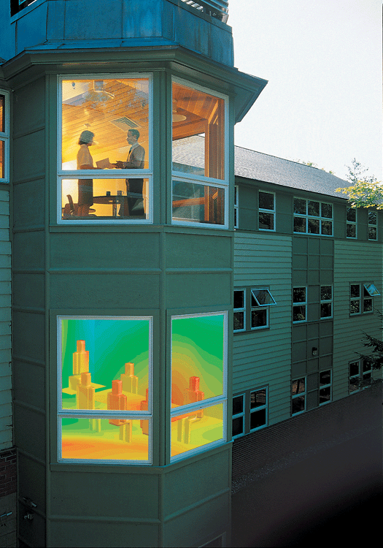
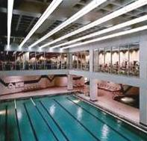
7 Indoor Environment
New Construction
Existing Building
Ventilation System
(including HVAC access)
Lighting (daylighting & electric maintenance)
Source Control and Indoor Pollutants
Integrated Pest Management
Thermal Comfort
Acoustic Comfort
Indoor Air Quality (ventilation, filtration, humidification, cooling towers, parking and receiving, control of pollutants at the source, IAQ management, mold, temperature)
Lighting (lighting features, lighting management)
Noise (volume, acoustic privacy)
Insulated cavity closer discourages mold and bacteria growth
Notes:
17
And finally, the Indoor Environment section assesses:
The ventilation system, upgraded to ASHRAE 55 2010 standards
Sources of indoor pollution control with updated VOC content thresholds
Lighting (integration of daylighting & electric)
Thermal comfort, updated to ASHRAE 90.1 2010
Acoustic comfort

Slide 18
Green Globes for New Construction
Eligibility
Each building requires its own assessment
A minimum of 400 square feet
Occupied less than 18 months
At least partially enclosed, occupied (at least on an interim basis), and incorporate some mechanical systems
Supporting space (such as parking garages, connecting corridors, mechanical plants, etc.) may be added to the assessment.
Addition & major renovation projects eligible if sufficient scope can be addressed by criteria
  Green Globes encompasses a whole building approach. Building or site features already in place that meet criteria are eligible for credit
Notes:
18

Slide 19
Third-Party Assessment
Complete Online Survey
Highly Qualified Third-party Assessor
On-site Visit & Interview
Document
Review
Notes:
19

Slide 20
Green Globes Strengths
Individual criteria are weighted, based on impact
No Pre-requisites, Non-Applicable provision for most technical criteria, and possible partial credit
1000 point based assessment program allows for accurate weighting of individual criteria’s environmental impact
Emphasizes energy
Third-party Assessor’s professional judgment exercised
Requires third-party site visits for certification – allowing dialogue with the assessor
Notes:
20

Slide 21
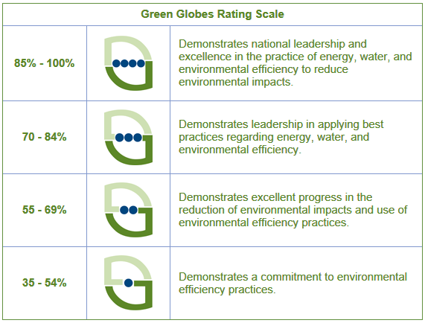
Green Globes® Ratings
Once an assessment is verified by a third party, buildings achieving a score of 35% or greater receive a Green Globes rating based on the percentage of total points achieved.

Slide 22
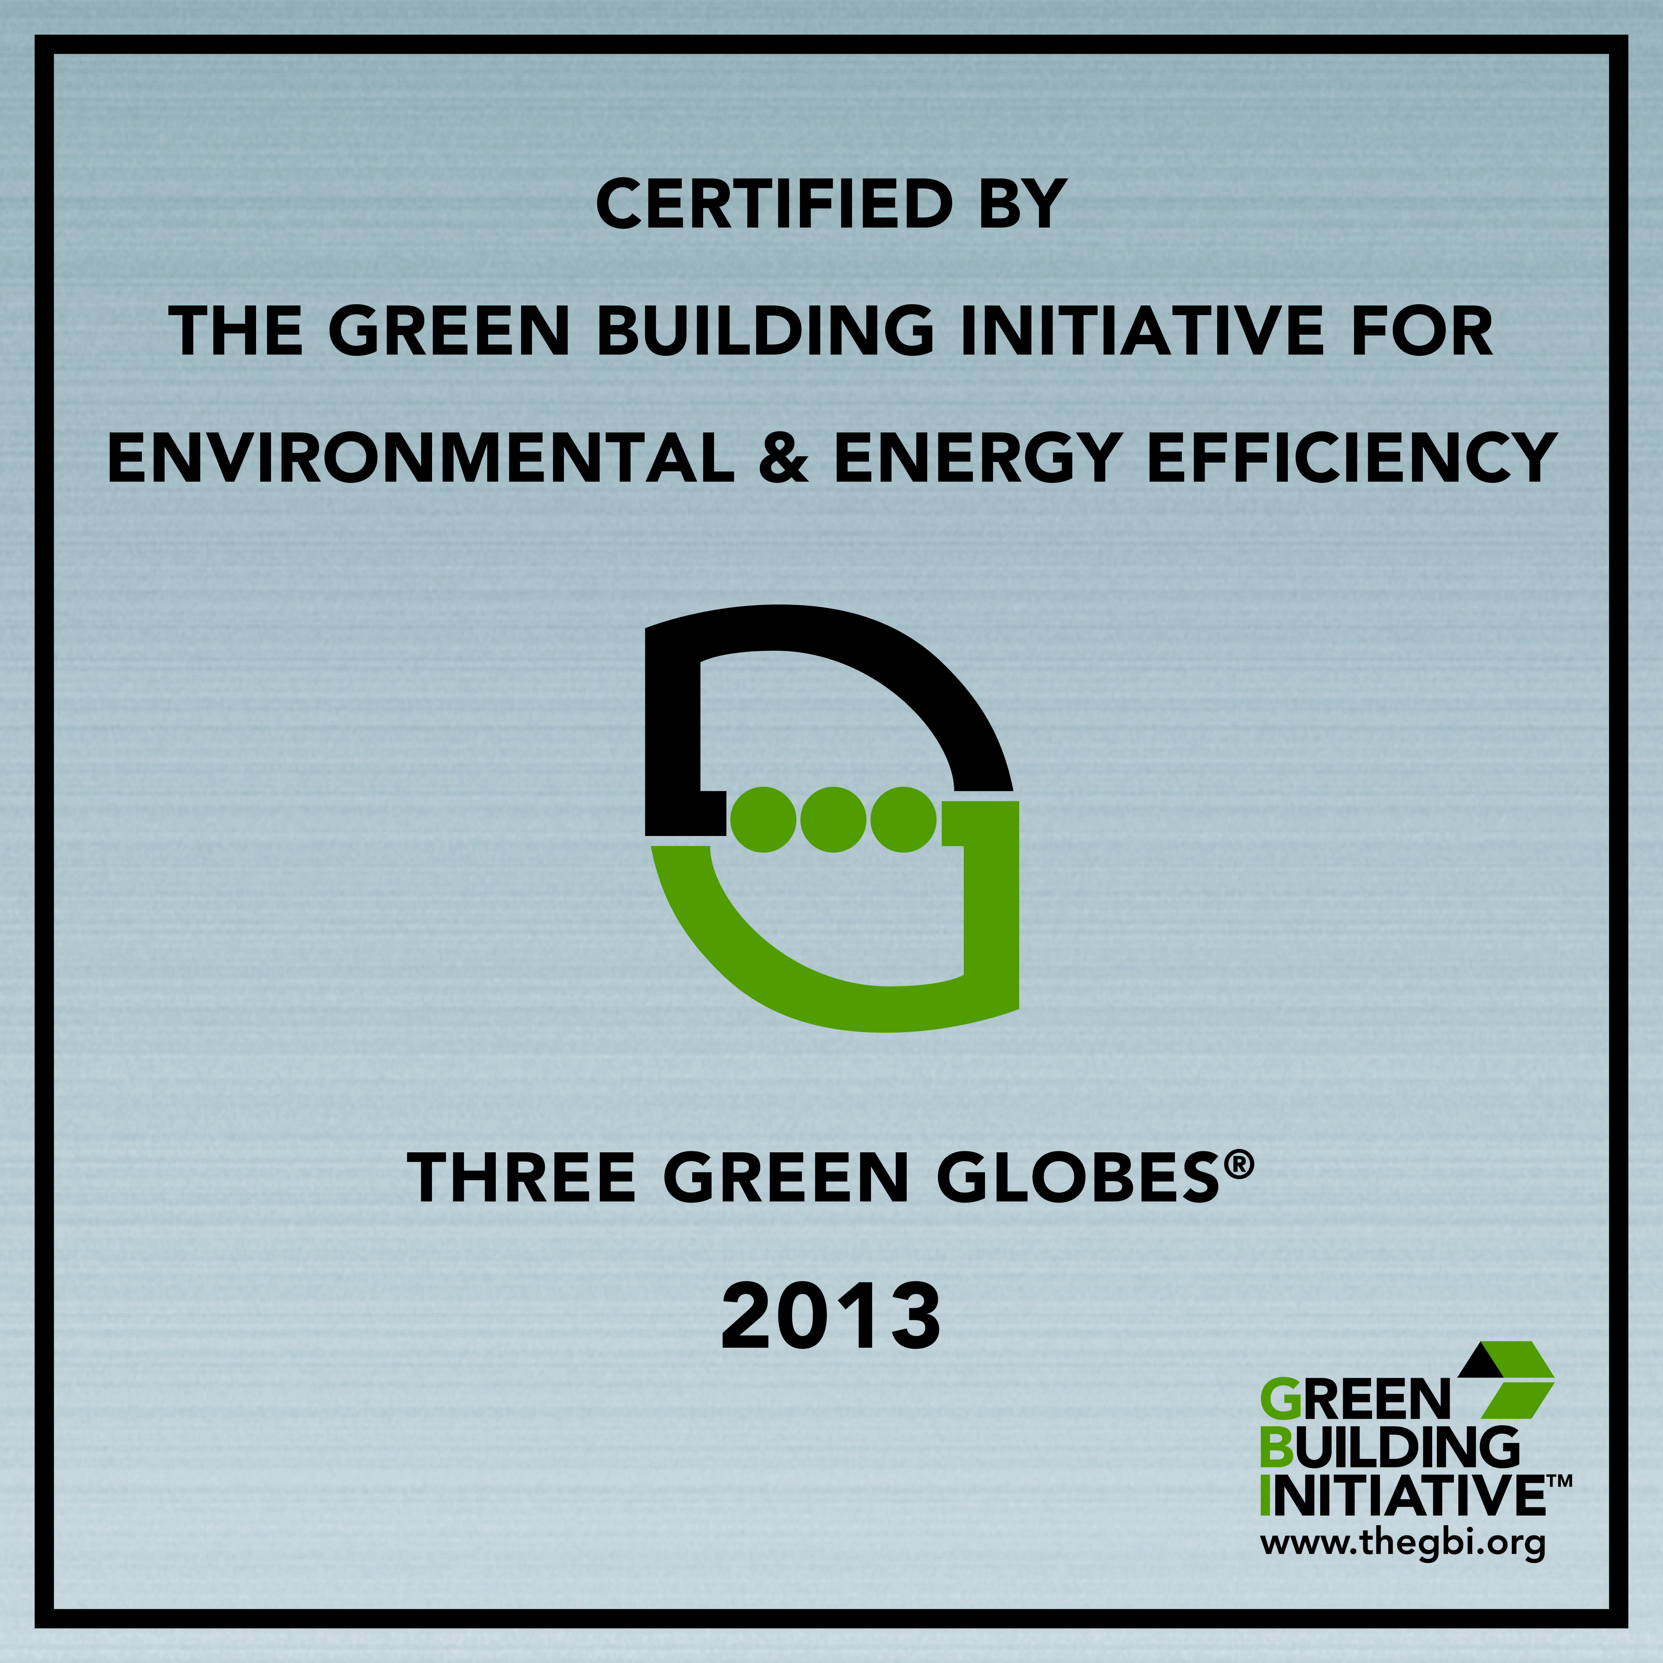
Certification & Recognition
Notes:
22

Slide 23
Green Globes for New Construction
Support for Certification
GG NC Technical Manual
Itemization of each criterion including:
  Scoring
  ToolTips
  Assessment guidance – identifies what is required to meet the criterion
  References/resources
GG NC Checklist
Identifies each criterion within the evaluation
Provides space to identify supporting documentation which verifies compliance to each criterion to assist client and assessor
Green Globes Frequently Asked Questions (FAQ)
GBI Staff
Available to answer questions
GBI Assigned Third-Party Assessor
After assignment, available to answer questions relating to the GG NC assessment process and clarify assessment requirements
Notes:
In addition to the ability to trial the software, you will have access to the following:
23

Slide 24




GBI Personnel Certification
ADEQ Headquarters, North Little Rock, Arkansas
Supports the Green Globes process

Slide 25


Personnel Certifications
Green Globes Professional (GGP)
  Qualified to assist in filling out the GG questionnaire and getting the building ready for certification
  FREE for a limited time (AIA 5 credits, LU/HSW)
Green Globes Assessor (GGA)
  Qualified to act as an independent third-party for the GBI and to audit registered projects and assign the appropriate number of GG

Slide 26
Training and Examination Subject Matter
  Incorporation of energy and environmental best practices into green building design;
  The Green Globes online assessment tools;
  Assessment protocol for both new and existing buildings and LCA;
  Energy modeling, including use of the EPA’s Energy Star tools; and
  The Green Globes Certification process
Notes:
26

Slide 27
Training Offered
    AIA Accredited Courses
    Green Globes for New Construction
    1 LU/HSW Credit (FREE)
    Green Globes for Sustainable Interiors
    1 LU/HSW Credit (FREE)
    Green Globes Professional (GGP)
    5 LU/HSW Credits
    Guiding Principles Compliance Professional (GPCP)
    5 LU/HSW Credits
Notes:
27

Slide 28
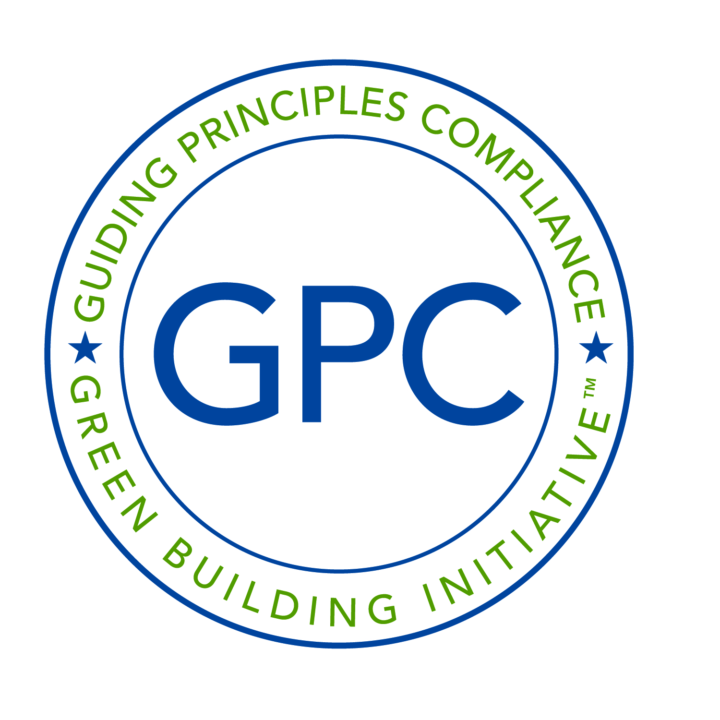

Green Building Initiative …
Guiding Principles Compliance Assessment Tools
New Construction and Major Renovation
Existing Buildings

Slide 29





5 Environmental Assessment Areas
Guiding Principles Compliance
  1: Employ Integrated Assessment, Operation, and Mgmt. Principles
  2: Optimize Energy Performance
  3: Protect and Conserve Water
  4: Enhance Indoor Environmental Quality (IAQ)
  5: Reduce Environmental Impact of Materials

Slide 30
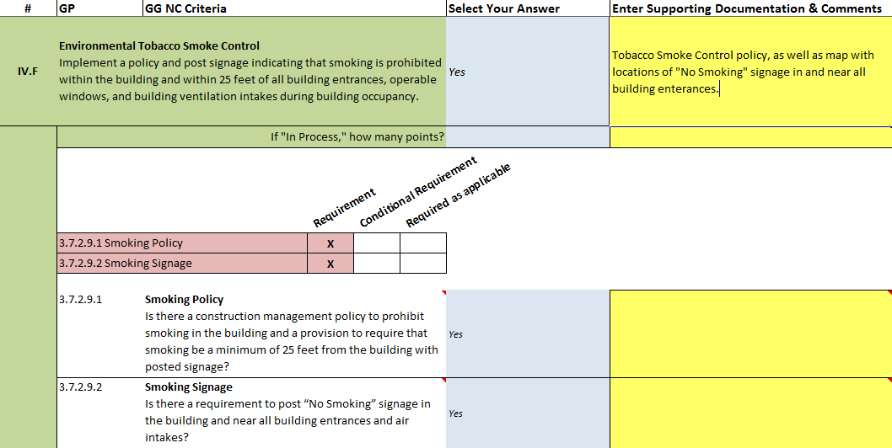
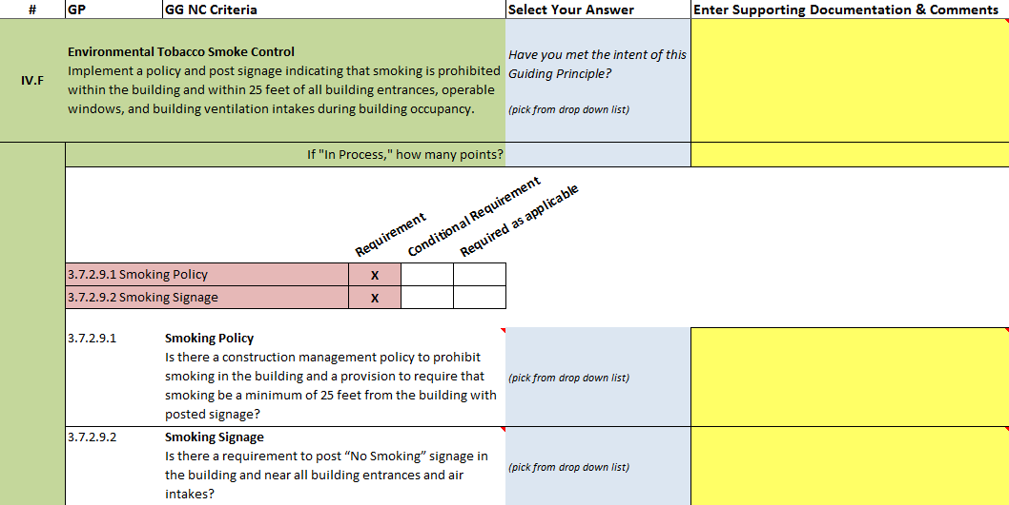
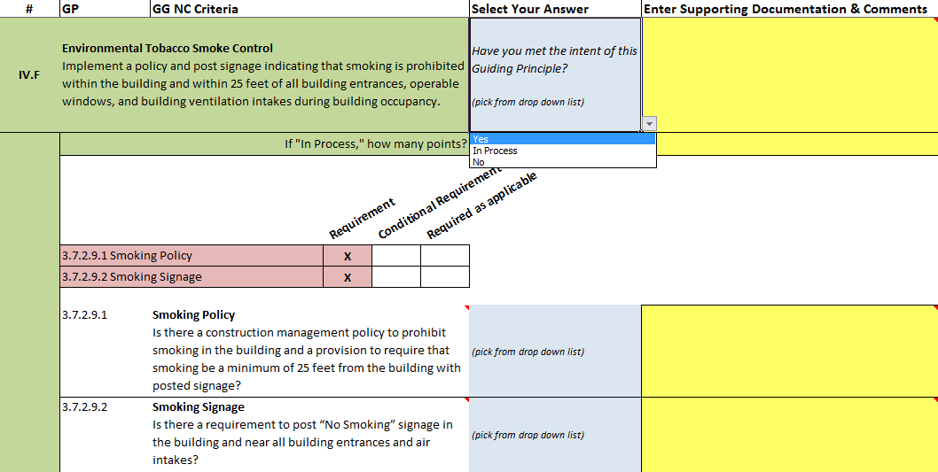



GPC NC: Survey & Document Checklist
Notes:
GBI’s primary tool for assessing compliance to the Guiding Principles for New Construction and Major Renovations is the GPC NC Survey & Document Checklist. This screenshot shows one of the Guiding Principles within the survey, in addition to a GPC Requirements Table and two criteria from the Green Globes for New Construction program. GBI’s GPC NC program goes beyond including the Guiding Principles, and includes strategies, technologies, programs and policies from Green Globes for New Construction as specific examples of methods for meeting compliance to each Guiding Principle. These Green Globes criteria have been included within the GPC NC Survey to assist the Integrated Design Process Team (or project manager), but are optional and do not need to be utilized in order to meet compliance to the Guiding Principles. Ultimately, each Guiding Principle is assessed as either meeting full compliance, in process towards full compliance, or not in compliance at all based on the methods – either listed within the survey or not – that have been utilized.
Compliance is assessed by a third-party assessor during two separate stages of the building project: 1) A Pre-design Assessment, and 2) An On-site Assessment taking place after construction of the building. A third, optional Design Review is also offered between Pre-design and the On-site Assessment. During each of these assessments, the GPC NC Survey will be completed by the Integrated Design Process Team who indicate whether the intent of each Guiding Principle has been met by selecting from the pull-down list next to the Guiding Principle [CLICK NEXT]. If utilizing the Green Globes criteria, as listed within the GPC Requirements Table, simply select the pull-down list [CLICK NEXT] next to each criteria to answer it [CLICK NEXT]. Yellow fields have been included for specifying supporting documentation and any additional comments for the assessor who will be reviewing the survey as well as supporting documentation [CLICK NEXT]. ToolTips have also been provided throughout the GPC NC Survey [CLICK NEXT] with additional guidance for users wherever necessary.

Slide 31

GPC NC: Survey & Document Checklist
Survey results list all answers w/in the survey.
Click on any blue link to jump to that spot in the survey.
Notes:
Included within the GPC NC Survey is a ‘Survey Results’ tab that lists all answers to the Guiding Principles as completed within the survey. The purpose of this tab is to identify if any Guiding Principle questions have been missed prior to submitting the survey to GBI for review – unanswered GPs are identified as “Not assessed.” Clicking on the blue links within this tab will jump to that spot within the GPC NC Survey.

Slide 32





GPC NC: Technical Reference Manual
Notes:
[CLICK as you go along] The GPC NC program includes a technical manual to provide guidance on completing the GPC NC Survey and individual criteria during the GPC NC assessment process. The manual is organized according to the ordering of the GPC NC Survey in order for users to cross-reference any question within the survey to its location within the manual, and includes appendices for those who wish to review examples of supporting documentation for each criteria, external references (such as to other standards), and a glossary of terms used throughout the manual. This manual comes as part of the GPC NC program materials for clients who have ordered the GPC NC Survey and assessment.

Slide 33
GPC NC: The Process
GPC NC Rating & (potential) Certification
Pre-design Assessment
On-site Assessment
On-Site Assessment Report
GPC NC Survey
GPC NC Survey
Pre-design Report
(optional)
Design Review
GPC NC Survey
Design Report
Notes:
The GPC NC process includes two required and one optional stage, respectively called the 1) Pre-design Assessment, 2) On-site Assessment, and 3) optional Design Review. Each of these stages aid the integrated design team throughout a new construction or major renovation project. Federal agencies undergoing a GPC NC assessment begin the Pre-design Assessment by completing the Excel-based GPC NC Survey [CLICK 1] and compiling all supporting documents, which are then reviewed by an assigned third-party assessor. The assessor then writes a Pre-design Report [CLICK 2] that summarizes the initial findings, provides recommendations for meeting full compliance (if necessary), and includes a projected GPC NC score and rating. After reviewing the GPC NC Pre-design Report, project managers should discuss with the IDP Team any changes they wish to make in the design as necessary to meet compliance to the Guiding Principles.
Between the Pre-design and On-site Assessments, the project manager will complete the design phase, develop the construction documents, and manage project construction. When construction is essentially complete, the project manager begins the On-site Assessment process [CLICK 3] by completing the GPC NC Survey [CLICK 4] for any design or project changes that occurred after the Pre-design stage. Once the completed survey and supporting documents have been compiled, an on-site assessment will be scheduled for the assessor to interview key project players, perform a thorough walk-through of the site, and any additional documentation reviewed on-site. After the visit, the assessor will write an On-site Assessment Report [CLICK 5] that summarizes the findings and provides the final Guiding Principles Compliance score and rating [CLICK 6].
[CLICK 7] An optional Design Review is available for agencies (for an additional fee) who wish to have an additional, third-party assessment of the completed design prior to the beginning of construction. The Design Review is similar to the Pre-design Assessment process, with the exception that the project manager must submit the completed construction documents to the assessor in addition to the updated survey for the additional review.

Slide 34


Guiding Principles Compliance Program: Existing Building
Complete GPC Survey
Compliance is assessed with an interactive Adobe PDF Survey
Select drop-down boxes and fill-in the appropriate comment fields
Read tool-tips for additional assessment guidance
If applicable, replicate campus-wide data for multiple buildings
Notes:
The pdf file is interactive
34

Slide 35




Guiding Principles Compliance Program: Existing Building
Complete GPC Survey
  Completing the Survey…
  Completing the Survey…
Yes
Meets guidelines. Full points awarded.
No
Does not meet guidelines. No points awarded.
In Process
Partially compliant. Partial point awards possible.
Not Assessed
Not assessed for compliance by client. No points awarded in preliminary report.
Review each GPC criteria
Select a compliance status
Select status verification that shows compliance
Enter in additional documentation and policy details
Always remember to save your Survey!
Notes:
Compliance Status Options:
Yes - Meets guidelines. Full points awarded.
No - Does not meet guidelines. No points awarded.
In Process - partially compliant. Partial point awards possible
Not Assessed - not assessed for compliance by client. No points awarded in preliminary report. This will NEVER be a response within the Assessor Survey. ALL items are assessed for compliance.
When completing the survey…………
Be sure to answer the questions for the specific building being assessed.
Be sure the selection demonstrates verification for that building. For example, if a general corporate policy exists, ensure specific documentation supports implementation of that policy for the building and/or location.

Slide 36


Guiding Principles Compliance Program: Existing Building
Complete GPC Survey
Other Survey considerations:
Certain GPC criteria have multiple options or combination of options to demonstrate compliance . Select the option most likely to receive compliance.
A few criteria have multiple Status Verification drop-downs. Select all that apply.
Read the Tool-tips for additional guidance.
Notes:
Tool-tips are available throughout the survey to assist you.
Let’s look at the survey.
36

Slide 37

Guiding Principles Compliance Program: Existing Building
Supplemental Guide
In addition to the tooltips, GBI provides a GPC Supplemental Guide
Provides
  Definitions and examples of the compliance verification documents for each Guiding Principle criterion listed within the GPC Survey
  Available via the same link used to download the GPC Survey within the Account Home screen of your GBI User Account
Notes:
37

Slide 38

GPC Report: Roadmap to Compliance
Guiding Principles Compliance
Lists all points missed in the Survey (pre-design assessment; final assessment)
Organizes compliance recommendations by individual criteria
Allows you to focus on where and how to comply with the Guiding Principles
Notes:
38

Slide 39





Guiding Principles Compliance
Rating System
Buildings are assessed for compliance on a 0 – 100% point scale
A minimum score of 40% is required in order to be Certified
There are three central elements to the GPC Rating System
100%
80% - 99%
60% - 79%
1: Compliance Score
40% - 59%
0% - 39%
Not Certified
2 GPC
3 GPC
4 GPC
5 GPC
2: Compliance Rating
3: GPC Logo
Notes:
The Guiding Principles Compliance program assesses buildings for compliance against a 0% - 100% point scale. There are three, central elements to the Guiding Principles Compliance Rating System:
1: Compliance Score: each building being assessed for Guiding Principles Compliance receives a Compliance Score from 0% - 100%. The final Compliance Score is based upon the third-party awarded points upon the conclusion of an onsite assessment.
2: Compliance Rating: additionally, each building meeting the minimum score of 40% receives a Certified Compliance Rating from 2 to 5 GPCs. The number of GPCs earned corresponds to a range within the 100-point Compliance Rating Scale as identified in this graph.
3: GPC Logo: lastly, the GBI assigns a GPC logo identifying the Compliance Rating and Certification of the building. For buildings not meeting the minimum score of 40% to be certified, the logo specifies that the building has been “Assessed” and not “Certified”.

Slide 40

Certification Plaque
Notes:
40

Slide 41


Summary
Guiding Principles Compliance for New Construction
Two Stage Assessment Review
  Pre-Design
  On-Site
Option to include Design phase
Each GP has strategies, technologies, programs and policies from Green Globes as specific compliance examples
Customer support
Roadmap for improvement included in assessment report
Notes:
The program uses a streamlined & transparent process that starts with entering building data in a web-based survey
It uses the latest criteria and life cycle assessment to provide an accurate assessment of sustainability
Performance criteria are emphasized over prescriptive criteria providing more ways for owners/designers to create sustainable buildings
The use of performance criteria and “non-applicables” enables a wide variety of sustainable buildings to be certified
Customer support is available throughout the process to ensure the process is efficient
And the program is more affordable as it avoids “point chasing” and prerequisites that may not contribute to sustainability

Slide 42







ADEQ Headquarters, North Little Rock, Arkansas
Guiding Principles
Compliance Professional
(GPCP)

Slide 43
Thank you
Alberici Headquarters, St. Louis, MO
Erin Shaffer
VP of National Affairs
202-285-8339
erin@thegbi.org
www.thegbi.org
Notes:
43
Thanks for the opportunity to meet you, and to update you on Green Globes. We are available at any time to answer questions. There will be more news regarding additional product releases, case studies, and industry partnerships.

