Slide 1

NATIONAL ACADEMY OF SCIENCES & ENGINEERING CONFERENCE
Washington, D.C.
April 15, 2015
Innovation in Facility Management: Positioning Facilities for Greater Functionality and Resilience
Presented by: Stephanie Dawson
Acting Chief Operating Officer

Slide 2
Mission
“Meet the critical transportation infrastructure needs of the bi-state region’s people, business and visitors by providing the highest quality and most efficient transportation and port facilities and services to move people and goods within the region, provide access to the nation and the world and promote the region’s economic development.”

Slide 3
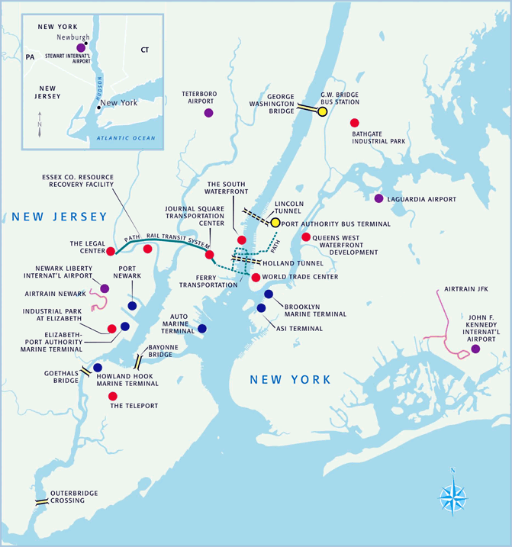
Port Authority Facility Map
Aviation
John F. Kennedy International Airport
LaGuardia Airport
Newark Liberty International Airport
Stewart International Airport
Teterboro Airport
Atlantic City Airport
Bridges
Bayonne Bridge
George Washington Bridge
Goethals Bridge
Outerbridge Crossing
Terminals
Port Authority Bus Terminal
George Washington Bridge Bus Terminal
Journal Square Transportation Center
Port Commerce
Port Jersey-Port Authority Marine Terminal
Brooklyn-Port Authority Marine Terminal
Elizabeth-Port Authority Marine Terminal
Howland Hook Marine Terminal
Port Newark
Tunnels
Holland Tunnel
Lincoln Tunnel
Rail
PATH Rail Transit System
WTC
ATLANTIC CITY AIRPORT

Slide 4
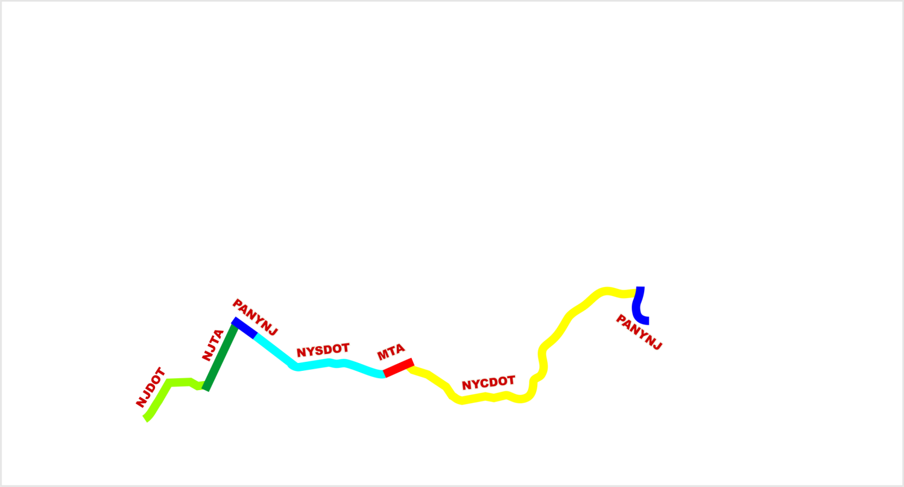
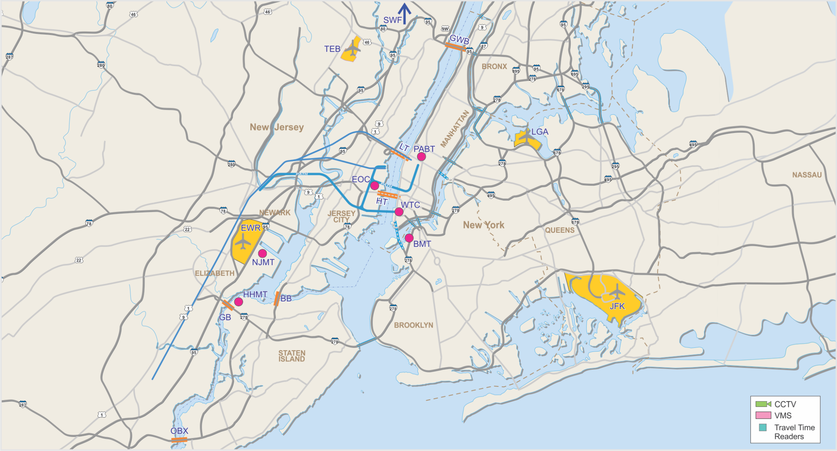
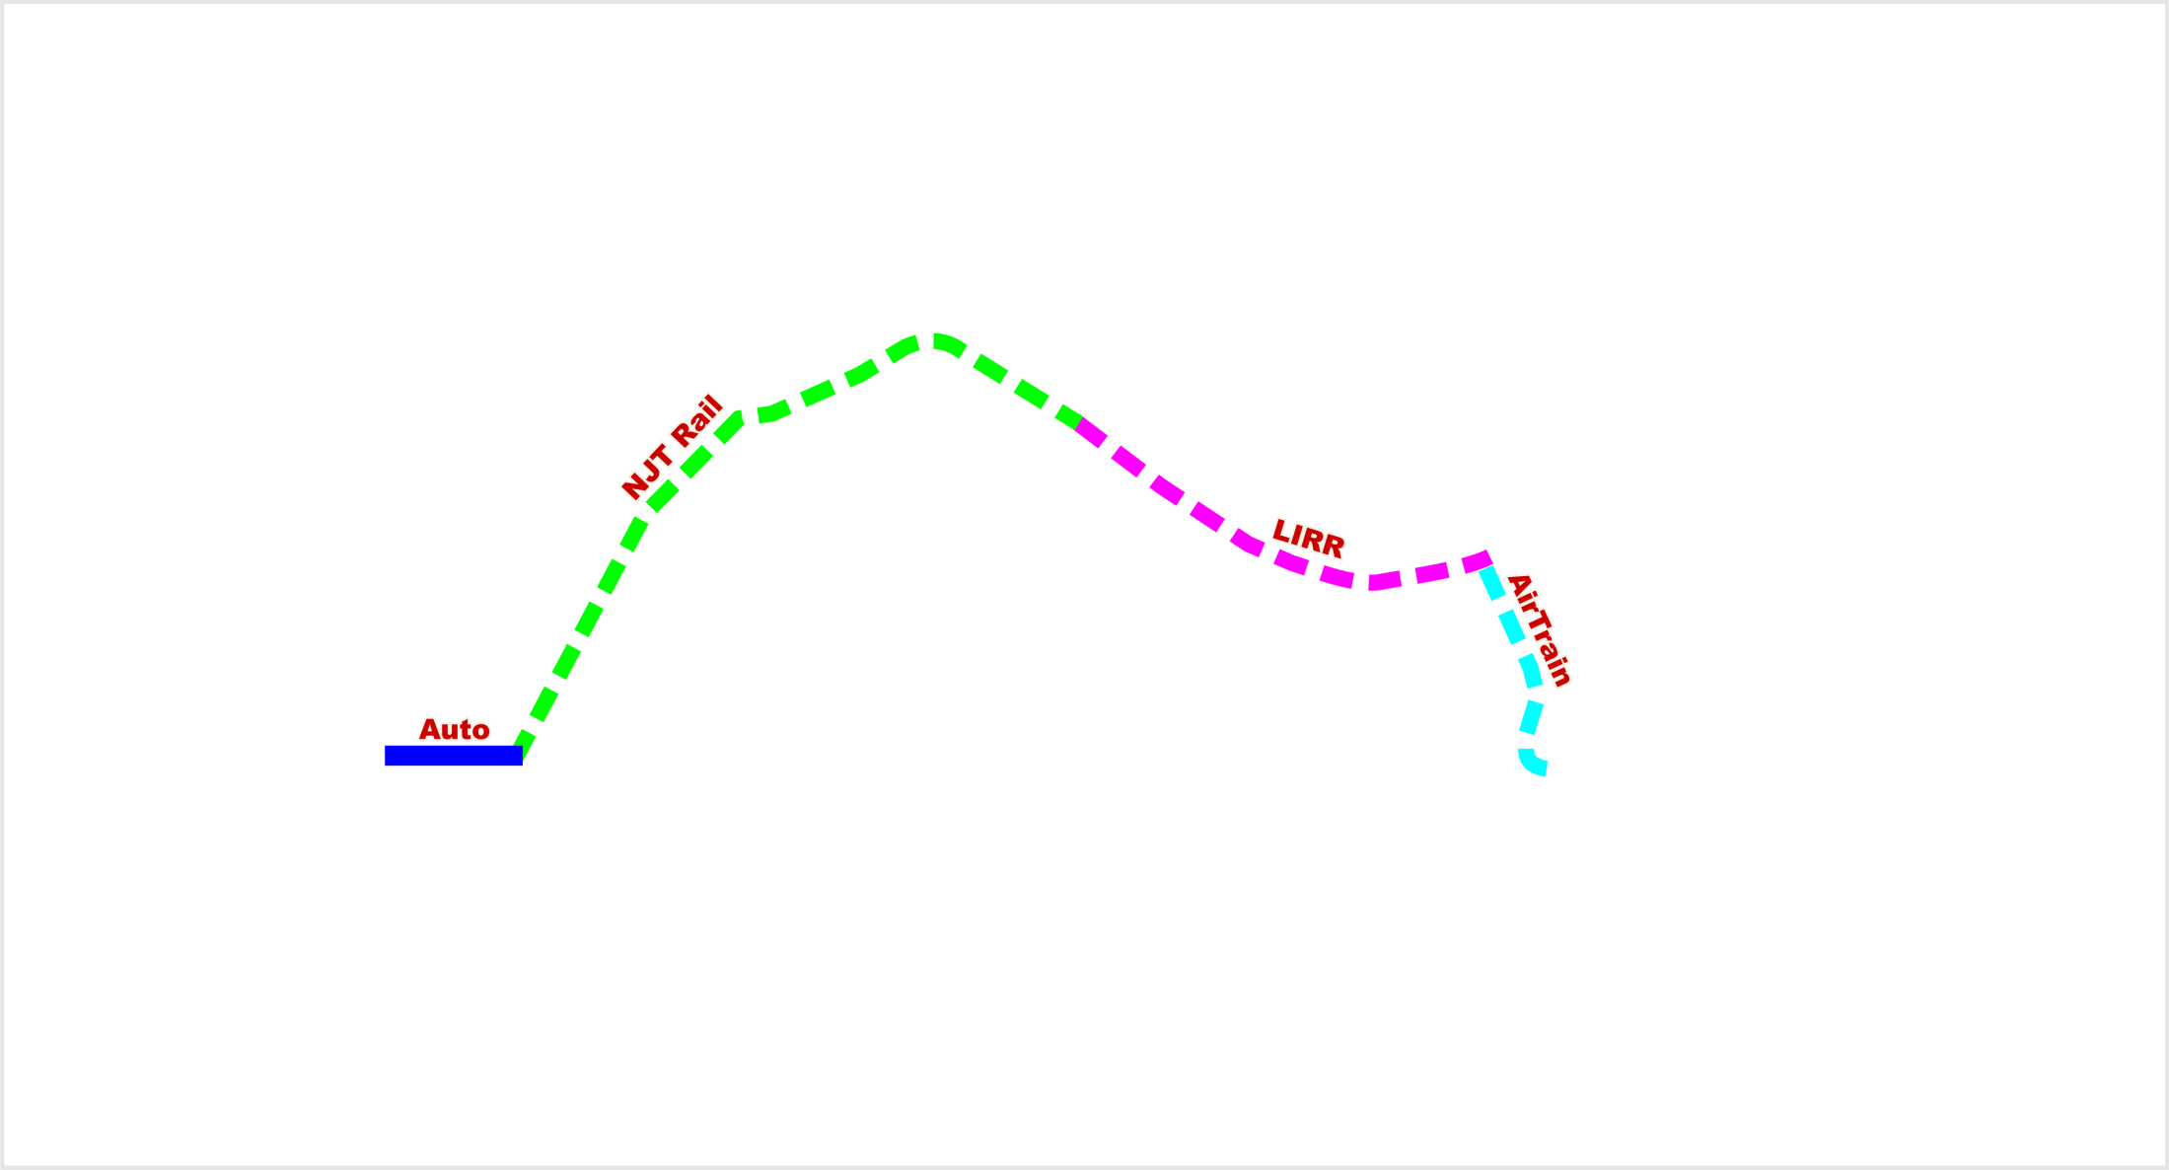
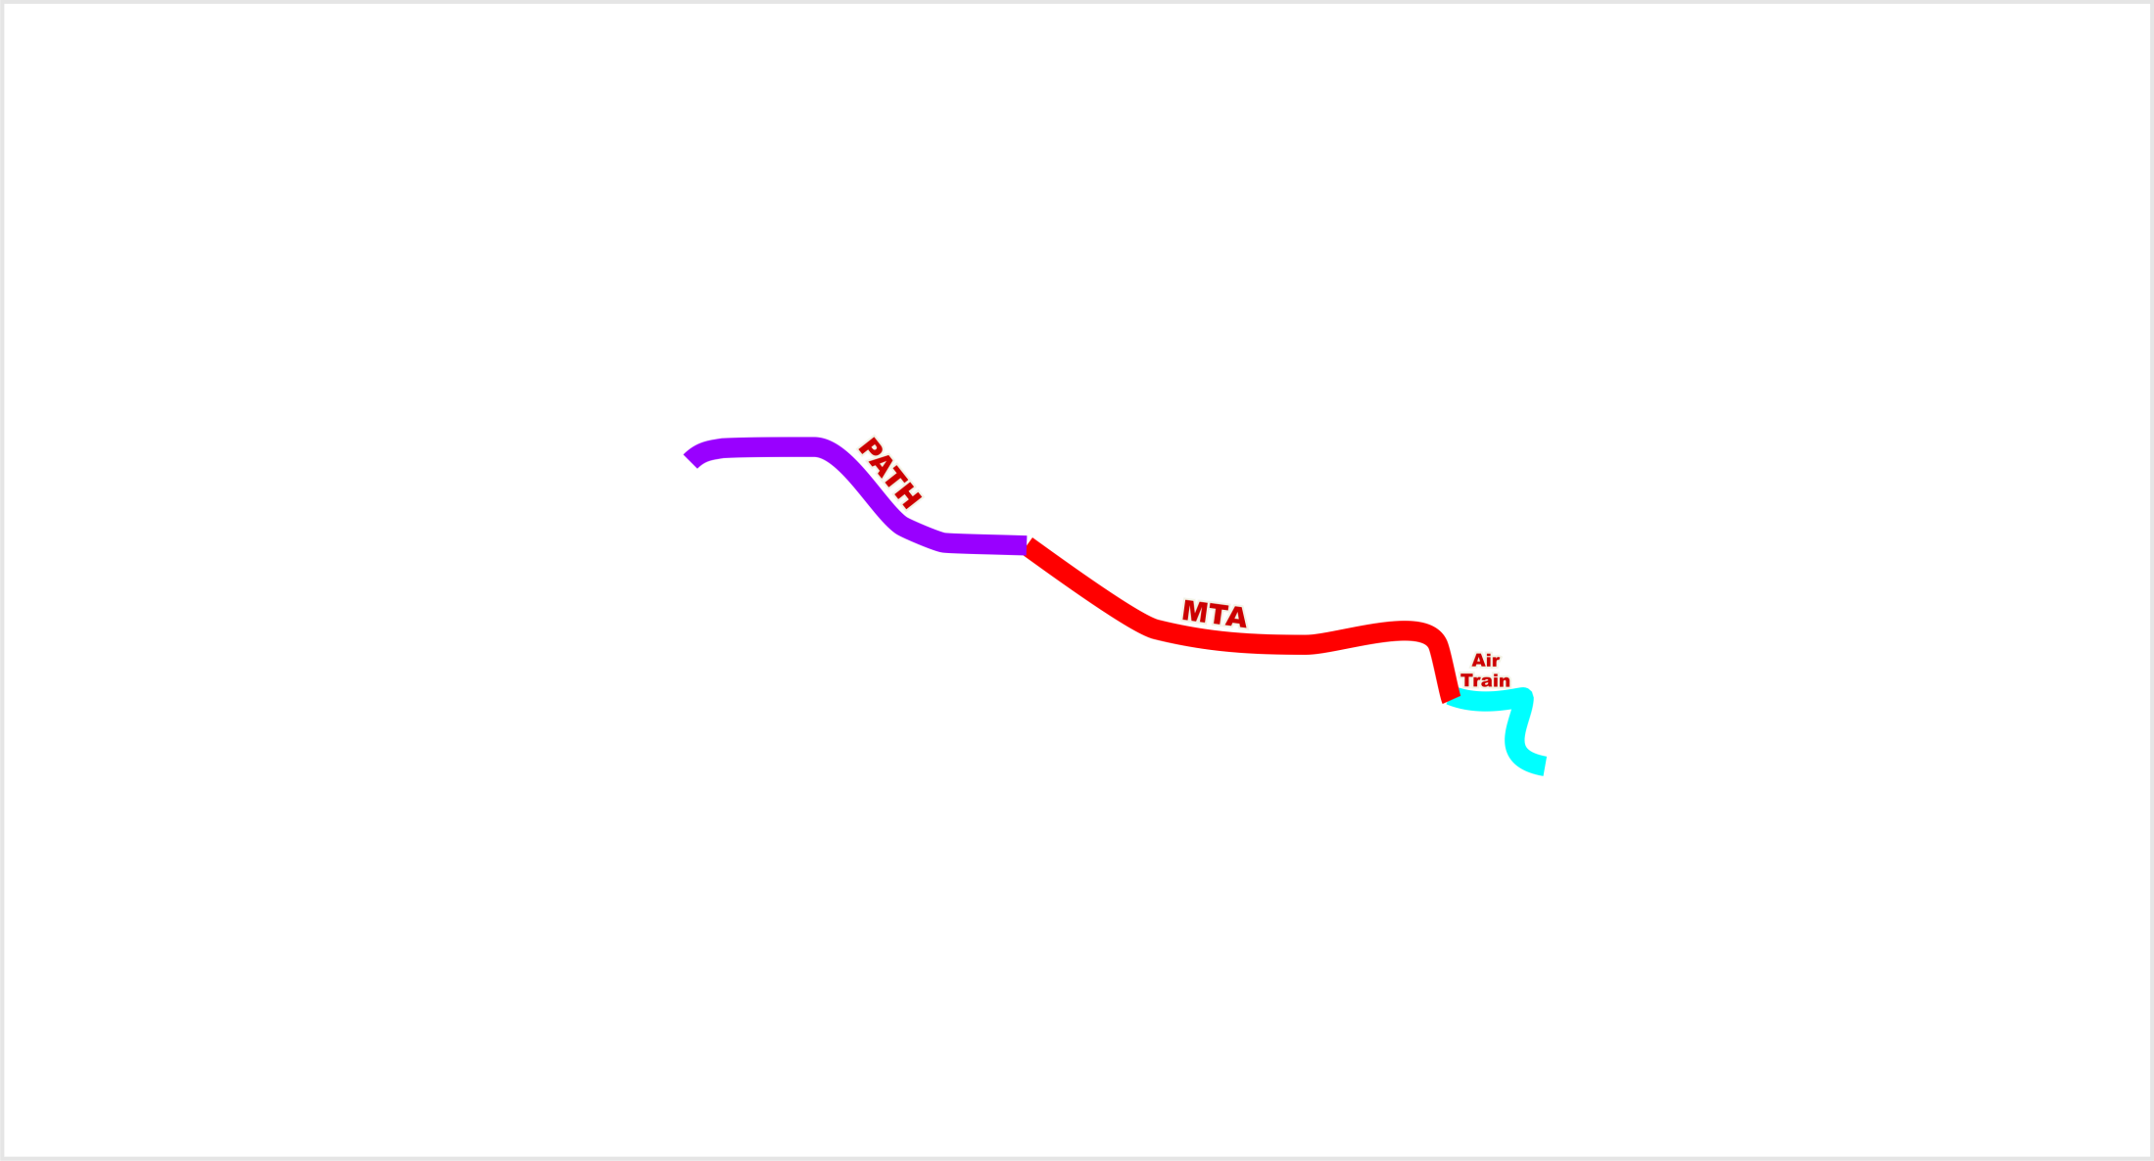
The Goal: Seamless Regional Travel
Notes:
4

Slide 5
The Challenge: Operations & Resiliency Management
Asset Management
Asset Management
Operations
MISSION
MISSION
Enable maximum availability of physical assets for intended purpose
Build in Resilience
Utilize risk based (including functionality) determinations regarding on-going financial investments
Ensure staff is trained, available and deployed to support strategies
Optimize use of technology
Maximize asset life while minimizing asset costs.
Organize and manage resources and responsibilities for maximum effectiveness during on going 24/7 operations or emergency operations
Exploit resilience
Ensure staff operational competence, nimbleness, knowledge transfer
Leverage contemporary assets to extract efficiencies for on-going and emergency operations
Implement preparedness, response, and recovery plans and procedures to lessen the event impact. Reduce vulnerability to hazards to improve response and recovery times

Slide 6
Asset Lifecycle Management
Asset Management
Asset Management
Inspections & Assessments
Asset Lifecycle Management involves:
Understanding and accounting for the assets that are essential for providing transportation services, and
Ensuring functionality and increasing attainment of useful life and maximum asset availability to ensure reliability, reduce asset failure and reactive maintenance, and optimize agency investments.
Capital
Management
Maintenance
Management
Infrastructure
Management
New Projects
Completed Projects

Slide 7
Connecting Information Silos
Asset Management
Budget PRO | PeopleSoft | SAP
Asset Management
Inspections & Assessments
Capital
Management
Maintenance
Management
Infrastructure
Management
New Projects
Completed Projects
ICMS
Present + Planned Workload System
Contrak (aka Wintrak)
Airport Certification Program
Boiler Inspection Program
Contractor Systems
Electrical Integrity Program
Environmental Compliance Programs
Fire Protection Program
Geographical Info. Systems
MMIS + VMMS
Accident Analysis & Mitigation System
As-Built Drawings
Base Map Management System / Annual Mapping Program
Geographical Information Systems

Slide 8
Connecting Information Silos
Asset Management
Budget PRO | PeopleSoft | SAP
Asset Management
Capital
Portfolio
Infrastructure
Management
Maintenance
Management
Pavement Management System
Roadway Device Management System (RDMS) for Traffic Signals
Structural Integrity Program
Utility Management System
Vertical Transportation Inspection Program
PATH Maintenance of Way Sys.
PATH Work Order Tracking Sys.
Railroad Compliance Program
Roadway Device Condition Surveys & Safety Audits
System Control & Data Acquisition System (SCADA)

Slide 9
Department perspective:
FACILITY ASSETS

Slide 10

Aviation Profile
Peak Daily Activity *
230,000 Air Passengers
2,700 Air Traffic Movements
4,500 Tons of Air Cargo
27,000 Parked Card
5 Airports (2 International, 2
Domestic,1 General Aviation)
17 terminals: average age of 30 yrs
& over 220 gates
13 runways: over 100,000 feet
combined and over 60 miles of
taxiway
Cargo Space: over 2 million sq. ft.
*May 2014
The World’s Largest System of Airports
2 Light Rail Systems: JFK AirTrain & Newark AirTrain
23 parking lots and 6 garages with over 45,000 spaces
Fuel storage facilities, central heating and refrigeration plant, electrical substations

Slide 11
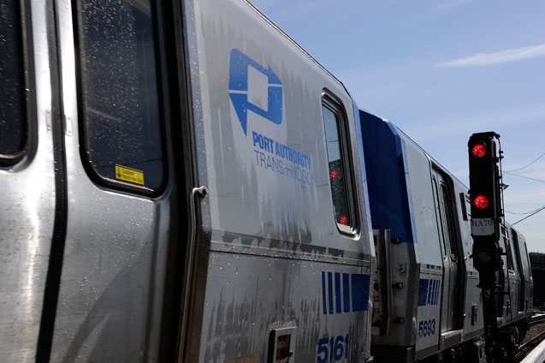
PATH Profile
NJ
Newark
Journal Square
Hoboken
Pavonia/Newport
Harrison
Exchange Place
Grove Street
World Trade Center
33rd Street
23rd Street
14th Street
9th Street
Christopher Street
Average Daily Ridership
250,000 Passengers
NY
PATH PA-5 Revenue Car *Nov 2014

Slide 12
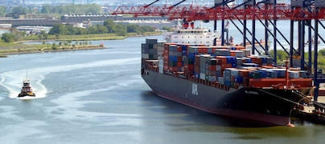
Port Commerce Profile
Seven Marine Terminals
Peak Daily Activity
8,900 Containers
1,150 Autos
NJ
Port Newark
Port Jersey
Port Elizabeth
Greenville Yard
Brooklyn Marine Terminal
Howland Hook
Red Hook
NY
2nd Largest U.S. Port System *May 2014
2,600 acres of property:
Warehousing and other specialized facilities | Various equipment: Reach stackers, straddle carriers, top loaders
Bulk cargo handling facilities | Rail Systems
Automobile processing | Various production plants

Slide 13
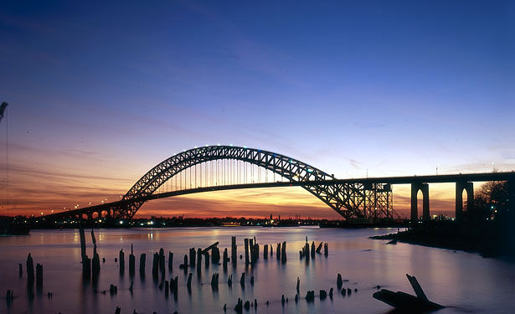
TB&T Profile
4 Bridges
    George Washington Bridge
    Bayonne Bridge
    Goethals Bridge
    Outer Bridge Crossing
    65 Toll lanes in 8 Toll Plazas
Peak Daily Activity *
9,685 buses
25,800 trucks
286,000 automobiles
  2 Tunnels
    Holland Tunnel
    Lincoln Tunnel
  2 Bus Depots
    George Washington Bridge Bus Station
    Port Authority Bus Terminal
Over 67,000 Feet of Roadway *May 2014

Slide 14
Keys to sustainability

Slide 15

Port Authority Emergency Response Long Term Recovery
Partnership with:
OEM Staff
Storm Mitigation & Resilience Office
AGENCY
COO
Chief Engineer
CTO
CSO
CFO
Chief, Capital
Planning
Insurance
Adjusters
Consultant
Contractor
Partners
FEMA
FTA

Slide 16
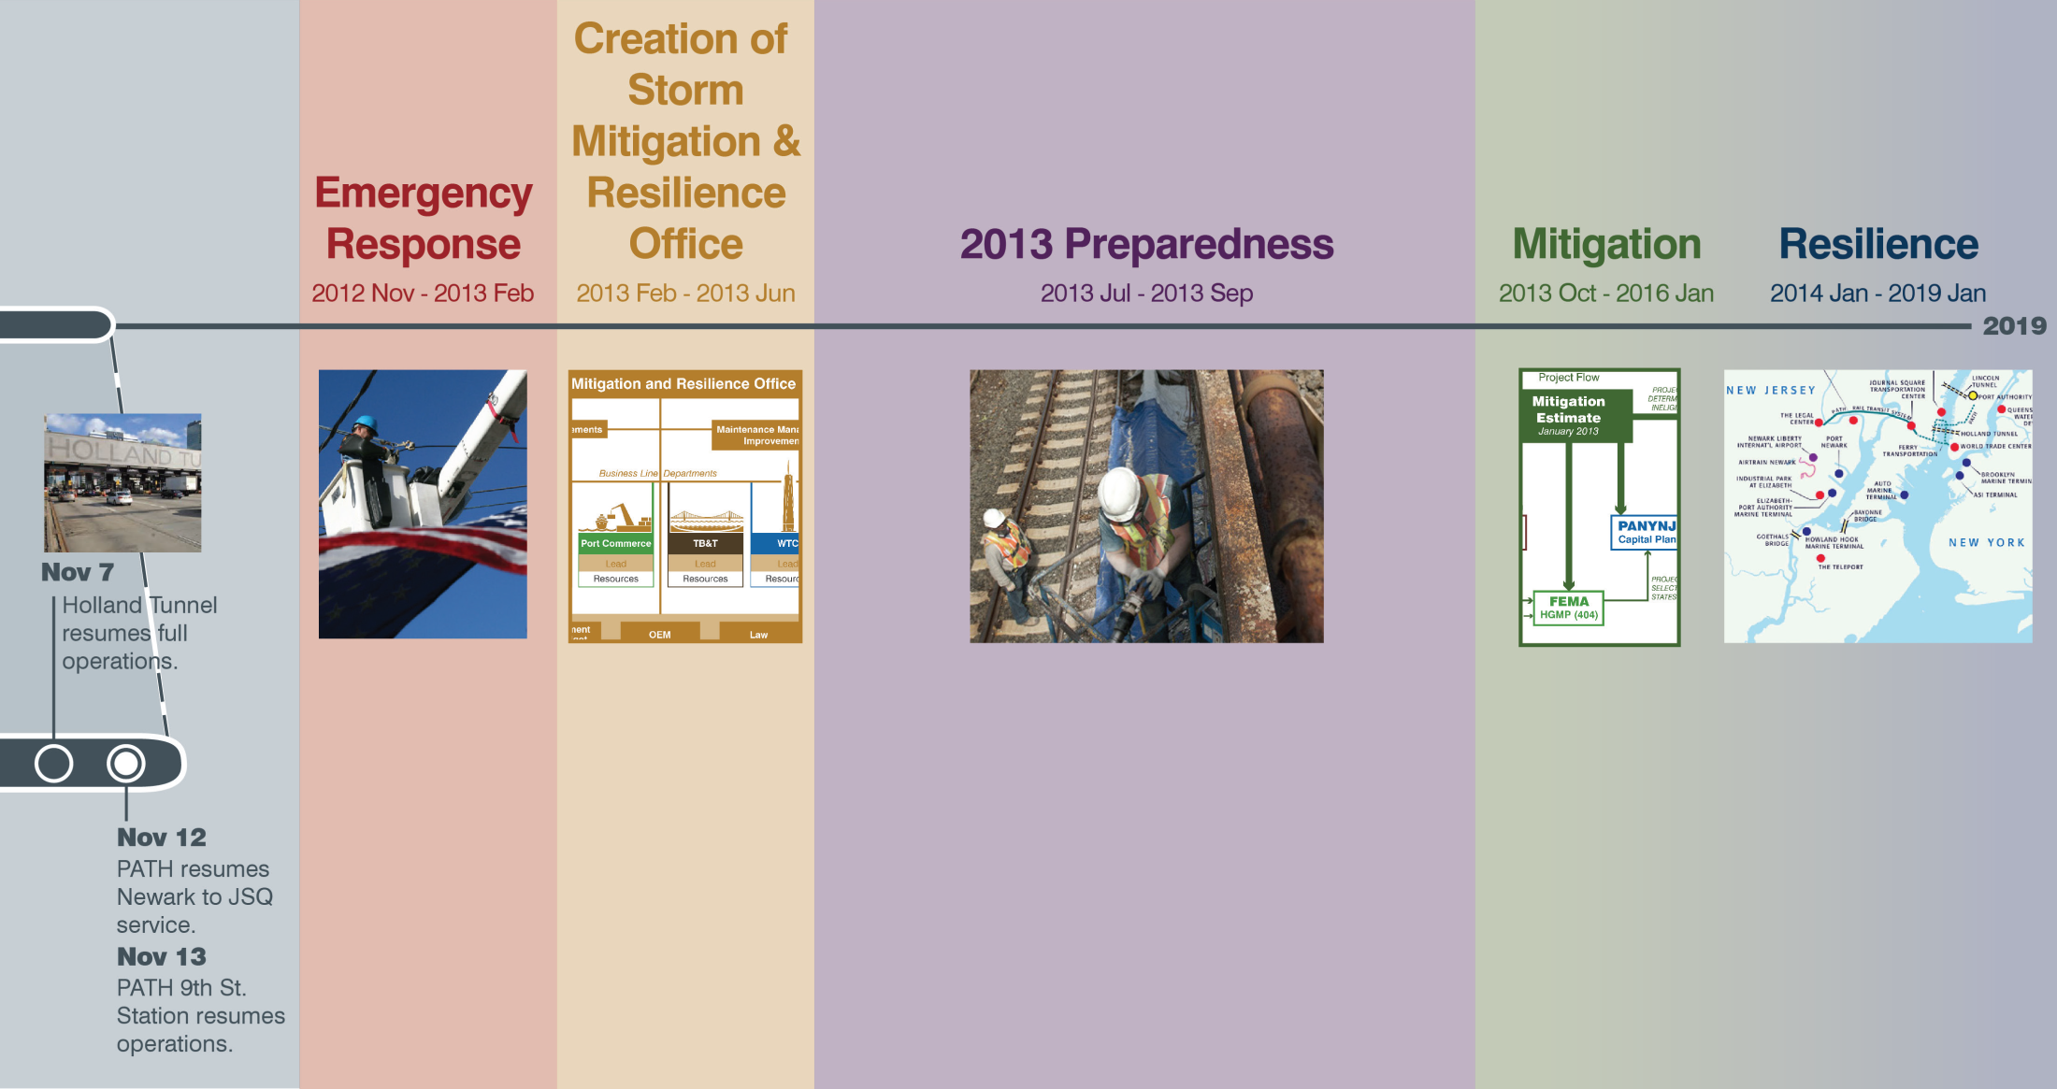
Storm Mitigation & Resilience Office
Goal

Slide 17
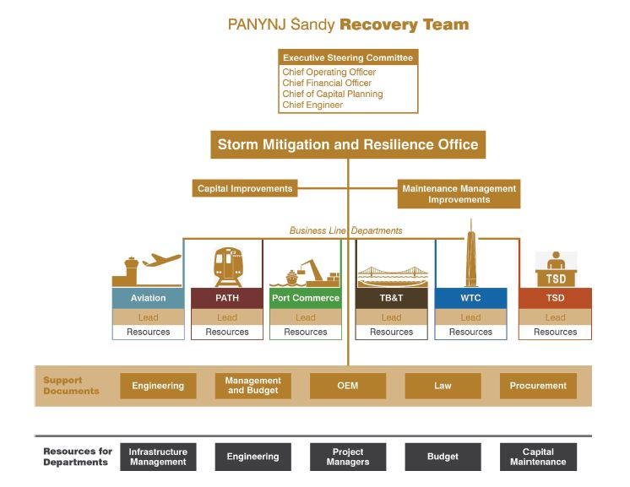
Created Storm Mitigation Office
Goal

Slide 18
Mitigation & Resilience Planning…
Short Term – Immediately Protect Critical Assets
Identified and completed “low hanging fruit” initiatives (interim protective
measures) where appropriate in 2013 and 2014.
  Focused on assets damaged that are most critical to operations.
  Expedited capital projects with “resilience” components.
2. Engineering led effort to develop revised “Resilience” Design Criteria for
application to capital program.
Strengthen and institutionalize partner relationship with suppliers and
consultants.
4. Complete Federal Resilience Projects: Port Authority has been awarded more than $200 million in competitive federal disaster grant funding from the FTA and FEMA to support mitigation and resiliency initiatives.

Slide 19
New Design Guidelines
Long Term Resilience: Revised Agency Design Guidelines
The Engineering Department, in consultation with the line departments, updated the agency’s standard design guidelines to ensure that current and future projects are more resilient to climate events.
2. The Guidelines:
  Comply with updated resiliency codes,
  Identify critical infrastructure,
  Consider federal, state and local recommendations,
  Consider climate change including sea level rise and extreme weather events.
  3. Baseline: Building Code + Sea Level Rise

Slide 20
Implementation of New Design Guidelines
Collaborative Implementation: Project mitigation strategies spearheaded by Engineering Department and developed in conjunction with Office of Storm Mitigation & Resilience, Office of Emergency Management and Enterprise Risk Management.
Process:
a. Risk Analysis: Port Authority staff performs a risk analysis to determine the impact of extreme weather events including anticipated sea level rise.
b. Benefit-Costs Analysis: used to determine the appropriate level of protection for the asset.
c. Final Preliminary Design: includes analysis and recommendation for the appropriate flood protection.

Slide 21
SELECTED major projects

Slide 22
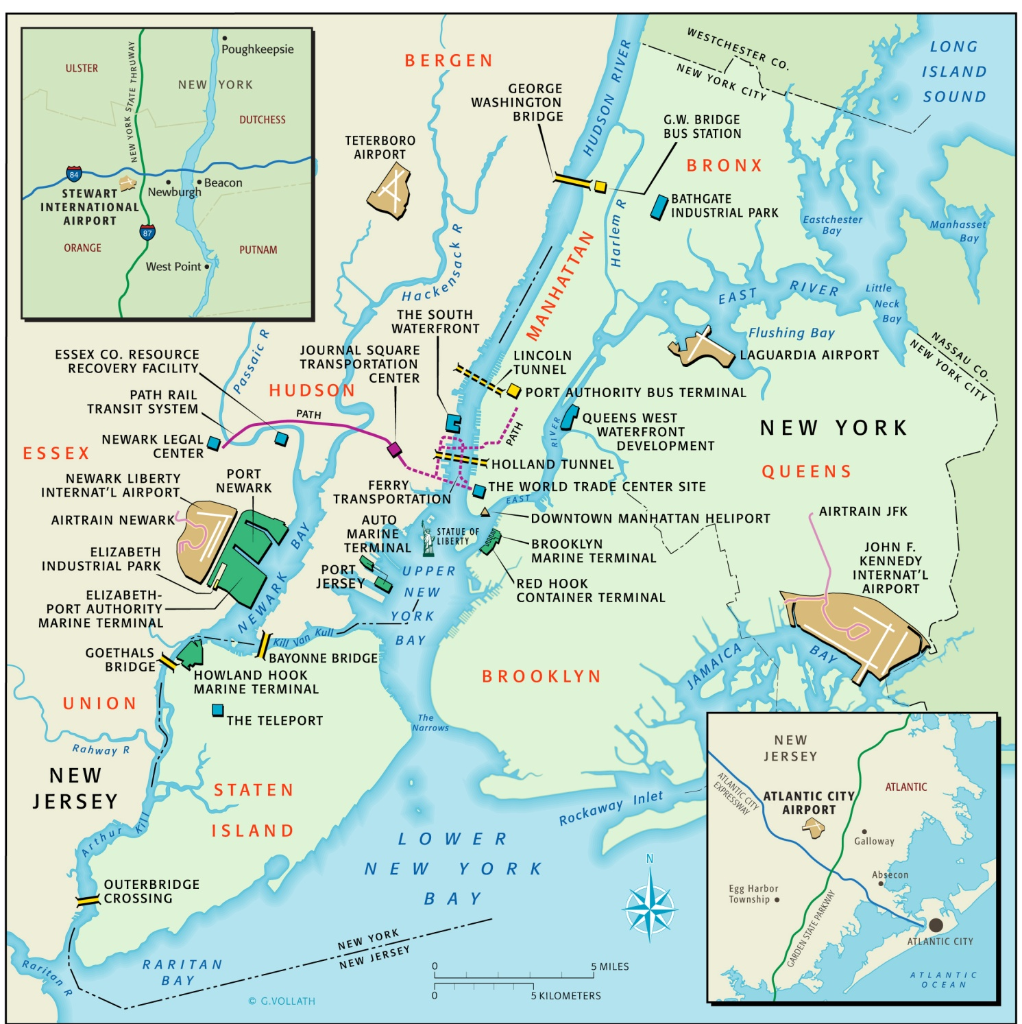
Trans-Hudson Transportation Initiatives
George Washington Bridge Suspender Ropes
GWB Bus Terminal
Lincoln Tunnel Helix
and Access
Port Authority Bus Terminal
Harrison & Grove St Stations PATH Signal Replacement
PATH Extension to Newark Airport
Bayonne Bridge Navigational Clearance
Goethals Bridge Replacement

Slide 23
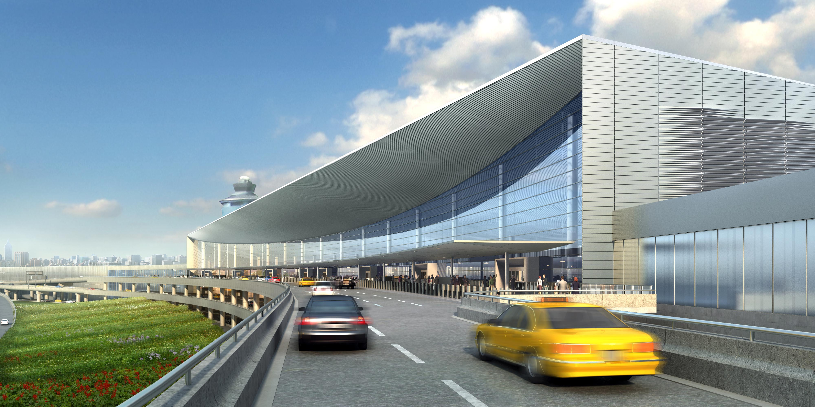
Aviation Department: LGA Redevelopment Program
NY Governor’s design competition
In parallel with final planning and contract award
Key Milestones
Owners portion of construction underway
Ten new gates are expected to be open in late 2016, with the new headhouse opening in 2018
The complete, 35-gate CTB is expected to be in operation by late 2021
Resilience elements: East & West substation designs revamped………

Slide 24
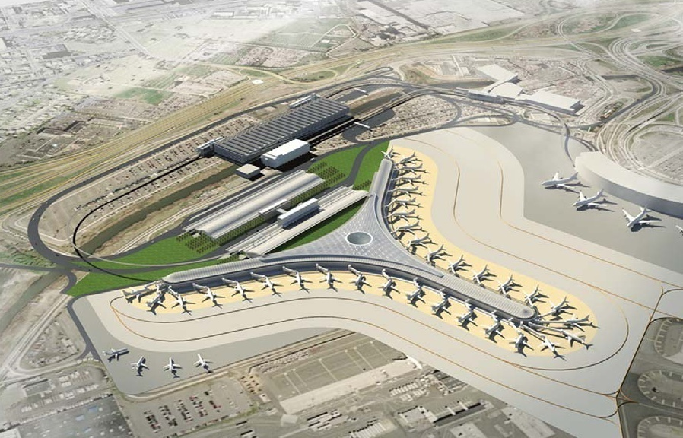
EWR Terminal A Redevelopment Program
  Construction of a new One Million Sq. Ft. State of the Art Facility
  Designed for effective and efficient transfer of commuters.
  Terminal with 33 Group III Aircraft gates
    Associated airside and landside redevelopment
    3000 Space Parking Garage
    Roadways and Utilities

Slide 25
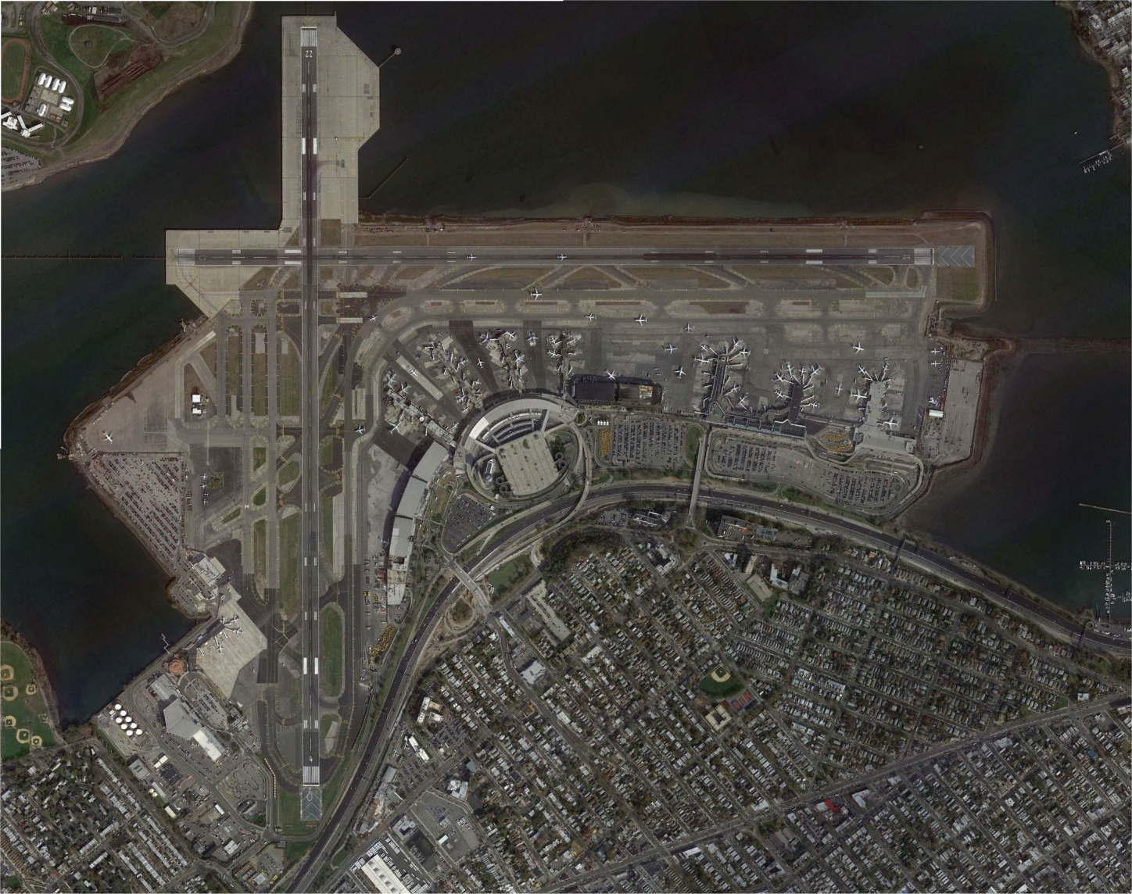
Aviation Department: LGA Flood Mitigation and Storm Resiliency Program
Flood Protection at the West End Substation
Flood Protection at the West Field Lighting Vault
Emergency Storm Drainage Outfalls
SCADA System Upgrade
Installation of Emergency Generators
West Field Lighting Vault
Drainage Outfalls
Drainage Outfalls
West End Substation

Slide 26
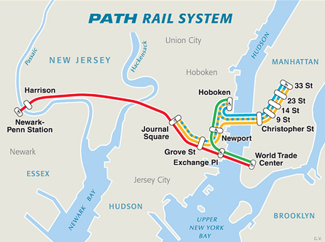
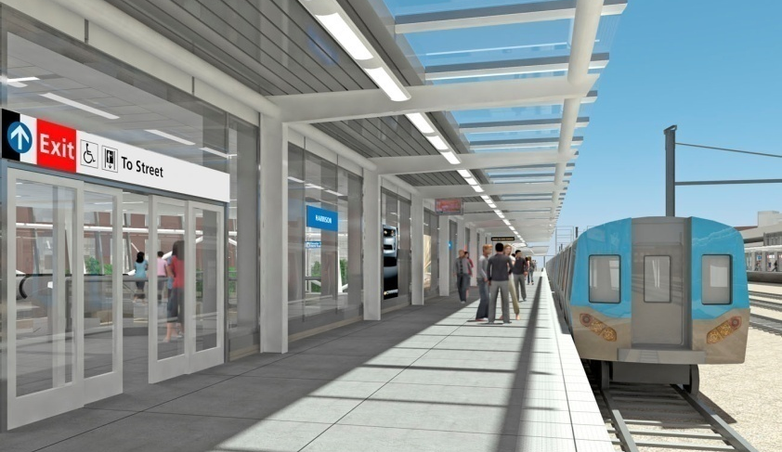
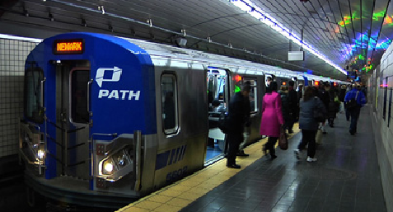
PATH
New Train Control Center
Station Modernizations
Super Storm “Sandy” Projects
Electrical Power Upgrades

Slide 27
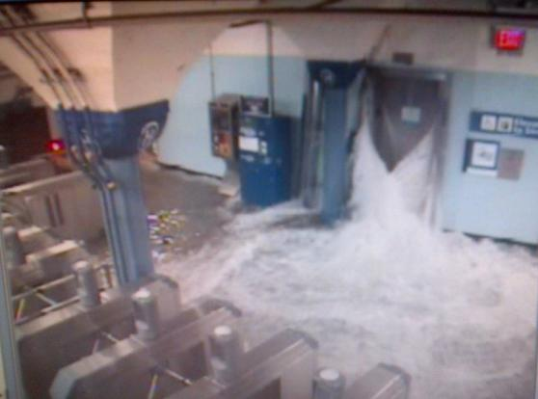
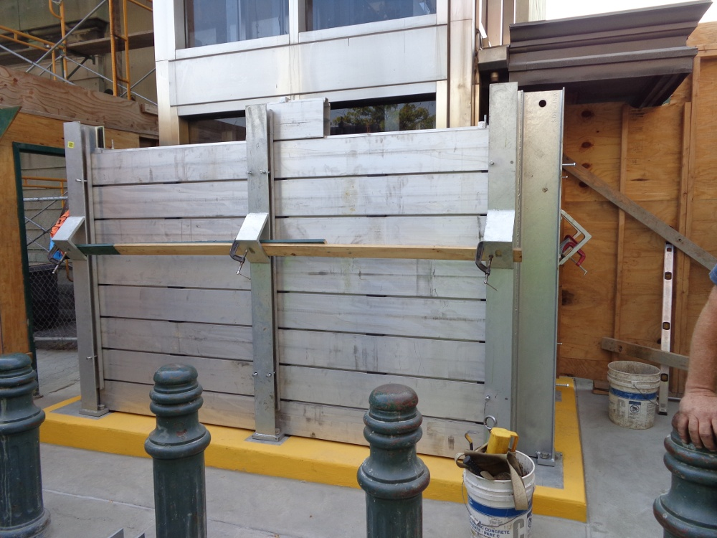
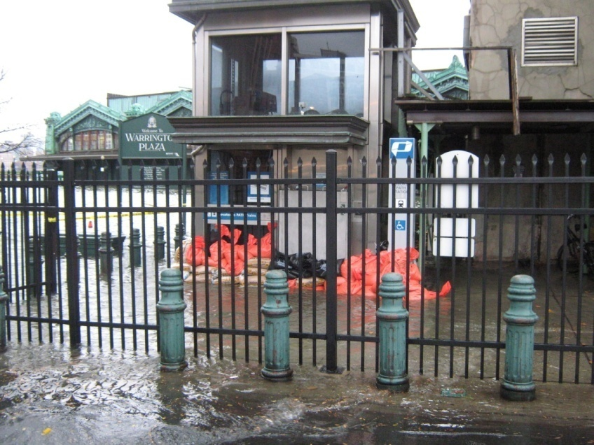
PATH Hoboken Passenger Elevator
Before
After

Slide 28
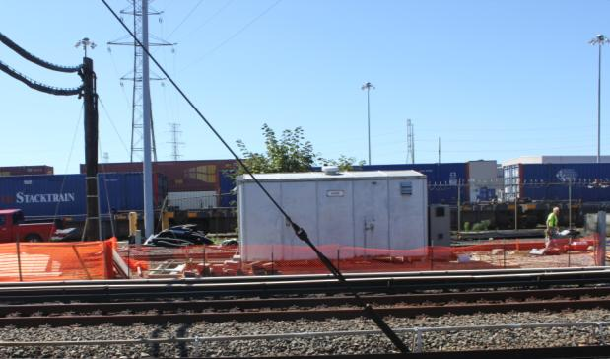
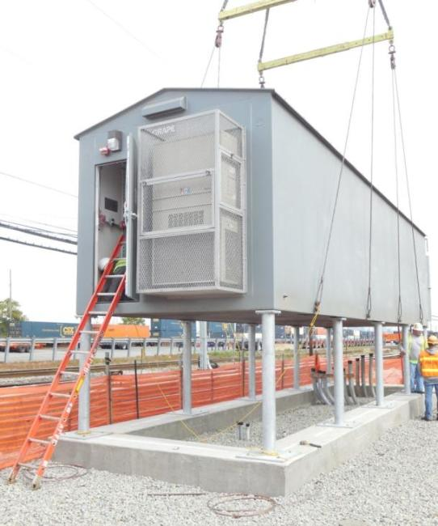
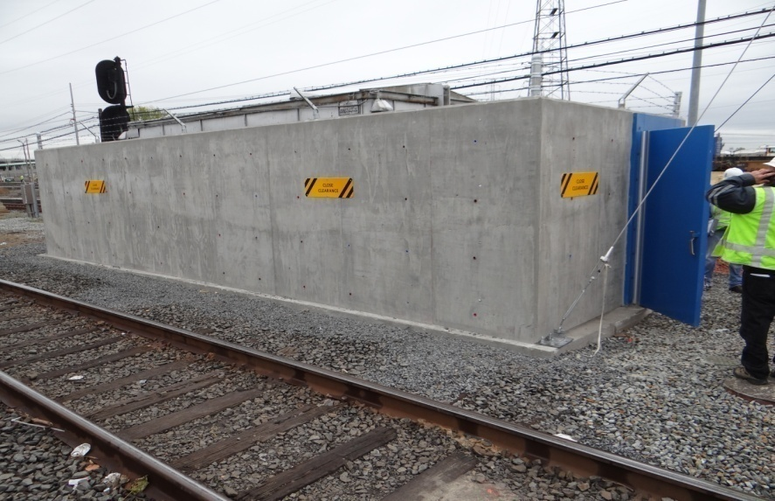
PATH Resiliency Efforts - Bungalows
Before
After
Interim 9/1 Protection

Slide 29
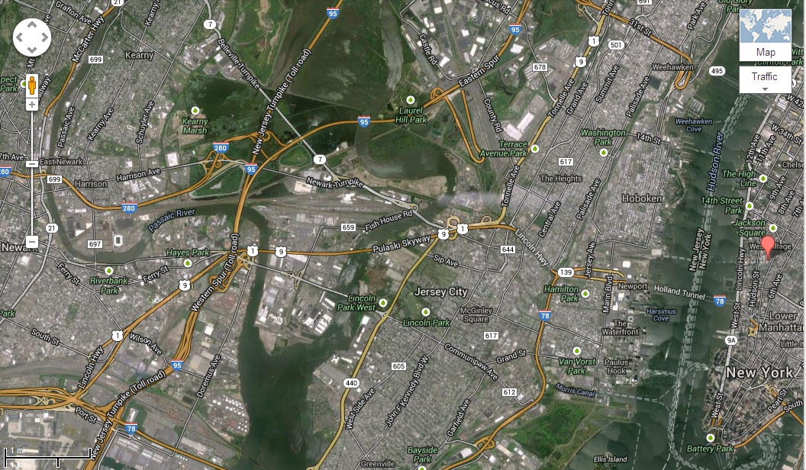
PATH Substation Construction
Replacement/Upgrading of PATH Facilities
    Substations No.7, 8 and 9
    DC switchgear in Switching Stations No. 6 and 10
Sub 7
Sub 9
Sub 8
PATH Right-of-Way

Slide 30
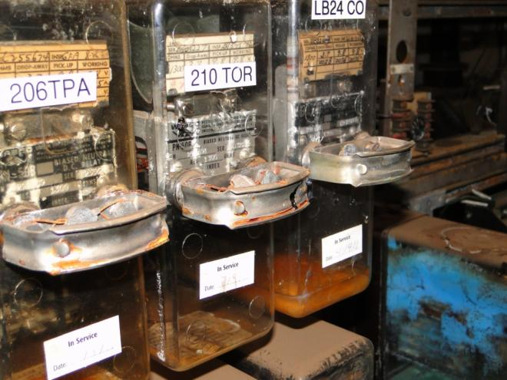
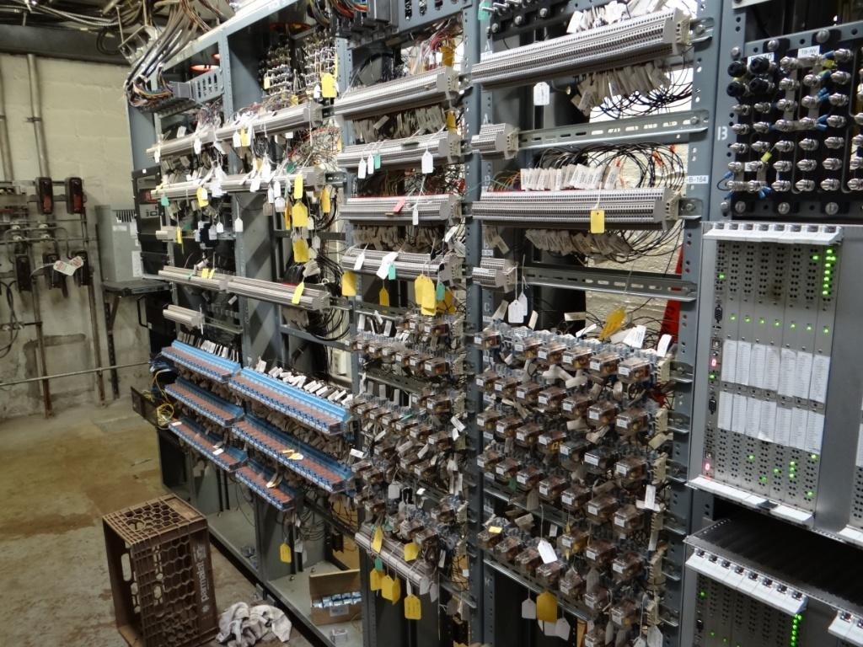
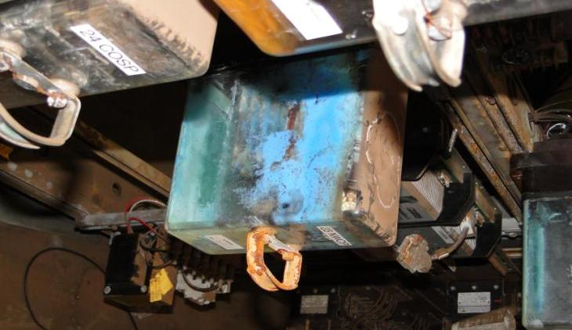
PATH Superstorm Sandy Damages Speed Innovation
e
BEFORE: OLD MECHANICAL RELAYS
AFTER: OLD MECHANICAL RELAYS
Old mechanical relays damaged by flooding
New microprocessor relays leveraged from Automated Train Control Project and repurposed

Slide 31
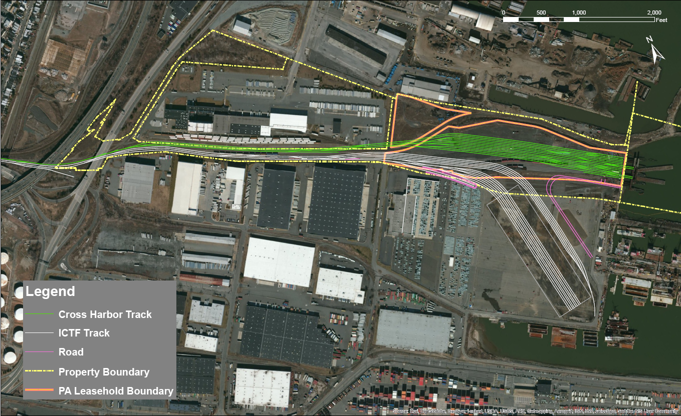
Port Commerce Department:
Greenville Yard Redevelopment Program
Cross Harbor
ICTF
Global Container Terminal

Slide 32
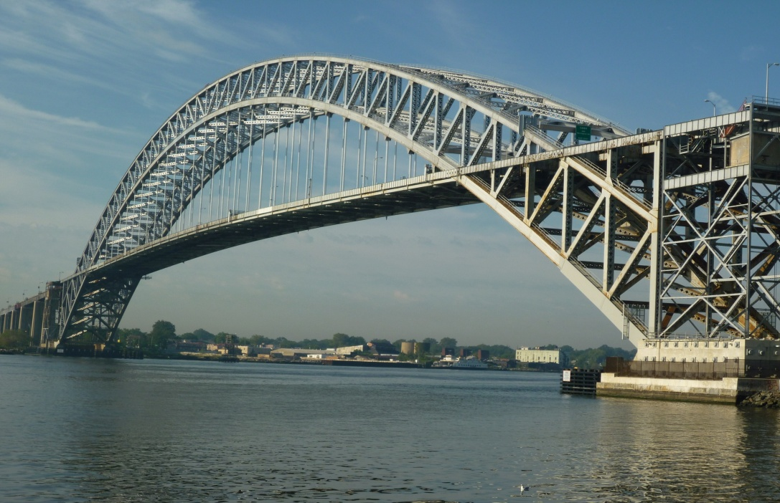
Bayonne Bridge Navigational Clearance Program
Tunnels, Bridges & Terminals Department (TB&T)

Slide 33
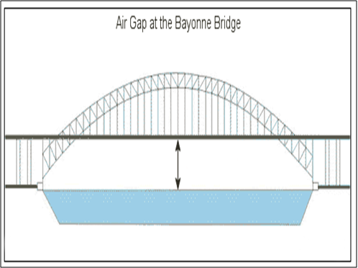
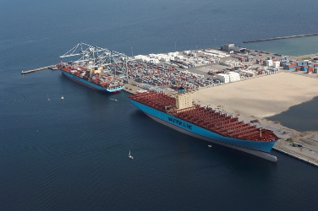
TB&T: Bayonne Bridge Air Draft Restriction
  Existing 151-foot air draft
  The expansion of the Panama Canal will allow for newer, larger, (Post-Panamax) ships with increased clearance requirements
  Taller ships (up to 200-ft), will not be able to navigate beneath the Bayonne Bridge
151 Feet

Slide 34
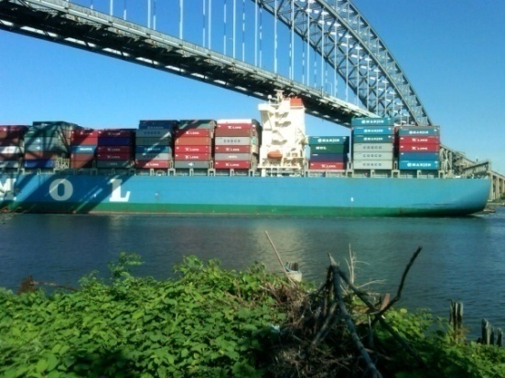
TB&T: BBNCP: Program Benefits
  Enhanced regional economic competiveness
  Increased environmental sustainability
  Improved safety conditions
  Modernized roadway
  Maintenance of community character

Slide 35
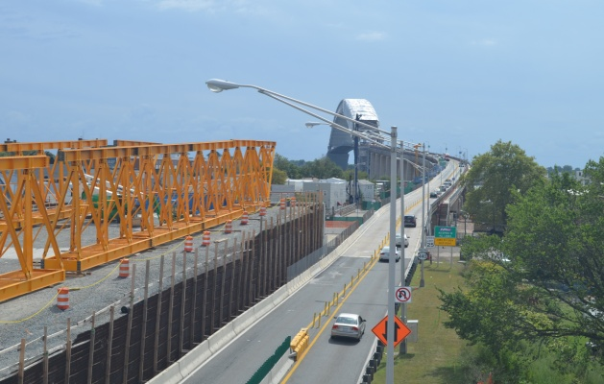
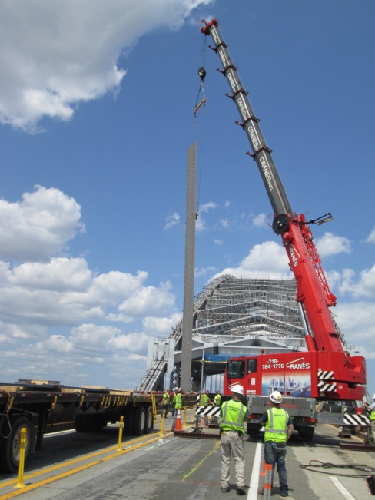
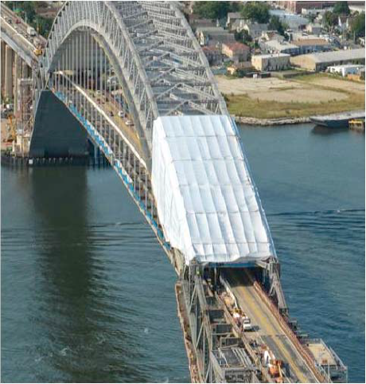
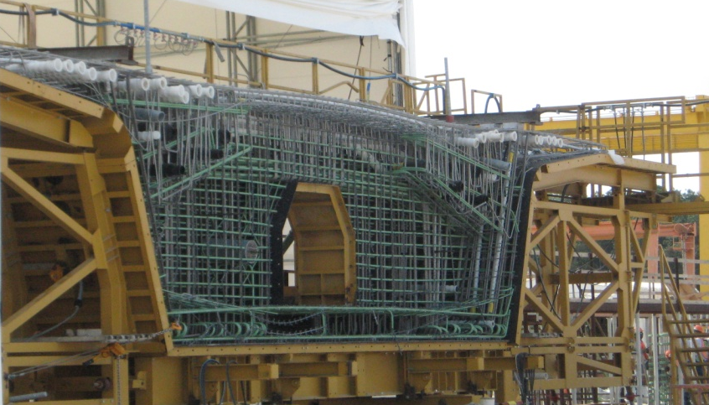
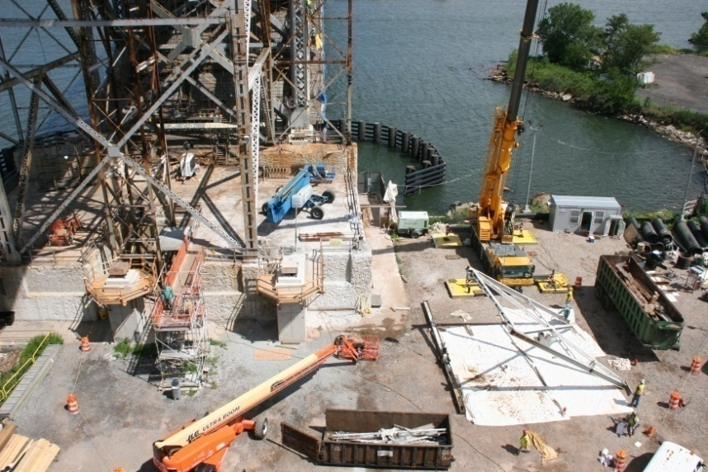
TB&T: BBNCP: Construction Activities

Slide 36
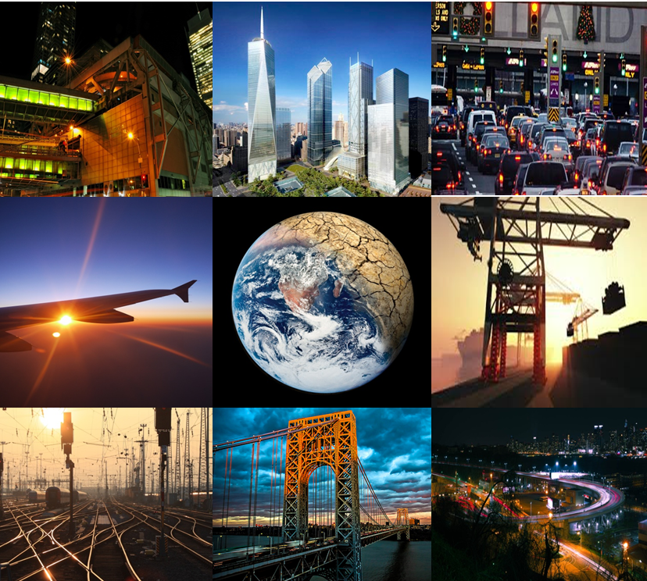

Asset Management
ASSET
MANAGEMENT

