Slide 1
Inference for Big Data
Mike Daniels The University of Texas at Austin Department of Statistics & Data Sciences Department of Integrative Biology

Slide 2
Frontiers in Massive Data Analysis (NRC, 2013)
[T]he challenges for massive data go beyond the storage, indexing, and querying that have been the province of classical database systems (and classical search engines) and, instead, hinge on the ambitious goal of inference. Inference is the problem of turning data into knowledge, where knowledge often is expressed in terms of entities that are not present in the data per se but are present in models that one uses to interpret the data. Statistical rigor is necessary to justify the inferential leap from data to knowledge, and many difficulties arise in attempting to bring statistical principles to bear on massive data. Overlooking this foundation may yield results that are not useful at best, or harmful at worst. In any discussion of massive data and inference, it is essential to be aware that it is quite possible to turn data into something resembling knowledge when actually it is not. Moreover, it can be quite difficult to know that this has happened. Indeed, many issues impinge on the quality of inference….
Notes:
Although that study mentioned the importance of inference, it did not treat inferential issues in detail

Slide 3
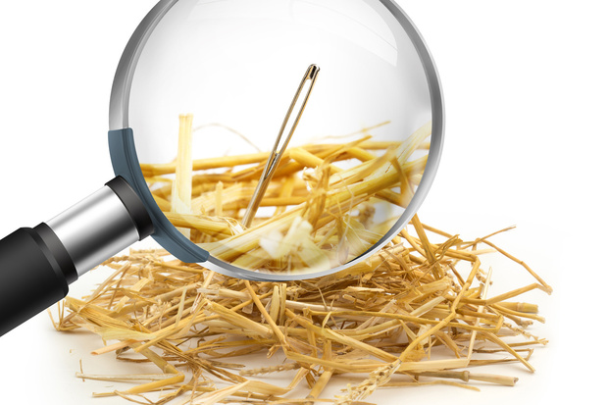
Big Data has its perils, to be sure. With huge data sets and fine-grained measurement, statisticians and computer scientists note, there is increased risk of “false discoveries.” The trouble with seeking a meaningful needle in massive haystacks of data, says Trevor Hastie, a statistics professor at Stanford, is that
“many bits of straw look like needles.”

Slide 4
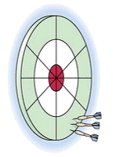
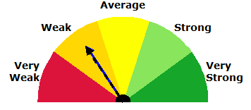
Major Themes
Bias
Quantifying uncertainty
Strength of Evidence (SOE)/Reproducibility
© 2013, Ksenia Zhivago
Notes:
Vishy Talk

Slide 5
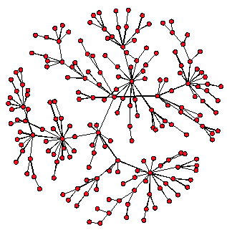
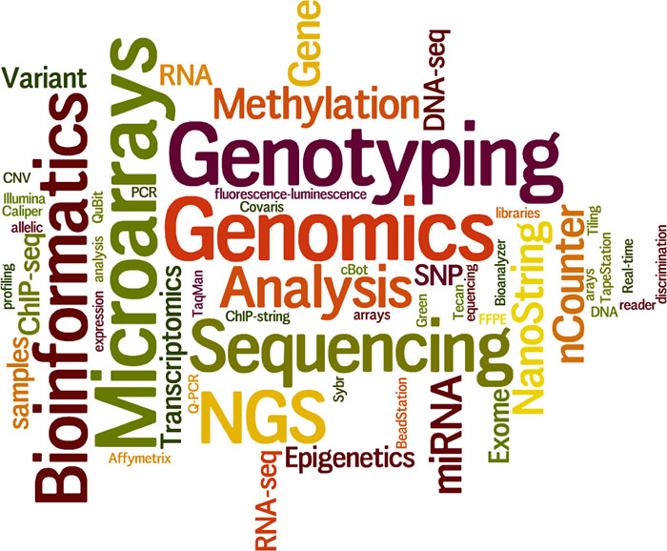
The workshop will explore four key settings of scientific inference:
Inference about causal discoveries driven by large observational data
Inference about discoveries from data on large networks
Inference about discoveries based on integration of diverse datasets
Inference when regularization is used to simplify fitting of high-dimensional models

Slide 6
Inference about causal discoveries
Many large observational data available including EHRs
Incredible (incredibly dangerous) treasure trove of information
Comparative Effectiveness Research (CER) v. precision (personalized) medicine

Slide 7
CER complications
selection bias
confounding bias
covariates (data)
necessary for missingness—related to missingness and outcome
necessary for confounding—related to exposure and outcome
generalizability

Slide 8
Complex Problems
more than trt A vs. B (effect modifiers)
mediation—using genomics, images
“replace” complex mathematical models

Slide 9
Some open questions
What are the fundamental limitations of causal inference in longitudinal studies of health and disease over large populations?
How can a large-scale data-driven observational study be designed to winnow down the possible causative factors (precision medicine) that can be tested in a smaller-scale interventional follow-up study?
What role can regression-based variable selection procedures play in prescreening confounding factors and missingness factors?
Notes:
Combine personal med and CER
How can large-scale causal inference procedures be modified to handle the multiple comparisons problem and yield unbiased confidence intervals on odds ratios associated with treatment combinations?
How can data-driven sequential design procedures be incorporated into such large-scale studies to minimize unnecessary exposure time with a guaranteed level of error control?
Are there testable conditions that dictate when it is best to implement parametric versus semi-parametric versus non-parametric methods of causal inference, e.g., a structural equation model (SEM) versus an inverse probability weighting method versus a non-parametric Bayesian model?

Slide 10
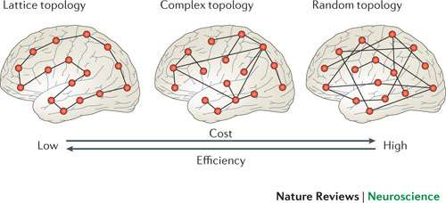
Inference about discoveries from data on large networks
Large networks arise throughout computational biology, neuroscience, and infectious diseases:
interacting genomic expression
regulatory RNA sequencing
connectivity among brain regions
social networks
Analysis goals:
large-scale patterns of connectivity
discover specific relationships among interacting components using patterns of covariation
When examining very large numbers of potential associations:
Are apparent patterns are likely to reflect genuine, reproducible relationships, OR
potentially spurious effects resulting from the great opportunity for false positives?

Slide 11
Open questions
How should statistical tests be formulated in this context?
When there is evidence in favor of genuine relationships, how should uncertainty about their magnitudes be assessed?
How can such techniques be modified to analyze dynamic changes in network structure across time?
Notes:
Similar issues with maps
Longitudinal aging fMRI studies
And how can they incorporate dependence on external variables that may be used to characterize individuals?

Slide 12
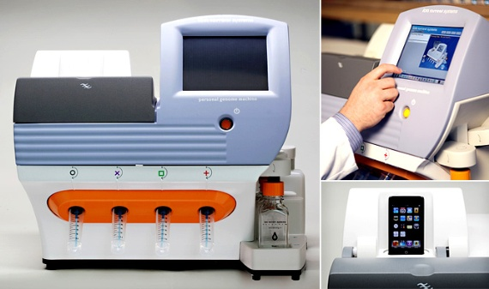
Integration of diverse datasets
Biomedical settings:

Slide 13
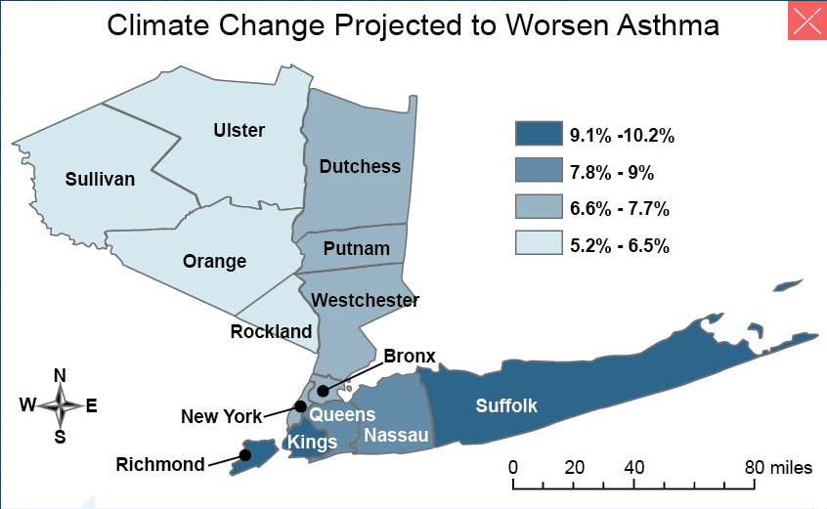
Integration of diverse datasets
Health effects of air pollution/climate change
different scales
missingness
correlation
causality
Sheffield, P. E., and P. J. Landrigan, 2011: Global climate change and children’s health: Threats and strategies for prevention. Environmental Health Perspectives, 119, 291-298, doi:10.1289/ehp.1002233.

Slide 14
Open Questions
What if missing an entire 'platform' for subset of individuals?
When different data types are collected simultaneously from the same subject, what kinds of joint integration methods can most accurately account for and exploit correlations between the data types?
What is proper tradeoff between model mismatch (bias) and model overfitting (variance) for multimodal data integration?
Notes:
How should one select appropriate criteria (bootstrapped confidence intervals, FDR, AUC, gene-ranking consistency) to gauge the quality of the data integration when there is no ground truth?
How does one reliably combine ranked lists of biomarkers obtained from multiple studies?
Are there computational or systems biology models that can assimilate different datasets together resulting in better data integration?
When combining data from multiple studies how does one account for and reduce technical noise and instrument calibration errors, in order to accurately register the studies to each other?
When different data types are collected simultaneously from the same subject, what kinds of joint integration methods can most accurately account for and exploit correlations between the data types?

Slide 15
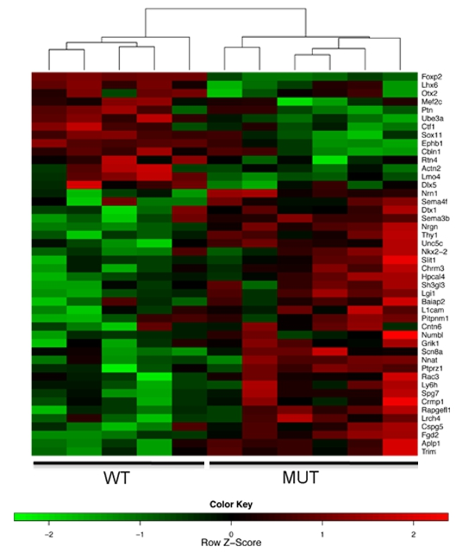
Inference when regularization (p >> n)
Setting: the number of variables or parameters typically greatly surpasses the number of available data points used to determine relevant relationships.
Strategy: search for relationships having the greatest magnitudes while assuming all others are negligible (Sparsity).
Where are we:
Efficient algorithms for point estimation—Yes
Clever penalties—Yes
Inference/Uncertainty—No
Some work so far in simple settings of linear and binary sparse regression (Lockhart et al., 2014; Mukherjee et al., 2015; Lu et al., 2016)
Figure from Microarray Analysis, Wellcome Trust Centre for Human Genetics, Oxford Genomics Centre. http://www.well.ox.ac.uk/ogc/microarray-analysis
Notes:
Figure shows differential expression of Foxp2 target genes in E16 developing mouse ganglionic eminences.

Slide 16
Open Questions
How can current approaches for inference be extended to more complex settings?
How can uncertainty be accurately quantified?
What should be done when the relevance of the sparsity assumptions is questionable?

Slide 17
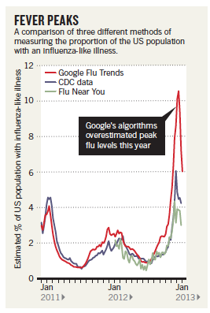
Wrap-up
Existing statistical tools are still, in many of these cases, inadequate.
Today, we will see current state of the art for all the problems and see, in more detail, what open questions are in each of these areas.
Butler, Declan. “When Google Got Flu Wrong,” Nature. Vol. 494, 2/14/13, p. 155
Notes:
Be careful

Slide 18
Inference based on integration
Inference with large observational data
Inference with regularization
Bias
Uncertainty
SOE

