Slide 1
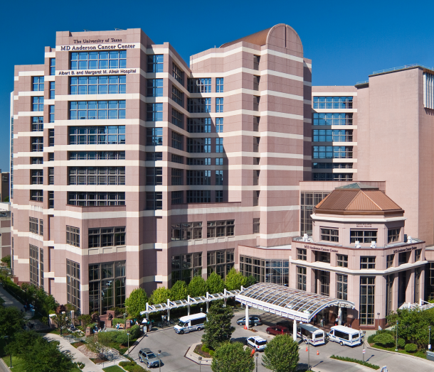


Discussion: Statistical Integration for Medical/Health Studies
Jeffrey S. Morris
Del and Dennis McCarthy Distinguished Professor
Department of Biostatistics
The University of Texas M.D. Anderson Cancer Center

Slide 2
Big Data in Biomedical Research
Explosion of complex information-rich data has revolutionized biomedical research
Molecular biology: multi-platform genomics yield genome-wide information on DNA, RNA, epigenetics, proteins
Imaging
  Various types of diagnostic imaging modalities
  Neuroimaging modalities: structural/functional
Question: How can we best extract biological knowledge from these data?

Slide 3
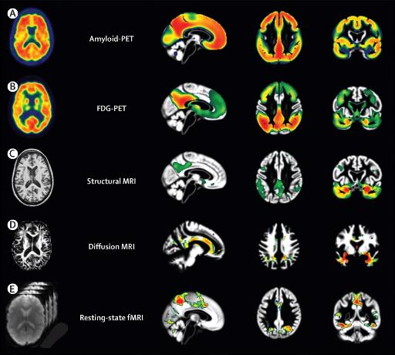
Multi-modal Imaging
Different structural and functional modalities capture different types of information
From Teipel, et al. (2015 The Lancet Neurology 14: 1037-1053)
Notes:
Amyloid PET reveals prescence of Ameloid beta plaques
FDG PET measures glucose uptake
sMRI measures physical brain volume
Diffusion MRI measures white matter fiber tracts
Resting state fMRI measures functional activity

Slide 4
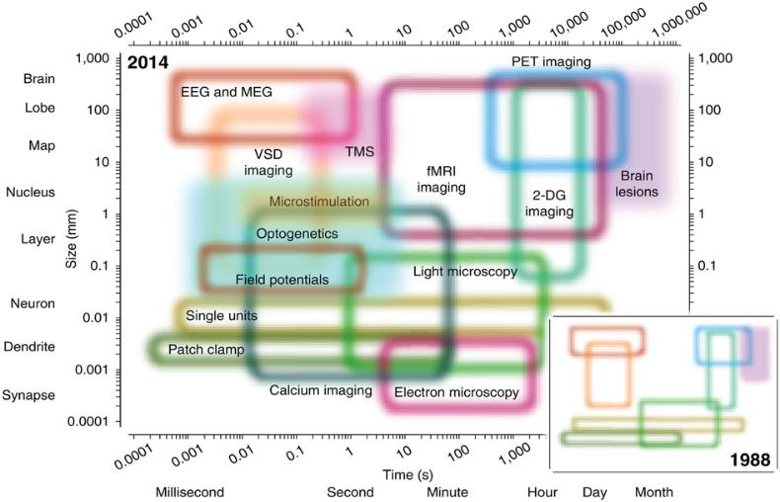
Functional Neuroimaging Modalities
From Josh Vogelstein (JHU http://docs.neurodata.io/ndintro)
Notes:
VSD Imaging: voltage-sensitive dyes
TMS: transcranial magnetic simulation
LFP: Local Field Potential
Ooptogenetics – light used to control neurons geneticall modified to express light sensitive ion channels (Control/monitor neurological activity)

Slide 5
Multi-modal Integration
Integration is one of key scientific challenges
  Each data type offers different insights into the underlying biology, gives incomplete picture
  There are known relationships across data types that can be exploited (more on that later)
Goal of integrative analyses is to link together different types of information to get more holistic picture of biology (and hopefully uncover new bio/medical insights!)

Slide 6
Practical Challenges of Integration
Missing data
  Shrinking sample size in Venn diagram
Experimental design/batch effects
  Systematic biases/noise in data
  Worse for complex, high-dimensional data
Preprocessing
  Each platform has own challenges/difficulties
Data management
  Management of large data sets
  Ability to link genomic, imaging, clinical data
Choice of Modeling Unit
  Different platforms have different observational units
  How to match up elements across platforms (genes?)

Slide 7
Statistical Problems
Building predictive models
  Easy to allow multi-modal predictors/ensemble
  Trickier with different data types (cont./bin./count): scale
Structure learning (cluster/factor analysis)
  Empirically estimate sparse structure in data
  Detect/exploit correlation among elements to gain sparsity and discover interrelationships
  Validation important to assess which structure “real”
Network structure learning
  Graphical models to infer edges indicating pairwise associations in data (GGM+Ising)
  Flexible exponential family framework for graphical modeling that can incorporate different data types
  Can allow nodes from various modalities

Slide 8
Incorporating Known Biology
These strategies focus on integration as a meta-analysis on the p-space – concatenate and discover
Other integrative modeling strategies can attempt to integrate known biological information from existing theoretical knowledge and/or literature
Approaches to Integrate Biological Information
  Build models according to theoretical structural relationships among different modes/platforms (iBAG)

Slide 9
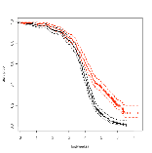
Proteomics (proteins)
(RPPA, Peptide arrays
Mass spectrometry)
Phenotypes
- imaging
Genomics (DNA)
Genotypes
Copy number
- Mutation status: point mutations/indels/ translocations
(SNP array, DNAseq)
Transcriptomics (mRNA)
(Gene Expression arrays, RNAseq)
Histological and molecular subtypes
Clinical Outcomes
miRNA
(arrays/RNAseq)
- survival
Epigenetics
Methylation
Histone modifications
Chromatin remodeling
- response rates
(patient-specific)
Cancer Integromics
Notes:
Epigenetics – study of heritable changes in gene expression not involving DNA sequence

Slide 10
Incorporating Known Biology
These strategies focus on integration as a meta-analysis on the p-space – concatenate and discover
Other integrative modeling strategies can attempt to integrate known biological information from existing theoretical knowledge and/or literature
Approaches to Integrate Biological Information
  Build models according to theoretical structural relationships among different modes/platforms (iBAG)
  Focus on “biologically relevant” information (functional effects)
  Incorporate known biological information from literature (incorporate pathway information, histone modifications, etc.)

Slide 11
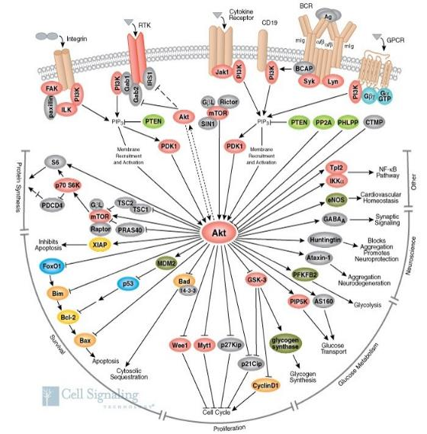
Molecular Pathways
Genes/proteins work together in complex interactive pathways
Some known, much unknown
This structure crucial for understanding function

Slide 12
Incorporating Known Biology
These strategies focus on integration as a meta-analysis on the p-space – concatenate and discover
Other integrative modeling strategies can attempt to integrate known biological information from existing theoretical knowledge and/or literature
Approaches to Integrate Biological Information
  Build models according to theoretical structural relationships among different modes/platforms (iBAG)
  Focus on “biologically relevant” information (functional effects)
  Incorporate known biological information from literature (incorporate pathway information, histone modifications, etc.)
Rest of Talk: Overview biological integration efforts
  Context: Case study involving subtypes of colon cancer

Slide 13
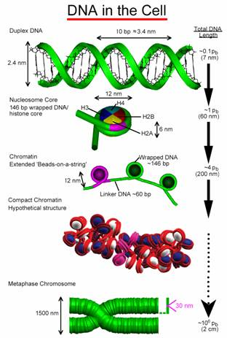
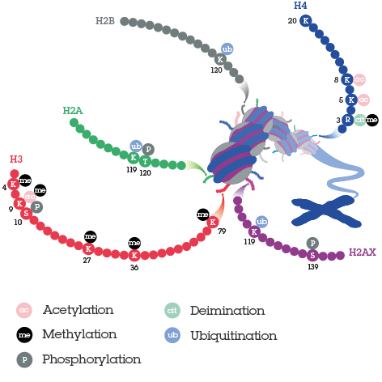
Chromatin Structure/Histone Modifications
Histone modifications can change chromatin structure and affect transcription
Next

Slide 14
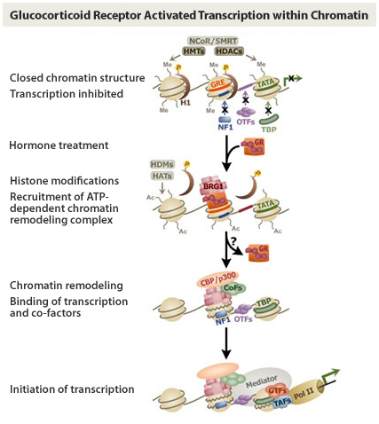
Chromatin Remodeling
Return

Slide 15






Continuum of Precision Medicine
CMS1
CMS2
Colorectal Cancer
CMS3
CMS4
Precision Medicine
Traditional Medicine
Individual Patients
Molecular Subtypes
Heterogeneous group
Personalized Therapy
Subtype-guided Therapy
Standard Therapy
N=1: lacks power
Medium N: moderate power
Large N: high power
Targeted Discovery
Notes:
Applications of subgroups:
May be prognostic or predictive of current therapies
May be able to find CMS-specific subgroups.
May use subgroups to identify promising drugs
Can also perform de novo supervised subtyping to predict responders
Note: turning a hard problem into a simpler problem. This may enable us to more effectively discover local signals.

Slide 16
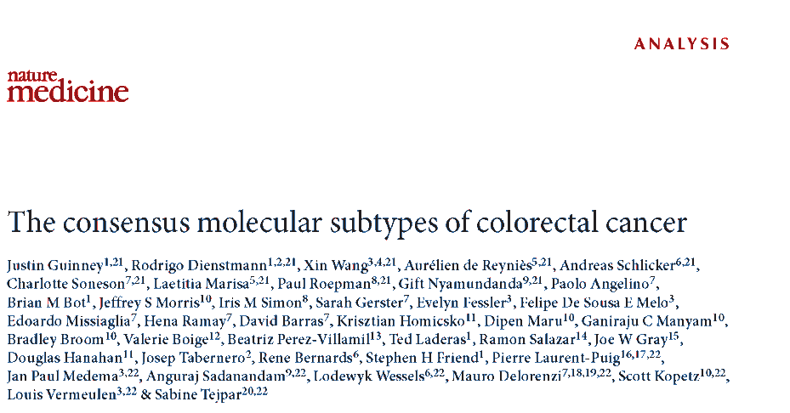

Consensus Molecular Subtypes of CRC
CRCSC: Combine information across 18 mRNA studies (N~4000) and 6 previous systems to identify consensus subtypes
CMS1 (14%): MSI Immune Immune pathways, CIMP+, MSI
CMS2 (37%): canonical epithelial, WNT, MYC
CMS3 (13%): metabolic epithelial; metabolic dysregulation
CMS4 (23%): mesenchymal EMT-like, TGF-β, stromal invasion, angiogenesis, poor prognosis
Has generated great interest from the CRC biomedical community

Slide 17
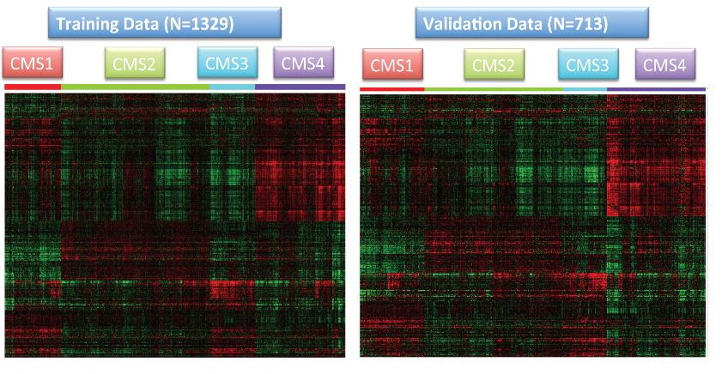
Persistent CMS Structure
CRCSC data set large and diverse enough to find persistent (true?) consensus signal in data

Slide 18
TCGA/MDACC Integromics
mRNA not actionable: need to understand upstream effectors to translate knowledge to the clinic
CRC Integromics cohorts:
  TCGA (N~250): DNA/methyl/miRNA/mRNA/protein
  MDACC (N~220): DNA/methyl/miRNA/mRNA/protein/ histone/histology/clinical outcomes
Goal: deeply characterize CMS molecular biology
Ultimately develop CMS-based precision therapy
  Prognostic: CMS with worse prognosis for aggressive trt
  Predictive: CMS responding differentially to specific trt
  Target discovery: CMS-specific targets for new drugs
Integrative modeling key to learning

Slide 19
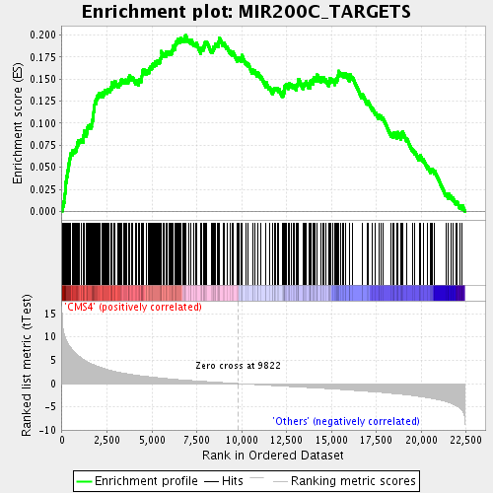
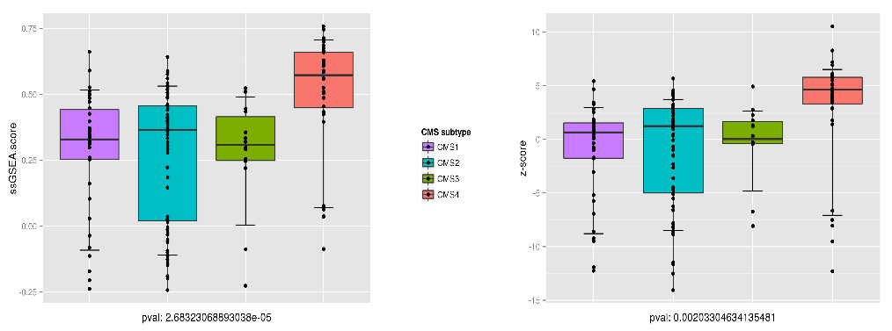
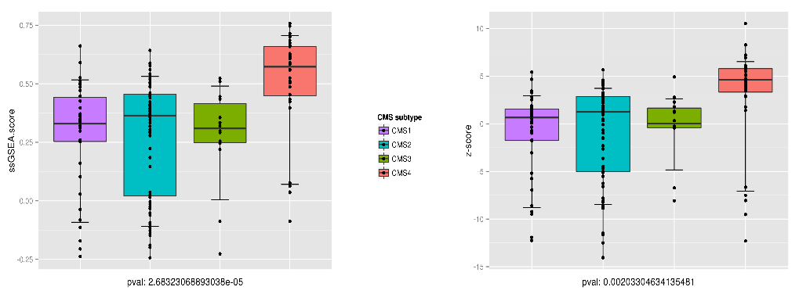



Example: miRNA and CMS4
MiR targets enriched in CMS4
miR expression
Epithelial-Mesenchymal Transition
miR DNA methylation
miR targets ssGSEA-score
Methylation inactivates this miR, allows activation of EMT-regulating genes
Notes:
Mir-200 family plays essential role in tumor suppression by inhibiting epithelial-mesenchymal transition (EMT), initiating step of metastatisis
Occurs as part of embryonic development, and shares similarities with cancer progression
Directly targets ZEB1/ZEB2 – mir-200 repressed which leads to ZEB1/ZEB2 and mesenchymal state.

Slide 20
Methylation, Expression, and Histone Modifications
How to integrate methylation and mRNA? Methylation is measured for many sites per gene
Restrict to sites for which methylation is correlated with mRNA (functionally relevant)
Construct gene-level methylation summaries
  Find parsimonious set of functionally relevant sites
  Find weights to construct gene-level methylation score we dub “Gene-Specific Methylation Profile” (GSMP)
  Compute % expression explained by methylation to obtain list of genes strongly modulated by methylation

Slide 21
Gene-Specific Methylation Profiles
Construct GSMP
  Sequential lasso focusing first on a priori likely sites
  Sparse set of CpG capturing meth-expr correlation
  Gene-level methylation scores for integration
ChromHMM used to determine chromatin status/histone mod.
Notes:
NCBI: involved in transcription regulation and chromatin remodeling. Cancer causing gene?
KDM5C: histone lysine demthylases (KDMs) epigenetic enzymes that remove repressive and activating histone marks. KDM5 family members remove histone H3 lysine 4 dimethylation-activating marks – potential players in downregulation of tumor suppressors.
KDM5C associated with relapse-free survival (high – more growht) (Stein et al. Am J Path 2014 pp2430)

Slide 22
Bayesian Hierarchical Integration
iBAG: Model biological interrelationships in unified model for discovery of insights.
f_{i}(•): nonparametric effect; mRNA explained by platform i
Y: clinical outcome (continuous; categorical/censored also possible)
Z: non-genomic factors
γ^{i}: effect of mRNA on outcome through platform i
γ⁰: effect of mRNA on outcome unexplained by modeled platforms
Bayesian model: sparsity priors on γ^{i} to effectively select prognostic gene/platform combinations
Selects prognostic genes and upstream genomic effector
Mechanistic Model
Clinical Model

Slide 23
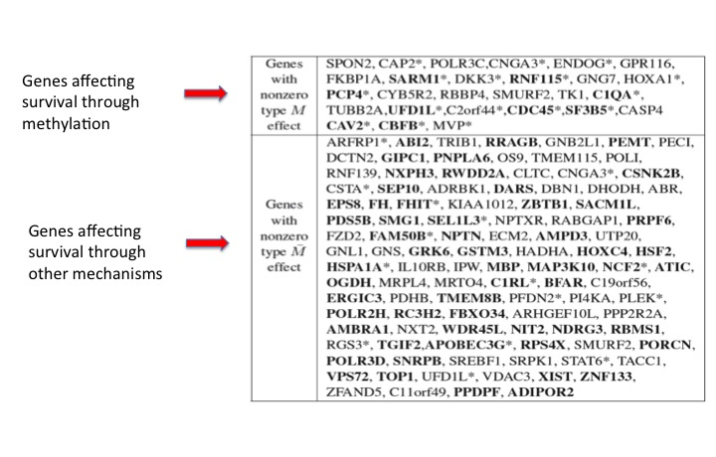
iBAG results: glioblastoma
Can have multiple hierarchical layers in mechanistic model

Slide 24
piBAG: Pathway-based iBAG
Hierarchical sparsity prior: genes(pathways)
  Induces sparsity
  Borrows strength across genes in same pathway
    Adaptive: less shrinkage for genes in prognostic pathways
  Yields pathway scores
Pathway scores

Slide 25
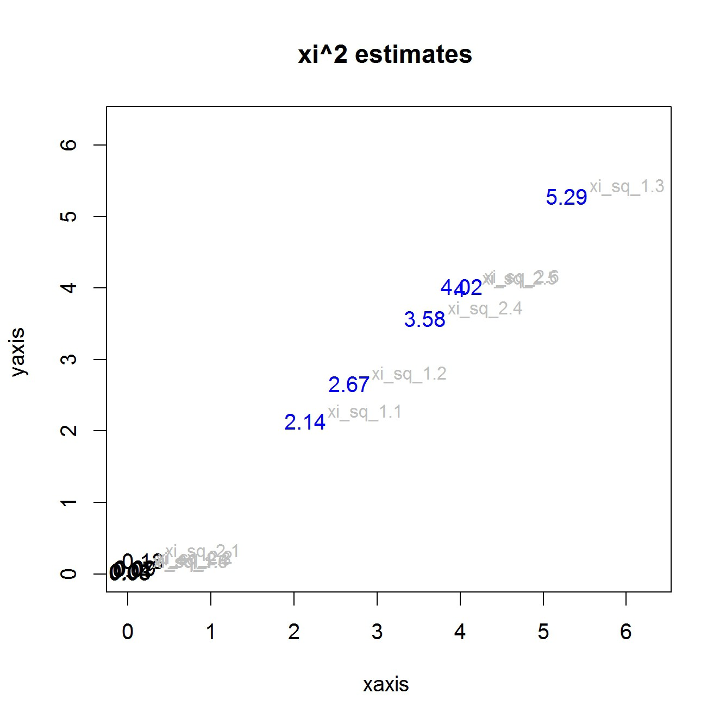
piBAG: Pathway-based iBAG
Pathway scores
Indicate prognostic pathways
Better predication/selection
Measure | piBAG | iBAG | pBAG | BAG
MSE | 30.2 | 50.2 | 2138.8 | 2154.7
Sens (g/p) | 0.939 | 0.901 | NA | NA
Spec (g/p) | 0.973 | 0.920 | NA | NA
Sens (g) | 0.976 | 0.943 | 0.633 | 0.649
Spec (g) | 0.885 | 0.891 | 0.582 | 0.600
Simulation:

Slide 26
Radio-piBAG: Radiogenomics
DNA/Epigenetic Measurements (genes g=1,…,G)
Copy Number
Methylation
mRNA (genes g=1,…, G)
mRNA_{CN}
mRNA_{methyl}
Pathways (p=1,…,P) (select over genes/platforms)
Pathway 1
…
miRNA
mRNA_{miR}
mRNA_{other}
Pathway P
Radiomic Meta-Features (RMF, i=1,…,I) (select over pathways)
RMF_{path1}
…
RMF_{pathP}
RMF_{nopath}
Clinical outcome (select over image meta-features/pathways)
…
…
Identify prognostic RMF, predominant pathway(s), major genes, upstream effectors of gene expression

Slide 27
Integrating multi-modal data/biology
Potential benefits
  Reduce size of model space (gain efficiency!)
  Ensure relevant and interpretable discoveries with biologically coherent explanations (our collaborators like this!)
  Robustify discoveries (more likely to be reproducible?)
Potential drawbacks
  Bias (not everything in literature is true)
  Hard to do! Requires deep knowledge of biology

Slide 28
Conclusions
We have only scratched the surface of integrative analysis methods
Many informatic, computational, and modeling challenges remain
Key: how to integrate information in efficient and meaningful way, incorporating known biological information
The ball is in our court!!! But we need to collaborate closely with biologists!

Slide 29
Acknowledgements
CRC Moonshot
Integromics iBAG
Scott Kopetz David Menter Veera Baladanayuthapani
Bradley Broom Ganiraju Manyam Youyi Zhang Elizabeth McGuffey
Wonyul Lee Chris Bristow Wenting Wang Kim Anh-Do
Huiqin Chen Wenhui Wu Raymond Carroll
CRCSC GSMPs
Justin Guinney Rodrigo Dienstmann Yusha Liu Keith Baggerly
Sabine Tejpar Louis Vermeulen
Maro Delorenzi Lodewyk Wessels
Jan Paul Medema Anguraj Sadanandam

