Slide 1
Discussion OF “Learning from time” by Daniela Witten
Michael R. Kosorok
Biostatistics/Statistics & Operation Research
University of North Carolina at Chapel Hill

Slide 2
Outline
Overview of key contributions
Inference for models fitted using regularization
Rotationally invariant approaches
Interactions and Feature selection
Concluding Comments

Slide 3
Overview of Key Contributions
Gene expression time course data
Infer edge direction through first order differential equation with nonparametric main effects (fairly flexibile).
Uses integration to avoid estimating derivatives
Errors-in-variables model
Neuronal spike train data
Infer edge direction through “first order” Hawkes process with nonparametric main effects transfer functions (a form of stochastic derivative)
Appropriate basis function development somewhat challenging

Slide 4
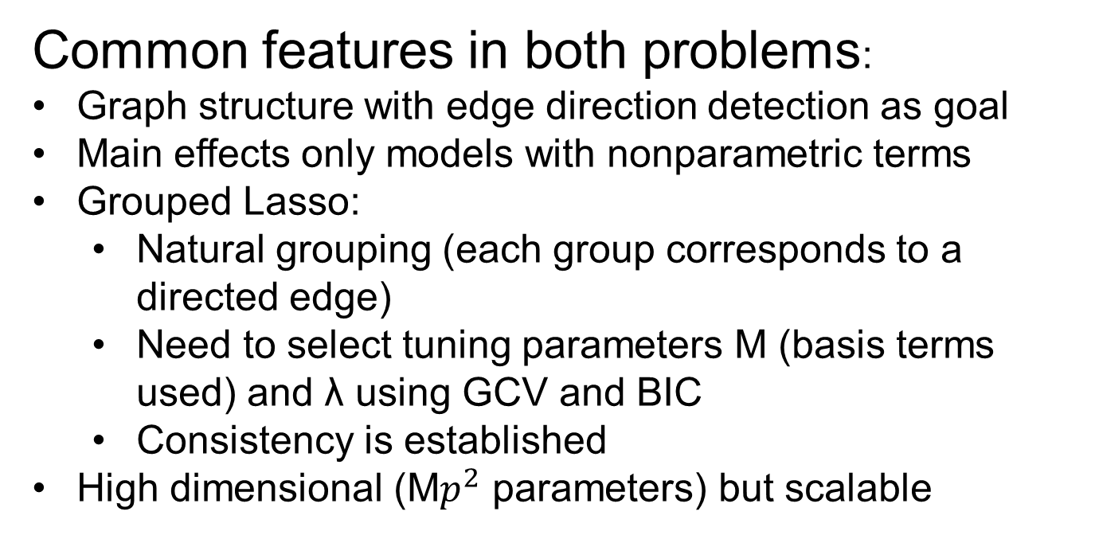
Key Contributions, Cont.
Common features in both problems:
Graph structure with edge direction detection as goal
Main effects only models with nonparametric terms
Grouped Lasso:
Natural grouping (each group corresponds to a directed edge)
Need to select tuning parameters M (basis terms used) and λ using GCV and BIC
Consistency is established
High dimensional (M$p^{2}$ parameters) but scalable

Slide 5
Inference under regularization
Zero order inference
Is the approach consistent or not?
First order inference
What aspects do we do inference on?
Model structure (e.g., directed graphs)
Model coefficients (etiology)
Prediction/classification error
Approaches
Change estimates to yield asymptotic normality (van de Geer, Buhlmann, Ritov and Dezeure, 2014 AOS)
Condition on estimated model structure (Lee, Sun, Sun, and Taylor, 2014, AOS)
Other approaches

Slide 6
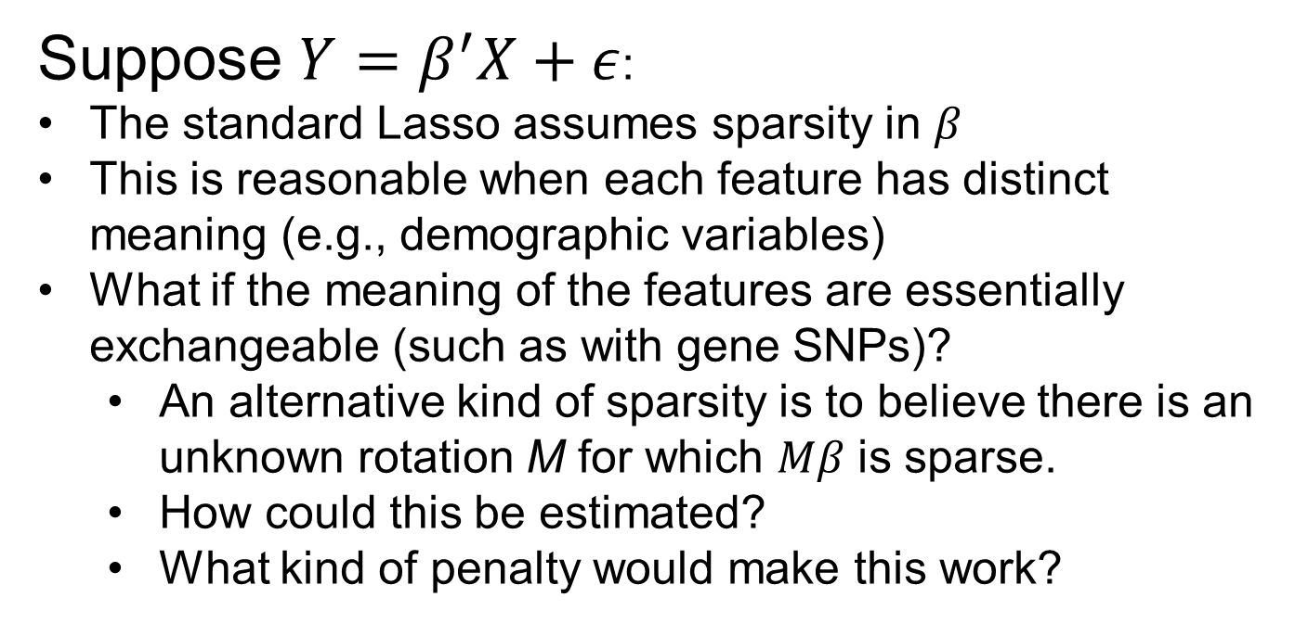
Rotational Invariance
Suppose $Y=β^{′}X+ε$:
The standard Lasso assumes sparsity in $β$
This is reasonable when each feature has distinct meaning (e.g., demographic variables)
What if the meaning of the features are essentially exchangeable (such as with gene SNPs)?
An alternative kind of sparsity is to believe there is an unknown rotation M for which $Mβ$ is sparse.
How could this be estimated?
What kind of penalty would make this work?

Slide 7
Interactions
The Lasso can be constrained to enforce strong heredity
This can be done as a convex optimization problem (Haris, Witten and Simon, 2015, JCGS; Radchenko and James, 2010, JASA)
Could the proposed methods for gene time course and spike train data be generalized to allow for nonparametric interactions using tensor products of the bases?

Slide 8
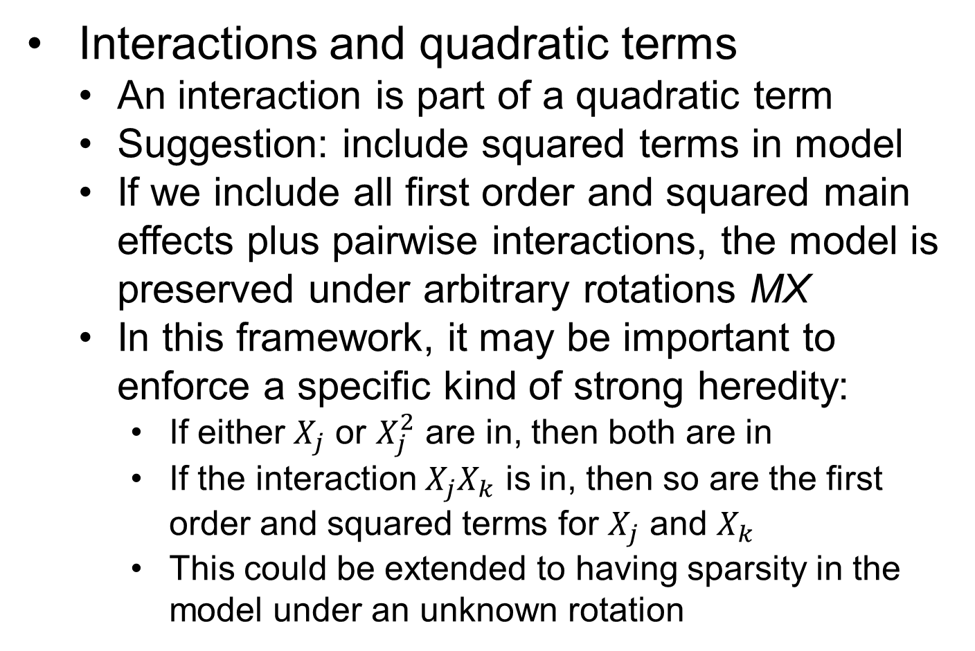
Interactions, Cont.
Interactions and quadratic terms
An interaction is part of a quadratic term
Suggestion: include squared terms in model
If we include all first order and squared main effects plus pairwise interactions, the model is preserved under arbitrary rotations MX
In this framework, it may be important to enforce a specific kind of strong heredity:
If either $X_{j}$ or $X_{j}^{2}$ are in, then both are in
If the interaction $X_{j}X_{k}$ is in, then so are the first order and squared terms for $X_{j}$ and $X_{k}$
This could be extended to having sparsity in the model under an unknown rotation

Slide 9
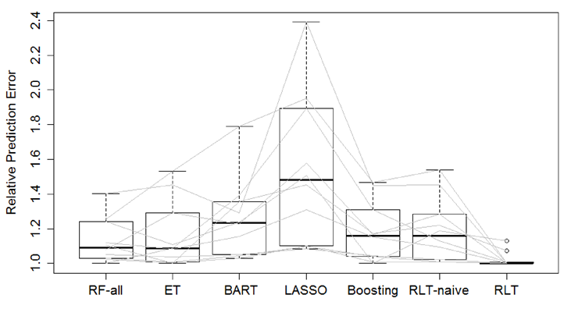

Feature Selection
Feature selection for nonparametric regression: $Y=f\left(X_{1},X_{2},…,X_{p}\right)+ϵ$
When we remove $X_{j}$, we remove all its interactions
Can this be done in a consistent manner with improved prediction error?
Reinforcement Learning Trees (Zhu, Zeng, Kosorok, 2015, JASA) for high dimensional prediction
The method adaptively
selects features while
generating random
forests
Dramatic improvement
over many competing
prediction approaches
Consistency and improved
convergence rates

Slide 10
Conclusion
Excellent and well-motivated work using the Lasso
The models are interpretable yet quite rich (flexible)
There remains much work to be done in terms of inference after regularization
Cautionary thoughts:
We need to decide what to do inference on and this should be clearly connected to the research goals
We need to be careful not to require model assumptions which are too strong

