Slide 1
Data Science and Statistical Agencies
John M. Abowd Associate Director for Research and Methodology and Chief Scientist, U.S. Census Bureau NAS Roundtable on Data Science Meeting 1 Keck Center December 14, 2016

Slide 2
Acknowledgments and Disclaimer
I have leaned heavily on my statistical colleagues at the Census Bureau and other principal statistical agencies
I focused on statistical agencies because that is what I know best; administrative agencies often look to the statistical agencies within their departments for this type of expertise
The opinions expressed in this talk are the my own

Slide 3
Outline
Overview
Canon
Motivation
Training
Enabling

Slide 4
Overview
I know statistical agencies
Other government activities might be better represented by inviting a “Chief Data Officer” onto the Roundtable (e.g., Ian Kalin of the Commerce Department)

Slide 5
Canon
Designed data methodology
Statistical/machine learning
Hierarchical modeling
Curation and reproducibility

Slide 6
Instantiation of Canon
Groves et al. (2009) Survey Methodology
Hastie et al. (2009) Elements of Statistical Learning
Gelman et al. (2014) Bayesian Data Analysis
Stodden et al. (2014) Implementing Reproducible Research

Slide 7
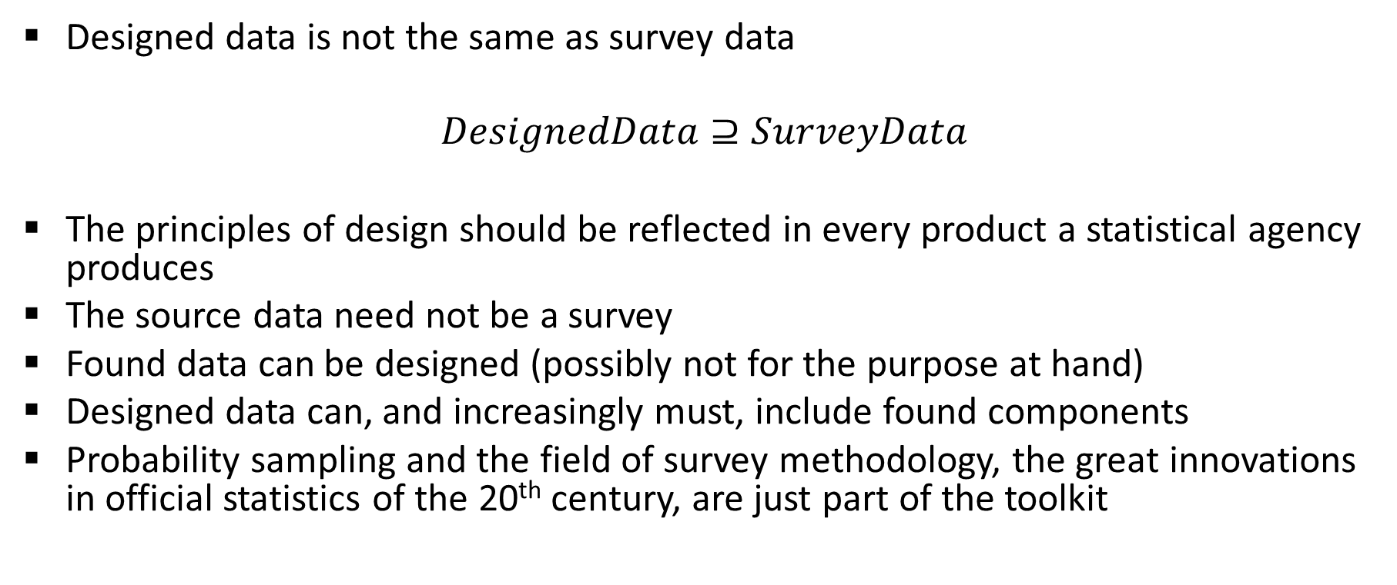
Motivation
Designed data is not the same as survey data
$$DesignedData⊇SurveyData$$
The principles of design should be reflected in every product a statistical agency produces
The source data need not be a survey
Found data can be designed (possibly not for the purpose at hand)
Designed data can, and increasingly must, include found components
Probability sampling and the field of survey methodology, the great innovations in official statistics of the 20th century, are just part of the toolkit

Slide 8
Inference Is Not Just Prediction
Data science’s well deserved reputation for bringing machine learning and related capabilities to a broad range of problems is largely based on its success in building reliable prediction models
Try redistricting every governmental jurisdiction in the United States with one of these models, but no designed inputs like the decennial census of population and housing

Slide 9
Training
History: Joint Program in Survey Methodology
Focused on traditional survey issues
Well summarized by Groves et al from the canon (text was developed from that program)
Focused on providing these skills to those in the statistical system who didn’t have them on hire, or needed an advanced degree to further their careers
Present: need for expanded competencies
General data science
Data analytics
Reproducible science
Software design and engineering
Predictive modeling/artificial intelligence/machine learning
Distributed computing environments including cloud
Business intelligence systems
Data storage and retrieval models
Optimization (linear and nonlinear)
Privacy-preserving data analysis systems
GIS analytics
Hierarchical statistical modeling
Simulation methods
Supply chain management

Slide 10
Sample Curricula
De Veaux et al. 2016. Curriculum Guidelines for Undergraduate Programs in Data Science, Annual Review of Statistics
Undergraduate guidelines workgroup, American Statistical Association 2014. Curriculum Guidelines for Undergraduate Programs in Statistical Science
At the masters and Ph.D. levels, intense exposure or actual degree in a content area (economics, biostatistics, etc.)

Slide 11
Enabling
Massive increase in computing capacity required
Management of this enabler is extraordinarily difficult in the federal government
Federal Information Security Management Act (FISMA)
Reporting structure for Chief Information Officers
GSA Fedramp

Slide 12
Thank you.
john.maron.abowd@census.gov

