Slide 1
Teaching data science for the humanities
Ted Underwood
Information Sciences / English
University of Illinois, Urbana-Champaign

Slide 2
Research opportunities: huge
Many basic questions still need to be posed.
Data is abundant; results easily reproducible.

Slide 3
geography and demographics
genre
effects of sales and prestige
emergence of “literature” itself

Slide 4
Pedagogical reality: almost nothing.
Students in most humanities disciplines take no quantitative courses.
“Digital humanities” at scores of schools.
But few of those courses actually introduce students to quantitative reasoning.
Researchers mostly self-taught.

Slide 5
Reversing the usual path to data science.
Many sciences (incl. social sciences) already had statistics, and added computation.
Humanists are mostly approaching data science from the other end: starting with computation.

Slide 6
High. Way. To. The. Danger zone!
That’s us!

Slide 7
High-dimensional data lacks an easy on-ramp.
We have never had a lot of “iris datasets.”

Slide 8
High-dimensional data lacks easy on-ramps.
Unsupervised learning; e.g., topic modeling.

Slide 9
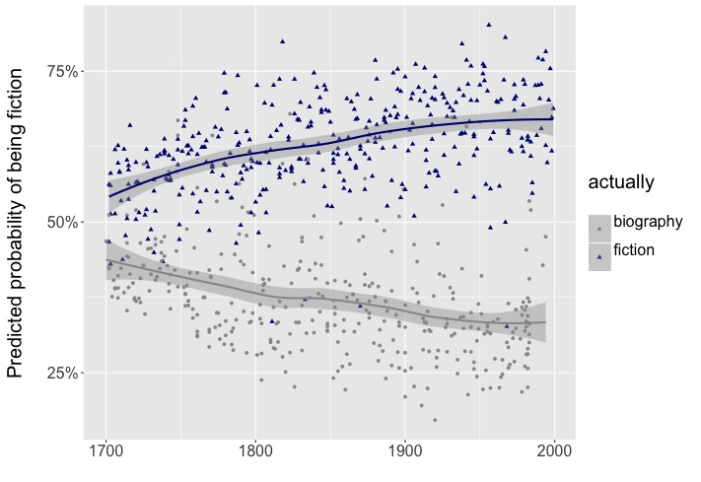
High-dimensional data lacks easy on-ramps.
Supervised learning, used in somewhat unconventional ways. (The goal may really be to understand the categories rather than to “correctly” categorize instances.)

Slide 10
How do we teach this, if it’s taught at all?
Typically depts have only one “digital” person.
One course has to motivate students with examples, discuss critiques of this emerging field, and convey how-to knowledge.
Quantitative foundations are covered unevenly.

Slide 11
Paths forward.
We recognize these problems, and are discussing them.
Building stronger bridges to the social sciences, and iSchools, may help.
Recommended: Andrew Goldstone, https://andrewgoldstone.com/blog/ddh2018preprint/

Slide 12
Obstacles.
Undergrads don’t know what this is for yet.
Even faculty & grad students who do know what it’s for may be daunted by the prospect of retraining.

Slide 13
What we need are …
Good “gateway drugs.”

