Slide 1
Postsecondary Data Science Education at the University of Washington
Bill Howe
Associate Professor, Information School
Adjunct Associate Professor, Computer Science & Engineering
Associate Director, eScience Institute
Director, Urbanalytics
University of Washington

Slide 2
In the next 20 minutes….
Chronology and Context (5 min)
Retrospective on a First Data Science MOOC (5 min)
Undergraduate Specialization in Data Science (5 min)
Data Science for Social Good Summer Program (5 min)

Slide 3
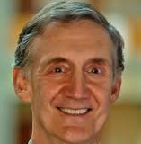
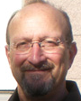
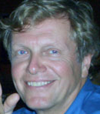
2005-2008
“All across our campus, the process of discovery will increasingly rely on researchers’ ability to extract knowledge from vast amounts of data… In order to remain at the forefront, UW must be a leader in advancing these techniques and technologies, and in making [them] accessible to researchers in the broadest imaginable range of fields.”
In other words:
  Data-intensive science will be ubiquitous
  It’s about intellectual infrastructure
http://escience.washington.edu
Notes:
The eScience Institute was founded circa 2005-2008 depending on how you count with two ideas in mind: data-intensive science will be completely pervasive, and that the “secret sauce” to enbaling data-intensive science is about the “intellectual infrastructure” rather than just computational infrastructure.

Slide 4
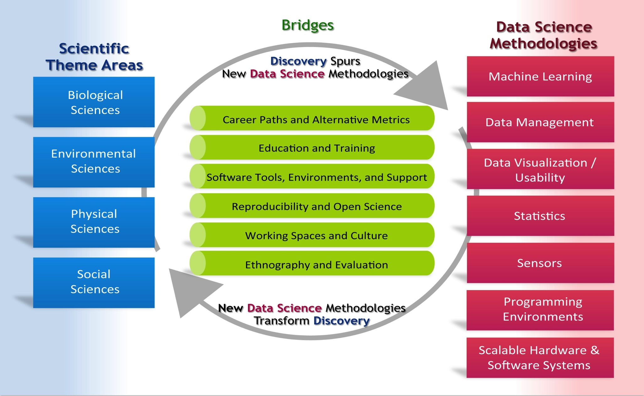
Establish a virtuous cycle
6 working groups, each with
3-6 faculty from each institution

Slide 5
Data Science Education Programs at UW
2011: Data Science Professional Certificate
  Fee-based program operated by Continuing Education for mid-career professionals
2013: Data Science MOOC with Coursera
  200,000 students across two offerings, now a fee-based specialization
2013: Data Science Sequence, iSchool
  Three-course graduate sequence, three-course undergraduate sequence
2014: PhD: Advanced Data Science Specialization (NSF IGERT)
  Applied Math, Astronomy, Biology, Chemical Eng, Computer Science & Eng, Genome Sciences, Math, Oceanography, and Statistics
2015: UGrad: Data Science Specialization
  Departments choose how to meet global curricular goals (early adoption by Applied Math, CSE, iSchool, more on the way)
  Underway: Two campus-wide freshman courses: “Introduction to Data Science Methods” and “Data Science & Society”
2016: Masters: Interdisciplinary Data Science Masters Degree
  6 departments on campus: Applied Math, Biostats, CSE, HCDE, iSchool, Stats
  40 students enrolled, 500+ applicants for year 2

Slide 6

People
  Research Staff (~4 100% Data Scientists, ~4 50% Research Scientists)
  Postdocs (~12 at steady state)
  Faculty (~9 Exec Committee, ~20 Steering Committee, ~100 Affiliates)
  Adminstrative Staff (Program Managers, Finance, Admin)
Programs
  Short and long-term research, education programs ugrad/masters/Phd, software, research consulting
  Leadership on all things data science around campus
Funding
  $700k / yr permanent appropriation from the state of WA
  $32.8M for 5 years jointly with NYU and UC Berkeley from the Gordon and Betty Moore Foundation and the Alfred P Sloan Foundation to build a “Data Science Environment”
  $9M for 5 years from the Washington Research Foundation
  $500k / yr from the Provost for half-lines for recruiting in relevant fields

Slide 7
Selfish Goals for the MOOC experiment (ca 2012)
Capitalize on interest in data science to expose students to important problems in the domain sciences.
Build muscle in delivering education at scale
Conduct an experiment to reorganize 3-5 courses worth of data science material into a single introductory course
  databases, machine learning, stats, visualization, ethics
Ulterior motive: Put database concepts into the forefront of the nascent data science discussion
  Jennifer Widom’s survey

Slide 8
Syllabus
Data Science Landscape (~1 week)
Data Manipulation at Scale
  Databases, RA (~1 week)
  MapReduce, scalable algorithm design (~1 week)
Analytics
  Statistics Pearls (~1 week)
  Machine Learning Pearls (~1 week)
Visualization (~1 week)
Special Applications (Graphs, Text) (~1 week)
Guest Lectures (~1 week)

Slide 9
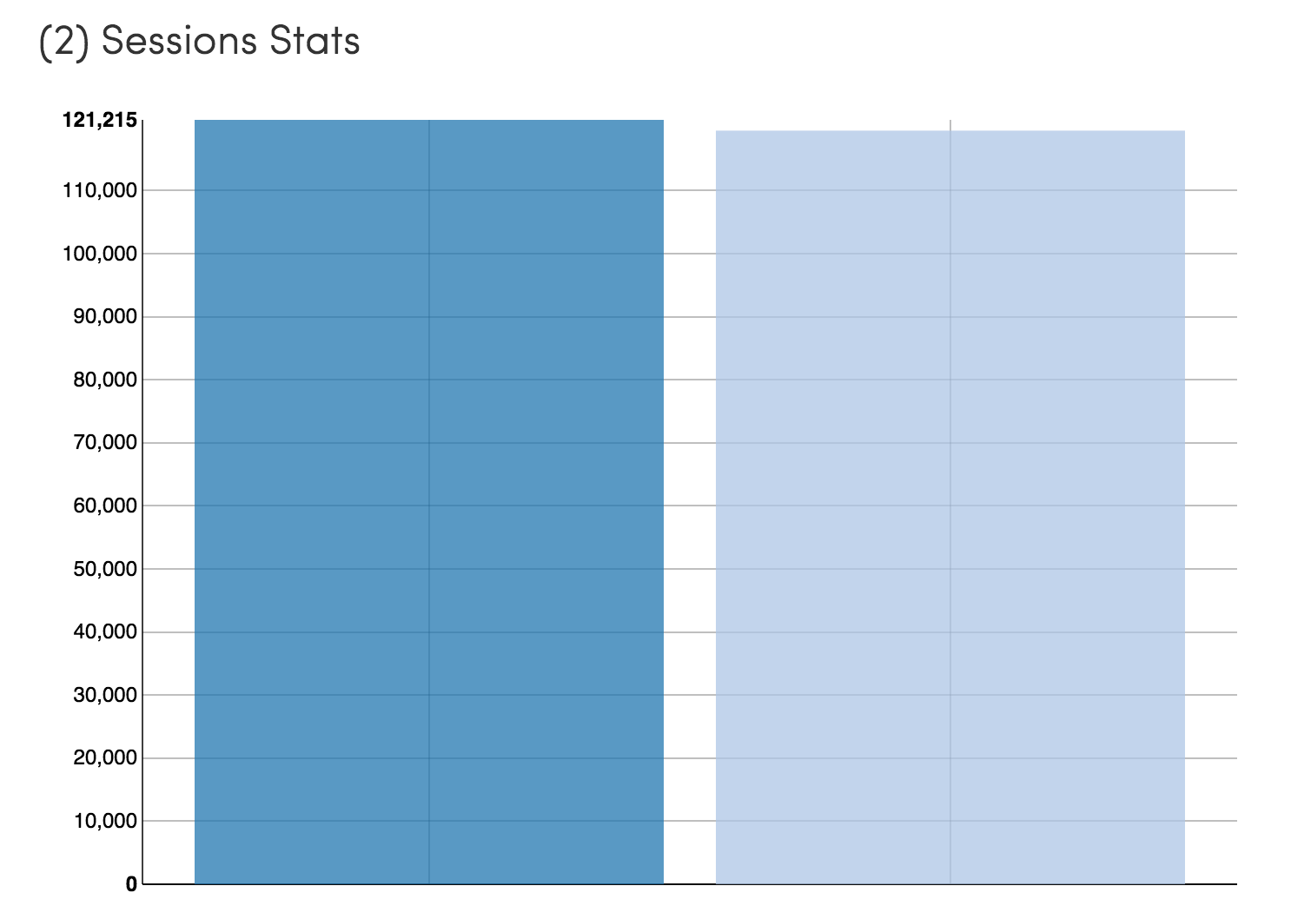
Introduction to Data Science MOOC on Coursera
Session 2
Summer 2014
121,215 students
Session 1
Spring 2013
119,504 students

Slide 10
Participation numbers
“Registered:” 119,517 totally irrelevant
Clicked play in first 2 weeks: 78,589
Turned in 1st homework: 10,663
Completed all assignments: ~9000 typical for a MOOC
“Passed:” 7022
Forum threads: 4661
Forum posts: 22,900
Fairly consistent with Coursera data across “hard” courses
Define success however you want
  Many love it in parts, start late, don’t turn in homework, etc.
  Learning rather than watching television

Slide 11
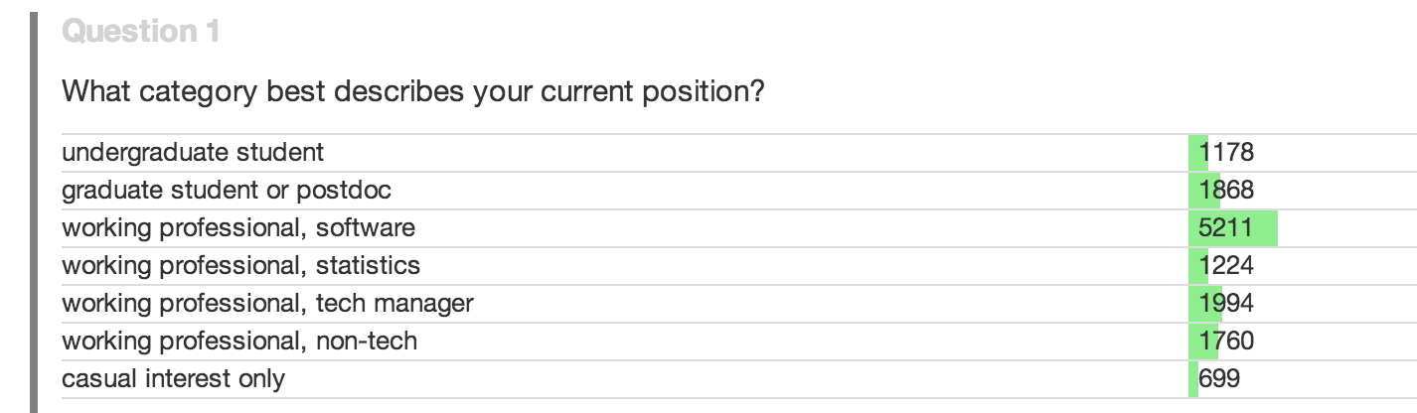
Who took the course?

Slide 12
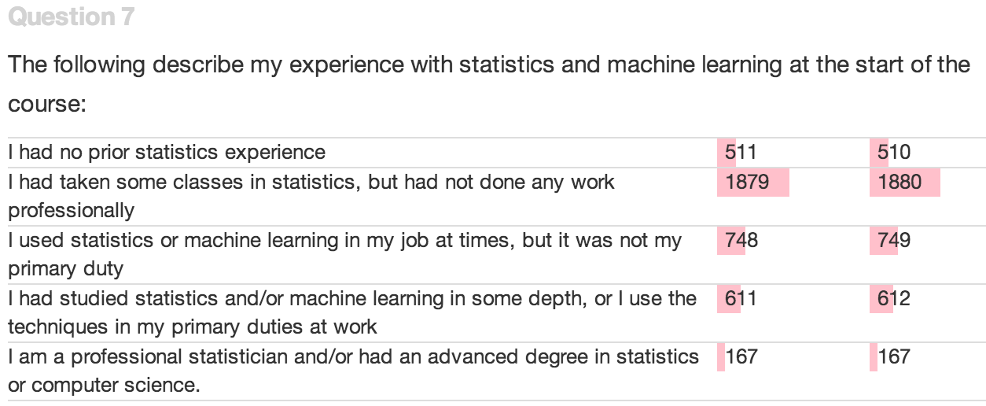

Slide 13
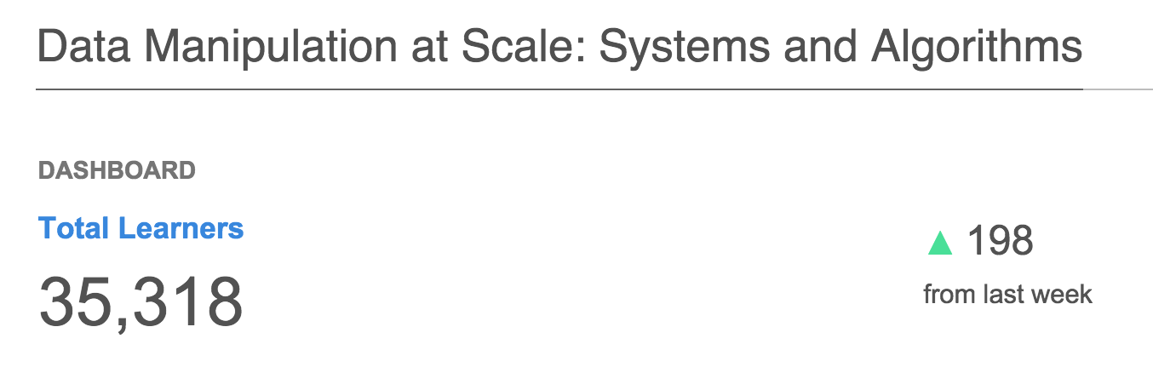
2015: MOOC Recast as a 4-course “Specialization”
Data Manipulation at Scale
Databases, Systems, Algorithms
Principles of working at scale – show the commonalities in the system soup
Practical Predictive Analytics
Stats (resampling methods, multiple hypothesis testing, more)
ML (rules/trees/forests, ensembles/boosting/bagging, SVMs, GD, eval…)
Communicating Data Science
Visualization, ethics and privacy
Capstone
updated 3/20/2017

Slide 14
Question:
Has the expression of emotion in the literature changed over time?
Dataset:
  Literature over the last 100 years

Slide 15
Acerbi A, Lampos V, Garnett P, Bentley RA (2013) The Expression of Emotions in 20th Century Books. PLoS ONE 8(3): e59030. doi:10.1371/journal.pone.0059030
1) Convert all the digitized books in the 20th century into n-grams (Thanks, Google!)
(http://books.google.com/ngrams/)
2) Label each 1-gram (word) with a mood score.
(Thanks, WordNet!)
3) Count the occurences of each mood word
A 1-gram: “yesterday”
A 5-gram: “analysis is often described as”
Notes:
Researchers were able to chart historical periods of positive and negative moods through literature. Values above zero indicate generally "happy" periods, and values below the zero indicate generally "sad" periods.

Slide 16

sum of all the occurrences of words with a particular mood
number of occurrences of word i
number of occurrences of the word “the”
divide by the number of words with that mood label

Slide 17
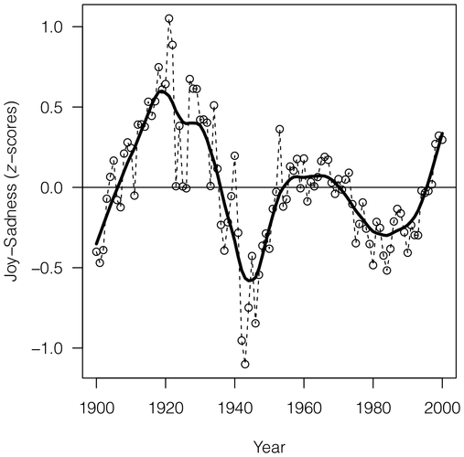
Acerbi A, Lampos V, Garnett P, Bentley RA (2013) The Expression of Emotions in 20th Century Books. PLoS ONE 8(3): e59030. doi:10.1371/journal.pone.0059030
Notes:
Researchers were able to chart historical periods of positive and negative moods through literature. Values above zero indicate generally "happy" periods, and values below the zero indicate generally "sad" periods.

Slide 18
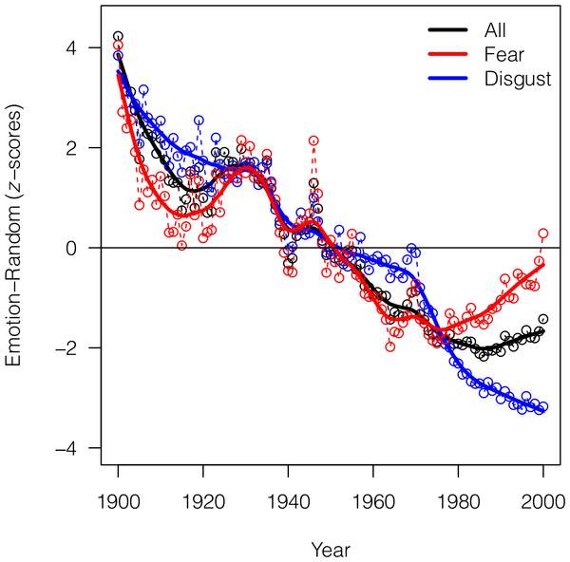
Acerbi A, Lampos V, Garnett P, Bentley RA (2013) The Expression of Emotions in 20th Century Books. PLoS ONE 8(3): e59030. doi:10.1371/journal.pone.0059030

Slide 19
Undergraduate Specialization in Data Science

Slide 20
Experimental MOOC
Undergraduate Themes
Key observation: Different domains can satisfy these requirements in different ways
programming
Data manipulation at scale
data management
statistics
Practical Predictive Analytics
machine learning
visualization
Communicating Results
societal implications of data science

Slide 21
Instantiation model
programming
  CSE 142/143, parallel programming in applied math, MATLAB courses in engineering, etc.
statistics
  Stats 220/221, but analysis courses exist in oceanography, new courses emerging in biology, etc.
machine learning
visualization
  CSE 442, HCDE 411, INFO 447, GIS courses, vis courses in three departments
data management
  CSE 344, iSchool 445, Geography 482,
societal implications of data science

Slide 22
Programs approving a “Data Science Track”
Applied and Computational Mathematical Sciences
Computer Science & Engineering
Information School
Human Centered Design & Engineering
Statistics
…more on the way

Slide 23
Project-Based Programs:
Data science for Social Good

Slide 24
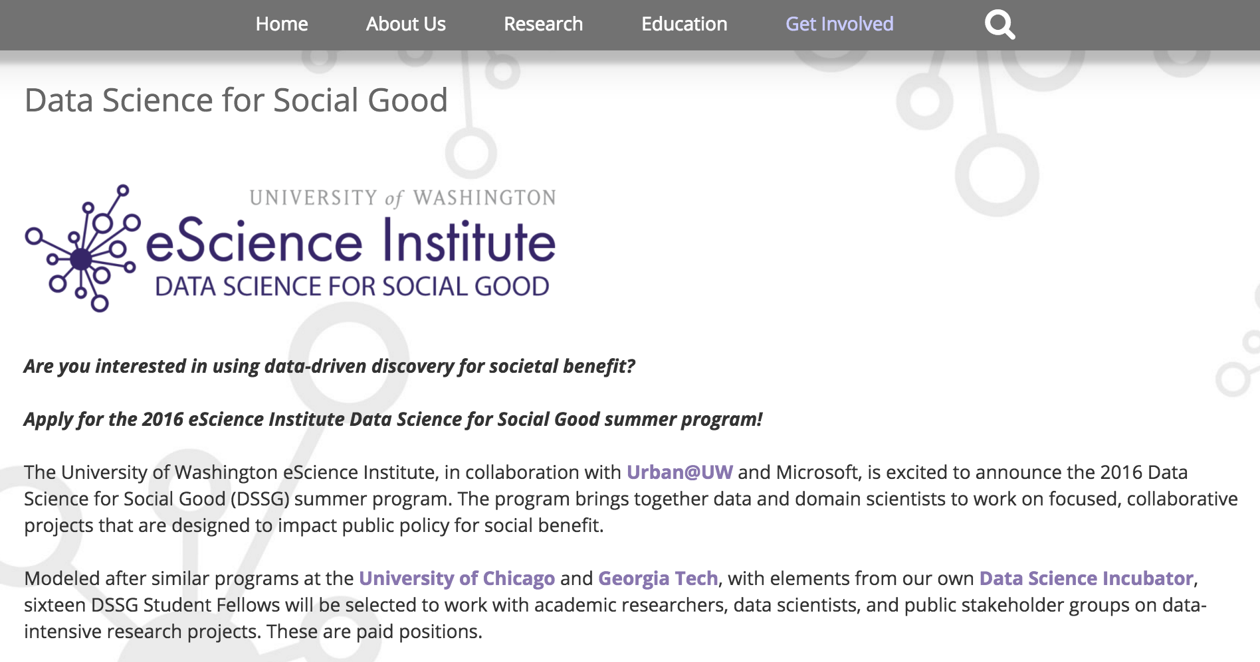
Data Science for Social Good
Inaugural 2015 program:
16 spots
140 applicants
…from 20+ departments
Assessing Community Well-Being
Third-Place Technologies
Optimization of King County Metro Paratransit
Computer Science & Engineering
Predictors of Permanent Housing for Homeless Families
Bill and Melinda Gates Foundation
Open Sidewalk Graph for Accessible Trip Planning
Computer Science & Engineering

Slide 25
Data Science for Social Good
2016 program:
16 spots
190 applicants
Mining Online Data to Detect Unsafe Food Products
Elaine Nsoesie, Institute for Health Metrics and Evaluation
ORCA data for improved transit system planning and operation
Washington State Transportation Center (TRAC)
Global Open Sidewalks: Creating a shared open data layer Taskar Center for Accessible Technology
CrowdSensing Census: A tool for estimating poverty
Bell Labs, Nokia
New in 2016: An explicit emphasis on data ethics

Slide 26
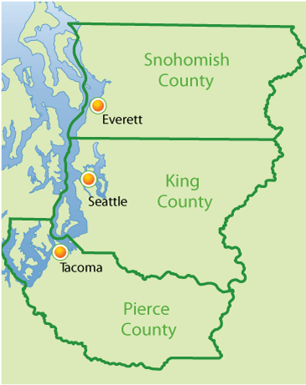
Background on homelessness in Tri-county area
Over 4,000 homeless families in the Tri-county area every year (Snohomish, King, Pierce).
Families spend on average 8 months moving from shelter to shelter.
Bill & Melinda Gates Foundation and Building Changes: cut family homelessness in half by 2020 and reduce time family spends homeless to 1 month.

Slide 27







Homeless families may take many pathways through programs
Transitional housing
Rapid
re-housing
Permanent housing
Emergency shelter
Housing with services
Unsuccessful exit

Slide 28
Create data cleaning pipeline for messy Homeless Management Information Systems data
King HMIS extract
Pierce HMIS extract
Cleaned data for households
Cleaned data for families
Family enrollments
Family episodes
Snohomish HMIS extract
Mapping of enrollments to episodes

Slide 29
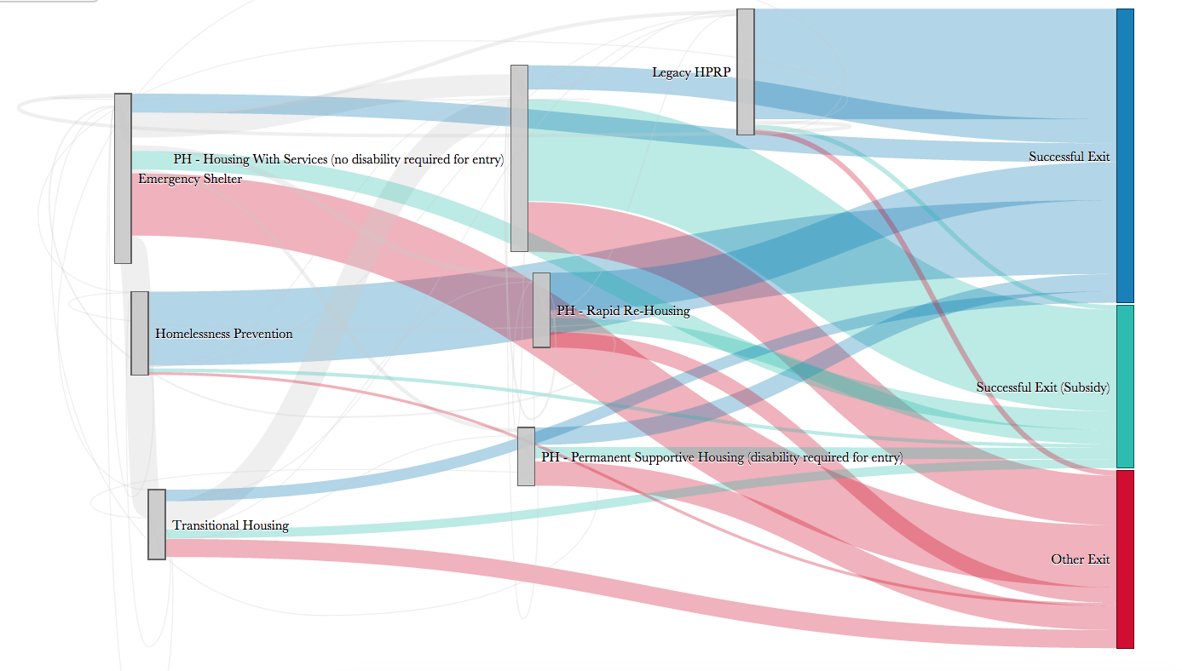
Develop visualizations to show how homeless families move through programs

Slide 30
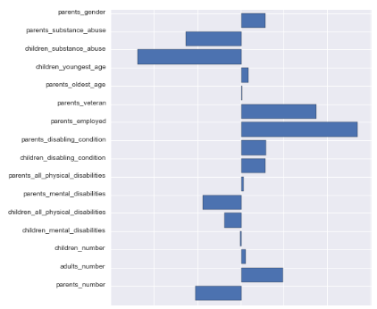
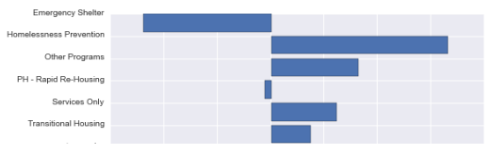
Conduct analysis to identify predictors of permanent housing
Substance abuse strongly associated with unsuccessful outcomes
Homelessness Prevention programs more strongly associated with positive outcomes than transitional housing
Emergency Shelter use tends to be associated with unsuccessful outcomes (unsurprising!)
Parent employment strongest predictor of successful outcomes
Correlation with successful outcome, by homelessness program
Correlation with successful outcome,
by family characteristics

Slide 31
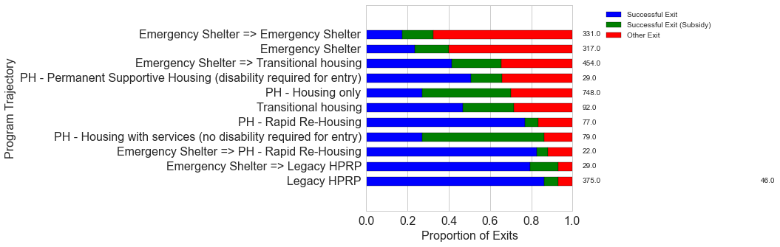
Novel Analyses of Family Trajectories through Programs
An example using Pierce County data
Common trajectories lead to different outcomes:
  a successful exit from an episode would mean that the family found a permanent housing solution
  a proportion of these still receive government subsidies
  other exits are exits back into homelessness, or to other, unknown destinations

Slide 32
What’s next?
Current
Two large-scale courses for all freshmen
  Introduction to Data Science Methods
  Data Science & Society
Upcoming
Modular and reusable assignments, lectures
Advising support for students navigating choices
Lightweight review process for topic instantiations
  What does a data science specialization mean, if every department defines it differently?

Slide 33
Final thoughts
The goal is to teach students how to construct a convincing argument
Some convincing arguments require the manipulation of large, noisy, and heterogeneous datasets
The ability to construct these kinds of arguments has traditionally been concentrated in relatively few fields
But now, everybody has access to L,N,H Data, so everybody needs to be able to construct convincing arguments using them.
This does NOT imply everyone needs to know everything
The way to teach students this stuff is to have them work on problems important to them.
  Domain-sourced assignments and examples
  Domain-focused summer programs and capstone programs
  Domain-specific courses (with some common themes)

Slide 34
Final thoughts (2)
“All science is data science.” “We’ve been working with big data for years.”
It’s useful to consider what is actually different nowadays.
The easy availability of large, noisy, heterogeneous datasets is what is different.
Advances in automated data acquisition outpaced the advances in (and democratization of) automated data analysis
Everything we label as “data science” should be pertinent to this trend. It’s not just stats. It’s not just programming.
“Computational science” is very influential, but unlike computer science or applied math, you don’t get a degree in it. Why is data science different?

Slide 35
Final thoughts
The goal is to teach students how to construct a convincing argument
Some convincing arguments require the manipulation of large, noisy, and heterogeneous datasets
The ability to construct these kinds of arguments has traditionally been concentrated in relatively few fields
But now, everybody has access to L,N,H Data, so everybody needs to be able to construct convincing arguments using them.
But this does NOT imply that everyone needs to learn everything
  You are trying to convince your peers
  You are not trying to convince all statisticians, all computer scientists, etc.
  Ex: Fisherian significance testing is not a gold standard of scientific argument. It’s not about whether an effect would be seen in repeated experiments, it’s about the size of the effect and whether it matters. Vioxx, etc.

Slide 36
UW Masters Degree in Data Science
Fall 2016
Collaboration between CSE, Stats, Biostats, Applied Math, HCDE, and the iSchool
Curriculum: 45 credits
  Introductions to Statistics & Probability
  Applied Statistics and Experimental Design
  Statistical Machine Learning for Data Scientists
  Data Management for Data Science
  Scalable Data Systems and Algorithms
  Software Design for Data Science
  Data Visualization and Exploratory Analytics
  Human-Centered Data Science
  Capstone Program
Stats / Biostats (+CSE)
CSE
HCDE (+iSchool, CSE)
iSchool (+HCDE)

