Slide 1
Berkeley’s Data Science Curriculum
National Academies Roundtable on Data Science Education
Meeting #2 – March 20, 2017
Examining the Intersection of Domain Expertise and Data Science
Cathryn Carson (@CathrynCarson)
clcarson@berkeley.edu
On behalf of colleagues across UC Berkeley
Program website: data.berkeley.edu

Slide 2
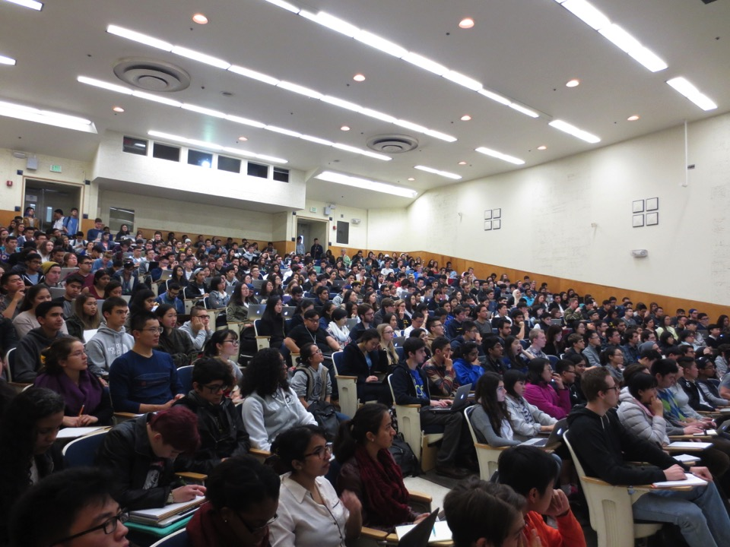
Foundations of Data Science at Berkeley

Slide 3
Concept
Berkeley’s Data Science program aims
to make it possible for every student to engage capably and critically with data, as part of a 21st century education
and building on this foundation to provide pathways to further progress in many fields of study
That points us toward
an integrative, connected, comprehensive curriculum
built from the entry level upward,
to meet students’ needs for data fluency,
to serve a broad range of programs of study that now or in the future will integrate data science capacities,
and to provide the depth of understanding required for an undergraduate major and (possibly multiple) minors

Slide 4
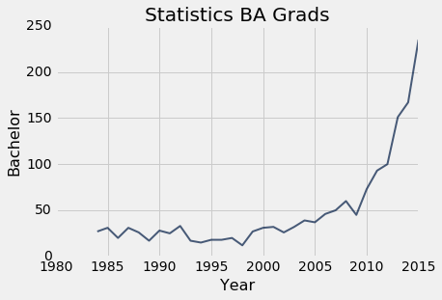
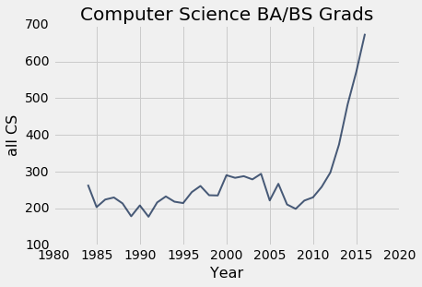
How Berkeley’s curriculum came together
Something is happening with the students
  Fast growth, increasing numbers of multiple majors
  Demand rising in depts across the university
  Innovative instructors taking up the slack piecewise
Something is happening with the faculty
  Hiring choices for new asst professors
  Moore-Sloan grants => BIDS
Local assets to build on
  Strong programs with strong linkages
  Charismatic individuals
  Culture of collaboration and make-it-happen
Data Science Education Rapid Action Team
  Charged July 2014, reported January 2015
  First classes offered August 2015

Slide 5
Berkeley’s Data Science Education Philosophy
Intellectual Values
Recognize a new science is emerging ...
Integrating abstraction with concreteness, principles with practice
Stretching across many of today’s disciplines, taking different forms in each
With limits and perils, too
Create free spaces for it to emerge, grow it in sync with research
Take seriously the call for a multi-disciplinary mindset
Organizational Values
Follow the lead of the students and faculty
Build it in a Berkeley spirit
Make it diverse and inviting
Bake in critical thinking, ethics, and societal context
Avoid early tracking
Create a common platform and distributed ownership
Meet common needs in economical ways
Breadth via modularity and customization
Grow it from the ground up
Try and learn, scale it fast
Social Values
Coercion doesn’t work
Let individuals take the initiative – general guidance at most
Stabilized around shared resources and vision
Heavy demands on social relationships (a.k.a. networks, patience, trust)
Different needs and opinions are a given (a.k.a. conflict)
Working together is key
Notes:
2nd slice

Slide 6
Berkeley’s Blueprint for Data Science in the Undergraduate Experience
Rolling out to the students
Today’s Majors
DS Minor
DS Major
Concentrations
Student Paths
Experience level
Data Science Core
Soc
Biz
Connectors
Phys
CS
Data Science Foundation (CS+Stat+Critical Thinking w/ data)
Existing course
Thesis, Research
Undergrad Class
DS in field
DS focus
6
Notes:
1st slice

Slide 7
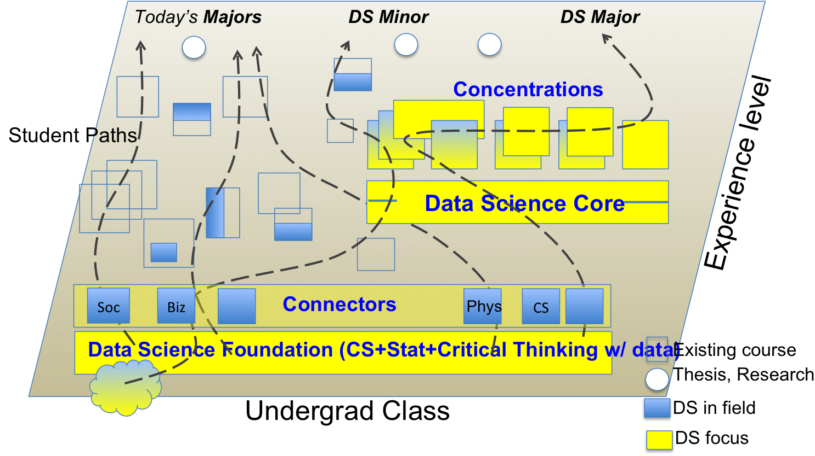
1st Stage:
Entry Level – Foundations of Data Science (Data 8) and Connectors

Slide 8
Foundations of Data Science at Berkeley

Slide 9
The platform: Foundations of Data Science
Online syllabus, labs, homeworks, videos – data8.org
Online textbook – inferentialthinking.com

Slide 10
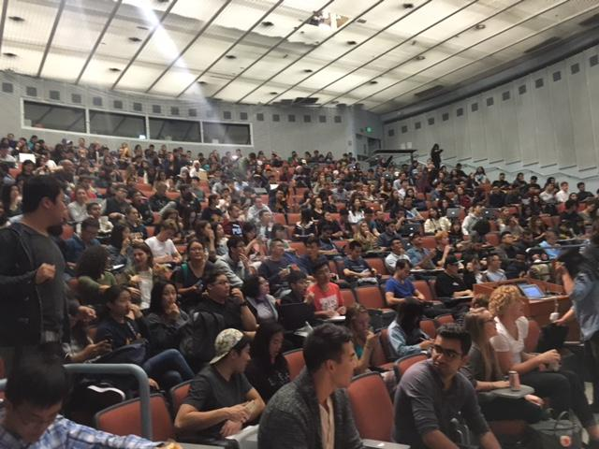
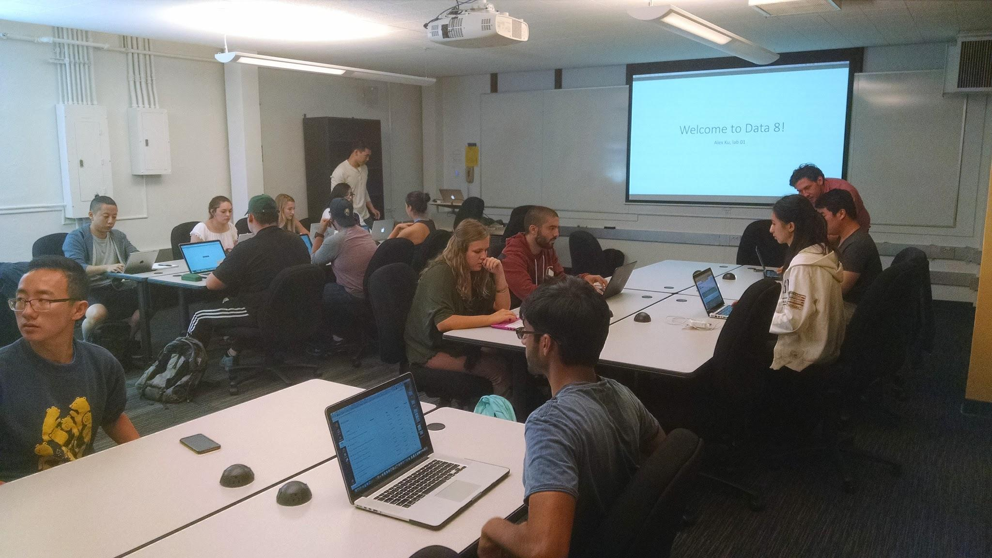
Foundations of Data Science - “Data 8”
(CS/Stat/Info C8)
Aimed at 1st/2nd-year students of any major
  No CS or stats experience required
  Approx 700 students in Spring 2017
  4 units, MWF lecture + 2-hour W-F lab
Designed to draw students in
  Real-world examples, get-your-hands-dirty labs
  A better way to meet many majors’ statistics or computing requirements
  Meets Quantitative Reasoning (QR), but not a university requirement itself
Developed and taught by multiple faculty
  8 faculty on the design team
  Usually 2-3 faculty involved each semester (mainstays and guests)
Leverage the computational platform
  Labs, homeworks, videos – all at data8.org
  Online textbook – inferentialthinking.com
  Problem-solving in a notebook environment
  Minimize barriers by teaching in the cloud

Slide 11
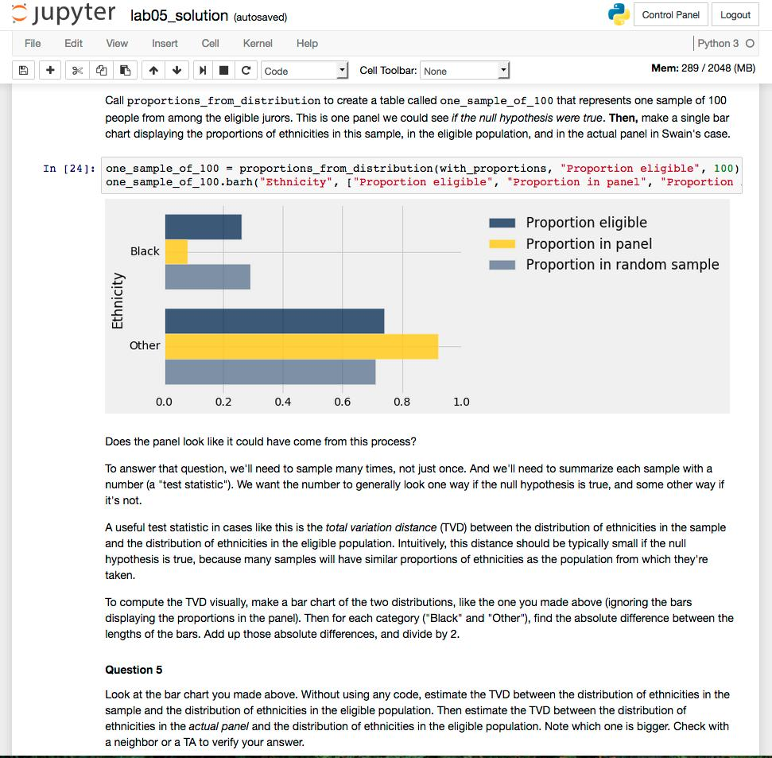
Understanding the Null Hypothesis –
Sampling and Jury Selection
11

Slide 12
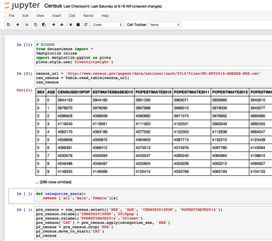
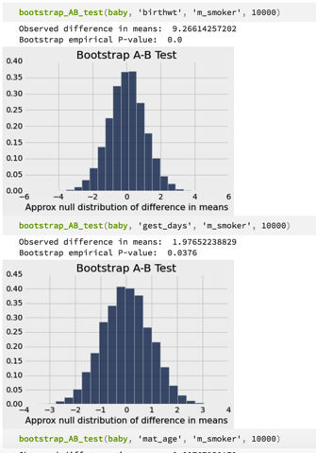
Data 8 - Concepts and Computing
Fundamental co-mingling of CS & Stat concepts on real data
  Learn computing concepts by doing interesting things on data
  Learn advanced statistical concepts by observing what’s interesting
  Codify understanding of concepts symbolically
“Explorations” into visualization, privacy, personalized medicine, etc.
Cloud-based computing environment built on Jupyter notebooks (thank you Jupyter team!) plus UCB datascience Tables, taught in Python

Slide 13
Data 8 Content – The Building Blocks
From a data analysis perspective, students understand:
Visualization for understanding and communication (graphs, histograms, bars, scatters, maps)
Distributions and random sampling (with and without replacement)
Properties of several statistics (median, mean, max, total variation distance)
Testing statistical hypotheses
Estimation, prediction, and assessing predictions and models
Regression and correlation
Clustering and classification
Comparison, causality, and decisions
In the process they gain an understanding of classical statistical concepts:
Probability theory, e.g., complements and multiplication rule, birthday surprise, permutations
Distributions of data (categorical and numerical) and of probabilities
Empirical distributions
Law of averages, Central Limit Theorem
Sampling variability, standard errors of estimates
p-values and error probabilities in tests of hypotheses
Bootstrap, permutation tests, null hypothesis
Bayes’ Rule and the probability of false positives
And familiarity with computational concepts:
Data types and data structures (tuples, lists, arrays, tables)
Representation, operators, interpretation
Sequencing, conditionals, iteration, comprehensions
Use and definition of functional abstractions
Data parallel programming techniques
Higher-order functions
Database operations (select, filter, join)
Repetition, convergences, searching, sorting
Testing, debugging, exceptions
Objects and modules
13

Slide 15
Connector courses “connect” data science with students’ interests
Leverage the learning students do in Data 8
  Take it as the foundation, then don’t have to repeat the content
  So far, 2 unit classes – in the future, can be 3 units or more
Apply Data 8 concepts to real-world issues or extend technical depth
  Offered by departments on their own terms, for their own areas
  Can be built into their requirements of their majors
Philosophy of symmetry with Data 8
  Taken concurrently with Data 8 or subsequently
  Students bring perspective into Data 8, knowledge & skills into connector
  Connector community gives feedback to Data 8 instructors
Students like the connectors as much as Data 8!

Slide 16
Connectors offered in 1st 4 semesters
CivEng 88 | Data Science for Smart Cities | Stat 88 | Probability and Mathematical Statistics in DS
CivEng 88B | Time Series Analysis | Stat 89A | Introduction to Matrices and Graphs in DS
Cog Sci 88 | Data Science and the Mind | L&S 39 | Race, Policing, and Data Science
CS 88 | Computational Structures in Data Science | L&S 88 | Health, Human Behavior, and Data
ESPM 88A | Geospatial Data Explorations | L&S 88 | Child Development Around the World
ESPM 88B | Data Sciences in Ecology and the Environment | L&S 88 | Literature and Data
Geog 88 | Data Science Applications in Geography | L&S 88 | Genomics and Data Science
Hist 88 | How Does History Count? | L&S 88 | Social Networks
Info 88A | Data and Ethics | L&S 88 | Data Science for Cognitive Neuroscience
Legal St 88 | Crime and Punishment | L&S 88 | Data Science, Demography, and Immigration
MCB 88 | Immunotherapy of Cancer

Slide 17
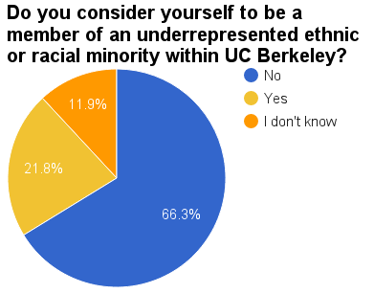
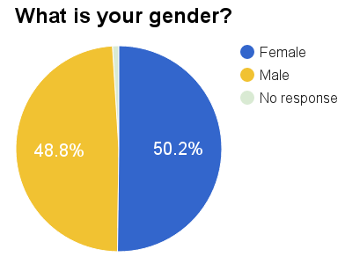
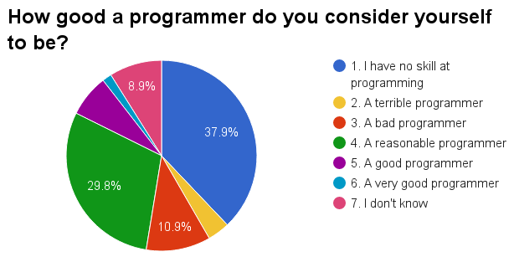
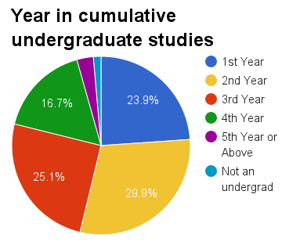
Demographics in Data 8
Fall 2016

Slide 18
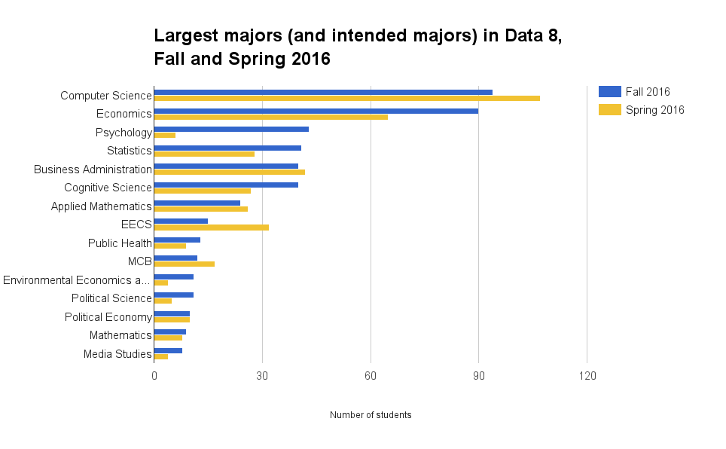
About 60 majors are represented among Data 8 students so far

Slide 19
Data 8 Student Reactions
“One of the things I most enjoy about data science is the diversity—my classmates range from English majors to bio majors to computer science majors —all looking at data from our different perspectives.”
“This class puts theory into practice. I was able to use data to tell powerful visual stories about the struggles I experienced growing up in southeast LA.”
“Out of all the classes I’ve taken, this class gave me the most practical knowledge. I’m applying it in my internship at Google already.”
19

Slide 20
Enrollments in Berkeley’s Data Science classes so far (Fall 2015 - Sp 2017)

Slide 21
2nd Stage:
Reaching Outward and Upward

Slide 22
The Summer Faculty Short Course on Data Science Pedagogy and Practice
Departments and programs represented: American Cultures, Business, Demography, Economics, History, Linguistics, Math, Near Eastern Studies, Neuroscience, Optometry, Physics, Political Science, Rhetoric, Sociology
Selected quotes from survey respondents:
  “I loved the integration of the statistical concepts and the computing; seeing really is believing, and I think this will motivate students to study statistics in a more rigorous way as well (especially those who are more reluctant to engage the math).”
  “I definitely want to work on developing a ‘module’ for my Ethnic Studies courses to both animate the existing course material from another dimension, and also to bring into our students' lives a taste of other methodological techniques which can complement our field of study.”

Slide 23
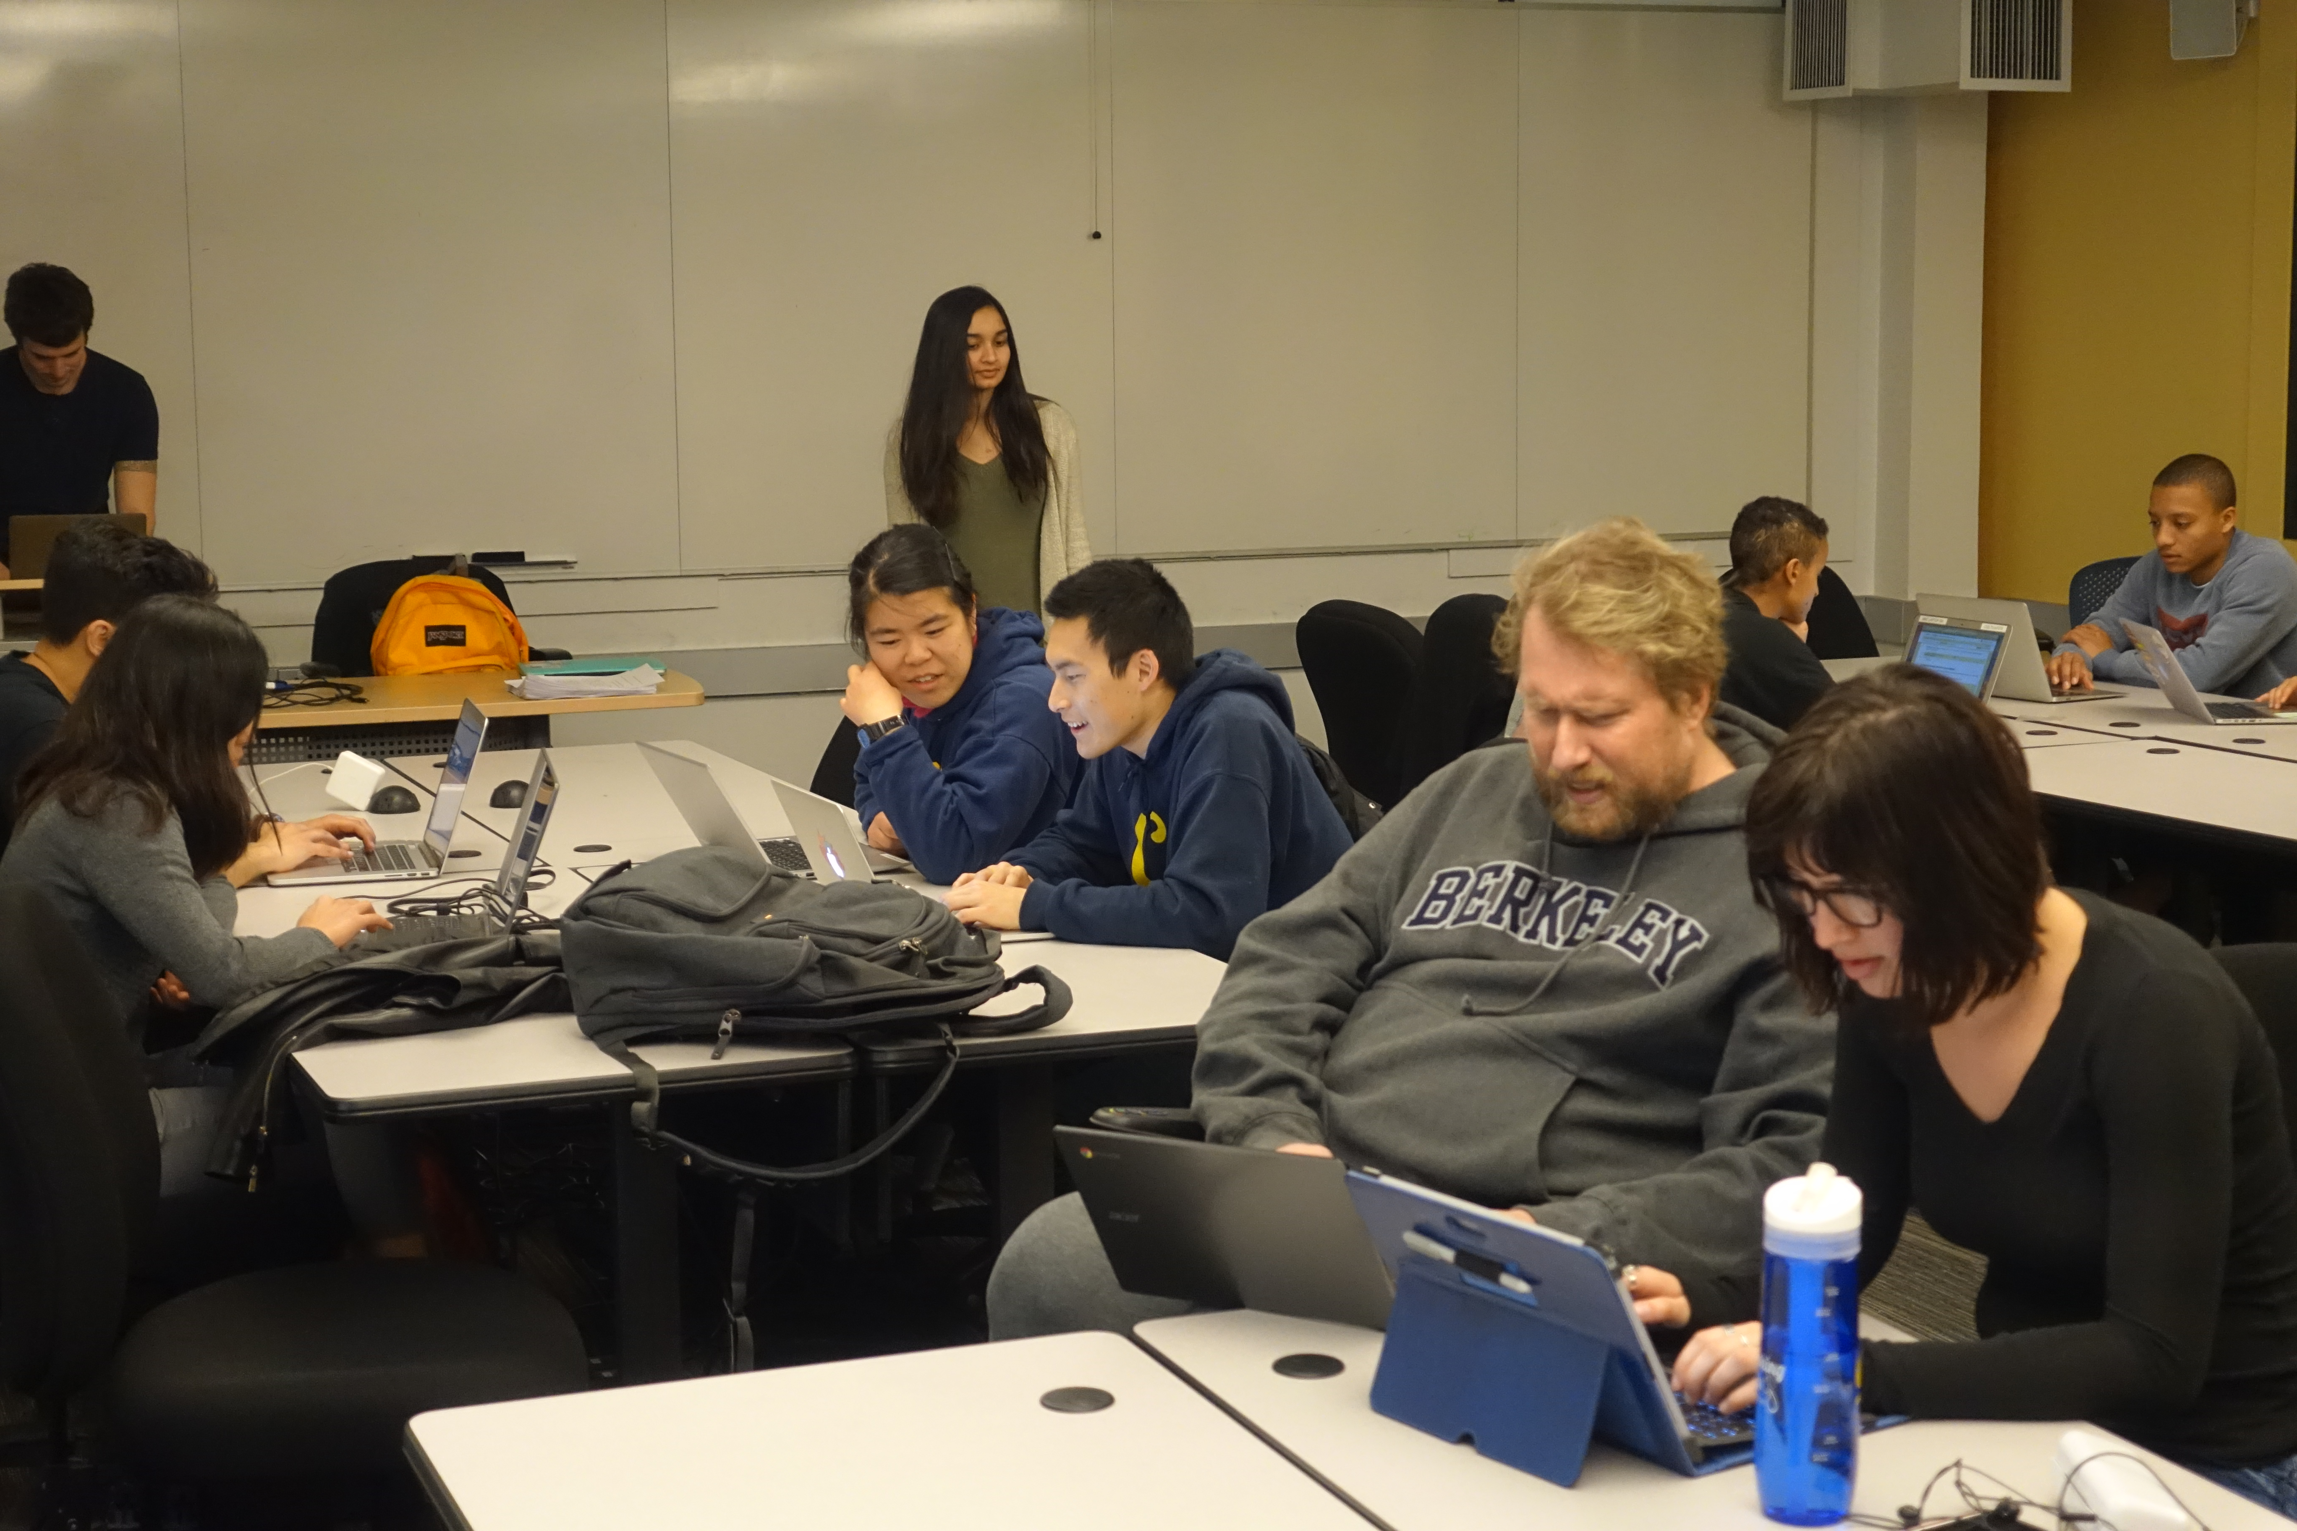
Modules in classes
http://data.berkeley.edu/news/data-science-crops-diverse-undergraduate-courses

Slide 24
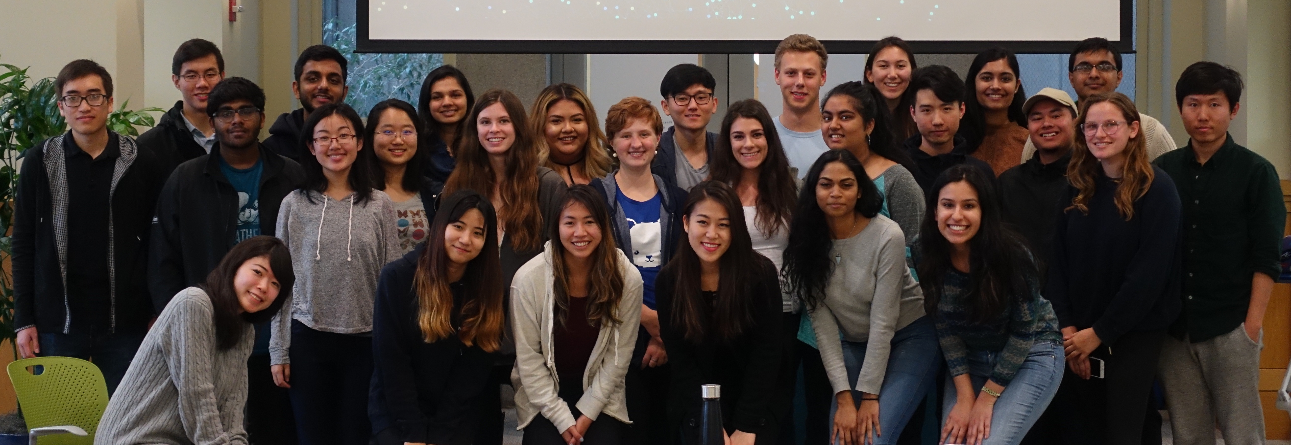
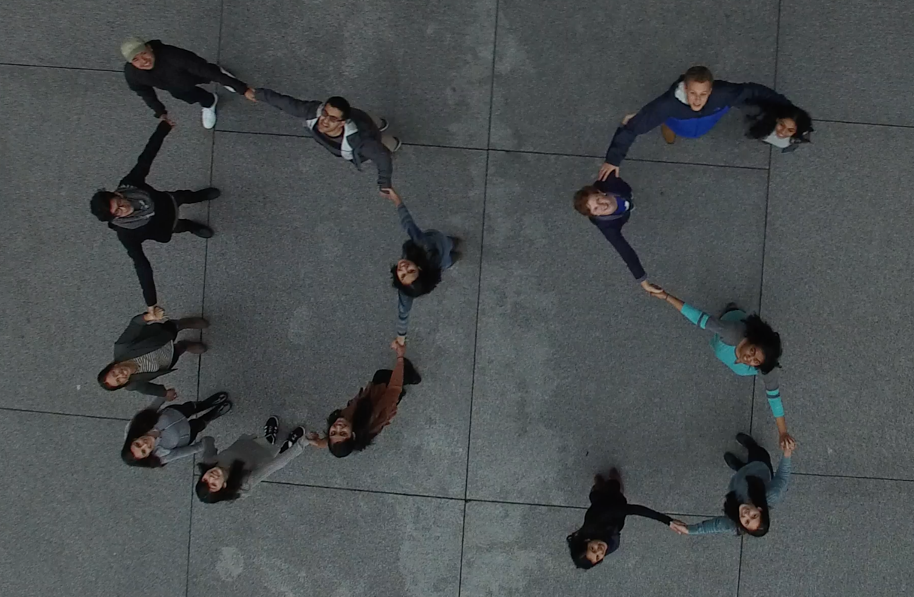
DS Education Program student team
Student team leads for
Technical Infrastructure
Curriculum Development
Connector Support
Mapping
Outreach
Projects
Diversity
Ambassadors

Slide 25
How Do We (Collectively) Meet the Needs of the Domains?
What do domain students need?
  What future(s) are we preparing them for?
  What do they need inside their formal programs of study?
  What do they need outside?
  Besides just asking, what tracking do we do?
What do domain faculty need in their courses?
  What are the necessary interfaces with colleagues’ new courses?
  What feedback do they give?
  What pieces do they take on themselves? What’s best taught that way?
  What materials or support would help?
  What gets taken off their plate?

Slide 26
NEW: The upper-division gateway, DS 100
Organized (at least aspirationally) around the data science lifecycle
Online syllabus and more – ds100.org

Slide 27
Principles and Techniques of Data Science:
“pilot” DS 100 syllabus
Week 1
Week 2
Week 3
Week 4
Week 5
Week 6
Big Concepts in Data Science
Working with Real Data and SQL
Week 7
Week 8
Week 9
Week 10
Week 11
Week 12
Basic Statistical
Modeling
Review &
Midterm
Inference, Prediction, &
Machine Learning
Spring
Break
ML Techniques
Week 13
Week 14
Week 15
Week 16
ML Techniques
RRR
Analytics at Scale
http://www.ds100.org/sp17/syllabus

Slide 28
Big Concepts in DS 100
Data preparation and representation
Efficient and scalable data processing
Question formulation and experimental design
Exploratory data analysis and visualization
Modeling fitting and inference
Machine learning techniques and overfitting
Validation and hypothesis testing

Slide 29
NEW: Statistical Methods for Data Science
No additional math (or other prereqs beyond Data 8)
Notes:
The course will introduce a broad range of statistical methods that are used to solve data problems.
group comparisons, parametric statistical models, multivariate data visualization, multiple linear regression and classification.
Students will obtain hands on experience in implementing a range of commonly used statistical methods on numerous real world datasets.
The labs in the course will offer an introduction to the widely used R statistical language
as well as methods of reproducible statistical analysis.

Slide 30
NEW: Probability for Data Science
Rethink how we teach probability using computation

Slide 31
Scaffolding a DS major
Upper division unit total: 30-36
Depth
Domain Emphasis
Upper-div integrative experience (in some form)
Societal context & ethics
Upper-div anchor
Upper div
Lower div
Foundations
Lower-div anchor

Slide 32
Berkeley’s Data Science Educational Philosophy
Intellectual Values
Recognize a new science is emerging ...
Integrating abstraction with concreteness, principles with practice
Stretching across many of today’s disciplines, taking different forms in each
Create free spaces for it to emerge, grow it in sync with research
Take seriously the call for a multi-disciplinary mindset
Organizational Values
Follow the lead of the students and faculty
Build it in a Berkeley spirit
Avoid early tracking
Make it diverse and inviting
Bake in critical thinking, ethics, and societal context
Create a common platform and distributed ownership
Meet common needs in economical ways
Breadth via customization
Grow it from the ground up, so all can build on it
Try and learn, scale it fast
Social Values
Coercion doesn’t work
Let individuals take the initiative – general guidance at most
Stabilized around shared resources and vision
Heavy demands on social relationships (a.k.a. networks, patience, trust)
Different needs and opinions are a given (a.k.a. conflict)
Community is key
Notes:
2nd slice

