Slide 1
NASEM Subsea Bolt Performance Workshop
April 11, 2017
Bolt Manufacturing –
A Look at Critical Operations
Lester Burgess
Director of Technical Services and Quality
TSP/U.S. Bolt Manufacturing, Inc.

Slide 2
Critical Operations
We will look at the following:
Forging / Forming
Heat Treatment
Machining (Threading)
Testing

Slide 3
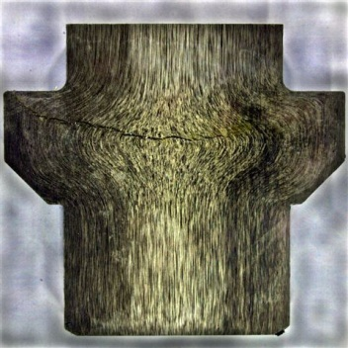
Control of Forging - Critical
Large bolt, sectioned lengthwise showing forged head with large internal crack running horizontally.
Internal crack caused by overheating during forging operation.

Slide 4
20E Forging Controls
The following are forging/hot heading parameters, as applicable:
a) equipment;
b) heating method (furnace, induction);
c) temperature control (thermocouple, optical or infrared pyrometer, fail safe cut-off);
d) times and temperatures;
e) dimensional control.
The manufacturer shall have a written forging procedure defining, at a minimum, the parameters defined in 5.4.3. When induction heating is used for forging, the manufacturer’s equipment shall include temperature monitoring equipment and an automatic fail-safe system to prevent overheating.

Slide 5
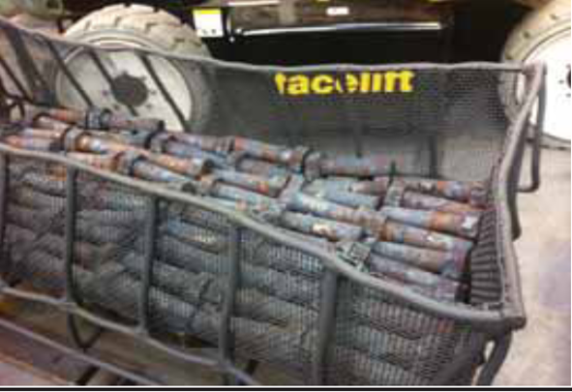
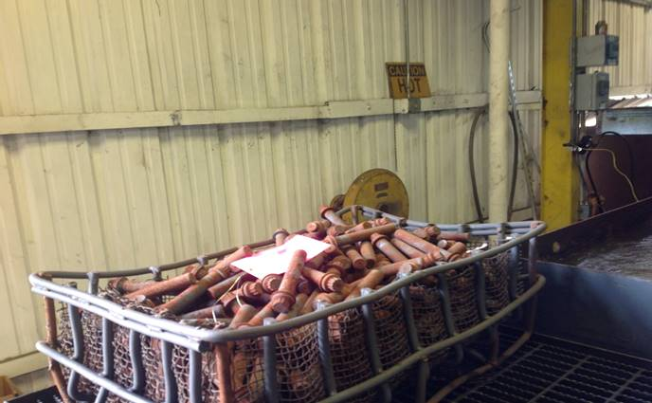
Heat Treatment - Critical
Bolts must be heat treated to achieve proper strength by cooling rapidly from high temperature. Nesting the parts prevents uniform cooling.
Random stacking of the parts and maximizing furnace load is often used for commercial bolting but it is not acceptable for critical bolting.

Slide 6
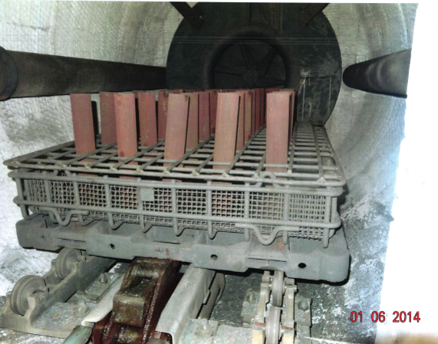
Furnace Loading for Critical Bolting

Slide 7
20E Heat Treat Controls
The following are heat treat parameters, as applicable:
a) equipment (batch, continuous, induction, direct resistance);
b) times and temperatures;
c) cooling media (e.g. type, polymer concentration, quench temperature, agitation);
d) control and calibration methods;
e) maximum transfer time;
f) quench media start and finish temperature;
g) furnace load diagrams.
Furnace calibration shall be in accordance with API 6A, Annex M; SAE AMS2750; or SAE AMSH6875.

Slide 8
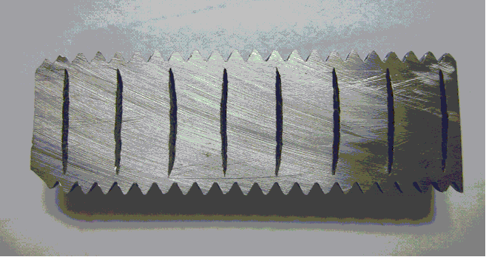
Threading
Cross-section of threaded bolt with internal bursts resulting from improper thread forming.

Slide 9
20E Control of Threading
General Variables
The following are general variables, as applicable:
machining and threading equipment— single point (lathe), multiple chaser, roll, cutting tap, form tap;
machining and threading control methods.

Slide 10
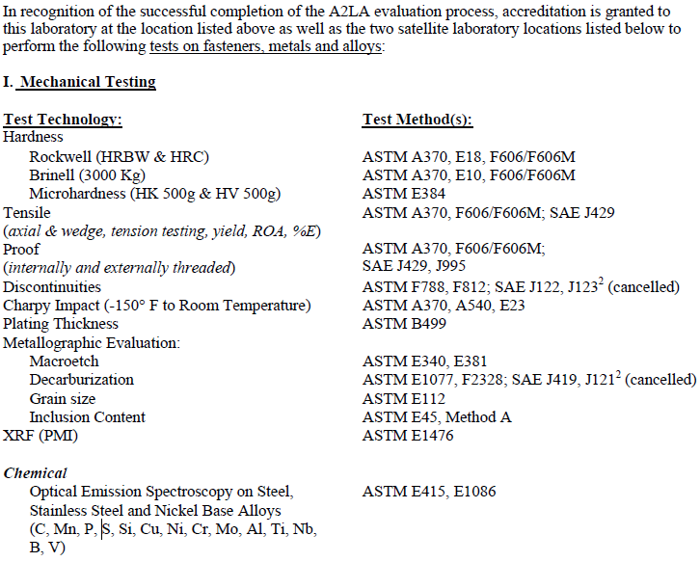
Testing
Must be accurate – 20E requires compliance to ISO 17025.
Excerpt from ISO 17025 Accreditation Certificate:

Slide 11
Testing Limitations
Provides determination of actual properties
Confirms compliance to requirements
Cannot overcome inadequate processing:
Not possible to test each part all properties
Some defects are difficult or impossible to reveal
Testing an inadequately controlled process can only prove it bad, it cannot prove it good.

Slide 12
Assured Bolt Quality
Process Control

