Slide 1
An Experiment in Hiring Discrimination via Online Social Networks
Alessandro Acquisti and Christina Fong
Carnegie Mellon University
Notes:
Delighted to be here
Joint work
Economist by training
Economics of privacy
Chose non-traditional path (berkeley, hal varian, school of information; mix of econ, behavioral econ, and data mining aimed at investigating trade-offs and decisions)
This study is an example of that. Started early on investigating online social networks; experiment in the wild. Data used in many ways; the hiring angle.
Warn you – very preliminary results, and very young paper (although kind of ironic, since we started the project over 4 years ago)
Three challenges to overcome.
We started with the idea of studying whether employers are using socal media, and how it affecting them; over the years the 1st question became redundant, but the second is still open, since there may be a gap between what employers say they use social media for, and how they are actually affected by it. and by “it”, I refer to information which is risky to ask during the hiring process (as it may lead to discrimination lawsuits), but which candidates nowadays volunteer online. so we focus on that information, and we stress that our claim is not that we are using social media to investigate how employers react to a trait per se, but how they react to the trait and the fact that the trait is being self-reported by the candidate.

Slide 2
Online social networks: new arena for discrimination
Traditionally, information about certain “protected” traits was relatively easy to protect in the job search process.
Employers who ask about these traits may face legal exposure. (E.g., in the U.S.: Federal Equal Employment Opportunity Laws.)
Nowadays many job candidates volunteer their private information online.
Traits that were traditionally easier to hide than race and gender may enter the arena.

Slide 3
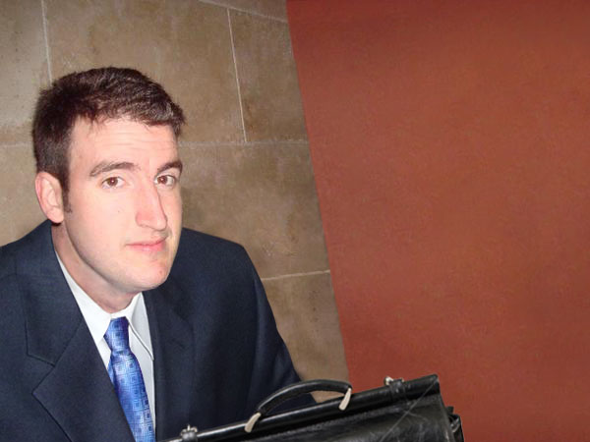
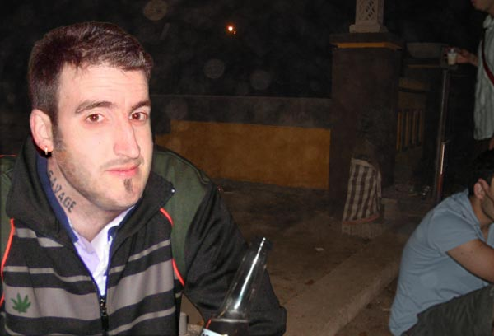
Notes:
Dressed for success vs tattoos and cannabis

Slide 4
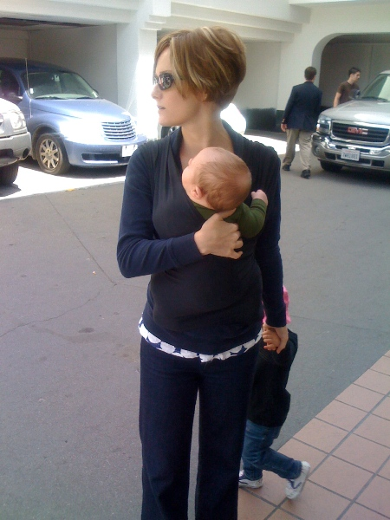

Slide 5
Religion
Not difficult to protect this information at work
From an early age many immigrants’ kids assimilate easily
Personal example: Two American school girls named Maya
At school they are racially and ethnically indistinguishable
Maya #1 has two parents from Saudi Arabia
Maya #2 has two American parents, Jewish mom
At home their ethnic beliefs and practices differ
What price will Maya #1 pay when she or her parents post photos of her family life?

Slide 6
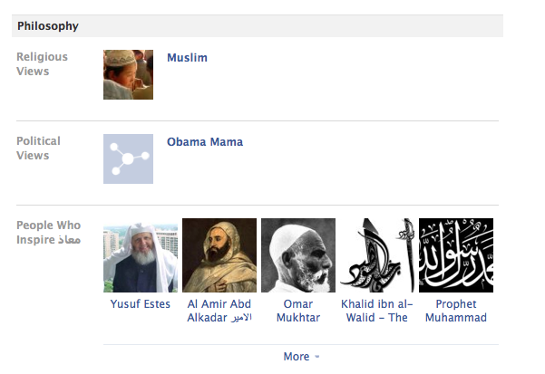

Slide 7
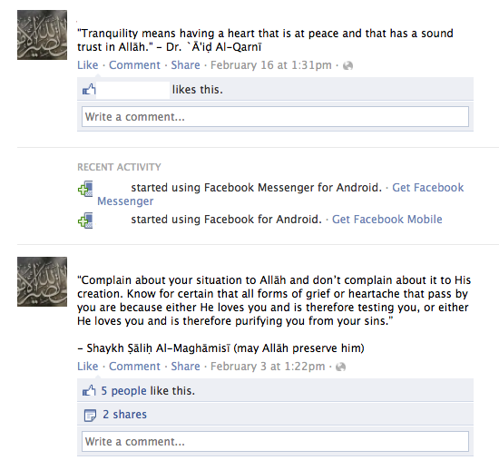

Slide 8
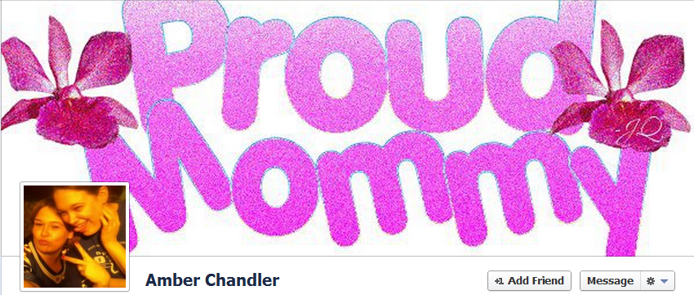

Slide 12
Recap: Online search activity
Online search lowers employers’ search cost and legal exposure.
Surveys of employers suggest that some (many?) use online tools to research candidates but extent is not known.¹
Searching not illegal, per se, but can lead to discrimination and legal risk.
Hence, some companies are now being advised not to seek online information about prospective candidates.
¹Sources: 2007 Ponemon Institute HR Special Analysis, 2008 Career Builder Study, 2010 Microsoft Survey, 2012 EmploymentScreenIQ Survey
Notes:
From ponemon
Discovery of “bad” information not otherwise known

Slide 13
Randomized field experiment: Purpose
Test joint hypothesis:
Do US employers actually search candidates online?
AND, if so:
Are their hiring decisions affected by “protected” information posted online?

Slide 14
Randomized field experiment: Method
Manipulate online social network (OSN) profiles.
Send real applications to real employers.
Measure interview invitations.
Notes:
When we started this, first question. Now…
[note: not true of professional/unprofessional profiles]

Slide 15
Related work
Large body of economic research on (job) discrimination
More recently, a burgeoning set of field experiments Resume studies following Bertrand and Mullainathan AER 2004
Little research on online search or online discrimination
Following us, a paper on search costs: Matthieu, Pajak, and Soulié (2014)

Slide 16
Our Paper
Religion manipulation (Christian vs. Muslim)
Sexual orientation manipulation (Straight vs. Gay)
Pilot survey experiment
Approx. 770 observations
Field experiment
Real employers
Between subjects
n > 4,000. It was the entire population of suitable jobs opportunities for our candidates.
About half a dozen job types (and corresponding resumes)
Combination of IT, managerial, and policy positions

Slide 17
Approach
Created unique names for each candidate (4 in this study)
Designed (identical) resumes associated with each name
Designed (identical) LinkedIn profiles associated with each name
Designed (manipulated) Facebook profiles associated with each name
Notes:
What I mean by “created”

Slide 18
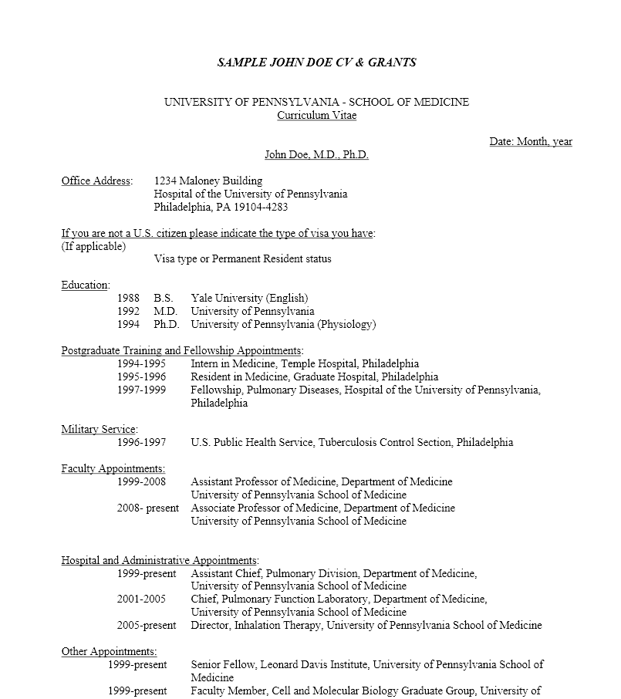
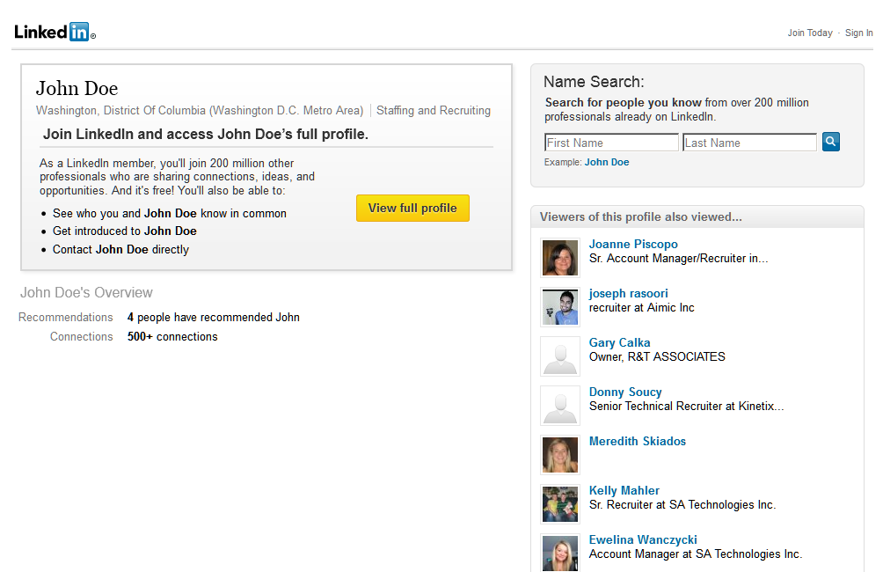
In a nutshell
Notes:
Replace with linkedin

Slide 19
Candidate’s background
US born
Technical skills
Work experience
Mix of fabricated (“Cendro Technologies”) and real but defunct companies (Lehman Brothers)

Slide 20
Names
Created and tested names
Criteria:
Unique on FB and LinkedIn
High rank when searched on Google/Bing/Facebook
No confounds (MTurk pre-study, N ~ 1k)
Religion
Sexual orientation
Relationship status
Maternity status
Professionalism
Race

Slide 21
Facebook close-ended fields
Profile information based on statistical analysis of 15k Facebook profiles demographically similar to candidate
Selected higher frequency items for fields such as Movies, Activities, Interests, Books, TVs
Notes:
15k Facebook profiles on a North American college’s Facebook network

Slide 22
Facebook open-ended fields
About me, status updates, quotes, background photo
Condition-specific text retrieved from manual analysis of actual Facebook profiles

Slide 23
Facebook profile photo
Model for photo chosen through an additional pre-study
Constant across conditions

Slide 24
Facebook timeline photo
Manipulated across conditions to match profile’s ostensible background
Again, based on actual Facebook profiles

Slide 25
Facebook profile: constant info
About
Work and Education: Carnegie Mellon University – Masters in Information Systems Management – Pittsburgh, PA; Carnegie Mellon University – Bachelor of Science in Computer Science – Pittsburgh, PA
Living: Pittsburgh, Pennsylvania – Current City; Pittsburgh, Pennsylvania – Hometown
Basic Information:
Birthday: January 2, 1982
Interested In: Women
Relationship Status: Single
Religious Views: Christian
Contact Information:
Address: Pittsburgh, PA, United States
Email: XYZ@gmail.com / XYZ@andrew.cmu.edu
Networks: Carnegie Mellon
Life Events: Started School at Carnegie Mellon University; Started School at Carnegie Mellon University
Friends
[list of friends, constant across conditions]

Slide 26
FB profile: manipulated info, Christian
Interests
Jesus Christ, Movies, Music
Activities
Reading, Running, Hiking, Church, Gospel choir
Likes
City: Pittsburgh, Pennsylvania
University: Carnegie Mellon University
Music: The Beatles, Coldplay, Red Hot Chili Peppers, Switchfoot, Jars of Clay
Books/Authors: Ender’s Game, The Bible, The Chronicles of Narnia
Movies: The Lord of the Rings, Inception, The Passion of the Christ, Chariots of Fire
Television: House, The Office, Manna Fest with Perry Stone, Joel Osteen
About You:
I recently graduated from CMU, majoring in Information Systems Management. I love reading, attending sporting events and hanging out with friends. I am a believer of our Lord Jesus Christ and that is my love. God has kept his promises to me and here I am. Grateful for His love and wisdom.
Favorite Quotations:
“The Lord Jesus Christ Said: I am the Way, the Truth, and the Life, nobody can come to the Father (God) except by me.” – Colossians 1:26

Slide 27
FB profile: manipulated info, Muslim
Interests
History of Islam, Movies, Music
Activities
Reading, Running, Hiking, Living Halal, Islamic Society of North America
Likes
City: Pittsburgh, Pennsylvania
University: Carnegie Mellon University
Music: The Beatles, Coldplay, Red Hot Chili Peppers, Maher Zain, Sami Yusuf
Books/Authors: Ender’s Game, The Quran, Fortress of a Muslim
Movies: The Lord of the Rings, Inception, Doha Film Institute, Kingdom of Heaven
Television: House, The Office, All American Muslim, Mujaddidun
About You:
I recently graduated from CMU, majoring in Information Systems Management. I love reading, attending sporting events and hanging out with friends. I love the person that I am and I thank Allah every day for how my life turned out.
Favorite Quotations:
“The best of you is those who learn Quran and teach it to others.”

Slide 28
Empirical Approach
We do not separate search from discrimination.
Cannot observe which employers search
Possible causal links between search and bias
Prior results suggested strong heterogeneity. We must grapple with this.
Certain types of Americans show more explicit attitudinal bias against both Muslims and gay people: Republicans, older people, and people who do not know as many Muslims/gay people
Test for heterogeneity according to these variables only (to tie our hands).

Slide 29
Summary of field results
Estimated 1/10th to 1/3rd of employers search online
Religion manipulation
No sig. effect in whole sample
Substantial bias against Muslim and in favor of Christian in Republican states and counties
Bias in Republican areas significant and significantly higher than in non-Republican areas
Sexual orientation manipulation
No sig. main treatment effect, no interaction

Slide 30
Callback rates in whole sample
PANEL A: Religion manipulation
 | Christian male | Muslim male
Invitation rate | 12.64% | 10.96%
N | 1060 | 1022
Two-sided Fisher’s exact p-value | 0.249
PANEL B: Sexual orientation manipulation
 | Straight male | Gay male
Invitation rate | 10.63% | 10.69%
N | 1025 | 1066
Two-sided Fisher’s exact p-value | 1.000

Slide 31
Callback rates in Republican areas
 | (1) Muslim [N] | (2) Christian [N] | (3) χ² p-value {Fisher’s exact} H₀: (1)=(2) | (4) Pooled gay and straight [N] | (5) χ² p-value {Fisher’s exact} H₀: (1)=(4) | (6) χ² p-value H₀: (2)=(4)
Republican states | .0227 [44] | .1731 [52] | 0.016 {0.019} | .1477 [88] | 0.028 {0.034} | 0.690
Republican counties | .0625 [64] | .2258 [62] | 0.009 {0.011} | .0900 [100] | 0.525 {0.768} | 0.016
There are no significant differences in callback rates for the straight and gay candidates.

Slide 32
OLS regression. Depvar = Callbacks
Table 2. OLS Regressions using state level data in the Christian-Muslim Conditions (column 1) and the Gay-Straight conditions (column 2). Dependent Variable is Callbacks.
* p < 0.10, ** p < 0.05, *** p < 0.01. Standard errors (in parentheses) are clustered on the state and county where the job will be located. Dep. Var. =1 if the candidate is contacted for an interview, zero otherwise.
 | Muslim vs. Christian
Muslim candidate | -0.132**
 | (0.054)
Politically mixed area | -0.024
 | (0.056)
Democratic area | -0.025
 | (0.072)
Muslim*Politically mixed area | 0.115*
 | (0.057)
Muslim*Democratic area | 0.127**
 | (0.060)
Additional controls included? | YES
Constant | 0.102
 | (0.067)
Observations | 1898
R² | 0.043

Slide 33
Conclusions
Online pilot experiment:
Bias in religion manipulation but not sexual orientation manipulation
Suggestive evidence of stronger bias among Republicans.
Field experiment:
Minority of employers search
Large and significant bias in Republican states and counties
This bias is significantly larger than bias in non-Republican areas

Slide 34
Extra slides

Slide 35
Callback rates in field experiment by state-level political party strength

Slide 36
Facebook profile, Christian candidate
About
Work and Education: Carnegie Mellon University – Masters in Information Systems Management – Pittsburgh, PA; Carnegie Mellon University – Bachelor of Science in Computer Science – Pittsburgh, PA
Living: Pittsburgh, Pennsylvania – Current City; Pittsburgh, Pennsylvania – Hometown
Basic Information:
Birthday: January 2, 1982
Interested In: Women
Relationship Status: Single
Religious Views: Christian
Contact Information:
Address: Pittsburgh, PA, United States
Email: XYZ@gmail.com / XYZ@andrew.cmu.edu
Networks: Carnegie Mellon
Life Events: Started School at Carnegie Mellon University; Started School at Carnegie Mellon University
Friends
[list of friends, constant across conditions]
Interests
Jesus Christ, Movies, Music
Activities
Reading, Running, Hiking, Church, Gospel choir
Likes
City: Pittsburgh, Pennsylvania
University: Carnegie Mellon University
Music: The Beatles, Coldplay, Red Hot Chili Peppers, Switchfoot, Jars of Clay
Books/Authors: Ender’s Game, The Bible, The Chronicles of Narnia
Movies: The Lord of the Rings, Inception, The Passion of the Christ, Chariots of Fire
Television: House, The Office, Manna Fest with Perry Stone, Joel Osteen
About You:
I recently graduated from CMU, majoring in Information Systems Management. I love reading, attending sporting events and hanging out with friends. I am a believer of our Lord Jesus Christ and that is my love. God has kept his promises to me and here I am. Grateful for His love and wisdom.
Favorite Quotations:
“The Lord Jesus Christ Said: I am the Way, the Truth, and the Life, nobody can come to the Father (God) except by me.” – Colossians 1:26

Slide 37
(1) RomneyVote List: states categorized by % Romney vote in the 2012 U.S. Presidential election |  | (2) Gallup List: states categorized by the Gallup Organization using Daily tracking data on political party identification from Jan. 1 – Dec. 31 of 2012 | (3) Combined List: Republican and Democratic states are the union of Republican and Democratic states in columns (1) and (2)
Panel A: Three lists of the most Republican states resulting from different definitions
AL |  | AL | AL
ID |  | ID | ID
KS |  | KS | KS
NE |  | NE | NE
OK |  | OK | OK
UT |  | UT | UT
WY |  | WY | WY
AR |  | AK | AK
KY |  | MT | MT
WV |  | ND | ND
 |  |  | AR
 |  |  | KY
 |  |  | WV
Panel B: Three lists of the most Democratic states resulting from different definitions
DC |  | DC | DC
DE |  | DE | DE
HI |  | HI | HI
MA |  | MA | MA
MD |  | MD | MD
NY |  | NY | NY
RI |  | RI | RI
VT |  | VT | VT
CA |  | CT | CT
NJ |  | IL | IL
 |  |  | CA
 |  |  | NJ

Slide 38
Table 1 – Manipulation Checks H0: Frequencies of Three Belief Response Categories do not differ (p-values reported)
 | BELIEFS
CONDITIONS | Gay/ Straight | Muslim/ Christian | Kids/ NoKids | Unprofessional/Professional | Female/ Male | Attractive/ Unattractive | Married/ Single | Caucasian/ African American
NO FACEBOOK LINK PROVIDED
Gay/Straight | 0.515 | 0.129 | 0.424 | 0.878 | 0.083* | 1.000 | 0.236 | 0.520
Muslim/Christian | 0.524 | 0.820 | 0.403 | 0.465 | 0.104 | 0.717 | 0.297 | 0.194
Has kids/No kids | 0.006*** | 0.180 | 0.560 | 0.841 | 0.174 | 0.001*** | 0.054* | 0.106
Unprofessional/ Professional | 0.995 | 0.485 | 0.307 | 0.460 | 0.895 | 0.065* | 0.437 | 0.247
FACEBOOK LINK PROVIDED
Gay/Straight | 0.000*** | 0.000*** | 0.434 | 0.211 | 0.141 | 0.217 | 0.000*** | 0.915
Muslim/Christian | 0.081* | 0.000*** | 0.165 | 0.249 | 0.725 | 0.071* | 0.029** | 0.001***
Has kids/No kids | 0.088* | 0.325 | 0.000*** | 0.783 | 0.642 | 0.961 | 0.000*** | 0.143
Unprofessional/ Professional | 0.002*** | 0.661 | 0.000*** | 0.000*** | 0.928 | 0.684 | 0.000*** | 0.375

Slide 39
Thank you!
Chris Canning, Jessica Dougan, Jeffrey Flagg, Oliver Haimson, Steven Mollura, Seth Monteith, Nicole Navolio, Merav Pishoto, Nikolas Smart, Ben Wasser, George Abraham, Nithin Anantharamakrishnan, Alankrit Badjatya, Aditya Balapure, Nick Baragar, Jessica Barnabei, Nithin Betegeri, Anurag Bhatt, Yuchu Cao, Mohar Chakrabarty, Danning Chen, Jie Chen, Emily Feenstra, Jessica Fleck, Pooja Gangote, Tushar Goyal, Elena Gutierrez, Navin Lalwani, Lisa Lederer, Paul Li, Carol Luk, Ladan Khamnian, Vijay Kumar, Akhil Jain, Ashita Jain, Amar Javalkar, Diwei Jiang, Omkar Joglekar, Rose Jose, Priyanka Malkan, Jason Martin, Kevin Mauro, Ian Meeker, John Paul Menniti, Ralph Minderhoud, Manu Nahar, Hitesh Nangrani, Rahul Pandey, Tejas Patwardhan, Kuriakose Punnilathil, Emily Rentschler, Soham Sangupta, Kevin Shang, Sanjana Sharma, Mingrui Shen, Duvvuri Shravan, Preeti Singh, Sonia Siok, Matthew Vela, Lucy Xu, Jian Yang, Yiku Zhang, and Mengjue Zhuo
We thank for helpful comments Idris Adjerid, Laura Brandimarte, Shereen Chaudhry, Brian Kovak, Amelia Haviland, Veronica Marotta, Eyal Peer, Lamar Pierce, Sasha Romanosky, Sonam Samat, Fred Stutzman, Curtis Taylor, Lowell Taylor, and Liad Wagman
Ponemon Institute, CareerBuilder, and Socialbakers for providing data, Ralph Gross and Tom Mosser for technical help. National Science Foundation under Grant CNS-1012763, Carnegie Mellon CyLab, TRUST (Team for Research in Ubiquitous Secure Technology), which received support from the National Science Foundation (NSF award number CCF-0424422), and the IWT SBO Project on Security and Privacy for Online Social Networks (SPION).

Slide 40
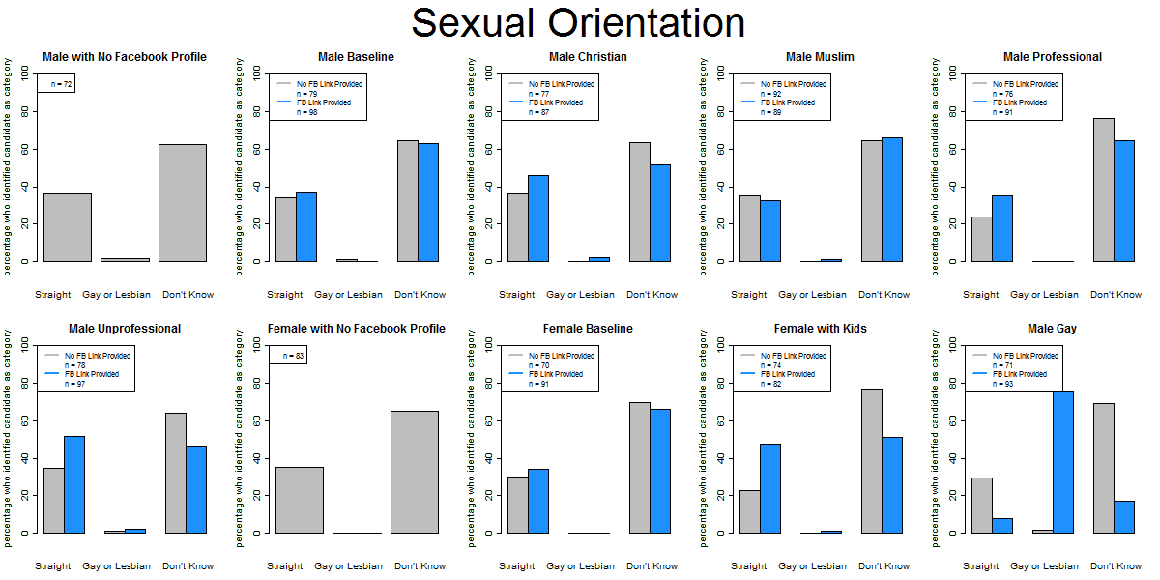
Study 1: Manipulation check (Example)

Slide 41
How can US employers get to candidates’ ‘protected’ information?
Several ways:
Candidate made her Facebook profile openly accessible
Candidate protected her profile, but information that remains publicly visible (e.g., the primary profile photo) signals relevant trait(s)
Employer uses social engineering (e.g., interns or friends of friends connections) to access profile
Employer asks candidate to provide password to profile
Employer uses other Web 2.0 services (blogs, twitter, etc.)

