Slide 1

Urban Data for Statistical Research
Houston Urban Data Platform
Katherine B. Ensor, Director http://kinder.rice.edu/UrbanData/

Slide 2
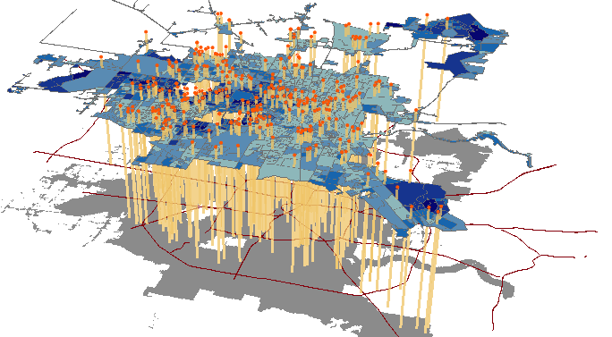
What if…
You had 2000+ data sets for one metropolitan area…
  Data on residents (all aspects), the built environment, the physical environment….
The data sets were all linked in time and space….
The data were curated and research ready…
The data were regularly updated….
What questions can the statistician answer? And where are the limitations?

Slide 3
Houston UDP
Geo-referenced Downloadable Data
Interface – web-portal
Non-secure data can be downloaded
There will be a distinction made between UDP curation and contributor curation
Expectation is that data will be cited when used.

Slide 4

HOUSTON UDP SECURE SYSTEM
HIPAA compliant data library focused on Houston
  Geocoded for easy links
  Cleaned & research ready data
  Servers housed at Rice
Analysis software tools
  Esri ArcGIS, Python, R, SAS, Stata, Tableau
User Access
  Virtual Private Network (VPN)/ Virtual Desktop Infrastructure (VDI)
  Web portal
  A few high performance desktops

Slide 5
The value of Curated Data
Vetted
Cleaned and research ready
Geo-referenced allowing linking across multiple data sets by shared geography
Regular update schedule
PUBLISHED and ARCHIVED
A ONE STOP SHOP….

Slide 6
Digital Object Identifier (DOI)
A DOI is a unique, registered string for persistent identification of digital content and associated metadata.
Kinder will pursue minting DOIs for each published dataset through DataCite in collaboration with Fondren Library.
Prefix [allocated]
Suffix [chosen by institution]
http://dx.doi.org/10.4683/udp.07.034
URL of
DOI Foundation Server
DOI registry
Registrant
(Rice University)
Digital Object
(UDP dataset identifier)

Slide 7
Houston Community Data Connections
A participant in the National Neighborhood Indicators Partnership
  A collaboration of the Urban Institute and partners in 30 cities to further the development and use of neighborhood-level information systems for community building and local decision making.
Approximately 100 neighborhood indicators
  For the most part, summary statistics (means) by super neighborhoods
  Many entities will make inferences from these indicators.

Slide 8
Three outlets for Houston data via the
Urban Data Platform
UDP HIPAA compliant server.
  Controlled access. Vetted and trained users.
  Contains data at the individual level.
UDP Geo-referenced non-secure data server.
  Open access – registration required
  Data published and should be cited when used.
HCDC neighborhood indicators
  Open access
  Data may or may not be published.
  Used for community development.

Slide 9
Key challenges to building these systems
Technology – local servers and/or cloud computing
Regular updating – sustainability
Legal, legal and legal … oh and then there are the legal aspects
Management and oversight -- CRITICAL
Credit for effort
Cross-system linking? Would open up significantly more opportunities.

Slide 10
Understanding our cities is worth the effort.
Important that our statistics research answer the right question, or clearly indicate why we cannot.

Slide 11
Examples: Answering the RIGHT question
Cardiac Arrest: Are lives saved by expanding the EMS response to cardiac arrest calls to include response by fire fighters?
Can we reduce the asthma incidents of students in the Houston Independent school districts? Are these incidents related to ambient air quality?
How has Houston land use changed in the last 20 years?

Slide 12
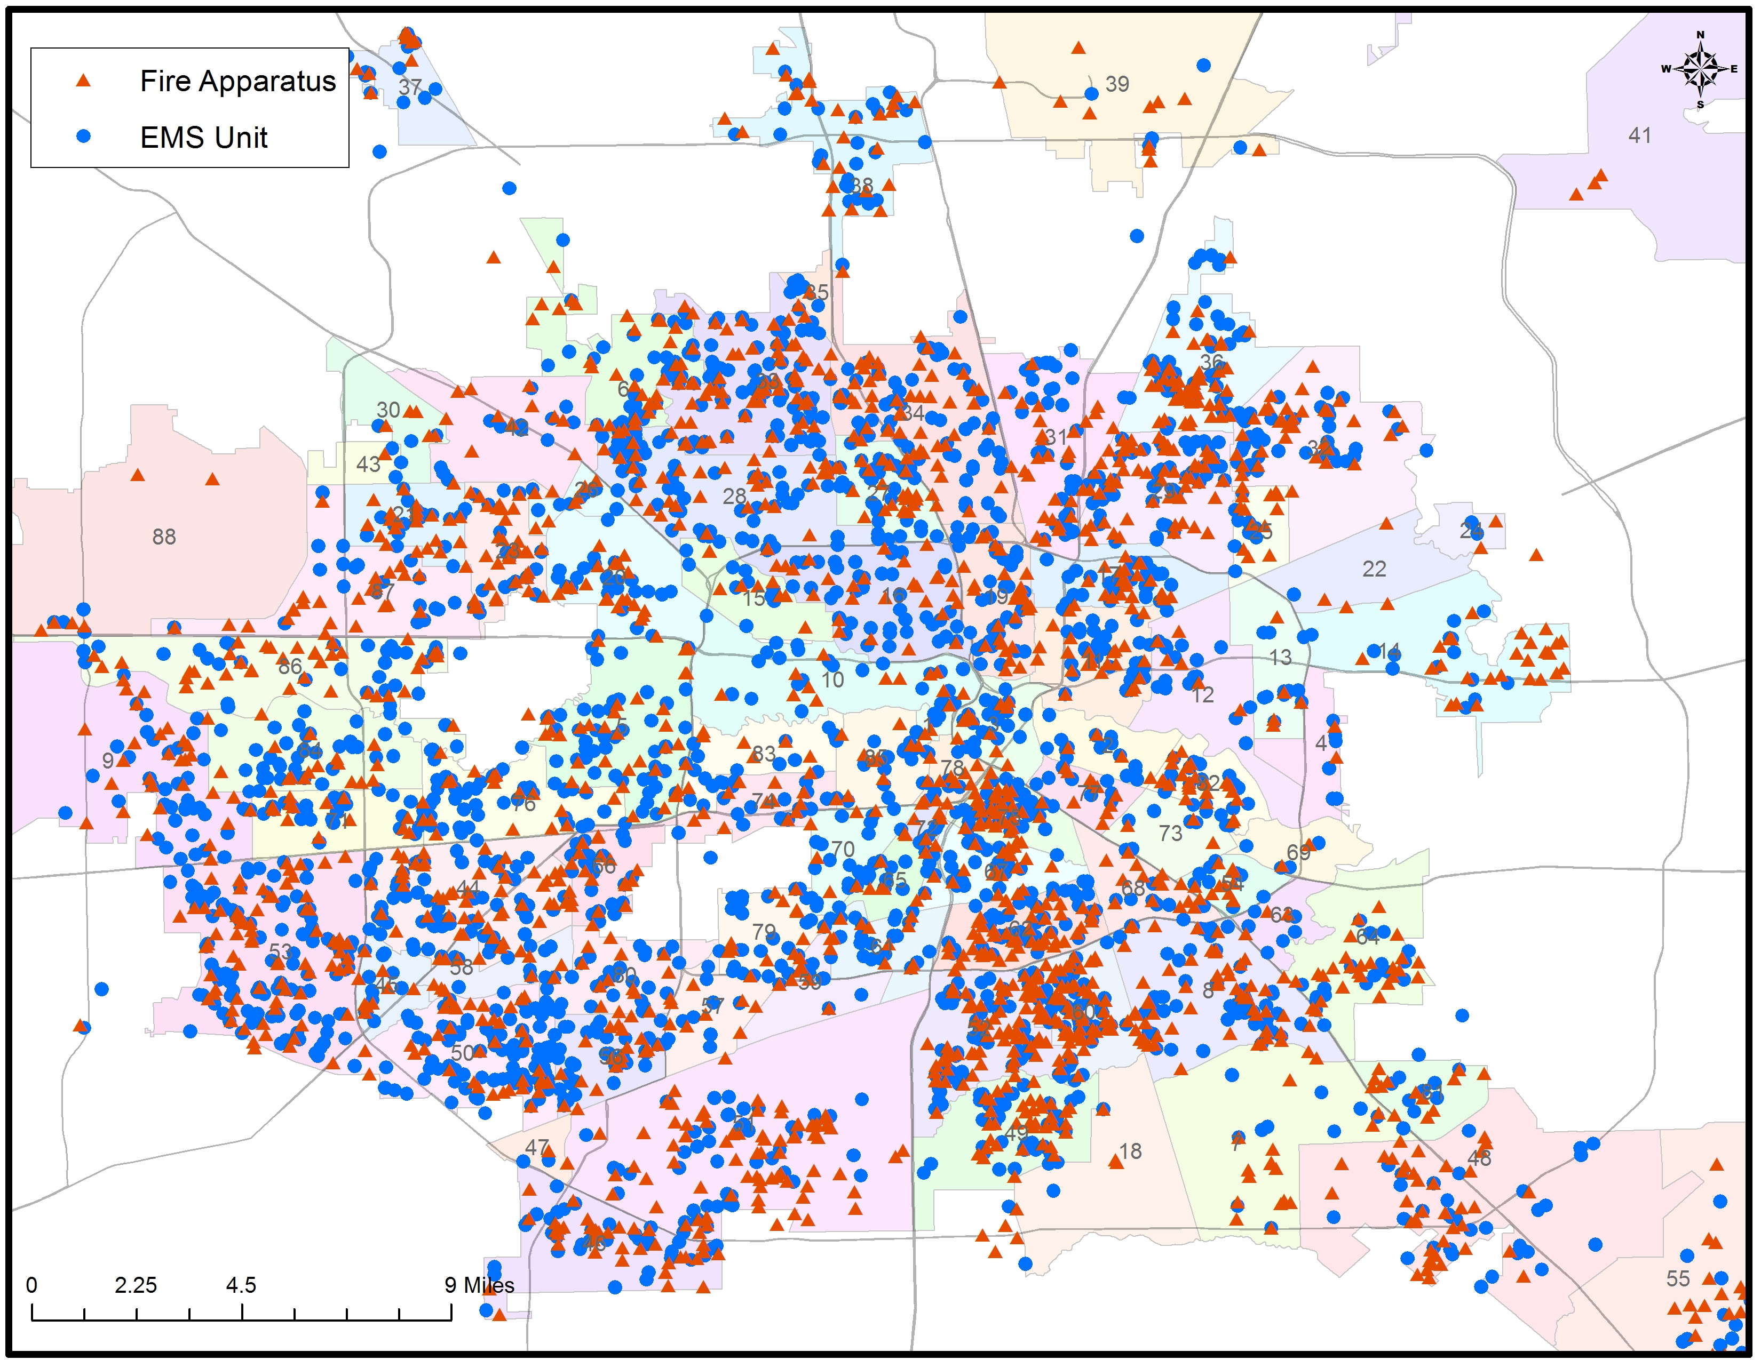
CARDIAC ARREST
EMS + Fire Response
DATA: 911 EMS response to cardiac arrest in Houston
Cardiac arrest first responders
Augmenting the EMS network with response by fire personnel decreases the overall emergency response time.

Slide 13
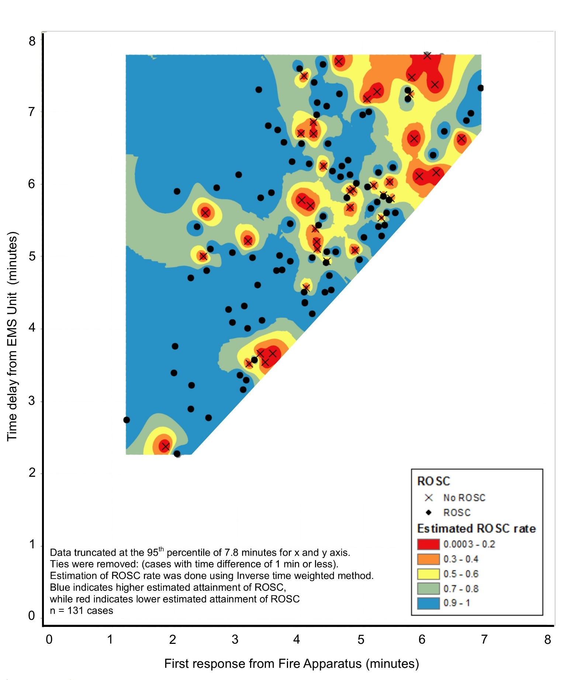
Saving lives
The expedited response time by firemen increases the return of spontaneous circulation of cardiac arrest patients.
Blue is good!
Statistical analysis confirmed the added benefit of fire personnel.

Slide 14
EMS Data + Air Quality
GOAL: Reduce frequency of childhood asthma EMS calls by better managing care
Collaboration with City of Houston and HISD
Identified the air quality mixture that produces a measurable increase in the frequency of EMS calls for asthma.
Developed an air quality alert network and readiness plan for actionable days.

Slide 15
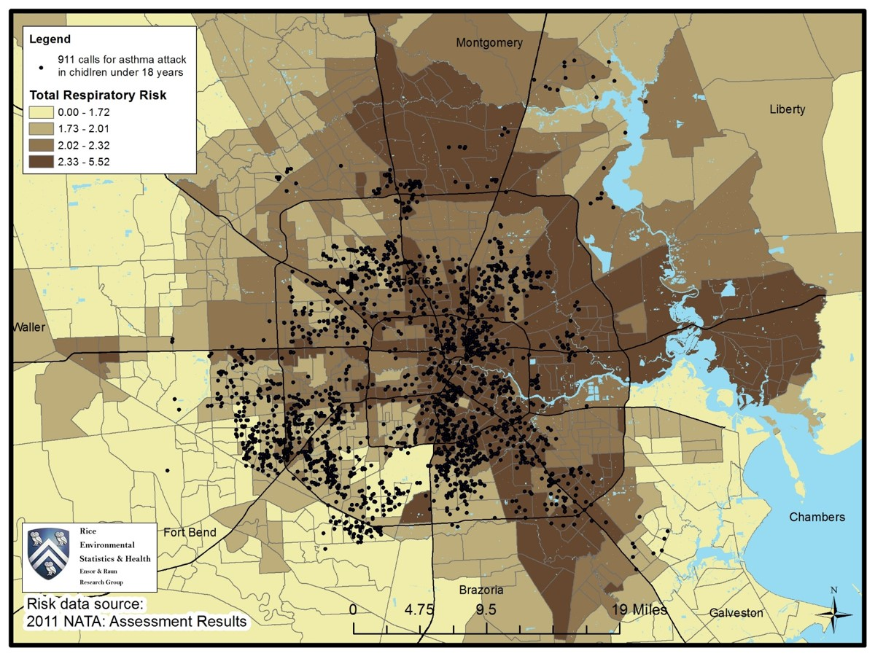
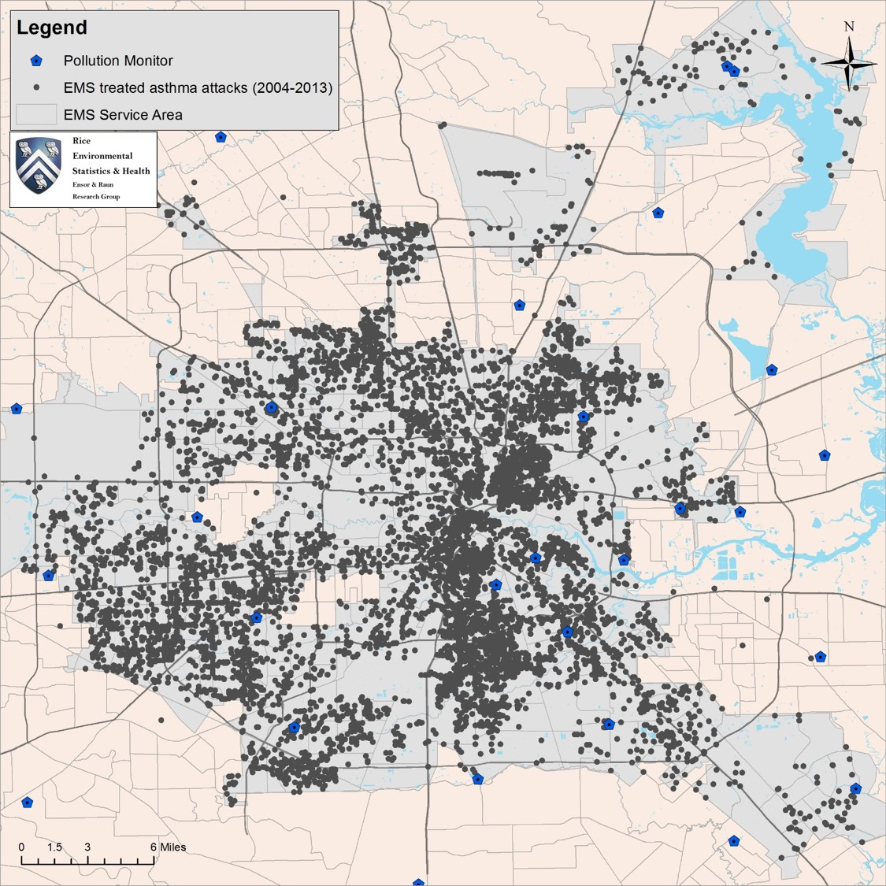
Understanding Air Pollution and Asthma
NO2 and Ozone matter

Slide 16
Toward a Dynamic Multi-Pollutant Model
Pollution mixture changes throughout the day
Temporal Dynamics are IMPORTANT
7am
2pm
3 Years of Hourly Observations
Correlations change locally in time

Slide 17
Identified air quality mixture when asthma incidents are high
Data utilized (10+ years)
  911 call for treatment of asthma attack; individual information available
  Daily aggregate air quality measurements at 40 fixed monitors (created from hourly measurements)
  Meteorological variables
  Missing --- pollen
What population is represented? What are biases?
Multiple statistical strategies implemented
  Developed “daily” pollution measures
  Case-crossover to find an effect --- both NO2 and Ozone are key
  Pollution levels identified through extensive case-crossover relative risk comparisons
  Working now on a refinement of the “levels” using daily counts of asthma incidents.

Slide 18
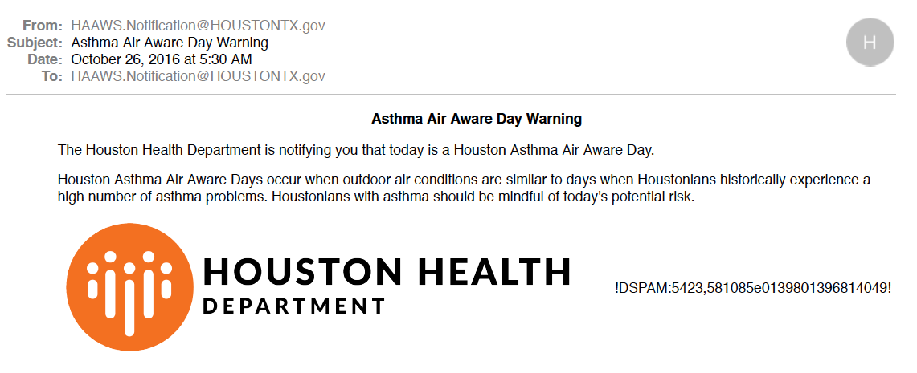
Program with HISD and Houston Health Department: Example email

Slide 19
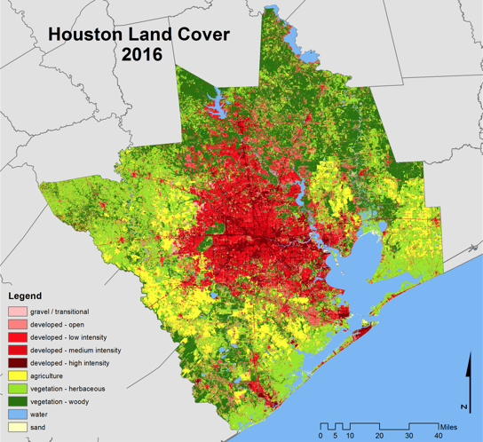
  “How” is Houston growing? A dynamic city and community
  where are farms and forests being converted to urban areas?
  where are urban areas growing denser?
  how fast are these changes occurring?
Hakkenberg et al, 2017

Slide 20

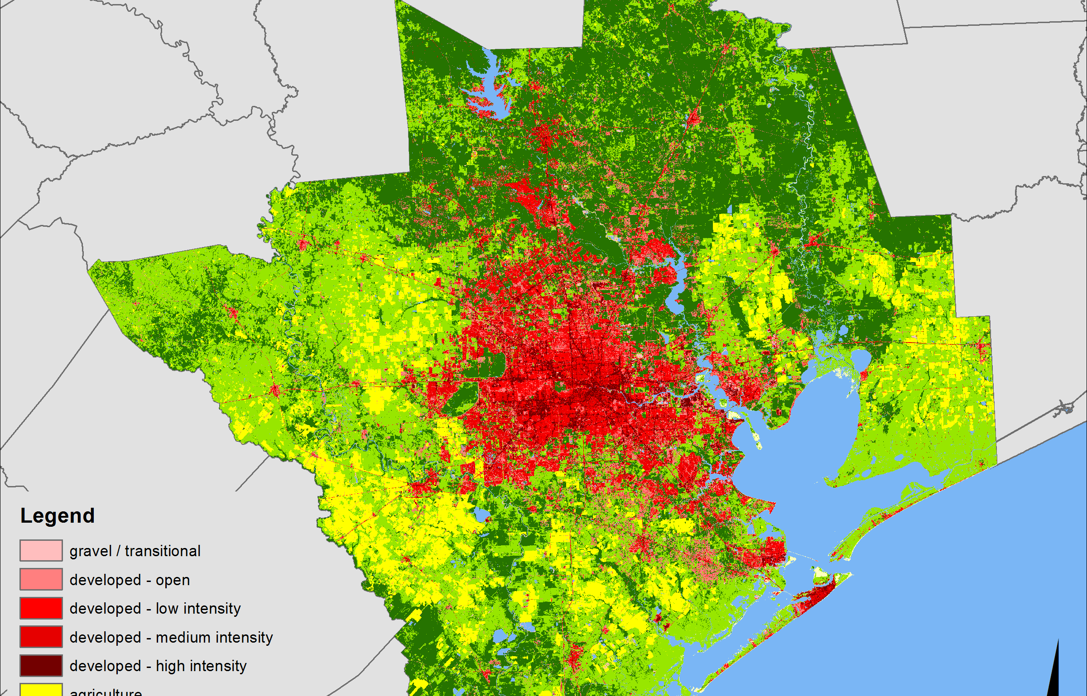
Now (2016) and then (1997)

Slide 21
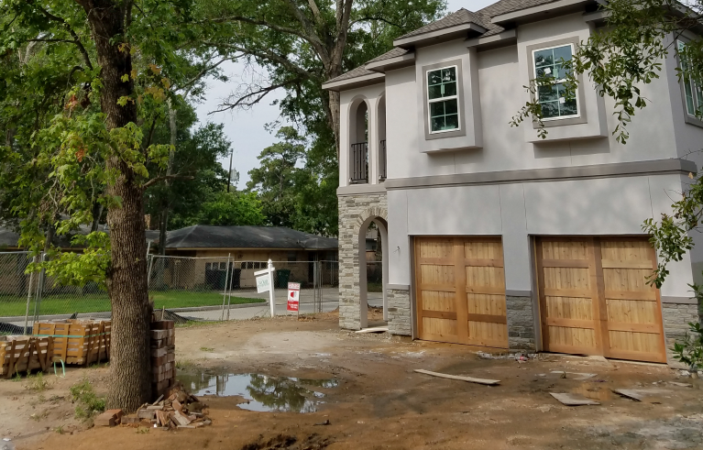
Distilling Harris County Appraisal District Data
Kelsey Walker and Kyle Shelton, Kinder Inst.
Kinder Institute report and interactive map
HoustonInFlux.com
Collaborations:
  National Trust for Historic Preservation: Character Score
  Reinvestment Fund: Market Value Analysis
UDP team spent extensive effort “cleaning” the HCAD data – this it at the core of all geospatial analyses.

Slide 22
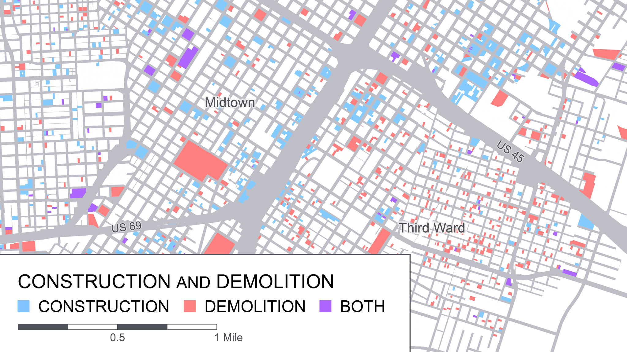

Slide 23
The VALUE of Local
Shout out for a local urban analytics
Value in controlled access to sensitive data
Requires local advanced analytic abilities
Or improved, easy access, software that incorporates key statistical issues
  Incorporate more inference structure into GIS software
  Develop a toolkit identifying when analyses have gone astray
  Move the general users beyond descriptive statistics and mapping

Slide 24
Key Statistical Challenges
Observational data with inherent bias
  Security of individual level data
  Data quality
Space / time
  Different scales
  Complex dependence structure is too often ignored.
  TYPE of spatial structure --- distance metric can be important
  DON’T forget time
Data mixtures
Working with aggregated data --- can we do MORE not less here??
Needed: simple fixes for standard methods that are easily accessible; more roadmaps to follow – in a world of “uncontrolled” use.

Slide 25
Urban Analytics: Needed Innovation
Renewed interest in sampling and issues of data representation
Linking across platforms
Is there a way to perform key analyses that cross secure platforms? Or non-secure but protected platforms?
Strategies
  Solving the “security” issues
  Statistical solution … what information is essential to answer questions as if you were linking at the individual level?
    A CALL TO THE STATISTICAL COMMUNITY
  Increase the use of synthetic data

Slide 26
Urban Analytics…
What if …. you had 2000+ data sets for one metropolitan area…
What questions can the statistician answer? And where are the limitations?
Thank you to Houston Endowment, Inc. for support of this effort.
http://kinder.rice.edu/UrbanData/
http://ensorgroup.blogs.rice.edu
Thank you
ensor@rice.edu

