Slide 1
No Free Lunch: Working Within the Tradeoff Between Quality and Privacy
Matthew Graham
Product Coordination & Quality Assurance Branch
LEHD Program, Center for Economic Studies
U.S. Census Bureau
June 6, 2017

Slide 2
Desiderata
Disclaimer: Any opinions and conclusions expressed herein are those of the authors and do not necessarily represent the views of the U.S. Census Bureau. All results have been reviewed to ensure that no confidential information is disclosed.
Additionally, these opinions and conclusions are not representative of other data products or programs within the Census Bureau.

Slide 3
Background
LEHD Program: Administrative + census/survey data on firms/jobs/workers
Research on the labor market, firms, and workers
From research, data products are developed:
Quarterly Workforce Indicators (QWI)
LEHD Origin-Destination Employment Statistics (LODES)
Job-to-Job Flows (J2J)

Slide 4
LEHD Data Infrastructure
QCEW = Quarterly Census of Employment and Wages
UI = Unemployment Insurance
OPM = Office of Personnel Management
UI* Wage Records
OPM*
Economic Survey Data
Business Register
Federal Records
Linked National Jobs Data
Firm Data
Jobs Data
Person Data
Demographic Census/Survey Data
QCEW*
Job data cover over 96% of private employment and most state, local, and federal jobs
Data availability: 1990-2016, start year varies by state, rolling end date
Ongoing Research
Confidentiality Protection
Public-Use Data Products…
Notes:
How the data are used:
Public-use data products
Internal research projects
Research projects conducted through Federal Statistical Research Data Centers (FSRDC)
Both public-use tables and research work product must be approved for release
Quality:
Issues that affect data quality/utility:
Non-reporting (firms/establishments/jobs/workers)
Item missingness
Edit/imputation methods
Confidentiality protection

Slide 5
Mandates, Generally Speaking
Publish statistics about people and economy
Protect confidentiality of data collected by the Census Bureau (Title 13 of US Code)
Individuals
Operations of Businesses
Protect confidentiality of Federal Tax Information (Title 26 of US Code)
State partner sensitivity
Notes:
Note: Not going to distinguish between “privacy” and “confidentiality” in this talk. They are used variously in different settings and I will not differentiate here.

Slide 6
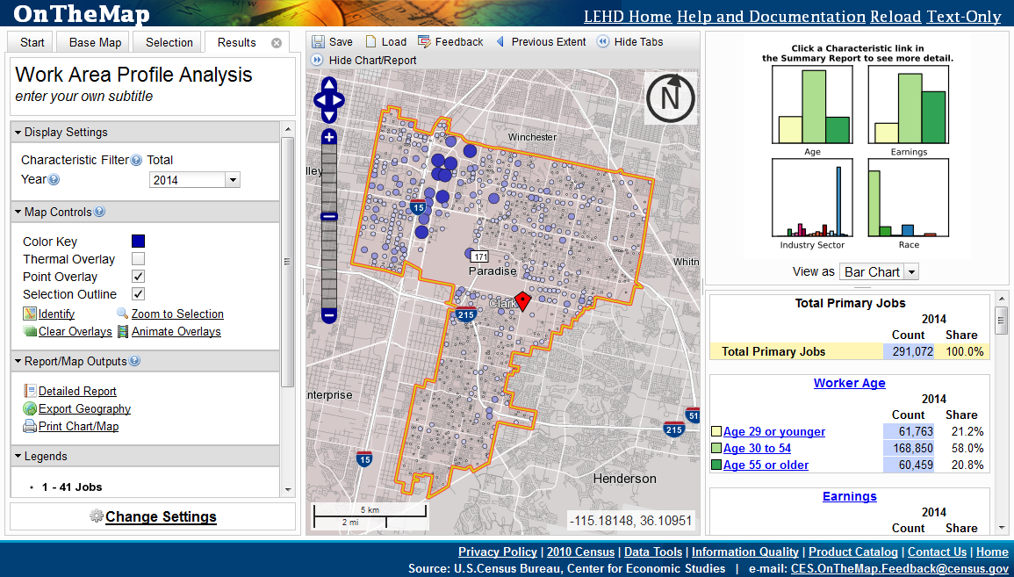
Example: LODES/OnTheMap
LODES: Origin-Destination data on jobs
130m jobs, annual release
Geography
Home & Work Census Blocks (11m)
Firm Characteristics
Ownership (3), NAICS Sector (20), Firm Age (5), Firm Size (5)
Person/Job Characteristics
Age (3), Earnings (3), Race (6), Ethnicity (2), Sex (2), Education (4)
Large & Sparse (1.3×10⁸ / 1.6×10²⁰)
Distributed through map-based, analytical tool: OnTheMap
http://onthemap.ces.census.gov/

Slide 7
Protection Systems
Exact Employment: Permanent multiplicative noise distortion factor for employers and establishments. Synthetic methods for small cells. (Abowd, et al. 2006)
Residential Location: Synthetic data methods using probabilistic differential privacy. (Machanavajjhala et al. 2008)
Current Research: Develop provable protection for employers/establishments and attribute composition (Haney et al. 2017)

Slide 8
Tradeoffs (Primary)
Privacy vs. Data accuracy
Simply put, provable privacy sets a “budget” and we must decide how much privacy loss we are willing/able to trade for data accuracy (a dimension of quality).
Social choice!
But privacy loss and data quality are (usually) complex constructs…

Slide 9
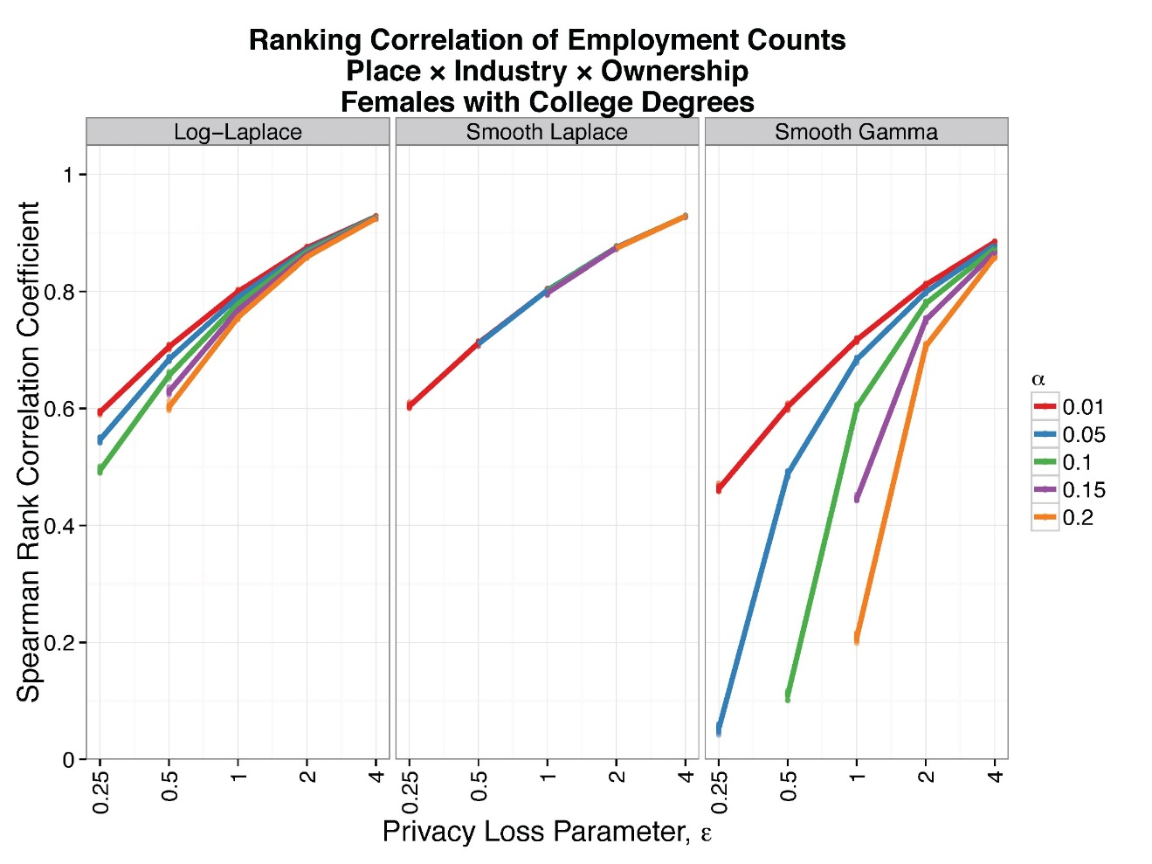
Tradeoffs (Primary)
Less Accuracy
More Quality
Less Privacy
Less Privacy

Slide 10
Tradeoffs (Secondary)
How is privacy defined in a complex dataset?
Sometimes laws and policy speak directly
Sometimes new policy must be made
E.g. Are we free to trade off employment precision with attribute composition?
How is quality defined in a complex dataset?
Our quality budget can be directed at different parts of the dataset
Which users/uses are favored with good quality?
Public policy choice!

Slide 11
Takeaways
Start with existing law/policy
What are the mandates for privacy and data release?
What is the technology? Is it provable?
Provable privacy demands clarity, which is a virtue.
How are the tradeoffs (quality vs. privacy and the components of quality and privacy) to be decided?

Slide 12
Contact/References
LEHD Program: lehd.ces.census.gov
Email: matthew.graham@census.gov
Selected References:
LEHD Origin-Destination Employment Statistics (LODES) Technical Document. http://lehd.ces.census.gov/data/lodes/LODES7/LODESTechDoc7.2.pdf
J. M. Abowd, B. E. Stephens, and L. Vilhuber. Confidentiality protection in the Census Bureau’s Quarterly Workforce Indicators. Technical Report TP-2006-02, U.S. Census Bureau, LEHD Program, December 2006.
A. Machanavajjhala, D. Kifer, J. M. Abowd, J. Gehrke, and L. Vilhuber. Privacy: Theory meets practice on the map. In ICDE, pages 277–286, 2008.
S. Haney, A. Machanavajjhala, J. M. Abowd, M. Graham, M. Kutzbach, L. Vilhuber. 2017. Utility Cost of Formal Privacy for Releasing National Employer-Employee Statistics. In Proceedings of the 2017 ACM International Conference on Management of Data (SIGMOD ‘17). ACM, New York, NY, USA, 1339-1354. DOI: https://doi.org/10.1145/3035918.3035940

