Slide 1
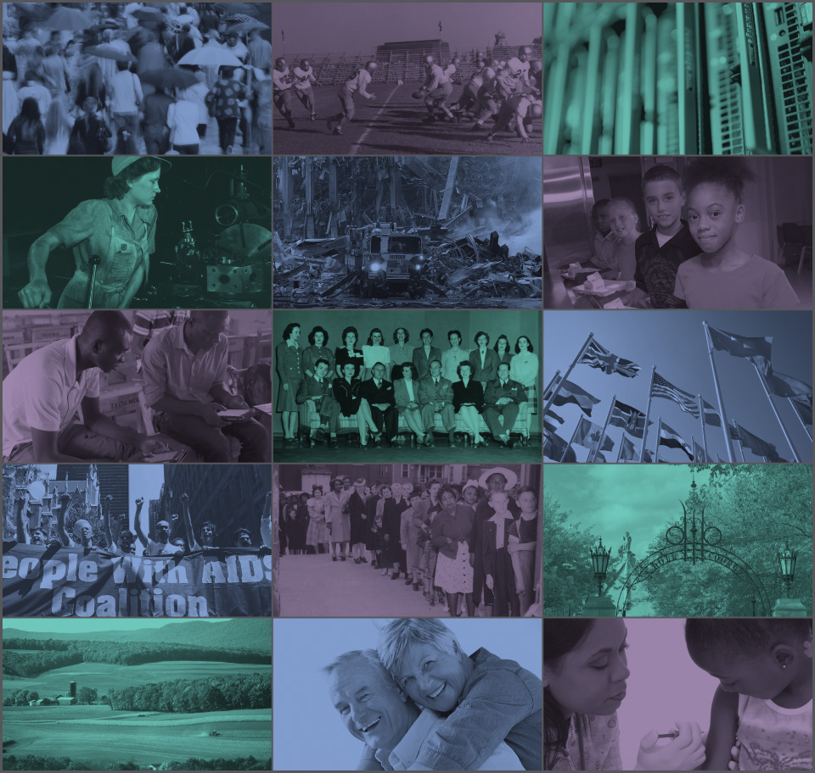
Best Practices for Protecting Privacy in a Data Enclave
National Academy of Sciences
Privacy of Employee Data Workshop
June 6, 2017
Timothy Mulcahy
Vice President, Program Director, NORC Data Enclave

Slide 3
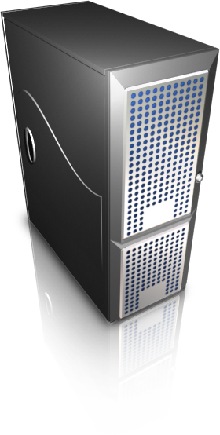
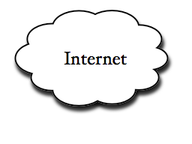





What is a Data Enclave?
A Data Enclave is a high-performance computational and analytical environment that provides authorized users secure remote access to confidential microdata and tools.
* Researchers authenticate into the secure data center via an encrypted web and analyze sensitive data in a secure, remote environment that is both convenient and cost-effective.

Slide 4
An Ideal Data Enclave System
Secure, flexible, low cost
Meet replication standard: the only way to understand and evaluate an empirical analysis fully is to know the exact process by which the data were generated
Metadata crucial to meet the standard
Composed of documentation and structured metadata
Create foundation for metadata documentation and extend data lifecycle

Slide 5
NORC Data Enclave®
Developed and implemented in 2006 in partnership with the National Institute of Standards and Technology
Clients span across state and federal governments, as well foundations, research institutes, and universities
Currently support more than 800 researchers
Results are used to inform a wide spectrum of policy and programming decisions across the public and private sector, as well as journal articles, books, book chapters, position papers, professional conferences, dissertations, etc.

Slide 6
Holistic Security Protocol
Safe Projects
Must have institutional approval and backing
Safe People
Trusted Researchers
Safe Setting
Data and processing housed in secure network
Users access environment over secure connection
Safe Outputs
Strict disclosure review of all exports
= Safe Use

Slide 7
Portfolio Approach to Secure Data Access
Educational / training protection
Statistical protection
Legal protection
Operational / technological protection

Slide 8
Educational / Researcher Training
Remote / web-base, online modules
Researcher locations (academic institutions, conferences AAEA, JSM, AOM, ASA, ASSA, NBER summer institute)
Navigating through the enclave environment (drives, data views, statistical tools); data-specific training (metadata documentation, weighting), statistical disclosure control (import/exports)
Note: The training is designed to go above and beyond current practice in terms of both frequency and coverage

Slide 9
Statistical Protection
Remove obvious identifiers and replace with unique identifiers
Statistical techniques chosen by agency (recognizing data quality issues)*
Noise added?
Full disclosure review of all data exported coordinated between NORC and Data Producer
* Note: At discretion of producer and can go above and beyond the minimum level of protection

Slide 10
Ensuring Safe Derivative Outputs
We work closely with our sponsors to define their statistical disclosure needs
We develop a customized data protection plan that specifies all disclosure rules for statistical output review and safe release, processes, protocols and personnel for receiving, responding, and reviewing disclosure review requests
Once output has been cleared for release it is delivered to researchers via a secure mobile file share mechanism.

Slide 11







Statistical Disclosure Review
Secure Lab
Data
Work Area
Researcher Logs in
Disclosure Review
Online transfer site
Exports/Output
Imports/Input

Slide 12
Legal Protection
On an annual basis:
Approved researchers sign Data User Agreements (legally binding the individual and institution)
Researchers and NORC staff sign Non-disclosure Agreements specific to each dataset
Researchers and NORC staff complete confidentiality training
Penalties: CIPSEA violators subject to up to 5 years in prison and $250,000 fine

Slide 13
Data Protection / Operational
Encrypted connection using virtual private network (VPN) technology prevents outsiders from reading the data transmitted between the researcher’s computer and NORC’s network.
Users access the data enclave from a static or pre-defined narrow range of IP addresses.
Citrix’s Web-based technology.
All applications and data run on the server at the data enclave.
Data enclave prevents users from transferring any data from data enclave to a local computer.
Data files cannot be downloaded from the remote server to the user’s local PC.
User cannot use the “cut and paste” feature in Windows to move data from the Citrix session.
User is prevented from printing the data on a local computer.
Audit logs and audit trails

Slide 14
Restrictions in the Data Enclave
Access only to authorized applications
Most system menus have been disabled
Some control key combinations or right click functions are also disabled on keyboard
Closed environment: no open ports, no access to Internet or email
No output (tables, files) may be exported and no datasets imported without first being reviewed for disclosure issues
File explorer is on default settings

Slide 15
IT, Systems, and Data Security
The NORC’s Data Enclave IT Security Plan is fully compliant with the Federal Information Security Management Act (FISMA), provisions of mandatory Federal Information Processing Standards (FIPS), and meets all of NIST’s IT, data, system, and physical security requirements.
Auditors conduct a design-level review of controls that support the security of the Data Enclave using NIST Special Publications 800-53 (Moderate-Impact assets) and HIPAA as the security standards, and an analysis of risks to electronic protected health information (ePHI) in the Data Enclave on an annual basis and after any significant changes to security infrastructure.
The Data Enclave maintains a disaster recover site with redundant systems to guarantee a high level of availability. Privately managed datacenter allows for greater operational controls and data security.

Slide 16
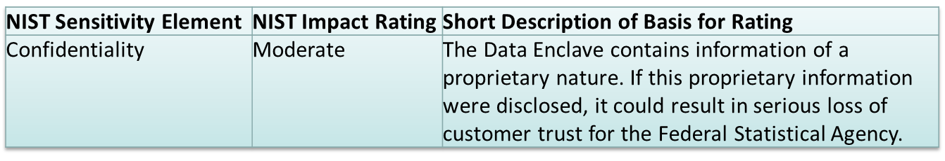
IT, Systems, and Data Security (cont.)
Multi-factor authentication provides access to a Citrix-based, encrypted terminal session, virtual private network
Controlled laboratory environment for data analytics
Limit who can access the data / limit data views
All data and analyses conducted in secure HIPAA and FISMA compliant data center

Slide 17
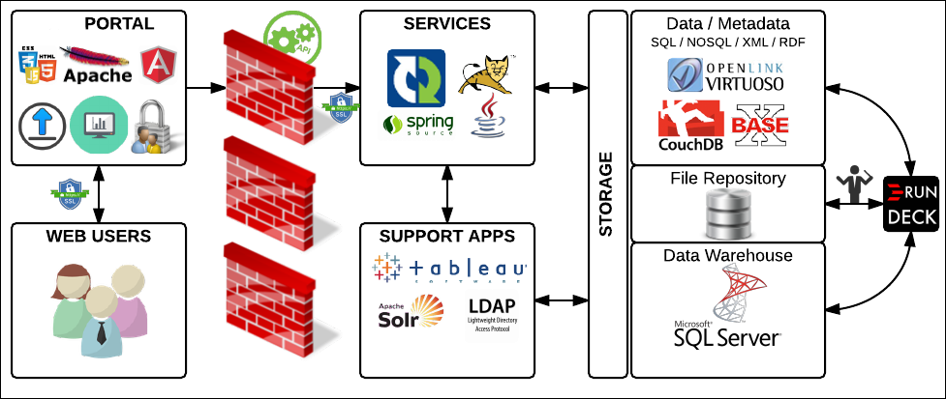
Platform Infrastructure, Architecture, Technologies

Slide 18
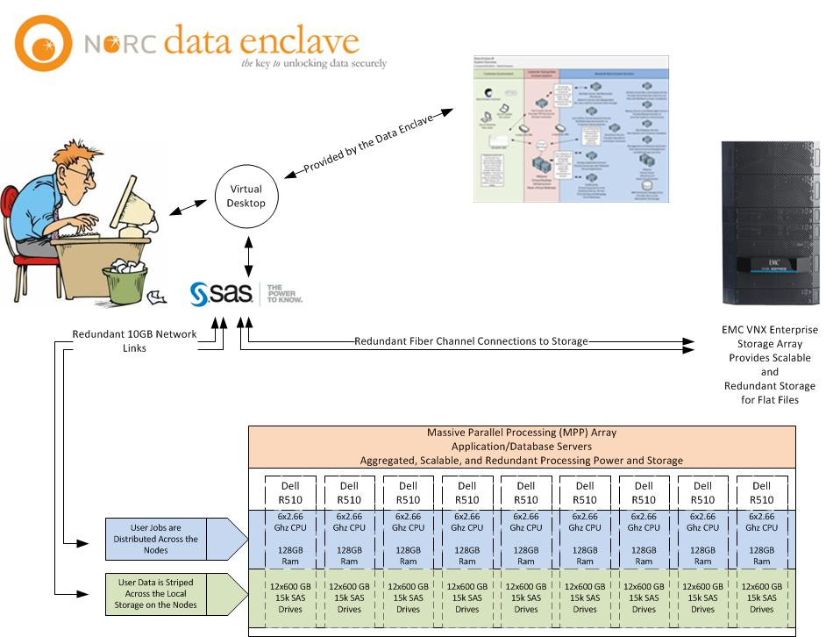
Massive Parallel Processing Solutions
Infrastructure:
HP Vertica
HP commodity servers
EMC VNX/Dell
Compellent SANs
VMware
Citrix XenApp / XenDesktop
Analytic / Intelligence Suite (Tableau, SAS, R, SPSS, SQL)
** HortonWorks Hadoop v1
Distribution
** Red Hat Linux EOS v6.4
supported by StackIQ

Slide 19
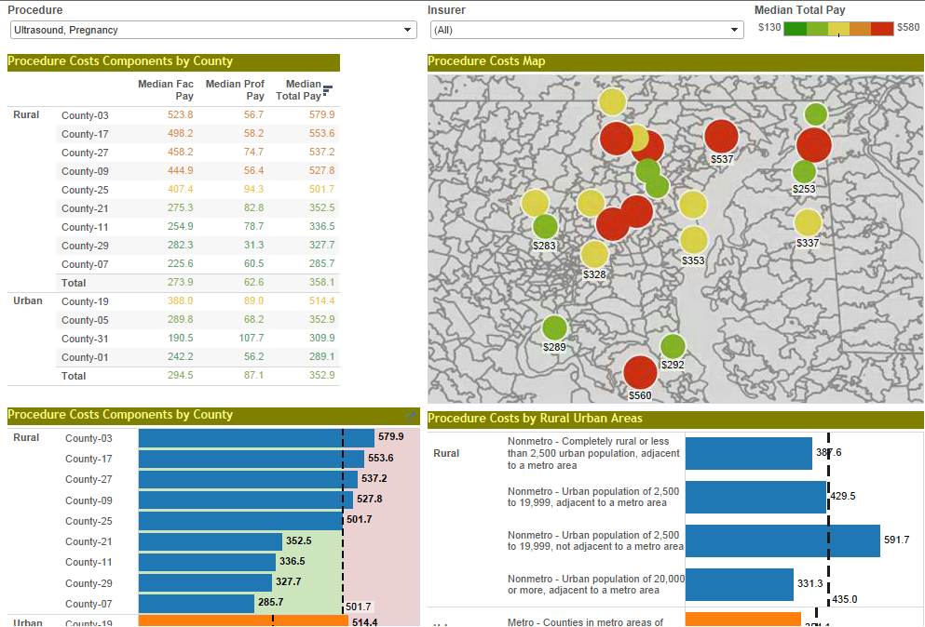
Example Dashboards

Slide 20
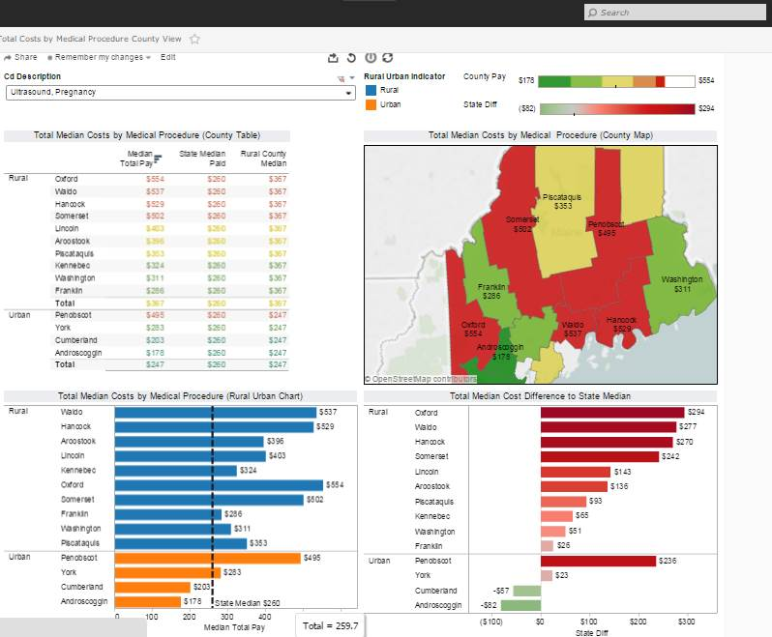
Example Dashboards

Slide 21
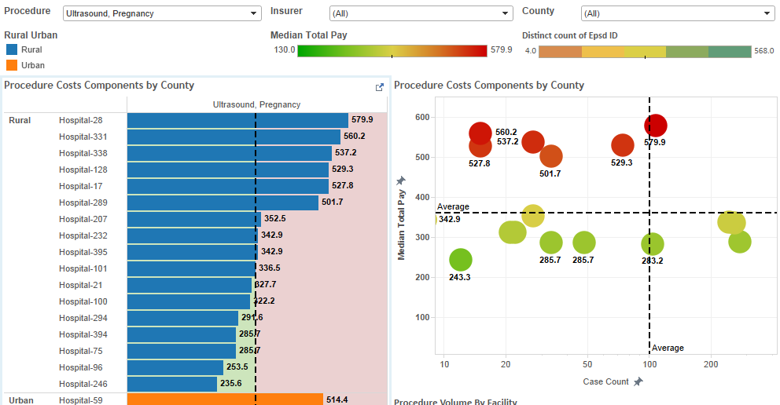
Example Dashboards

Slide 22
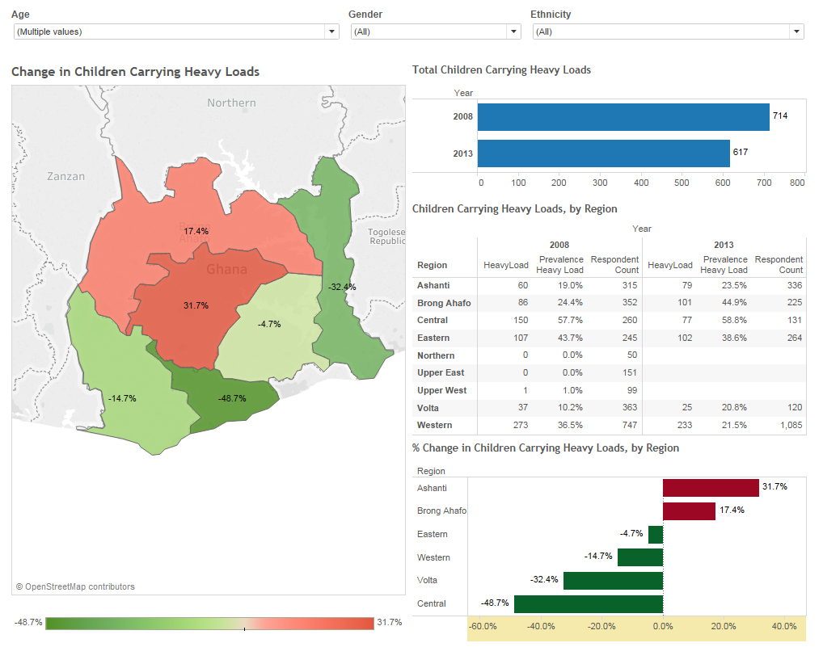
Example Dashboards

Slide 23
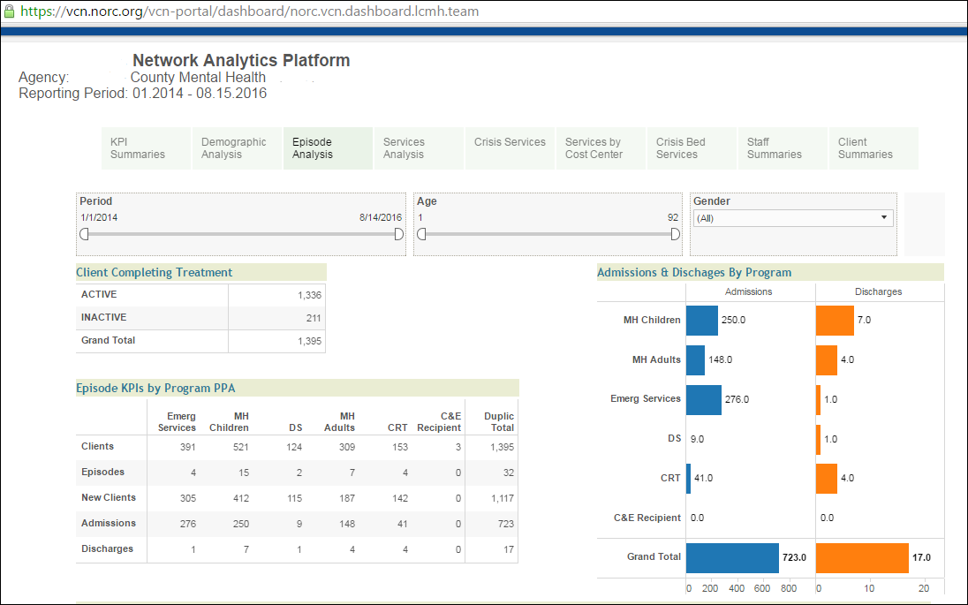
Example Reports

Slide 24
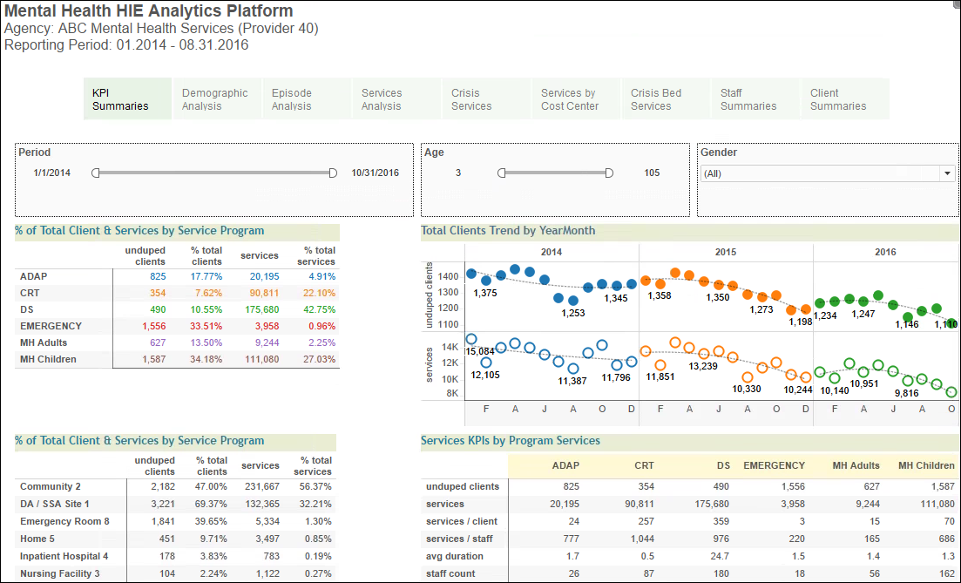
Examples Reports

Slide 25
Enclave Clients
Annie E. Casey Foundation
Administration for Community Living, Administration on Aging
Bureau of Justice Statistics
Centers for Medicare and Medicaid
Services
Consumer Financial Protection Bureau
Duke University
Economic Research Service
Federal Communication Commission
Financial Crisis Inquiry Commission
Health Care Cost Institute
Human Services Research Institute
IMPAQ International, LLC.
Kauffman Foundation
Kresge Foundation
MacArthur Foundation
Maine Health Data Organization
Mellon Foundation
Metadata Technology North America
National Agricultural Statistics Service
National Bureau of Economic Research
National Institute of Standards and Technology
National Science Foundation
Northeastern University
Ohio State University
Oregon State University
Private Capital Research Institute
The College Board
University of Chicago
Vermont Care Network

Slide 26
Questions?

