Slide 1
Statistical Methodology to Protect Privacy
Jerry Reiter
Department of Statistical Science
Duke University

Slide 2
Acknowledgments
Research ideas in this talk supported by
National Science Foundation
ACI 14-43014, SES-11-31897, CNS-10-12141
National Institutes of Health: R21-AG032458
Alfred P. Sloan Foundation: G-2-15-20166003
US Bureau of the Census
Any views expressed are those of the author and not necessarily of NSF, NIH, the Sloan Foundation, or the Census Bureau

Slide 3
An argument for public use data
Record-level data are enormously beneficial for society
Facilitates research and policy-making
Trains students at skills of data analysis
Enables development of new analysis methods
Helps citizens understand their communities
Even in a world where analysis is brought to the data

Slide 4
Microdata: redaction strategies
Alter data before releasing them
Aggregate -- coarsen geography, top-code, collapse categories
Suppress data
Swap variables across records
Add random noise
High intensity perturbations degrade quality in ways that are difficult to unwind
Low intensity perturbations not protective

Slide 5
An alternative: Synthetic data
Fully synthetic data proposed by Rubin (1993)
Fit statistical models to the data, and simulate new records for public release
Low risk, since matching is not possible
Can preserve associations, keep tails, enable estimation at smaller geographical levels

Slide 6
Synthetic data products
Implementations by the Census Bureau
Synthetic Longitudinal Business Database
Synthetic Survey of Income and Program Participation
American Community Survey group quarters data
OnTheMap
Other implementations by National Cancer Institute, Internal Revenue Service, and national statistics agencies abroad (UK, Germany, Canada, New Zealand)

Slide 7
Longitudinal Business Database (LBD)
Business dynamics, job flows, market volatility, industrial organization…
Economic census covering all private non-farm business establishments with paid employees
Starts with 1976, updated annually
>30 million establishments
Commingled confidential data protected by US law (Title 13 and Title 26)

Slide 8
Synthesis: General approach
Generate predictive distribution of Y|X
f(y1,y2,y3,…|X) = f(y1|X)·f(y2|y1,X)·f(y3|y1,y2,X) ···
Use industry (NAICS) as “by” group
Models include multinomials, classification trees, nonparametric regressions....

Slide 9
Variables used (Phase 2)
Notes:
9

Slide 10
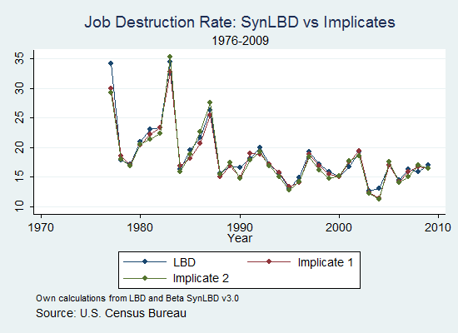

Slide 11
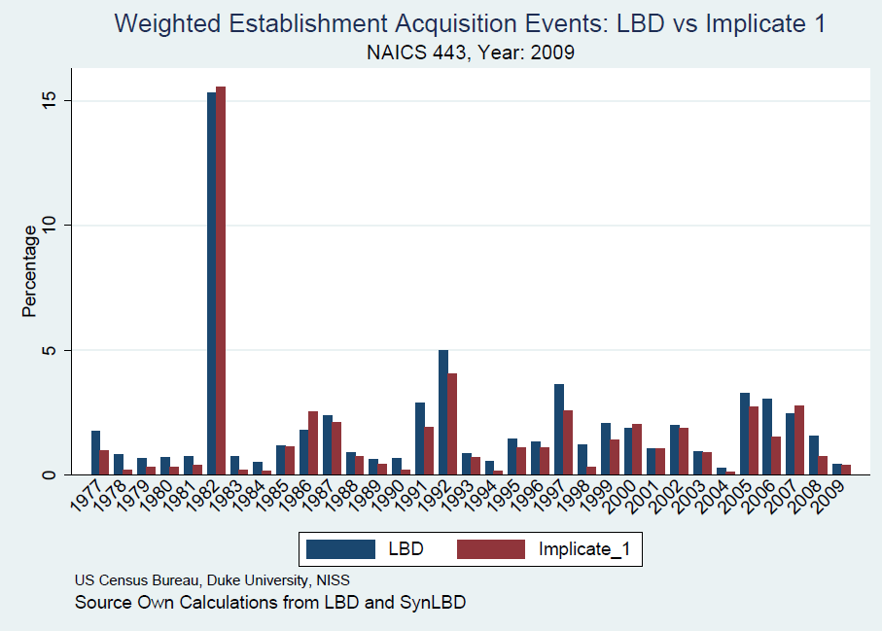

Slide 12
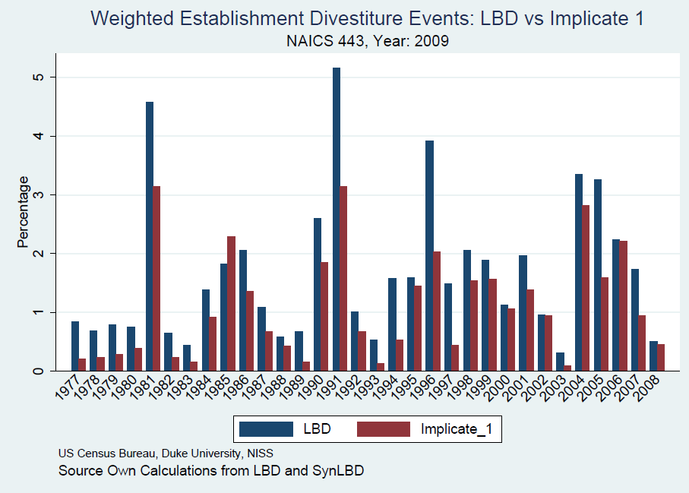

Slide 13
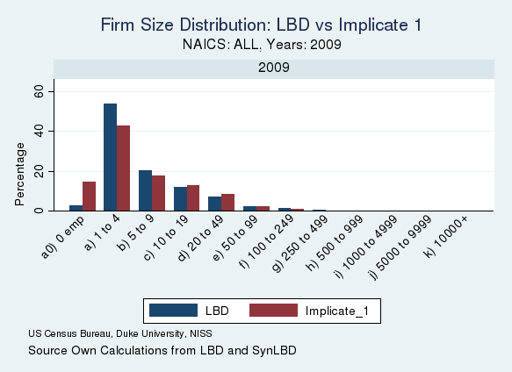

Slide 14
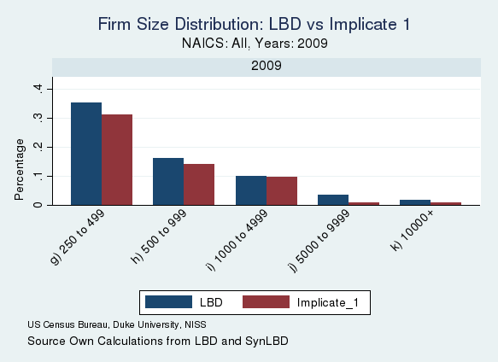

Slide 15
Variants of Synthetic Data
Partial synthesis: replace only sensitive data and leave non-sensitive data at original values
Compared to full synthesis
Easier to get valid inferences
Greater risks of re-identification disclosures
Applications
Survey of Consumer Finances
American Community Survey group quarters data

Slide 16
Limitations of synthetic data
Synthetic data inherit only features baked into synthesis models
Quality of results based on synthetic data dependent on quality of synthesis models
Synthetic data cannot preserve every analysis (otherwise we have the original data!)
Implementation is hard work. General plug-and-play routines?
Model based synthesis – yes, but hard to characterize disclosure risks beyond re-identification
Formally private synthesis – much theoretical development, but not much practical experience for complex datasets

Slide 17
How to assess quality of synthesis?
Verification servers (Reiter et al. 2009)
Separate system with confidential and redacted data
User submits query to system for verification of particular analysis
Server reports back measure of similarity of analysis on confidential and redacted data
User can decide to publish if quality sufficient
But quality measures can leak information
Use differentially private verification to manage leakage

Slide 18
Disclosure Risk in Synthetic Data
Tend to have low risks of identification disclosure, since not meaningful to match synthetic records to actual individuals
Inferential disclosure risks of more concern
Synthesizer may perfectly predict some x for a certain type of individual, so synthetic x for individuals of this type always match actual x
Related, synthesizer may be too accurate in predicting some values

Slide 19
How to Assess Disclosure Risks?
Find records in synthetic data who look like individuals in actual data on variables that are readily available
For these records, examine whether synthetic values for sensitive variables (e.g., lab values) are too close to those for actual individuals

Slide 20
Remote access servers
Provide results of computations without allowing user to view microdata
Coefficients and SEs in regression models
Counts in tables
Clever queries, and their interactions, generate risks
Often queries restricted: minimum universe size, maximum number of interactions
Often results redacted: based on subsample of cases, reported with added noise
Hard to figure level of protection

Slide 21
Popular solution in (CS) literature
Add noise to outputs to satisfy differential privacy
Provable guarantees of confidentiality, even against intruders with very detailed information
In large samples, noisy answer can be close to truth
Difficult to satisfy for some queries
Can get different outputs for same quantity
Formally requires cessation after a certain point (depends on level of privacy, nature of queries)
Requires pre-specified model, without seeing data

Slide 22
My thoughts on model servers
Not clear if ad hoc approaches sufficiently protective
But differential privacy has practical limitations
My favored approach
Protect the underlying microdata
Base results on the protected microdata
View servers as convenient software tools for the public
For tables, consider differential privacy to create one-time releases that could be queried by servers

Slide 23
Restricted data access
Key disclosure issue (other than trusting researchers)
Risks of releasing results based on confidential data
Outputs required to satisfy ad hoc rules, checked by disclosure review boards
Not clear that these rules are sufficiently protective

Slide 24
What can be done?
Add noise to outputs to satisfy differential privacy
This has limitations like those mentioned previously
Conclusion: we don’t really know how to deal with arbitrary outputs from confidential data….
Create repository of attack strategies, apply band-aids, do more research, and hope for the best
Side note: results based on confidential data combined with redacted microdata can lead to disclosure risks

Slide 25
The vision we are working towards
Integrated system for access to confidential data including
unrestricted access to fully synthetic data, coupled with
means for approved researchers to access confidential data via remote access solutions, glued together by
verification servers that allow users to assess quality of inferences from the synthetic data.

Slide 26
Synergies of integrated system
Use synthetic data to develop code, explore data, determine right questions to ask
User saves time and resources when synthetic data good enough for her purpose
If not, user can apply for special access to data
This user has not wasted time
Exploration with synthetic data results in more efficient use of the real data
Explorations done offline free resources (cycles and staff) for final analyses

Slide 27
Where are we now?
Allowable verifications depend on user characteristics
We have developed verification measures that satisfy differential privacy
Plots of residuals versus predicted values for regression
ROC curves in logistic regression
Statistical significance of regression coefficients
Tests that coefficients exceed user-defined thresholds
R software package in development
Open question: how to scale up while respecting privacy budgets

Slide 28
Concluding remarks
Implementing this idea on data from the Office of Personnel Management on the work histories of federal government employees
Synthetic data not yet approved for release
Manuscript on arxiv.org/abs/1705.07872
More information
Duke/NISS NCRN node: sites.duke.edu/tcrn/
The NCRN network: ncrn.info

Slide 29
Comments on differential privacy
Differential privacy provides provable guarantees on privacy and quantifies additional leakage
Most work to date theoretical and methodological. Questions for translating to practice
How to set privacy parameters?
How to decide which analyses get priority?
How can we deal with data preparation, e.g., editing, imputation, etc.?
What to do with sampling weights?
What sort of analytic validity can be obtained for high dimensional analyses?

Slide 30
Synthetic data: Where are we now?
Available data products (released by Census Bureau)
Synthetic Longitudinal Business Database
Synthetic Survey of Income and Program Participation
OnTheMap
Off-the-shelf software to generate synthetic data? Not yet.
General plug-and-play routines?
Model based synthesis – yes, but hard to characterize disclosure risks beyond re-identification
Formally private synthesis – much theoretical development, but not much practical experience for complex datasets

Slide 31
Illustrative application: The OPM Synthetic Data Project
Created fully synthetic version of the OPM CPDF-EHRI status file
Longitudinal work histories of civil servants from 1988 to 2011
Simulate careers, demographics, grades and steps, salaries, ….
Only available to OPM and Duke IRB approved researchers at the moment

Slide 32
Illustrative application: Verification of regression
Regress log salary on demographics, including gender and race
Hypothetical results from the synthetic data (dummy numbers as we are vetting final analyses):
Median salaries for Asian men are about 1.5% lower than median salaries for white men, holding all else constant
Huge sample sizes, so statistically significant
Is the result from the synthetic data believable?

Slide 33
Illustrative application: Verification of regression
User defines a threshold that represents a result of practical significance
Test if true coefficient for Asian male B < -.01
Verification software returns differentially private answer that reflects uncertainty due to noise
Goal: estimate the probability, p = Pr( B < -.01 )
Output: 95% credible interval for p
Examples:
interval for p is (.92, 1.0), conclude synthetic data result valid
interval for p is (.52, .64), don’t trust synthetic data result

