Slide 1
Overview: Strengthening Data Science Methods for DOD P&R
Privacy and Employee Data Workshop
June 6, 2017
Sallie Keller
Professor of Statistics & Director

Slide 2
Committee Members
STEPHEN M. ROBINSON, Chair, NAE, University of Wisconsin-Madison
PASCALE CARAYON, University of Wisconsin-Madison
DAVID CHU, Institute for Defense Analyses
CYNTHIA DWORK, NAS/NAE, Microsoft Research
TERRY P. HARRISON, Pennsylvania State University
ALAN F. KARR, RTI International
SALLIE KELLER, Virginia Polytechnic and State University
ALAIR MACLEAN, Washington State University, Vancouver
DAVID MAIER, Portland State University
STEPHEN M. POLLOCK, NAE, University of Michigan (until June 2015)
PAUL R. SACKETT, University of Minnesota
MARK S. SQUILLANTE, IBM Research
WILLIAM J. STRICKLAND, HumRRO
STEVEN TADELIS, University of California, Berkeley

Slide 3
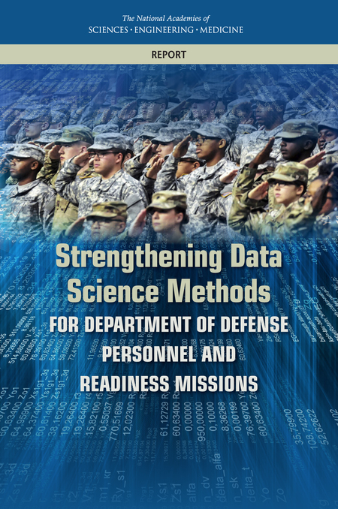
Study Statement of Task
Charge: Develop a roadmap and implementation plan for integrating data analytics in support of decisions within the purview of the Office of the Under Secretary of Defense (Personnel & Readiness).
Interpretation: The committee interpreted the charge as calling for high-level conceptual advice, acknowledging P&R must have the latitude to craft specific plans for strengthening its capabilities in, and use of, data science.

Slide 4

Principle outcomes for which P&R is responsible
Ensuring DoD can recruit, train, motivate, and retain the necessary numbers of qualified personnel
Creating incentives that guide the department to an optimal mix of personnel
Ensuring DoD creates a force that is ready to carry out directed actions
Influencing DoD’s decisions that affect the shape of military careers
Ensuring the services provided to support DoD personnel and their dependents are properly structured.
Anticipating and responding to sensitive behavioral issues

Slide 5
P&R Policy and Oversight Areas
Staffing decisions for both service members and civil service employees
Recruiting standards for both service members and civil service employees
Selection criteria for military recruits
Selection criteria for civil service positions
Job assignment
Compensation standards for service members
Training and education programs for personnel
Promotion criteria for service members and civil service employees
Security clearance determinants
Access to DoD buildings and locations
Process for and time of transitions out of the armed forces;
Provisions for mental and physical health care to service members, civil service employees, retirees, and dependents;
Suicide prevention among service members
Provisions for the needs of families
Responses to problematic behavior
Provisions for health and retirement benfits to separated service members
Responses to congressional requests for information

Slide 6
The Data

Slide 7

Need to open the data aperture to enable more research
"Data need to be easily accessible and shared across groups in a way that reduces the hurdles currently faced when researchers and analysts seek to find or share data while ensuring proper privacy and security protections."
"Analytic methods available to P&R need to be expanded to enable stronger and more rapid responses to significant P&R research and analysis questions."
Person-Event Data Environment

Slide 8
Relevant findings for today's discussions
Finding: Analyses developed to support the Secretary of Defense are often disjoint, one-off activities developed to be responsive to immediate questions and may lack a continuity plan for future use of data or analytic methods.
Finding: The reuse of operational data for analytic purposes can expose issues in data collection, recording, transmission, cleaning, coding, and loading. Problems are often not detected until the point of analysis when anomalies crop up in results.
Finding: Enhanced data sharing within DoD, across agencies, and with the research community could promote the creation of new statistical methods, tools, and products.

Slide 9
Recommendations around privacy and data governance
Recommendation: DoD should consider adopting or adapting the privacy and governance structure developed by the Office of Management and Budget for civilian statistical agencies. In particular, DoD should follow the guidance on use of administrative records and establishing of statistical units under the Confidential Information Protection and Statistical Efficiency Act (CIPSEA) for both military and civil service personnel. In doing so, DoD should examine the applicability of Fair Information Practice Principles in the treatment of DMDC data.
Recommendation: In its role as steward of the Person-Event Data Environment, the Defense Manpower Data Center should consider ways to adapt and use privacy and governance practices that the Office of Management and Budget has created for civilian use.
Recommendation: DoD should carry out research on the feasibility of differential privacy methods for its personnel analytics.

Slide 10
Adopt a paradigm based on trust, policy, and governance?
Data governance versus data access
Policy analytics versus use for administration
Control use versus controlling data access
Trusted data commons versus data enclaves

