Slide 1

U.S. Demil, LLC
Patented “Decineration™” Thermal Process

Slide 2
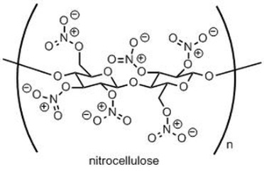
Science of Decineration™ Technology
Emission Abatement System
C≠N
N≠O
CO2
N2 H2O
Add Heat
N≠N
Breaks Bonds
In Chemistry this is called “Decomposition”
The industrial embodiment of the Decineration™ process is the use of an externally heated, rotating horizontal tube which essentially duplicates the laboratory model known as "a horizontal flat plate in atmosphere".

Slide 3
Decineration™ is a non–incinerative, thermal process as determined by the US EPA Headquarters Solid Waste Division and the Indiana Department of Environmental Management.
Complex, long chain, solid energetics (nitrocellulose, nitramines and nitrate esters) are decomposed into short chain, light hydrocarbon gases by fracturing the carbon-carbon, carbon-nitrogen, nitrogen-oxygen and nitrogen-nitrogen bonds.
The process occurs at ambient pressure and moderate temperature of approximately (400° - 700° F) in an externally heated rotary tube without contact between heating source and munitions components.
Notes:
3

Slide 4
The science of the decomposition of energetic compounds has been studied by the Military Services and Research Universities for decades; e.g., G.T. Long, Department of Chemistry, University of Utah (Thermal Analysis of High Explosives: Liquid State Decomposition of RDX) and LT K.K. Miles, Naval Postgraduate School (The Thermal Decomposition of RDX).
The process is fully mature and has been known to industry (i.e. petrochemical) for more than a century.

Slide 5
Rotary Furnace built for PD-DEMIL sponsored economic study
DOTC Contract W15QKN-09-9-1001, Purchase Order No. PO10119299

Slide 6
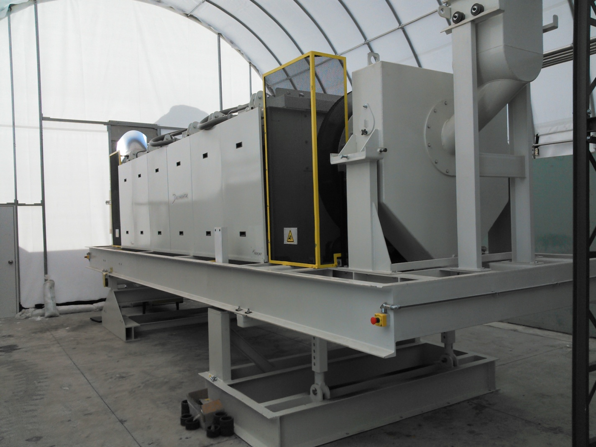
Notes:
6

Slide 7
Advantages
Decineration™:
Has precise temperature and time (dwell) control
Does not form lead oxide in the off gas
Does not burn heavy metals such as cadmium or chrome
Does not melt non-ferrous metals such as aluminum
Processes the broadest spectrum of munitions of any current technology; the very definition of OMNIVEROUS!!!
Proven to Meet the MACT Standards of US EPA for NEW SOURCES

Slide 8
Decineration™ gases are removed for treatment in an Emissions Abatement System (EAS), leaving behind fully demilitarized munitions in a “Material Determined As Safe” (MDAS) condition.
The resulting metal has been determined by QASAS certified personnel, through chemical testing, to be 100% demilitarized.
Unlike other technologies which can destroy the metal alloy, Decineration™ leaves metal components ready for immediate recycling and/or possible reuse.
Low Decineration™ temperatures avoid the formation toxic compounds such as dioxin.
Notes:
8

Slide 9
Incineration is a Legal Term defined within
US EPA Regulations
The Layman’s Test: is there a direct path from the heat source to the material being treated?
IF Yes – It is incineration
IF No – It is NOT incineration

Slide 10


Rotary Kiln vs Oven Technology
APE 1236
1800° +F
DIRECT PATH - INCINERATION
USD ELECTRIC FURNACE
450° F
NO DIRECT PATH – NOT INCINERATION

Slide 11
WHY IS THIS IMPORTANT?
IT’S ABOUT GETTING THE PERMIT!!!
The USEPA and the State Regulatory agencies have not granted a permit for a new explosive waste incinerator on a US Army facility in more than 20 years.
USEPA and Indiana Environmental Management BOTH agree that DECINERATIONTM is NOT Incineration

Slide 12
US EPA RCRA Letter

Slide 13
IDEM Letter

Slide 14
Comparative Potential Emissions of DecineratorTM vs RF-9 (APE1236) Incinerator
Potential to Emit – Theoretical Uncontrolled running 24 hours per day X 356 days per year
Pounds of munitions per hour – 1,000
Pounds of munitions per year – 8,760,000
DODIC used for model – A652 20MM TP-T
All figures based upon actual emissions profiles obtained during RATA, prior DecinerationTM contracts and Nevada Operating Permit for RF-9 at HWAD
PM
VOC (TOV)
SO_{X}
NO_{X}

Slide 15
Potential to Emit – Theoretical Uncontrolled running 24 hours per day X 356 days per year
Pounds of munitions per hour – 1,000
Pounds of munitions per year – 8,760,000
DODIC used for model – A652 20MM TP-T
All figures based upon actual emissions profiles obtained during RATA, prior DecinerationTM contracts and Nevada Operating Permit for RF-9 at HWAD

Slide 16
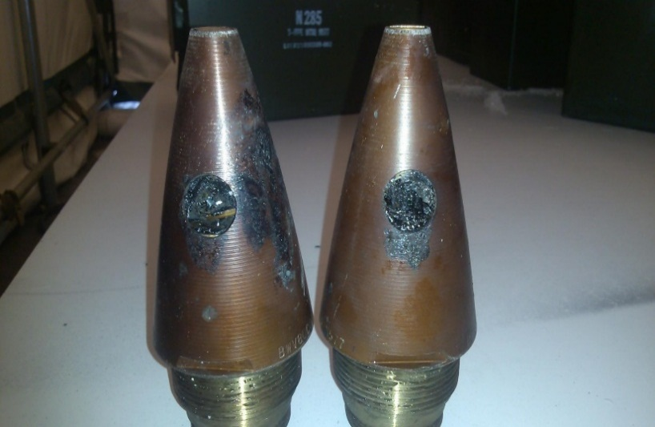
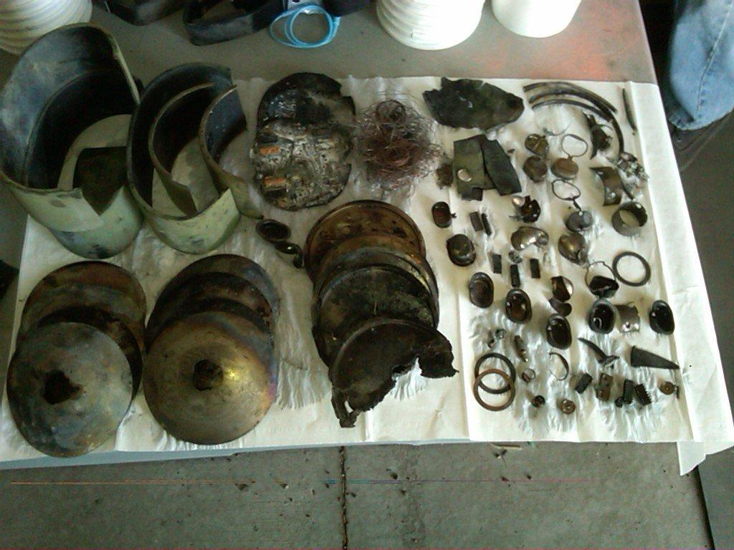
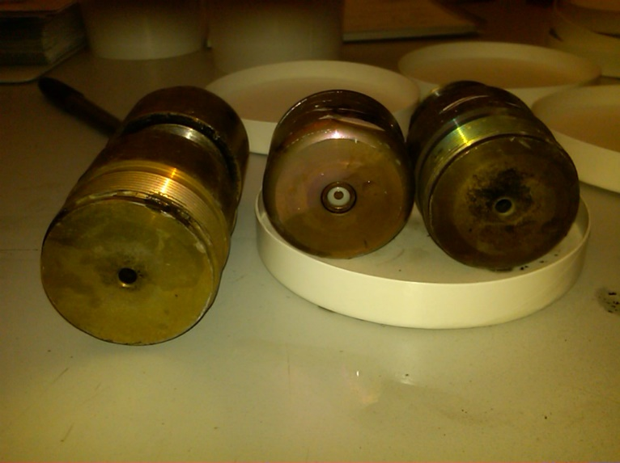
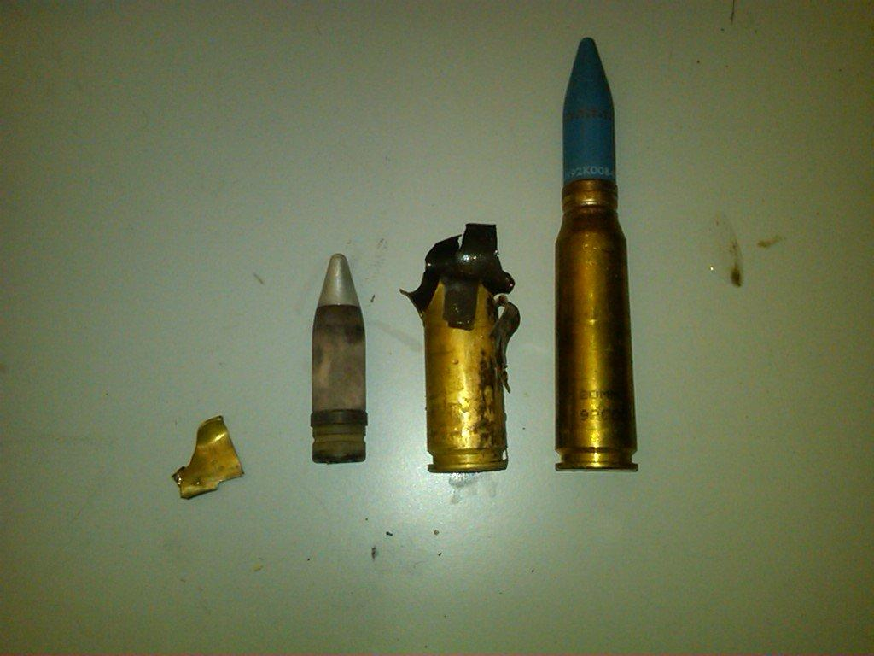
Sample DODIC’s processed through Decineration™ Unit at TEAD
N285 MTSQ M577/A1 Fuze
184 AT M75 GEMSS Mine
MF64 Canister
A652

Slide 17
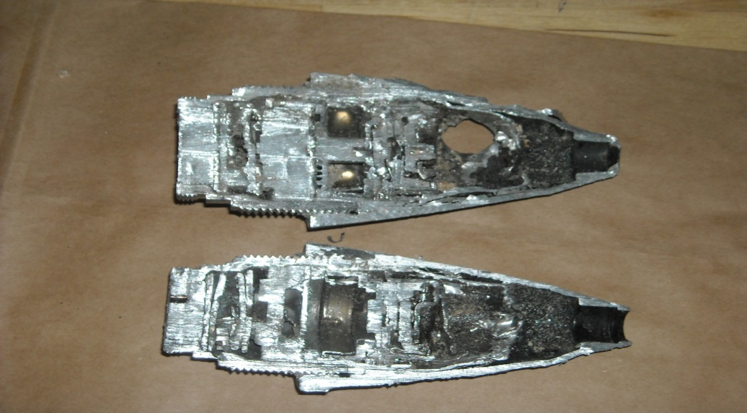
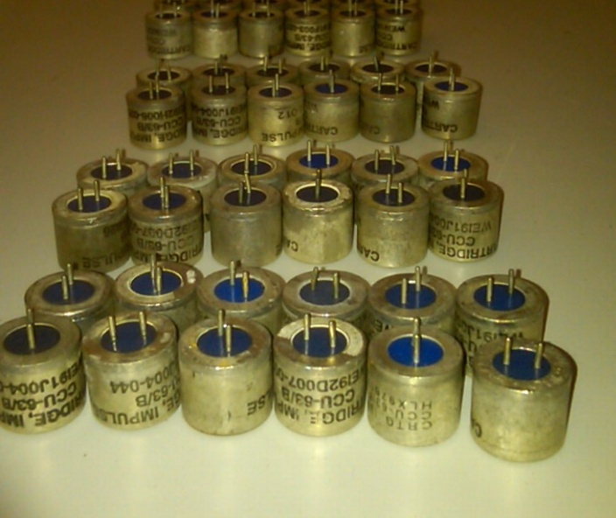
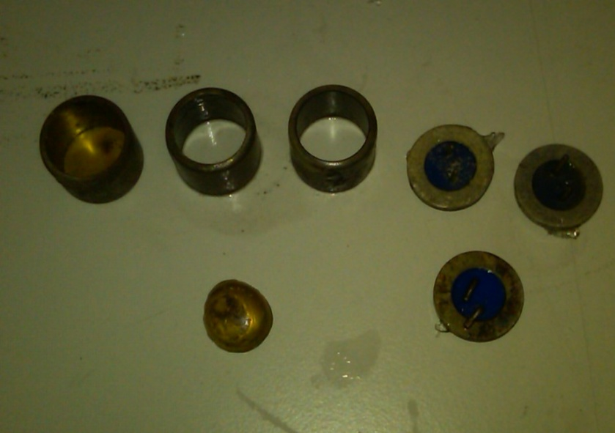
Processed 1390-N285 Mechanical Timed Fuze, cut to validate explosive free
1377-MF29 Impulse Cartridge Before and After Processing
Notes:
17

Slide 18
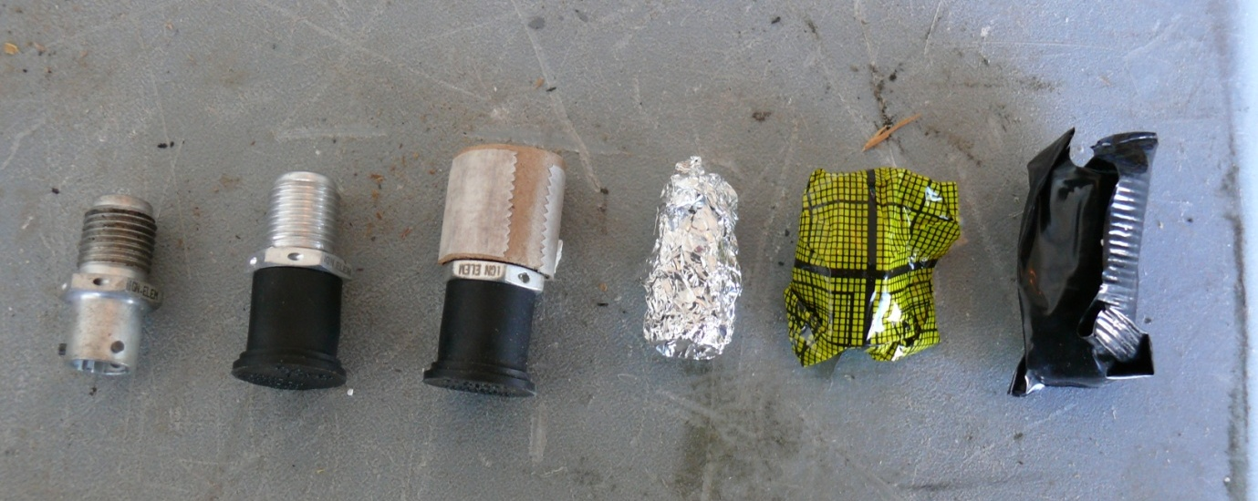
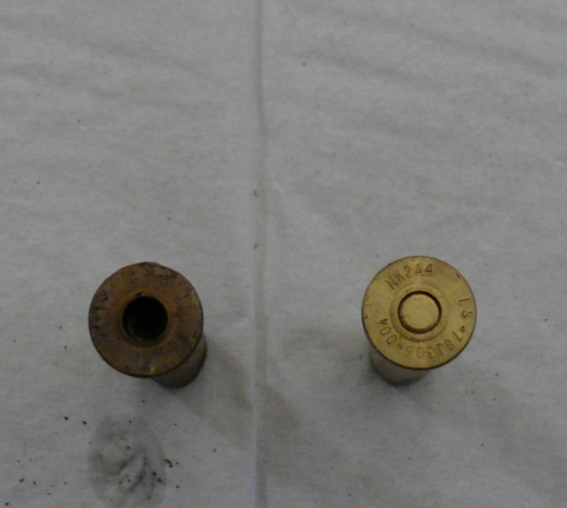
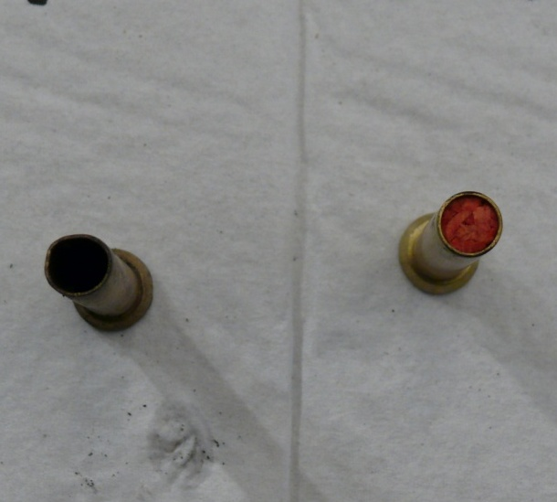
M934 Ignition Element Packaging
1390-N525 Percussion Primer Before and After Processing

Slide 19
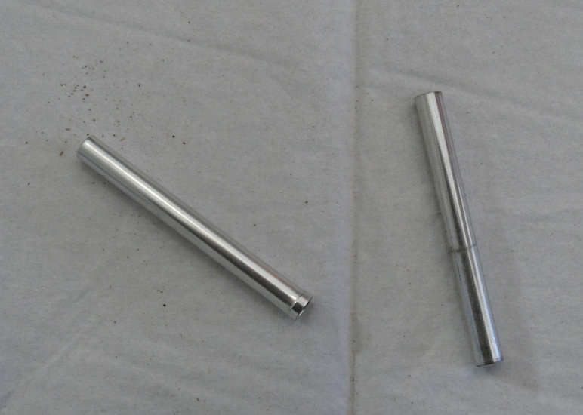
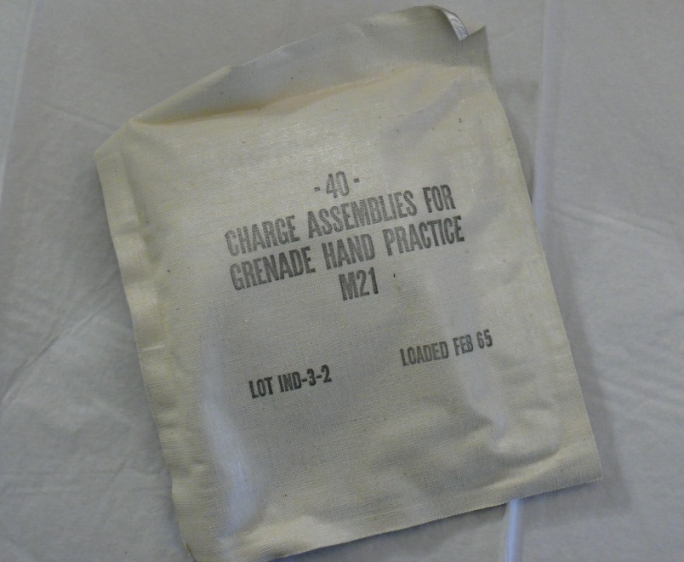
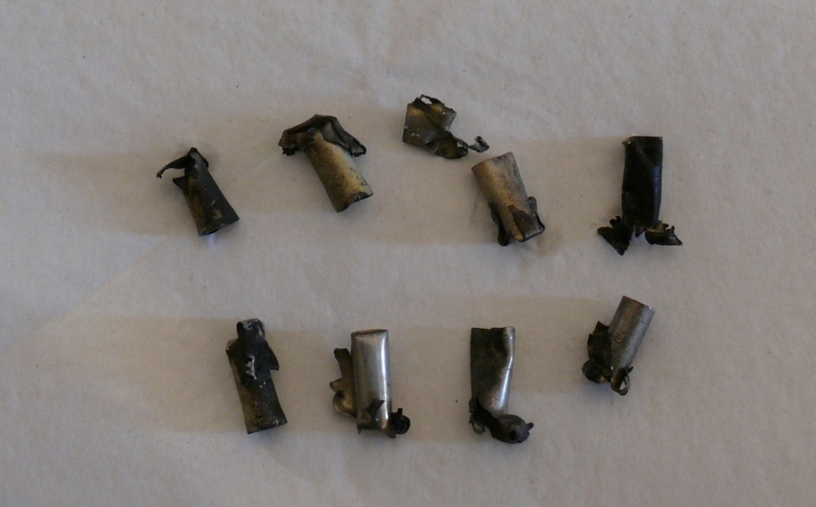
1376-ML68 Detonator Before Processing
1330-G850 Charge Before Processing
1375-M131 Blasting Cap After Processing

Slide 20
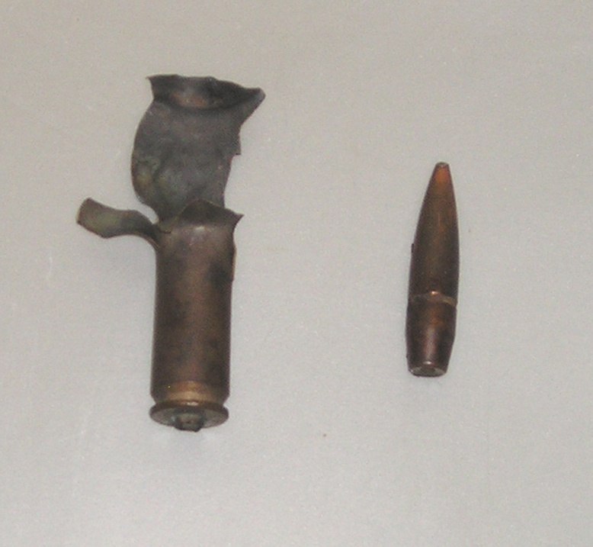
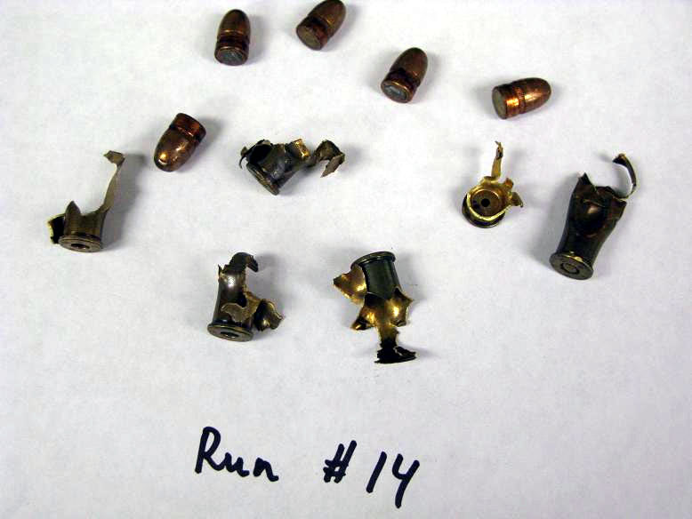
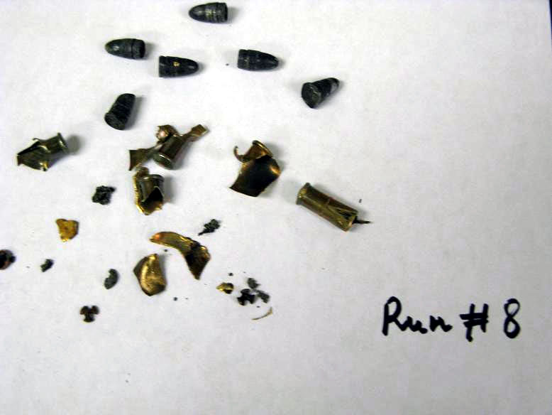
“Decinerated”- Processed Material Condition
CTG. CAL .50 BALL M2 LINKED
CTG. CAL .38 SPEC BALL M41
Intact Copper Clad Lead Bullet
Intact Lead Bullet
CTG. CAL .22
Notes:
20

Slide 21
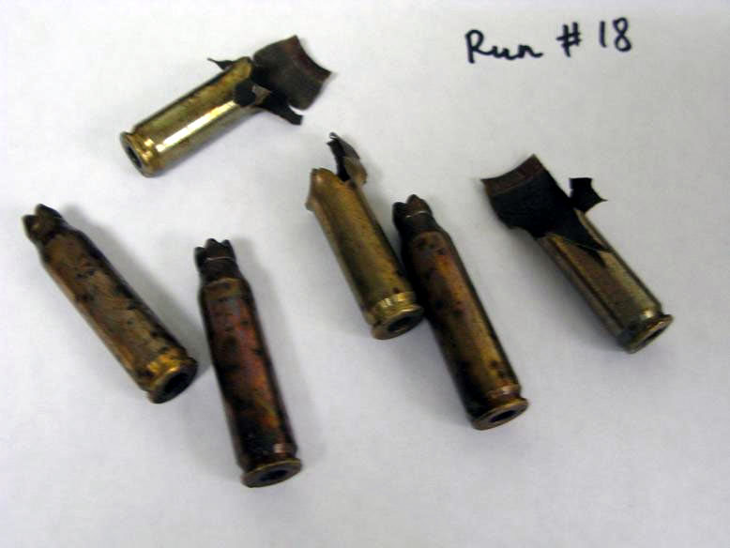
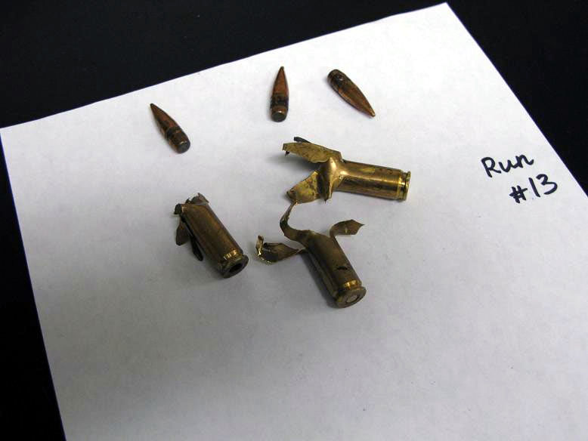
“Decinerated”- Processed SAA Material Condition
Intact Copper Clad Lead Bullet
CTG. GREN RIFLE 7.62MM M64
CTG. 7.62MM 4 BALL M80/1 TR M62 LINKED
Notes:
21

