Slide 1
Unconfined nature of Open Burn (OB) and Open Detonation (OD) makes it difficult to:
Measure releases; or
Evaluate the efficiency of destruction for the waste stream
Without defensible data, the perception is this is really bad!

Slide 2
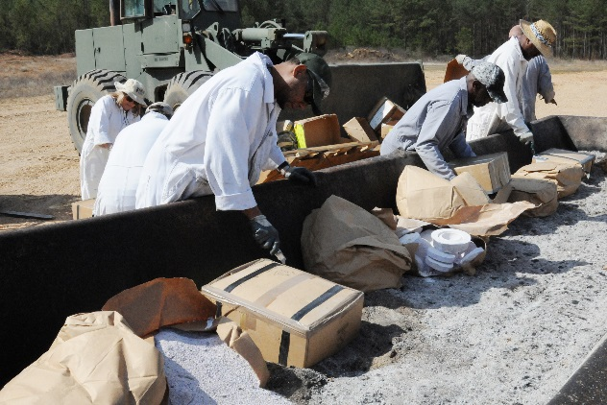
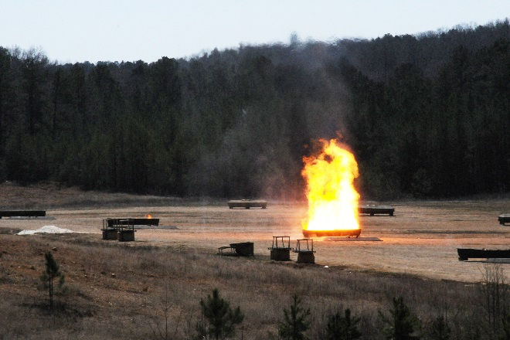
  DoD Open Burn and Open Detonation (OB/OD)
Meeting of the National Academy of Science CMD Committee
22 – 23 August 2017

Slide 3
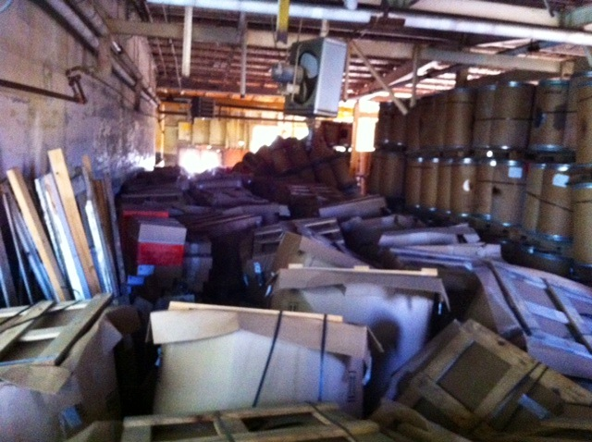
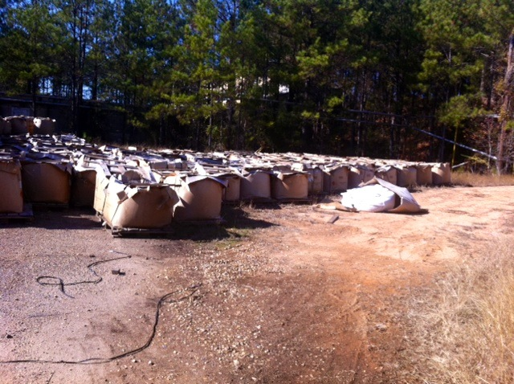
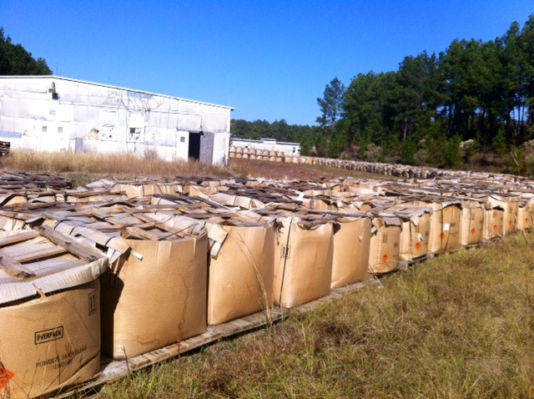
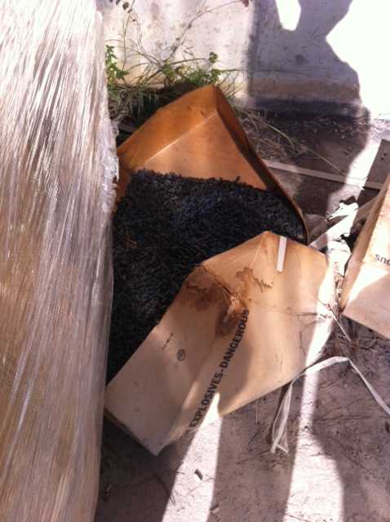
Camp Minden
What is wrong with these pictures?
3

Slide 4
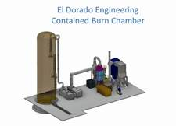
Camp Minden – The Perfect Storm
The 18M pounds of propellant and explosives in storage at the time of initial explosive incident were not DoD military munitions – about 15M pounds of M6 belonged to Explo Inc.
By court order, the Louisiana Military Department (LMD) took ownership of the approximately 15M pounds of M6
Environmental Protection Agency (EPA) and State wanted to reduce the explosive hazard immediately – described as an imminent and substantial endangerment to the public
Department of the Army (DA) advised, with Secretary of the Army approval, EPA that the quickest way to reduce the potential danger was by using Open Burning (OB)
EPA’s plan to OB 15M pounds of M6 created a firestorm of public outcry and Congressional interest
EPA, with advise of DA, settled on use of an Eldorado Engineering Inc. (ESI) -designed Contained Burn Chamber (CBC) – similar to one being emplaced at Letterkenny Army Depot
LMD contracted ESI to conduct a removal action at Camp Minden using a CBC
4

Slide 5

Problem Statement
U.S. citizens living near Department of Defense (DoD) military installations that demilitarize (destroy) munitions through Open Burn and Open Detonation (OB/OD) expressed concerns regarding emissions and pollutants effecting their health, the environment, and the overall well-being of their communities.
Public concerns have resulted in:
  Local activism
  Requests for information from elected officials
  Media inquiries, printed articles, and other reports across a variety of media
Responses to public and media questions are usually locally generated by installations with OB/OD sites and are not centrally managed for situational awareness or distributed throughout the DoD.

Slide 6
DoD Open Burn and Open Detonation
(OB/OD) Requirement
DoD recognizes that EPA, state environmental regulators, state legislatures and the public are expressing concerns about the potential environmental implications associated with the disposal of munitions through OB/OD.
DoD is committed to engaging with EPA and state regulators to address these concerns, while safely maintaining a critical capability that supports munitions management and training requirements.
DoD is dedicated to protecting human health and the environment by handling, storing and destroying excess, obsolete and unserviceable munitions safely and in an environmentally responsible manner.

Slide 7

DoD Open Burn and Open Detonation
(OB/OD) Requirement
DoD maintains thousands of different types of military munitions in support of the National Defense.
Military munitions are inherently dangerous.
DoD actively manages its munitions stockpile to minimize munitions that are obsolete, excess, or unserviceable.
DoD manages munitions through:
Foreign Military Sales
Recycling or recovering parts or the whole munition
Demilitarization through alternative
technologies
OB/OD
Foreign Military Sales
Recycling /
Recovery
OB/OD

Slide 8
DoD Open Burn and Open Detonation
(OB/OD) Requirement
DoD primarily uses:
Open burn (OB) to destroy bulk propellants, raw explosives (e.g., contaminated explosive waste) or explosive-contaminated packaging that may not be able to be transported or demilitarized safely using other available technologies.
Open detonation (OD) to destroy DoD military munitions that:
  Are recovered during an explosives or munitions minimum
  Determined unsafe for storage or transport;
  Cannot be demilitarized safely by other means because of their design, size or explosive content.
OB/OD sites are permitted based on a limited amount of munitions that can processed at a given time.

Slide 9
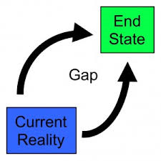
Desired End State
DoD maintains its capabilities to demilitarize excess, unserviceable, and obsolete military munitions through OB/OD, when required.
Maintaining this End State requires effectively communicating with citizens, elected officials, and the media.

Slide 10
J. C. KING
Director for Munitions and Chemical Matters
Office of the Deputy Assistant Secretary of the Army for Environment, Safety and Occupational Health
(703) 697-5564
James.c.king4.civ@mail.mil

