Slide 1
National Academies of Sciences, Engineering, and Medicine “Alternatives for the Demilitarization of Conventional Munitions”
Ken Shuster – August 22, 2017
U.S. Environmental Protection Agency
Office of Resource Conservation and Recovery

Slide 2
Outline
OB/OD Background/History
OB/OD Universe
Status
RCRA Permit Procedures
RCRA OB/OD Permit Conditions
Status of EPA Projects Underway:
OB/OD Contamination
OB/OD Corrective Action/Clean Closure Procedures, Successes; Clean-up Costs
Alternatives to OB/OD

Slide 3
Background of Open Burning and Open Detonation (OB/OD) under RCRA
1978 EPA proposed to ban all open burning of hazardous waste
Public comments (including DOD and private sector): Need to allow OB/OD of energetic wastes in cases where there are no safe alternatives
1980 Final Rule: OB/OD of all hazardous waste is prohibited, except for explosives/propellants when there are no safe alternatives or it is an emergency
This OB/OD exemption for energetics was considered temporary pending development of alternative technologies (preamble to final rule)

Slide 4
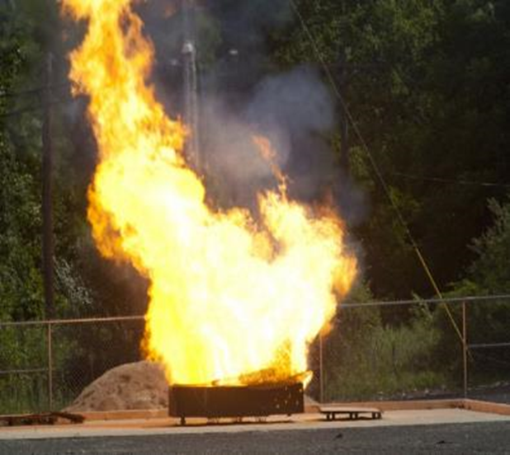
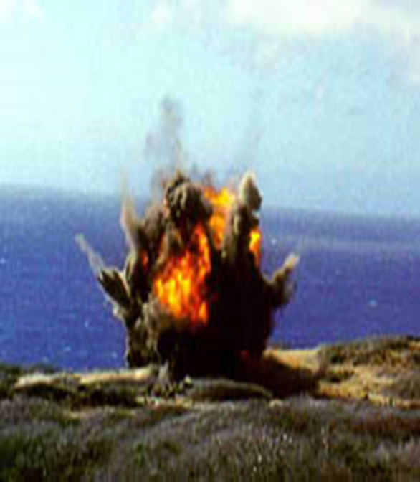
OB/OD RCRA Universe
OB/OD Universe
182 RCRA OB/OD sites:
57% closed (104)
33% active (60) (53 active and 7 interim status)
10% inactive (18)
54 Superfund OB/OD NPL sites (includes some RCRA)
Lots of OB/OD outside this universe
Range cleanup
Training
Emergencies

Slide 5
OB/OD Facilities, by Ownership
 | Operating | Other | Closed | Total
Army | 21 |  | 43 | 64
AF | 7 |  | 22 | 29
Navy/Marines | 7 |  | 14 | 21
Joint | 1 |  |  | 1
DOD Total | 36 (31%) |  | 79 (69%) | 115
DOE | 4 |  | 5 | 9
NASA | 1 |  | 2 | 3
Other Fed |  |  | 1 | 1
Private | 23 |  | 42 | 65
Univ |  |  | 5 | 5
Total | 64 (32%) |  | 134 (68%) | 198
Emergency permit | 2 |  | 7
Delay of Closure |  | 5
Protective filer/ Proposed |  | 5
Nonnotifier/Illegal |  |  | 11

Slide 6
OB/OD Universe (cont)
OB/OD Functions
OB/OD Tons Treated 2005-2013
Demilitarization
Manufacturing
Research & Development
Range Cleanup
Emergencies
Training
OB
OD
Year | Tons
2005 | 304.9M
2007 | 148.6M
2009 | 16.4M
2011 | 12.4M
2013 | 11.1M
Source: RCRA Biennial Report

Slide 7
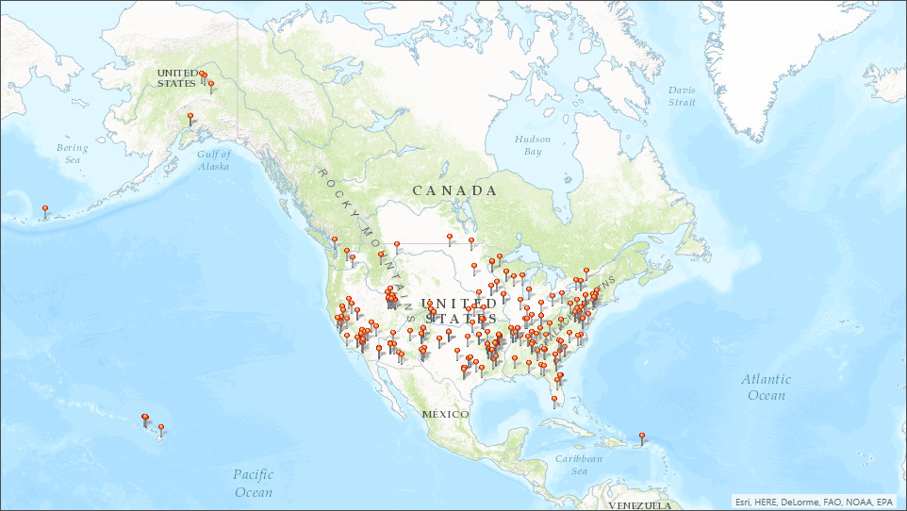
All Open Burning/Open Detonation Facilities

Slide 8
RCRA and Superfund Facilities

Slide 9
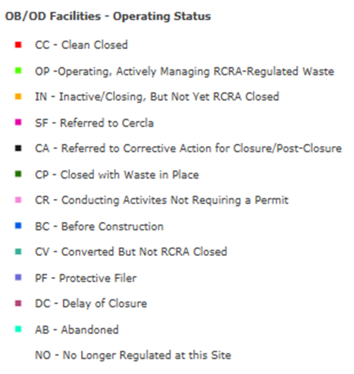
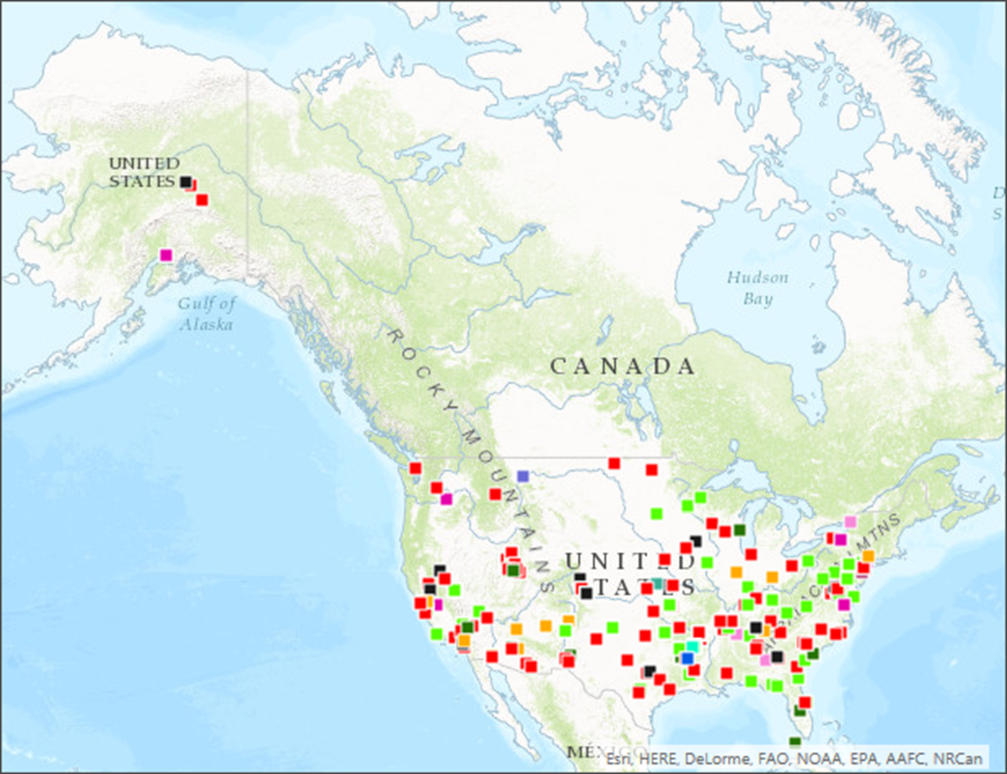
Operating Status of OB/OD Facilities

Slide 10
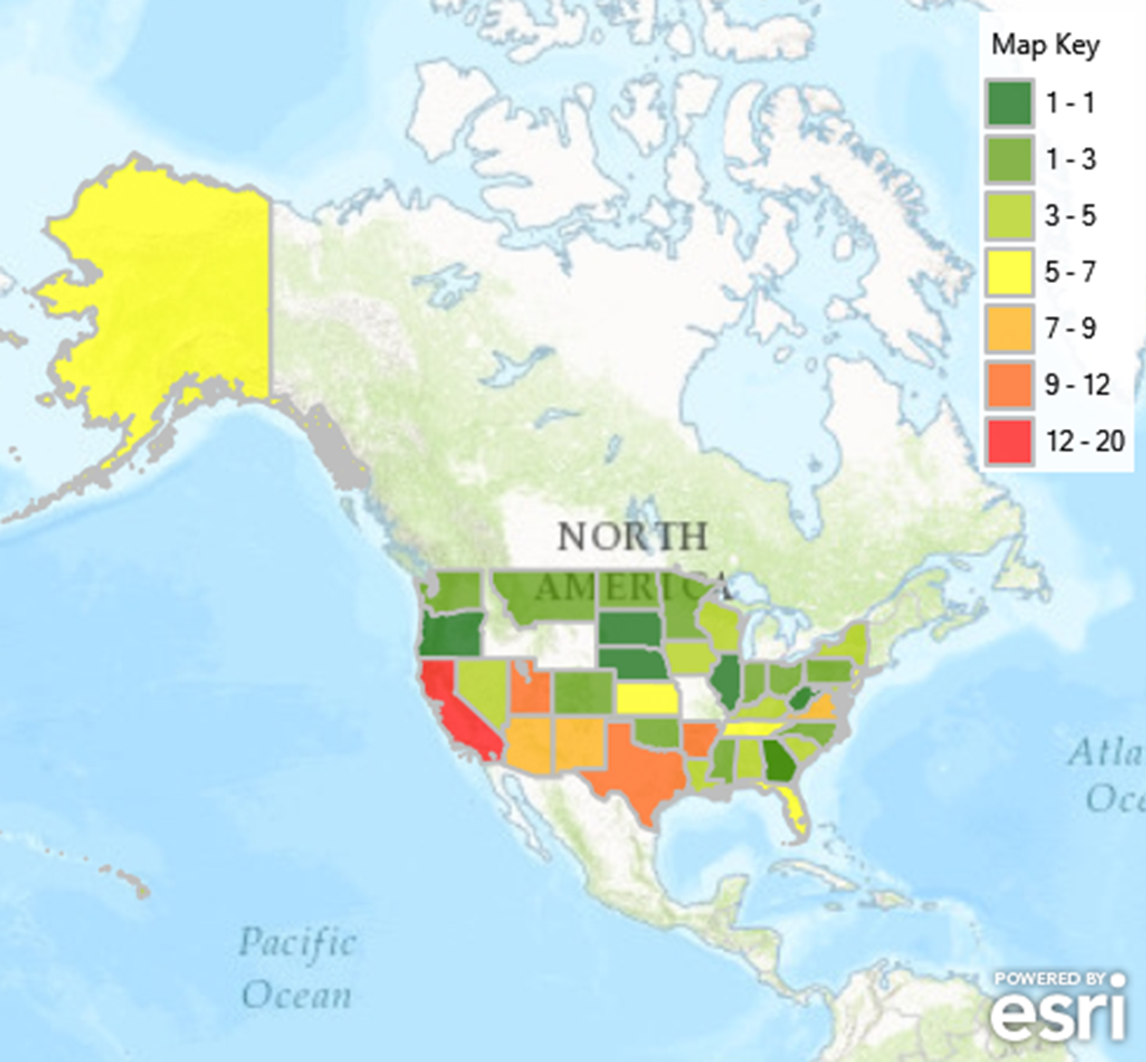
State Aggregate of OB/OD Facilities

Slide 11
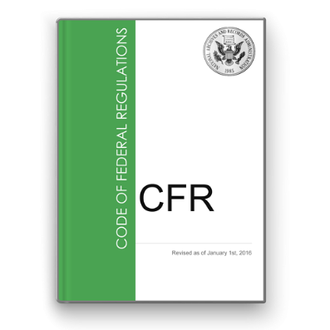
What is a Resource Conservation and Recovery Act (RCRA) Permit?
RCRA Permits are built from a standard foundation of RCRA regulatory requirements, then customized per facility.
The foundation requirements are 40 CFR Parts 260 to 270.
Authorizing/empowering the state equivalent requirements, 40 CFR Part 271.
States can become authorized to implement the RCRA program and thus states typically issue RCRA permits.
The Permit Writer must ensure that:
A permit is consistent with the regulatory requirements.
A permit identifies what is regulated, approves the facilities’ chosen or modified regulatory controls (e.g., design, monitoring), and speaks to how regulatory compliance will be measured.
A permit is not issued if the application or results of inspection demonstrate noncompliance or has conflicting information.

Slide 12
What is a RCRA Permit?
The Permit establishes a detailed specification of parameters established to measure compliance (e.g., the remedy to be constructed, groundwater cleanup standard to be met).
The Permit includes Schedules of Compliance to complete specified documentation to be submitted, construction, investigations, and other remedy decisions or work.
The Permit may also impose unique “Omnibus Authority” conditions.
Section 3005(c)(3) of RCRA, referred to as the “Omnibus Authority,” requires that each RCRA permit contain terms and conditions as the Administrator or State Director determines necessary to protect human health and the environment. This provision, codified at 40 CFR 270.32(b)(2), and its associated information requirement at 40 CFR 270.10(k), gives permit writers the authority to impose permit conditions in addition to applicable permit standards found in 40 CFR 264, if needed for the permit to be protective.

Slide 13
Who Needs a RCRA Permit?
RCRA requires a permit for the treatment, storage, and disposal of any hazardous waste identified or listed in 40 CFR Part 261.
Owners or operators of facilities that treat, store, or dispose of hazardous waste must obtain an operating permit under Subtitle C of RCRA.
Treatment, storage, or disposal facilities (TSDFs) in existence on or before November 19, 1980, operate under interim status until a final permit decision is made.
New TSDFs (i.e., those that were not in operation on or before November 19, 1980) are ineligible for interim status and must receive a RCRA permit before construction can commence.

Slide 14
RCRA Permitting Process Flow Diagram
Applicant holds informal meeting with the public prior to permit application
Applicant submits Part A and Part B permit applications
FINAL PERMIT DECISION
Permitting agency announces receipt of permit application, makes application available for public review and comment, and reviews application to verify completeness
Permitting agency announces
decision and issues Record of Decision explaining decision
If application is incomplete,
the permitting authority issues a Notice of Deficiency (NOD) directing correction and completion
If application is complete,
the permitting authority notifies permittee of application’s completeness
Public has 45 days to comment on the decision; public can request hearing
If decision to deny permit, permitting authority issues notice of intent to deny
If decision to issue permit, permitting authority issues an application complete determination and drafts permit
Permitting agency evaluates whether permit satisfies technical requirements and makes preliminary decision to issue or deny the permit

Slide 15
RCRA Permit Conditions
All RCRA permits generally have conditions that address the following:
General facility standards (e.g., waste analysis, security, inspections, training, requirements for ignitable-reactive-incompatible wastes, location standards)
Preparedness/prevention
Contingency plan and emergency procedures
Recordkeeping/reporting
Corrective action/site remediation of contaminated media

Slide 16
RCRA Permit Conditions
General permit conditions applicable to all permits (continued)
Closure/post closure
Financial assurance
Use and management of tanks/containers
Many other requirements based on the specific operations and design of the facility

Slide 17
Types of OB/OD RCRA Permit Conditions
Treatment operations such as OB/OD that do not have specific regulatory design/operation requirements must be permitted pursuant to 40 CFR 264, Subpart X requirements.
Subpart X stipulates that permits for these “miscellaneous units” must contain terms and provisions as necessary to protect human health and the environment.

Slide 18
Types of OB/OD RCRA Permit Conditions
This includes permit conditions that generally cover requirements applicable to:
Treatment unit design, operation, and monitoring
Prevention of releases to ground, surface water and air that pose unacceptable risk
Responses to releases of hazardous waste or hazardous constituents
OB/OD permit limits differ and are site-specific
However, all permits must ensure protection of human health and the environment

Slide 19
Types of OB/OD RCRA Permit Conditions
Example OB/OD operating conditions from permits – each permit will not necessarily include all these requirements
Waste restrictions (e.g. energetic/reactive waste only, on-site generated waste only)
Daily/annual/event limits on amount OB/OD’d
Some have waste concentration limits
Days/hours of operation restrictions
# of days per week, during daylight hours only
Weather condition restrictions
Wind speed, rain forecast, lightening, etc.
Some prohibit operations on O₃ action days

Slide 20
Types of OB/OD RCRA Permit Conditions
Example OB/OD operating conditions from permits – each permit will not necessarily include all these requirements
Fire hazard managers required on scene
Periodic soil, groundwater monitoring
Requirements specific to risk thresholds
Operations shall not cause carcinogenic risk of 1X10⁻⁶ to be exceeded offsite
Operations shall not cause non-carcinogenic chronic hazard index of 1.0 to be exceeded offsite
Some permits require periodic assessments of the info used to model pollutant transport and risk, including emission factors and appropriateness of risk determination assumptions

Slide 21
Types of OB/OD RCRA Permit Conditions
Example OB/OD operating conditions from permits – each permit will not necessarily include all these requirements
Notification requirements, access restrictions
Siren, clearing nearby river of boaters, etc.
Signs, gates, surveillance teams
Public complaint procedures
Clearing dry grass, leaves, and other combustibles
Water run on/off controls (stormwater control)
Pre and post burn/detonation inspections
Spilled waste management requirements

Slide 22
Types of OB/OD RCRA Permit Conditions
Example OB/OD operating conditions from permits – each permit will not necessarily include all these requirements
Example operating conditions specific to Open Detonation
Management/retrieval of kickout
Munition burial depth prior to detonation
Noise restrictions
Waste transport requirements
Donor charge requirements
Unit maintenance (e.g., wetting)
Minimum protective distances

Slide 23
Types of OB/OD RCRA Permit Conditions
Example operating conditions specific to OB
Burn pad design (height, refractory design, precipitation covers, waste kept below critical height to prevent detonation)
Hazardous waste shall not be used as burn pan accelerants
Burn box shall remain closed when waste is not being burned/treated
Some permits require periodic assessments of the
availability of alternatives to OB/OD

Slide 24
EPA Projects Examining OB/OD
Contamination at OB/OD sites
Corrective action, clean closure procedures, metrics, and successes, and associated costs
Alternatives to OB/OD

Slide 25
EPA Projects - Contamination
First Project: Documentation of OB/OD Contamination (RCRA & Superfund)
Contaminants identified and levels found in:
Soil
Ground water
Surface water
Documentation of Cleanup Costs
OB v. OD
Waste Quantities

Slide 26
Contamination Observed at OB/OD Sites
It is difficult to parse out contamination from current OB/OD operations from historical contamination.
Soils Exceedances of Residential Screening levels
RDX [5.6 mg/kg EPA residual screening level]
Chemtronics, Inc. 290 mg/kg 52X
Camp Minden (LA AAP) 100mg/kg
TNT [19 mg/kg EPA residential screening level]
Umatilla Army Depot, OR 36,045 mg/kg 1897X
Chemtronics, Inc. 280 mg/kg
Perchlorate [15 µg/L]
Redstone Arsenal 106,000 µg/kg 7067X
(Army/NASA)
Worst concentrations tend to be close in and further out.

Slide 27
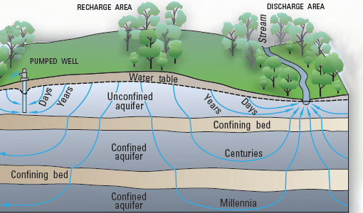
Contamination Observed at OB/OD Sites
Groundwater Exceedances of Groundwater Quality Standards
RDX [2 µg/L]
Bangor Ordnance Disposal (Navy) 10,000 µg/L 5,000X
Nebraska Ordnance Plant 534 µg/L
Mass Military Reservation 370 µg/L, 7300 ft plume
Dahlgren Naval Warfare Center 127 µg/L
Redstone Arsenal (Army/NASA) 96 µg/L
TNT [2 µg/L]
Banger Ordnance Disposal (Navy) 40 µg/L (stormwater) 20X
Nebraska Ordnance Plant 39 µg/L
Perchlorate [15 µg/L]
Mass Military Reservation 500 µg/L, 10,000 ft plume 33X

Slide 28
EPA Projects – Corrective Action, Clean Closure, Costs
Second Project: Assessment of Clean Closure and Corrective Action
Monitoring/Site Assessment
Clean-up Procedures
Metrics/Successes
Costs

Slide 29
Cleanup Costs for Sites Associated with OB/OD Facilities
3 contamination zones:zones: Unit (including particulate fallout area) Kick-out area Ground Water Plume Ground water plume Cleanup costs: [Millions (m)] Lawrence Livermore Natl Lab $627m (DOE) Ft. Wingate, NM $192m Castle Air Force Base >$150m Nebraska Ordnance Plant $61m Umatilla Army Depot, OR >$60m Idaho Natl Eng Lab (DOE) $48m Iowa Army Ammunition Plant $40m US Army Garrison/ $11m Ft. Wainwright | Plattsburgh Air Force Base $8.9m Banger Ordnance Disposal $8.9m Chemtronics, Inc. $6.2-8.2m Aqua Tech Env. Inc. (Groce Labs) $4.7m Picatinny Arsenal, NJ $3.9m Cecil Field USN Air Station $2.8m US Army/NASA Redstone Arsenal $1.7m Moffett Naval Air Station, CO $1.1m Bangor Naval Submarine Base $0.9m

Slide 30
EPA Projects - Alternatives
Third Project: Identification of Alternatives to OB/OD
Technologies
Companies
Applicability
Throughput
Residuals
Capital Cost
Operational Cost
Environmental
Safety

Slide 31
Alternative Technologies Project
Assessing alternative technologies that may be used in place of OB/OD
Parameters of assessment include:
Technology type with applicable subcategorizations ;
Type of waste and constituents the technology is designed for (e.g., bulk energetics including: tetrytol, M28 propellant, M8 propellant, or fireworks, flares, etc.);
The scale with which the technology has been used
(e.g., bench, pilot, full-scale use);
Throughput capability (e.g., pounds per hour);
Whether the technology requires pre-treatment and/or post-treatment technologies;
Output associated with technology (e.g., air emissions, hazardous or solid waste, wastewater);

Slide 32
Alternative Technologies Project
Parameters (continued)
Whether or not approved for use by the Department of Defense Explosives Safety Board (DDESB);
The manufacturer of the technology including contact information;
Cost to purchase, install, and operate the treatment unit;
Where the technology is or has been used and the type of waste treated;
Ability to treat: thin-walled; thick-walled; bulk items
Ability to treat unarmed v. armed munitions
Most importantly, the focus is the waste stream to be treated so that we can determine which technology type(s) are suitable.

Slide 33
Examples of Alternative Technologies
Case Disassembly
1) Reverse Assembly
Manual
b) Robotic
II. Case Penetration and Energetic Removal
2) Fluid Jet Cutting
a) With or w/o abrasives
b) Various fluids (e.g., water, ammonia)
3) Cryogenic
a) Liquid nitrogen cryofracturing
b) Dry ice (CO2) blasting at supersonic velocity

Slide 34
Examples of Alternative Technologies
Case Penetration and Energetic Removal (cont.)
4) Laser Cutting
a) Ultra short laser pulses (Femtosecond) with no heat
5) Acid Digestion
a) Nitric acid
6) Removal by Melting
a) Autoclave meltout
b) Microwave meltout
7) Fluid Shredding or Drilling
8) Ultrasonic separation in fluids
9) Vacuum Infusion
Note: Fluids include water, ammonia, solvents (Methylene chloride, methyl alcohol, acetone, toluene), carbon dioxide, nitric acid.

Slide 35
Examples of Alternative Technologies
III. Destruction
10) Controlled Detonation Chambers
a) Stationary or mobile treatment units (MTUs)
11) Thermal
a) Direct flame (contained burn, incinerator, rotary kiln, car-bottom furnace, flashing furnace)
b) Indirect/external heat (microwave, fluidized bed, rotary thermal tube, plasm arc, hot gas decontamination)
12) Chemical
a) Base hydrolysis, neutralization, supercritical water oxidation, wet air oxidation, electro-chemical oxidation, peroxydisulfate oxidation, oxidation with sulfur (Adams process)
13) Biological

Slide 36
Alternative Technologies Permitted* and/or Deployed
STATE | FACILITY | ALTERNATE TECHNOLOGY
AL | Anniston Army Depot* | Thermal Treatment Closed Disposal Process (TTCDP), Static Detonation Chamber (SDC)
CA | Santa Susana Field Laboratory | Controlled Detonation Chamber
CO | Pueblo Chemical Depot | Explosive Detonation System
CT | Clean Harbors* | Detonation Confinement Chamber
IL | General Dynamics* | Popping Furnace
IN | Newport Chemical Depot | Supercritical Water Oxidation/ Hydrolysis
KY | Blue Grass Army Depot* | Dynasafe Static Detonation Chamber/ Donavan Chamber/ Supercritical Water Oxidation
LA | Camp Minden | Contained Burn Chamber
MO | EBV Explosives Environmental/General Dynamics* | Motor Saws, Static Kiln, Thermal Treatment Unit
MA | Mass Military Reservation | Controlled Detonation Chamber
MY | Edgewood Chemical Biological Center | Controlled Detonation Chamber
MY | Aberdeen Proving Ground | Hydrolysis
OK | McAlester Army Ammunition Plant* | Deactivation Furnace
PA | Letterkenny Army Depot* | ARMD Thermal Treatment System
SD | Tech Ord/ Amtec Corporation* | Confined Treatment Unit
UT | Tooele Army Depot* | Disassembly/hydrolysis/ static fire unit/DAVINCH Chamber
UT | Dugway Proving Ground | Supercritical Water Oxidation
UT | Pueblo Chemical Depot* | Controlled Detonation Chamber
WA | Pier 90/91 FUDS site | Controlled Detonation Chamber

Slide 37
DDESB Approved Technologies
Technology | Location
Hot Gas Decontamination Facility | Hawthorne Army Depot, NV
Industrial Waste Processor (IWP) and Caffee Road Thermal Decontamination Area (CRTDA) | Indian Head, MD
Transportable Controlled Detonation Chamber – Models T-25, T-30, T-60
Ammunition Peculiar Equipment (APE)-1236 Rotary Kiln Incinerator (Deactivation Furnace) | Crane, IN; Toole, UT; McAlester, OK; Hawthorne, NV
Static Detonation Chamber (SDC) 1200 CM | Anniston, AL
Vacuum Integrated Chamber (DA VINCHTM DV-60)
Explosives Destruction System (EDS) Phase 1 and Phase 2 Units
Tactical Missile Demilitarization (TMD) | Letterkenny, PA
Source: https://www.epa.gov/sites/production/files/2015-03/documents/9545931.pdf

Slide 38
Conclusions:
EPA is exploring ways to better manage certain explosive wastes and reduce contamination from OB/OD operations.

Slide 39
Explosive Disposal Alternatives Team
Sasha Gerhard-Team Leader (HQ)
Ken Shuster (HQ)
Jeff Gaines (HQ)
Mike Galbraith (HQ)
Terri Crosby-Vega (R4)
Amanda Kohler-Branch Chief

Slide 40
Contact Information:
Ken Shuster/Sasha Gerhard
U.S. EPA Headquarters
Arlington, VA
Shuster.Kenneth@epa.gov
703-308-8759
Gerhard.Sasha@epa.gov
703-879-8501

