Slide 1
Recovered Chemical Materiel Directorate
Explosive Destruction System Overview
August 23, 2017
Presented To: National Research Council
Presented By: Laurence G. Gottschalk
Director, RCMD

Slide 2
Overview
Explosive Destruction System (EDS): Description and History
Evolution of EDS
P2 Retrofit (P2R) Improvements
P2A Improvements
P2A Qualification Testing
Permitting

Slide 3
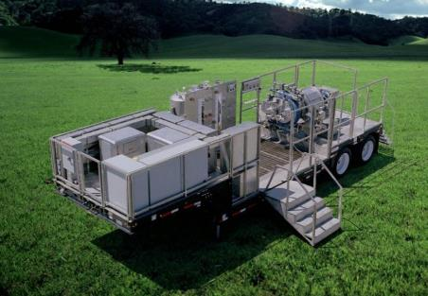
Explosive Destruction System (EDS)
EDS is a transportable system that:
Destroys chemical munitions
Contains all blast, fragments, and gases
Chemically treats munitions’ fill
Confirms destruction by sampling
Waste sent to permitted TSDF
STORE – PROTECT – COMPLY – ASSESS & DESTROY

Slide 4
EDS P2 System Components
STORE – PROTECT – COMPLY – ASSESS & DESTROY

Slide 5
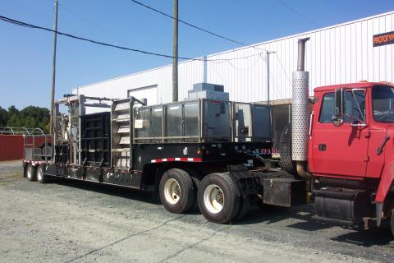
Rapid response for small quantities
Original requirements:
Portable
3 munition types
  75 mm
  4.2 inch
  Livens
2 chemical agents
  Mustard
  Phosgene
1 lb explosive weight
1 munition/operation
Multi-day operation
  Process time didn’t matter
Deploy 1-2 times a year
STORE – PROTECT – COMPLY – ASSESS & DESTROY

Slide 6
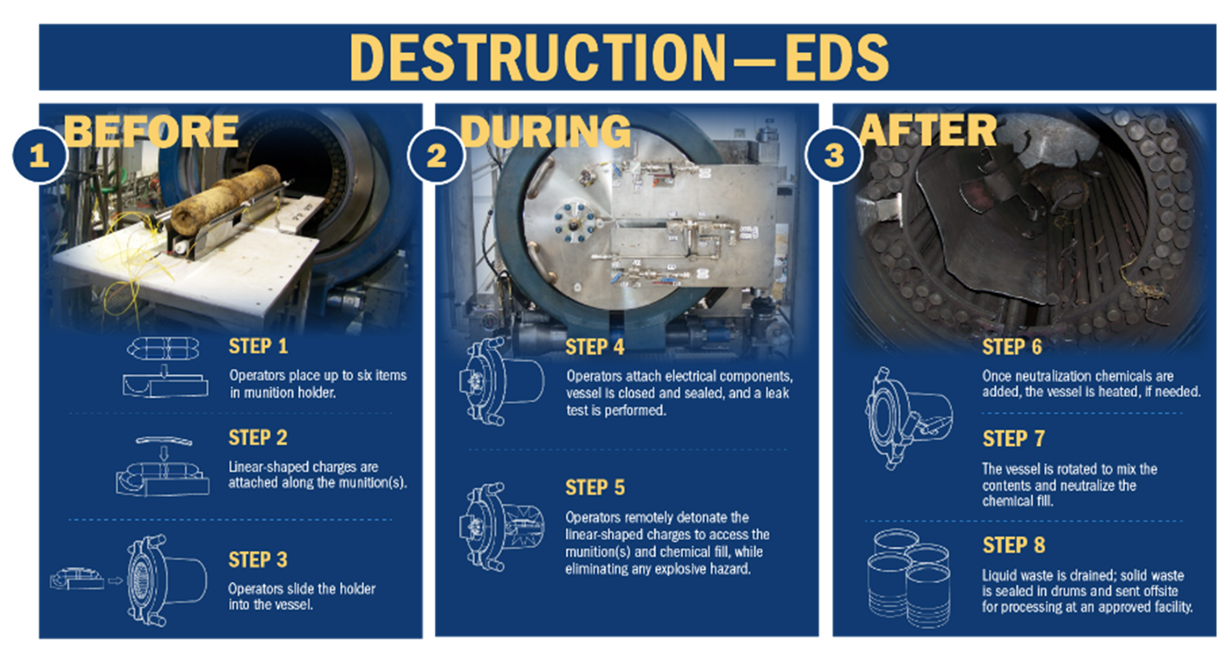
EDS Process

Slide 7
Original EDS Design Limitations
Requires two-day process
Heat applied to vessel by external band heaters
After heating water rinse to 100ºC, vessel must cool overnight prior to draining
System uses 55-gallon waste drums rated for 70ºC maximum
Door sealing system requires manual tightening
STORE – PROTECT – COMPLY – ASSESS & DESTROY

Slide 8
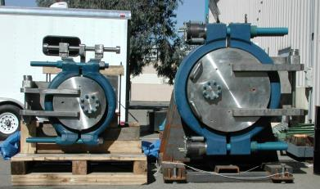
EDS mission and capabilities increased
Due to successful initial operations, the EDS mission increased to more chemical agents, multiple munitions and larger calibers
Vessel Size: 6.5 ft³ (P1) to 21.9 ft³ (P2)
Explosive capacity
  P1 vessel: 1 lb. TNT to 1.5 lb. TNT
  P2 vessel: 4.8 lb. TNT to 9 lb. TNT
Number of agents: 2 to 15+
Types of munitions: 3 to 15+
Number of munitions per batch: 1 to 3 to 6
Deployments: range from a few munitions per site to continuous operation for months or years
STORE – PROTECT – COMPLY – ASSESS & DESTROY

Slide 9
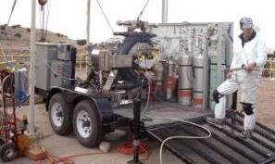
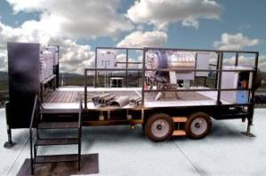
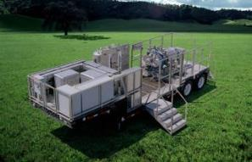
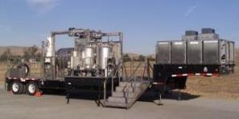
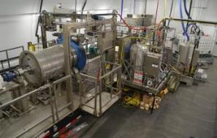
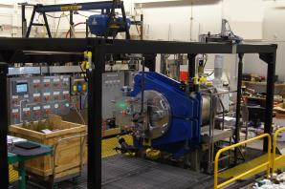
EDS Evolution
Proof of Concept
Phase 1, Unit 1
Phase 1, Unit 2,3
EDS Phase 1: Weighs 32,000 lbs. with an explosive rating of 1.5 lbs. (TNT Equivalent)
Phase 2
Phase 2 Retrofit
Phase 2 ACWA
EDS Phase 2: Weighs 68,000 lbs. with an explosive rating of 4.85 lbs. (TNT Equivalent)
EDS Phase 2 Retrofit and Phase 2 ACWA: Explosive rating of 9.0 lbs. (TNT Equivalent)
STORE – PROTECT – COMPLY – ASSESS & DESTROY

Slide 10
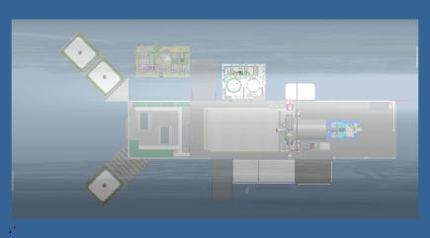
P2 Retrofit (P2R)
Retrofitted P2U3 System
  Designed to reduce process time
  Completed May 2014
Substantial modifications
  Containment Vessel, 9 lbs. NEW
  Rebuilt reagent supply wing
  Added steam heating for reagents
  Added larger volume reagents IBCs
  Added ability to drain 100C fluids
  Allows for a 1 day mustard process
* NEW- net explosive weight
* IBC- Intermediate Bulk Containers, typically 330 gallons
STORE – PROTECT – COMPLY – ASSESS & DESTROY

Slide 11
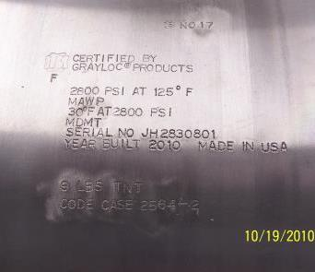
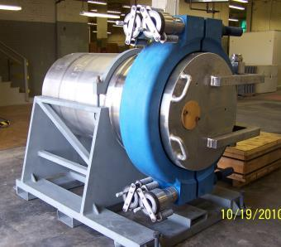
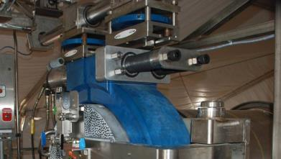
P2R Improvements - Containment Vessel
Built per ASME Code Case
  Increased explosive rating to 9 lbs.
  Tested with 11.25 lbs. NEW
  Used High Speed Digital Image Comparison to better characterize vessel response
Added nut runners for faster clamp closure
STORE – PROTECT – COMPLY – ASSESS & DESTROY

Slide 12
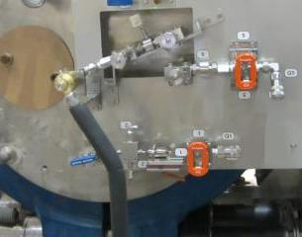
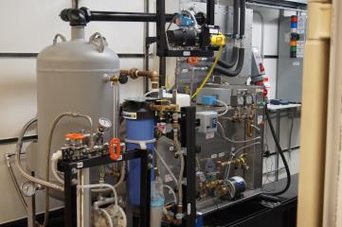
P2R Improvements - Vessel Heating and Cooling
Steam injection heats reagent and water rinses faster
Hot effluent transferred to intermediate tank to cool
Cold water cools and rinses vessel
  Steam generator and chiller located in Boiler Chiller Container (BCC)
  Rotating union allows vessel to rotate while heating the reagent
  Steam flow regulated to control vessel temperature
  Heating and cooling times reduced from hours to tens of minutes
STORE – PROTECT – COMPLY – ASSESS & DESTROY

Slide 13
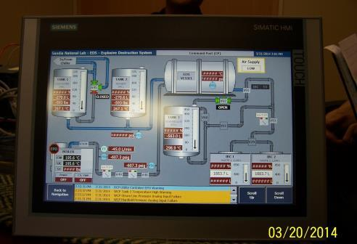
Other P2R Improvements
Larger pumps for faster fluid transfer
IBCs for waste and reagent
Human Machine Interface to display data on the trailer and in the Command Post
STORE – PROTECT – COMPLY – ASSESS & DESTROY

Slide 14
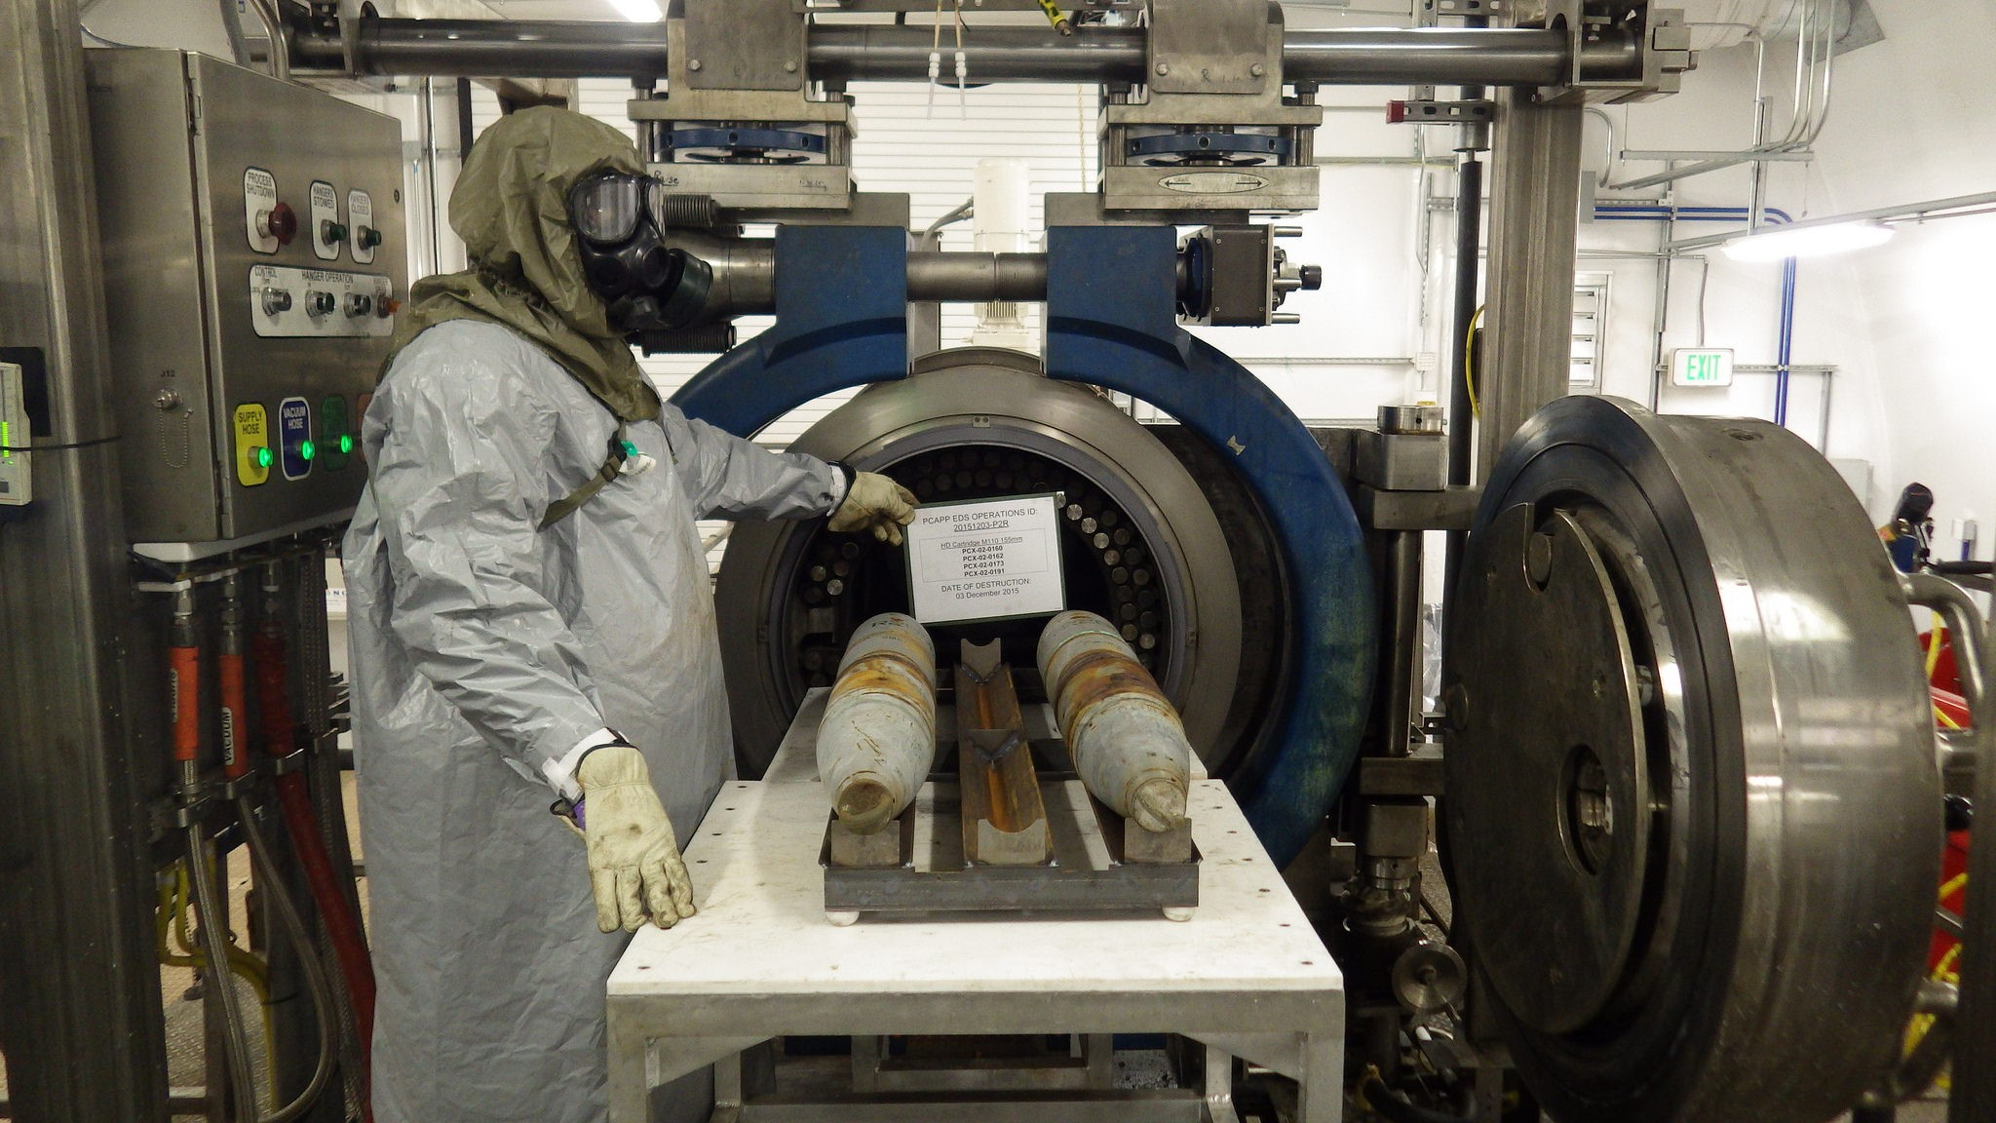
EDS P2R at PCAPP 18 Mar 2015 – 11 Feb 2016
STORE – PROTECT – COMPLY – ASSESS & DESTROY

Slide 15
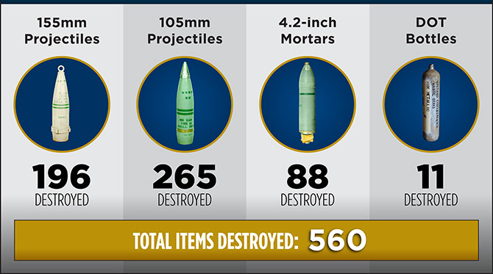
EDS P2R at PCAPP 18 Mar 2015 – 11 Feb 2016
STORE – PROTECT – COMPLY – ASSESS & DESTROY

Slide 16

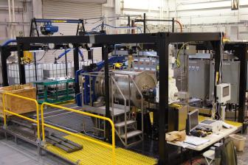
P2A Development
Designed and built specifically for use at PCAPP
Built on ISO frames
  Transportable but not mobile- semi-fixed site
  Easier access (no stairs)
  More working area
  Greater access for maintenance
  Still easily transportable on standard trucks
Has all P2R improvements
  Uses same BCC and support skids as the P2R
STORE – PROTECT – COMPLY – ASSESS & DESTROY

Slide 17
Regulatory Status for PCAPP EDS
P2A deployment to PCAPP EDS contingent upon RCRA Class 1 permit modification
Draft permit modification currently being prepared
Target date to submit modification to PCD Environmental for submission to Colorado Department of Public Health and Environment (CDPHE) 2QFY18
Class 1 modification and supporting facility construction certification could take a minimum of 30 days for CDPHE to approve
STORE – PROTECT – COMPLY – ASSESS & DESTROY

Slide 18
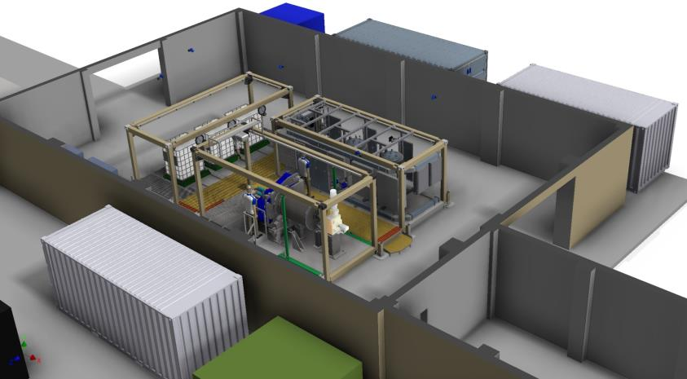
P2A Layout
Boiler Chiller Container (BCC)
Reagent Waste Frame (RWF)
Process Control Frame (PCF)
Vessel Support Frame (VSF)
STORE – PROTECT – COMPLY – ASSESS & DESTROY

Slide 19
P2A Qualification Testing at APG-S
Testing conducted August-September 2016
Goals included:
  Demonstrate system could be transported, set up, and operated
  Demonstrate maturity of Standing Operating Procedures, Operator Training Program, other documentation
  Demonstrate system could reliably operate and destroy HD to treatment goal of <50ppm
All goals were met
STORE – PROTECT – COMPLY – ASSESS & DESTROY

Slide 20
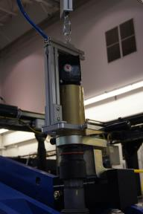
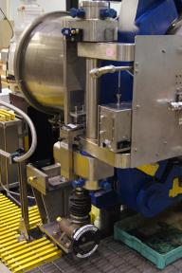
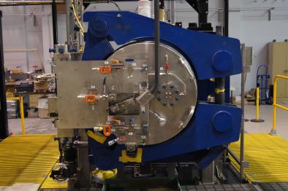
P2A Improvements – Containment Vessel
Three-piece clamp
  Single-drive screw
  Pneumatic wrenches
  Closes in minutes
  Less labor intensive
Improved hinge design
  Door opened and closed easily by one person
  Latch holds door in desired location
STORE – PROTECT – COMPLY – ASSESS & DESTROY

Slide 21
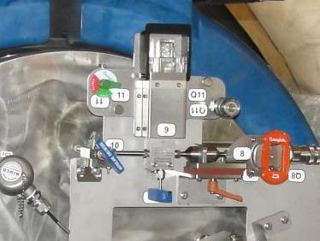
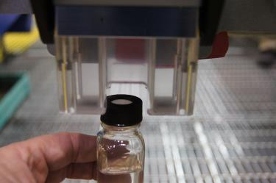
P2A Improvements – Liquid Sample Collection
Sample bottle with septum
  Easier to attach and remove bottle
  Visual indication that sample has been collected
  Much easier for lab to transfer sample
  Demonstrated safety and reliability
STORE – PROTECT – COMPLY – ASSESS & DESTROY

Slide 22
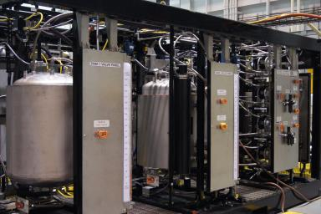
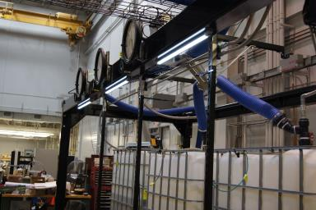
Additional P2A Improvements
Larger supply tanks
  125 gallons
  Needed to optimize processing of 6 ea. 155’s with 72 lbs. of mustard
Improved reagent tank heater
Oil-free helium leak detector
Simpler connections to waste IBCs
Improved venting of IBCs
STORE – PROTECT – COMPLY – ASSESS & DESTROY

Slide 23
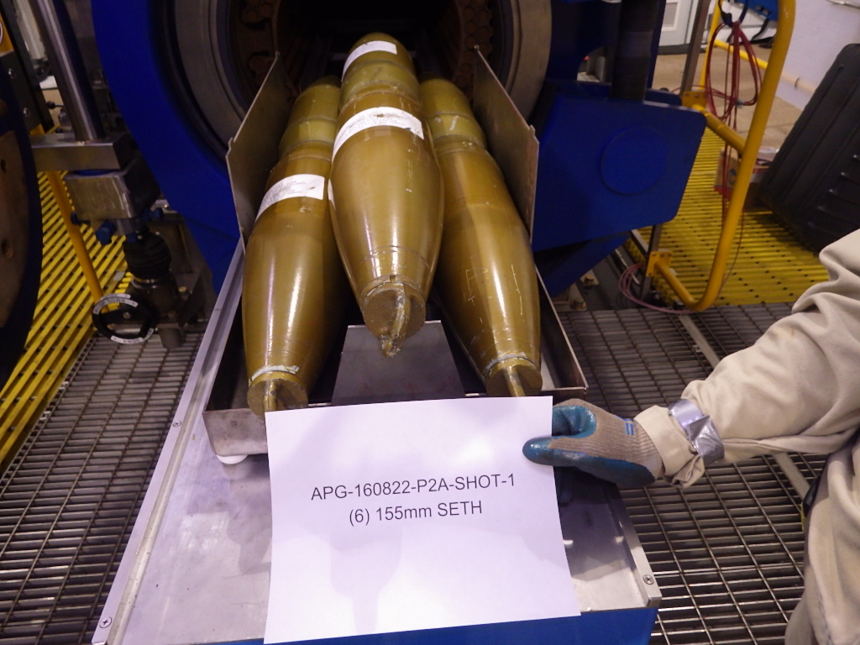
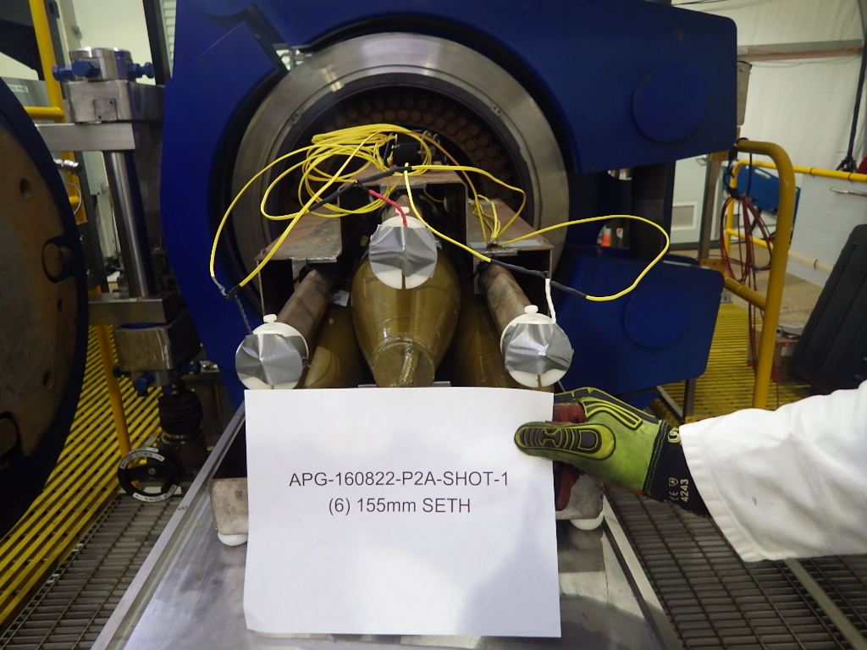
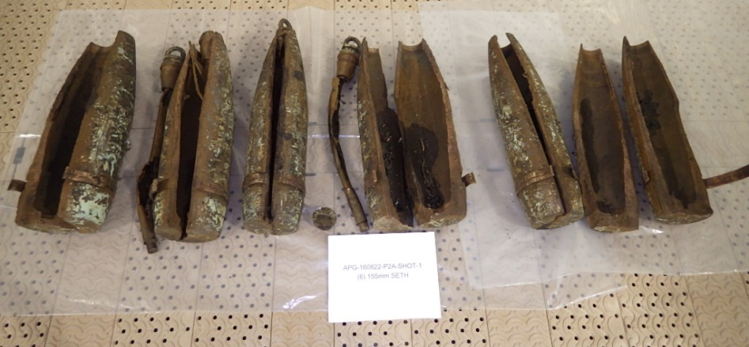
EDS P2A Qualification Test - Simulated 155mm Projectiles
STORE – PROTECT – COMPLY – ASSESS & DESTROY

Slide 24
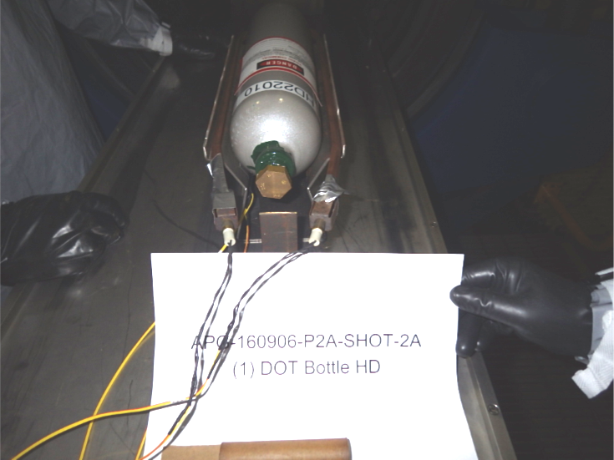
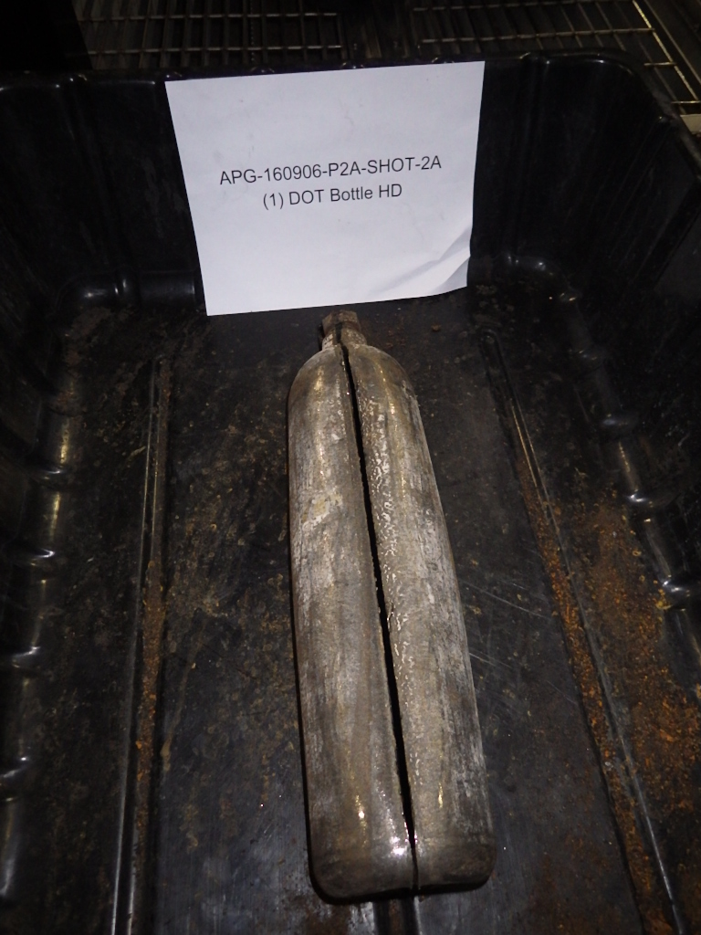
EDS P2A Qualification Test - Mustard (HD) Testing
STORE – PROTECT – COMPLY – ASSESS & DESTROY

Slide 25
Regulatory Compliance – RCRA
Facility prepares RCRA permit application (§270.10, §270.13)
Facility provides public notice of pre-application meeting at least 30 days prior to the meeting
Facility holds public meetings
(§124.31 (b))
Facility provides record of meeting
to permitting authority (§124.31 (c))
Permitting authority receives and reviews permit applications (§124.3)
Permitting authority establishes mailing list of interested parties (§124.10(c))
Permitting authority provides public notice of application submittal and tells people where the application is available for review (§124.32)
Facility establishes and maintains information repository (if directed by permitting authority) (§124.33(b))
Facility notifies mailing list that repository is established (§124.33(e))
Draft permit or notice of intent to deny permit (§124.6(a))
Fact sheet or statement of basis sent to members of the mailing list (§124.7, §124.8)
Facility establishes and maintains information repository (if directed by permitting authority (§124.33(b))
Public comment period (§124.10)
Public notice of draft permit (§124.10(a)), allowing for public comment (§124.10(b))
Public hearing (if requested in writing during public comment period (§124.11)) (§124.12)
Public notice of public hearing 30 days before hearing (§124.10(b)(2))
Facility establishes and maintains information repository (if directed by permitting authority) (§124.33(b))
Final permit decision (§124.15)
Permitting authority issues written response to comments on draft permit (§124.17)
Permitting authority issues a notice of decision to all commenters (§124.15)
Facility establishes and maintains information repository (if directed by permitting authority (§270.30(m))
Permitting authority notifies the public prior to a trial (or test) burn at a combustion facility (§270.62(b)(6))
Source: RCRA Orientation Manual, EPA, 2006

Slide 26
Regulatory Compliance – CERCLA
CERCLA works in conjunction with other environmental laws by requiring that response actions meet applicable or relevant and appropriate requirements (ARARs)
At Federal facilities, CERCLA often “shares” authority with RCRA in directing what must be done
It does NOT establish specific cleanup levels or standards
Requirements:
  Is applied for closed/abandoned sites
  Short-term removals; prompt response
  Long-term remedial actions; serious, not life threatening
  Potentially responsible parties (PRPs) can assume lead
  Funding may be used for removal/remediation at non-federal facilities
  Storage must occur on-site
  Must comply with RCRA for waste transportation

Slide 27
Conclusions
EDS Technology: proven, safe, effective system based on 15 years of successful operation
Destroyed more than 2,600 items at 15 locations
Mission/capabilities expanded over years
Flexible to treat a wide variety of munitions and agents
P2R and P2A decreased process time, increased weekly throughput
EDS P2A tested, suitable for deployment to Pueblo Chemical Depot for PCAPP reject/leaker campaigns
STORE – PROTECT – COMPLY – ASSESS & DESTROY

Slide 28
Contact
For more information contact:
Laurence Gottschalk
Director, RCMD
410-436-1083
Laurence.g.gottschalk.civ@mail.mil
STORE – PROTECT – COMPLY – ASSESS & DESTROY

