Slide 1

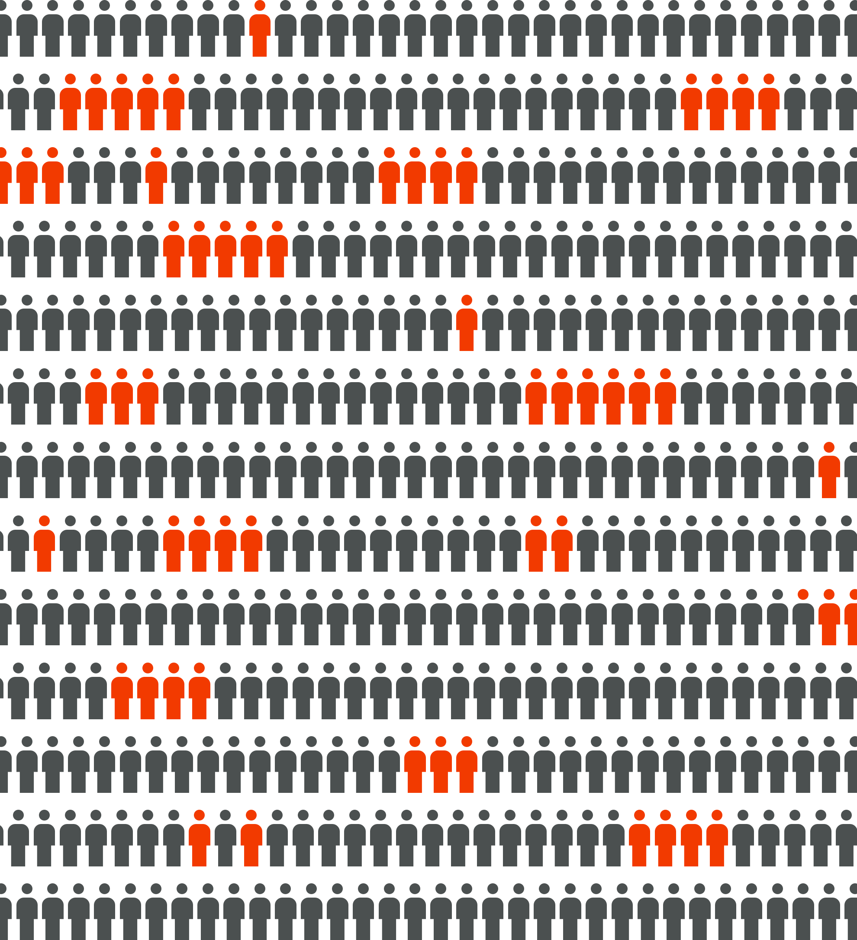

Scott Darnell,
Director
Dave Higdon,
Professor
A Data-Driven Approach
to Addressing the Crime Spike in Albuquerque
September 14, 2017
A presentation to the National Academies of Sciences, Engineering and Medicine

Slide 2

ABQ Size: 189 square miles
ABQ Pop: 570K
Population Rank: 32nd largest
Bernalillo County Pop: 676K

Slide 3
Context: A Crime Spike in Albuquerque
Unprecedented spike in crime
Historically-low crime rate years

Slide 4
Context: A Crime Spike in Albuquerque
 | 2013 | 2014 | Change (‘13-‘14) | 2015 | Change (‘14-‘15) | 2016 | Change (‘15-‘16) | Change (‘13-‘16)
Violent Crime Incidents
Murder | 37 | 30 | (-19%) | 46 | (+53%) | 61 | (+33%) | (+65%)
Rape | 439 | 402 | (-8%) | 404 | (+0.5%) | 381 | (-6%) | (-13%)
Robbery | 1,046 | 1,381 | (+32%) | 1,686 | (+22%) | 1,957 | (+16%) | (+87%)
Agg. Assault | 2,803 | 3,121 | (+11%) | 3,273 | (+5%) | 3,846 | (+18%) | (+37%)
Property Crime Incidents
Burglary | 7,297 | 6,123 | (-16%) | 5,996 | (-2%) | 6,236 | (+4%) | (-15%)
Larceny | 20,229 | 20,756 | (+3%) | 22,818 | (+10%) | 24,582 | (+8%) | (+22%)
Auto Theft | 3,005 | 3,558 | (+18%) | 5,179 | (+46%) | 7,710 | (+49%) | (+157%)
+26%
Violent Crime Rate
(2014-2016)
+26%
Property Crime Rate
(2014-2016)
Source: Preliminary Uniform Crime Report Data, Provided by APD

Slide 5
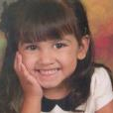
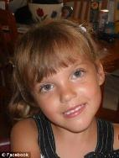
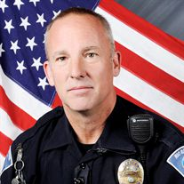


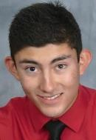


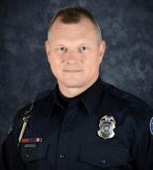
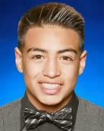
Context: A Concerned Community

Slide 6
Context: A Decentralized Justice System
Governor
Bernalillo County Commission
Mayor
Albuquerque Police Dept.
Bernalillo County District Attorney
Metropolitan Detention Center
State Supreme Court
NM Legislature
ABQ City Council
Bernalillo County Sheriff’s Dept.
Admin Office of D.A.’s
NM Department of Corrections
Admin Office of the Courts
Elected Officials
University of NM Police Dept.
Office of Public Defender
Corrections
2nd Judicial District Court
New Mexico State Police
Public Defender Commission
District Court Criminal Judges
Tribal Police Agencies
U.S. Attorney
Metro Court and Judges
FBI, ATF, DEA, US Marshals
Prosecution & Defense
State Court of Appeals
Probation and Parole (NMDC)
Federal Court and Judges
Police
Judges & Courts

Slide 7
Context: A Justice System in Flux
44%
12th
Reforming Police Dept., DOJ Oversight
Overall conviction rate in Bernalillo County
Conviction rate ranking among New Mexico’s 13 judicial districts (2nd lowest)
Drop in Jail Population
New District Attorney
1,000
152
No. of officers needed to fully staff APD
Current officer shortage at APD
New Bail Rules
Rapid
Succession
of Change
Preventive Detention/ Const. Amendment
7,800
14.7%
Approx. number of unindicted criminal cases backlogged at the D.A.’s Office
Felony conviction rate over past 3 yrs on felony arrests of the most serious repeat offenders
Case Mgmt. Order
New Risk Assess. Tool for Courts
Officer Shortage in ABQ
222
60%
Average pre-trial length of stay for inmates at the local jail in August 2012
The approx. percent decline in the average daily jail population over the past several years
(from 2,900 to 1,200)

Slide 8




Slide 9
Insights from Stakeholder Meetings
Poor differentiation of offenders leads to poor tailoring of interventions
Data infrastructure is fragmented (separate systems, no unique identifiers across data sets)
Ongoing strategic crime analysis across the justice system is severely lacking
Consensus around poor performance of previous D.A., belief that a strong D.A./police relationship is positive
Contentious conversations and “cross-talk” around impact of justice system reforms (further need for clarity)
Heavy reliance on violent/non-violent offender dichotomy
System “speaks” in terms of cases, files, incidents, etc. --- not generally in terms of “people”
Share Information
Take a Balanced Approach
Improve Efficiency
Shared Values
Tailor Interventions
Differentiate Offenders

Slide 10
Makes a big problem smaller, and a seemingly impossible one more manageable
Lays the foundation for collaboration, referees disputes/disagreements
Reduces hand-wringing, illuminates a path forward
A Data-Driven
Response
●●●
WHY?
Reduces “creep,” instills focus
Guides resource allocation/ maximization toward investments believed to have the greatest impact
Keeps the problem (and those affected by it) at the forefront
Identifies optimal areas for the testing of new interventions and approaches
Helps explain problems and responses: a well-constructed statistic is worth a thousand words
Most large problems and public policy challenges are really the result of
numerous smaller problems that have a detrimental cumulative impact

Slide 11
Research Approach
Place-Based Approach
Understand the geographic concentration and distribution of crime in Albuquerque
FEB
AUG
Person-Centered Analysis
Understand the characteristics and criminal behavior of those who have been arrested for committing crimes in Bernalillo County
MAR
DEC
Phase 1
Phase 2
Insight Seeking to Peer Behind the Data
Use various research methods to gain insights into offender behavior, give voice to public concerns and perspectives, and explore root causes of problems
MAY
OCT

Slide 12
Summary: Crime Concentration in ABQ
Note: Crime concentration analyses were conducted using arrest, incident, and calls-for-service data provided by the Albuquerque Police Department.
The period of study was 2014 through 2016, unless otherwise noted. Non-fatal shootings data run from June 2016 to March 2017.

Slide 13
Central Findings: Crime Concentration
Violent
Crime
Property
Crime
Arrestee
Addresses
incidents are spread more diffusely throughout the city, but still prevalent in the same few cluster areas
incidents are heavily concentrated in a few key areas comprising a small portion of the city’s area and population
in ABQ for both property crimes and violent crimes are heavily concentrated in the same few cluster areas
Other Findings: (a) Identified high crime areas tend to have larger minority populations, lower household income, and lower educational attainment levels, and (b) in identified high-crime areas, about 1 in 10 addresses (on average) have been the location of at least one violent crime over the past three years, while 1 in 5 addresses (on average) have been the location of at least one non-larceny property crime, proportions that significantly exceed the citywide average.
Note: Crime concentration findings do NOT imply that violent or property crimes are isolated to only certain parts of the city or that, during the recent crime spike, the increase in the prevalence of these crimes is occurring in only certain parts of the city; rather, violent and property crimes occur throughout the city, and data shows they have been increasing in number throughout the city. That being said, with some exceptions, we do not currently find significantly altered patterns over the past three years concerning the distribution and proportion of criminal activity that occurs in various areas throughout Albuquerque.

Slide 14
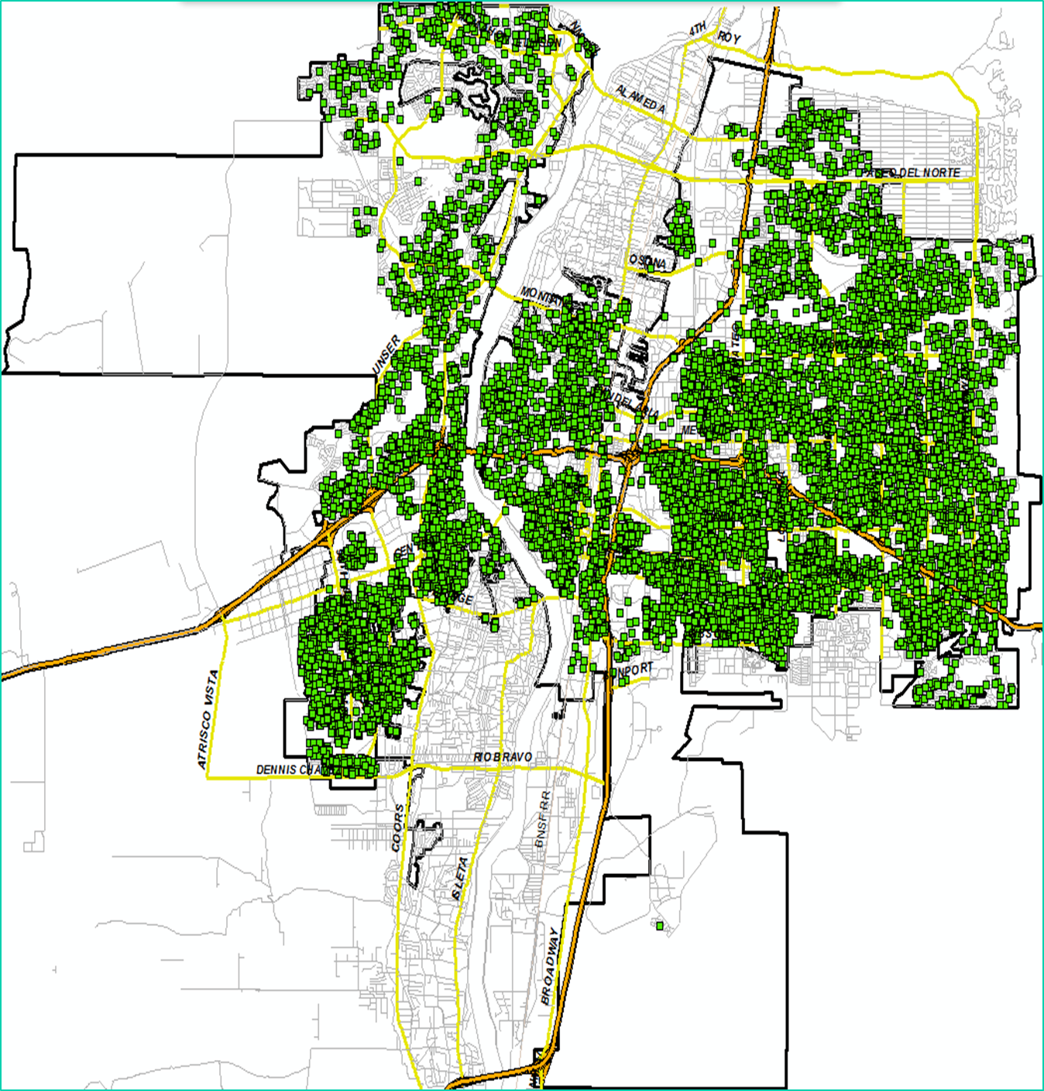
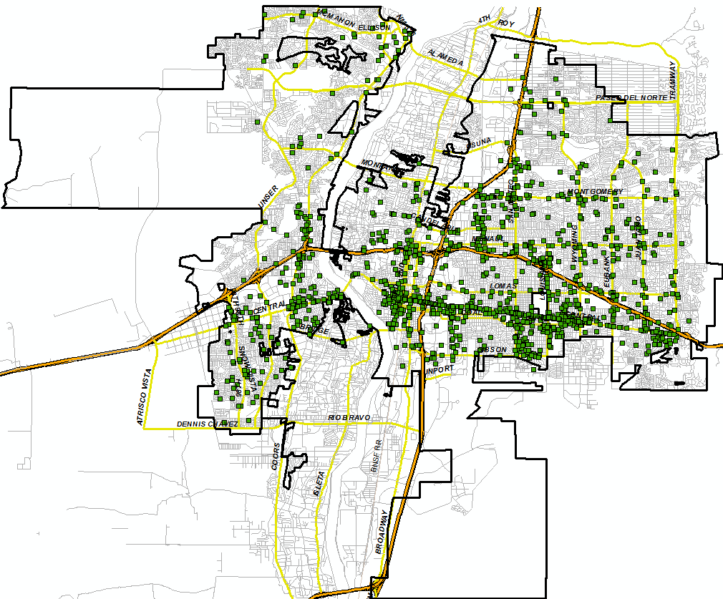
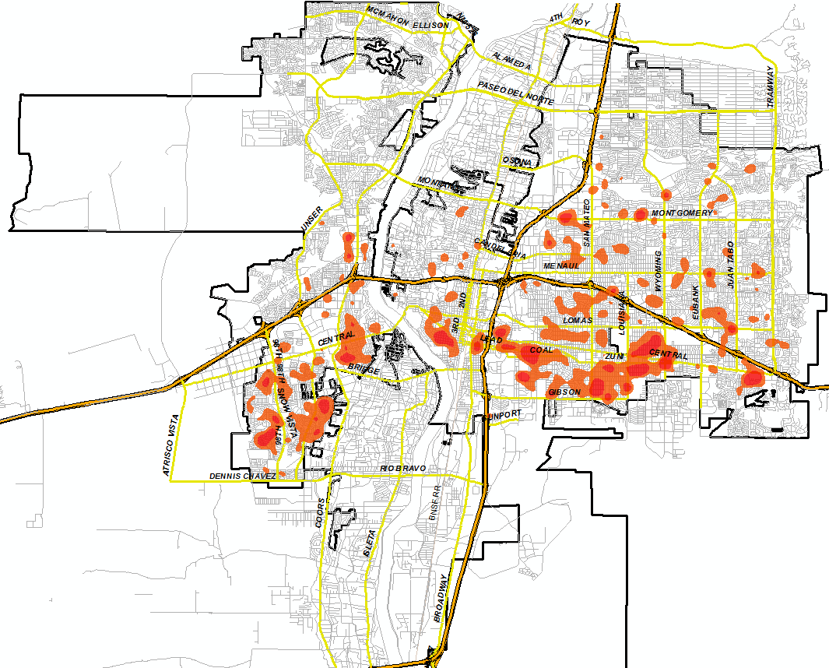
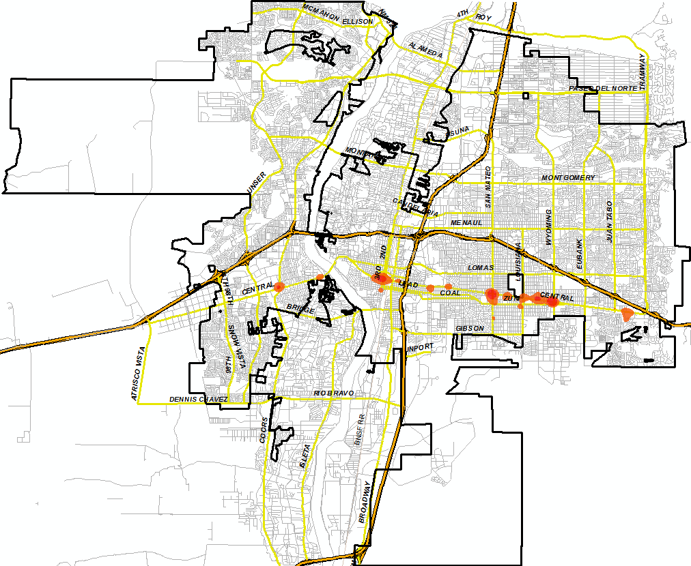
Example: Residential Burglary vs. Robbery
Property – Residential Burglary
Violent – Robbery of Individual
Incidents (2014-2016)
AUG
Hot Spots (2014-2016)

Slide 15
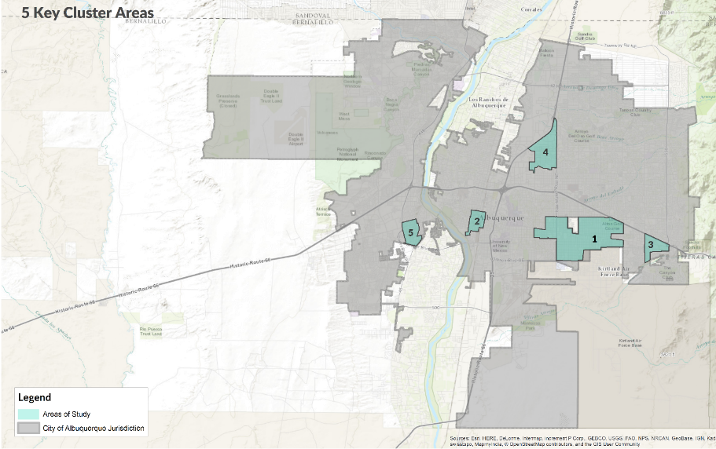
5 Key Areas: High Crime Concentration
Cluster | Area (sq. mi.) | Percentage of City Area | Population | Percentage of City Pop.
Area 1: SE/Primary | 5.54 | 2.93% | 37,631 | 6.73%
Area 2: Downtown | 0.69 | 0.37% | 2,597 | 0.46%
Area 3: Far Southeast | 0.75 | 0.39% | 4,945 | 0.88%
Area 4: San Mateo | 1.74 | 0.92% | 6,419 | 1.15%
Area 5: Southwest | 0.69 | 0.37% | 5,700 | 1.02%
Total | 9.41 | 4.98% | 57,292 | 10.23%
A Small Portion of the City’s
Total Population and Area

Slide 16
Violent Crime Concentration
49.0% of Non-Fatal Shootings with Injury
43.6% of Murders
5 Crime Clusters
5% of ABQ Area
10% of ABQ Population
36.2% of Robberies/Individuals
34.5% of Aggravated Assaults
29.4% of Non-Fatal Shootings without Injury
27.0% of Carjackings
26.3% of Home Invasions
19.7% of Robberies/Commercial

Slide 17
Property Crime Concentration
23.7% of Commercial Burglaries
22.3% of Auto Thefts
5 Crime Clusters
5% of ABQ Area
10% of ABQ Population
17.5% of Larcenies
16.6% of Residential Burglaries
14.3% of Auto Burglaries

Slide 18
Arrestee Address Concentration
42.3% of Carjackings
39.1% of Robberies of Individuals
5 Crime Clusters
5% of ABQ Area
10% of ABQ Population
34.0% of General Robberies
31.4% of Aggravated Assaults
26.1% of Murders
23.5% of Commercial Robberies
33.1% of Residential Burglaries
31.3% of Commercial Burglaries
Notes:
Murder percentage calculated using information provided by APD Homicide
Figures reflect percentage of ABQ arrestee addresses by crime type that are located in these 5 areas
Roughly 10% of arrestee addresses were outside of ABQ (still in NM) for violent crime categories
Roughly 16% of arrestee addresses were outside of ABQ (still in NM) for property crime categories
28.5% of Larcenies
26.0% of Auto Burglaries
23.4% of Auto Thefts

Slide 19
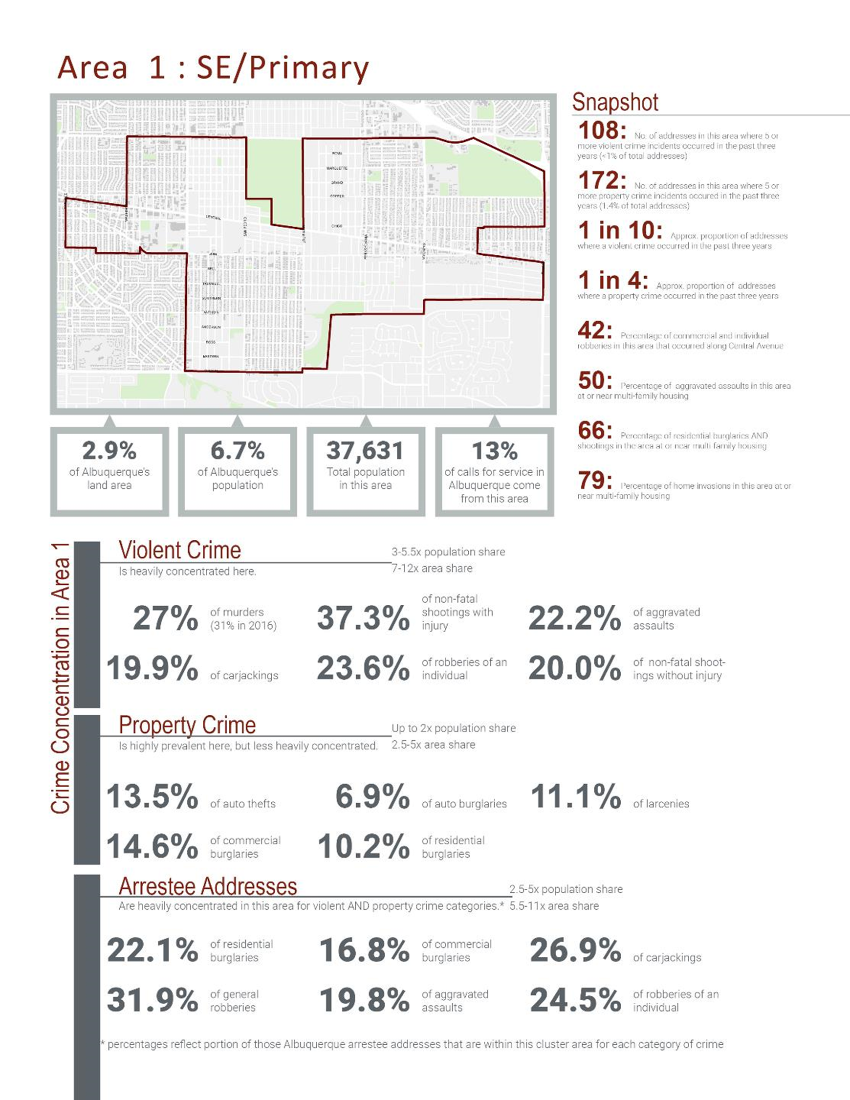
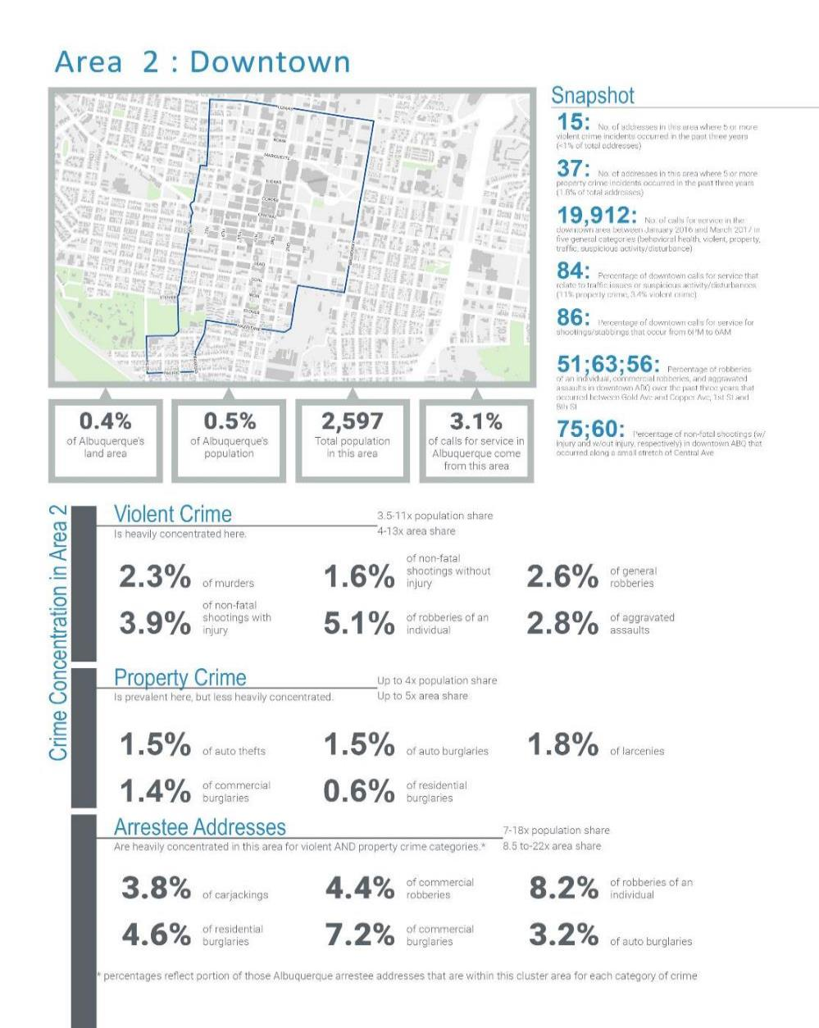

Slide 20
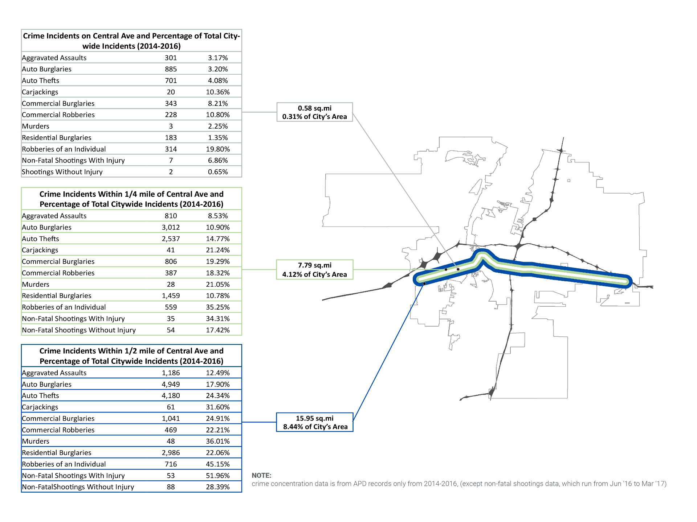
An Alternative Look:
Central Avenue Crime Concentration

Slide 21
Potential Applications
PUBLIC SAFETY LIGHTING IMPROVEMENTS
Target lighting upgrades in key high-crime areas
LAW ENFORCEMENT AND SOCIAL SERVICES RESOURCE ALLOCATION
Intentionally invest, focus, and direct resources for enforcement efforts and social services to key high-crime neighborhoods
GEOGRAPHIC APPROACH TO PROSECUTION
Use data to help deploy and allocate prosecutorial resources on a more geographic basis
SAFETY CORRIDOR TASK FORCE, DEPLOY CRIME-FIGHTING TOOLS AND TECHNOLOGY
Establish an agile safety corridor task force to focus on deterring, better investigating crime along Central Ave. (and in nearby high-crime areas), and strategically deploy license plate readers, security cameras
“SCAN” SECURITY CAMERA RECRUITMENT
Urge residents/businesses in key high-crime areas to sign up for the Security Camera Analytical Network
CROSS-AGENCY CITY SERVICE TEAMS
Train and deploy city workers across all agencies who work within key high-crime areas on crime mitigation strategies (transit, solid waste, cultural services, parks, and recreation, etc.)
MULTI-FAMILY HOUSING INTERVENTIONS
Make owners of high-crime multi-family housing aware of the activity occurring on their property, and seek changes to processes and operations to improve safety
OTHER/MISCELLANEOUS:
Mapping tool for ongoing strategic crime analysis
Baseline from which to evaluate progress
Guide for qualitative work, deeper insight-seeking and understanding about root causes and crime drivers

Slide 22
Breaking the Crime Cycle:
An Ongoing Study of the Characteristics and Criminal Activity of Arrestees in Bernalillo County

Slide 23
Arrestee Study: The Basics
Commissioned and Guided by the ABQ i-team
Researchers: Dr. Dave Higdon, Virginia Tech and Dr. Paul Guerin, University of New Mexico
Partners: City of ABQ, Albuquerque Police Dept., Bernalillo County Sheriff’s Dept., Bernalillo County (Metro Detention Center), NM Sentencing Commission, and NM Dept. of Public Safety
Goal: Provide the first comprehensive understanding and accounting of the size, composition, and behavior of those who have been arrested for crimes in Bernalillo County. Ensure the analysis is operationally useful in the short-term for justice system agencies and capable of supporting strategic decision making over the long-term.
PHASE 1 – Baseline Data
PHASE 2 - Microanalyses
Basic counts of arrestees and demographic analysis
Distribution of arrests/arrestees by crime categories, charge class
Differentiation of arrestees based on frequency and seriousness of offenses
Analysis of differences between first-time and repeat arrestees
Exploration of high-level questions: which offenses are most often committed by repeat offenders, are repeat offenders specialists or generalists as it relates to their criminal behavior over time
Various types of microanalyses of subsets of the arrestee population, including the exploration of crime pathways for certain types of offenders
Incorporation of other types of data (e.g. case disposition, mental health crisis intervention, state prison history)
Long-term: use this study as a foundation for further data integration efforts in the justice system
Note: This research project uses law enforcement and jail data to study those who have been arrested for crimes in Bernalillo County. Currently, the master data set does not contain any data relating to the disposition of these arrests/cases.

Slide 24
Arrestee Study: Data Sources
APD
Arrests, Citations, and Summons
BCSD
Arrests, Citations, and Summons
DPS
Statewide Fingerprint Cards
MDC
Local Jail Bookings
VA Tech
UNM
ABQ i-team
Master Arrestee Data Set
Period of Study: January 1, 2010–December 31, 2016
429,814
Total Charges
312,212
Total Arrests
127,792
Total Individuals

Slide 25
APD Police Records – By Charge
Case # | Arrest Date | Last Name | First Name | DOB | ID # | Description | M/F | Description
90087849 | 8/30/10 | JOHNSON | KAREN | 2/11/90 | 1045 | Public Order | MW | Misdemeanor Warrant
90087849 | 8/30/10 | JOHNSON | JAMES | 10/25/86 | 8758 | Public Order | FW | Felony Warrant
90087849 | 8/30/10 | LUTZ | NINA | 12/3/77 | 1652 | Public Order | FW | Felony Warrant
90113044 | 6/20/12 | GUTIEREZ | DAVID | 1/27/82 | 7723 | Drug | F2 | Trafficking Controlled/Manufact
90113044 | 6/20/12 | GUTIEREZ | DAVID | 1/27/82 | 7723 | Public Order | F4 | Conspiracy
90113044 | 6/20/12 | GUTIEREZ | DAVID | 1/27/82 | 7723 | Public Order | MH | Tampering W/Evidence
90113044 | 6/20/12 | VERDASCO | ELLEN | 6/30/86 | 5930 | Drug | F2 | Trafficking Controlled/Manu 3599
90113044 | 6/20/12 | VERDASCO | ELLEN | 6/30/86 | 5930 | Public Order | F4 | Conspiracy 4808
90113044 | 6/20/12 | VERDASCO | ELLEN | 6/30/86 | 5930 | Public Order | MH | Tampering W/Evidence 4804
90124157 | 12/21/11 | ANSON | SAUL | 1/13/79 | 6241 | Domestic Violence | F4 | Aggravated Assault HH Member
90125641 | 1/15/10 | BAKER | GEORGE | 1/25/83 | 3460 | Public Order | F4 | Aggravated Fleeing An Officer 801
90125641 | 1/15/10 | BAKER | GEORGE | 1/25/83 | 3460 | Property | Unkn | Recovered Vehicle
100000044 | 1/2/10 | RUIZ | JULIO | 7/15/88 | NA | Public Order | MW | Misdemeanor Warrant
Note: Many variables not shown: race, gender, charge information, location. Personal information altered.

Slide 26
APD Police Records – By Arrest
Case # | Arrest Date | Last Name | First Name | DOB | ID # | Description | M/F | Description
90087849 | 8/30/10 | JOHNSON | KAREN | 2/11/90 | 1045 | Public Order | MW | Misdemeanor Warrant
90087849 | 8/30/10 | JOHNSON | JAMES | 10/25/86 | 8758 | Public Order | FW | Felony Warrant
90087849 | 8/30/10 | LUTZ | NINA | 12/3/77 | 1652 | Public Order | FW | Felony Warrant
90113044 | 6/20/12 | GUTIEREZ | DAVID | 1/27/82 | 7723 | Drug | F2 | Trafficking Controlled/Manufact
90113044 | 6/20/12 | VERDASCO | ELLEN | 6/30/86 | 5930 | Drug | F2 | Trafficking Controlled/Manu 3599
90124157 | 12/21/11 | ANSON | SAUL | 1/13/79 | 6241 | Domestic Violence | F4 | Aggravated Assault HHMember
90125641 | 1/15/10 | BAKER | GEORGE | 1/25/83 | 3460 | Public Order | F4 | Aggravated Fleeing An Officer 4801
100000044 | 1/2/10 | RUIZ | JULIO | 7/15/88 | NA | Public Order | MW | Misdemeanor Warrant
Useful to look by arrest
Records consistent within an arrest
Keep highest charge
Note: Personal information altered.

Slide 27
Many Individuals also Appear as Arrests in DPS Database
Arrest Date | Last Name | First Name | DOB | ID # | Description
2012-10-02 | GUTIEREZ | DAVID | 1982-01-27 | 15979 | Other F Failure to comply
2012-10-02 | GUTIEREZ | DAVID | 1982-01-27 | 15979 | Violent F Possession of fire
2012-10-02 | GUTIEREZ | DAVID | 1982-01-27 | 15979 | Violent F Possession of fire
2012-10-02 | GUTIEREZ | DAVID | 1982-01-27 | 15979 | Drug F Possession of a co
2013-01-05 | GUTIEREZ | DAVID | 1982-01-27 | 15979 | Property F Receiving/Transfer
2013-01-05 | GUTIEREZ | DAVID | 1982-01-27 | 15979 | Property F Receiving/Transfer
2013-02-01 | GUTIEREZ | DAVID | 1982-01-27 | 15979 | Property F Receiving/Transfer
2013-03-08 | GUTIEREZ | DAVID | 1982-01-27 | 15979 | Other F Failure to comply
2013-03-08 | GUTIEREZ | DAVID | 1982-01-27 | 15979 | Property F Embezzlement of a
2014-01-09 | GUTIEREZ | DAVID | 1982-01-27 | 15979 | Property F Burglary (commerci
2014-01-09 | GUTIEREZ | DAVID | 1982-01-27 | 15979 | Other F Failure to comply
DPS has its own ID variable
Charges are not easily mapped from one database to another
Developed mapping from APD to DPS charges
Different events may lead to records in the various databases
Note: Personal information altered.

Slide 28
Some Individual Histories in the APD and DPS Databases
Randomly Selected People with APD and DPS Values (Timeline)
Random Person ID
Dates

Slide 29
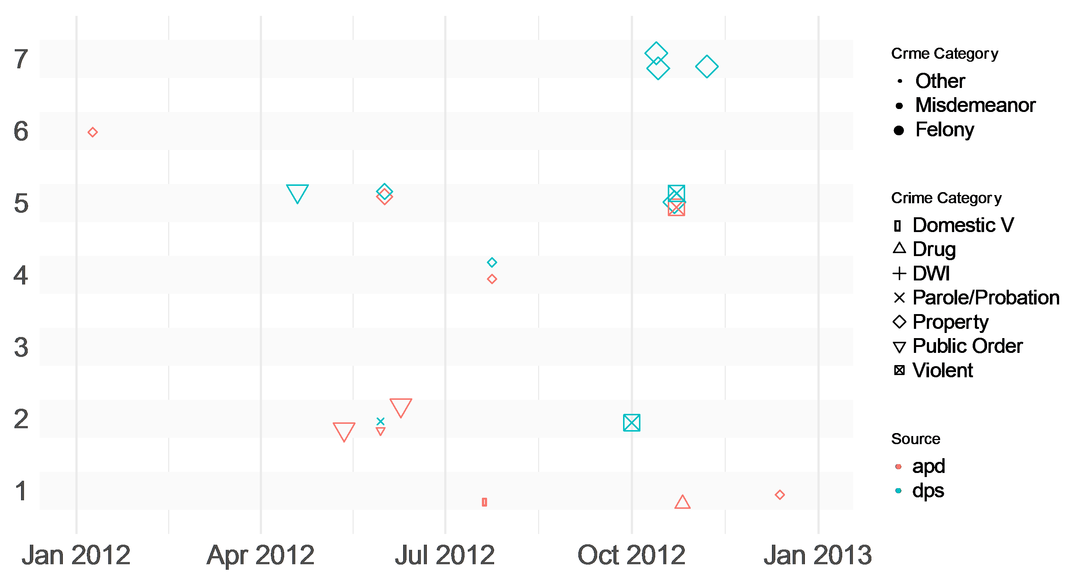
Some Individual Histories in the APD and DPS Databases
Randomly Selected People with APD and DPS Values (Timeline)
Random Person ID
Dates

Slide 30
Approach for Linking Records
Consistency of Names, DOB, IDs, other identifiers
Crude approach for now; will improve and codify for later
Within a database, as well as between databases
Based on “fuzzy” matching within pairs
ID 1 | ID 2 | Last Name | First Name | Sex | DOB | Arrest Date
 | 16838 | GONZALES | JUAN | M | 1985-05-19 | 2014-02-08
 | 16838 | GONZALES | JUAN | M | 1985-05-19 | 2015-05-01
4198 |  | GONZALEZ | JUAN | M | 1990-06-06 | 2015-01-27
 |  | GONZALES | JUAN | M | 1990-06-06 | 2013-07-22
4198 |  | GONZALEZ-GOMEZ | JUAN | M | 1990-06-06 | 2011-07-24
Note: Personal information altered.

Slide 31
Approach for Linking Records
1
2
Match: dob+first+fuzzy (last)
Match: id+dob+fuzzy (last)
3
4
2 different individuals: (1,2) (3,4,5)
5
ID 1 | ID 2 | Last Name | First Name | Sex | DOB | Arrest Date
 | 16838 | GONZALES | JUAN | M | 1985-05-19 | 2014-02-08
 | 16838 | GONZALES | JUAN | M | 1985-05-19 | 2015-05-01
4198 |  | GONZALEZ | JUAN | M | 1990-06-06 | 2015-01-27
 |  | GONZALES | JUAN | M | 1990-06-06 | 2013-07-22
4198 |  | GONZALEZ-GOMEZ | JUAN | M | 1990-06-06 | 2011-07-24
Note: Personal information altered.

Slide 32
Captures Name Misspellings
ID APD | ID DPS | ID MDS | Last Name | First Name | Sex | DOB | Arrest Date
8633 |  | <NA> | CARLSEN | COLLETTE | F | 1982-09-21 | 2010-02-17
8633 |  | <NA> | CARLSEN | COLLETTE | F | 1982-09-21 | 2011-09-22
8633 | 17367 | <NA> | CARLSEN | COLLETTE | F | 1982-09-21 | 2010-11-04
8633 | 17367 | <NA> | CARLSEN | COLLETTE | F | 1982-09-21 | 2013-09-19
8633 |  | <NA> | CARLSEN | COLLETTE | F | 1982-09-21 | 2014-12-28
8633 | 17367 | <NA> | CARLSEN | COLLETTE | F | 1982-09-21 | 2010-05-30
 |  | 10017 | CARLSON | COLLETTE | F | 1982-09-21 | 2011-06-08
 |  | 10017 | CARLSON | COLLETTE | F | 1982-09-21 | 2011-06-13
 |  | 10017 | CARLSON | COLLETTE | F | 1982-09-21 | 2016-04-14
Note: Personal information altered.

Slide 33
Captures Name Changes - Female Only
ID APD | ID DPS | ID MDS | Last Name | First Name | Sex | DOB | Arrest Date
762 |  | 10007 | MARTINEZ | MELANIE | F | 1980-01-30 | 2011-04-12
 |  | 10007 | MARTINEZ | MELANIE | F | 1980-01-30 | 2015-12-11
 | 14540 | 10007 | MARTINEZ | MELANIE | F | 1980-01-30 | 2012-12-12
 | 14540 | <NA> | MARTINEZ | MELANIE | F | 1980-01-30 | 2010-09-17
 | 14540 | 10007 | MARTINEZ | MELANIE | F | 1980-01-30 | 2011-09-26
 |  | <NA> | MARTINEZ CASARES | MELANIE | F | 1980-01-30 | 2012-10-21
 |  | <NA> | MARTINEZ-CASARE | MELANIE | F | 1980-01-30 | 2010-05-10
762 |  | <NA> | MARTINEZ-CASARE | MELANIE | F | 1980-01-30 | 2012-04-16
762 |  | <NA> | MARTINEZ-CASARE | MELANIE | F | 1980-01-30 | 2014-01-18
 |  | <NA> | MARTINEZ-CASARES | MELANIE | F | 1980-01-30 | 2011-11-17
762 |  | <NA> | MARTINEZ-CASARES | MELANIE | F | 1980-01-30 | 2012-10-24
 |  | <NA> | MARTINEZ-CASARES | MELANIE | F | 1980-01-30 | 2010-02-20
 |  | <NA> | MARTINEZ-CASARES | MELANIE | F | 1980-01-30 | 2010-07-27
 |  | <NA> | MARTINEZ-CASARES | MELANIE | F | 1980-01-30 | 2011-08-22
 |  | <NA> | MARTINEZ-CASARES | MELANIE | F | 1980-01-30 | 2012-12-12
Note: Personal information altered.

Slide 34
Captures DOB Errors
ID APD | ID DPS | ID MDS | Last Name | First Name | Sex | DOB | Arrest Date
6672 |  | <NA> | JOHNSON | MICHAEL | M | 1971-07-15 | 2013-02-02
6672 |  | <NA> | JOHNSON | MICHAEL | M | 1971-07-15 | 2012-03-30
 | 32842 | <NA> | JOHNSON | MICHAEL | M | 1971-07-15 | 2012-09-05
 | 32842 | <NA> | JOHNSON | MICHAEL | M | 1971-07-15 | 2013-02-11
6672 | 32842 | 10000 | JOHNSON | MICHAEL | M | 1973-07-15 | 2012-10-15
 | 32842 | <NA> | JOHNSON | MICHAEL | M | 1970-07-15 | 2011-12-18
 | 32842 | <NA> | JOHNSON | MICHAEL | M | 1971-07-15 | 2012-04-15
 | 32842 | <NA> | JOHNSON | MICHAEL | M | 1971-07-15 | 2014-01-20
6672 |  | <NA> | JOHNSON | MICHAEL | M | 1971-07-15 | 2012-09-02
 | 32842 | <NA> | JOHNSON | MICHAELE | M | 1971-07-15 | 2012-07-20
Note: Personal information altered.

Slide 35
Trouble with Twins
A first initial/name problem?
Use sex?
Is it reliable enough?
Other fuzzy combinations?
ID APD | ID DPS | ID MDS | Last Name | First Name | Sex | DOB | SAME
558 |  | <NA> | MANZANO | JAMES | M | 1988-07-16 | 177016
558 | 54413 | <NA> | MANZANO | JAMES | M | 1988-07-16 | 177016
 |  | <NA> | MANZANO | JAMES | M | 1988-07-16 | 177016
4892 |  | <NA> | MANZANO | MARDOQUEO | M | 1988-07-16 | 178293
 |  | 10020 | MANZANO | MARDOQUEO | M | 1988-07-16 | 178293
4570 |  | <NA> | MANZANO | MONIQUE | F | 1988-07-16 | 178293
 |  | <NA> | MANZANO | MONIQUE | F | 1988-07-16 | 178293
4570 | 40539 | <NA> | MANZANO | MONIQUE | F | 1988-07-16 | 178293
Note: Personal information altered.

Slide 36
Issues Regarding Linkage
Consistency of names, DOB, other identifiers
Charge descriptors
Duplicates
IDs not always correct, often missing in some databases
Record corrections can appear as duplicates
Near-duplicates good for lookup, bad for counting
Within a database, as well as between databases

Slide 37
Future Work
Better accounting of uncertainty in record linkage
Extend probabilistic methods linking multiple records within a single database
Propagate uncertainties to counts of arrests and individuals
Reliable automation for charge linkage
Done by hand in this effort
Additional databases to see individual histories
Jail time, court records, sentencing
Leverage network approaches
Improve reliability of record linking
Discern more organized criminal activity

Slide 38
Arrestee Study: Components of Phase 1
1
ARREST FREQUENCY
Distribution of arrestee population by arrest frequency and type over time
4
ARRESTEE CRIMES
Distribution of arrestees by crime category and frequency of arrests
Distribution of arrestees by charge class and frequency of arrests
2
DEMOGRAPHICS
Demographic analysis of arrestee population
5
CRIME CROSSOVER
To what extent is arrestee behavior specialized or generalized in nature?
BCSO
3
ARREST TYPES
Distribution of arrests by crime category and arrestee frequency of arrests
Distribution of arrests by charge class and arrestee frequency of arrests
6
REPEAT ACTIVITY
Distribution of arrestee population by arrest frequency and type over time
Note: Analysis of data for Phase 1 of the Arrestee Study is ongoing with an anticipated release date of late September for a preliminary report of findings.

Slide 39
Arrestee Study: Next Steps, Applications
Further refinement of master data set (matching/merging)
Addition of other data sets
Microanalyses and potential applications (examples)
High-rate, high-risk offenders
High-rate, low-risk offenders
Identify candidates for diversion
Crime pathways of offenders
Case disposition review
Crime categories that affect repeat offenders
Makes a big problem smaller…
APD
FBI
Keeps the problem in focus…
…illuminates a path forward
Guides resource allocation…
Lays the foundation for collaboration…

Slide 40
Arrestee Study: Long-Term Goals
Preserve master arrestee database beyond i-team period of work
Automate process of incorporating future data, including merging and matching
Establish unique identifiers across data sets for all arrestees
Incorporate case disposition data, in particular
Establish a clearinghouse for ongoing strategic crime analysis
Ultimately, improve data integration and sharing across the justice system and shift collective thinking toward “people”

Slide 41

Special Acknowledgements
APD Real Time Crime Center
Dr. Paul Guerin, UNM

