Slide 1
D3M: The Organizational Perspective
Fred Oswald
Professor, Department of Psychology
Rice University
Principles for Data-Driven Decision Making
September 14, 2017

Slide 2

Big Data analytics provides reasons/opportunities to collaborate – if there is a culture for that. (e.g., Kantrowicz, 2014, 25% of 1,406 HR professionals satisfied with how talent data are managed)
Statistical Modeling
Findings/Discoveries
Future Organizational
Needs
Selection Purpose
Future Outcomes
Available Data
Ties to other org functions
(perhaps served by Big Data)
HR Assessment + Analytics + IT
+ Management + Teams/Employees +….

Slide 3
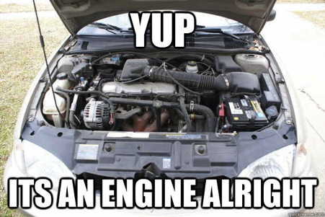
Principle 1:
Question the Data and Analysis Pipeline
Big Data only = the 3, 4, 5Vs
of data in the cloud, it’s useless.
Taylor 2013, HBR Blog: “We can amass all the data in the world, but if it doesn’t help to save a life, allocate resources better, fund the organization, or avoid a crisis, what good is it?”
Companies indeed have an increasing amount of data on hand.
Some of those data are directly relevant
(lots of online applications, screening tests).
Other data might be indirect, but an argument can be made for selection (resume text mining).
Still other data are indirect but can be difficult to justify even if predictive (e.g., time for an employee to complete a form online…)

Slide 4


Principle 1:
Question the Data and Analysis Pipeline
So predictions may be more accurate and robust than ever…
Sprinkles = data
Donut = model
Shake the donut = cross-validation

Slide 5
Principle 1:
Question the Data and Analysis Pipeline
So predictions may be more accurate and robust than ever…
What if we tried out a Pop-Tart® instead …and then a croissant…etc.
And then we averaged our predictions?
Sprinkles = data
Other pastries = model uncertainty
Shake the pastry = cross-validation

Slide 6
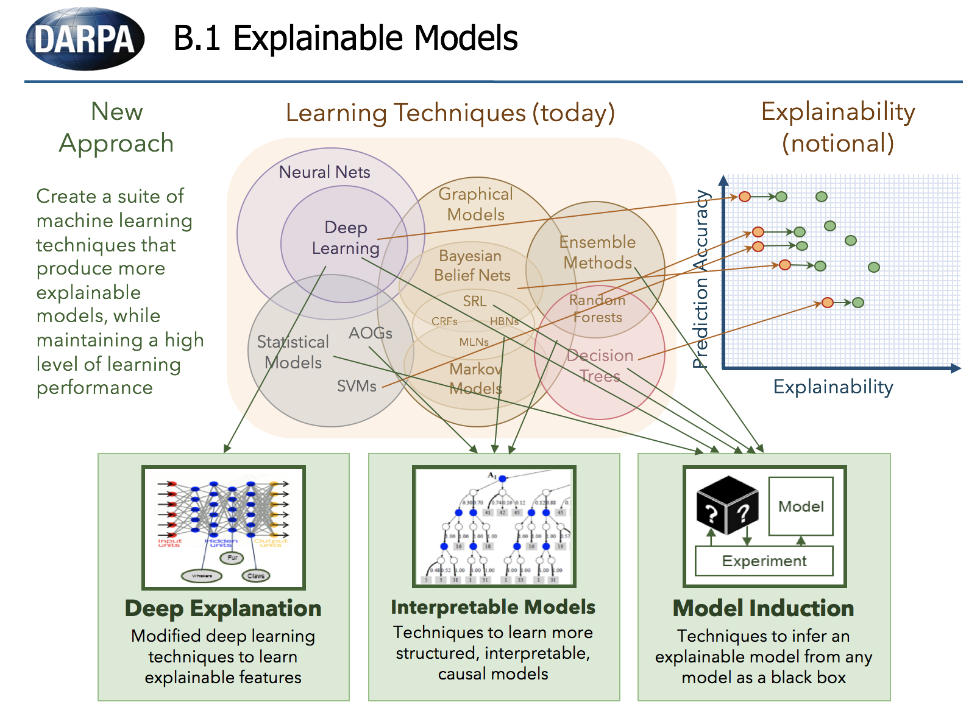
no single model or variable can be isolated
(Explainable Artificial Intelligence – DARPA, 2016)

Slide 7


Principle 1:
Question the Data and Analysis Pipeline
So predictions are more accurate and robust than ever…
  …but what’s missing…is it measurable/predictable
  (an especially helpful or hateful supervisor)?
  …is it translatable? (CNA’s RVU metric)
  (organizational data possible often larger than what’s available;
  additional data could change your model…entirely)
…what if models are cross-validated donuts in your (big) data but not stable across situations and over time?

Slide 8
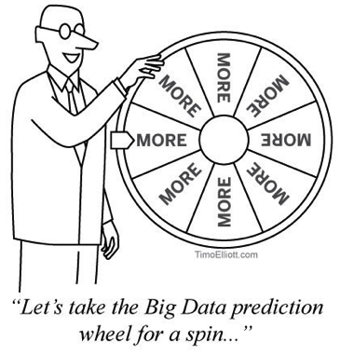
Principle 2:
Know Your Population and ask if the Data Match
Improving prediction using Big Data is not the same as actual improvement based on those predictions.
Simple (simplistic) Example:
Your model predicts that non-smokers (vs. non-smokers) have longer life spans.
This does not mean that people who quit smoking will live as long as those who never smoked.
Between-person differences are not always the same as within-person change.

Slide 9
Principle 2:
Know Your Population and ask if the Data Match
Improving prediction using Big Data is not the same as actual improvement based on those predictions.
Better Example: With Big Data, you predict applicants who are already your best-performing employees.
Does your model also suggest which employees will become better performers (via reskilling, management, teamwork, etc.)? data/models of knowledge/skill change from a reskilling decision process (IBM, prescriptive)
Note: Offering training itself may be viewed as the organization caring for the employee’s development, reducing attrition beyond KSAs

Slide 10
Principle 2:
Know Your Population and ask if the Data Match
Improving prediction using Big Data is not the same as actual improvement based on those predictions.
Better Example: With Big Data, you predict applicants who are already your best-performing employees.
…What if your best performers are more likely to leave?
Multivariate optimization/ tradeoffs…over time:
e.g., basically risk/reward choice (IBM, modeling + SME)
e.g., team support vs. task performance vs. turnover vs. engagement vs. customer satisfaction
e.g., volume vs. short-term cost vs. long-term cost in healthcare….
e.g., best profit vs. investment cycles
e.g., easy vs. difficult levers to pull w/ interventions!

Slide 11
Principle 2:
Know Your Population and ask if the Data Match
Improving prediction using Big Data is not the same as actual improvement based on those predictions.
“Prediction is difficult, especially about the future”
(ABQ: Spike in number/nature of crimes change)
There are many are different populations to sample with data (not just people: ABQ and regions; IDA and demography, geography; time cycles and span – IBM, skill demand, team building, and adaptive control)

Slide 12
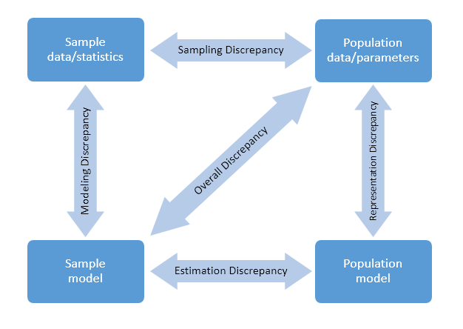
Principle 2:
Know Your Population and ask if the Data Match
Prediction = f(data, model)

Slide 13
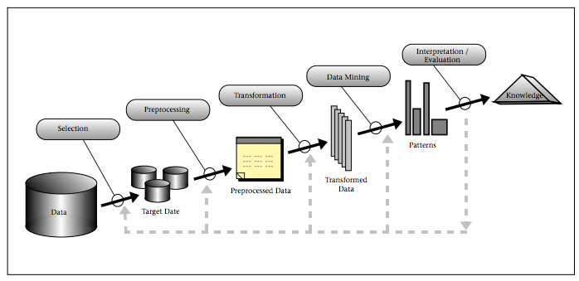
Principle 3:
Ask How the Data and Analysis Drive a Decision
Indirect data could lead to developing more interpretable and psychometrically reliable measures (given enough time, $...).
(expertise → new data)
(Fayyad et al., 1996)

Slide 14
Principle 3:
Ask How the Data and Analysis Drive a Decision
Big Data +
“Knowing Where to Cut”
(across people, time, settings…etc.)
Say you have 1,000,000,000,000s of data points for 1000s of employees, monitoring every millisecond of the day.
You could model performance dynamics and what applicant data predict it….how?
e.g., team vs. individual activities for selection, training, real-time intervention

Slide 15
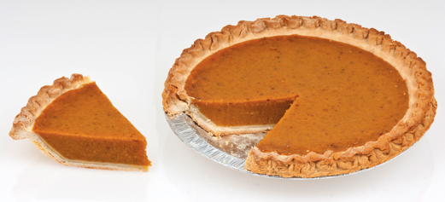
Principle 3:
Ask How the Data and Analysis Drive a Decision
Big Data +
“Knowing Where to Cut”
(across people, time, settings…etc.)
Even with an ambitious goal for prediction, you likely need to summarize the data.
By manager, department, team, season (hello, SQL…).
Cut the pie strategically means first labeling/stitching data strategically (ABQ/Higdon)
Can borrow “strength” across the data (given assumptions)
Big Data = data/visualization, not only analytics
(e.g., Bersin 2013, 86% of 435 US/Canadian orgs only using dashboards, simple analytics)

Slide 16
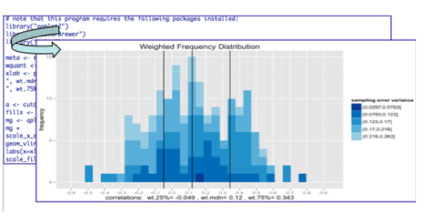
This collection of presentations reflect projects critically involving:
Engaged and Persistent Teamwork/Networks
involving critical stakeholder communication (ABQ agencies) even prior to the research/data collection (Yoakum)
Expert-Level Domain-Specific Knowledge
about the decision-making context/goals
Good Data (along with Big Data)
allowing signals to rise above the noise
manage ethics of access vs. privacy
Solid Analytic Approaches
Translating Knowledge to Decisions
Iteration on the Above

Slide 17
Thank you!
Fred Oswald
foswald@rice.edu

