Slide 1
Predictive Analytics in Child Welfare:
The Allegheny Screening Model
Rhema Vaithianathan

Slide 2
Background
Research suggests administrative data can identify children at risk of abuse or neglect*
August 2016 : Allegheny Family Scoring Tool
Douglas County, CO and California State
*Putnam-Hornstein, Needell and Rhodes (2013) ; Vaithianathan, Maloney, Putnam-Hornstein et al (2013)

Slide 3
Context
3.6 million referral calls to child maltreatment hotline every year
37% of all US children have had a maltreatment investigation by age 18 (Kim et al, 2017)
In Allegheny → 14% of all children referred by age 5
31% of Black or African American children

Slide 4
The Problem
Many child welfare (CPS) directors are concerned about their maltreatment screening decisions
In particular
  children screened out who are abused
  children being harmed that could have been avoided by better decision-making early on
  delays in families getting early help to avoid having their children removed
  Potentially needless investigation of “low risk” families

Slide 5
How does the Allegheny Family Screening Tool Work?

Slide 6
Call comes in…
Child & Family History
County Prison
Alcohol & Drug
Juvenile Justice
Probation
Public Welfare
Parental CPS
Family’s Welfare
Community indicators
Behavioral Health
The system harvests data from the data warehouse…
A Risk Score is produced for each child named in the call*
*Only if an MCI_ID is successfully established. The referral data used to build the model covers the period from 25 Aug 2008 to 13 March 2015, and there are 58,801 referrals (calls) and 50,076 (unique) victims in total. 2,236 victims (4.5%) did not have established MCI_ID

Slide 7
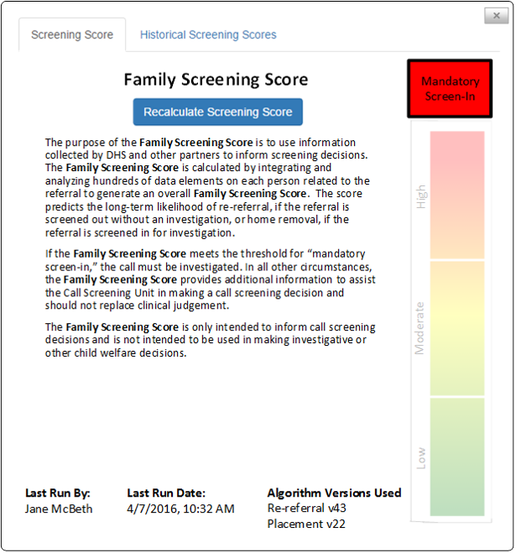
Operationalising the Score
SHOWN TO SCREENING STAFF ONLY

Slide 8
The predicted risk score is from 1 to 20
It tells us how likely the child is to have a placement in the 2 years if screened in or re-referral if screened out following the maltreatment call
The higher the score, the higher the chance of placement or re-referral
20
1 in 20 calls receive a score of 1
1 in 20 calls receive a score of 20
Bottom 5% of risk
Top 5 % of risk

Slide 9
Operationalising the Score
The screening score is an added ingredient in the human decision-making process – not a substitute for it
Screening staff must continue to use their judgement
Highest risk referrals are flagged as “Mandatory -screen in” but these can be over-ridden

Slide 10
Ethics and Community Engagement
The County consulted with its community more than a year before these models were brought in
Full and transparent process (ethics reports, methodology report, response to ethics report all online)
Independent process and impact evaluation
Ongoing monitoring by County leadership

Slide 11
Model Performance: Rebuild September 2017

Slide 12
How do various algorithms perform
for predicting placement within 2 years ?
Area Under ROC
Logistic Regression: 0.774
SVM: 0.815
Random Forests: 0.872
XGBoost: 0.909
Complexity
Note: based on more recent data from 6 monthly rebuild

Slide 13
Risk Groups and Average Placement Rates following screening-in (test sample only)
Risk Group | XG Boost
Mandatory -screen in | 47.6%
High | 7.0%
Medium | 2.4%
Low | 0.5%
Overall | 9%
Almost half of those identified as highest risk using xgboost end up being placed

Slide 14
Of all those who were placed in two years
  90% would have been scored as “Mandatory Screen In”
  0.4% would have been scored as low risk

Slide 15
Historic Practice
We retrospectively scored referrals. We found that
33% of children who were scored as mandatory screen in (highest risk) were being screened out – of these, one in 5 were re-referred and placed within 2 years
41% of the lowest risk group were being screened in – of these, 3 in 1,000 were placed within 2 years

Slide 16
Validation Using Fatalities and Near Fatalities of Children who were Referred (n=20)
12 children will have been scored as “mandatory screened in”
No children would have been scored as “low”

Slide 17
Validation of Risk Scores using hospital admission data
We risk scored children who had been referred between April 1, 2010 to May 4, 2016, and then linked to their hospital records
We looked at the correlation between risk scores received and cause of admission

Slide 18
Relative Risk of Hospitalisation
A child whose placement scores at referral is 20 vs. a child who scores 1 is…
21 times more likely to be admitted for a self-inflicted injury
17 times more likely to admitted for physical assault
1.4 times more likely to admitted for an accidental fall

Slide 19
Next Step: At Birth Model

Slide 20
At Birth Model
70-80% of children who are victims of fatal or near fatal maltreatment are not referred to CPS prior to the call
We are exploring identifying children at risk at birth
Model is trained on referral, case opening and placement by age five
AUC = 0.87

Slide 21
Would this at-birth risk score pick up children of interest?
We looked at fatalities and near fatalities that were reviewed under Act 33
There were 41 children who were victims of maltreatment-related fatalities or near fatalities in our cohort (2007-2014)
We were able to match 30 children …

Slide 22
Reason for Death | Risk Score Calculated by the Birth Model | Was child ever referred?
Blunt Force Trauma | 20 | No
Abusive Head Trauma | 20 | Yes – 6 months before incident
Abusive Head Trauma | 20 | No
Abusive Head Trauma | 20 | No
Abusive Head Trauma | 20 | No
Abusive Head Trauma | 20 | Yes, 5 months before incident
Abusive Head Trauma | 20 | No
Abusive Head Trauma | 20 | No
Burns (Fire) | 19 | Yes, 3 years before incident
Abusive Head Trauma | 19 | No
Burns (Fire) | 19 | Yes, 3 months before incident
Blunt Force Trauma | 19 | Yes, 3 months before incident
Gunshot | 18 | Yes, 3 years before incident
Gunshot | 17 | No
Abusive Head Trauma | 17 | No
Abusive Head Trauma | 17 | No
Ingestion (cocaine/suboxone) | 16 | No
Abusive Head Trauma | 16 | No
Gunshot | 16 | No
Abusive Head Trauma | 16 | No
Trauma | 15 | No
Abusive Head Trauma | 14 | No
Abusive Head Trauma | 14 | No
Abusive Head Trauma | 14 | No
Drowning | 13 | No
Medical neglect | 12 | No
Gunshot | 12 | No
Abusive Head Trauma | 10 | No
Trauma | 10 | No
Drowning | 8 | No
We looked at all children who had had a maltreatment related critical event and merged the risk scored children with referral data.
The majority of children (20/30) received a score higher than 16

Slide 23
Conclusion

Slide 24
Where are we headed?
We are working with lots of collaborators in academia and practice who want to model fair and transparent use of predictive analytics
But – lots and lots of challenges ahead!
Seemingly small ethical steps can lead us to an unethical place (E.g. if a child dies where a human overrode a model there will be pressure to stop human override. )

Slide 25
What I got wrong…
Not being more vigilant about data hygiene (linking, data entry etc.)
Not thinking about how to encourage behavioural change → not everyone finds statistics convincing so need to use case studies
Finding expertise→ there is no one person who is an expert in sufficient number of areas to implement a project like this so need to find expertise, but hard when the expertise is more than 1 degree removed from your own field
Lots of implementation fish-hooks and things we got wrong → which we are sharing with the community
What we got right → transparency

Slide 26
He aha te mea nui o te ao
He tangata, he tangata, he tangata*
*tr: What is the most important thing in the world?
It is the people, it is the people, it is the people
Maori proverb

Slide 27
Connect with us at www.csda.aut.ac.nz
Follow us on Twitter
@AUTCSDA
@rvaithianathan

