Slide 1
Fairness in Data-Driven Decision Making Predictive Risk Modeling in Child Welfare
Alexandra Chouldechova
Assistant Professor, Statistics and Public Policy
Heinz College, Carnegie Mellon University

Slide 2
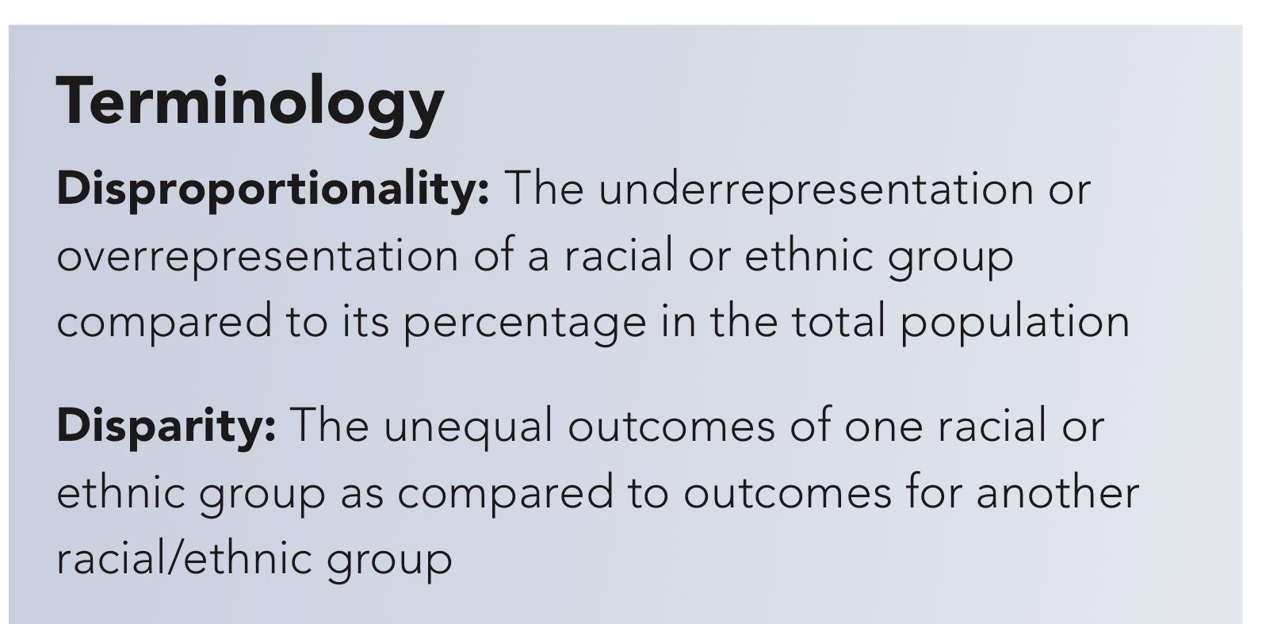
Source: childwelfare.gov

Slide 3
Disproportionate and disparate need
Geographic context
CWS factors
Racial bias & discrimination
Source: childwelfare.gov, citing Fluke, Harden, Jenkins & Ruehrdanz (2011) survey paper
Notes:
Disproportionate and disparate need:
- Visbility/exposure bias due to visibility to mandated reporters
- Has to do with what we’re measuring (e.g., rereferral)
- SES leading risk factor
CWS factors:
- such as lack of resources for families of colour, caseworker characteristics
- CWS may be less able to provide in AA communities
Geographic context:
- Differences present at an aggregate level may disappear when one looks at sufficiently fine granularity.
Racial bias and discrimination (e.g., by caseworkers and reporters):
For example, two studies in Texas found that race, risk, and income all influence case decision, but even though African- American families tended to be assessed with lower risk White families to have substantiated cases, have their children removed, or be provided family-based safety services (Dettlaff et al., 2011; Rivaux et al., 2008).

Slide 4
Two forms of human bias
Applying different risk cutoffs
Miscalibration

Slide 5
True score | 17 | 5 | 13 | 11 | 16
Notes:
Additionally, a study of child welfare cases in Texas found that although African-Americans had lower risk scores than Whites, African-Americans were more likely to have their case acted upon, either by service provision or the child’s removal from the home (Rivaux et al., 2011). This indicates that caseworkers have different risk thresholds depending on a family’s race.
One hypothesis about how racial disproportionality or disparities may arise, at least in part, is racial or ethnic differences between a family and its caseworker. One study using a national dataset, however, came to a different conclusion. The researchers found that Black caseworkers tended to assess all families—regardless of race—at higher risk levels than White caseworkers (Font et al., 2012). Since Black families are more likely to be assigned to a Black caseworker, they may have an increased likelihood of a substantiated case of maltreatment, which could increase their rates of disproportionality and disparity (Font et al., 2012).

Slide 6
How might this happen?
True score | 17 | 5 | 13 | 11 | 16
Investigate? | Yes | No | No | Yes | Yes
Notes:
Additionally, a study of child welfare cases in Texas found that although African-Americans had lower risk scores than Whites, African-Americans were more likely to have their case acted upon, either by service provision or the child’s removal from the home (Rivaux et al., 2011). This indicates that caseworkers have different risk thresholds depending on a family’s race.
One hypothesis about how racial disproportionality or disparities may arise, at least in part, is racial or ethnic differences between a family and its caseworker. One study using a national dataset, however, came to a different conclusion. The researchers found that Black caseworkers tended to assess all families—regardless of race—at higher risk levels than White caseworkers (Font et al., 2012). Since Black families are more likely to be assigned to a Black caseworker, they may have an increased likelihood of a substantiated case of maltreatment, which could increase their rates of disproportionality and disparity (Font et al., 2012).

Slide 7
Racial bias I: Applying different cutoffs
True score | 17 | 5 | 13 | 11 | 16
Notes:
Additionally, a study of child welfare cases in Texas found that although African-Americans had lower risk scores than Whites, African-Americans were more likely to have their case acted upon, either by service provision or the child’s removal from the home (Rivaux et al., 2011). This indicates that caseworkers have different risk thresholds depending on a family’s race.
One hypothesis about how racial disproportionality or disparities may arise, at least in part, is racial or ethnic differences between a family and its caseworker. One study using a national dataset, however, came to a different conclusion. The researchers found that Black caseworkers tended to assess all families—regardless of race—at higher risk levels than White caseworkers (Font et al., 2012). Since Black families are more likely to be assigned to a Black caseworker, they may have an increased likelihood of a substantiated case of maltreatment, which could increase their rates of disproportionality and disparity (Font et al., 2012).

Slide 8
Racial bias I: Applying different cutoffs
True score | 17 | 5 | 13 | 11 | 16
Assessed score | 16 | 5 | 13 | 10 | 16
Notes:
Additionally, a study of child welfare cases in Texas found that although African-Americans had lower risk scores than Whites, African-Americans were more likely to have their case acted upon, either by service provision or the child’s removal from the home (Rivaux et al., 2011). This indicates that caseworkers have different risk thresholds depending on a family’s race.
One hypothesis about how racial disproportionality or disparities may arise, at least in part, is racial or ethnic differences between a family and its caseworker. One study using a national dataset, however, came to a different conclusion. The researchers found that Black caseworkers tended to assess all families—regardless of race—at higher risk levels than White caseworkers (Font et al., 2012). Since Black families are more likely to be assigned to a Black caseworker, they may have an increased likelihood of a substantiated case of maltreatment, which could increase their rates of disproportionality and disparity (Font et al., 2012).

Slide 9
Racial bias I: Applying different cutoffs
True score | 17 | 5 | 13 | 11 | 16
Assessed score | 16 | 5 | 13 | 10 | 16
Investigate? | Yes | No | No | Yes | Yes
Notes:
Additionally, a study of child welfare cases in Texas found that although African-Americans had lower risk scores than Whites, African-Americans were more likely to have their case acted upon, either by service provision or the child’s removal from the home (Rivaux et al., 2011). This indicates that caseworkers have different risk thresholds depending on a family’s race.
One hypothesis about how racial disproportionality or disparities may arise, at least in part, is racial or ethnic differences between a family and its caseworker. One study using a national dataset, however, came to a different conclusion. The researchers found that Black caseworkers tended to assess all families—regardless of race—at higher risk levels than White caseworkers (Font et al., 2012). Since Black families are more likely to be assigned to a Black caseworker, they may have an increased likelihood of a substantiated case of maltreatment, which could increase their rates of disproportionality and disparity (Font et al., 2012).

Slide 10
Racial bias II: Miscalibration
True score | 17 | 5 | 13 | 11 | 16
Assessed score | 16 | 3 | 10 | 16 | 19
Investigate? | Yes | No | No | Yes | Yes
Notes:
Additionally, a study of child welfare cases in Texas found that although African-Americans had lower risk scores than Whites, African-Americans were more likely to have their case acted upon, either by service provision or the child’s removal from the home (Rivaux et al., 2011). This indicates that caseworkers have different risk thresholds depending on a family’s race.
One hypothesis about how racial disproportionality or disparities may arise, at least in part, is racial or ethnic differences between a family and its caseworker. One study using a national dataset, however, came to a different conclusion. The researchers found that Black caseworkers tended to assess all families—regardless of race—at higher risk levels than White caseworkers (Font et al., 2012). Since Black families are more likely to be assigned to a Black caseworker, they may have an increased likelihood of a substantiated case of maltreatment, which could increase their rates of disproportionality and disparity (Font et al., 2012).

Slide 11
Model calibration
Applying a consistent threshold is easy ^{(is it always desirable?)}
Miscalibration is possible

Slide 12
Calibration: Logistic Regression

Slide 13
Calibration: Random Forest

Slide 14
Know your trade-offs
Trade-offs that aren’t made explicitly are made implicitly.
Who should get to decide?
Notes:
Data scientist’s role is to clarify the tradeoffs

Slide 15
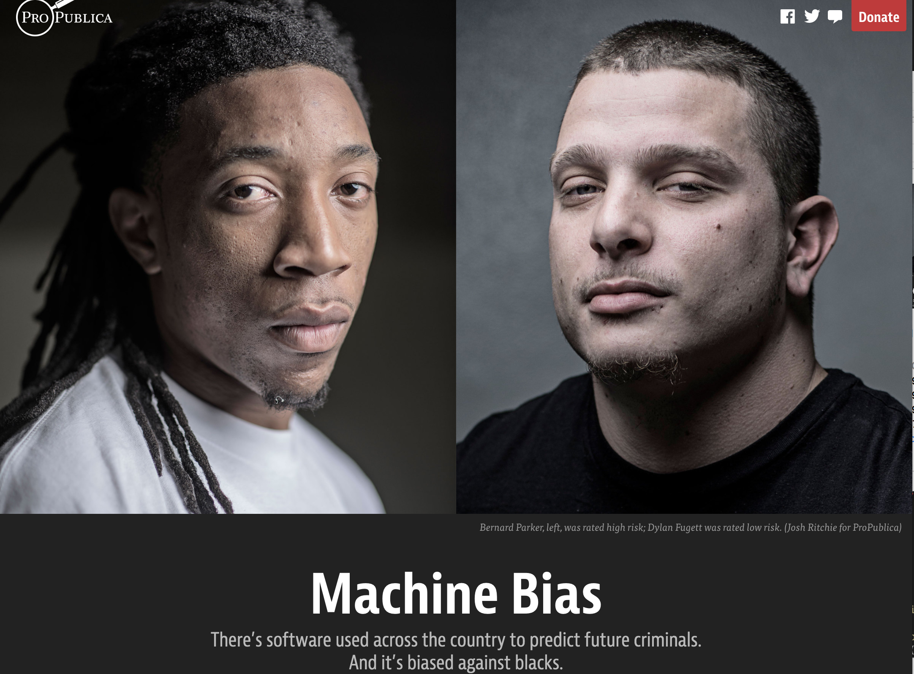
Source:
Julia Angwin,
Jeff Larson,
Surya Mattu and
Lauren Kirchner, ProPublica

Slide 16
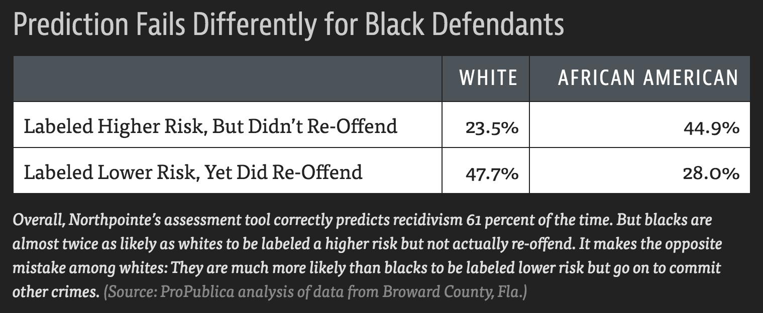




False positive rates
False negative rates
Positive predictive value (aka Precision)

Slide 17
Logistic regression

Slide 18
Random Forest

Slide 20
Placement rates differ across groups

Slide 21
Model choice matters
Models may differ in their predictions on a large number of cases, even when the models have similar accuracy.

Slide 22
Models disagree (surprisingly?) often
Model | AUC
Logistic | 0.77
RF sub | 0.83
Random forest | 0.88
SVM | 0.82
XGBoost | 0.91
Logistic and RF disagree on
1 in 6 cases
RF and XGBoost disagree on 1 in 9 cases
For more: See C., G’Sell (2017)

Slide 23
Fairness and Accuracy
The oracle test
Omitted objective bias

Slide 24

What questions remain?
Data scientist
Oracle

Slide 25
Omitted objective bias
Any questions that remain may help clarify concerns about issues such as:
the choice of target variable
a disconnect between the prediction target and decision criteria
explainability
effects of interventions
Oracle

Slide 26
Sensitive variables as model inputs
May improve model fairness and accuracy
Try it, and compare

Slide 27
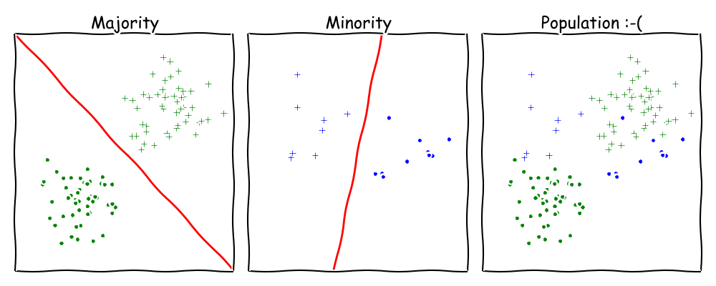
Source: Moritz Hardt

Slide 28
Fairness is a process property
Fairness is context specific
A fair model may result in unfair outcomes if not used as intended
*A fair model may result in highly disparate outcomes even if used exactly as intended

Slide 29
The algorithm isn’t making decisions
This is not your new process
This is your new process

Slide 30

Thank you.
achould@cmu.edu

