Slide 1
Analytics in Higher Education:
Methods Overview
Scott James
Data Scientist, Hobsons

Slide 2
Overview
Introduction
Predictive Modeling
Explanatory Modeling/Causal Inference
Example

Slide 3
Introduction

Slide 4
The First Task: Who is at Risk?

Slide 5
A More Difficult Task:

Slide 6
Analytics Drive Student Success
Identify
Understand
Analytics
Cycle
Act
Strategic
Goals
Analyze
Measurable
Strategic
Outcomes
Measure
Drives Institutional Momentum

Slide 7
Predictive Modeling

Slide 8
Predictive Modeling Process for Student Retention
Retention to the next year (12 to 18 months)
Training: Build the model
Examine variable distributions
Predictive Model:
Random Forest
Logistic Regression
Define Problem/
Outcome
Data Partition
Exploratory Analysis
Data Modeling and Validation
Predictions and Scoring
Validation: Test and compare model performance
Clustering, Factor Analysis, Feature Selection
Brier Score, AUC, Model Calibration
Score students for the next academic year

Slide 9
Common Predictive Models
Regression Models
Random Forests
Neural Networks
Ensemble

Slide 10
Classification vs Probabilities
Strong models are probabilistic rather than simply deterministic
Relying on classification rates (percent correctly predicted) can sometimes lead to overconfidence in the model
Notes:
In addition to providing less information than probabilities, using classification rates (or percent correctly predicted) to measure model performance can also be problematic
For example, for an institution that has a 90% retention rate one can produce a ‘model’ that is 90% accurate by classifying every student as being retained. Cut-offs for classifications in a model can be changed in order to maximize overall accuracy, but this doesn’t necessarily indicate the model is a good one

Slide 11
The Prediction is In…. Kansas to the Final Four

Slide 12
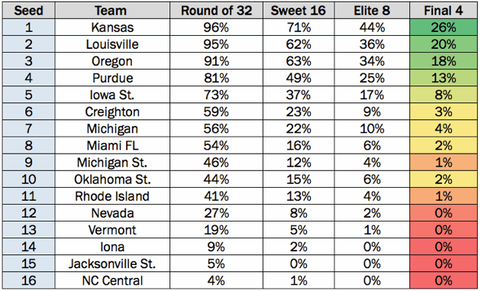
Probability of Winning the Midwest Region
Source: kenpom.com via Sports Illustrated

Slide 13
Explanatory Modeling and Causal Inference

Slide 14
Common Data Challenges
Confounding Variables
An extraneous variable that can mask the true relationship between a predictor variable and an outcome variable
Students participating in an intervention have lower than average SAT scores
Selection Bias
Occurs when intervention participants self-select in to or are selected in such a way that that they are not representative of the population of interest
Students participating in an intervention have lower than average SAT scores

Slide 15
Popular Causal Inference Methods
Propensity Score Matching (PSM)
Coarsened Exact Matching (CEM)
Well specified regression models
Multilevel Modeling
Structural Equation Modeling (SEM)

Slide 16
Example

Slide 17
Example: Evaluating Pre-Midterm Advising Meetings
Background:
1,234 first year, first time freshmen
four year public university
There are two possible outcomes: If the result confirms the hypothesis, then you've made a measurement. If the result is contrary to the hypothesis, then you've made a discovery.
Enrico Fermi Physicst
Enrico Fermi (1901-1954) Various sources including: Assessing Toxic Risk: Teacher Edition (2001)

Slide 18
Evaluating Pre-Midterm Advising Meetings
Hypothesis
Pre-midterm advising improves the likelihood of students earning a first term GPA of 2.0 or greater
Student Background Variables
Age
Gender
High School GPA
Race
SAT Scores
Notes:
Institution wanted to check their ‘gut’ that this intervention was effective, and is currently reviewing interventions available for first year, first time freshmen

Slide 19
Propensity Score Analysis
Predicting Intervention Participation
Of the five variables analyzed, these were the significant predictors:
Younger students more likely to meet with advisors before the midterm
Students with lower high school GPAs more likely to meet
Students with lower SAT scores more likely to meet

Slide 20
Results
Success! Hypothesis confirmed!
538 students in the resulting matched group (239 who went to advising and 239 similar students who did not)
80% of the students who went to advising achieved a higher GPA compared to 66% who did not (statistically significant at alpha= .001)
80% v 66%
Average
Weak
Strong
Little to No
Very Strong
Evidence Meter

Slide 21
Summary
Ask the Right Questions
Identify -> Predictive Modeling
Focus on Probabilities
Measure -> Explanatory Modeling/Causal Inference Methods
Ask Another Question!

Slide 22
Questions?

Slide 23
Propensity Score Creation
Predicting Intervention Participation
Age
Gender
Predictive Model for Advising Meetings
Propensity Score
HS GPA
Race
SAT
The propensity score is the probability of participating in the pre-midterm advising meetings based on the variables for which we have data.

Slide 24
Propensity Score Matching
Propensity Score matching using the Nearest Neighbor approach
Non-Participants
Participants
Student 1: PS=.20
Student 6: PS=.35
Student 2: PS=.35
Student 7: PS=.40
Student 3: PS=.40
Student 8: PS=.45
Student 4: PS=.45
Student 9: PS=.50
Student 5: PS=.50
Student 0: PS=.85

