Slide 1
Predictive Analytics in Education
Possibilities, Priorities, Policies
Predictive Analytics for Human Services and Education
September, 15, 2017
Elana Zeide
Seton Hall University School of Law

Slide 2
Overview
Predictive Potential
Problematic Possibilities
Classroom Consequences
Eligibility & Equality
Pedagogy & Policy

Slide 3
Predictive Potential
Learning Analytics
Academic Analytics

Slide 4

Problematic Possibilities
Bugs
Bias
Black Box
“Beta” Education

Slide 5
Classroom Consequences
Ubiquitous & Constant Collection
Chilling & Conforming Potential
Credentialing Effects
Intellectual Exposure & Experimentation
Academic Freedom

Slide 6
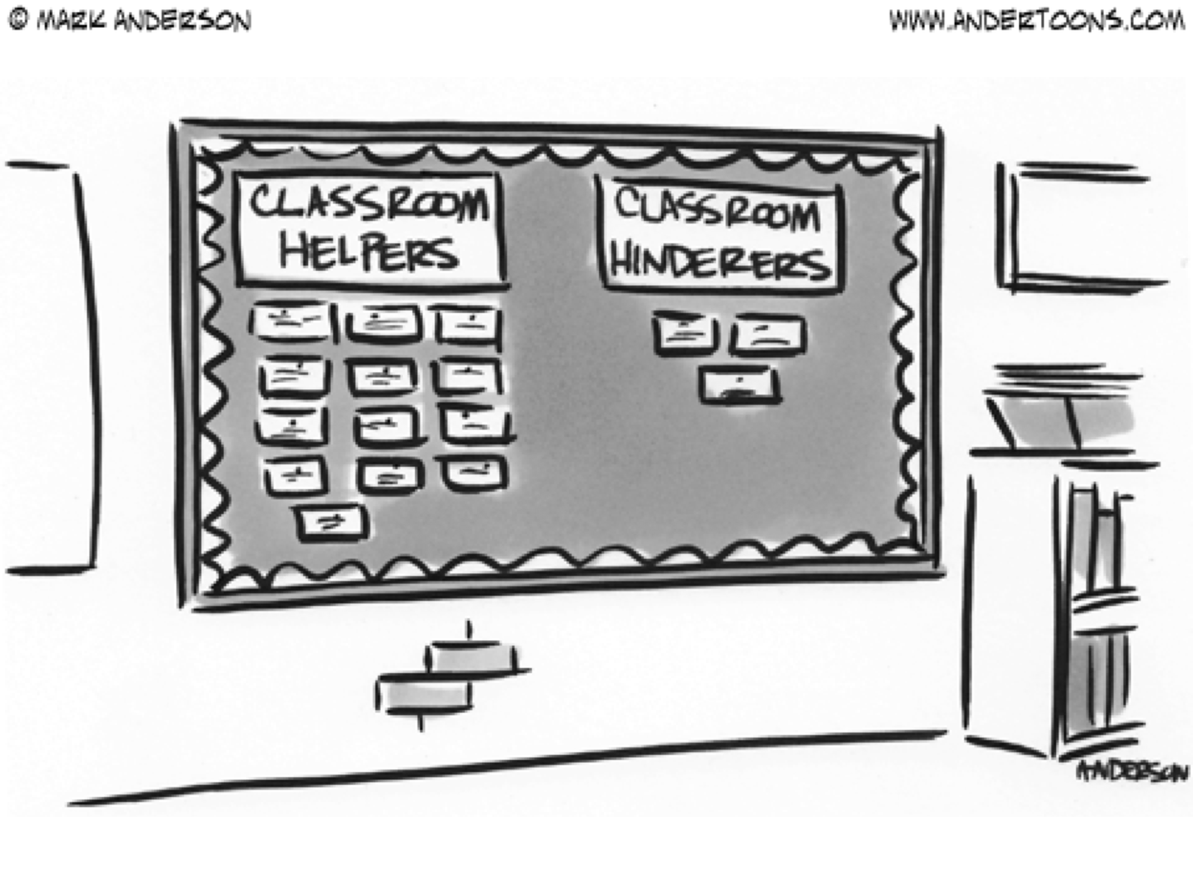
Eligibility & Equality

Slide 7

Predictions v. Predictive Analytics

Slide 8
PEDAGOGY & POLICY PRIORITIES
Curricula
Content
Metrics
Competencies
Credit
Credentials

Slide 9
What Counts as Education
WHAT “COUNTS” AS EDUCATION?

Slide 10
Elana Zeide elana.zeide@shu.edu @elanazeide www.elanazeide.com
Questions? Comments?

