Slide 1
The Static Detonation Chamber and Conventional Demilitarization
October 2017

Slide 2
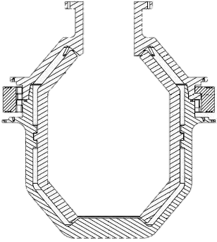

What is the SDC?
The Static Detonation Chamber (SDC)
A fully proven high technology one step system for the destruction of munitions
  Heated detonation chamber
  Fully automatic feeding system
  Double airlock feeding system

Slide 3
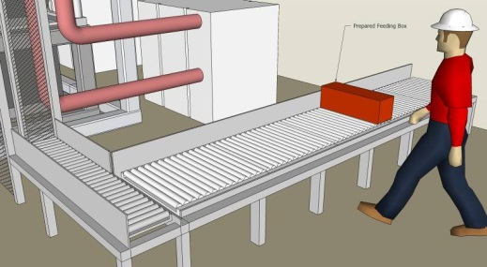
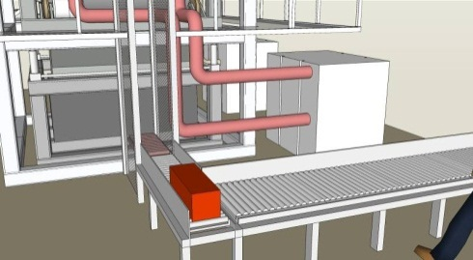
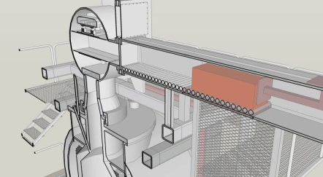
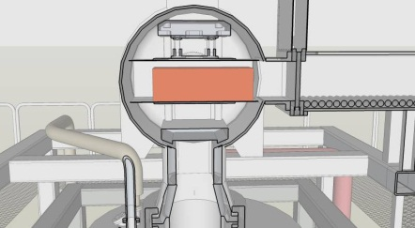
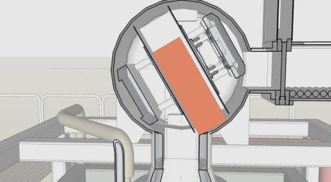
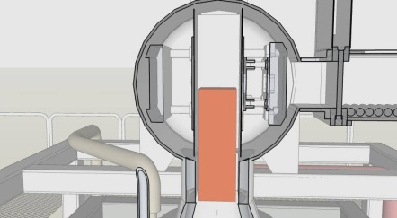
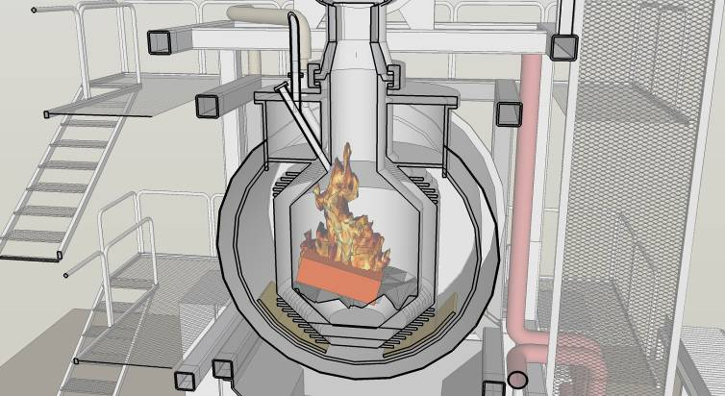
How Does the SDC Work?
Munitions are placed on an input conveyer.
  This is the last time anyone touches the munitions.
The munitions are conveyed to the feed system, which is an air-lock type
Munitions are fed to the detonation chamber which is maintained at a temperature above the critical temperature of the explosives in the munitions.
The high temperature causes the energetic materials to react and all energetics are destroyed.

Slide 4
The SDC Advantage
Armored indirectly heated detonation chamber
Temperature in the detonation chamber is above auto-initiation temperature of all known military explosives and propellants
Insures COMPLETE destruction:
    in one step
    without dismantling
    destroyed shells are free of explosives and other organic contamination (Clean for Release to the Public or the old 5X)

Slide 5
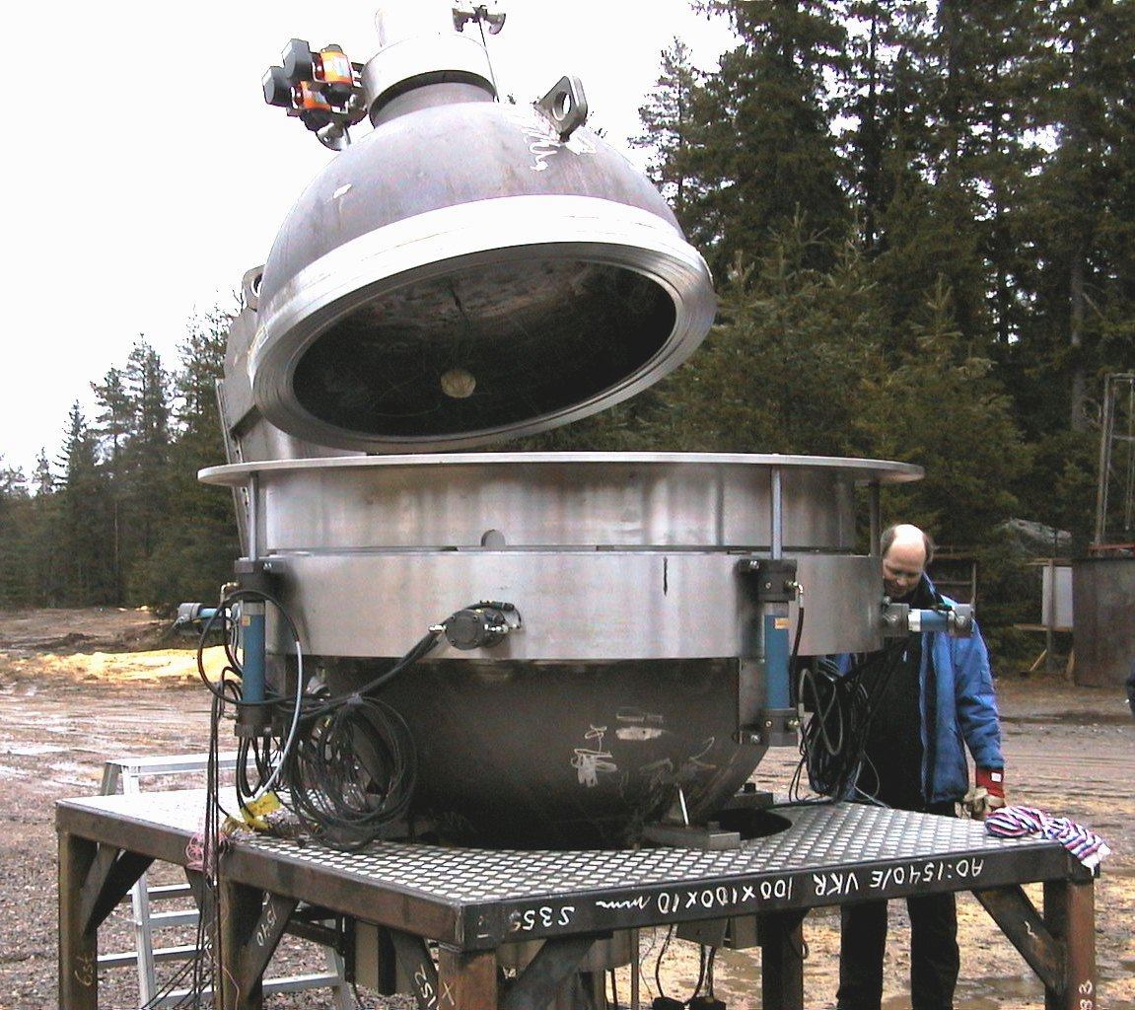
Why A Hot Chamber?
In a word, Safety.
  Dynasafe has built both cold and hot detonation chambers
  Cold Detonation chambers require adding explosive counter charges/detonators (handling) to munitions.
  Hot detonation chambers do not require counter charges
  Dynasafe analysis showed hot chambers are inherently safer, will last longer
  Dynasafe cold detonation chamber

Slide 6
Advantages of a Hot Detonation Chamber vs a Rotary kiln
The biggest advantage is that a scrap bed exists on the bottom of the Destruction Chamber (DC)
This scrap bed absorbs much of the fragment and shock damage from detonating munitions, which would otherwise cause wear on the chamber walls
As scrap builds up and is periodically emptied in the DC, the scrap level changes constantly, which prevents cumulative damage to particular areas of the DC, and spreads the wear more evenly in the unit.
In a rotary kiln, detonating items are typically in contact with the chamber walls. In the DC detonating items are typically at some distance from the chamber walls, leading to reduced wear on the DC.
The overall result is that in the SDC, equipment lasts longer and risk of chamber failure greatly reduced

Slide 7
Dynasafe has more than 25 years of operational experience in more than 70 countries
More than
1000 employees
globally
Headquarters:
Stockholm (Sweden)
Main sites:
Dartford (UK)
Ross on Wye (UK)
Karlskoga (Sweden)
Mülheim (Germany)
Ludwigsfelde (Germany)
Subsidiaries and branch offices:
Talladega (United States), Langenselbold (Germany), Vienna (Austria), Erbil (Kurdistan Region of Iraq), Kuwait City (Kuwait), Dubai (United Arab Emirates), Kabul (Afghanistan), Vientianne (Laos), Phnom Penh (Cambodia), Juba (South Sudan), Goma (Democratic Republic of Congo), Pretoria (South Africa), Maputo (Mozambique), Brookvale NSW (Australia)

Slide 8

Dynasafe Demil Systems Plants Worldwide
2
3
2
2
4
3
2
2
Plants
SDC 2000 2
SDC 1500 3
SDC 1200 9
SDC 1000 2
MEA 7
D 800 3
MDS 0,2 2
Demil 100 2
7 Plants for chemical munitions
22 Plants for conventional munitions and explosives

Slide 9
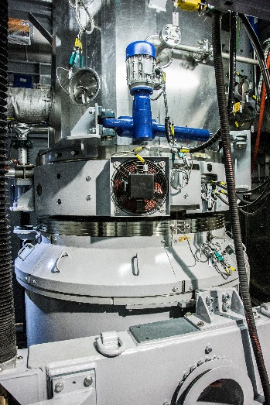
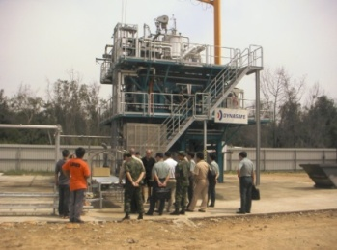
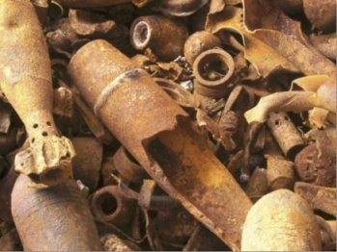
Dynasafe Demil Systems (DDS)
Provides SDC Demil Systems:
Ensures safe and environmentally friendly disposal of:
  Conventional and Chemical munitions
  Rockets
  Bombs
  Mines
  Explosives
  Hazardous material
DDS provides a wide range of services:
  Technical support
  Wear and spare parts
  Upgrades
  Training
  Consulting
  Turn key
  Operation
  Financing

Slide 10
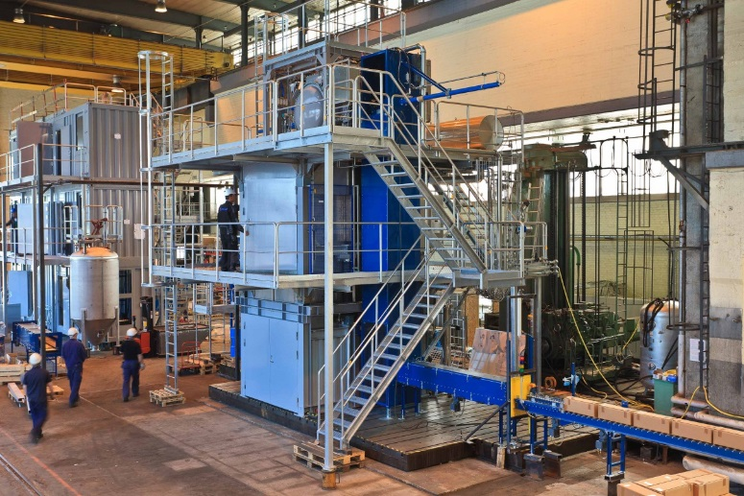
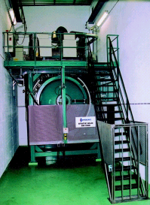
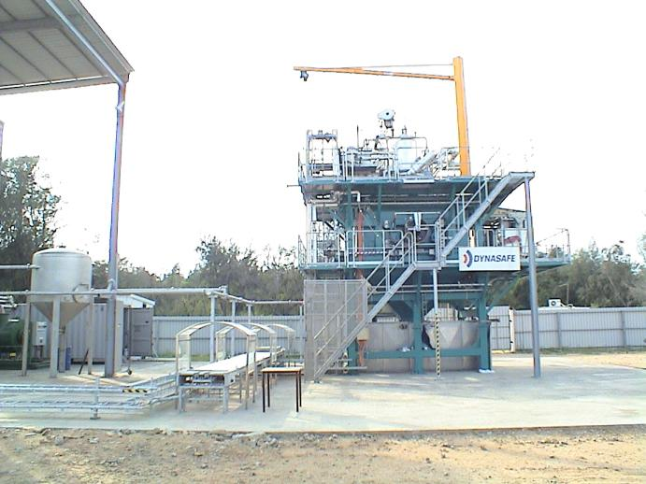
Conventional Demil (SDC Base – 16 Systems)
SDCs Delivered
  Sweden (2)
  Germany
  France
  Abu Dhabi
  Spain
  Portugal
  Taiwan
  USA (3)
  Japan (3)
  China (2)

Slide 11
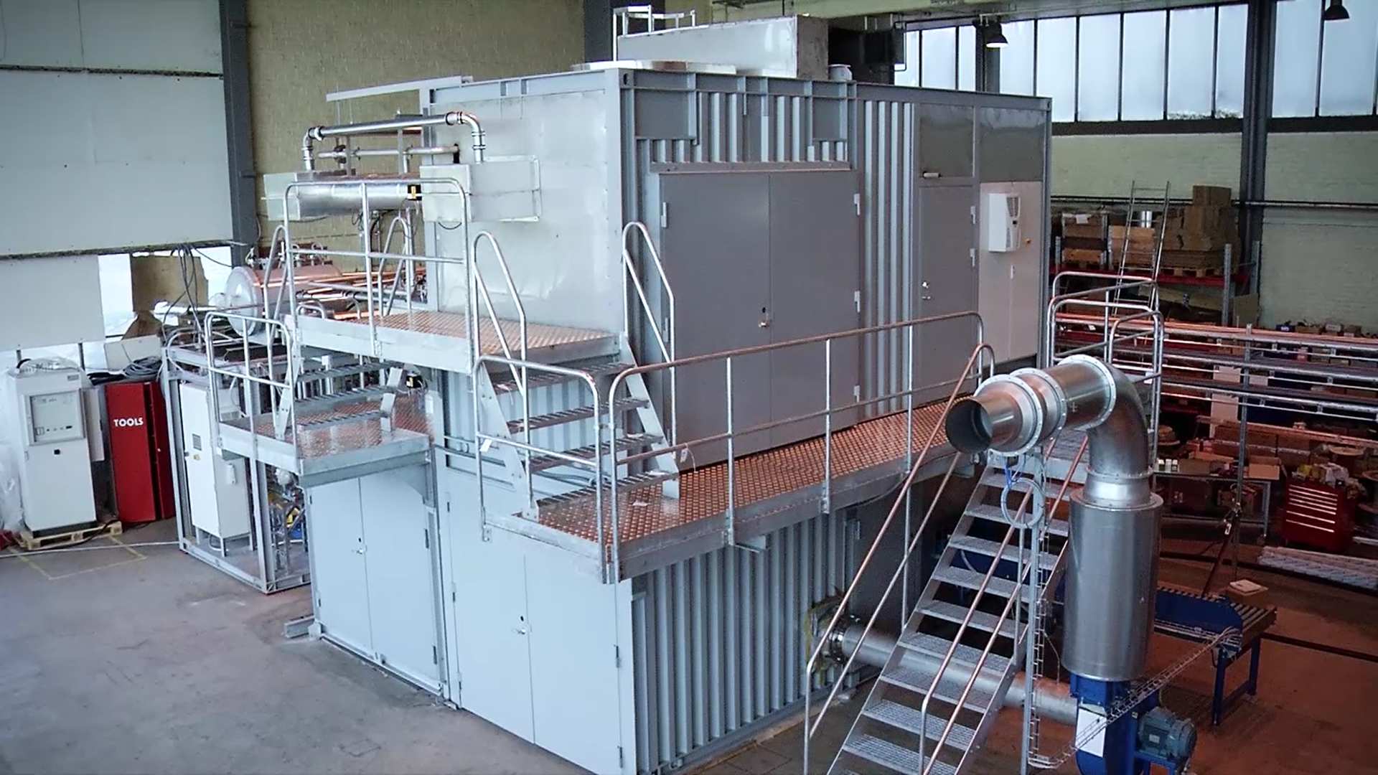
SDC 1000
Four 20’ sea containers
Can be air transported to site
Primary, secondary containment
Designed to meet US MACT environmental requirements

Slide 12
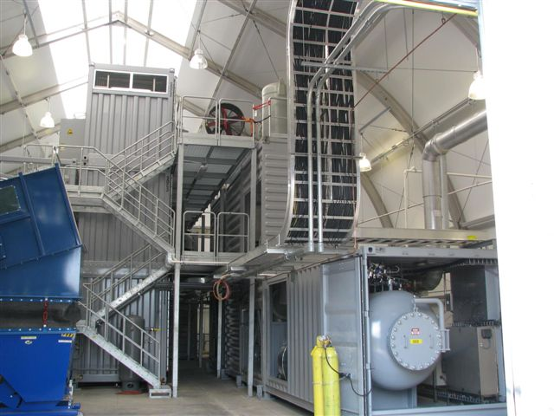
SDC 1200
Anniston plant, View from the South looking North
SDC Stack
PAS Stack
Reconfigurable, unit designed to be moved from site to site

Slide 13
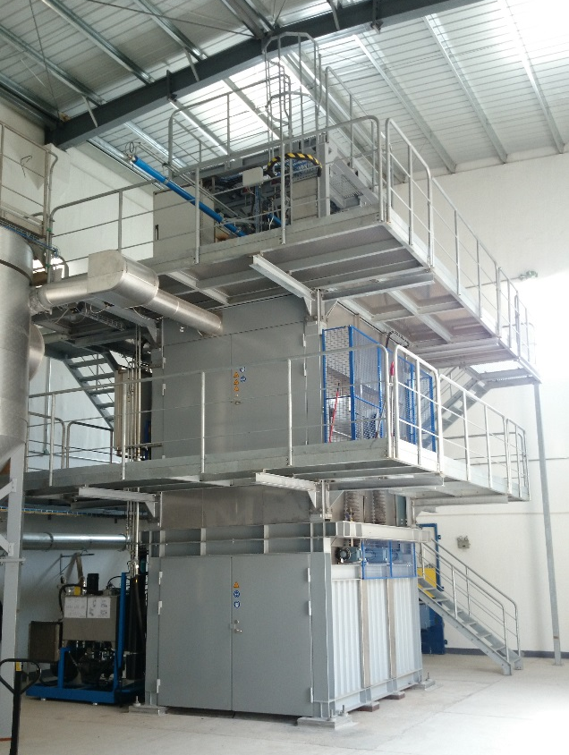
SDC 1500
SDC 1500 – Example of Fixed Facility Plant
Better accessibility, easier maintenance
SDC 1500
CETC
China

Slide 14
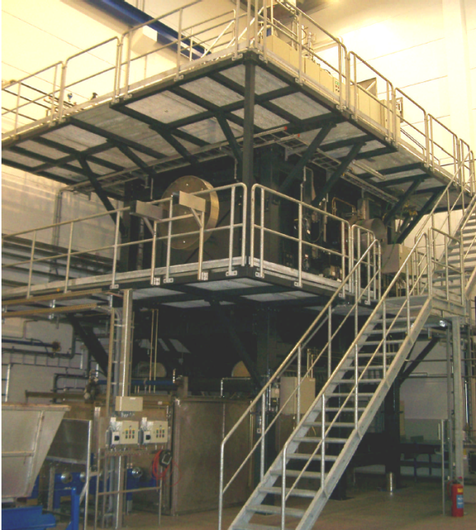
SDC 2000 C unit - Germany
GEKA, Munster, Germany
  Used to destroy German WWI and II RCWM
  Also used for Conventional UXO/Demil
  Germany now OPCW Treaty Compliant (since April 2007)
  Used for CWM disposal on as needed basis as munitions are found throughout the year.

Slide 15
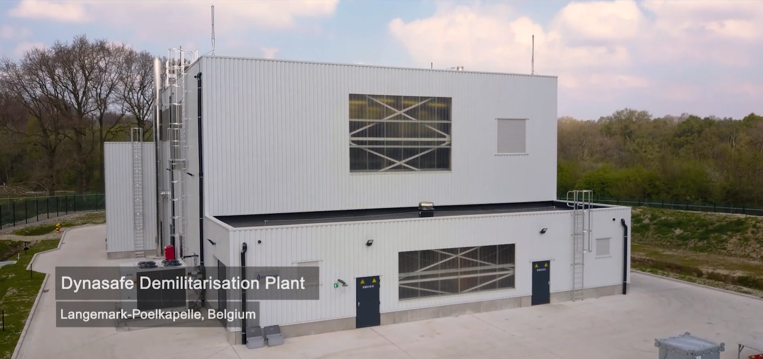
Newest SDC Plant in Belgium
SDC 1500 - Dynasafe Turnkey plant, similar to BGCAPP Plant
Video at: https://vimeo.com/219967736

Slide 16
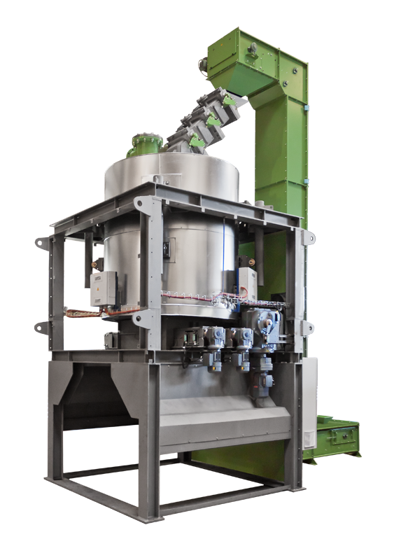
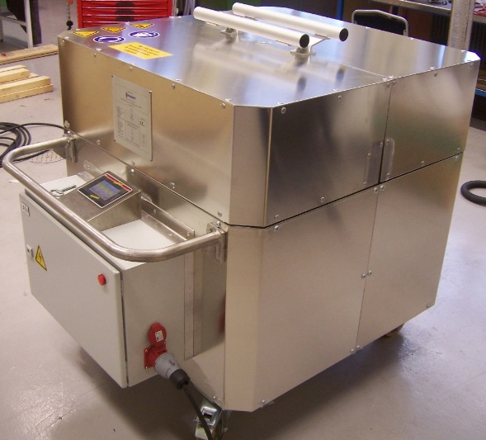
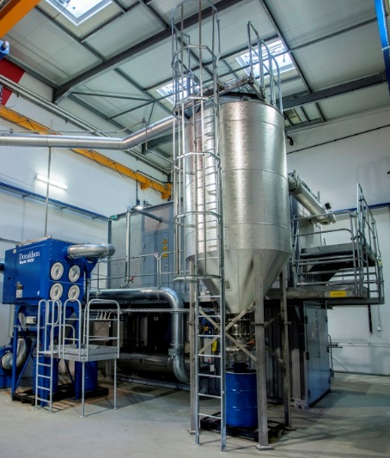
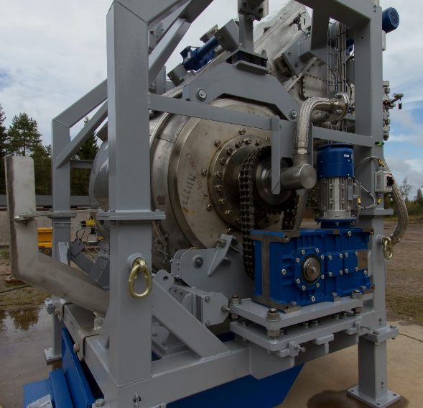
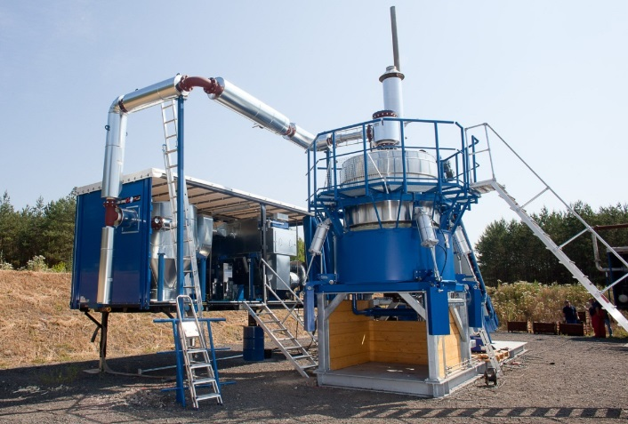
Demil Systems – Mobile Systems
Portable thermal disposal system for smaller quantities and calibers
Demil 100
SDC 1000
MDS 0,2
Demil 800
MEA with OGF

Slide 17
Off gas treatment systems
Customized to meet client needs in different countries
For example, NOx abatement systems not needed to meet US requirements, but are needed in Europe
Treatment systems can be dry or wet, and wet systems can be further classified as waste water free or conventional scrubber systems depending on if the Client installation has water treatment capability
Different sizes and capacities for different SDC models

Slide 18
Metals performance
 | Run 1 |  |  | Run 2 |  |  | Average
 | Feed Rate, | Emission Rate, | Removal Efficiency, | Feed Rate, | Emission Rate, | Removal Efficiency, | Feed Rate, | Emission Rate, | Removal Efficiency,
Metal | lbs/hr* | lbs/hr | %** | lbs/hr* | lbs/hr | %** | lbs/hr* | lbs/hr | %**
Antimony | 1,23E-01 | 2,01E-08 | 99,99998 | 1,23E-01 | 4,78E-08 | 99,99996 | 1,23E-01 | 3,39E-08 | 99,99997
Arsenic | 1,11E-01 | 3,10E-07 | 99,9997 | 1,11E-01 | 3,04E-07 | 99,9997 | 1,11E-01 | 3,07E-07 | 99,9997
Barium | 2,46E+00 | 3,82E-06 | 99,9998 | 2,46E+00 | 3,98E-06 | 99,9998 | 2,46E+00 | 3,90E-06 | 99,9998
Beryllium | 8,68E-04 | 1,78E-07 | 99,98 | 8,68E-04 | 1,74E-07 | 99,98 | 8,68E-04 | 1,76E-07 | 99,98
Boron | 1,52E-01 | 1,91E-05 | 99,99 | 1,52E-01 | 3,80E-05 | 99,97 | 1,52E-01 | 2,86E-05 | 99,98
Cadmiun | 1,16E-03 | 9,06E-08 | 99,992 | 1,16E-03 | 1,01E-07 | 99,991 | 1,16E-03 | 9,59E-08 | 99,992
Chromium | 1,27E+00 | 1,21E-06 | 99,99990 | 1,27E+00 | 1,24E-06 | 99,99990 | 1,27E+00 | 1,23E-06 | 99,99990
Cobalt | 8,73E-03 | 5,56E-08 | 99,9994 | 8,73E-03 | 6,07E-08 | 99,9993 | 8,73E-03 | 5,82E-08 | 99,9993
Copper | 8,98E-02 | 7,57E-07 | 99,9992 | 8,98E-02 | 9,50E-07 | 99,9989 | 8,98E-02 | 8,54E-07 | 99,9990
Lead | 3,66E+00 | 4,13E-07 | 99,999989 | 3,66E+00 | 3,82E-07 | 99,999990 | 3,66E+00 | 3,98E-07 | 99,999989
Manganese | 3,44E-01 | 1,65E-06 | 99,9995 | 3,44E-01 | 2,64E-06 | 99,9992 | 3,44E-01 | 2,15E-06 | 99,9994
Mercury | 1,35E-02 | 2,51E-05 | 99,81 | 1,35E-02 | 1,20E-05 | 99,91 | 1,35E-02 | 1,85E-05 | 99,86
Nickel | 1,63E-02 | 1,01E-06 | 99,994 | 1,63E-02 | 9,67E-07 | 99,994 | 1,63E-02 | 9,88E-07 | 99,994
Phophorus | 4,95E-01 | 1,92E-05 | 99,996 | 4,95E-01 | 1,84E-05 | 99,996 | 4,95E-01 | 1,88E-05 | 99,996
Selenium | 1,58E-03 | 8,71E-07 | 99,94 | 1,58E-03 | 9,67E-07 | 99,94 | 1,58E-03 | 9,19E-07 | 99,94
Silver | 2,61E-03 | 1,31E-06 | 99,95 | 2,61E-03 | 4,10E-06 | 99,84 | 2,61E-03 | 2,71E-06 | 99,90
Thallium | 3,27E-04 | 1,78E-07 | 99,95 | 3,27E-04 | 1,74E-07 | 99,95 | 3,27E-04 | 1,76E-07 | 99,95
Tin | 5,15E-02 | 1,58E-06 | 99,997 | 5,15E-02 | 1,65E-06 | 99,997 | 5,15E-02 | 1,62E-06 | 99,997
Vanadium | 1,03E-03 | 1,18E-06 | 99,89 | 1,03E-03 | 1,15E-06 | 99,89 | 1,03E-03 | 1,16E-06 | 99,89
Zinc | 1,17E-02 | 1,47E-05 | 99,87 | 1,17E-02 | 1,27E-05 | 99,89 | 1,17E-02 | 1,37E-05 | 99,88
Uranium | 6,72E-02 | 1,78E-07 | 99,9997 | 6,72E-02 | 1,74E-07 | 99,9997 | 6,72E-02 | 1,76E-07 | 99,9997
Excellent metals removal

Slide 19
Parameter | Units | AVERAGE
Sample Volume | dscf | 152,35
Stack Gas Flow Rate | dscfm | 764
O₂ Concentration | % | 15,8
 |  |  |  |  | Weighted TEF | Emission Rate
Congeners | TEF |  | Total |  | (pg) | (g/s)
2,3,7,8 TCDD | 1,0 | < | 2,65 | ND | 2,65
Total 2,3,7,8-TCDD | --- | < | 2,65 | ND | --- | 2,22E-13
Total TCDD | --- | < | 1.050,75 |  | ---
1,2,3,7,8 PeCDD | 1,0 | < | 4,37 | ND | 4,37
Total 2,3,7,8-PeCDD | --- | < | 4,37 | ND | --- | 3,65E-13
Total PeCDD | --- | < | 93,32 |  | ---
1,2,3,4,7,8 HxCDD | 0,1 | < | 2,22 | ND | 0,222
1,2,3,6,7,8 HxCDD | 0,1 | < | 3,19 | ND | 0,319
1,2,3,7,8,9 HxCDD | 0,1 | < | 3,34 | ND | 0,334
Total 2,3,7,8-HxCDD | --- | < | 8,74 | ND | --- | 7,30E-13
Total HxCDD | --- | < | 14,03 | ND | ---
1,2,3,4,6,7,8 HpCDD | 0,01 | < | 8,7 | ND | 0,087
Total 2,3,7,8-HpCDD | --- | < | 8,7 | ND | --- | 7,27E-13
Total HpCDD | --- | < | 9,5 | ND | ---
Total OCDD | 0,0003 | < | 39 | ND | 0,0117 | 3,26E-12
Sum | pg |  |  |  | 7,9872
Concentration (@ 7% O₂) | ng/dscm |  |  |  | 0,0050
2,3,7,8 TCDF | 0,1 | < | 84,75 |  | 8,48
Total 2,3,7,8-TCDF | --- | < | 84,75 |  | --- | 7,08E-12
Total TCDF | --- | < | 3.502,25 |  | ---
1,2,3,7,8 PeCDF | 0,03 | < | 28,22 | ND | 0,85
2,3,4,7,8 PeCDF | 0,3 | < | 50,43 |  | 15,13
Total 2,3,7,8-PeCDF | --- | < | 78,65 |  | --- | 6,57E-12
Total PeCDF | --- | < | 766,97 |  | ---
1,2,3,4,7,8 HxCDF | 0,1 | < | 14,55 | ND | 1,45
1,2,3,6,7,8 HxCDF | 0,1 | < | 6,64 | ND | 0,664
2,3,4,6,7,8 HxCDF | 0,1 | < | 7,8 | ND | 0,780
1,2,3,7,8,9 HxCDF | 0,1 | < | 2,55 | ND | 0,255
Total 2,3,7,8-HxCDF | --- | < | 31,52 | ND | --- | 2,63E-12
Total HxCDF | --- | < | 23,2 | ND | ---
1,2,3,4,6,7,8 HpCDF | 0,01 | < | 16,65 | ND | 0,167
1,2,3,4,7,8,9 HpCDF | 0,01 | < | 4,37 | ND | 0,0437
Total 2,3,7,8-HpCDF | --- | < | 21,02 | ND | --- | 1,76E-12
Total HpCDF | --- | < | 16,65 | ND | ---
Total OCDF | 0,0003 | < | 30,8 | ND | 0,00924 | 2,57E-12
Sum | pg |  |  |  | 27,82189
Concentration (@ 7% O₂) | ng/dscm |  |  |  | 0,018
Total TEQ (@ 7% O₂) | ng/dscm |  | --- |  | 0,023
Excellent Dioxin/Furan Performance

Slide 20
Limitations of the SDC
Many munitions can be fed as is to the SDC, however there are some limitations. These are:
Shape charge munitions (including shape charge submunitions)
      The shape charge must be defeated before feeding
Munitions containing:
      Depleted Uranium (DU)
      Radioactive materials
      Asbestos
      Thermites/thermates
    In principle, the DU, Radioactive and asbestos containing materials can be fed, however Dynasafe technicians are not registered or trained to work with SDCs contaminated with these materials, so if these are fed, Dynasafe cannot service them.

Slide 21
Explosive Hazard class (HC) and the SDC
While the DOT/DOD defines HC 1.1, 1.2, etc., processing in the SDC does not exactly fit these categories
What is more important is the behavior of the item in the fast cookoff test (FCO)
      The FCO test is a good indication of how a particular item will behave in the SDC
      ALL munition items are tested with the FCO for transportation purposes, so these records exist, but are hard for a contractor to access. Testing in an SDC is sometimes required.
      Items that detonate are assigned to the “confined” category
      High explosive Items that deflagrate or simply burn slowly are assigned to the “unconfined” category
      HC 1.3-1.9 are assigned to the “propellant” category
    A munition or bulk explosive with an exposed explosive surface will almost always deflagrate and is considered “unconfined”.
    In order to maximize throughput it is often advantageous to cut a detonating munition to expose an explosive surface.

Slide 22
Pre-processing of munitions
Pre processing is used when a particular munition item cannot be fed as is to the SDC.
Mostly involves cutting the munition to expose an explosive face or defeat a shape charge
Types of machines that can be used:
      Pull apart for case removal
      De-priming/defuzing machine
      Band saw (including underwater band saws)
      Water jet (usually abrasive water jet)
      Mills, Lathe, “pipe cutter” type machines
      Purpose built disassembly machines
Dynasafe provides all of these to clients according to their needs
Pre-processing allows almost any munition to be fed to the SDC
      It is only a question of economics

Slide 23
The SDC as part of an integrated Demil plant
The SDC is one tool in the toolbox, but an integrated demil plant should have a wide range of processing options in order to be as efficient and low cost as possible.
Some examples of other processes:
  Autoclave meltout of melt cast explosives
  Milling or boring out explosives
  Water or steam washout of explosives
Recovered explosives can be recycled to commercial mining market
The decision to recover or simply destroy the explosives then becomes an economic decision; determine which option results in the lowest overall cost
  The decision point may change from time to time depending on market conditions for recycled materials
  Segregation of metal scrap can also increase scrap metal value

Slide 24
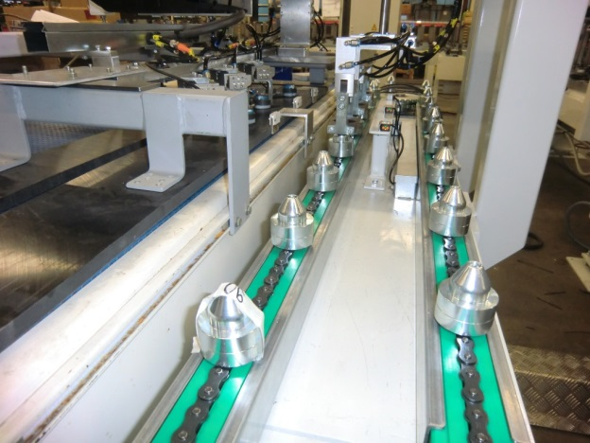
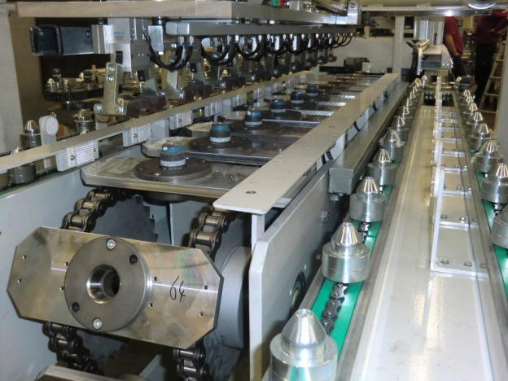
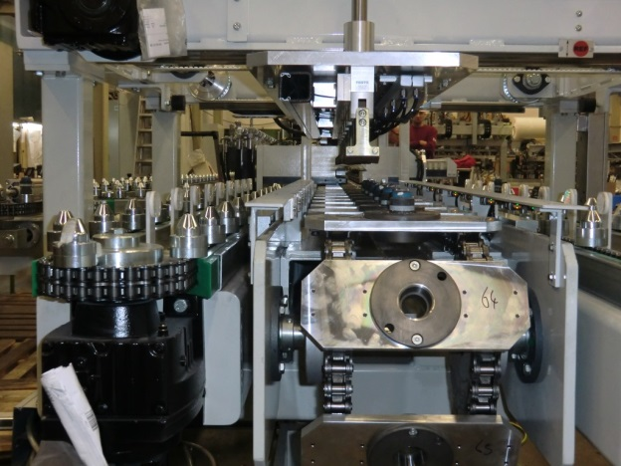
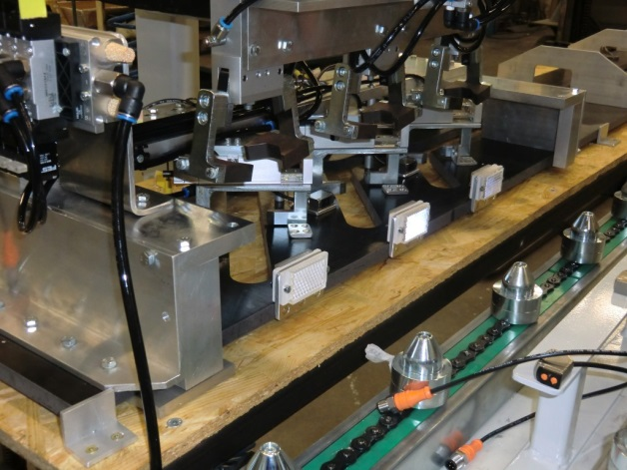
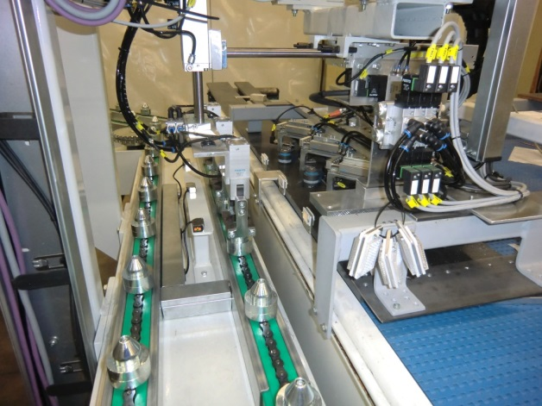
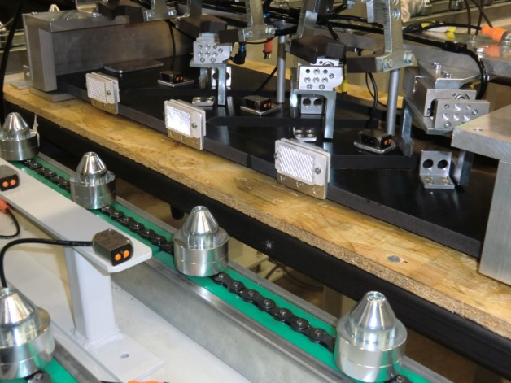
Fully automatic line for M 77 Bomblets – 3000 bomblets/h – scalable
Demil Systems – Submunition dismantalling

Slide 25
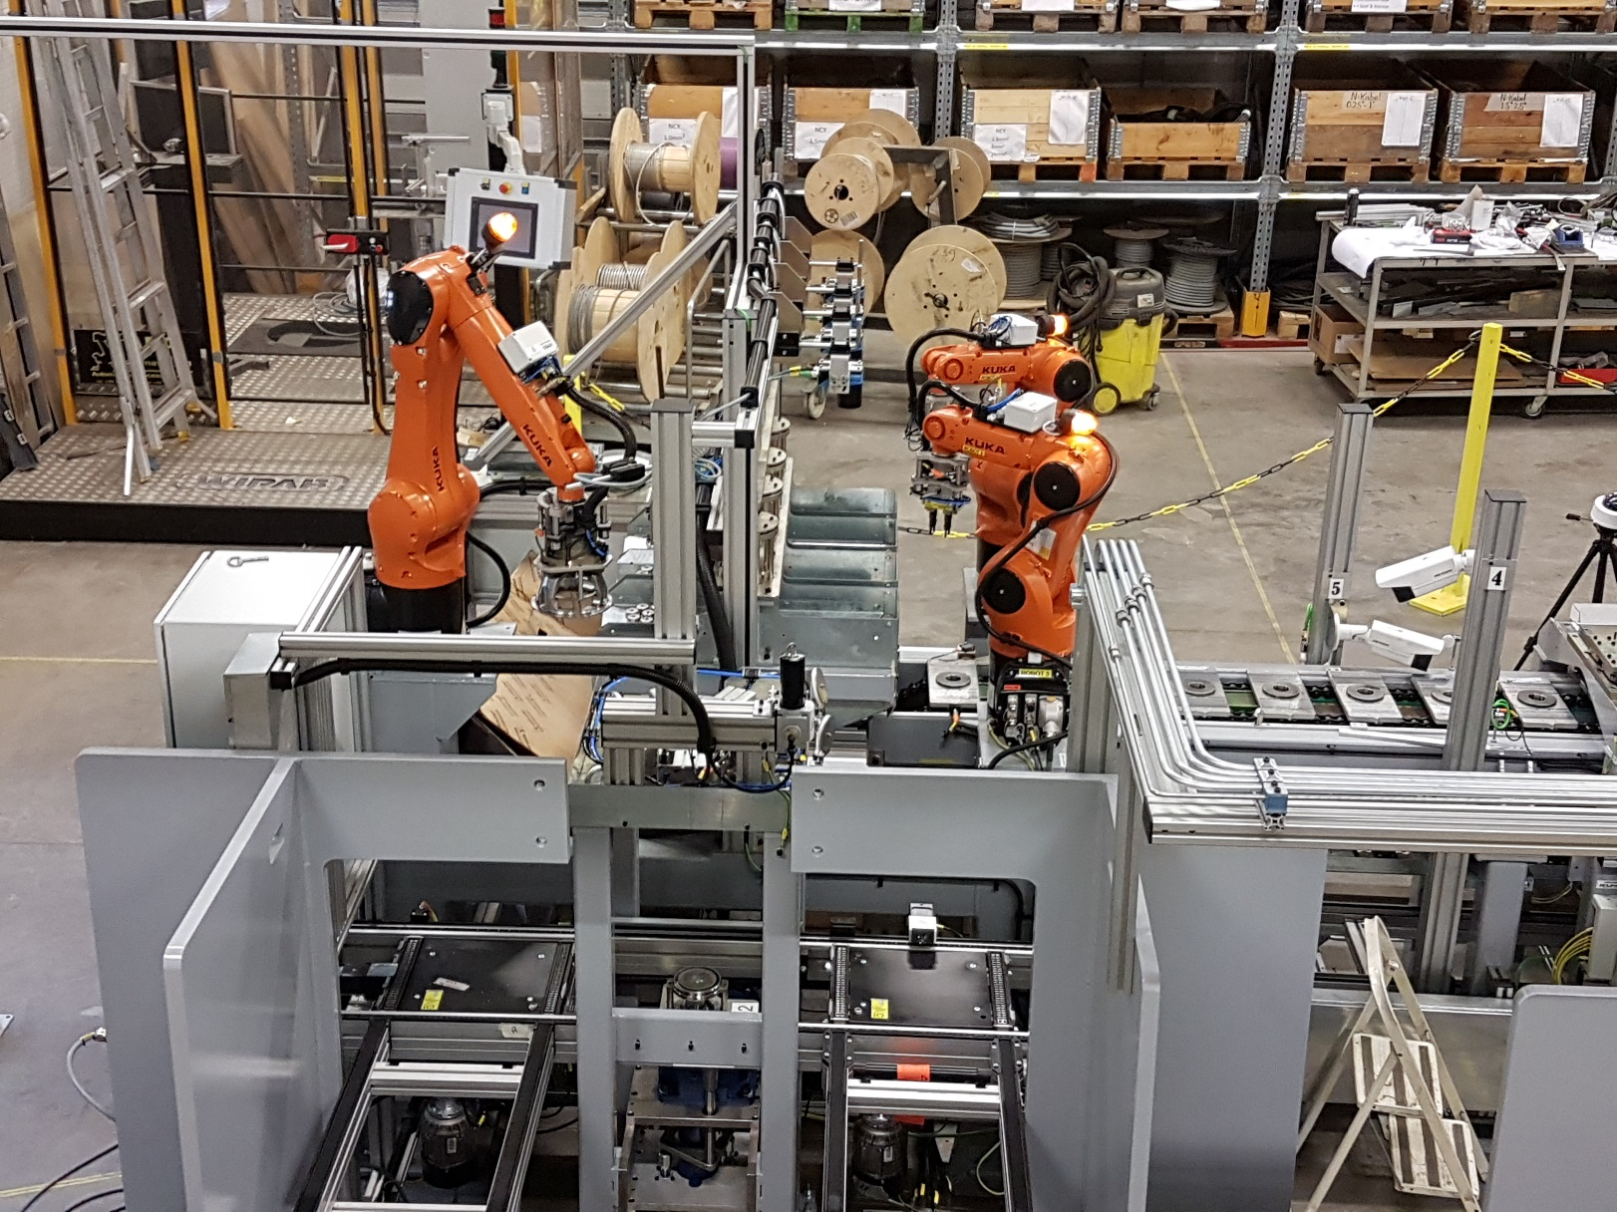
155mm D563/D864 pre-processing system

Slide 26
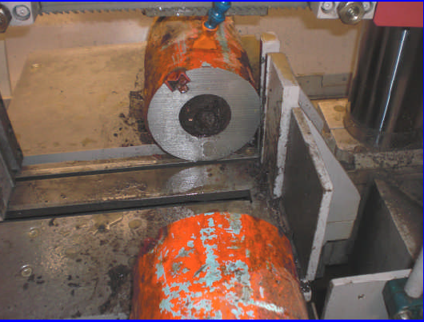
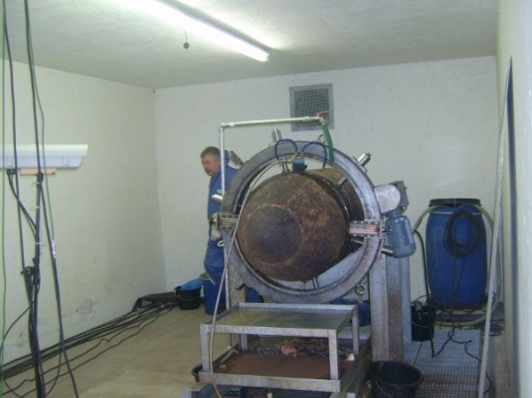
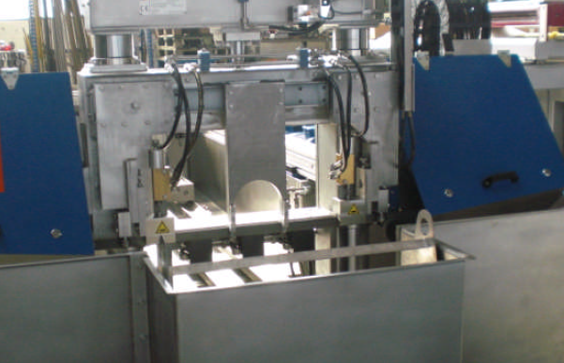
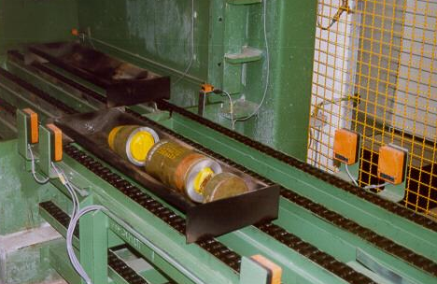
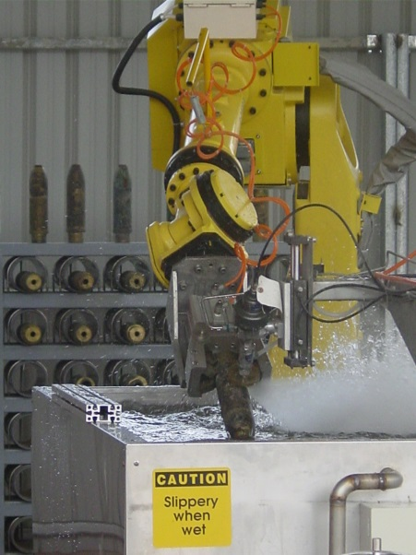
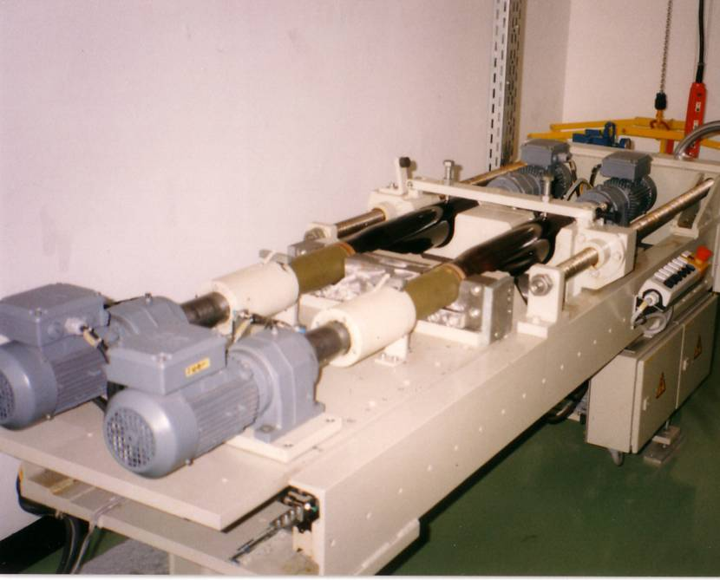
Demil Systems – Ancillary Equipment
Band Saw
Ring Cutter
Under water Band Saw
Waterjet
Defuzing Machine

Slide 27
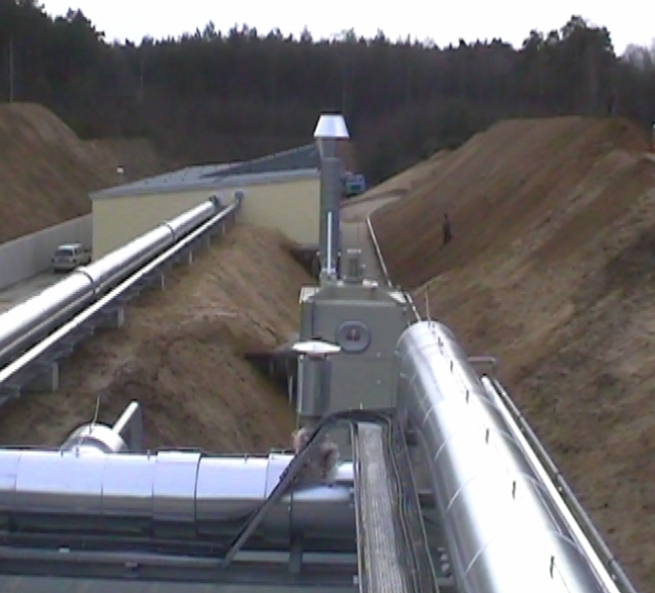
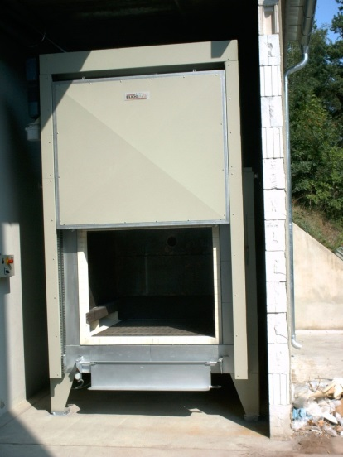
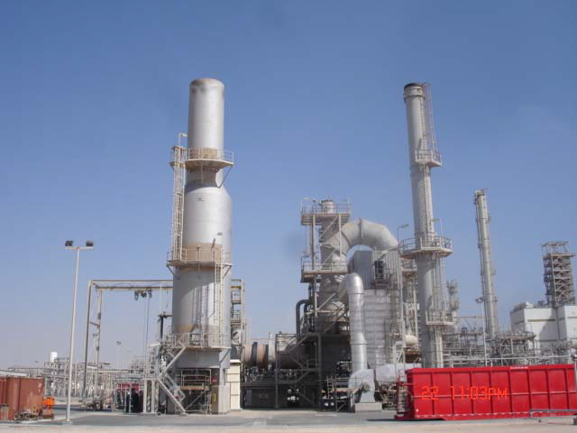
Other Thermal Systems
  Metal Parts Furnace (E/Fuel)
  Tunnel Furnace (150/600 kg/h)
  Rotary Kiln (direct/indirect heated)
  Liquid incinerators
  Clean burning chambers

Slide 28
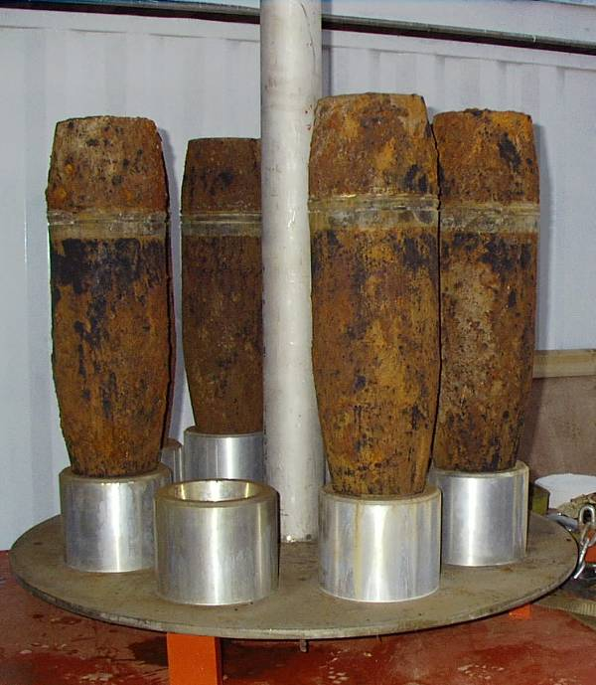
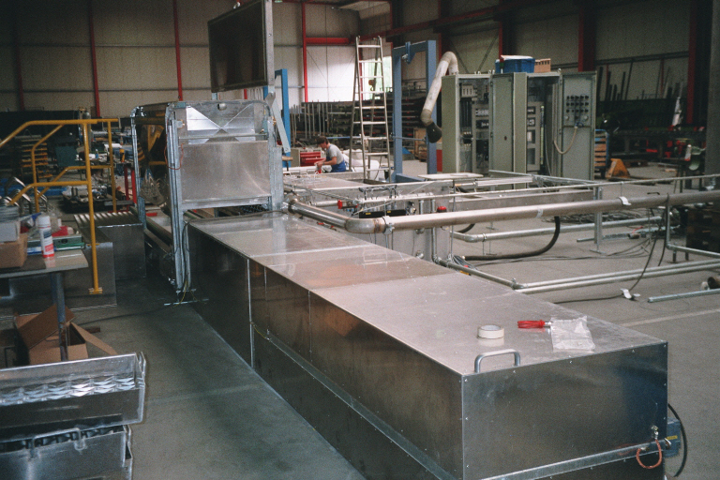
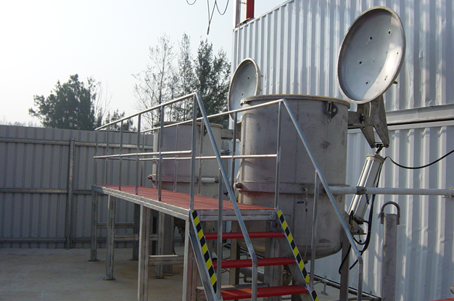
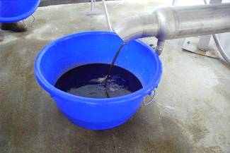
Demil Systems – Melt out, Water or Steam
Removes TNT from munitions
  Capable of processing munitions from the 60 mm mortar up to 900 kg bombs
  Recovered explosives are suitable for recycling or reprocessing
Melt out with water
Melt out with steam
Recovered TNT

Slide 29
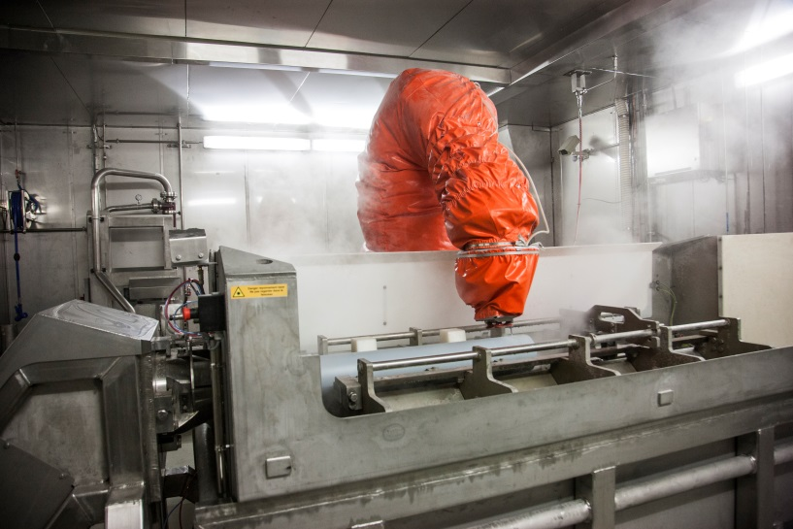

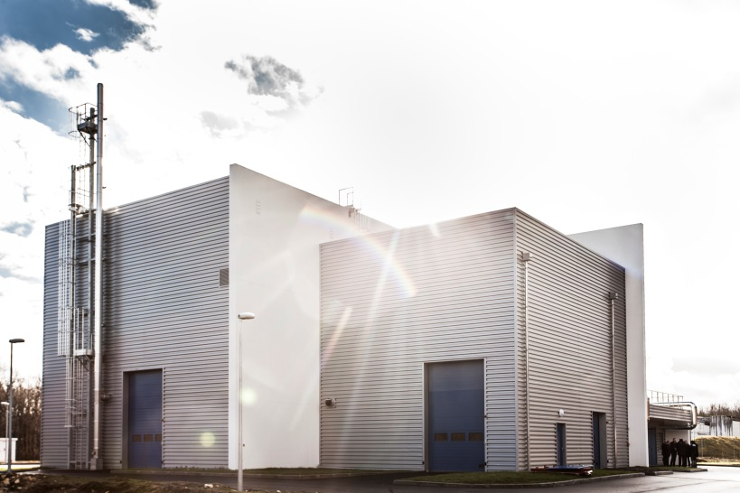
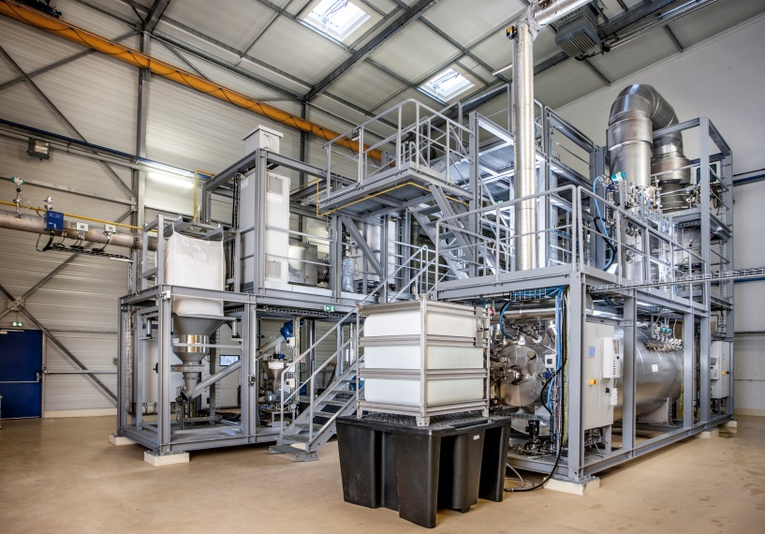
Case Study MBDA – MLRS Disposal
Demil Systems – SDC 1000 for Rocket Motors

Slide 30
Demil Systems - Capacities
All in kg

Slide 31
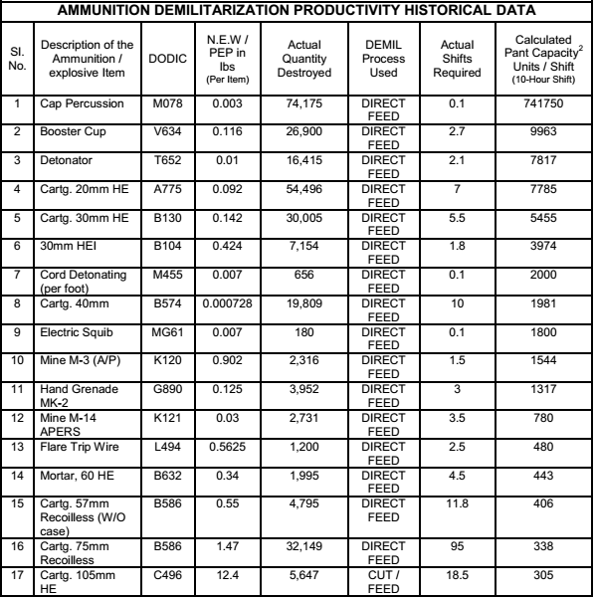
SDC Systems - Capacities for Thermal Treatment
The following report reflects a summary of US manufactured ammunition proceeded through SDC 1200 and 2000 units in Asia for the period of 1/1/2005 to 12/31/2005¹
Note 1: Figures above are from actual, historical processing data of an SDC-1200 and
an SDC-2000 system at a site in Southeast Asia. Unit throughput is computed by dividing the total qty. demilitarized by work shifts required. Numbers are
for rough order of magnitude purposes and may vary due to a variety of factors. Items
1-28 were processed through the SDC 1200, items 29-35 were processed in the SDC
2000 Items marked “DIRECT FEED” are fed intact directly to the unit with no feed
preparation. In most cases multiple items are fed at one time. Items marked “CUT /
FEED” are cut before feeding, in most cases to defeat shaped charges or reduce the
amount of explosive per item to the recommended limits for the unit.

Slide 32
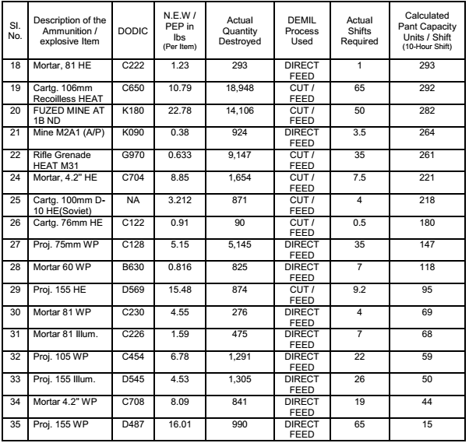
SDC Systems - Capacities for Thermal Treatment (Cont.)
Figures above include any unplanned processing stoppages (such as machine
repairs and unplanned maintenance), but do not include planned, programmatic
stoppages (such as scheduled maintenance intervals).
The total NEW/PEP destroyed over the interval covered was 769,604 lb. The total weight of munitions destroyed was approximately 5.1 million pounds or 2,565 short tons.

Slide 33



Demil Systems - Off Gas Treatment Systems
  Best environmental footprint in the Industry
  Can comply with all environmental permit requirements worldwide
  Munster II: EU 2000 – 76
  Munster III: EU 2000 – 76
  Abu Dhabi: EU 2000 – 76
  Portugal: EU 2000 – 76
  USA: USEPA MACT
  KHI: Japan Environmental Standard
  JFE: Japan Environmental Standard
  MBDA (France): EU 2000 – 76
  Taiwan: Taiwan Environmental Standards
  Libya USEPA MACT
  Qatar/Morocco/Singapore: Local Regulations

Slide 34

Typical Off Gas Treatment System

Slide 35


Can Process Old, Poorly Maintained Munitions
Kinmen Island, Taiwan ROC
Challenge
  Location, removal, and destruction of 40-year-old waste ammunition sealed in cement in underground tunnels that included streams
  Munitions in very poor condition, could not be safely transported
  Technology used:
  SDC 2000
  SDC 1200
  DES OGT
  Diverse disassembly equipment

Slide 36




Demil Systems
Scientific Background
FEM modeling
Static and dynamic numeric sollutions
Fluid dynamic calcuations
Life time fatigue stress analysis
Fragmentation analysis
Dynamic Process calcuations

Slide 37



Mass and Energy balance
Complete mass and energy balance (static and dynamic)
Waste and emission projection
Model based on plants built
Model backed by real data

Slide 38




Maintenance
Maintenance manuals and procedures for OGT/SDC
Maintenance schedules
Maintenance training
Dynasafe offers specific maintanance/wear&spare parts

Slide 39
Training/Operation
Dynasafe can provide
    Basic training program - this involves:
      Classroom training
      Safety training
      Hands on Maintenance training
      Hands on Operations training
      On the Job training while in operation
      Long term supervision / coaching of operations (up to several months)
      Certification of operators
    Additional training/operation support as necessary such as:
      Education on handling of toxic materials
      On line maintenance access to the plant
      Freshen up training on demand
    Complete analytical support
    Operation

Slide 40
Answers to committee questions (containment, Throughput)
Can the SDC be scaled -up further? What are the scale-up limitations?
  Yes it can be scaled up. The biggest limitation is transportation/shipping of the DC to the site (overweight/oversize load)
Will any version of the SDC be able to process 155mm D563, D864, D509, D502, D501, D514?
  Yes. The SDC at Anniston has already processed D501and D502 would be no problem. We are currently installing an SDC 1500 plant designed for D563/D864 (M42/46 submunitions) with purpose built pre-processing. This plant has already processed D509 and D514 projectiles.
What limits throughput rate? Can these limitations be addressed and by how much might throughput capability be increased?
  The ability of the SDC to absorb or reject heat from the feed materials is what currently limits throughput. We are investigating methods to improve the capability. Projections of improvement are around 25%.
How will throughput vary with the type of item fed to the chamber?
  Two factors, the time required for the item to heat up to the reaction temperature and the amount of explosive/item influence the throughput

Slide 41
Answers to committee questions (Versatility/robustness)
Looking at the list of DODIC items in the conventional munitions stockpile, which ones do you think an SDC of any size will be able to process and at what rates
  Please see the copy of the top 400 items in the demil stockpile provided. The first 100 items have been roughly calculated.
How robust is the technology? Can it manage deviations when a munition does not behave as expected or mistakes in feed preparation are made?
  Most munitions behave as expected. The explosive containment capability ratings for the SDC are very conservative, so if/when mistakes are made, the system can accommodate them. RCRA requires many checks and balances of feed materials, an automated system we produce can spot feed errors and reject the feed box if necessary
Does the process require extensive maintenance?
  We do not feel the system requires extensive maintenance, but some maintenance is required.

Slide 42
Answers to committee questions
Post-processing
Is this PAS compatible with emissions expected from processing conventional munitions
  Yes, in fact the PAS for conventional munitions is less complex than the one for chemical munitions (mustard gas), as conventional munitions generally do not contain large amounts of sulfur.
  Pre-treatment
Would the SDC be able to process rocket propellant
  Yes. SDCs worldwide have successfully processed rocket propellant, including composite propellants containing ammonium perchlorate. (MBDA France for example)
  Waste Stream Management
  Are there any solid or liquid waste streams that require special treatment prior to release to the environment or for recycle
    Dry salts from the bag house filter (mostly sodium chloride) can contain heavy metals if these metals are present in the feed materials. The same is true for dusts collected in the dust collection system. If these materials do not pass a TCLP test, they are sent to a TSDF for disposal. Spent activated carbon is typically sent to a supplier for regeneration. Spent filters are also sent to a TSDF for disposal.

Slide 43
Answers to committee questions
Resource Requirements
What are the utility requirements and how are they met?
  Water, Electricity and Natural Gas. The amounts vary with the size of the plant (SDC 1000, 1200, etc.). City or well water can be used as long as it is not too hard, if hard water is supplied then a water softener will be required. Electricity needs to be three phase 480 volts, and natural gas as supplied by pipeline is fine.
  Worker Health and Safety
  What are the major risks to worker health and safety when operating the SDC?
    The explosion risk is actually low due to the automated loading system. The control room is located behind a blast barrier or at some distance from the process. The largest risks to workers are burns from hot parts and dust inhalation from sorting the scrap after it is removed from the SDC. In some installations a scrap dedusting system (supplied by Dynasafe) is used, other clients supply it themselves. Dynasafe supplies training (both classroom and OJT) on these hazards and how to mitigate them while providing training for the operators and maintenance personnel for the plant. General explosive hazard training is the responsibility of the client.

