Slide 1

Chemical Neutralization Applications in Demilitarization of Conventional Munitions
October 24, 2017
Presented to:
Committee on Alternatives for the Demilitarization of Conventional Munitions (CMD Committee)
National Academy of Sciences
Washington DC. USA
Presented by:
Valentine Nzengung, PhD Professor University of Georgia
3675 Crestwood Parkway
Atlanta, GA 30096
www.munirem.com
vnzengung@munirem.com

Slide 2
Presentation Outline
Introduction to MuniRem™ technology
Demonstration/validation test for bulk explosives
Full scale chemical neutralization of bulk explosives
Chemical neutralization of bulk explosives abandoned on demilitarization equipment
On-site demilitarization of recovered underwater munitions
Chemical destruction of chemical warfare materiel (CWM)
Incorporation of MuniRem solution into existing demilitarization systems
MuniRem technology rating and summary

Slide 3
Introduction to Munirem Technology

Slide 4
Chemical Neutralization of Energetics
Chemical Oxidation
  Alkaline Hydrolysis
  Activated Persulfate
  High Temperature Oxidation
Chemical Reduction
  MuniRem
  Nano Zero Valent Iron (nZVI)

Slide 5
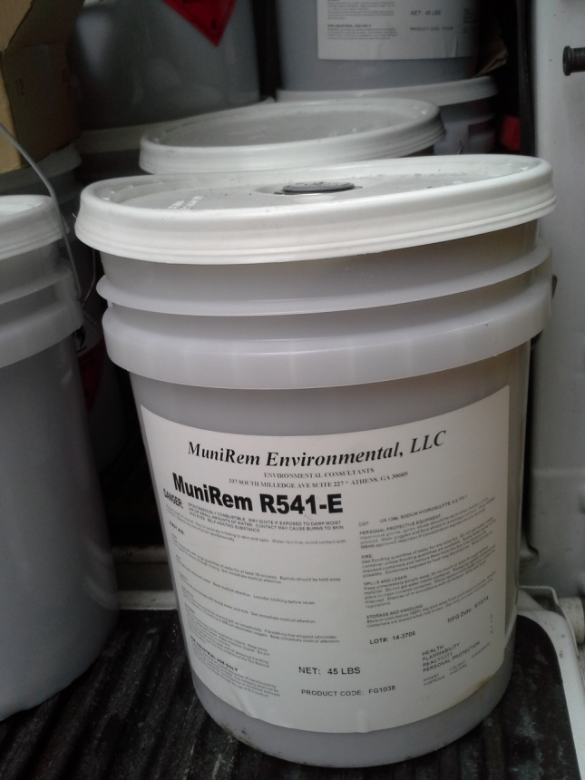
What is MuniRem?
MuniRem is the commercial name for a University of Georgia Research Foundation patented technology that employs reduction chemistry to rapidly neutralize and destroy explosives and energetics in different media.
The end product is non-hazardous.
MuniRem also degrades chemical warfare materiel (CWM) and stabilizes metals.
MuniRem is licensed exclusively to MuniRem Environmental, LLC

Slide 6
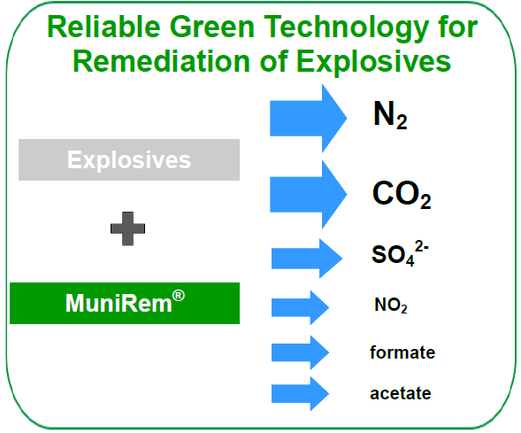
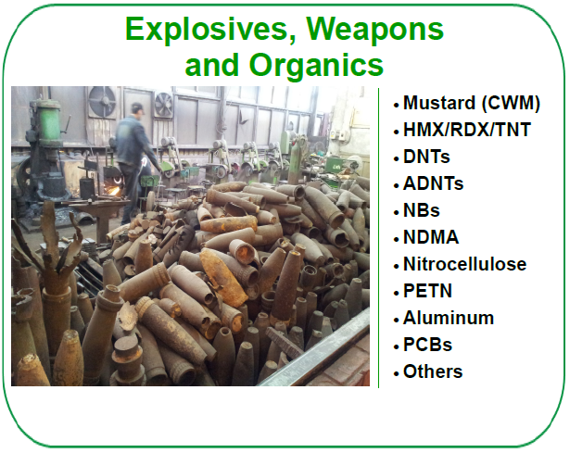
Types of Explosives Neutralized and End Products
Effective in Neutralization and Remediation of
Mustard (CWA)
HMX / RDX / TNT
DNTs / ADNTs
NBs / NDMA
Nitrocellulose Propellant
PBX / PETN PCBs Lead Styphnate Lead Azide Picric Acid AN/TATP
Reactive Aluminum
As, Ba, Cd, Cr, Pb, Hg, etc.
The MuniRem reagent is versatile in its ability to neutralize a variety of energetics

Slide 7
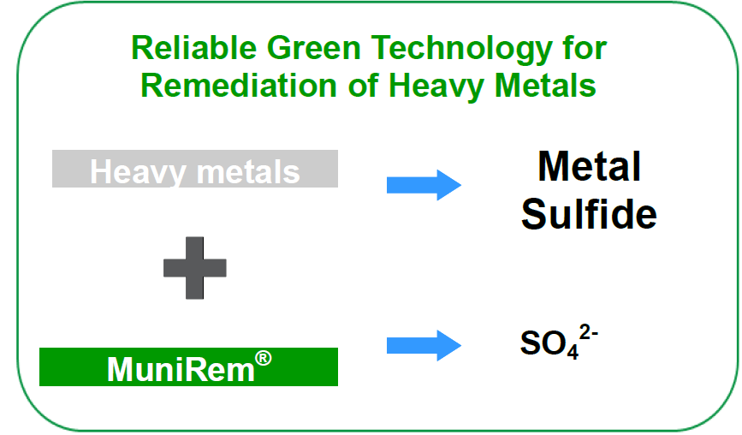
Effect of MuniRem reagent on Heavy Metals

Slide 8
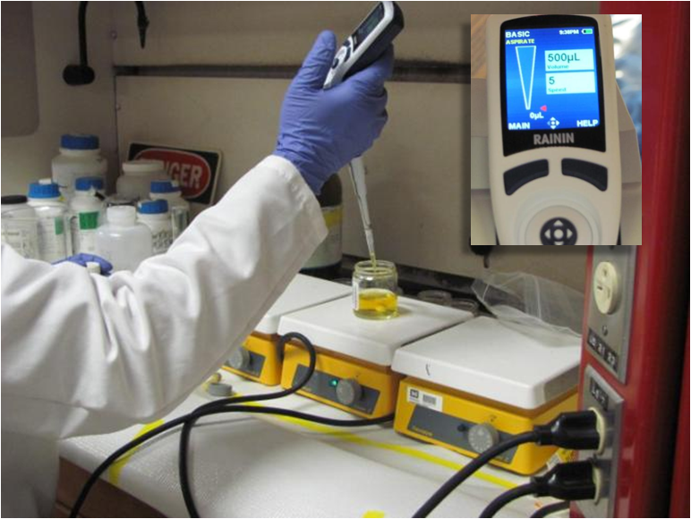
Multiple Evaluations at Bench & Pilot Scale
University of Georgia
Orbital ATK Laboratory, LCAAP
Army Laboratory, Vicksburg, MS
NDCEE/AEC Independent Evaluation, Pennsylvania
Non-Stockpile, Edgewood, MD
Indian Head (NAVFAC)
SMS

Slide 9
Demonstration/Validation Test for Bulk Explosives
Evaluation of MuniRem efficacy for the neutralization of bulk explosives
Contract # W912PP-09-P-0125

Slide 10
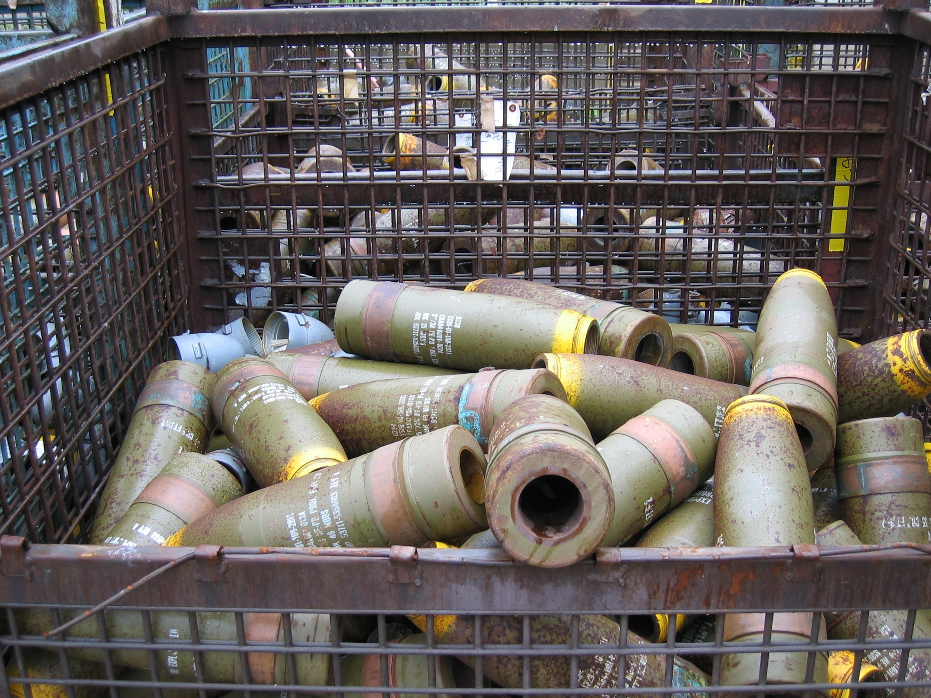
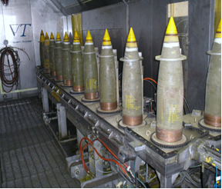
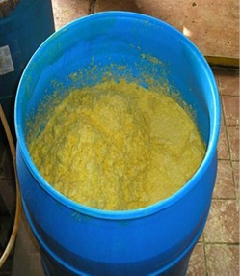
Options for Recovery of Bomb Fillers (Bulk Energetics)
Water jet
Water saw
Milling
Cryogenic Breaching
Projectile Casings
Breaching and Recovery of Bulk Energetics
Recovered Bulk Energetics

Slide 11
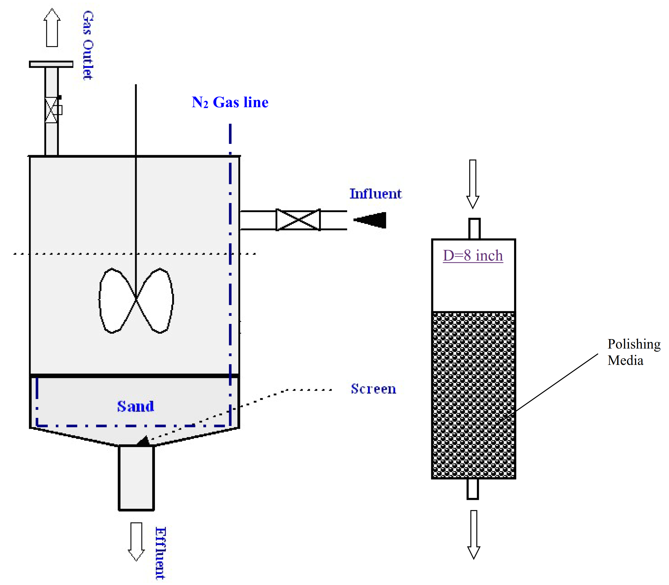
Custom Built Neutralization Reactor for Bulk Energetics
Waterjet breaching of Navy Projectiles
100 gallons neutralization tank
10 Lbs explosive per batch
Manual loading of explosives
Reaction time < 1 hour
Polishing column – packed bed reactive media

Slide 12
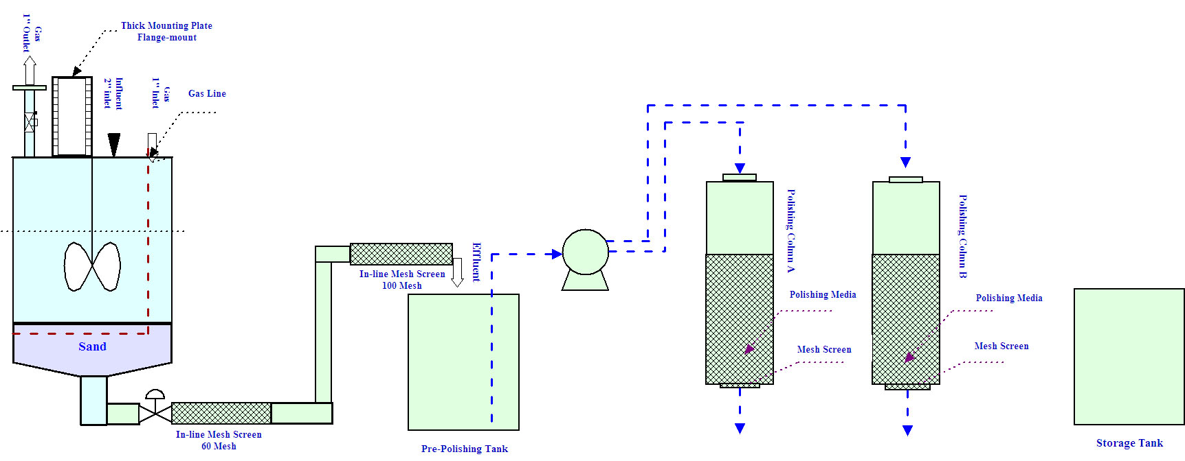
Chemical Neutralization of Recovered
Bulk Explosives (schematic)

Slide 13
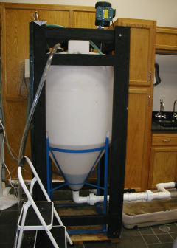
Pilot Scale Demonstration
Neutralization of Multiple 10 lb Batches of Bulk Explosives
Neutralization in under 30 minutes
Effluent wastewater target of 2 ppm explosives
Decontaminated casings to MDAS
Non-hazardous wastewater
Water recycling and re-use
Custom Built Explosive Neutralization Reactor

Slide 14
Pilot Scale Results:
Neutralization of Multiple 10-Lb Batches of Composition D
Batch # | Initial Conc’n (mass) | Conc’n in Effluent of Neutralization Reactor | Conc’n after Polishing Column | % Neutralized in Reactor | % Removal Effluent of Polishing Column
T0 | 1400 mg/L (1 lb) | 602 mg/Lª | 9 mg/Lª | 57.00% | 99.36%
T1 | 14,000 mg/L (10 lbs) | 3200 mg/L^{b} | 920 mg/L^{b} | 77.14 % | 93.43%
T2 | 14,000 mg/L (10 lbs) | 540 mg/L^{b} | 550 mg/L^{b} | 96.14% | 96.07%
T3 | 14,000 mg/L (10 lbs) | 24 mg/L^{b} | 2.2 - 9.9 mg/L^{b} | 99.83% (Optimized) | 99.93 %
Note: a = onsite detects; b = confirmatory results from TestAmerica (single detect or highest from multiple detects)

Slide 15
Full Scale Chemical Neutralization of Bulk Explosives

Slide 16
Scale-up Option
Small Scale Demilitarization (Schematic)

Slide 17
Industrial Scale Demilitarization
Chemical Neutralization Facility (Schematic)

Slide 18
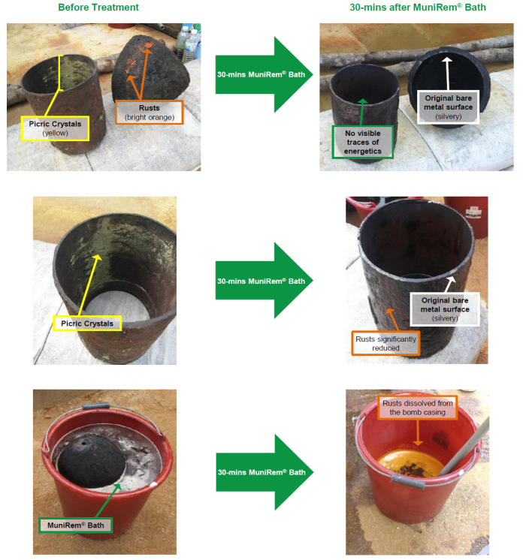
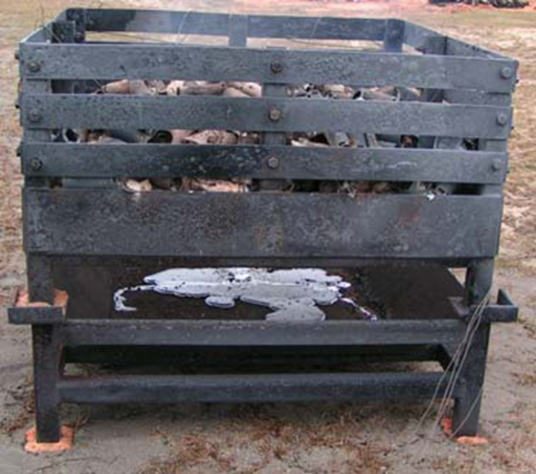
Thermal Vs. Non-thermal Decontamination
MuniRem Bath Decontamination
Thermal Decontamination

Slide 19
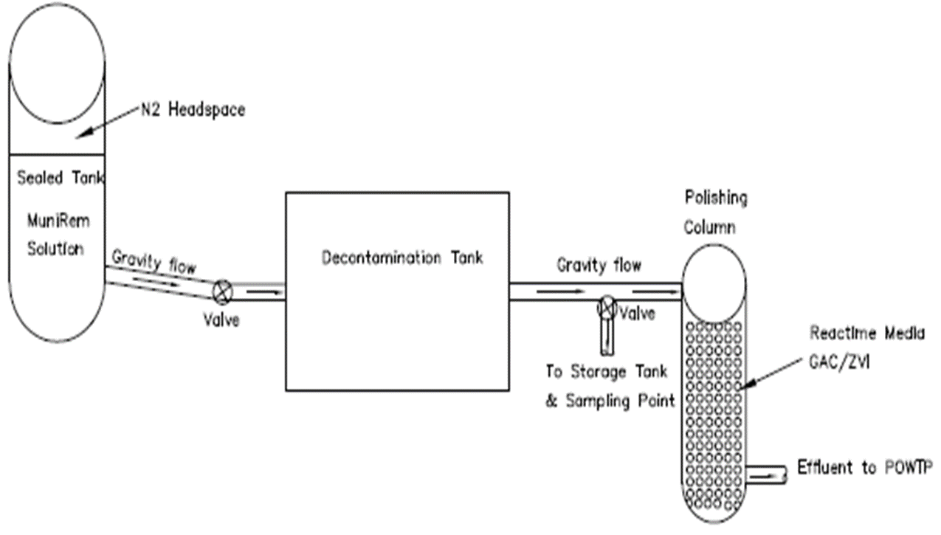
Large Scale Decontamination of Demil Scrap Metal (schematic)

Slide 20
Chemical neutralization of bulk explosives abandoned on demilitarization equipment
Camp Minden, Louisiana

Slide 21
Abandoned Bulk Explosive Neutralization
Melter/Flaker machine contained bulk H-6 (TNT, RDX, AL, Binder) explosives
Large crystallized chunks of H-6 on equipment
Wall surfaces and miscellaneous materials contaminated with explosives
Lead paint chips mixed in with explosives

Slide 22
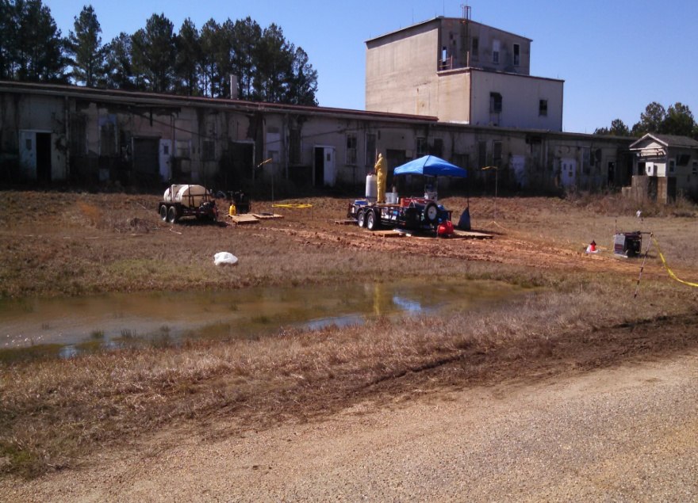
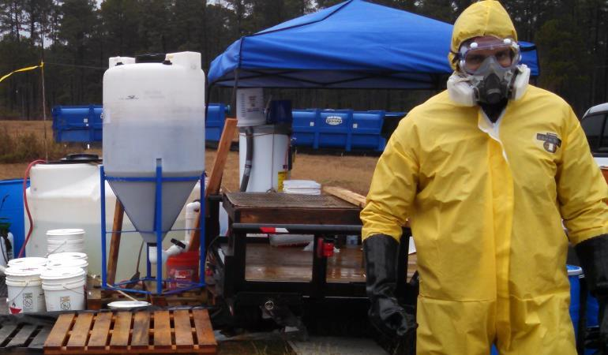
Small Footprint of MuniRem Solution Application
Explosives Neutralization Station Behind Building

Slide 23
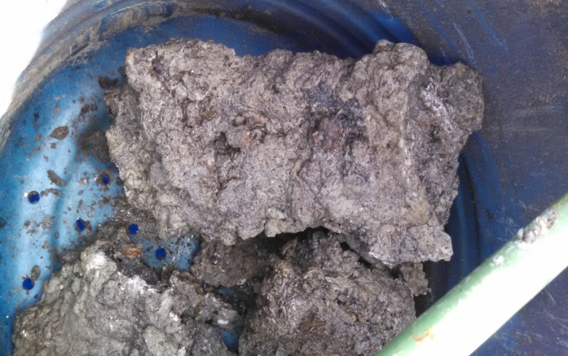
MuniRem Solution Provided Safe Recovery of Crystallized Explosives
Large H-6 chunks safely removed while spraying MuniRem solution
Large explosive pieces transferred to neutralization reactor
Neutralization of recovered explosives achieved rapidly in reaction tanks

Slide 24
Neutralization of Recovered Explosives
2,000 Lbs of H-6 explosives estimated as present on and in equipment
>1000 lbs destroyed in place by spraying concentrated MuniRem solution
>900 lbs recovered and neutralized on-site in reactor with MuniRem solution
Sludge and wastewater characterized as non-hazardous waste

Slide 25
On-site Demilitarization of Underwater munitions
MuniRem supports Savannah Harbor Expansion Project (SHEP)

Slide 26
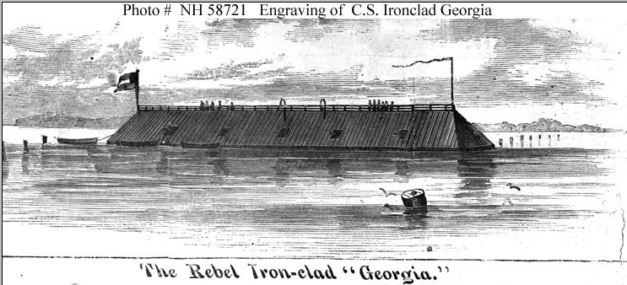
CSS Georgia Background
Ironclad gunboat built for the Confederacy in 1862
Completed Vessel was too heavy
CSS Georgia spent her life as a floating battery in what is now the north edge of the Savannah Harbor navigation channel
CSS Georgia scuttled by Confederate troops on December 24, 1864
Recovery of CSS Georgia and its munitions part of Savannah Harbor Expansion Project

Slide 27
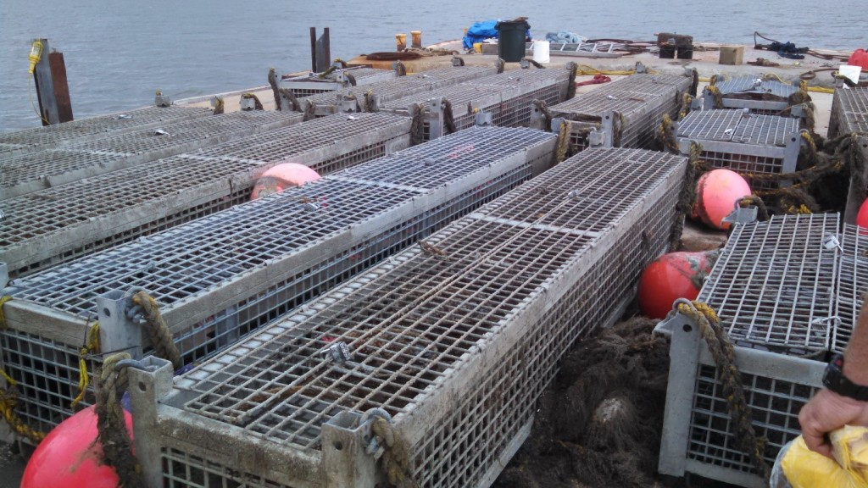
On-Site Neutralization of Munitions Recovered from Underwater Environment: Savannah River Harbor Expansion Program

Slide 28
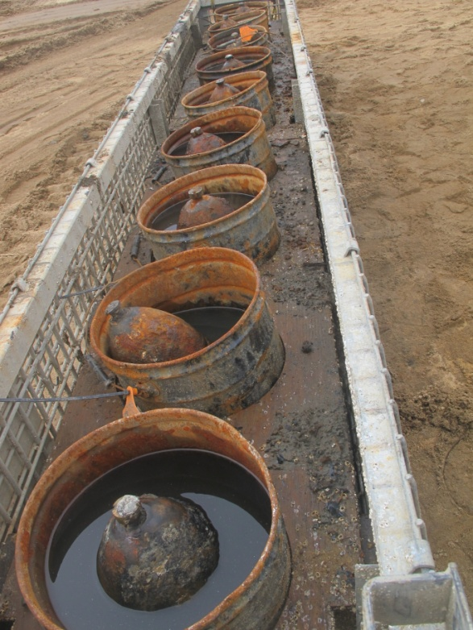
Breaching of Recovered Projectiles
Total projectiles breached and neutralized = 170
Breaching throughput = 12 projectiles per hour

Slide 29
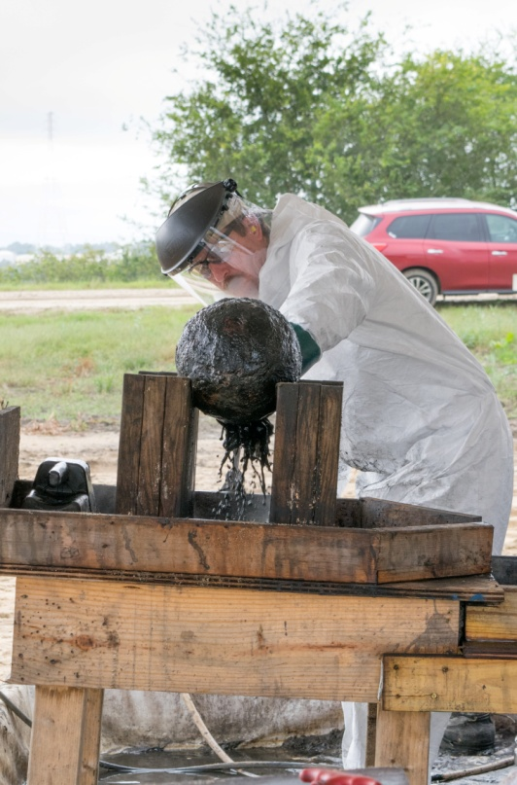
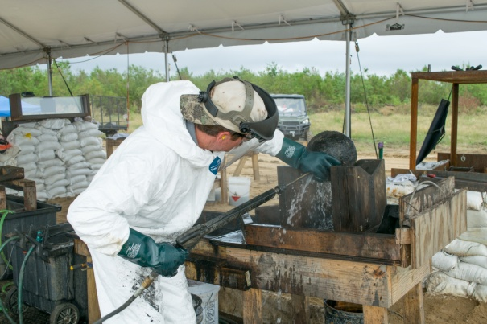
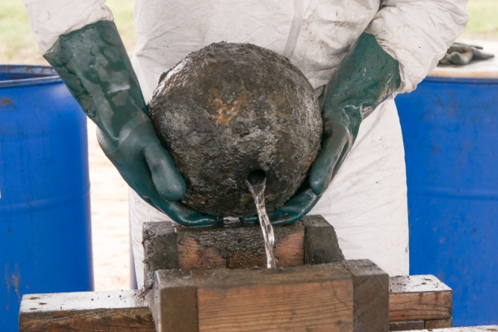
Neutralization of the Breached Munitions
After 150 years explosives still well preserved
Explosives washout using MuniRem solution
Explosives neutralized
Fuzes safely removed and inerted
Munitions certified by SUXOS as safe
Characterization and disposal of non-hazardous waste

Slide 30
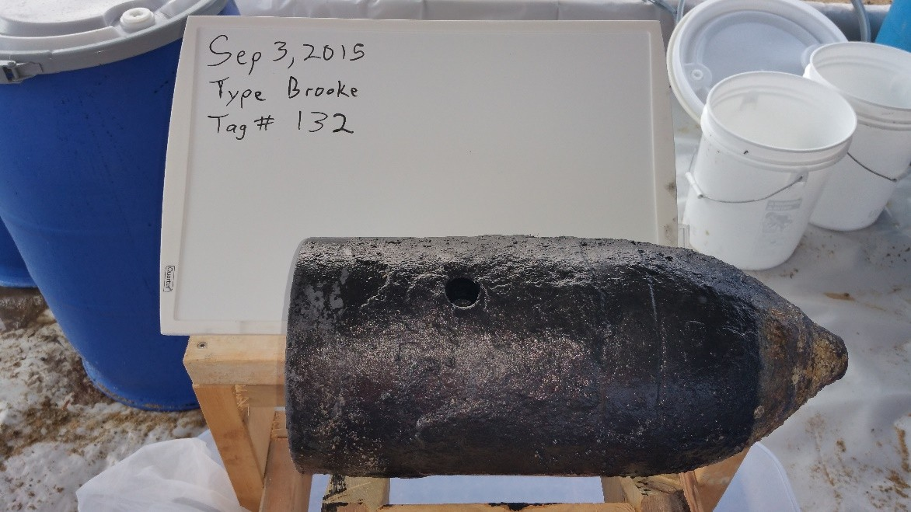
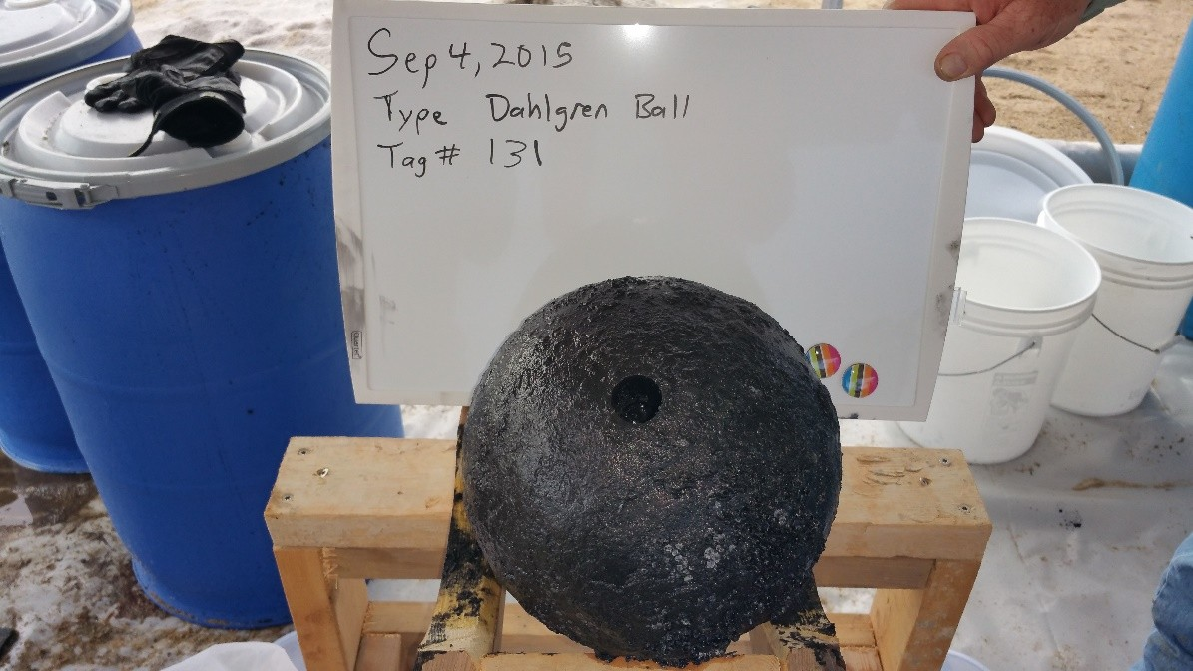
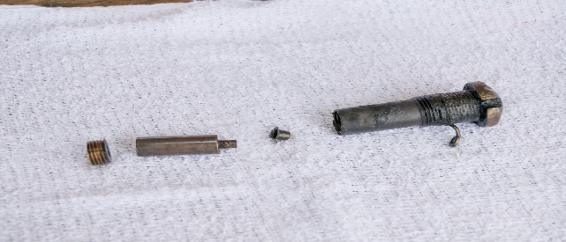
Summary – Underwater Munitions Demilitarization
170 Civil War munitions neutralized on-site in 2015
Munitions transferred to U.S. Army Corps
Munitions preserved for historical purposes
No hazardous waste produced
Largest on-site neutralization of recovered underwater Confederate munitions
Follow up project November 2017
Inerted Fuze

Slide 31
Chemical Destruction of Chemical Warfare materiel (CWM)
Contract #: W912PP-10-P-0034
Results presented are obtained from proof-of-concept test data for tests conducted at Non-Stockpile laboratory, Edgewood (2010)

Slide 32
CWM Deactivation/Neutralization Approaches
Baseline Incineration
Superchlorinated bleaches - solution or powder
Anionic Oxidation
Supercritical Water Oxidation
Electrochemical Oxidation
Donovan Chamber – TC-25
Hydrolysis – hydrolysis of larger amounts of HD (>0.1 M) is a reversible process.
Explosive Destruction System (EDS)
MuniRem

Slide 33
Criteria for Effective Neutralization of CWAs
Reagent should be stable over a wide range of temperatures
Effective over a wide pH range or stabilized with a buffer
Fast acting – possible free radical mediated reactions
Irreversible reactions
No toxic degradation products

Slide 34
Disadvantages of Mustard Hydrolysis
Hazardous end-product
Mustard undergoes reversible hydrolysis reactions
High upfront capital investment

Slide 35
Degradation of Mustard Mediated by
Sulfoxyl Free Radicals
Activated Persulfate (SO₄⁻•) → Chemical Oxidation
Activated hydrosulfite (SO₂⁻•) → Chemical Redcution

Slide 36
Tests at Lawrence Livermore National Laboratory
Title: “Direct Chemical Oxidation: Applications to Demilitarization and Decontamination”
Performers: John F. Cooper; Bryan Balazs; Patricia Lewis
CWA Treated: “one-armed mustard” gas - thiodiethanol [(OHH2CCH2)2-S] and dimethylsulfoxide [(CH3)2-SO], non-toxic surrogates for hydrolyzed Mustard gas.
Chemical Reagent: Oxidation at 90oC using peroxydisulfate (persulfate) solutions.

Slide 37
The Chemistry of Mustard Favors Abiotic
Degradation by MuniRem
Thioethers are characterized by C-S-C bonds. The C-S bond is both longer, because S is larger, and weaker than C-C bonds.
The bond dissociation energies for dimethyl sulfide and dimethyl ether are respectively 73 and 77 kcal/mol (305 and 322 kJ/mol).
Formulations of MuniRem dissociate C-C bonds in chlorinated ethenes and nitroatomatics

Slide 38
Results from Proof-of-Concept Evaluation Study Titled
MICRO-SCALE EVALUATION OF MuniRem REAGENTS FOR THE DEMILITARIZATION OF SULFUR MUSTARD
MuniRem reagent evaluation was independently performed by the United States Department of Defense at its Non-Stockpile Department, Edgewood, MD.

Slide 39
Rate of Degradation of HD by MuniRem Reagent vs.
Rate of Reversible Hydrolysis of HD by Water
Initial = 40 uL (9,000 mg/L)
Initial = 60 uL (14,000 mg/L)
MEA forms Hazardous Waste
Initial = 80 uL (18,500 mg/L)

Slide 40
Neutralization of Mustard (HD) with MuniRem Reagent
Nothing = Homogeneous Solution of MuniRem; no solids added.
Sand and Metal (Iron) was added to simulate reality
Initial Concentration of Mustard = 18,500 mg/L
Results for: 1 hour; 3 hours; 6 hours
3 Hours
1 Hour
6 Hours

Slide 41
Evidence of Mustard (HD) Destruction by MuniRem
Ethylene Production as a Function of Time

Slide 42
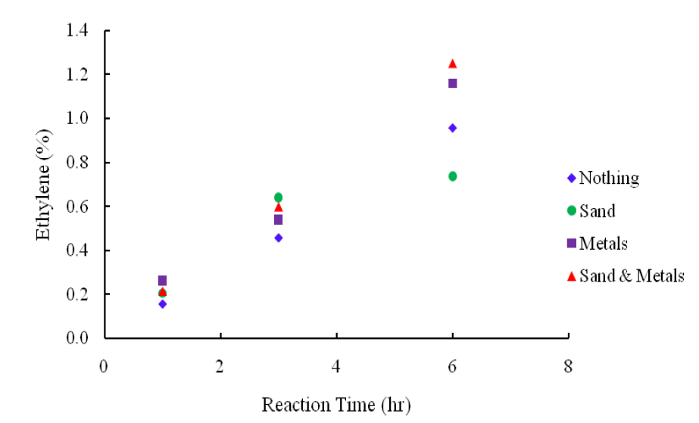
Quantitative Measurements of Ethylene End-Product in the Headspace of MuniRem Treated Mustard (HD)
Nothing = MuniRem Solution Only
Sand = MuniRem solution + Sand as Impurity
Metals = MuniRem solution + Metals (Fe oxides) as Impurity
Metals = MuniRem solution + Sand & Metals as Impurity

Slide 43
Formation of Ethylene from Mustard (HD)
Reductive Dechlorination
Catalyzed by MuniRem
CH₂=CH₂ + S²⁻ (formation of metal sulfide )

Slide 44
Incorporation of MuniRem into existing demilitarization systems

Slide 45
MuniRem Chemical Agent Neutralization Process
CW Munitions Moved from Storage
Chemical agent separated from shells or casings
Water & MuniRem
CWM in EDS reactor
Shells or casings soaked in MuniRem bath
CWM destroyed with MuniRem to Ethylene gas, chloride & sulfide
Shells or casings decontaminated
Sampling & analysis of treated waste
Shells or casings Rinsed with water
Treated waste discharged as non-hazardous waste
Waste analyzed & discharged as non-hazardous waste

Slide 46
Further Development of MuniRem Technology for Use in Explosive Destruction System (EDS)
Evaluation of optimized MuniRem reagent
Pilot test in EDS
Obtain needed approvals

Slide 47
Schematic of Closed Loop Decontamination of One Ton Steel Containers

Slide 48
MuniRem Rating and Summary

Slide 49
MuniRem Technology Rating
No. | Criteria | Rating
1 | Maturity | Already applied at full scale to demilitarize discarded military munitions and neutralize bulk explosives Compliments other demilitarization technologies
2 | Process Efficacy | Demonstrated and validated at bench, pilot and full scale
3 | Process Throughput | 10s to 100s pounds per hour. Determined by breaching and neutralization method
4 | Process Safety | Very safe. Near instant neutralization of most energetics
5 | Public & Regulatory Acceptance | Already approved on multiple State and Federal projects
6 | Secondary Waste Issue | Not a concern
7 | Destruction Verification Capacity | Available and Rapid. EXPRAY Test Kits and similar commercially available wet chemistry explosives sensors
8 | Process Flexibility | Very scalable and adaptable. Easily transportable for on-site demilitarization. Fixed facility not a requirement for application

Slide 50
Summary
MuniRem solution is versatile in its ability to neutralize a variety of energetics and chemical warfare agents.
The reaction of MuniRem reagent with bulk explosives is vigorous but not violent.
MuniRem solution is easily coupled with munitions breaching methods: waterjet cutting, milling, water saw cutting, steaming, shaped charge & cryogenic fracturing.
MuniRem solution treats the waste stream of waterjet and water saw cutting of munitions.
MuniRem solution increases throughput of EDS and similar demilitarization technologies.

Slide 51
MuniRem is a safe, well-proven technology that should be part of every project requiring munitions destruction

