Slide 1
Presentation to the National Academy of Sciences Committee on Alternatives for the Demilitarization of Conventional Munitions
Jane Williams and Frances Kelley
Steering Committee Members
Cease Fire! Campaign

Slide 2
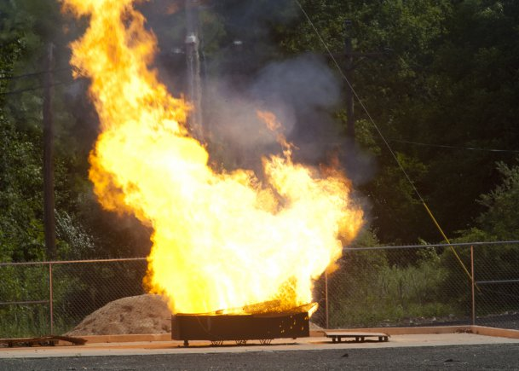

Today, open air burning of hazardous waste by the Department of Defense is commonplace. Open burning of all other hazardous waste in the country is prohibited.

Slide 3
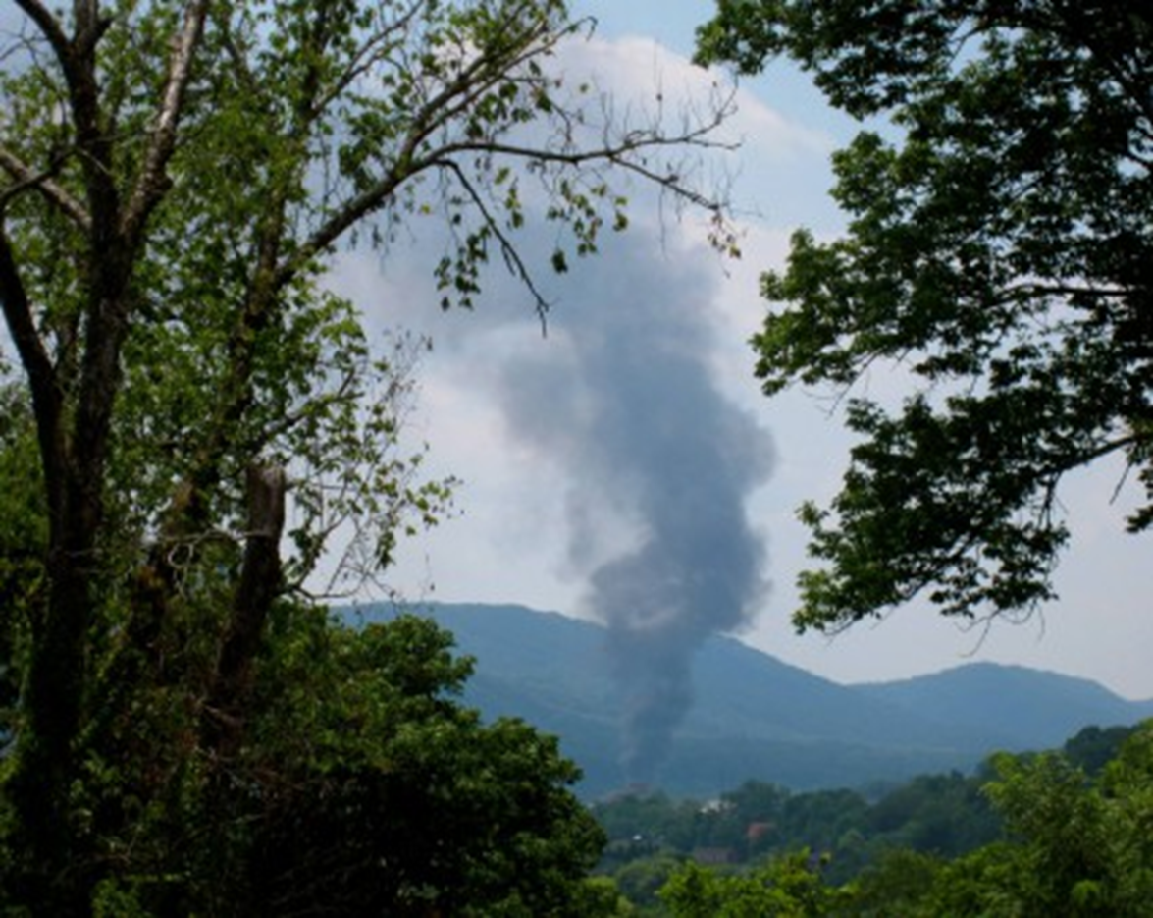
Volunteers for Environmental Health & Justice
This plume of toxic smoke is from open burning hazardous wastes at Holston Army Ammunition Plant in Tennessee.
Notes:
Holston AAP, TN

Slide 4
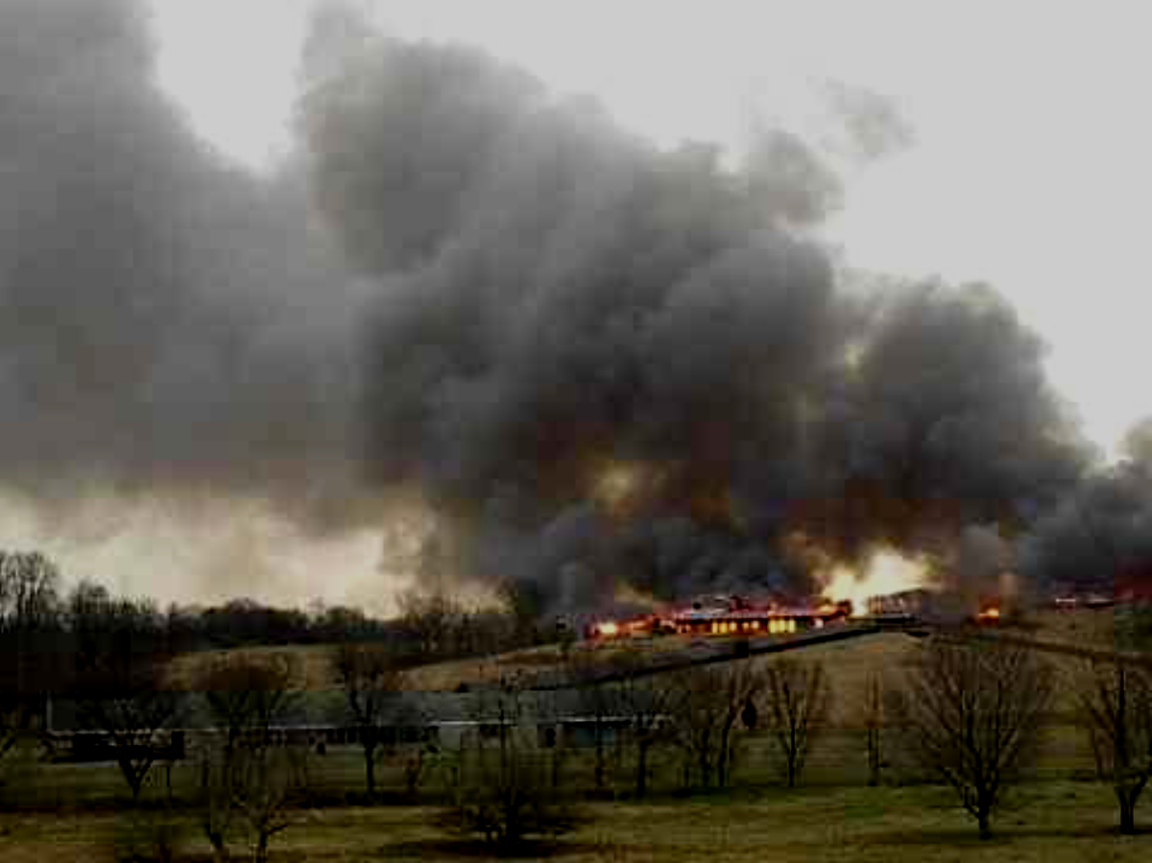
The Army routinely burns buildings too. This is Indiana Army Ammunition Plant. In early 2004, 64 buildings were burned.

Slide 5
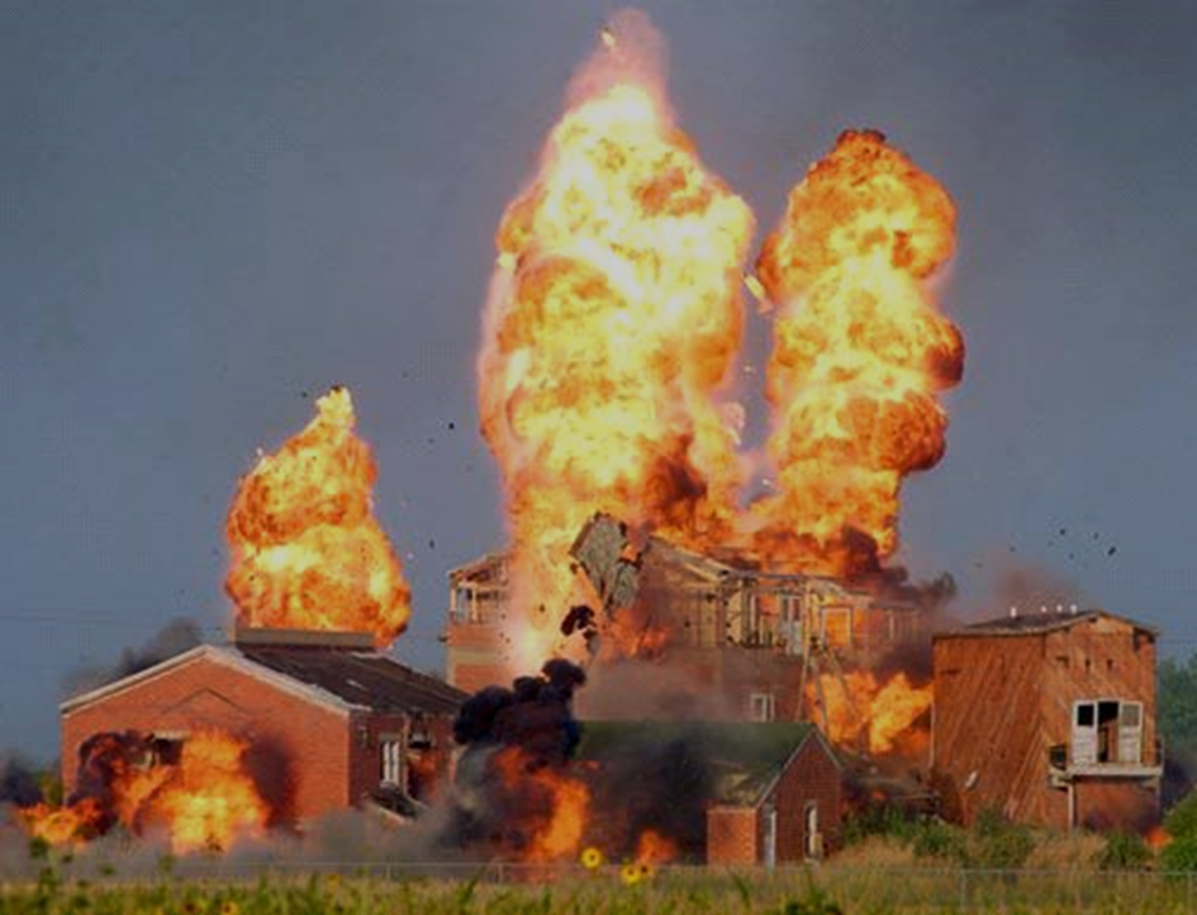
CSWAB.org
This is Sunflower Army Ammunition Plant in Kansas. From 1995-2005 the military burned 1,490 buildings during 142 events. Debris, including asbestos, was carried up to 3 miles offsite to residential areas.

Slide 6
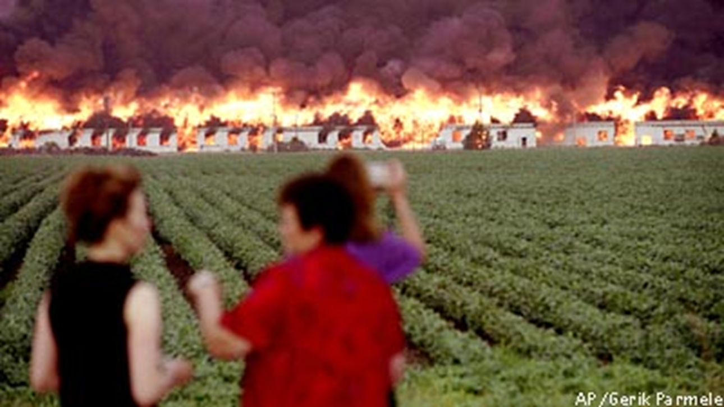
This is Cornhusker Army Ammunition Plant in Nebraska. In 2002, the Army burned 3/4 mile long Load Line 1.
Notes:
Nebraska. In 2002, three-quarter-mile-long Load Line 1 was set ablaze at Cornhusker Army Ammunition Plant, filling the prairie sky with thick black smoke

Slide 7
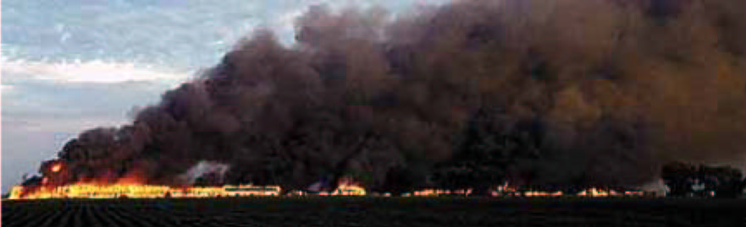
CSWAB.org
This is the same fire at Cornhusker. To give you a sense of scale, each little glowing dot is a building.

Slide 8
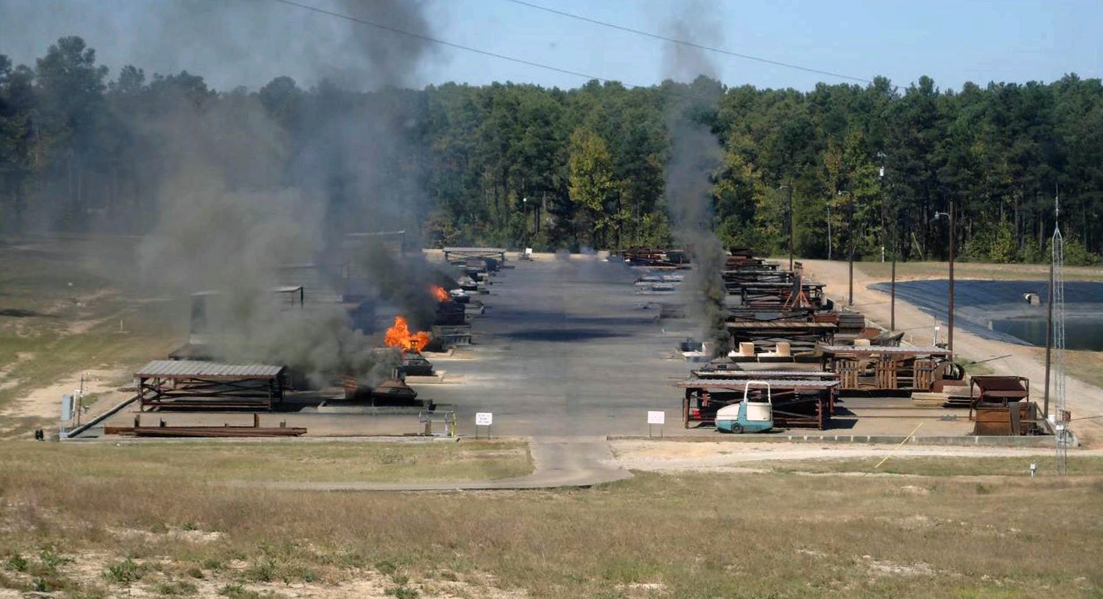
Central Louisiana Coalition for A Safe and Healthy Environment
Open air burning of hazardous munitions wastes is not limited to the military. This is the Clean Harbors facility in Colfax, Louisiana.
Notes:
Clean Harbors, civilian company

Slide 9
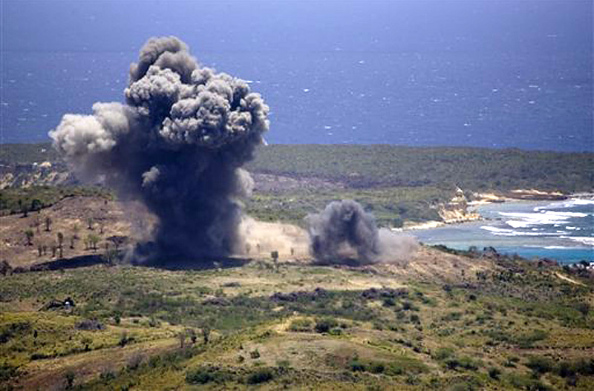
Justice for Vieques Now
In addition to burning, open detonation is routinely used to treat explosives-contaminated wastes. This detonation is in Vieques, Puerto Rico.

Slide 10
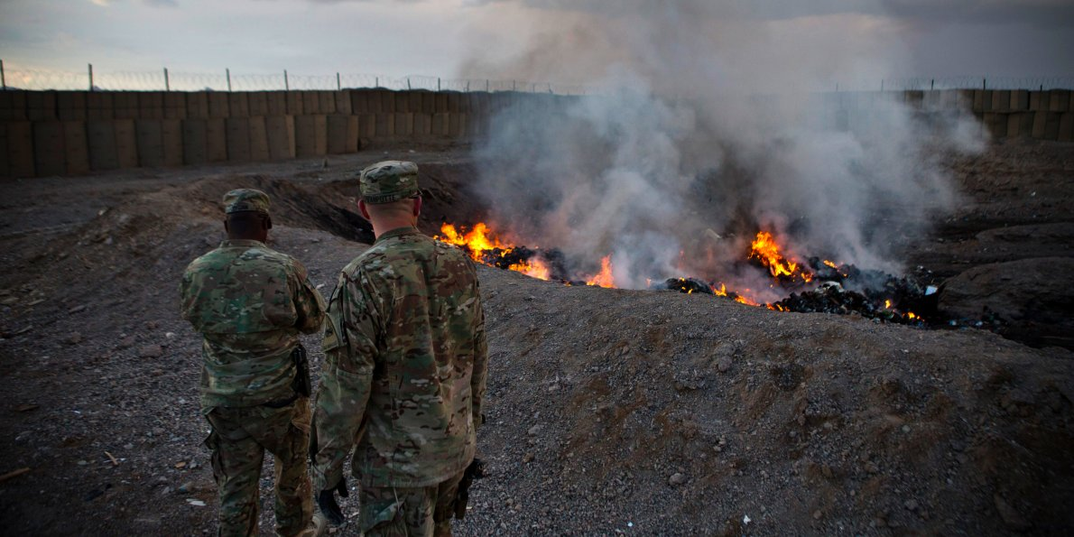
Overseas, the U.S. military and its contractors burn solid and hazardous waste in open pits, including munitions wastes.

Slide 11
How much waste are we talking about?

Slide 12
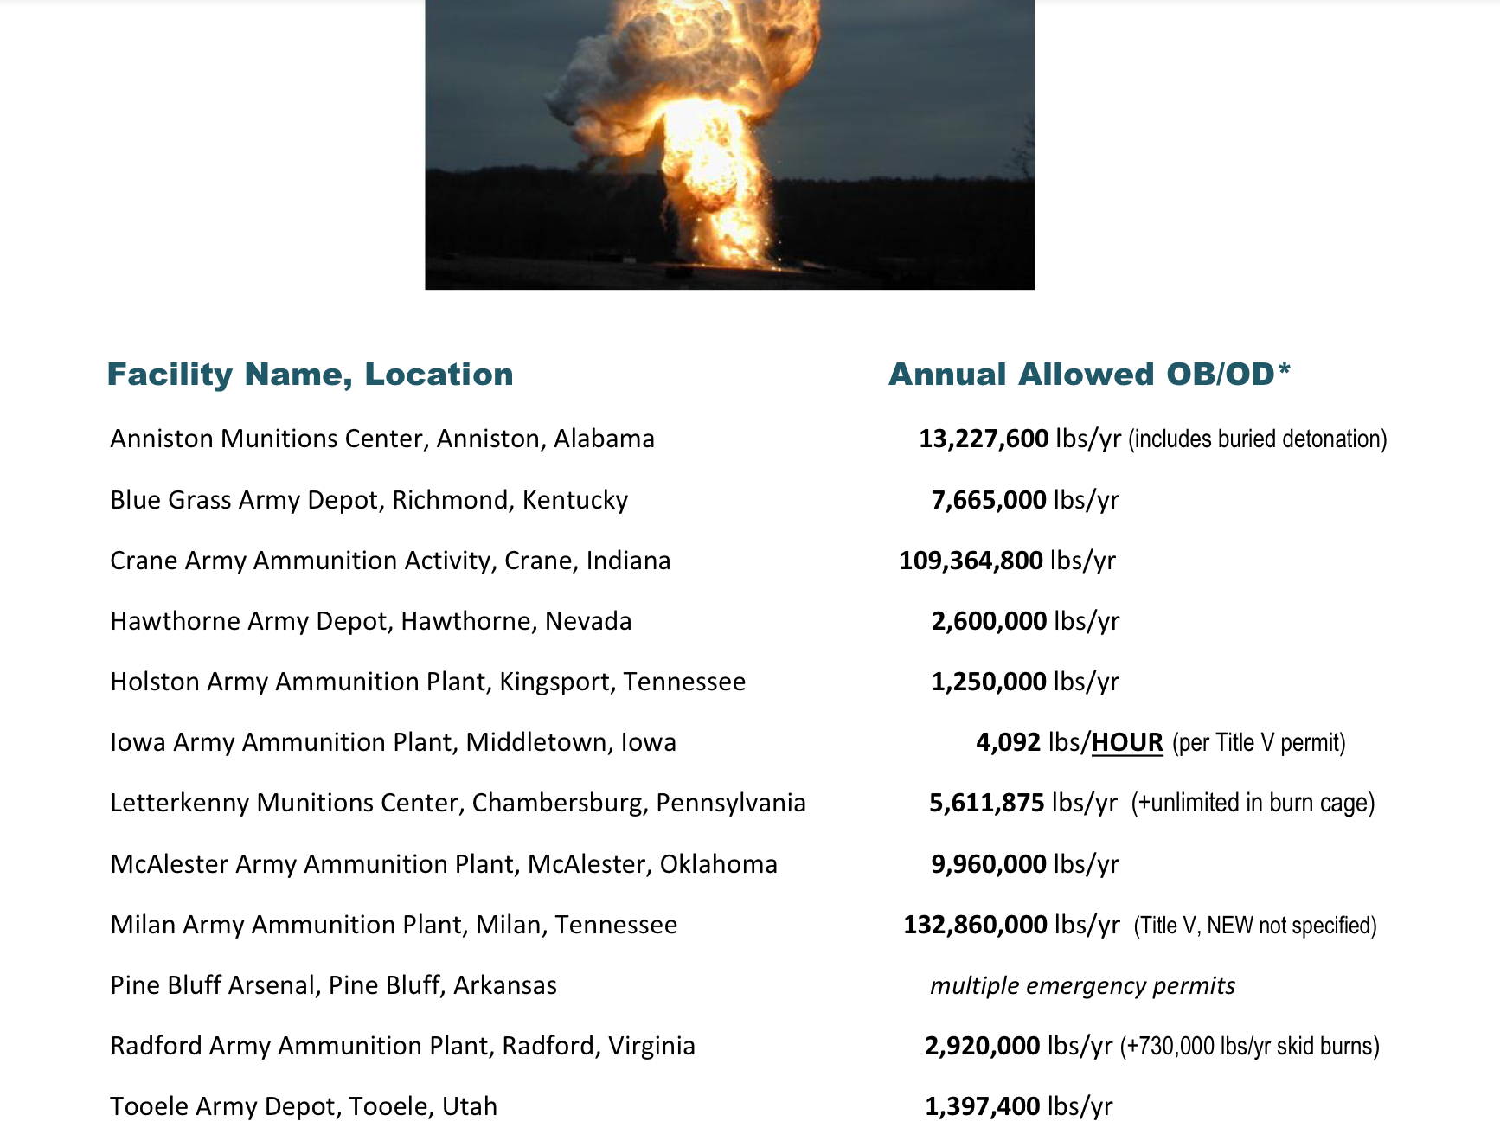

Slide 13
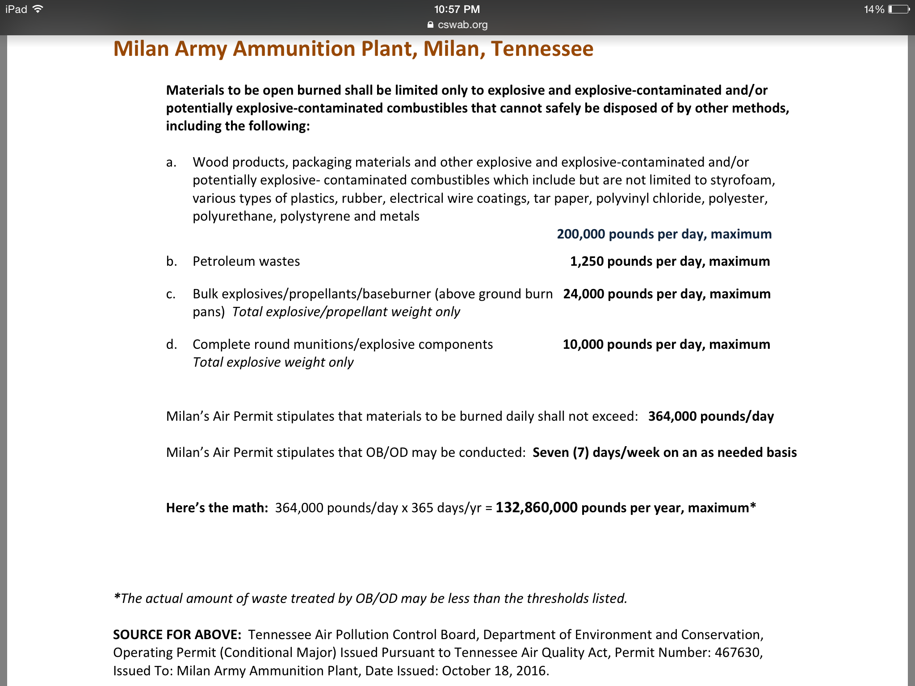

Slide 14
By 2025, the conventional munitions
demilitarization stockpile is expected to exceed 2,000,000,000 lbs.

Slide 15
The military has conducted open burning and open detonation on the island of Vieques in Puerto Rico.
Children in Vieques have a risk of developing cancer that is 2-3 times higher than in the rest of Puerto Rico.

Slide 16
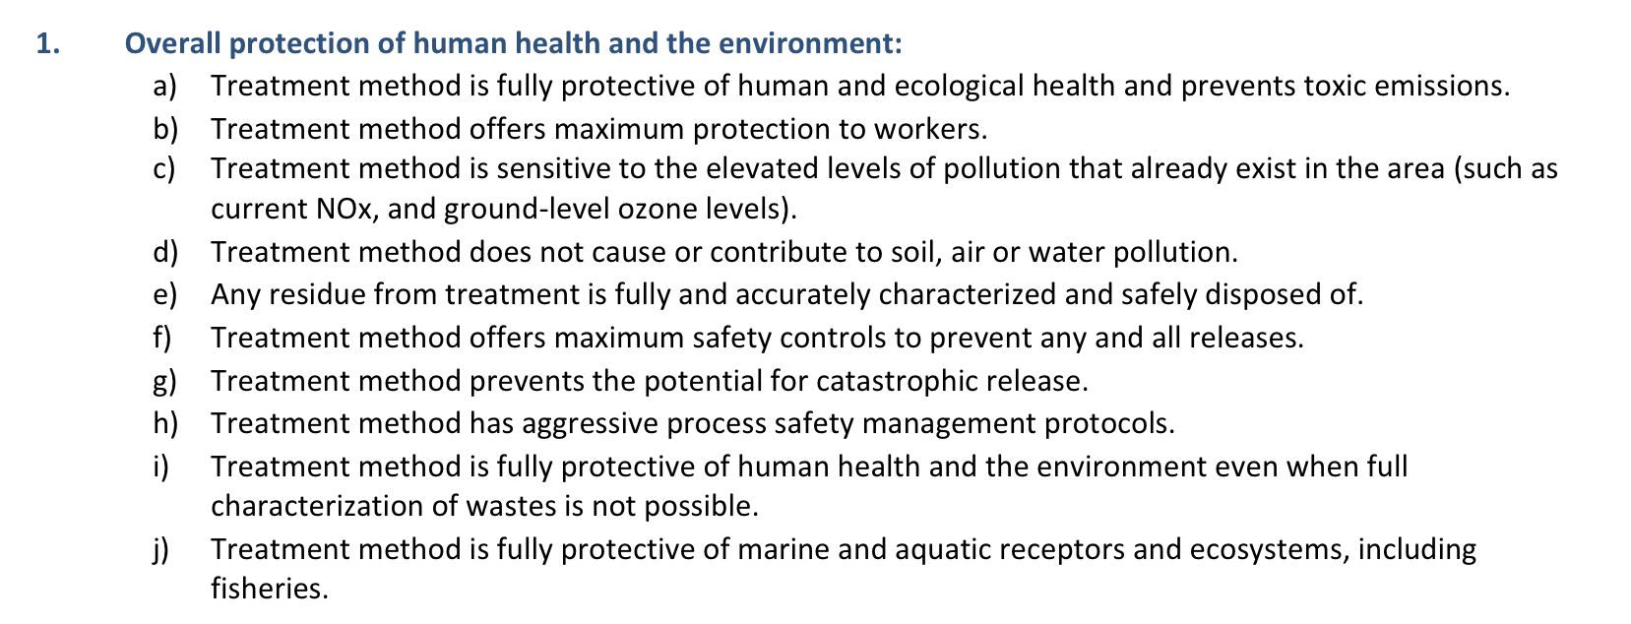
Technology Criteria

Slide 17
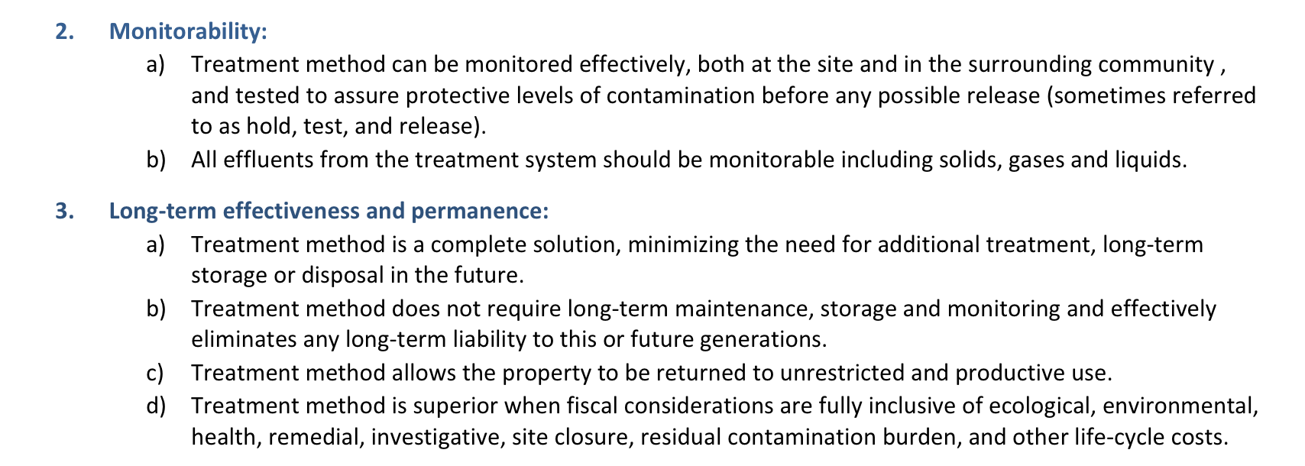

Slide 18
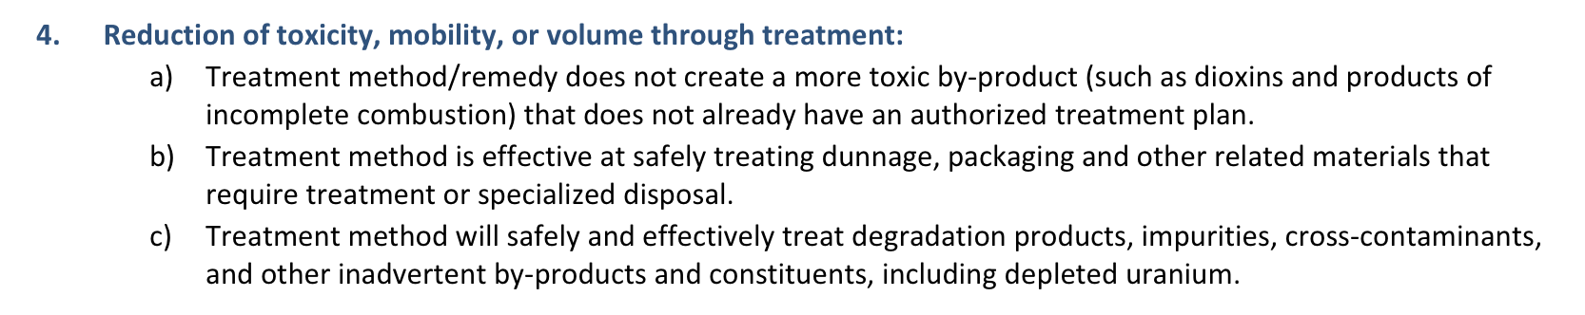
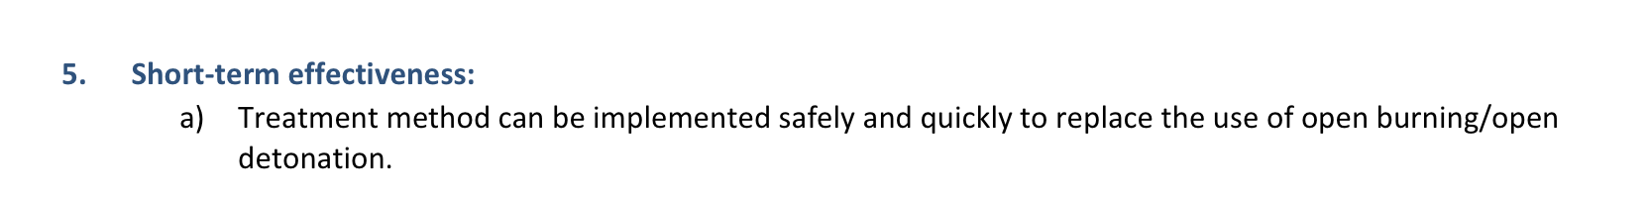

Slide 19
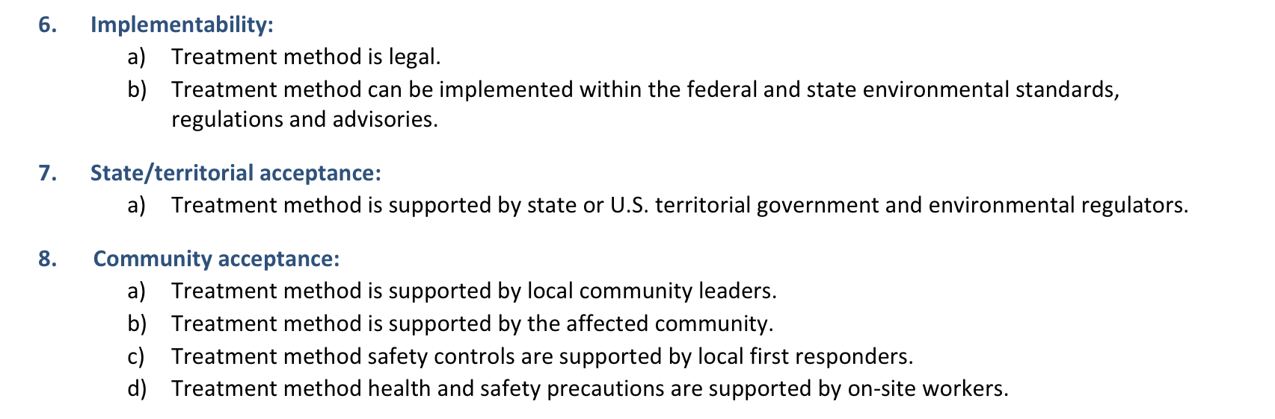

Slide 20
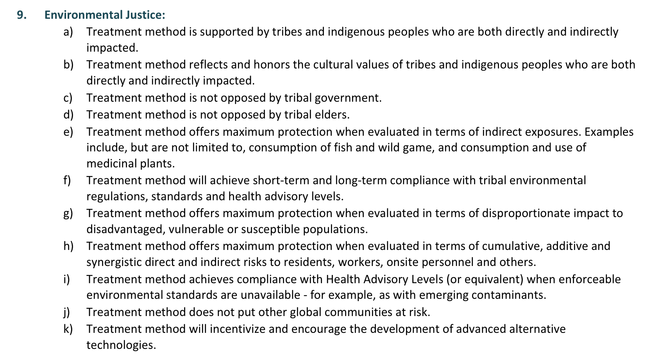

Slide 21
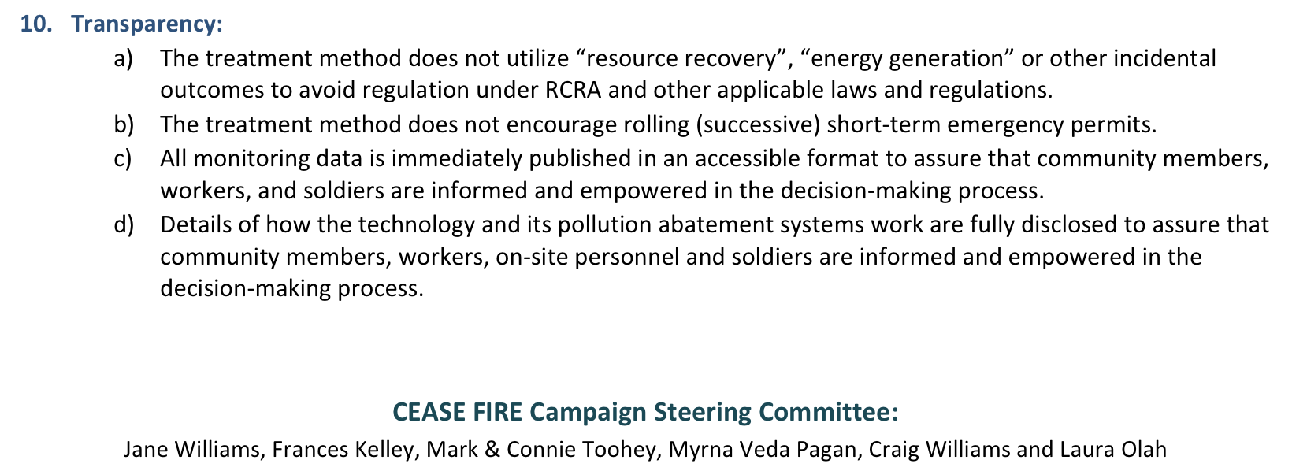

Slide 22
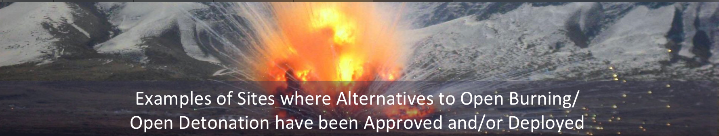
The Cease Fire! Campaign does not necessarily endorse or support any one of these technologies; this list is solely for the purpose of identifying examples of alternatives to OB/OD that have been approved and/or deployed.

Slide 23
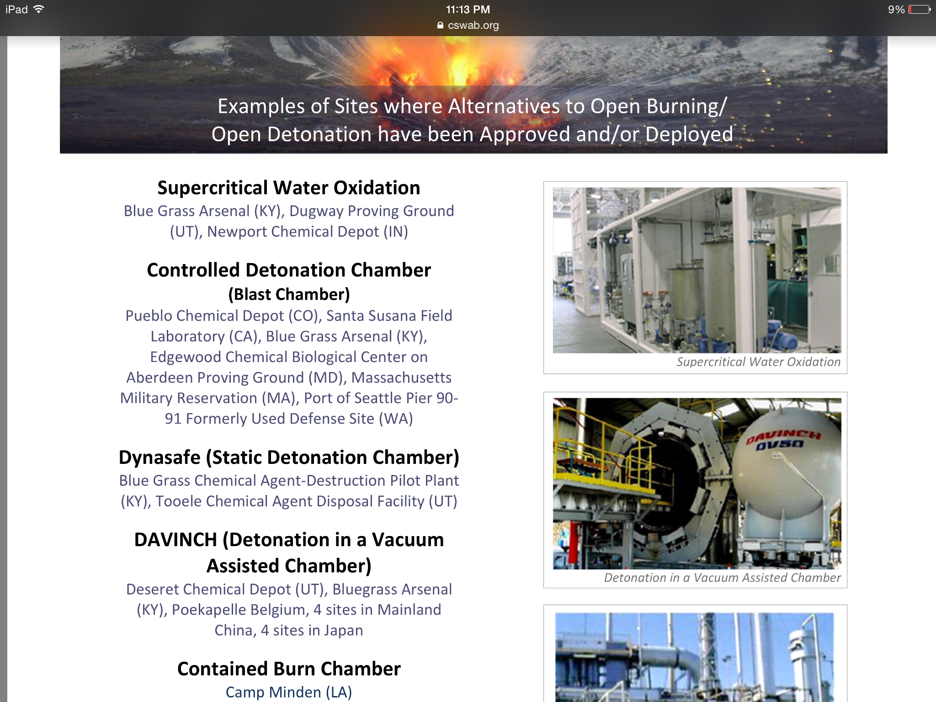

Slide 24
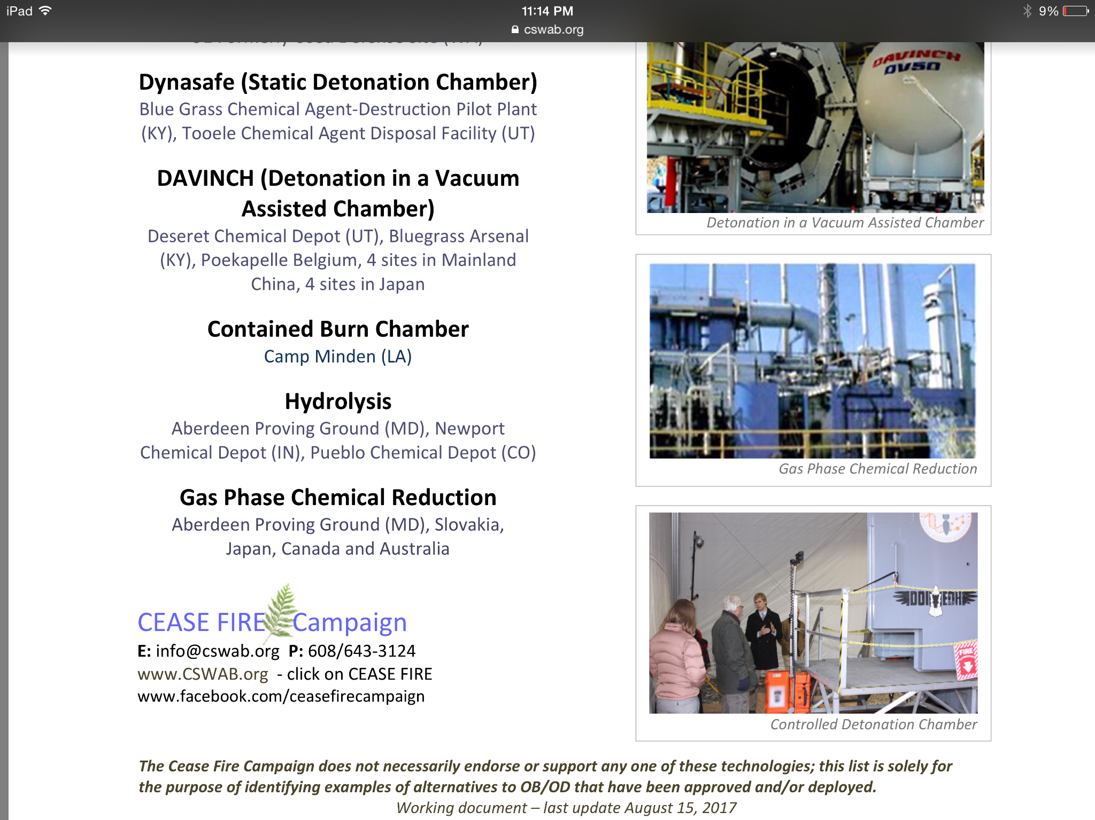

Slide 25
Cease Fire! Campaign
Frances Kelley, Louisiana Progress Action
Shreveport, LA
Craig Williams, Kentucky Environmental Foundation
Berea, KY
Jane Williams, California Communities Against Toxics
Rosamond, CA
Myrna Pagan, Vidas Viequenses Valen
Vieques, Puerto Rico
Laura Olah, Citizens for Safe Water Around Badger
Merrimac, WI
Connie and Mark Toohey, Volunteers for Environmental Health
Kingsport, TN

