Slide 1
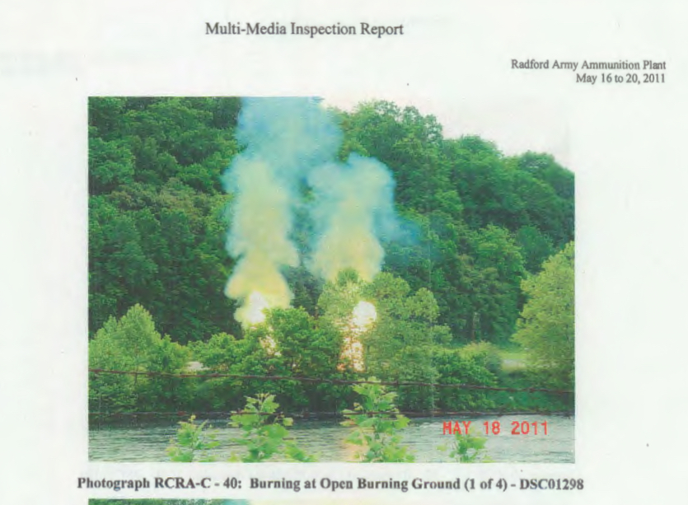
OB/OD A Living Legacy at RAAP
Radford Army Ammunition Plant/ RAAP
1941 to Present

Slide 2
GOCO: Government Owned Corporately Operated Open Burning Ground (OBG) includes tenant waste after 1995 ARMS Act
BAE Systems
Operating Contractor
July 1, 2012
Virginia Department of Health
Issues permit to ATK/NRE
to manufacture Depleted Uranium munitions 2010; renewed 2015
Alliant Techsystems
(ATK)
operating contractor
1995 to 2012
dba: New River Energetics (NRE)
ATK/NRE
transitions to
corporate tenant of
BAE Systems,
DEQ Removes ATK from Title V, Clean Air Act Facility Permit
Constructed and operated by Hercules Chemical 1941 to 1995

Slide 3
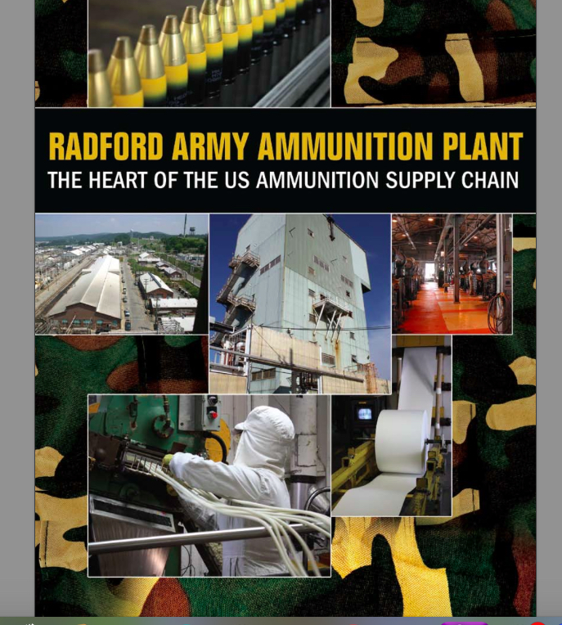
LTC Druschal, “You’ve got to remember, you don’t have any (nitrocellulose) you don’t have any propellants, you don’t have any bullets.” Roanoke Times, Dec. 10, 2008
Virtually every munition being addressed by this committee contains a component from the Radford Arsenal.
Lexington Institute, April 15, 2009

Slide 4
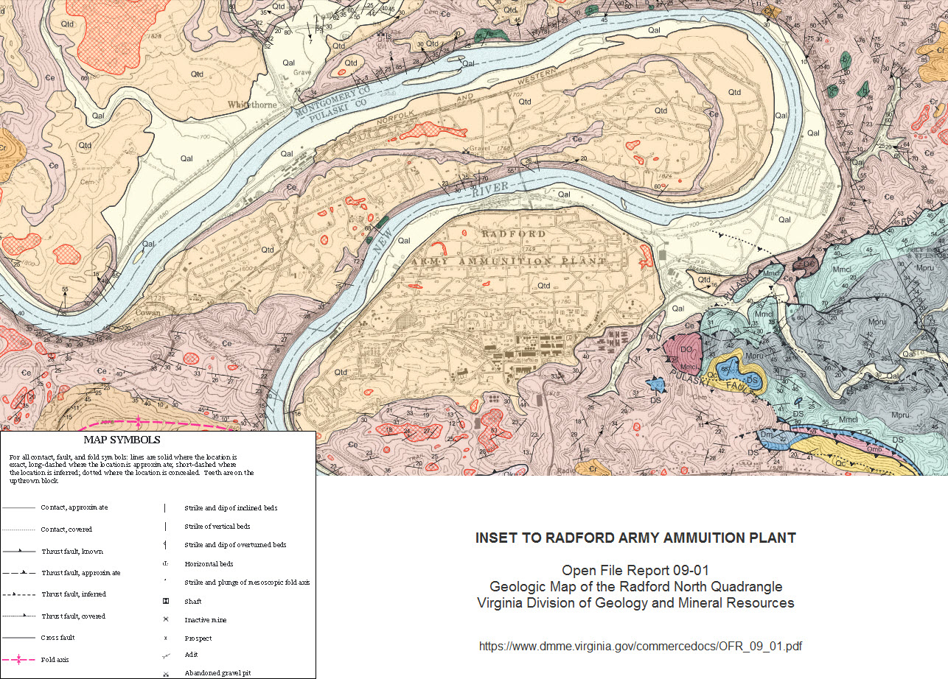
Site Selection Matters
Karst – underlain by caves, sinkholes & fractured rock
New River divides Pulaski & Montgomery Counties, flows Northwesterly, source of drinking water & recreation
Valley bottom with temperature inversions
~1.5 mi. upwind of Belview Elementary School,MCPS, Radford address 24141
~ 1 mile Pulaski Thrust Fault
In “100 Year” flood plane, repeated flooding events last 10 years

Slide 5
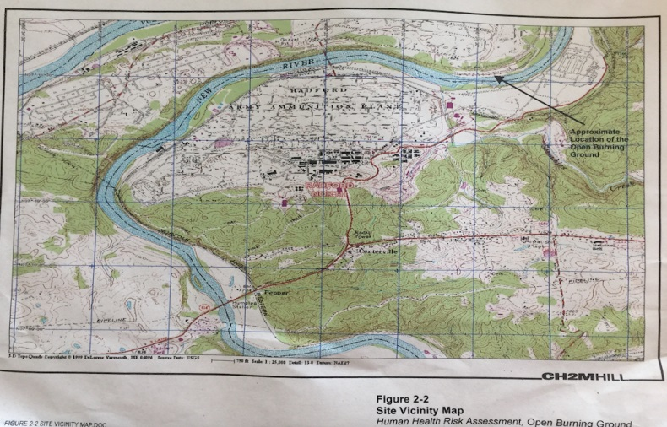
Regulatory Shifts Relevant to OBG
1995 EPA moves to place Radford Army Ammo Plant on National Priorities List
Decades of Open Burning contributes to Superfund Caliber Contamination
Red Water Ash Burial Grounds (S41 & 49): metals, explosives, SVOC’s
Propellant burning ash disposal (S54): Perchlorate, Metals, Explosives VOCs
Oily water burial area/ash disposal (S48; contiguous S41,49 & 54): Explosives, Metals
Propellant burning area (S46) Explosives, metals
Propellant burial area (S46) 1950’s Railroad derailment area covered in contaminated soil of unknown origin, sign denotes “burned explosive waste”
Hazardous waste landfill (HWMU16) 2 acres, used for waste from burning ground, incinerator and lab chemicals, GW migrating, Explosives, VOCs
1996 Governor Allen vetoes Superfund Listing
2000 EPA Region III issues Unique RCRA Permit
Virginia DEQ Authorized to administer RCRA, writes OBG Permit 2005
OBG Co~location: DEQ Groundwater (HWMU13) ~ EPA Region III Soil (SWMU13)

Slide 6
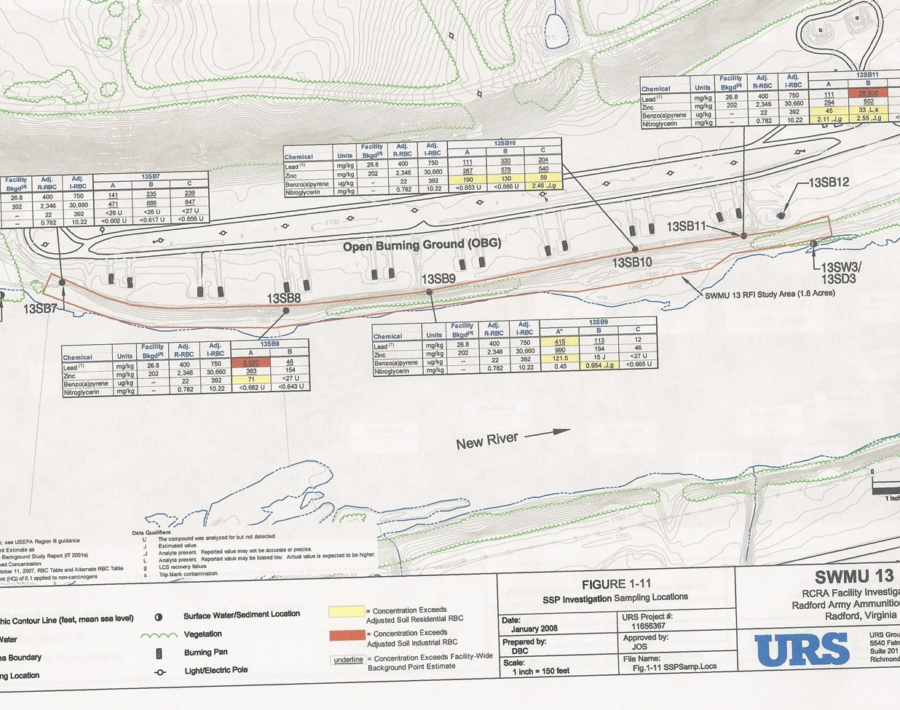
Soil Sampling January 2008
Lead, Zinc, Benzo(a)pyrene and Nitroglycerin all exceeding Residential and Adjusted Residential Based Limits
Open burning continues above under DEQ permit.

Slide 7
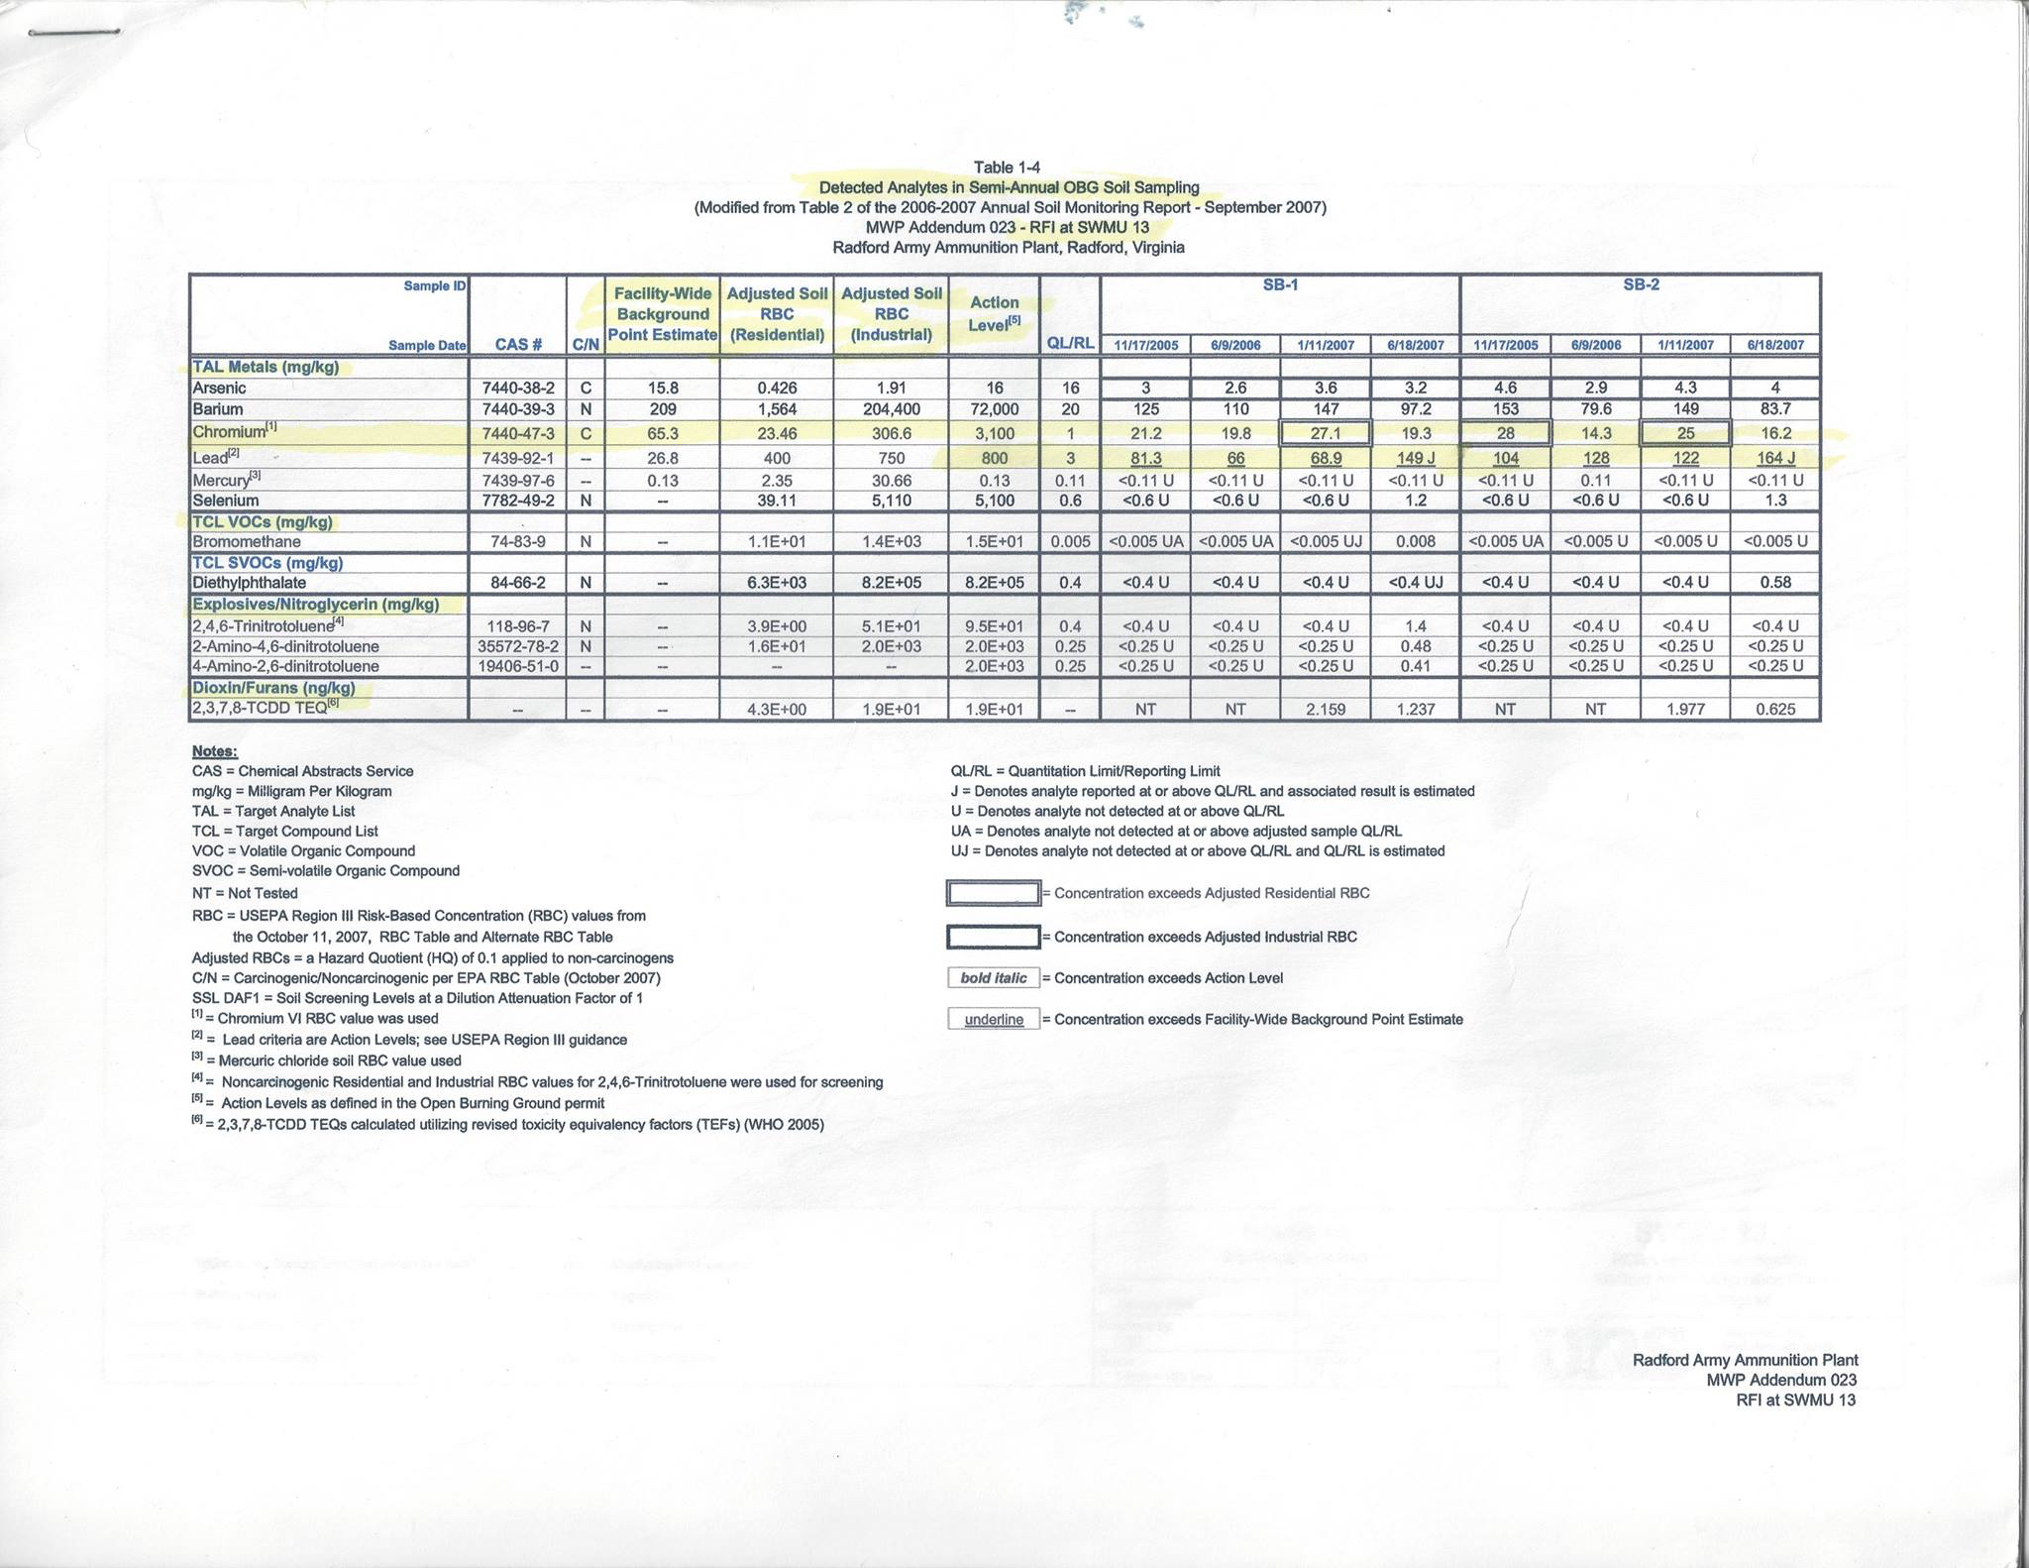
Soil Sampling finds Arsenic,Barium, Chromium, Lead, Mercury Selenium, VOCs, Various Toluene Isomers, Dioxin & Furans

Slide 8
Virginia DEQ OBG Permit Operating Conditions
8,000 pounds of munitions constituents per day, 365 days a year
No time restrictions, Winds under 20 mph & less than 50% chance of rain
No ambient air quality monitoring on or off site
Tenant waste accepted from: New River Energetics, Grucci Fireworks, Alexander Arms, and others. (Army & BAE tell community to “ask those companies” what is in the waste being burned for them at this tax-payer expense)
Groundwater contaminant levels include “Alternate Concentration Limits” exceeding EPA MCLs such as Chromium at 110 ppb, based on “background levels” of contaminants (EPA MCL for Cr 100 ppb)
“Feed Rates” of metals set for Aluminum, Barium, Chromium
Virginia DEQ issues Warning Letters for violations:
Not reported to, nor included in, EPA’s Enforcement database
2012 ATK too much Chromium on two separate occasions: 1st day of school 2011, Sunday in April 2012
2015 BAE Systems Excessive Lead
DEQ states facility does not report Chromium on TRI because it’s “under threshold”

Slide 9
2005 Human Health Risk Assessment by CH2MHill for ATK
Site Specific Investigation Report recomendations
“Mitigated Skid Burn Plan” to replace gasoline with natural gas to reduce risk
SCLERA 7.2: skid burns using diesel fuel are conducive to creating dioxin and furans
Virginia DEQ issues permit for open burning ground despite this advice, September of 2005
OBG Permit expired September 2015, currently operating under “shield status” while VA DEQ ”reviews application.”
Citizens continue to demand ambient air quality monitoring and an immediate end to Open Burning UNTIL it is proven safe for children to breathe downwind where burns can regularly be smelled.
DEQ declines to hold community meetings over last two years.
Army Joint Munitions Command & BAE Systems tell stakeholders a “custom incinerator” is being designed “just for their base” because the waste at RAAP is “so different,” it requires unique treatment.
Army, EPA, Congress, local government all remain silent, except April DeMotts, Mont. Co. Board of Supervisors, regularly attends meetings with questions; secured vote for PSA well testing.

Slide 10
COMMUNITY VOICES CONCERNS TO EPA Region III
Federal Facilities Enforcement 2010
EPA Region III conducts Multi-Media Inspection
May 16 – 20, 2011
One VA DEQ employee present
Reports potential compliance issues including OBG section
Attachment RCRA-C-1
“VA DEQ Approval for Open Burning at Contaminated Scrap Burn Area”
Details items burned including vacuum filters, construction debris,
metal piping, 200 tons contaminated wood, & more.

Slide 11
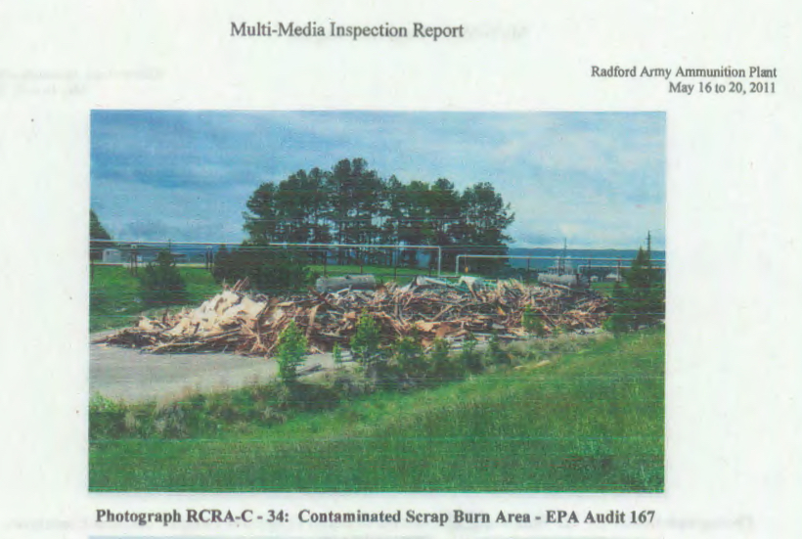
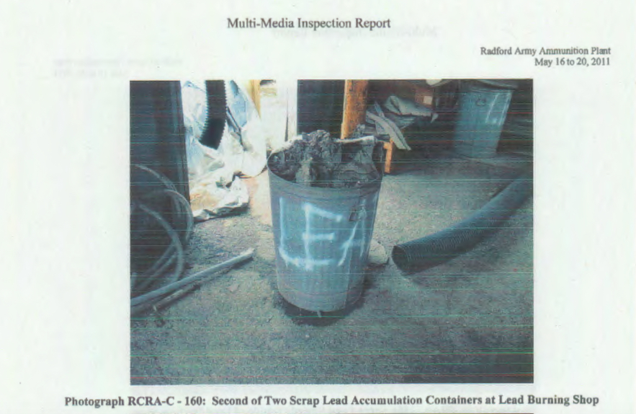
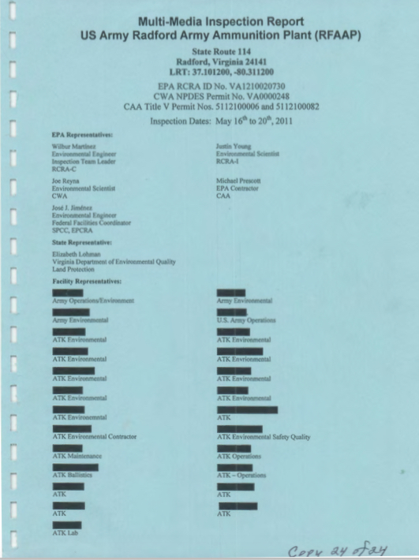
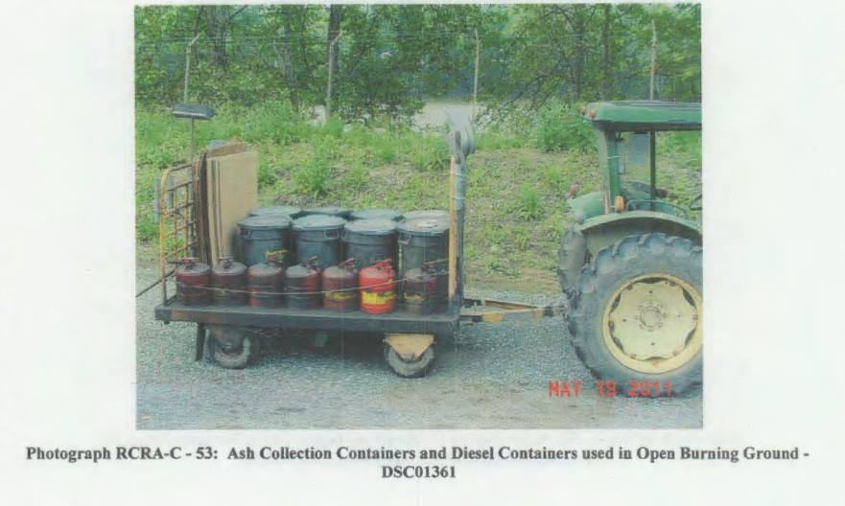
EPA Region III Multi Media Inspection Report, Redacted
Attachment C documents communication between DEQ & ATK granting permission to burn construction debris, vacuum filters, wood, etc
One Virginia DEQ employee present during entire
four day inspection
Notes:
One VA DEQ Employee, No enforcement action

Slide 12
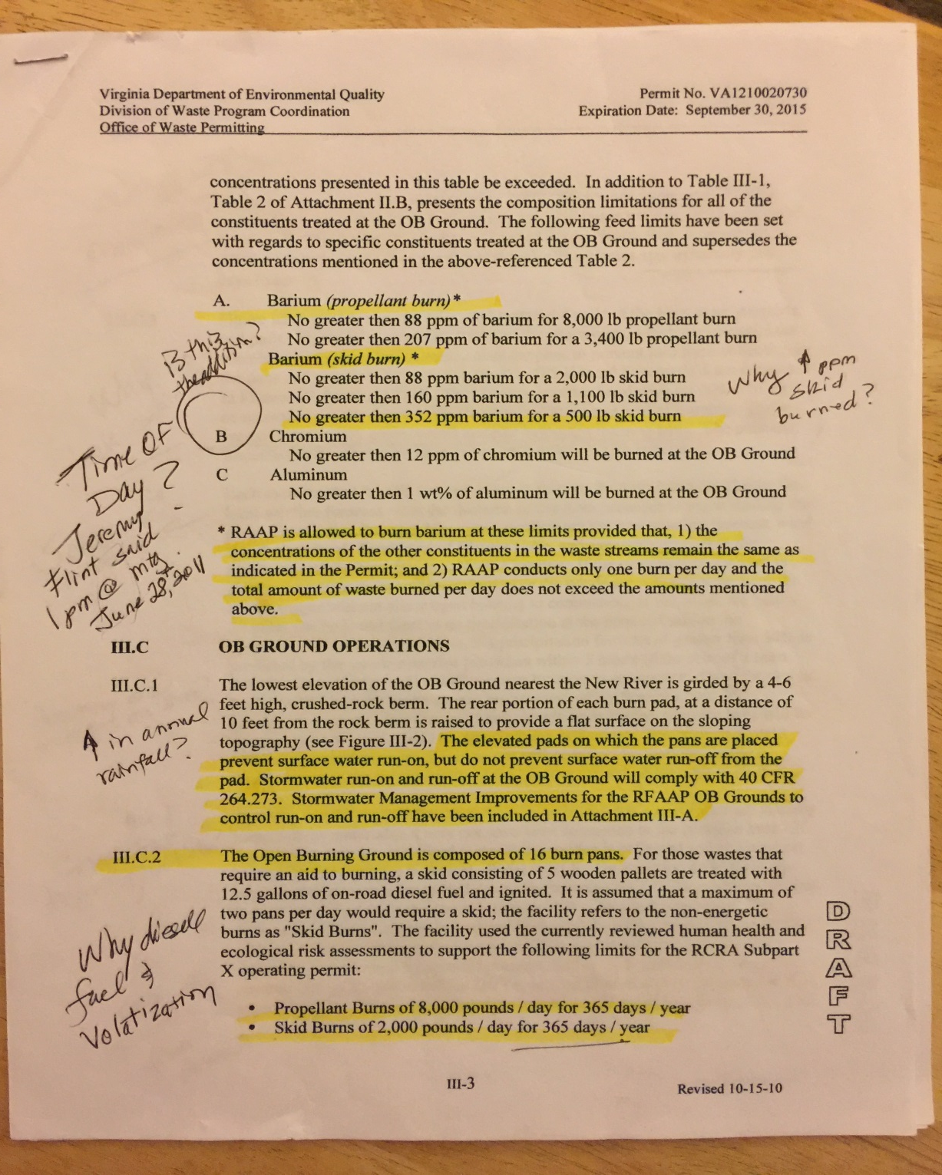
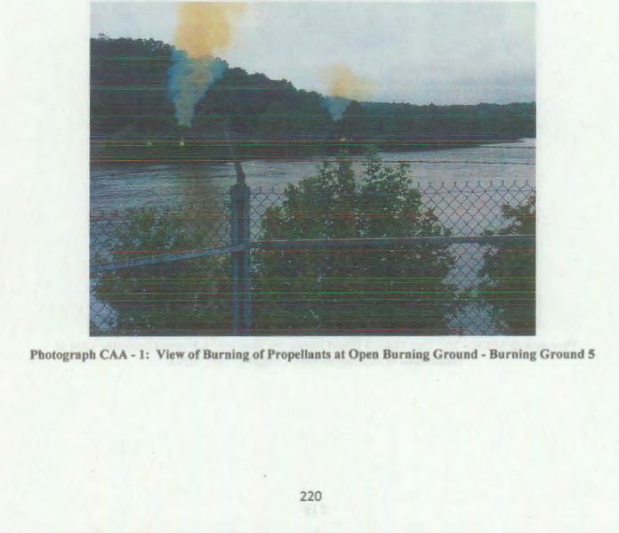
How much chromium can be soaked in gasoline, lit on fire & left to smolder for hours, yet still be safe for the children breathing downwind? Virginia DEQ Permit Says: “The following feed limits have been set…No greater than 12 ppm of chromium will be burned at the OB Ground” (a day, an hour, all year?) No ambient air quality monitoring required on or off base.

Slide 13
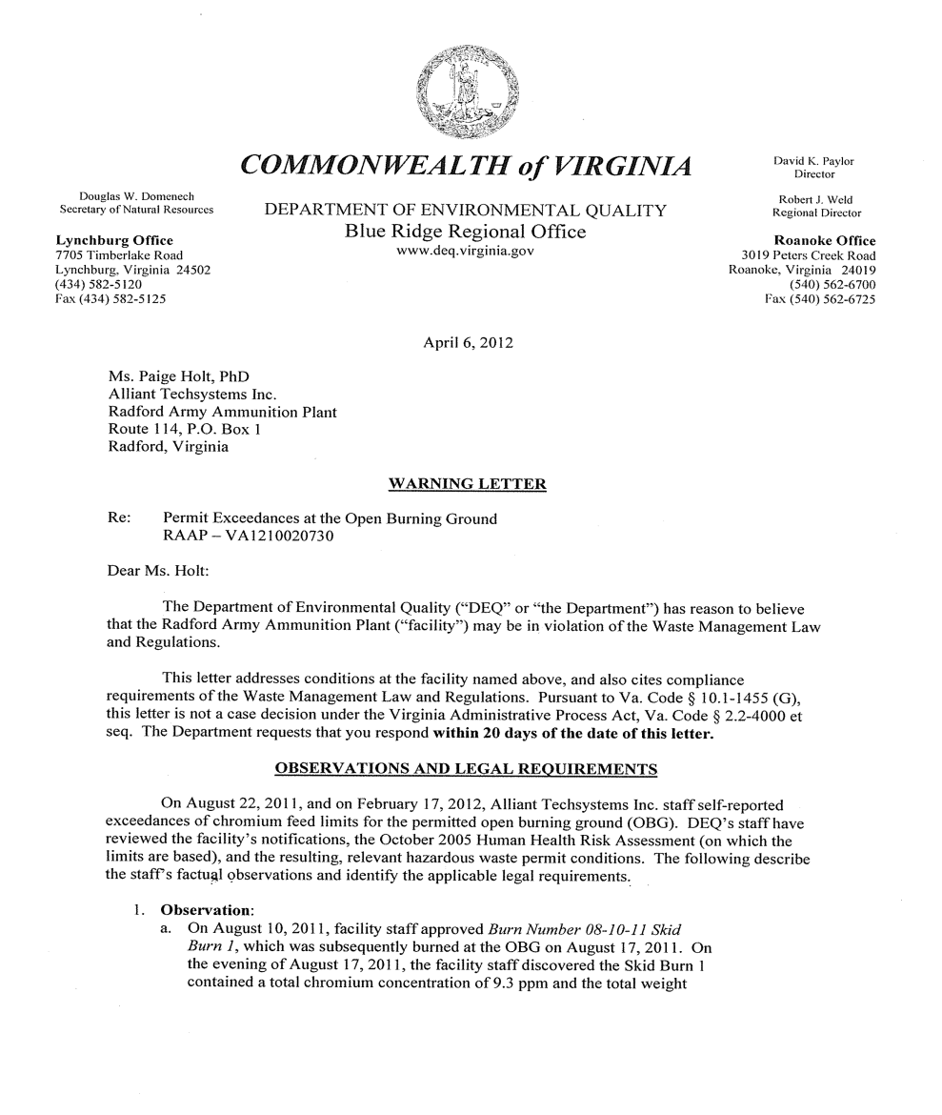
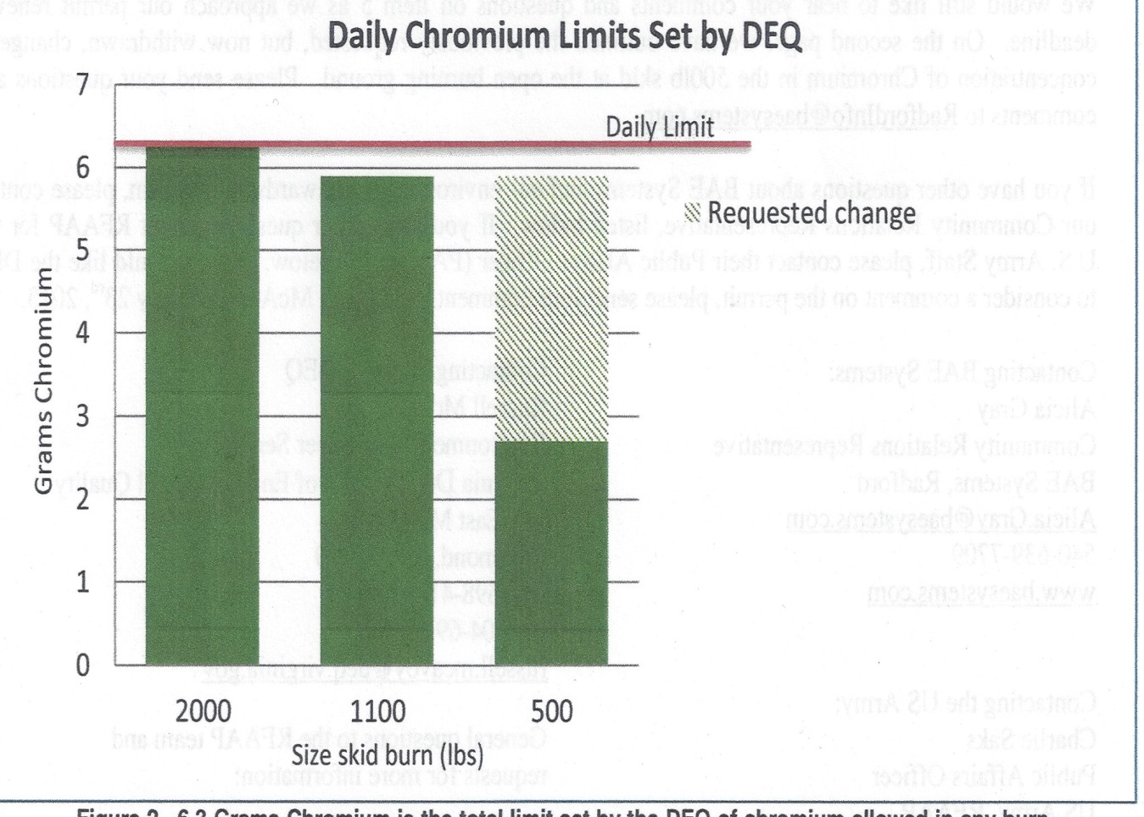
VA DEQ Issues Warning Letters for Exceeding Chromium Feed Rates to: Alliant Techsystems first day of school 2011 & a Sunday in 2012 prompts BAE Systems to submits Permit Mod. Request to increase Chromium 2013

Slide 14
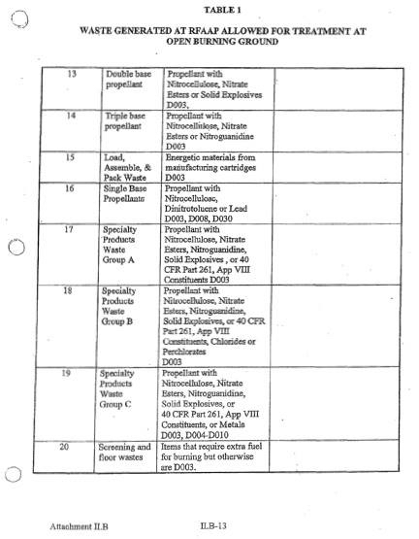
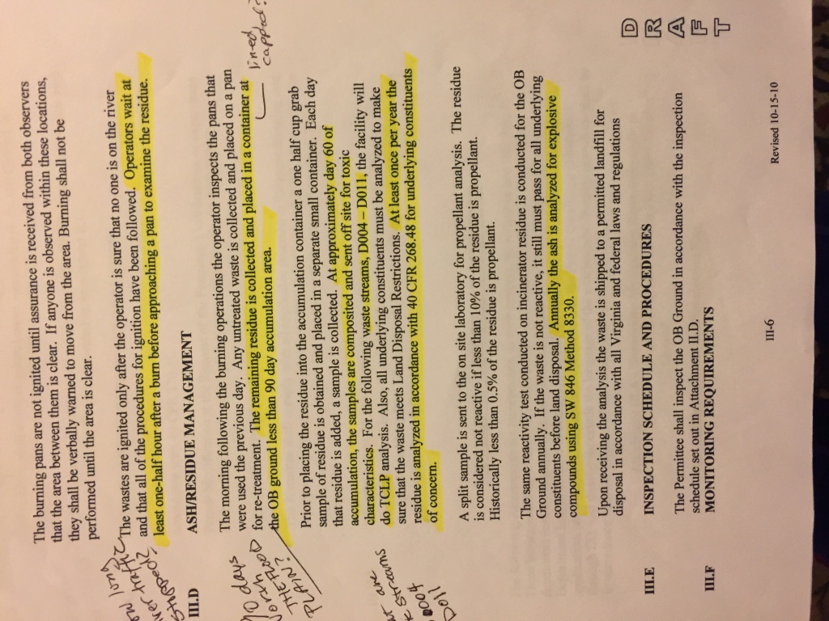
“Operators wait at least one-half hour after a burn before approaching the pan to examine the residue.”

Slide 15
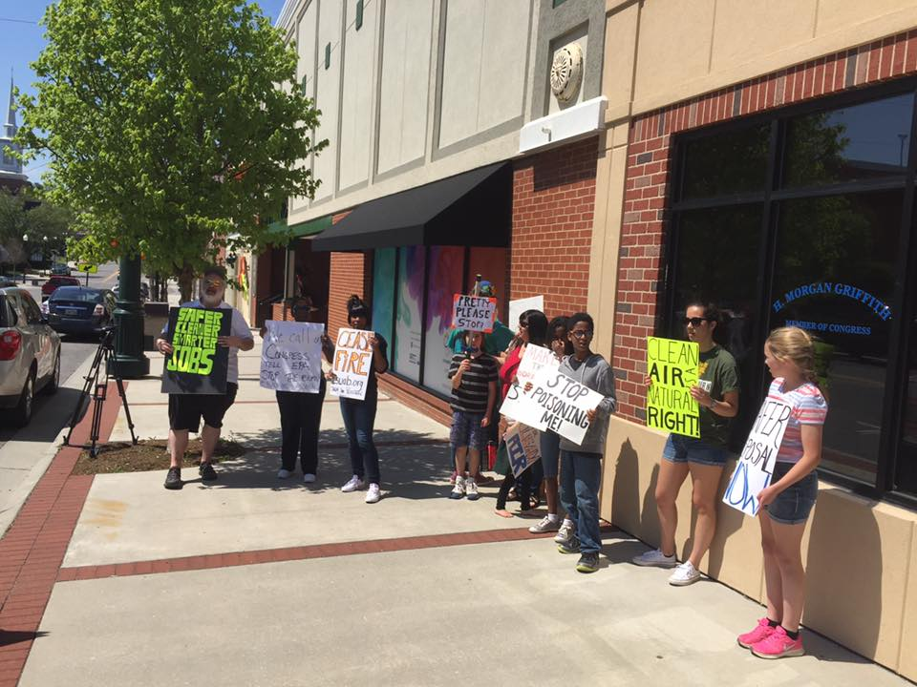
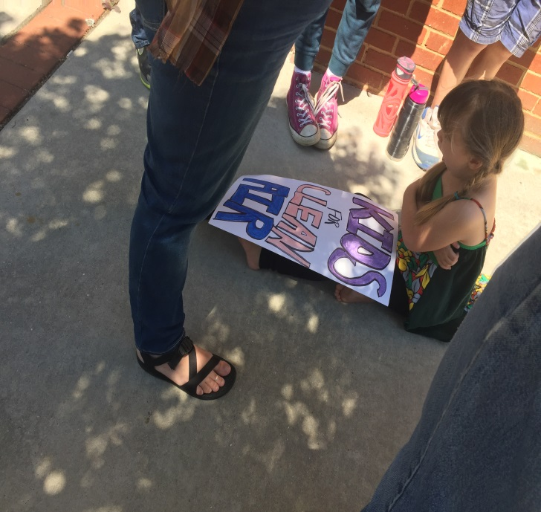

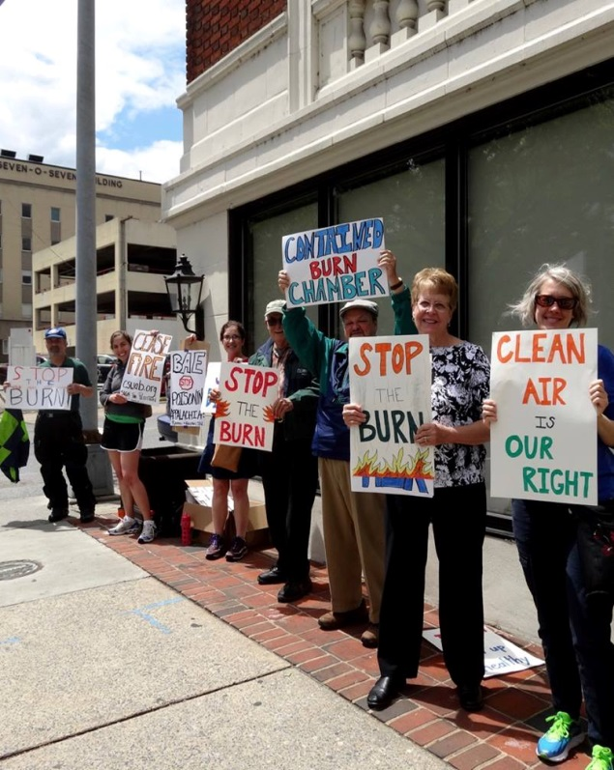
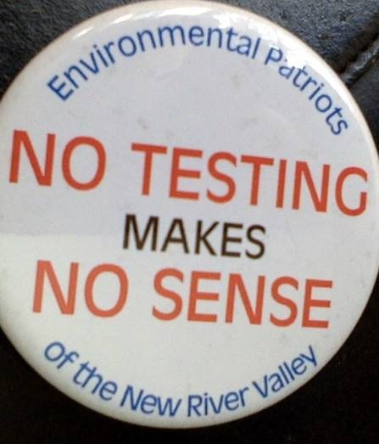
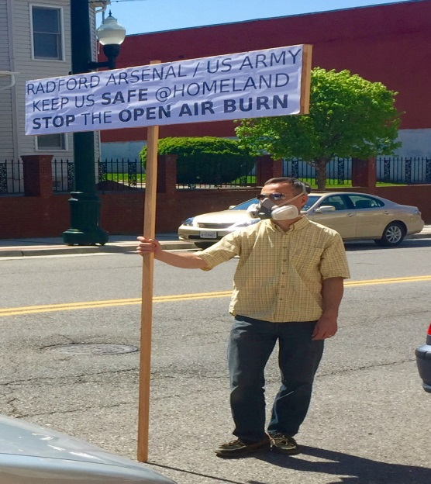
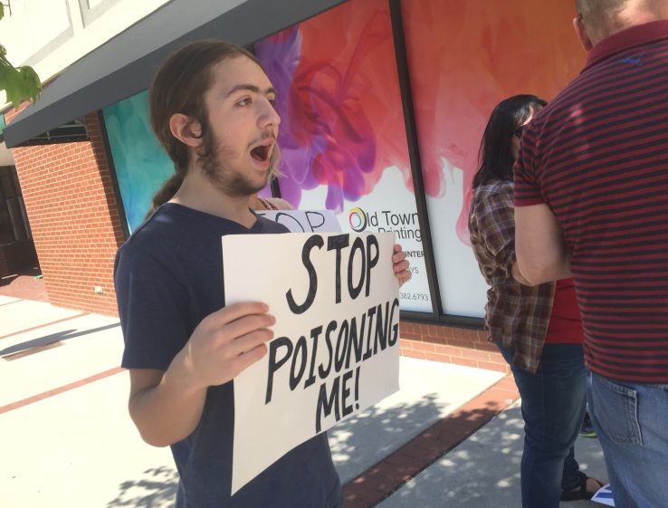
Community appeals to Congressman Griffith & Senator Tim Kaine, on the Armed Svcs. Cmte., for oversight action with no response.

Slide 16
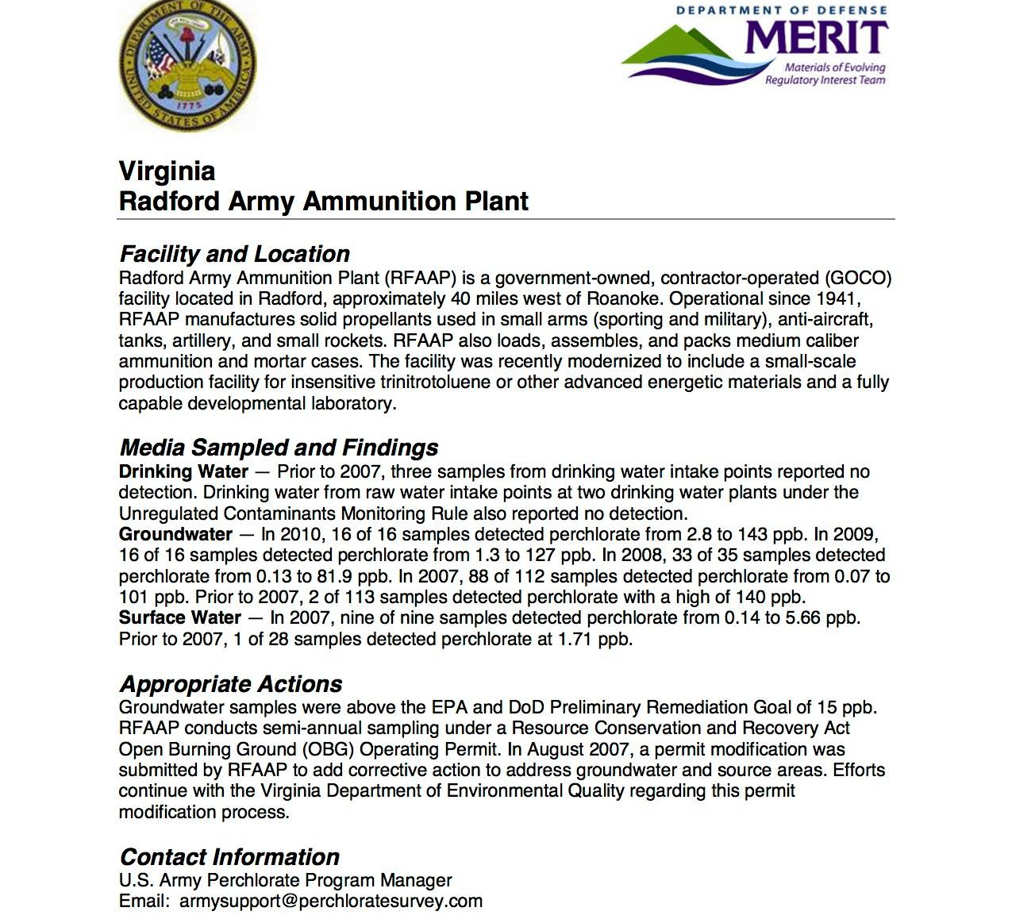
Army Perchlorate Directive 2007: Base Contamination Inventory sets 14 ppb standard

Slide 17
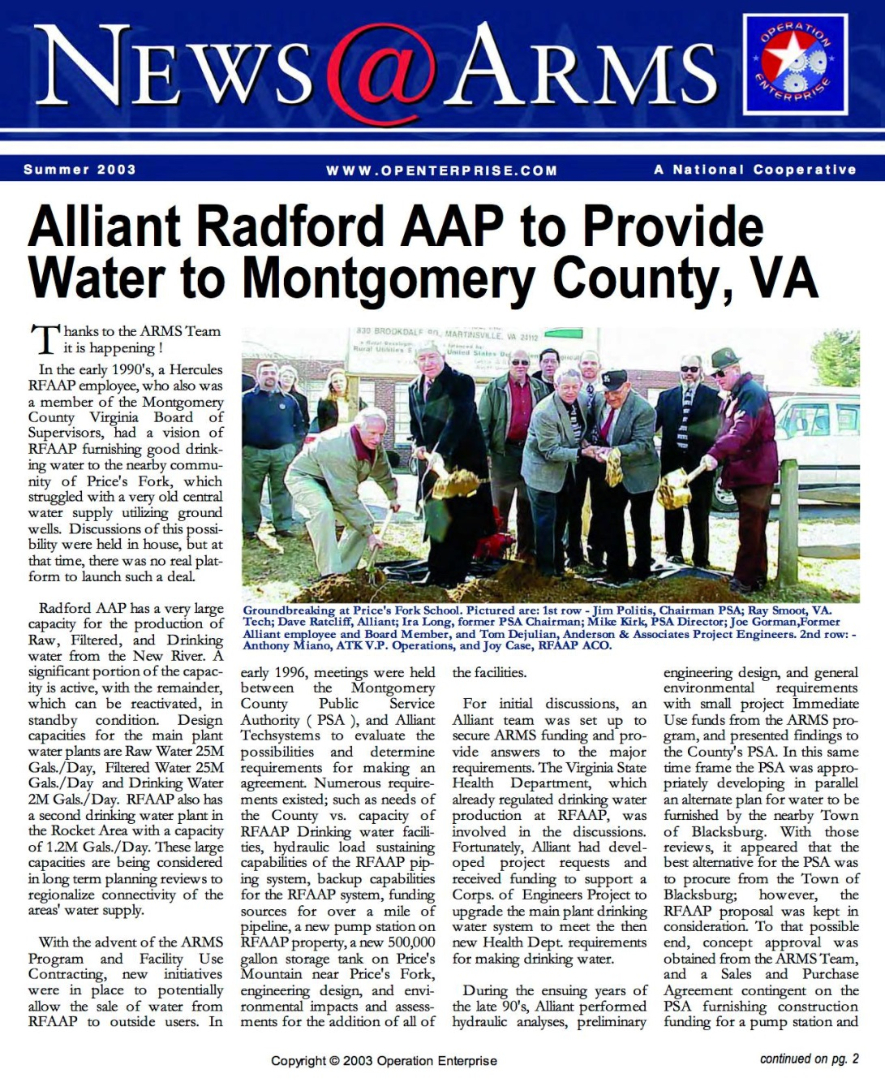
Water Intakes located downstream of OBG

Slide 18
Just to be clear, is the operation of the OBG part of the EPA's RCRA permit (Subpart X, I believe) for the Radford Arsenal? I see it identified as HWMU 13. Are the wastes burned in the OBG the result of current production at the Arsenal, or part of the "historic" RCRA waste sites, or both?
thank you so much!
Devawn Oberlender
On Wed, Jul 6, 2011 at 3:35 PM, Schneider, Jutta (DEQ) <Jutta.Schneider@deq.virginia.gov> wrote:
Devawn,
Thanks for attending our public meeting last week, it was nice to meet you. I received your voice message regarding the carbon tetrachloride and perchlorate concentrations at the OBG. The paragraphs below are excerpts from the 2010 annual groundwater monitoring report, which can be found in its entirety on the Radford Information Repository Index web site at the following link http://www.radfordaapirp.org/infore... (11th document from the bottom).
Arsenic was not detected in any well at the OBG during 2010.
Sincerely,
Jutta Schneider Program Manager, RCRA CA & Groundwater Office of Remediation Programs
2nd quarter 2010
Carbon tetrachloride was detected in POC well 13MW3 at a concentration of 7.9 mg/l, which is greater than the background concentration and the proposed GPS of 5 mg/l. Carbon tetrachloride was also detected in upgradient well 13MW2 at a concentration less than the quantitation limit of 0.5 mg/l.
Perchlorate was detected in POC well 13MW4 at a concentration of 143 mg/l I which s greater than the background concentration of 4 mg/l and the proposed GPS of 26 mg/l. These detections of carbon tetrachloride and perchlorate are consistent with previous data. However, due to the fact that the detected concentrations in POC wells 13MW3 and 13MW4 are greater than their respective proposed GPS, Radford AAP is required to establish a Corrective Action Program for carbon tetrachloride and perchlorate that meets the requirements of 40 CFR Part 264.100. Radford AAP has submitted a Corrective Action Program for carbon tetrachloride and perchlorate, which is pending final review for incorporation into the Permit.
4th quarter 2010
Perchlorate was detected in POC well 13MW4 at a concentration of 34.1 mg/l, which was greater than the background concentration of 4 mg/l and the proposed GPS of 26 mg/l. Perchlorate was also detected in POC well 13MW5 at a concentration of 6.36 mg/l, which was greater than the background concentration but below the proposed GPS. These detections of perchlorate are consistent with previous data; however, due to the fact that the concentration detected in POC well 13MW4 is greater than the proposed GPS, Radford AAP is required to establish a Corrective Action Program for perchlorate that meets the requirements of 40 CFR Part 264.100. Radford AAP has submitted a Corrective Action Program for perchlorate, which is pending final review for incorporation into the Permit.
Carbon tetrachloride was detected in POC well 13MW3 at a concentration of 4.2 mg/l, which is less than the background concentration and proposed GPS of 5 mg/l. This detection of carbon tetrachloride is consistent with previous data; however, due to the fact that previous carbon tetrachloride concentrations detected in POC well 13MW3 have been greater than the proposed GPS, Radford AAP is required to establish a Corrective Action Program for carbon tetrachloride that meets the requirements of 40 CFR Part 264.100. Radford AAP has submitted a Corrective Action Program for carbon tetrachloride, which is pending final review for incorporation into the Permit.

Slide 19
Real People Reporting Real-Life Health Concerns
Unexplained miscarriage despite pre-natal care, male urethra tube deformations, thyroid cancer rates over twice the national average, persistent & recurring skin rashes, headaches, thyroid disease rampant throughout NRV, asthma, autism,heart disease as reported Southwest Virginia’s Mortality Mystery,” Washington Post April 26, 2008
DEQ 2017 Fish Consumption Advisory for New River warns PCB’s from RAAP to WV line
Community complains of blasts breaking windows, excess accumulations of dust indoors, discolored water, high incidence of “rare” cancers which are also reported in dogs & horses
High blood lead levels in children in 24141 zip code NRV Health District Study, 2002
Montgomery County Public Service Authority detects high lead levels in Prices Fork service area after switching source water from municipal wells to Radford Arsenal, which uses New River as source water (sound familiar?)

Slide 20
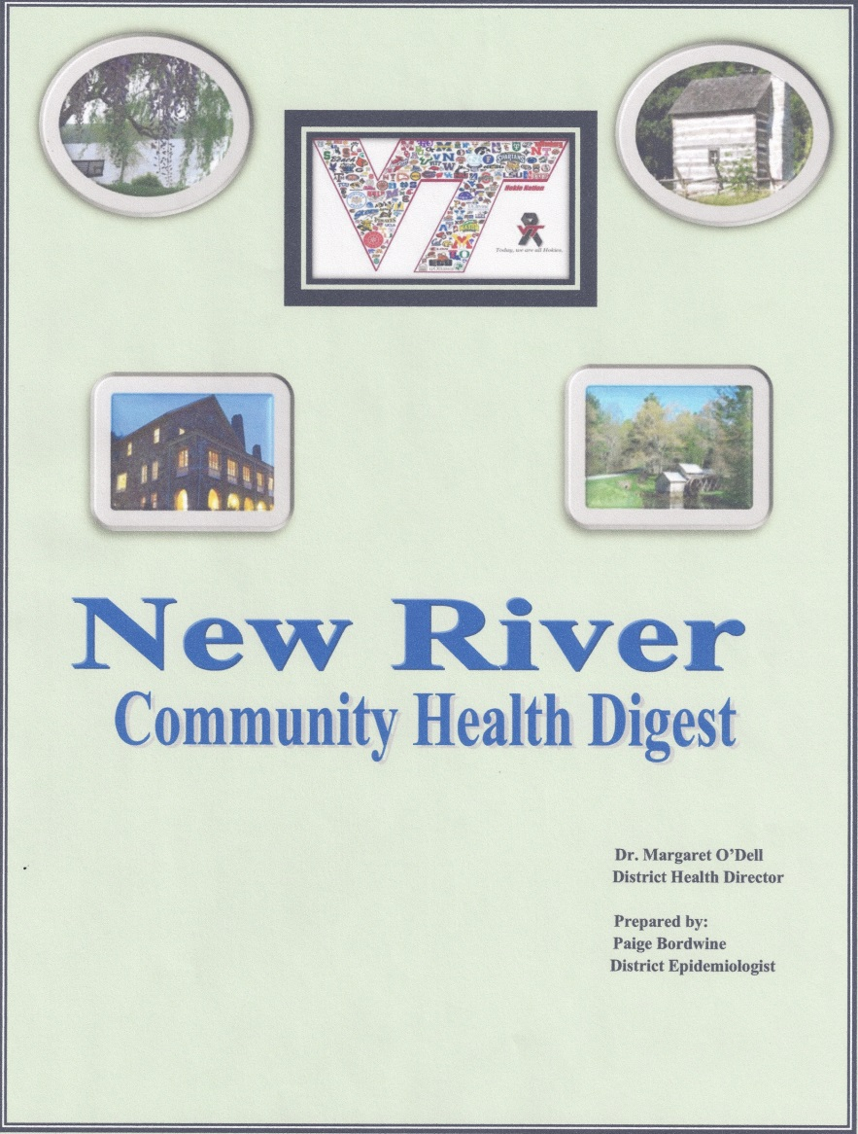
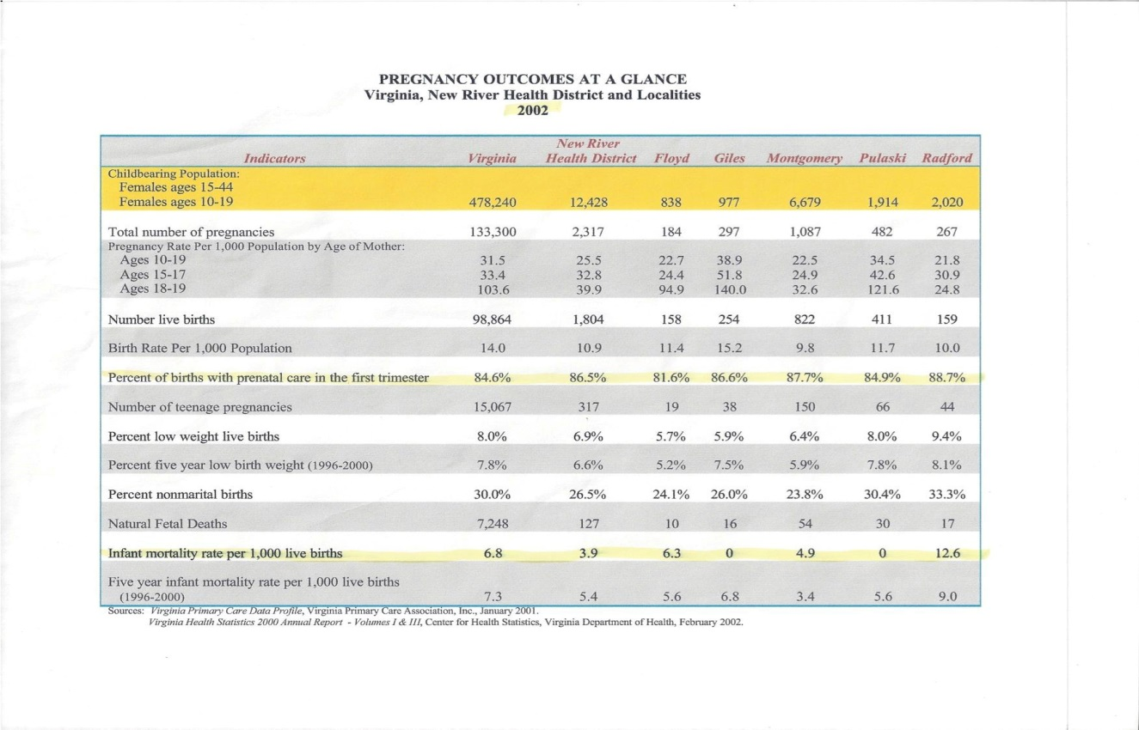
Radford zip of 24141 includes communities in Pulaski & Montgomery County that are unincorporated, including Belview Elementary School

Slide 21
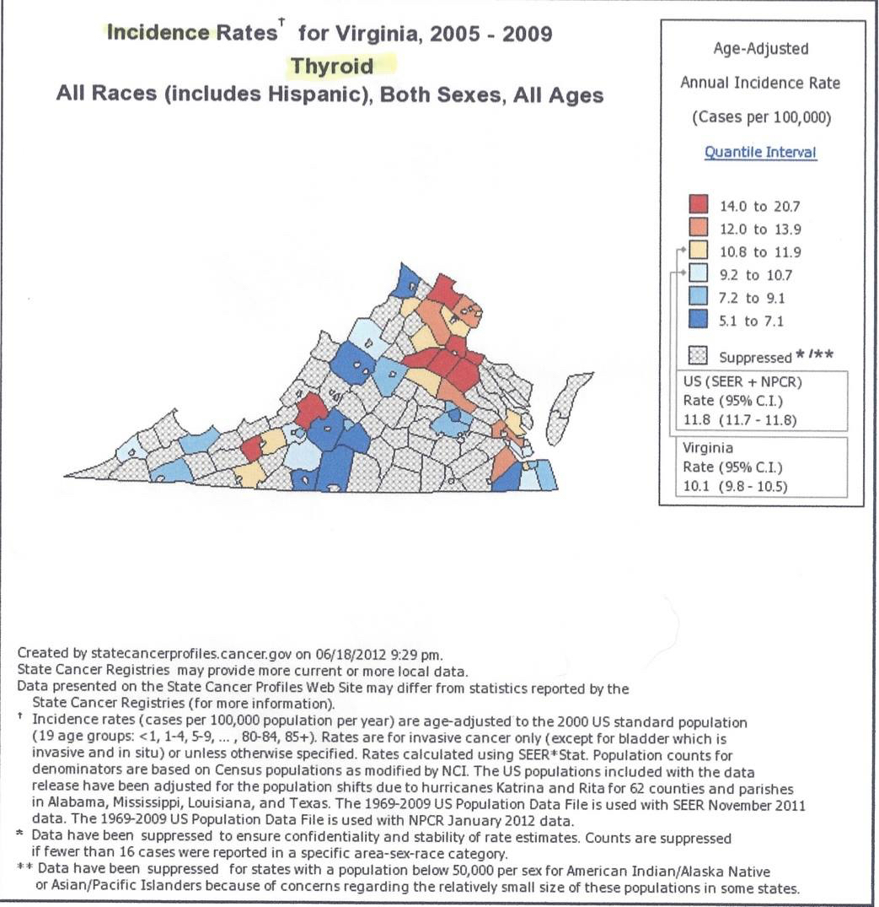
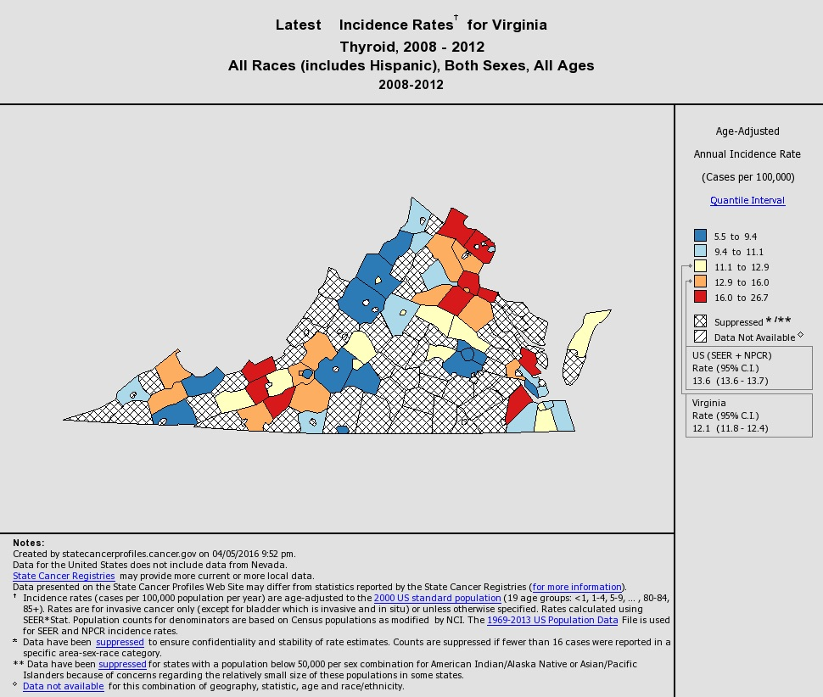
Carilion Endocrinology opens in NRV, 2007 Closes in 2008 , yet thryoid cancers continue to be diganosed and disease rates remain high but undocumented.

Slide 22
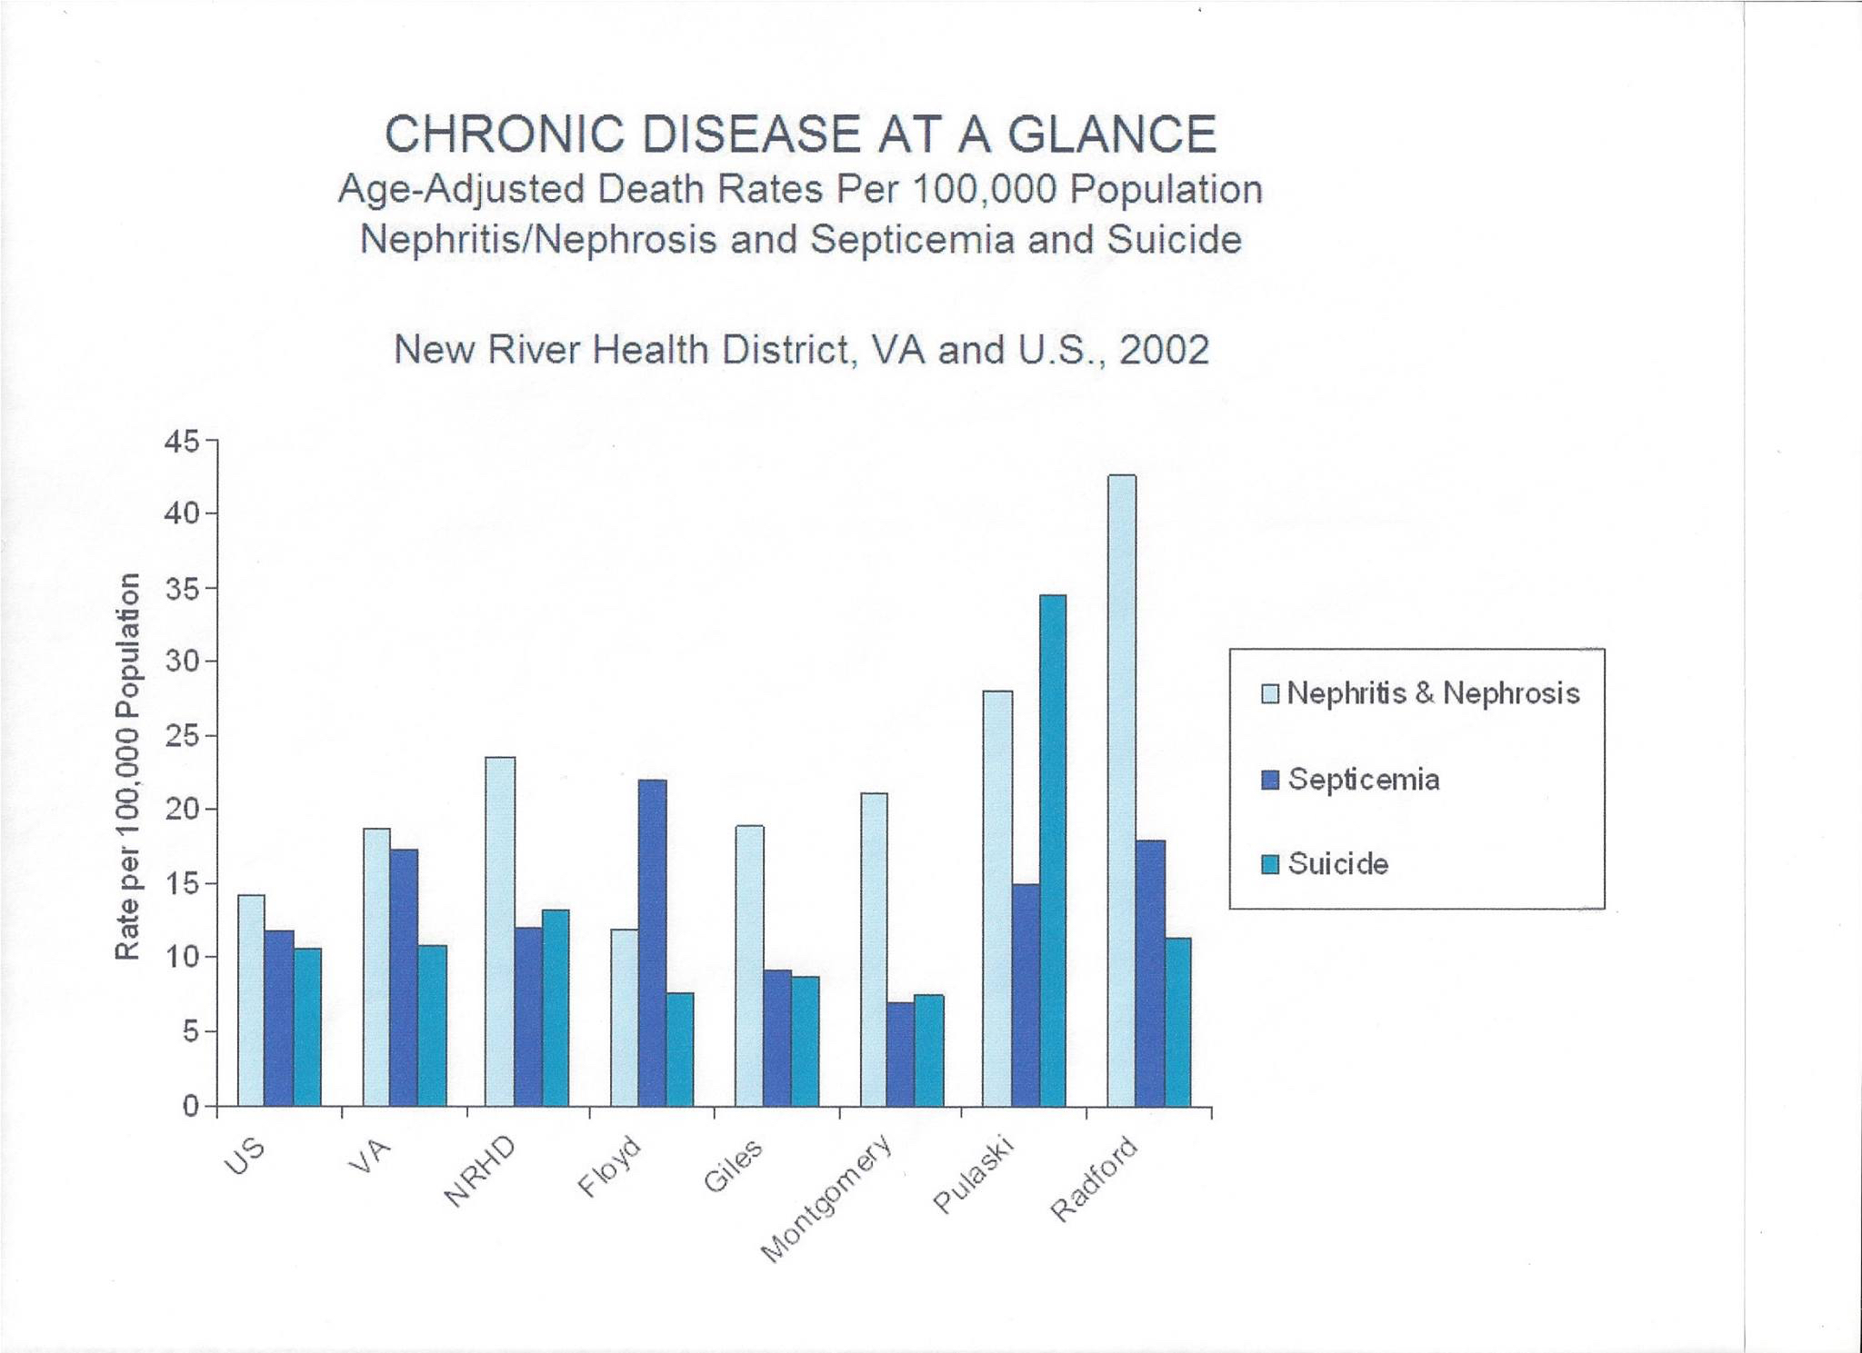
Renal system cancers in non-smokers throughout New River Valley

Slide 23
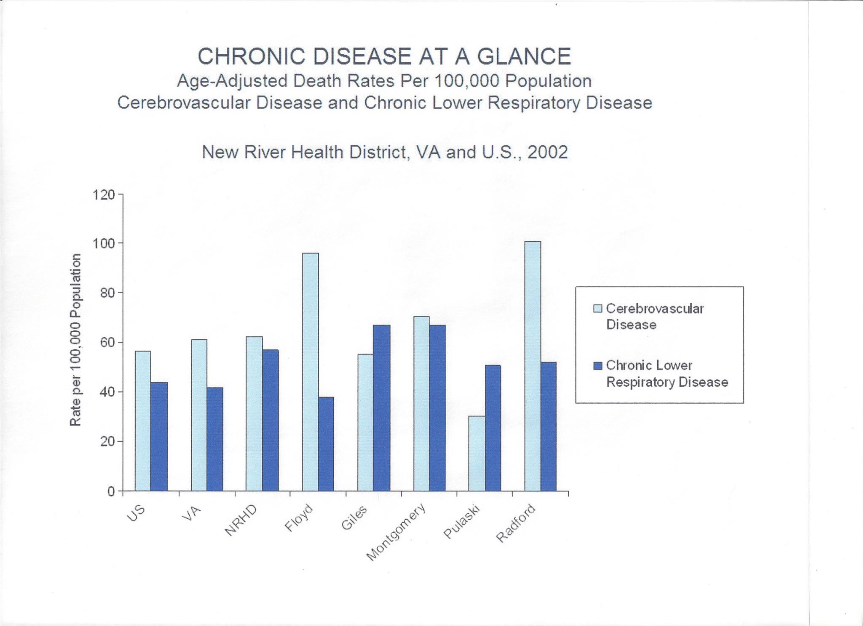
Toxic air pollution takes a heavy toll

Slide 24
Rob Davie, Army Joint Munitions Command, reported at a community meeting February 25, 2017 on concerns about thyroid disease, that perchlorate was found in the drone testing. Mr. Davie ”takes ownership” saying Grucci accidentally sent whistles containing perchlorate to OBG. This result is then denied by the Army & BAE Systems when official results are later released and reported by ProPublica in the ongoing Bombs in Our Backyard investigative report series VA DEQ plans to use these unverified results in new permit, Dr. Gullett acknowleged that this test was in the development of a valid testing protocol, i.e. a “test of a test”

Slide 25
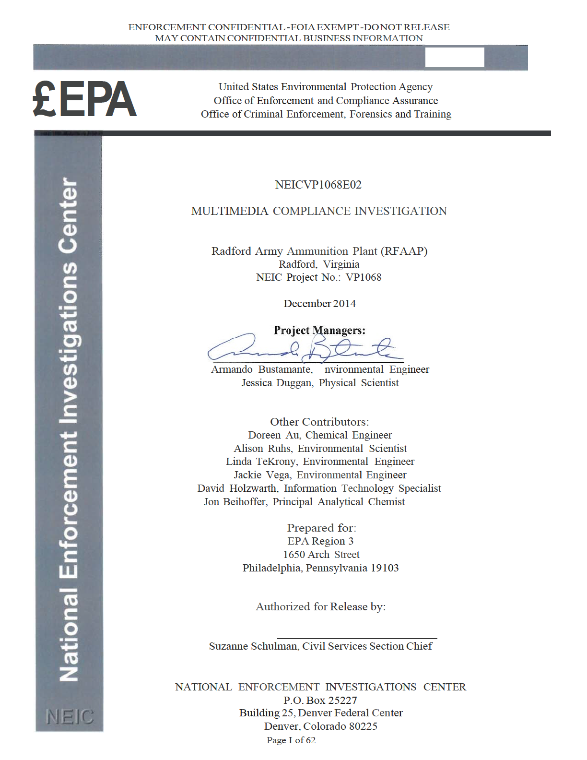
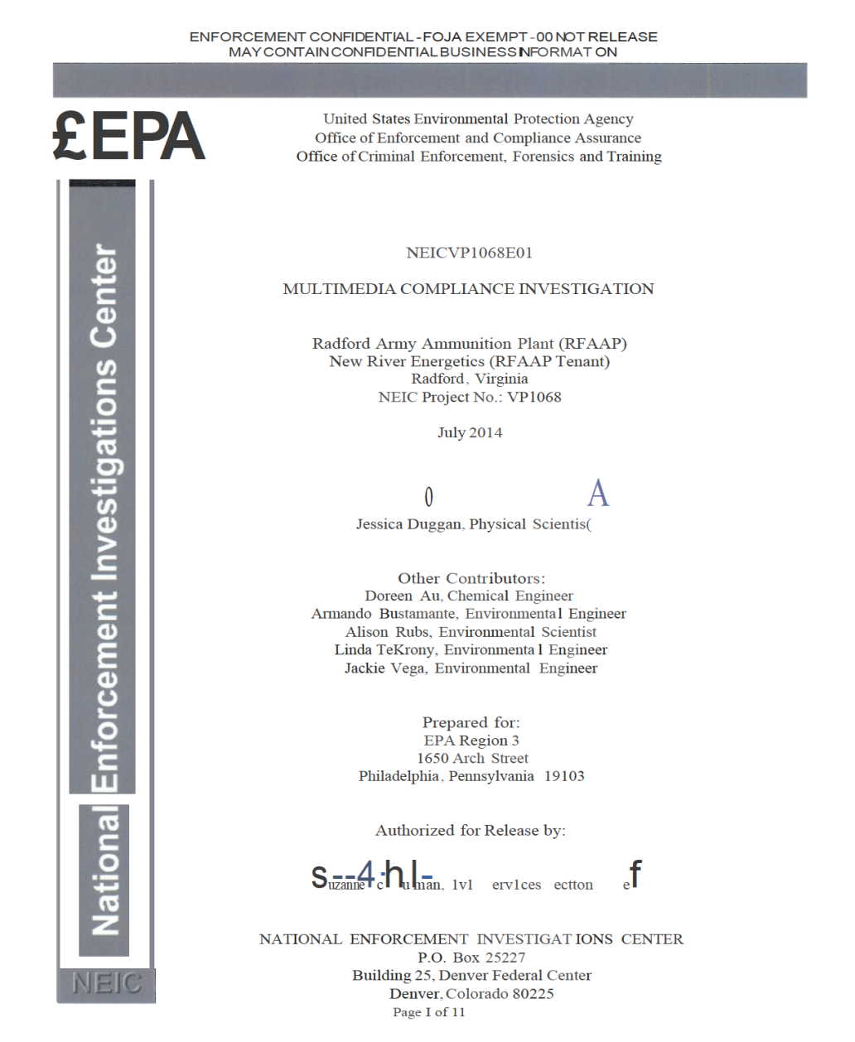
Responding to impassioned pleas about no enforcement action after Multi Media Inspection, EPA sends National Enforcement Investigation Center (NEIC) for Follow Up Inspection February, 2014
Notes:
No enforcement Action

Slide 26
Where are we now with regards to mitigating the cost of externalities in shortened, diseased lives for communities living around these sites of OB/OD?
No enforcement action despite EPA Region III and NEIC finding non-compliance issues presenting an imminent risk of substantial harm to human health and the environment from OBG and waste incinerators, respectively.
This violates RCRA 7002 & 7003, but lawyers are afraid they’ll go broke trying the case.
I’m going to law school, so time will tell ☺!
OBG continues to operate today under permit that expired September 2015
Tenant waste continues to be treated for a profit by BAE Systems at the OBG, including waste from New River Energetics, Fireworks by Grucci/Pyrotechniques and Alexander Arms

Slide 27
Inconsistent answers continue to sow distrust.
Are DU munitions manufactured and test fired at RAAP, for instance?
From: Name withheld for fear of repraisal @ epa.gov
Sent: Wednesday, April 06, 2016 3:36 PM
Subject: RE: DU technical brief
I am still looking for the past records for the Depleted Uranium project, but I have pulled the following information from records I have direct access to:
1) The Army Ammunition plants have been placed on the list by tracking different projectiles/munitions that contain depleted uranium, then tracking where the munition is manufactured. In some cases the plants have used the testing range for these munitions and,
if verified, we listed the facility based on that information.
2) There are several munitions developed that contain depleted uranium: MK149, M919, PGU-20, PGU-14, M774, M833, M900, M827, M829, M829A1, M829A2.
3) The Radford Army Ammunition Plant was approved by the Va Dept of Health to load and package PGU-14 munition.

Slide 28
Questions posed to VA DEQ persist regarding DU waste from Pentagon contracts awarded to New River Energetics with work to be completed at the Radford Army Ammunition Plant, in March of 2017. VA DEQ and former base commanders deny any DU production at RAAP.
Alliant Techsystems Operations LLC, Plymouth, Minnesota, was awarded a $25,691,554 modification (P00064) to contract W15QKN-10-C-0050 for M829A4 120mm armor piercing rounds. Work will be performed in Plymouth, Minnesota; Jonesborough, Tennessee; Orange, California; Cabot, Pennsylvania; Radford, Virginia; Elkton, Maryland and Rocket City, West Virginia, with an estimated completion date of March 30, 2017. Fiscal 2015 other procurement funds in the amount of $25, 691,554 were obligated at the time of the award. Army Contracting Command, Picatinny Arsenal, New Jersey, is the contracting activity.
(emphasis added) https://www.defense.gov/News/Contracts/Contract-View/Article/620608/

Slide 29
From: Devawn Bledsoe [mailto:devawno@gmail.com] Sent: Wednesday, October 11, 2017 4:56 PM To: Scott, Ashby (DEQ)Subject: the DU waste
Hi Scott,
It occurred to me that nowhere is the depleted uranium waste addressed in the permitting for the HWI or OBG. Is it assumed there is zero waste from this ongoing production by NRE?
From: Ann Regn
October 17, 2017
Dear Ms. Bledsoe,
I am replying to your email to Ashby Scott on October 11, 2017. Depleted uranium waste is not being manufactured, disposed or treated at the Radford Army Ammunition Plant. Depleted uranium waste is not permitted in the facility’s Hazardous Waste incinerator, nor at the facility’s open burning ground. This type of waste is regulated by the Nuclear Regulatory Commission and not by DEQ.
Sincerely,
Ann Regn DEQ Public Information & Outreach

Slide 30
October 20, 2017
Dear Ann,
Actually, the NRC delegated the authority for licensing the production of depleted uranium munitions to the states. In fact, the Virginia Department of Health first issued the permit to produce depleted uranium munitions at RAAP in 2010 and renewed it in 2015. The records show that the most recent batch of DU production completed at the Radford Arsenal was a contract awarded to New River Energetics for delivery in March of 2017. Please clarify how the waste from this production by NRE is addressed under DEQ permits. Note the DU is also documented in the recent ProPublica series on the military waste disposal practices:
______________
Hello Devawn,
DEQ has no knowledge of or involvement in this award. This is not our contract so I do not have any knowledge or information to share. I am glad to forward your question to RAAP, but you should confirm with your sources or pursue directly with DOD.
Ann Regn
DEQ Public Information & Outreach
O: www.deq.virginia.gov

