Slide 1

Thinking (and teaching) Quantitatively about Bias and Privacy
Aaron Roth

Slide 2
Two important “Social” Issues in Technology
Privacy
  A rigorous mathematical approach has been successful over the last 15 years.
  A widely accepted mathematical definition.
  An informative case study.
Fairness
  Emerging area of concern, explosion of research.
  No agreed upon definitions. Mutually exclusive desiderata.
  A precise, quantitative approach is still necessary.
Both require understanding tradeoffs.

Slide 3
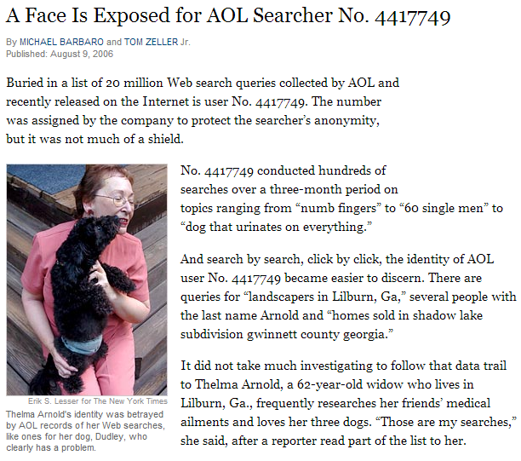
Privacy Violations are Bad

Slide 4
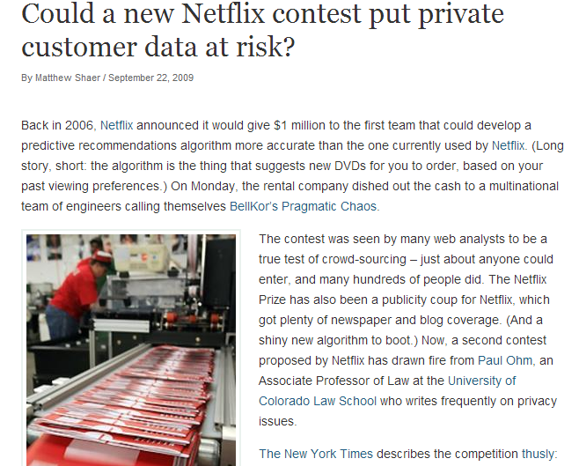
Privacy Violations are Bad

Slide 5
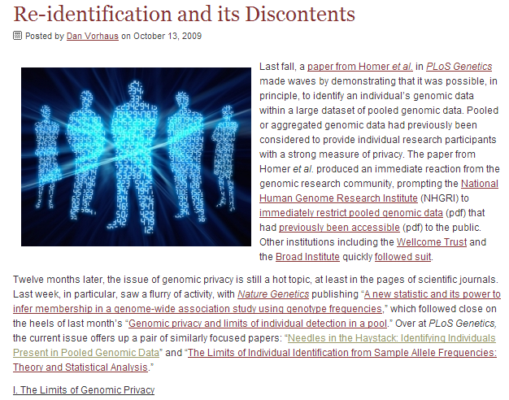
Privacy Violations are Bad

Slide 6
But what is “privacy”?

Slide 7
But what is “privacy” not?
Privacy is not hiding “personally identifiable information” (name, zip code, age, etc…)

Slide 8
But what is “privacy” not?
Privacy is not releasing only “aggregate” statistics.

Slide 9
So what is privacy?
Idea: Privacy is about promising people freedom from harm.
  Attempt 1: “An analysis of a dataset D is private if the data analyst knows no more about Alice after the analysis than he knew about Alice before the analysis.”

Slide 10
So what is privacy?
Problem: Impossible to achieve with auxiliary information.
  Suppose an insurance company knows that Alice is a smoker.
  An analysis that reveals that smoking and lung cancer are correlated might cause them to raise her rates!
Was her privacy violated?
    This is exactly the sort of information we want to be able to learn…
  This is a problem even if Alice was not in the database!
  This was not Alice’s secret to keep, even though it was related to Alice.

Slide 11
So what is privacy?
Idea: Privacy is about promising people freedom from harm.
  Attempt 2: “An analysis of a dataset D is private if the data analyst knows almost no more about Alice after the analysis than he would have known had he conducted the same analysis on an identical database with Alice’s data removed.”

Slide 12
Differential Privacy
[Dwork-McSherry-Nissim-Smith 06]
D
Bob
Xavier
Alice
Chris
Donna
Ernie
Algorithm
ratio bounded
Pr [r]

Slide 13
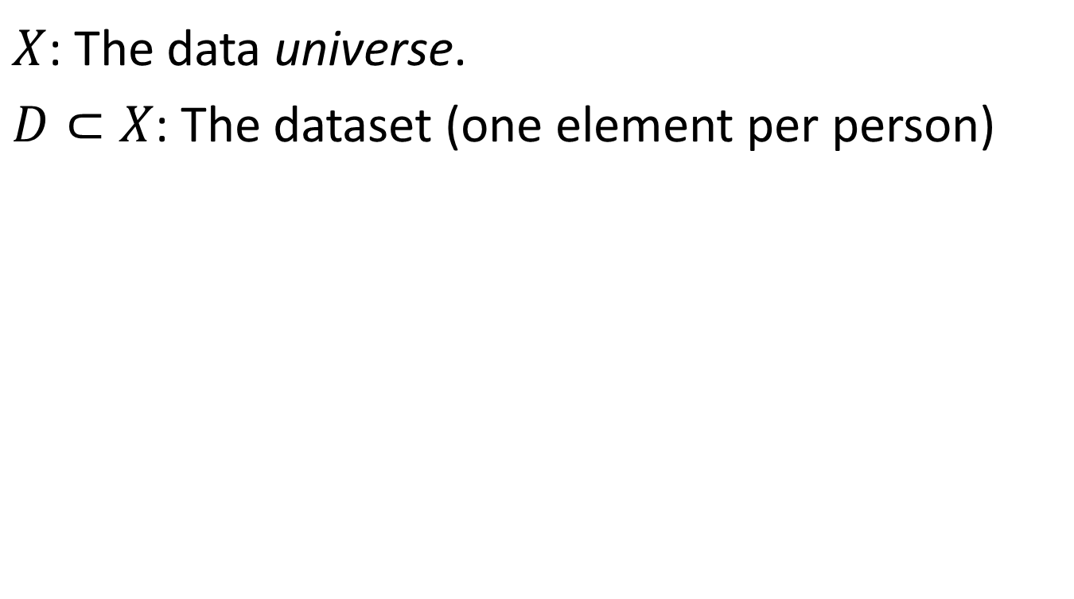

Differential Privacy
$X$: The data universe.
$D⊂X$: The dataset (one element per person)
Definition: An algorithm $M$ is $ε$-differentially private if for all pairs of datasets $D, D^{′}$ differing in one user’s data, and for all outputs $x$:
$$\operatorname{Pr}\left[M\left(D\right)=x\right]≤(1+ε)\operatorname{Pr}\left[M\left(D^{′}\right)=x\right]$$

Slide 14
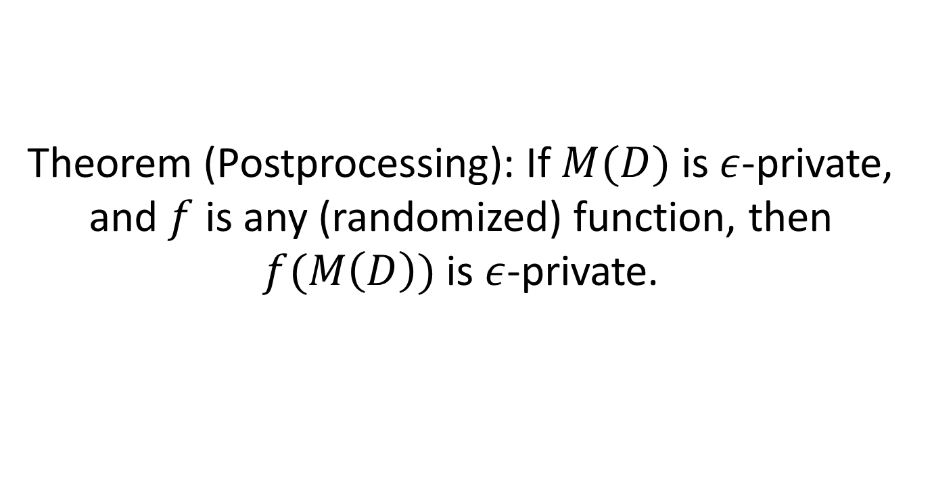
A Useful Property
Theorem (Postprocessing): If $M(D)$ is $ε$-private, and $f$ is any (randomized) function, then $f(M\left(D\right))$ is $ε$-private.

Slide 15

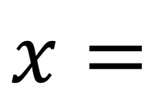
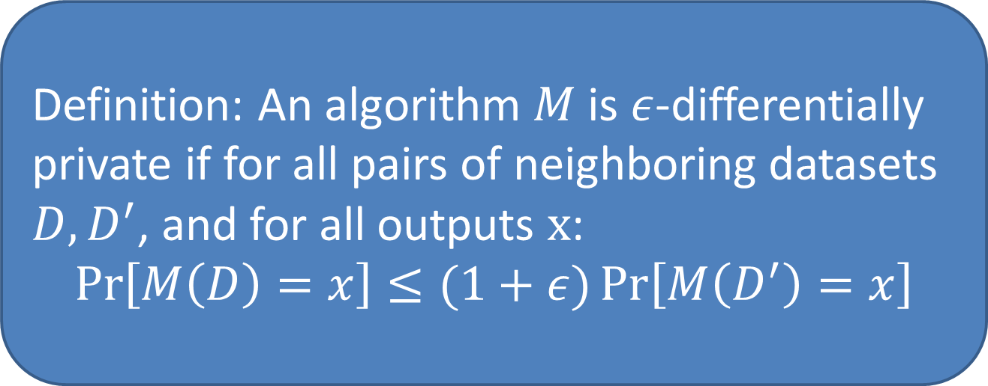
So…
Definition: An algorithm $M$ is $ε$-differentially private if for all pairs of neighboring datasets $D, D^{′}$, and for all outputs $x$:
$$\operatorname{Pr}\left[M\left(D\right)=x\right]≤(1+ε)\operatorname{Pr}\left[M\left(D^{′}\right)=x\right]$$
$$x=$$

Slide 16

So…
Definition: An algorithm $M$ is $ε$-differentially private if for all pairs of neighboring datasets $D, D^{′}$, and for all outputs $x$:
$$\operatorname{Pr}\left[M\left(D\right)=x\right]≤(1+ε)\operatorname{Pr}\left[M\left(D^{′}\right)=x\right]$$
$$x=$$

Slide 17
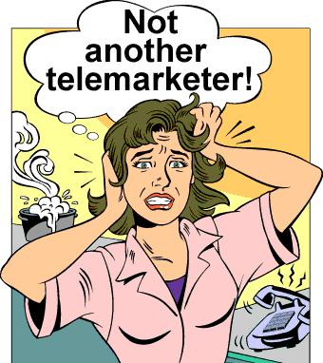
So…
Definition: An algorithm $M$ is $ε$-differentially private if for all pairs of neighboring datasets $D, D^{′}$, and for all outputs $x$:
$$\operatorname{Pr}\left[M\left(D\right)=x\right]≤(1+ε)\operatorname{Pr}\left[M\left(D^{′}\right)=x\right]$$
$$x=$$

Slide 18
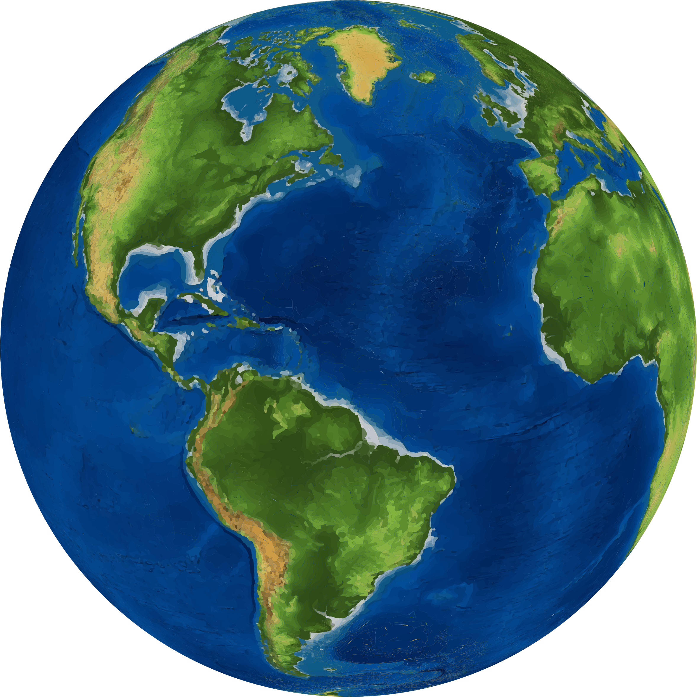

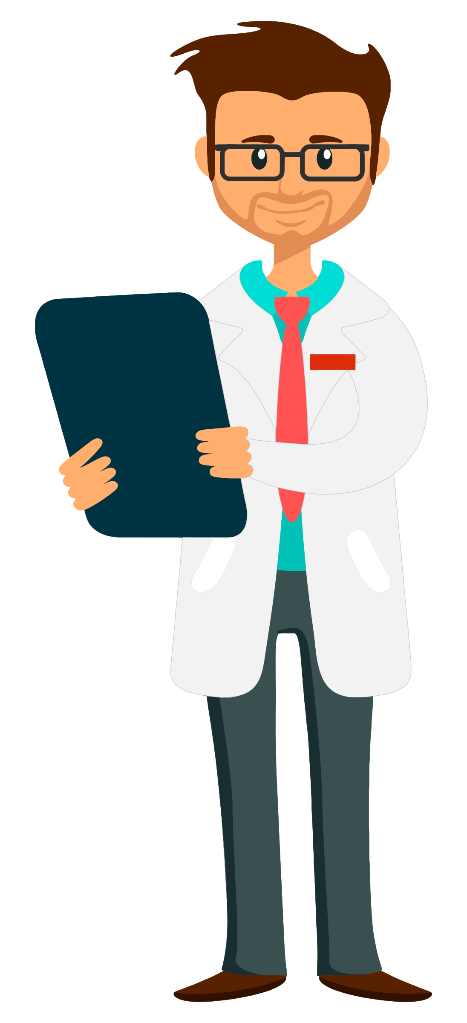

Can you do useful computations privately?
Example: Computing an average.
Traditional Method --- repeat $n$ times:
Who will you vote for?
Randomly sample someone
The Democrat

Slide 19
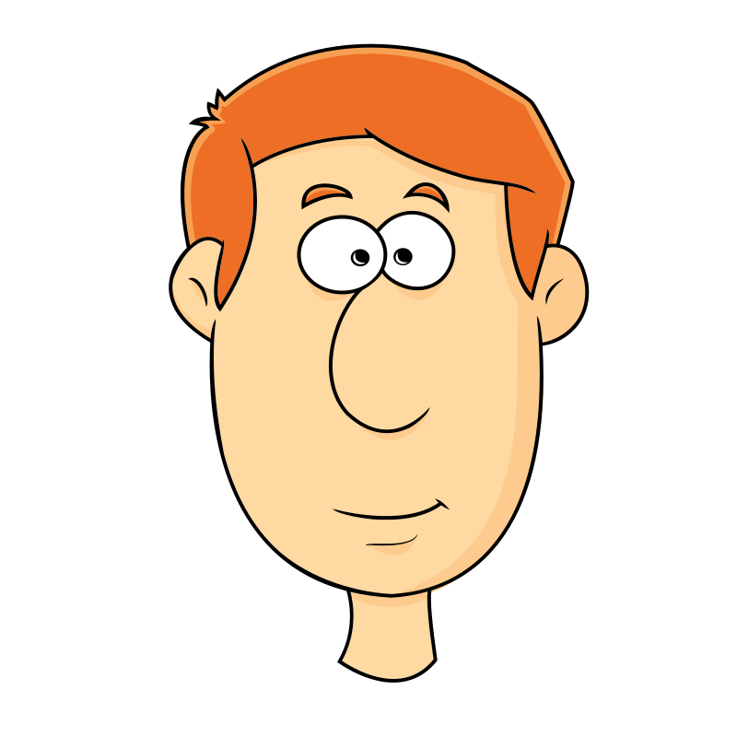
Can you do useful computations privately?
Example: Computing an average.
Traditional Method --- repeat $n$ times:
Who will you vote for?
Randomly sample someone
The Republican

Slide 20

Can you do useful computations privately?
Example: Computing an average.
Traditional Method --- repeat $n$ times:
Sampling error: $±O\left(\frac{1}{\sqrt{n}}\right)$
Average:
The Democrat will get 52% of the vote.

Slide 21

Can you do useful computations privately?
Example: Computing an average.
Via “Randomized Response” --- repeat $n$ times:
Flip a coin. If heads, tell me who you voted for. If tails, give me a random answer.
Randomly sample someone
The Republican

Slide 22
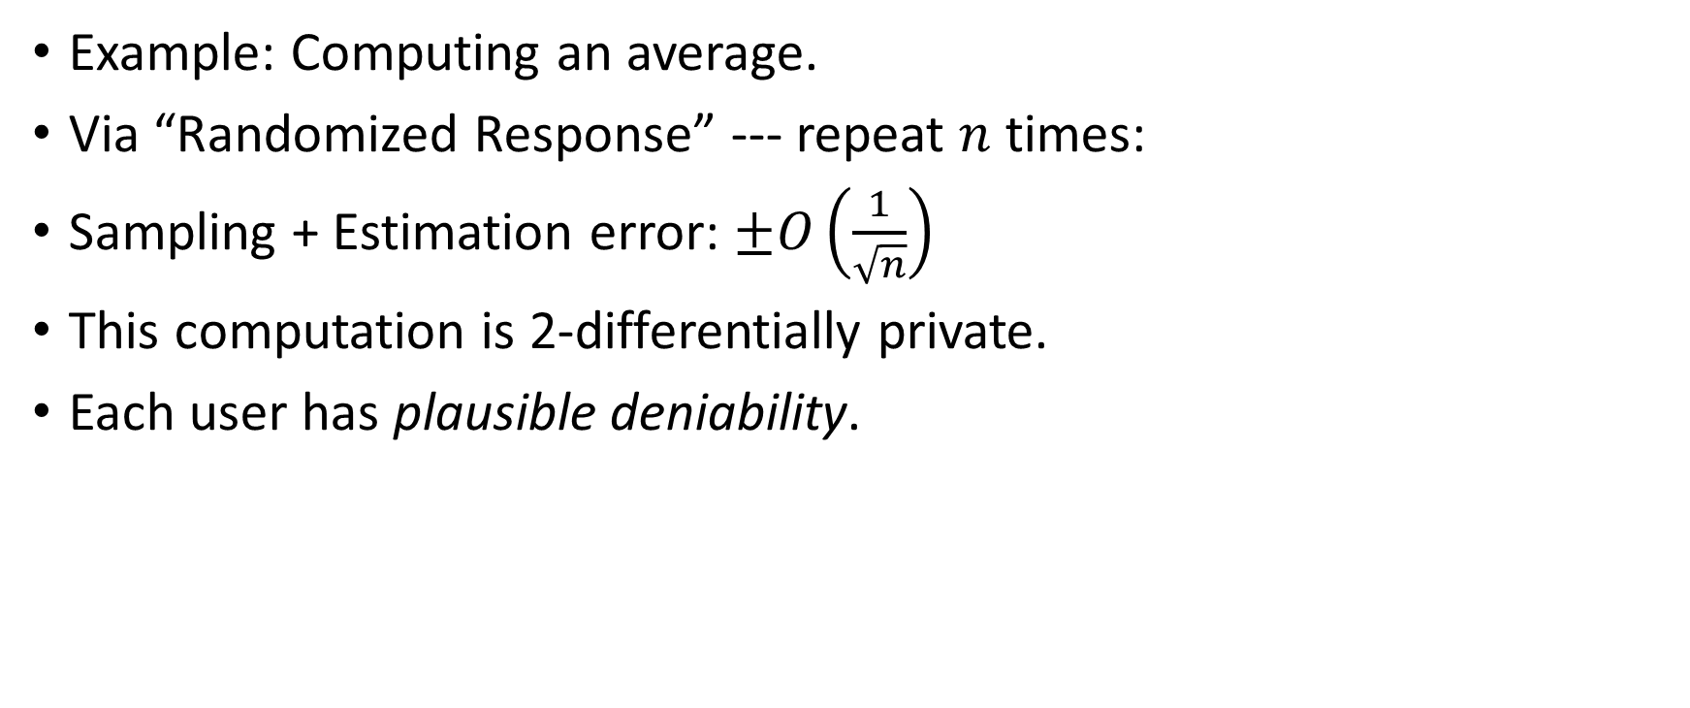
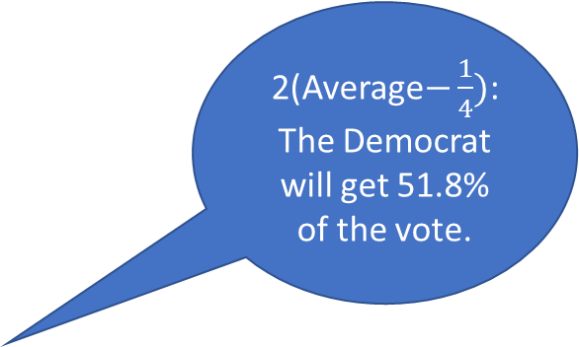
Can you do useful computations privately?
Example: Computing an average.
Via “Randomized Response” --- repeat $n$ times:
Sampling + Estimation error: $±O\left(\frac{1}{\sqrt{n}}\right)$
This computation is 2-differentially private.
Each user has plausible deniability.
2(Average$−\frac{1}{4})$:
The Democrat will get 51.8% of the vote.

Slide 23
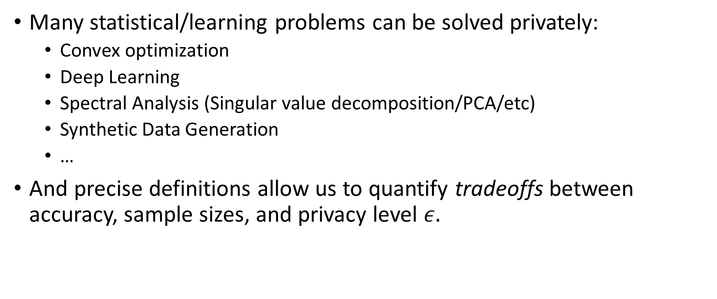
Can you do useful computations privately?
Many statistical/learning problems can be solved privately:
  Convex optimization
  Deep Learning
  Spectral Analysis (Singular value decomposition/PCA/etc)
  Synthetic Data Generation
  …
And precise definitions allow us to quantify tradeoffs between accuracy, sample sizes, and privacy level $ε.$

Slide 24



A decade later
A success story.

Slide 25
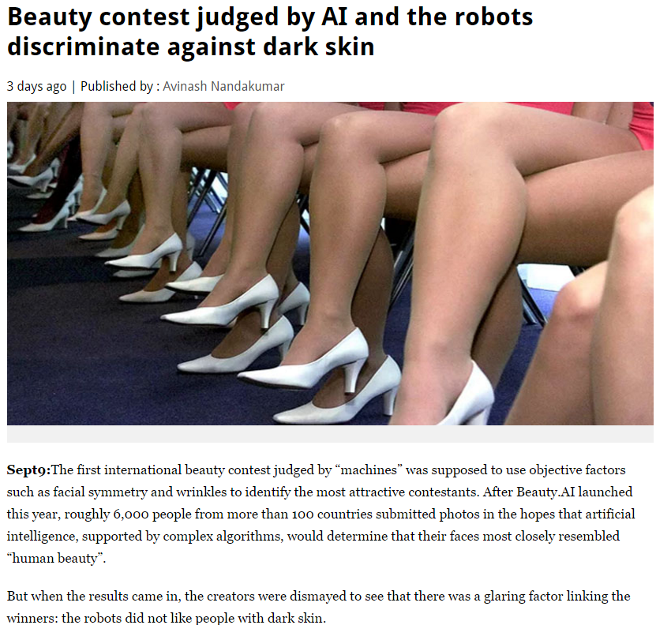
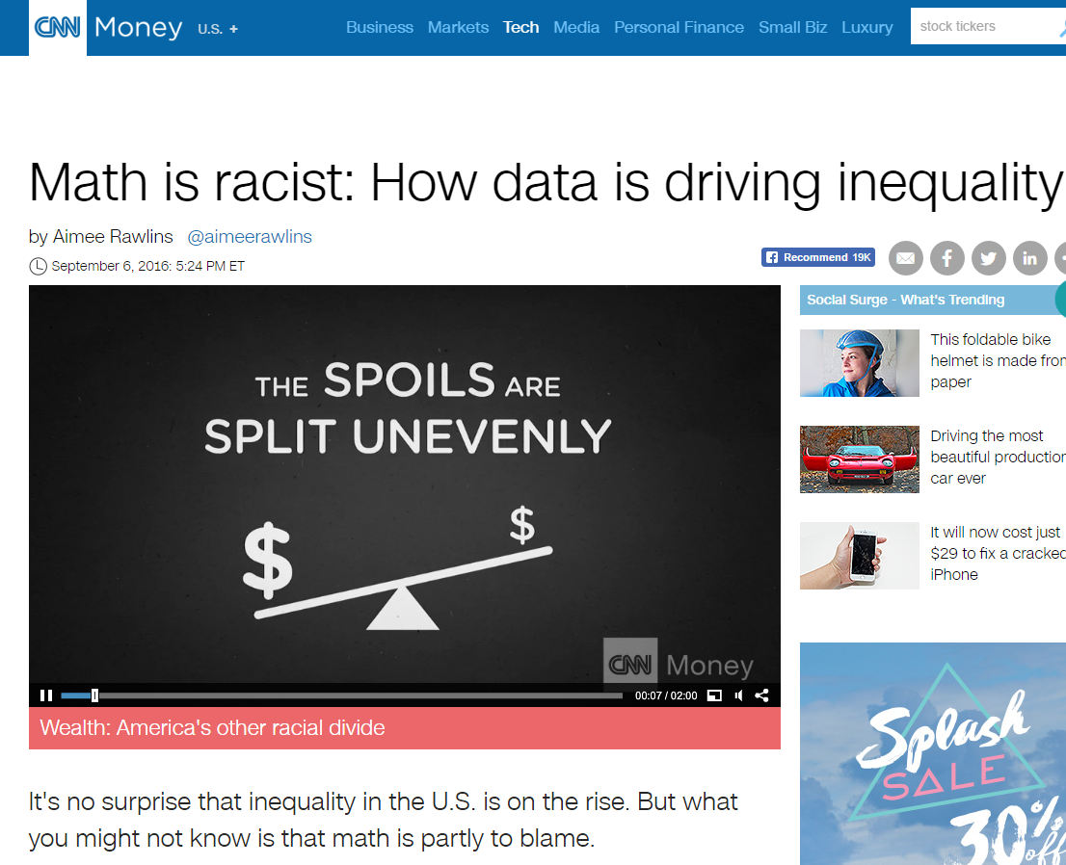
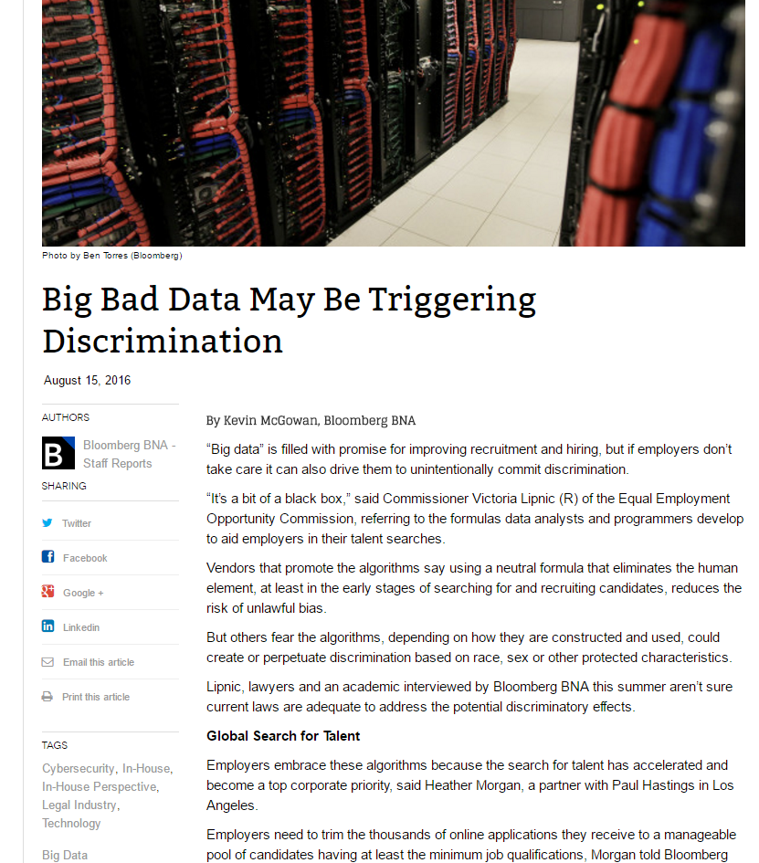
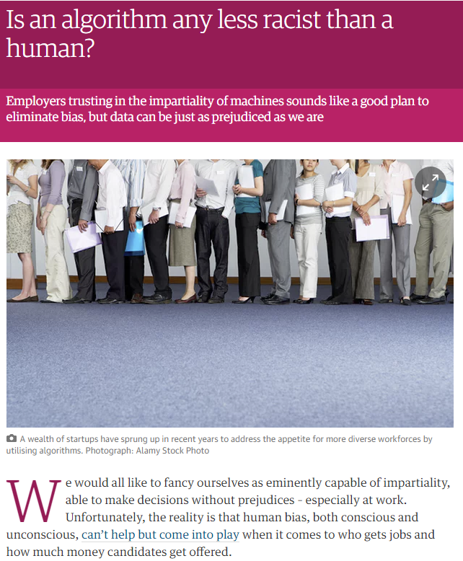
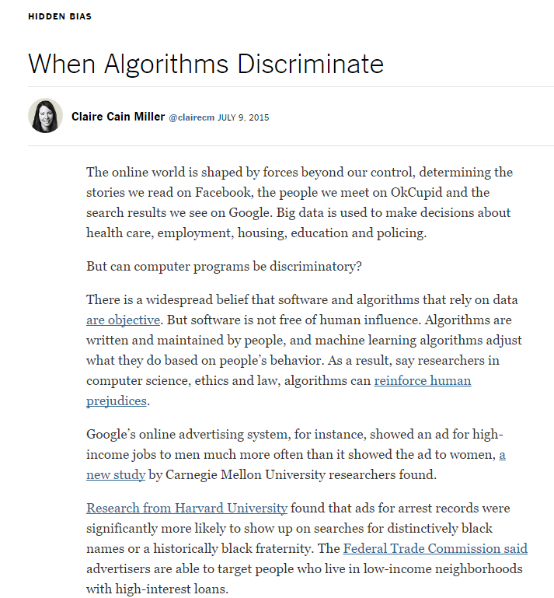
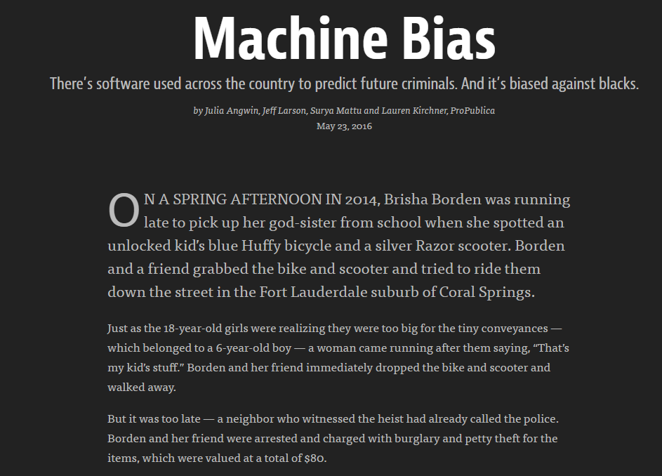
“Unfairness” is bad.

Slide 26



A Case Study: the COMPAS recidivism prediction tool.
The COMPAS risk tool is fair. It has equal positive predictive value on both the black and white population.
The COMPAS risk tool is unfair. It has a higher false positive rate on the black population compared to the white population.
A cartoon of the COMPAS tool:
  People have features $x$, and true label $y∈\{$R(eoffend), D(id not reoffend)}
  The tool makes a prediction $f\left(x\right)∈\left\{R, D\right\}.$

Slide 27
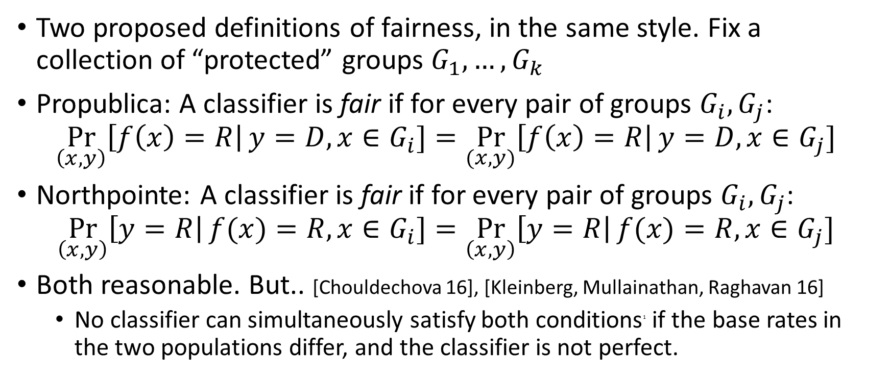
A Case Study: the COMPAS recidivism prediction tool.
Two proposed definitions of fairness, in the same style. Fix a collection of “protected” groups $G_{1},…,G_{k}$
Propublica: A classifier is fair if for every pair of groups $G_{i},G_{j}$:
$$\underset{\left(x,y\right)}{Pr}\left[f\left(x\right)=R\right|y=D, x∈G_{i}]=\underset{(x,y)}{Pr}\left[f\left(x\right)=R\right|y=D, x∈G_{j}]$$
Northpointe: A classifier is fair if for every pair of groups $G_{i},G_{j}$:
$$\underset{\left(x,y\right)}{Pr}\left[y=R\right|f(x)=R, x∈G_{i}]=\underset{\left(x,y\right)}{Pr}\left[y=R\right|f(x)=R, x∈G_{j}]$$
Both reasonable. But.. [Chouldechova 16], [Kleinberg, Mullainathan, Raghavan 16]
  No classifier can simultaneously satisfy both conditions¹ if the base rates in the two populations differ, and the classifier is not perfect.

Slide 28
Why does equalizing FP rates (sometimes) correspond to “fairness”?
Being incorrectly labelled as “High Risk” constitutes a harm. FP rate is your probability of being harmed if you are born as a uniformly random “Low Risk” member of a population.

Slide 29
Why does equalizing FP rates (sometimes) correspond to “fairness”?
Being incorrectly labelled as “High Risk” constitutes a harm. FP rate is your probability of being harmed if you are born as a uniformly random “Low Risk” member of a population.
Equal FP rates => Indifference between
groups when behind veil of ignorance.

Slide 30
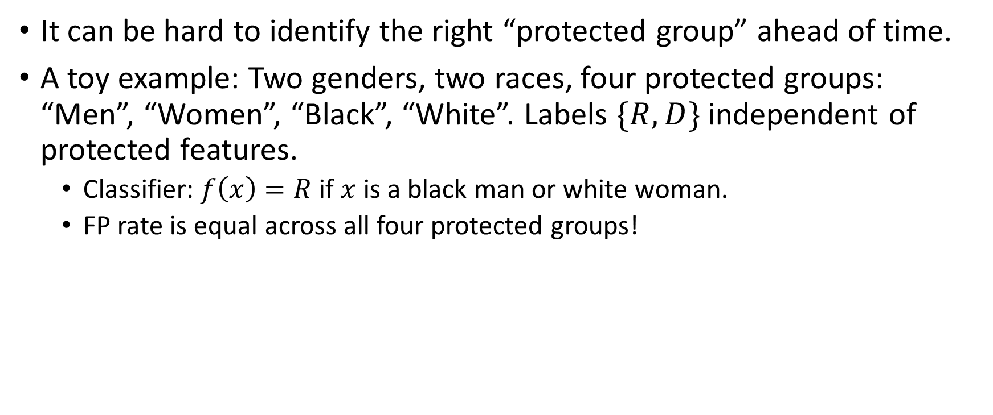
And when does it not?
It can be hard to identify the right “protected group” ahead of time.
A toy example: Two genders, two races, four protected groups: “Men”, “Women”, “Black”, “White”. Labels $\{R,D\}$ independent of protected features.
  Classifier: $f\left(x\right)=R$ if $x$ is a black man or white woman.
  FP rate is equal across all four protected groups!
FP Rates | Black | White
Men | 100% | 0%
Women | 0% | 100%

Slide 31
And when does it not?
Solution: Ask for equal FP rates across all possible divisions of the data?
  Impossible to satisfy (with non-trivial classifiers) without overfitting.
  Consider: Any classifier can be accused of being “unfair” to the subgroup, defined ex-post as the set of individuals who were mis-classified.
A Middle Ground: Ask for equal FP rates across all possible divisions of the data that can “reasonably be identified” with a simple decision rule.
  E.g. “with bounded VC-dimension”
  Can still be exponentially/infinitely many such groups.

Slide 32
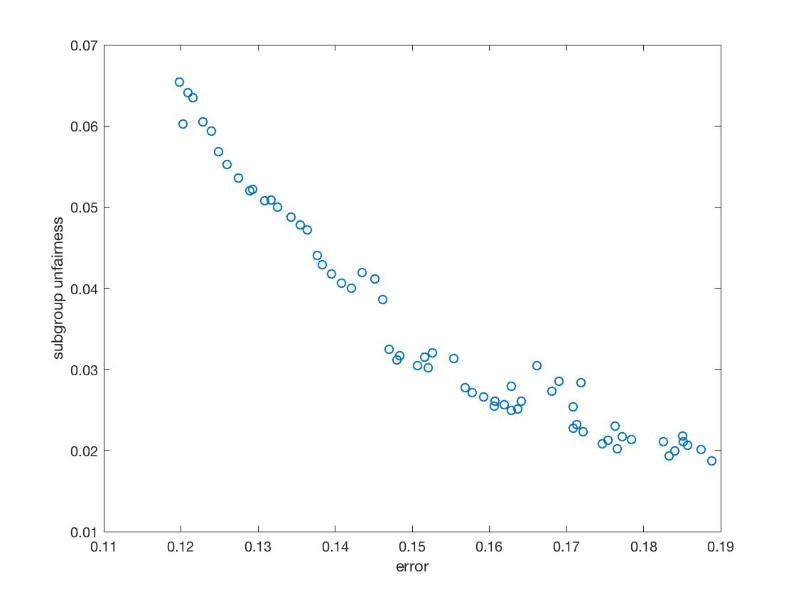
Once we have precise definitions, we can explore tradeoffs.
Due to impossibility results, must pick and choose even amongst fairness desiderata.
How does fairness trade off with classification accuracy?
  Quantitative definitions of fairness induce fairness/error “Pareto Curves” for classification tasks.
  Does not answer the question: Which point on the Pareto frontier should we pick?

Slide 33
In Summary
Scientific progress/understanding is driven in large part by precise definitions.
It can be difficult to capture much of what we mean by words like “privacy” and “fairness” in mathematical constraints.
But we should still try! When we succeed, we can:
  Understand/manage the inevitable tradeoffs between different desiderata
  Design algorithms which meet these definitions
  Bring precision to policy disagreements.
Privacy: A success story for this approach.
Fairness: A work in progress.

Slide 34
In Summary
Scientific progress/understanding is driven in large part by precise definitions.
It can be difficult to capture much of what we mean by words like “privacy” and “fairness” in mathematical constraints.
But we should still try! When we succeed, we can:
  Understand/manage the inevitable tradeoffs between different desiderata
  Design algorithms which meet these definitions
  Bring precision to policy disagreements.
Privacy: A success story for this approach.
Fairness: A work in progress.
Thanks!

Slide 35
SAT Score
Number of Credit Cards
Population 1
Population 2

Slide 36
SAT Score
Number of Credit Cards
Population 1
Population 2

Slide 37
SAT Score
Upshot: To be “fair”, the algorithm may need to explicitly take into account group membership.
Else, optimizing accuracy fits the majority population.
Number of Credit Cards
Population 1
Population 2

