Slide 1

Perspectives on Enhancing
Rigor and Reproducibility in Biomedical Research Through Training
Alison Gammie, Ph.D.
Director of Training, Workforce Development and Diversity

Slide 2
No Conflict of Interest to Report

Slide 3
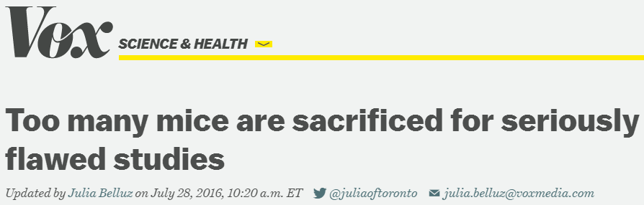
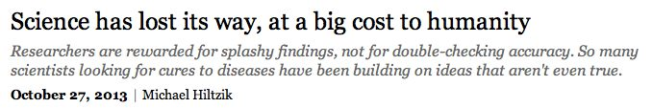
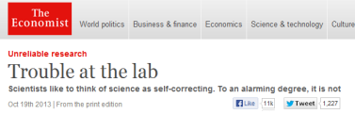
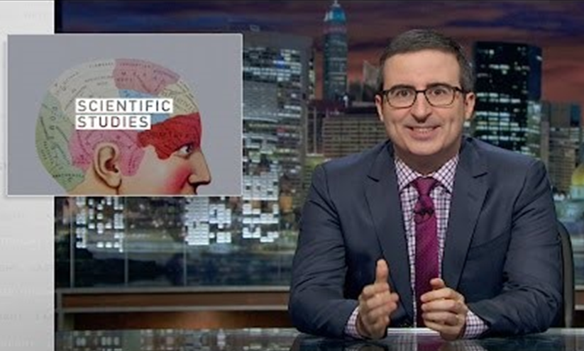


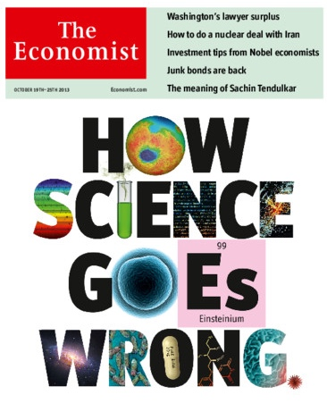
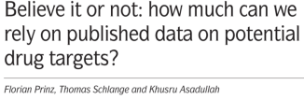
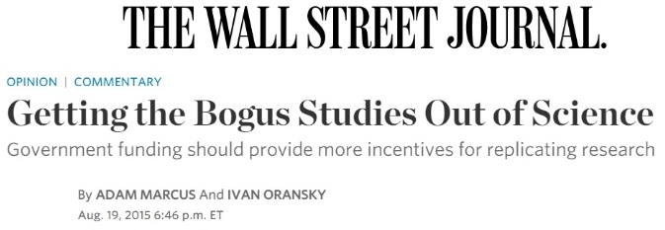


A Growing Challenge:
Ensuring the Rigor and Reproducibility of Biomedical Research

Slide 4
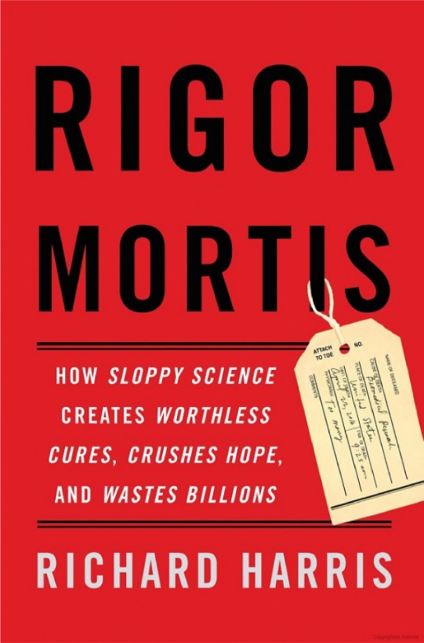

Media Coverage
(The Wall Street Journal Review, April 8-9, 2017)
The Breakdown in Biomedical Research
“Contaminated samples, faulty studies, and inadequate training have created a crisis in laboratories and industry, slowing the quest for new treatments and cures”

Slide 5
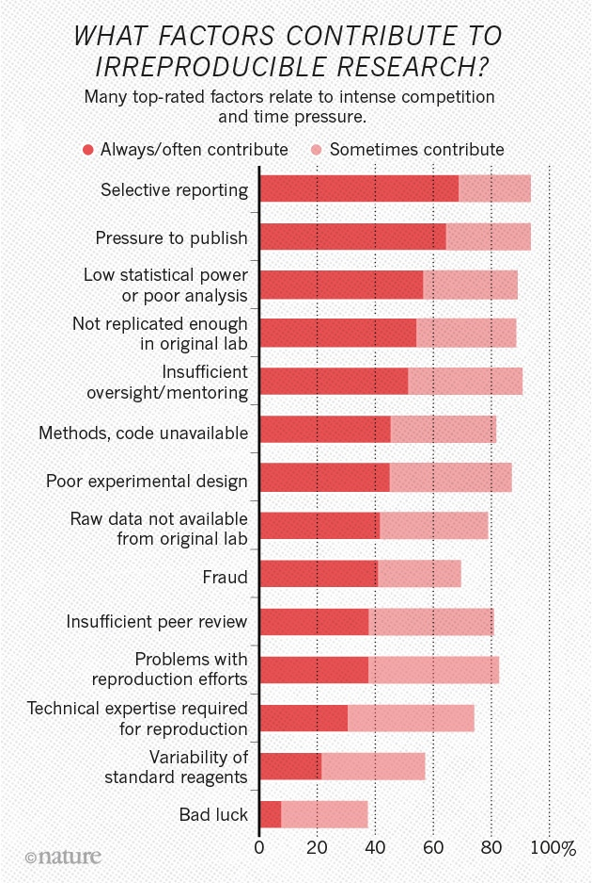
Survey Indicates a Number of Causes Contribute to the Problem
http://www.nature.com/news/1-500-scientists-lift-the-lid-on-reproducibility-1.19970

Slide 6
The “Reproducibility Problem”
Issues related to three main areas:
Training
and education
Methodology
experimental design,
reporting
Sociology
of science

Slide 7
The “Reproducibility Problem”
Issues related to three main areas:
Training
and education
Methodology
experimental design,
reporting
Sociology
of science

Slide 8

Some Underlying Systemic Issues:
The Biomedical Research Incentive Structure
Push for large labs
Tenure and promotion
Unstable funding
Publish or perish!
(Except negative data)
Soft money positions
Impact factor
“One-word journals”
“Innovation”
Networking pressure
“Novelty”

Slide 9
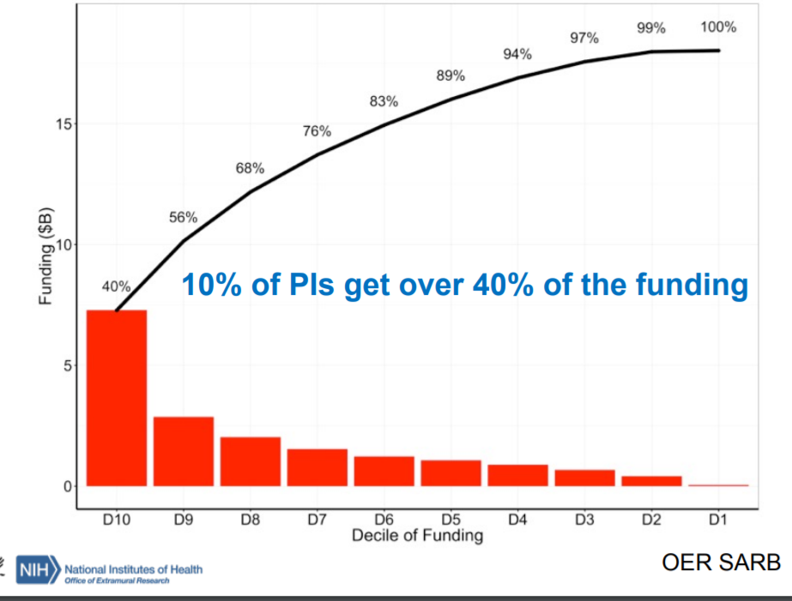

Slide 10
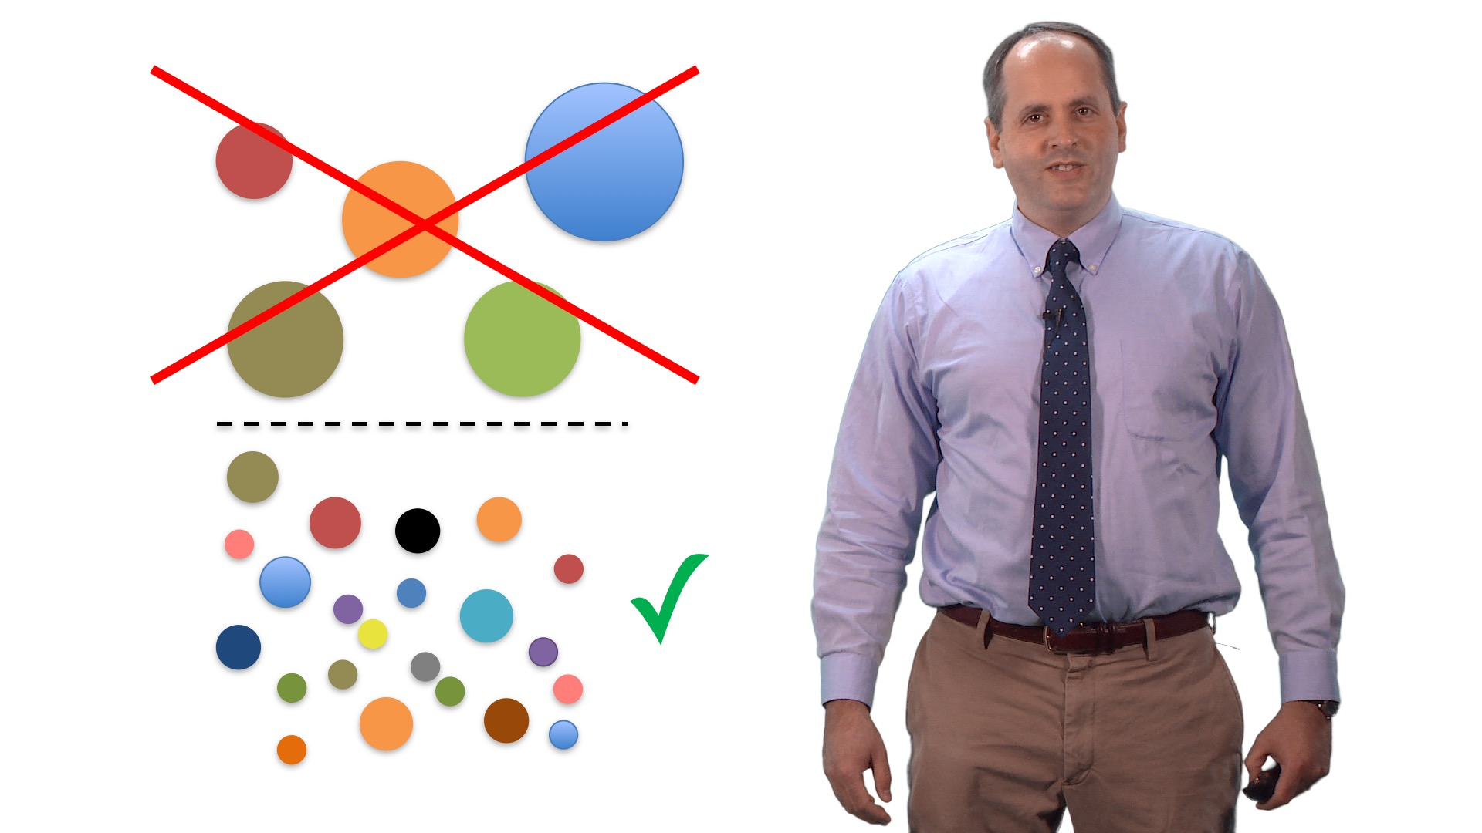
NIGMS MIRA Awards

Slide 11
The “Reproducibility Problem”
Issues related to three main areas:
Training
and education
Methodology
experimental design,
reporting
Sociology
of science

Slide 12
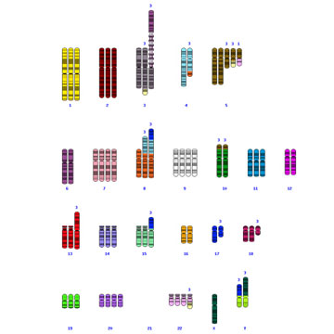
Cell Culture: A Case Study in the Challenges of Reproducibility
Cell line contamination & misidentification
    ~70% of researchers surveyed in 2014 had never checked the identity of their cell lines
    Major repositories report that 14-30% of submissions are contaminated
  Genomic instability
  Infections in stocks
    Mycoplasma
    Viruses
  Variability of growth conditions

Slide 13
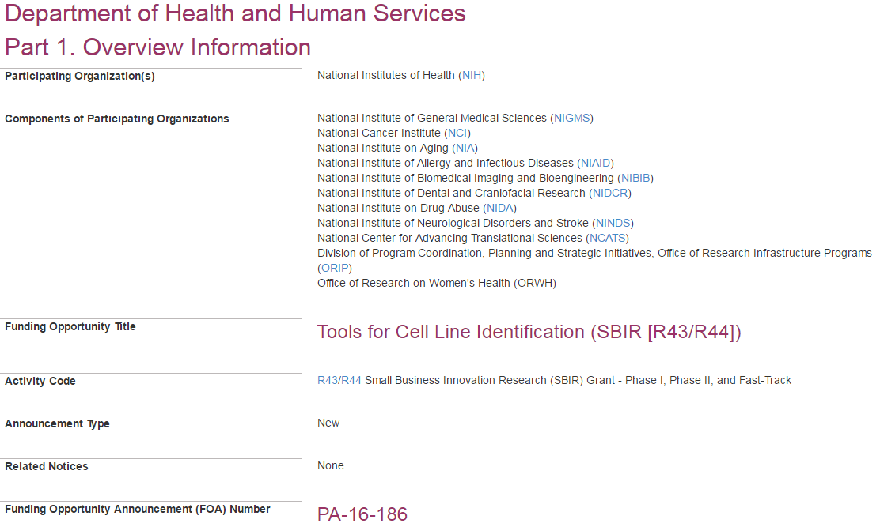
A Call for New Tools to Improve Cell Line Identification

Slide 14
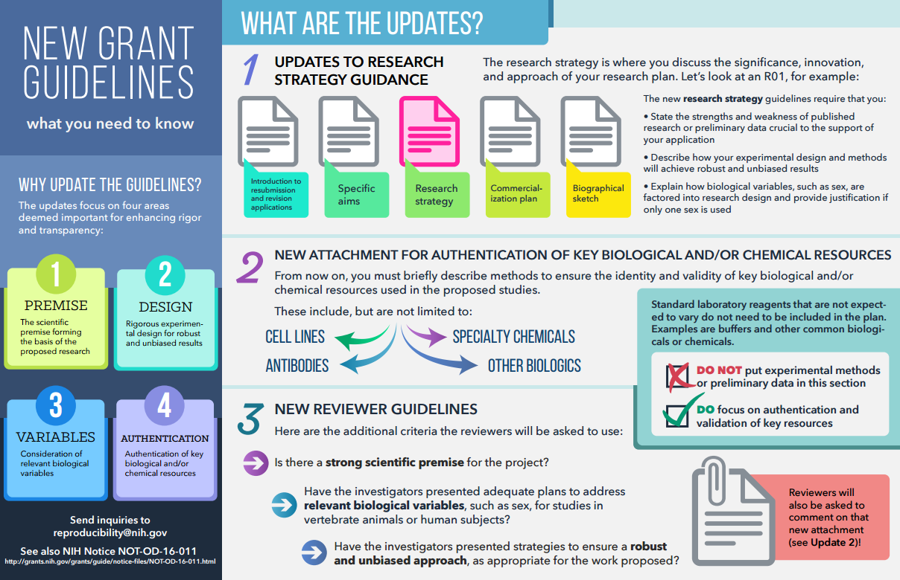

Slide 18
The “Reproducibility Problem”
Issues related to three main areas:
Training
and education
Methodology
experimental design,
reporting
Sociology
of science

Slide 19
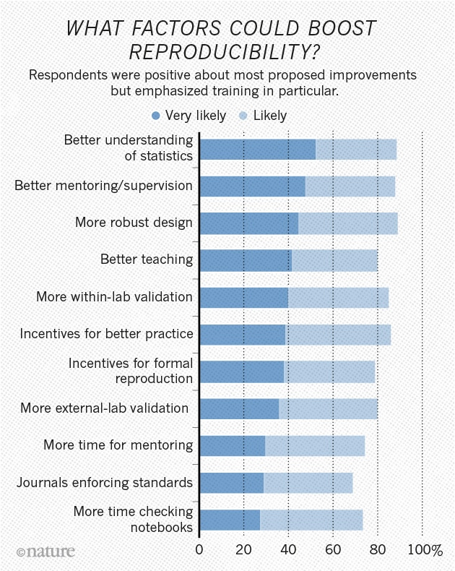
Survey Indicates Training Can Play a Role in Enhancing Reproducibility
http://www.nature.com/news/1-500-scientists-lift-the-lid-on-reproducibility-1.19970

Slide 20

New NIH Resources for Training and Education in Reproducibility and Transparency
NIGMS clearinghouse: home for trans-NIH initiative to develop educational resources
  Experimental design
  Laboratory practices
  Analysis and reporting
  Culture of science

Slide 21
Resources for Training and Education in Reproducibility and Transparency
NIGMS T32 administrative supplements to develop new local courses in experimental design and analysis:
RFA-GM-15-006 and RFA-GM-18-002 - to develop training modules to enhance data reproducibility
PA-15-136 and PA-16-060 - to develop local courses in experimental design & analysis

Slide 22
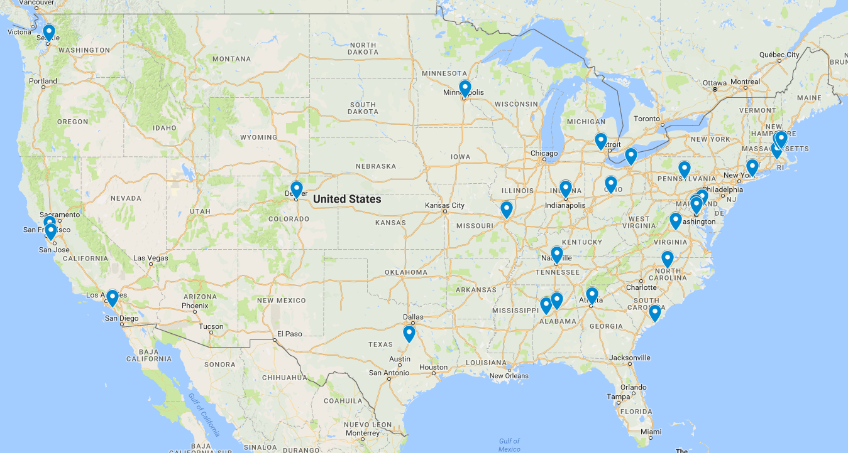
Training Modules and Local Courses in Experimental Design and Analysis

Slide 23
Graduate Training
Jointly Sponsored Neuroscience T32 (PAR-17-076)
  Formal instruction in the strict application of the scientific method to ensure that trainees understand the practices that underlie robust and unbiased experimental approaches, methods, analyses, data interpretation and transparent reporting of results.
  Plan for training in statistical methodology that emphasizes the importance of considering statistical principles in research design; the appropriate use of statistics in data analysis, interpretation of results and forming conclusions; and the practical application of statistics to data in different experimental paradigms.

Slide 24
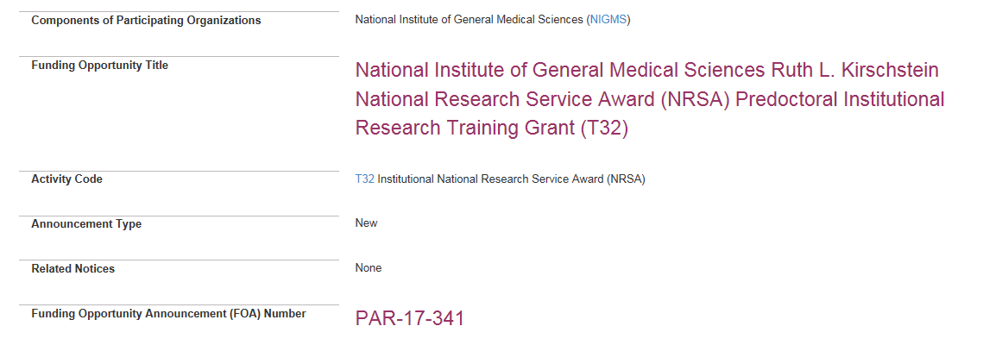
New NIGMS predoctoral T32 training grant mechanism emphasizing an integrated approach to improving rigor and transparency

Slide 25
New NIGMS predoctoral T32 training grant mechanism
The Overarching Objective of the NIGMS Predoctoral Institutional Research Training Grant (T32) program is to develop a diverse pool of well-trained scientists who have the following technical, operational and professional skills:
Technical
Operational
Professional
Acquiring Information,
Experimental Design
&
Data Interpretation
Methods
&
Technology
Quantitative
&
Computational
Management
&
Leadership
Communication
&
Teamwork
25 |
EAWG October 2017

Slide 26
Proposed Trainee Focused Objectives:
Technical/Operational Skills
A broad understanding across biomedical disciplines and the skills to independently acquire the knowledge needed to advance their chosen field
The ability to think critically, independently and to identify important biomedical research questions and approaches that push forward the boundaries of their area of study
Technical
Operational
Professional
Acquiring Information,
Experimental Design
&
Data Interpretation
Methods
&
Technology
Quantitative
&
Computational
Management
&
Leadership
Communication
&
Teamwork
26 |

Slide 27
Proposed Trainee Focused Objectives:
Technical/Operational Skills
A strong foundation in rigorous research design, experimental methods, quantitative literacy & reasoning skills, data analysis & interpretation
A commitment to approaching and conducting biomedical research responsibly and with integrity
Experience initiating, conducting, interpreting, and presenting rigorous and reproducible biomedical research with increasing self-direction
Technical
Operational
Professional
Acquiring Information,
Experimental Design
&
Data Interpretation
Methods
&
Technology
Quantitative
&
Computational
Management
&
Leadership
Communication
&
Teamwork
27 |

Slide 28
Proposed Trainee Focused Objectives: Professional Skills
The ability to work effectively in teams with colleagues from a variety of cultural and scientific backgrounds, and to promote inclusive and supportive scientific research environments
The skills to teach and communicate scientific research methodologies and findings to a wide variety of audiences (e.g., discipline-specific, across disciplines, and the public)
The knowledge, professional skills and experiences required to identify and transition into careers in the biomedical research workforce
Technical
Operational
Professional
Acquiring Information,
Experimental Design
&
Data Interpretation
Methods
&
Technology
Quantitative
&
Computational
Management
&
Leadership
Communication
&
Teamwork
28 |

Slide 29
New NIGMS predoctoral T32 training grant mechanism emphasizing an integrated approach to improving rigor and transparency
Principal Investigator(s) and Program Faculty must have a record of using rigorous and transparent methods in experimental design, data collection, analysis and reporting
  Biographical sketch. The personal statement should describe a commitment to scientific rigor, training, mentoring, as well as to promoting inclusive and supportive scientific environments.
Program plans should describe how the program will ensure that program faculty employ the highest standards of scientific rigor and impart those standards to their trainees

Slide 30
A Required Plan for Instruction in Methods for Enhancing Reproducibility
How trainees will be instructed in principles important for enhancing research reproducibility
  evaluation of foundational research underlying a project (i.e., scientific premise)
  rigorous experimental design and data interpretation
  consideration of relevant biological variables such as sex
  authentication of key biological and/or chemical resources
  data and material sharing, record keeping, and transparency in reporting
How instruction strategies are sufficiently well integrated into the overall curriculum
  taught at multiple stages of trainee development and in a variety of formats and contexts
  program faculty will reiterate and augment key elements of methods for enhancing reproducibility when trainees are performing research in their laboratories.

Slide 31
Letter of Institutional Support
The letter should describe the commitment to “……developing and promoting a culture in which the highest standards of scientific rigor, reproducibility and responsible conduct are advanced.”
Push for large labs
Tenure and promotion
Unstable funding
Publish or perish!
(Except negative data)
Soft money positions
Impact factor
“One-word journals”
“Innovation”
Networking pressure
“Novelty”

Slide 32
Review Criteria – Overall Impact Score
Will the training program produce a diverse pool of well-trained scientists with the skills necessary to conduct rigorous and reproducible research, and transition into careers in the biomedical research workforce?
Skills include:
technical (e.g., appropriate methods, technologies, and quantitative/computational approaches),
operational (e.g., independent knowledge acquisition, rigorous experimental design, and interpretation of data), and
professional (e.g. management, leadership, communication, and teamwork)

Slide 33
Questions & Comments? alison.gammie@nih.gov

