Slide 1

Data Science Specializations in PhD Programs at UW
Magdalena Balazinska
Professor, Paul G. Allen School of Computer Science & Eng
Director, eScience Institute
University of Washington

Slide 2
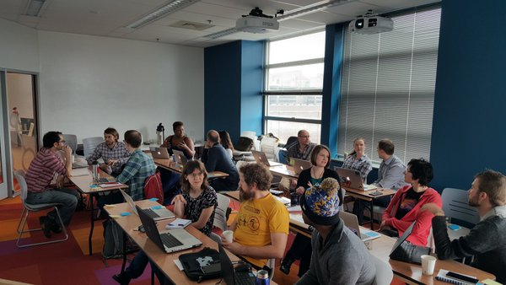
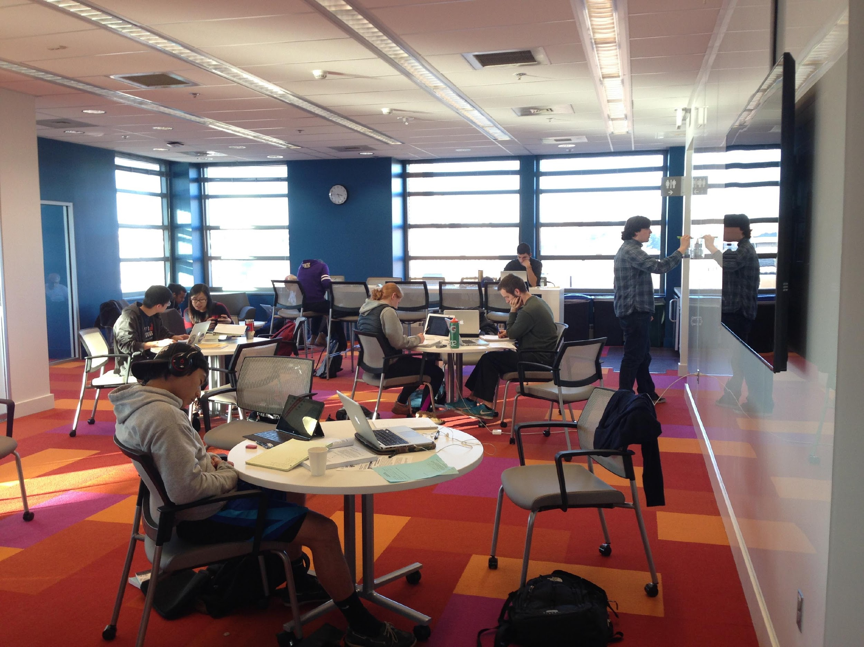
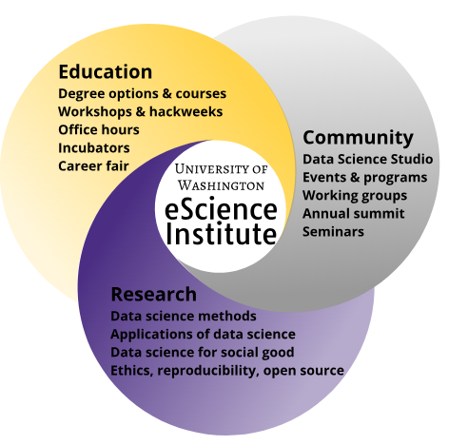

UW eScience Institute Since 2008
http://escience.washington.edu/
The eScience Institute empowers researchers and students in all fields to answer fundamental questions through the use of large, complex, and noisy data. As the hub of data-intensive discovery on campus, we lead a community of innovators in the techniques, technologies, and best practices of data science and the fields that depend on them
10 years!
Notes:
At the UW, we founded our…
Dean of University Libraries

Slide 3
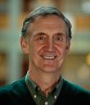
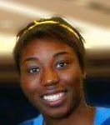
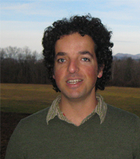
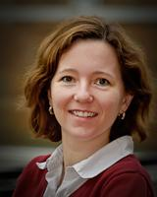
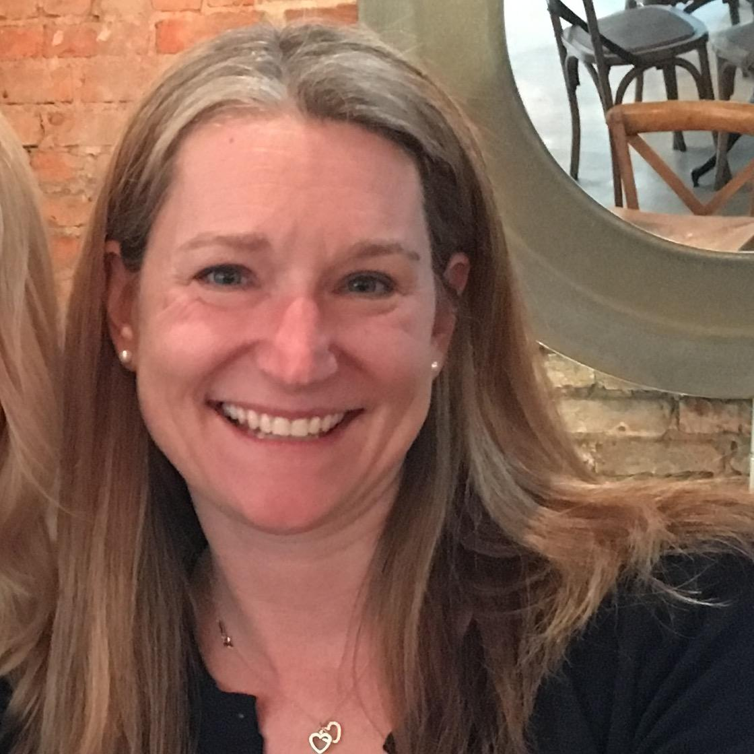
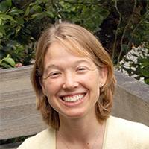
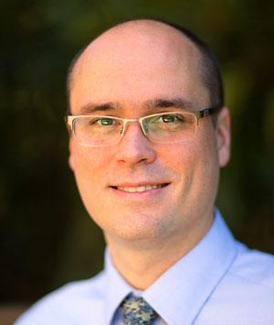
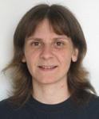
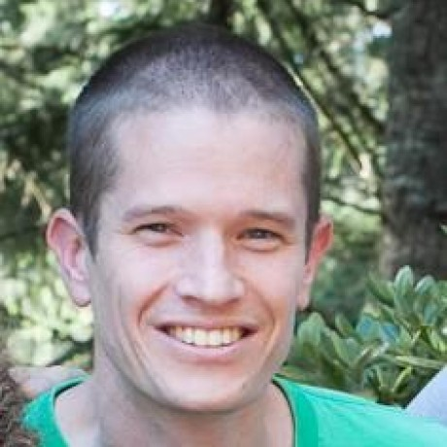
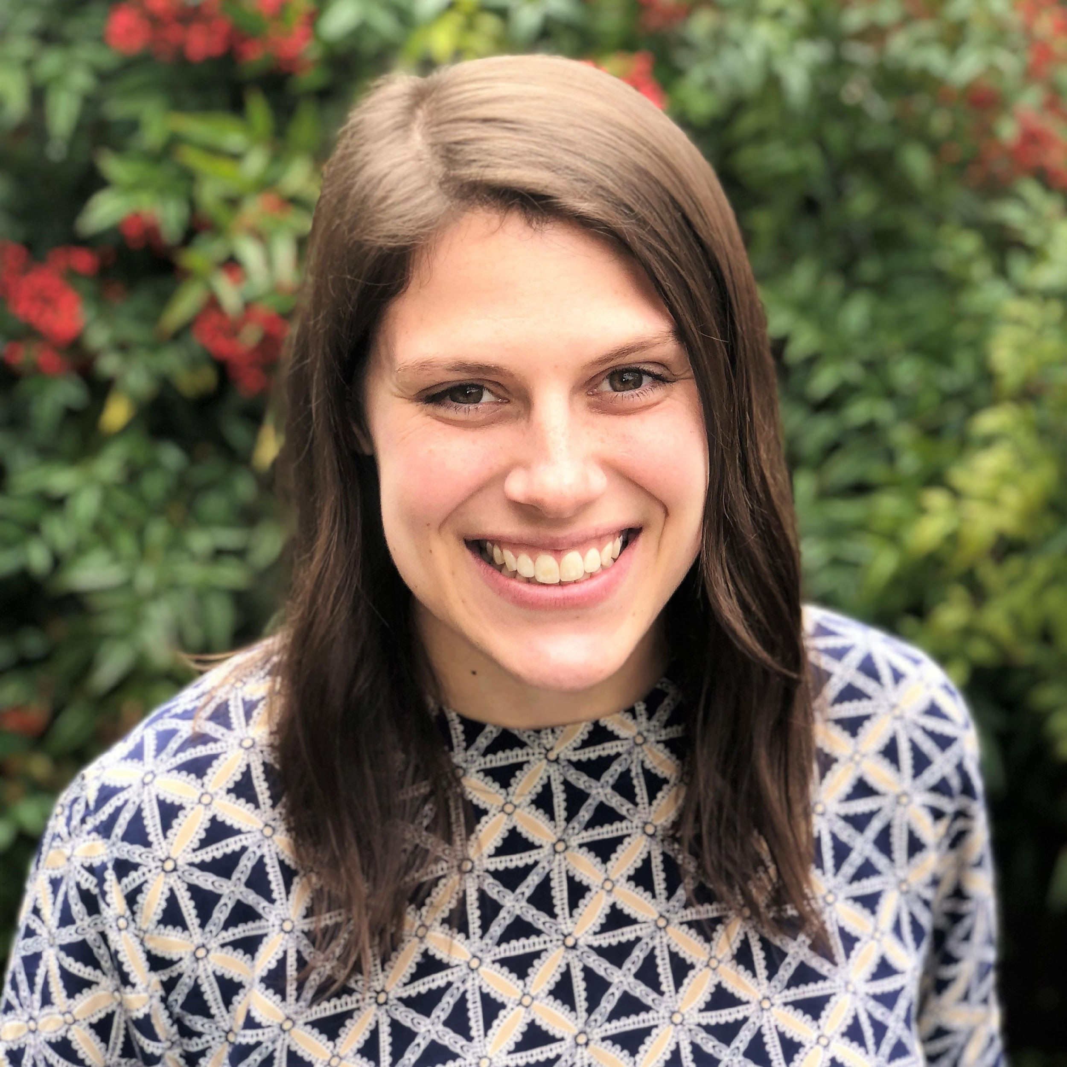
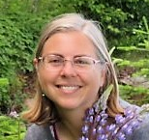
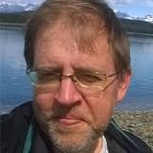
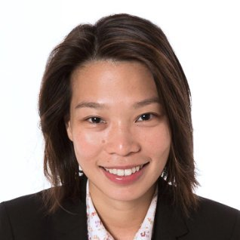
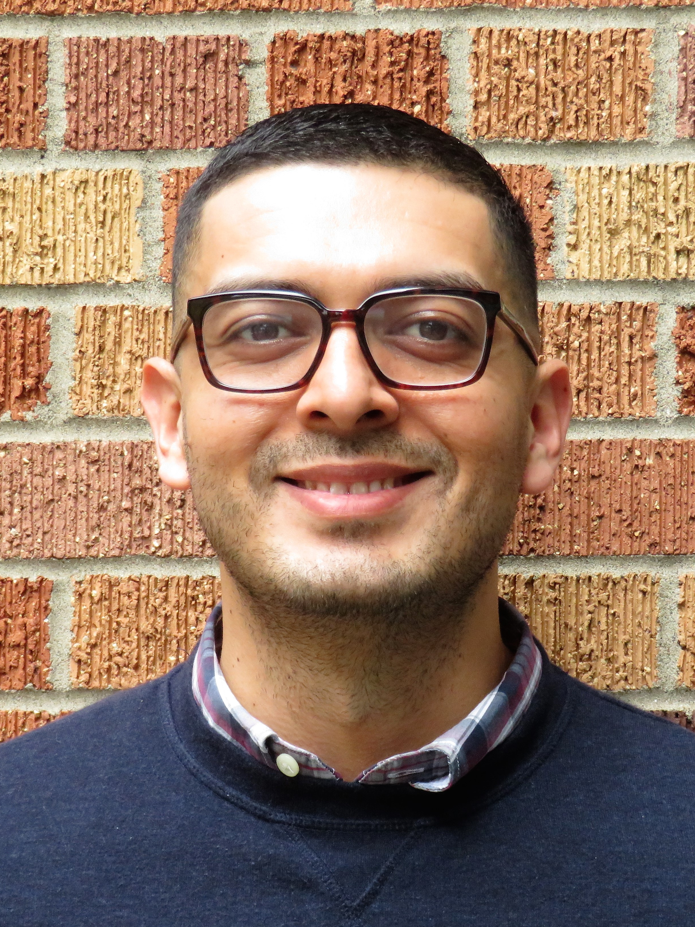
Who We Are?
Data Scientists
Founding Director
Ed Lazowska
Ph.D. Computer Science
Director
Executive Directors
Director of Research
Bernease Herman
B.S. Statistics
Formerly SE at Amazon
Ariel Rokem
Ph.D. Neuroscience
Magdalena Balazinska
Ph.D. Computer Science
David Beck
Ph.D. Medicinal Chemistry,
Biomolecular Struct. & Design
Micaela Parker
Ph.D. Oceanography
Sarah Stone
Ph.D. Oceanography
Events
Communications
Cloud Solutions
Valentina Staneva
Ph.D. Applied
Mathematics and
Statistics
Jake VanderPlas
Director of Open
Software
Ph.D. Astronomy
Rob Fatland
Director of Cloud &
Data Solutions
Ph.D. Geophysics
Amanda Tan
Cloud Technology Lead Developer
Ph.D. Civil & Env. Eng.
Rachael Murray
Program Specialist
Robin Brooks
Communications Associate
Jose Hernandez
PhD Measurement
& Statistics

Slide 4
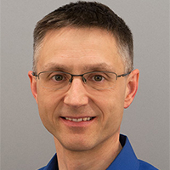
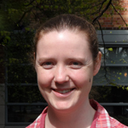
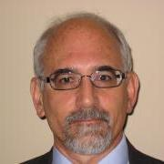
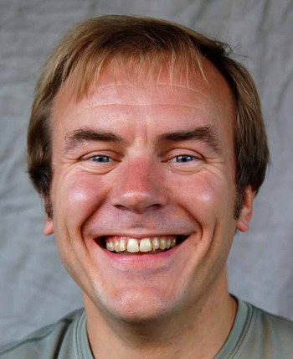
Research Scientists
Anthony Arendt
Ph.D. Geophysics
APL
Bryna Hazelton
Ph.D. Astrophysics
Physics
Joe Hellerstein
Ph.D. Computer Science
IBM Research, Microsoft Research, Google (ret.)
Vaughn Iverson
Ph.D. Oceanography
Oceanography

Slide 5
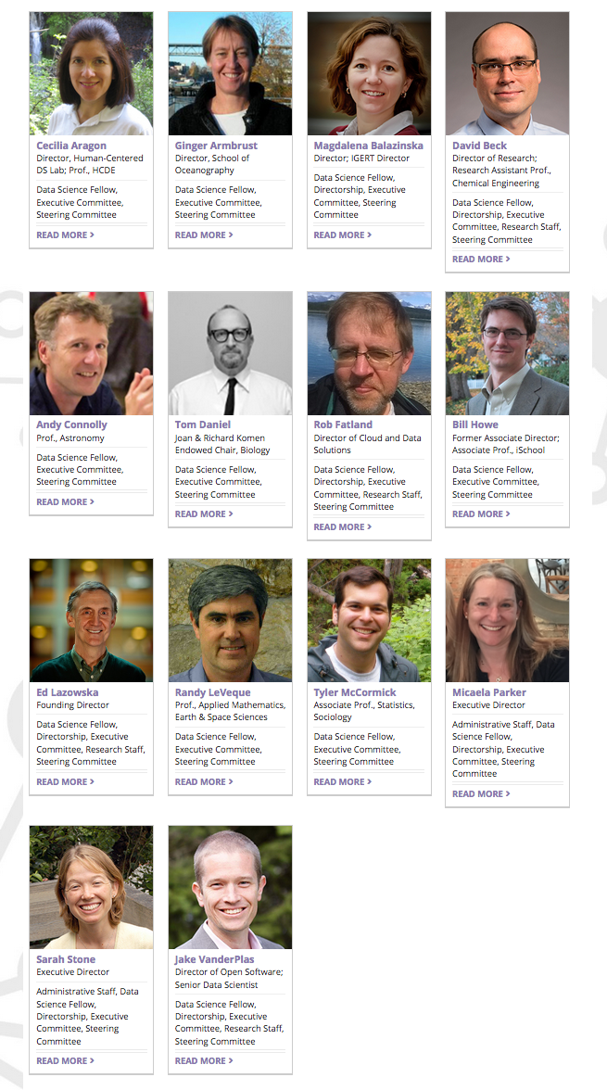
Executive Committee
and 100+ affiliated faculty from around UW

Slide 6
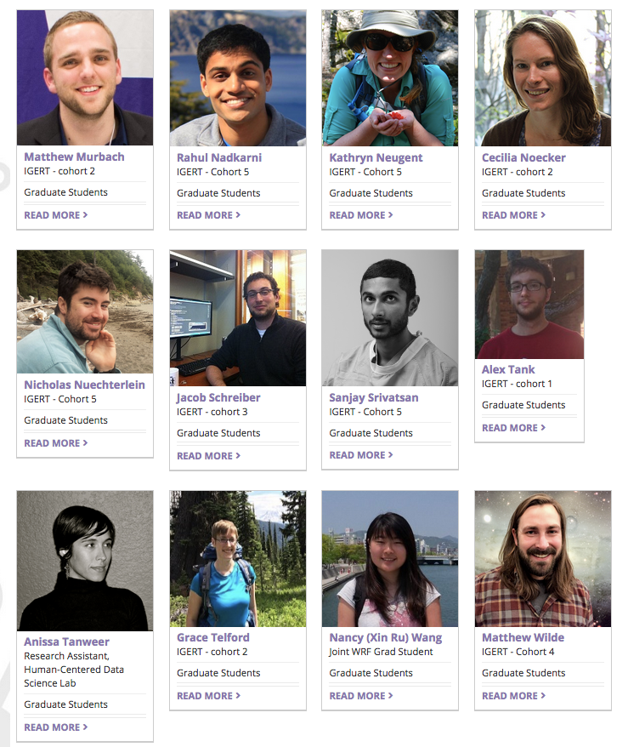
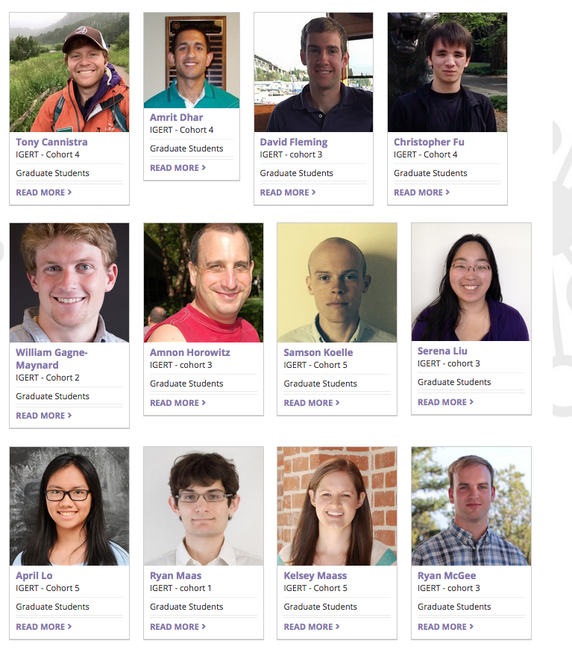
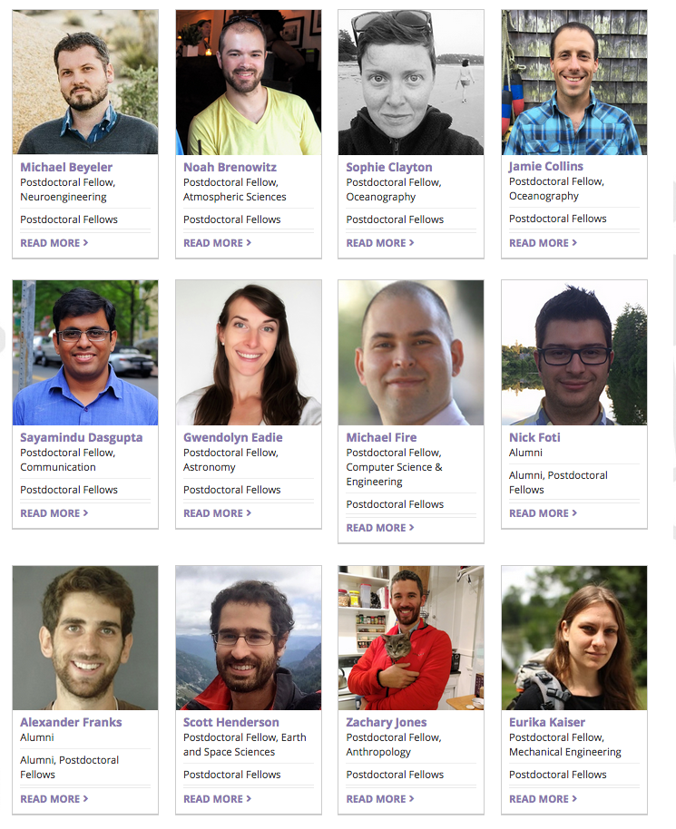
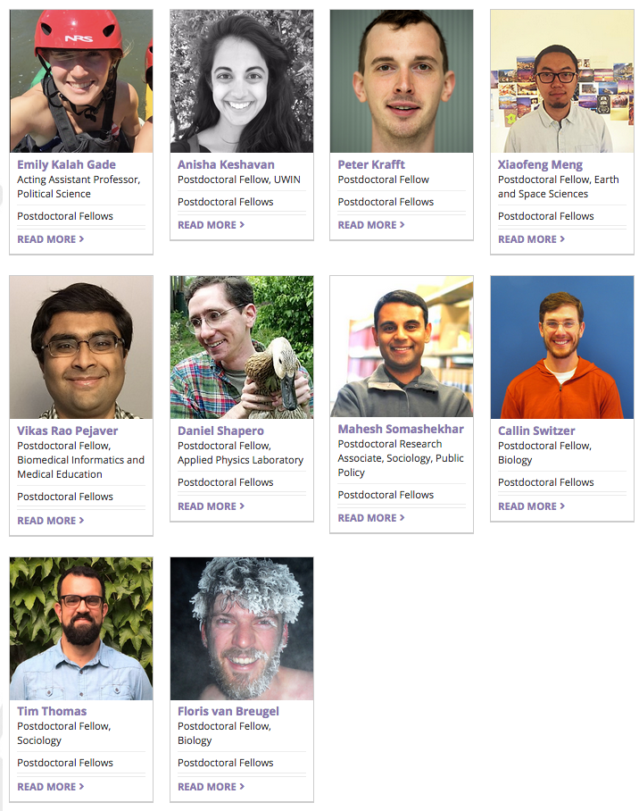
Postdocs and
PhD Students
NSF IGERT
(awarded in 2013)
Moore/Sloan & WRF Innovation in Data Science Postdoctoral Fellows

Slide 7
“Data Science for ALL”
Formal Programs
Short Courses, Workshops, & Seminars
eScience Education Working Group

Slide 8
Educational objectives
Goal 1: Educate ALL UW students in data science
Many need to learn how to use data science tools
Some need to learn how to build data science tools
Goal 2: Create a community of data science students
Inter-disciplinary community of students
Tied to eScience Institute community

Slide 9
“Data Science for ALL”
Formal Programs
Short Courses, Workshops, & Seminars
eScience Education Working Group

Slide 10
Formal Data Science Education Programs
Launched
Track: 2013
Option: 2015
PhD
Advanced Data Science Option
Data Science Option
2017
Undergraduate
2016
Data Science Option
Professional
Data Science Master’s
2016
Professional Certificates
Together with Many Departments/Schools/Colleges

Slide 11
PhD Data Science Options
Option: specialization within existing major
Student first admitted to participating department
Student elects to pursue the option
Single framework under eScience umbrella
Central steering committee
  One representative from each department/school
But otherwise managed by individual departments

Slide 12
Advanced Data Science Option (Transcriptable)
Bootstrapped with an NSF IGERT grant
Designed for tool builders
Grad courses in CSE & Stats + Seminar + Specialized
Stats
Machine Learning
Data Mgmt
Data Viz
eScience Seminar
Dept Specific
4 quarters
Three out of four

Slide 13
Data Science Option (Transcriptable)
Common framework with specialized instantiations
Designed for tool users
  Courses with limited pre-reqs, designed for everyone
  Courses by CSE, iSchool, HCDE, Stats, ChemE, other
Software Dev.
Machine Learning
Data Mgmt
Dept Specific
eScience Seminar
Stats
Data Viz
2 quarters
Three out of four

Slide 14
UW Big Data IGERT Program Details
Core data science curriculum
  Data management, machine learning, statistics, and data visualization
  Weekly seminar for everyone in the UW data science environment
Multidisciplinary Supervision
  Primary advisor from participating department
  Secondary advisor in a complementary field
Data science tools
  Either use or build new tools
Industrial Practical Training
Notes:
$2.8 million over 5 years, nearly all for students
Two year fellowships
Four cohorts of students: 5, 6, 6, and 5
But we ended-up with 2, 4, ?, ?, ?

Slide 15
Networking Activities
Annual retreat
NSF Data Science Workshop
Now annual “UW Data Science Summit”
Student-lead working seminars
Advanced data science seminar: Topics in data science
Quarterly program lunches and bi-weekly lunches with postdocs
Formal program evaluation
Career Fair

Slide 16
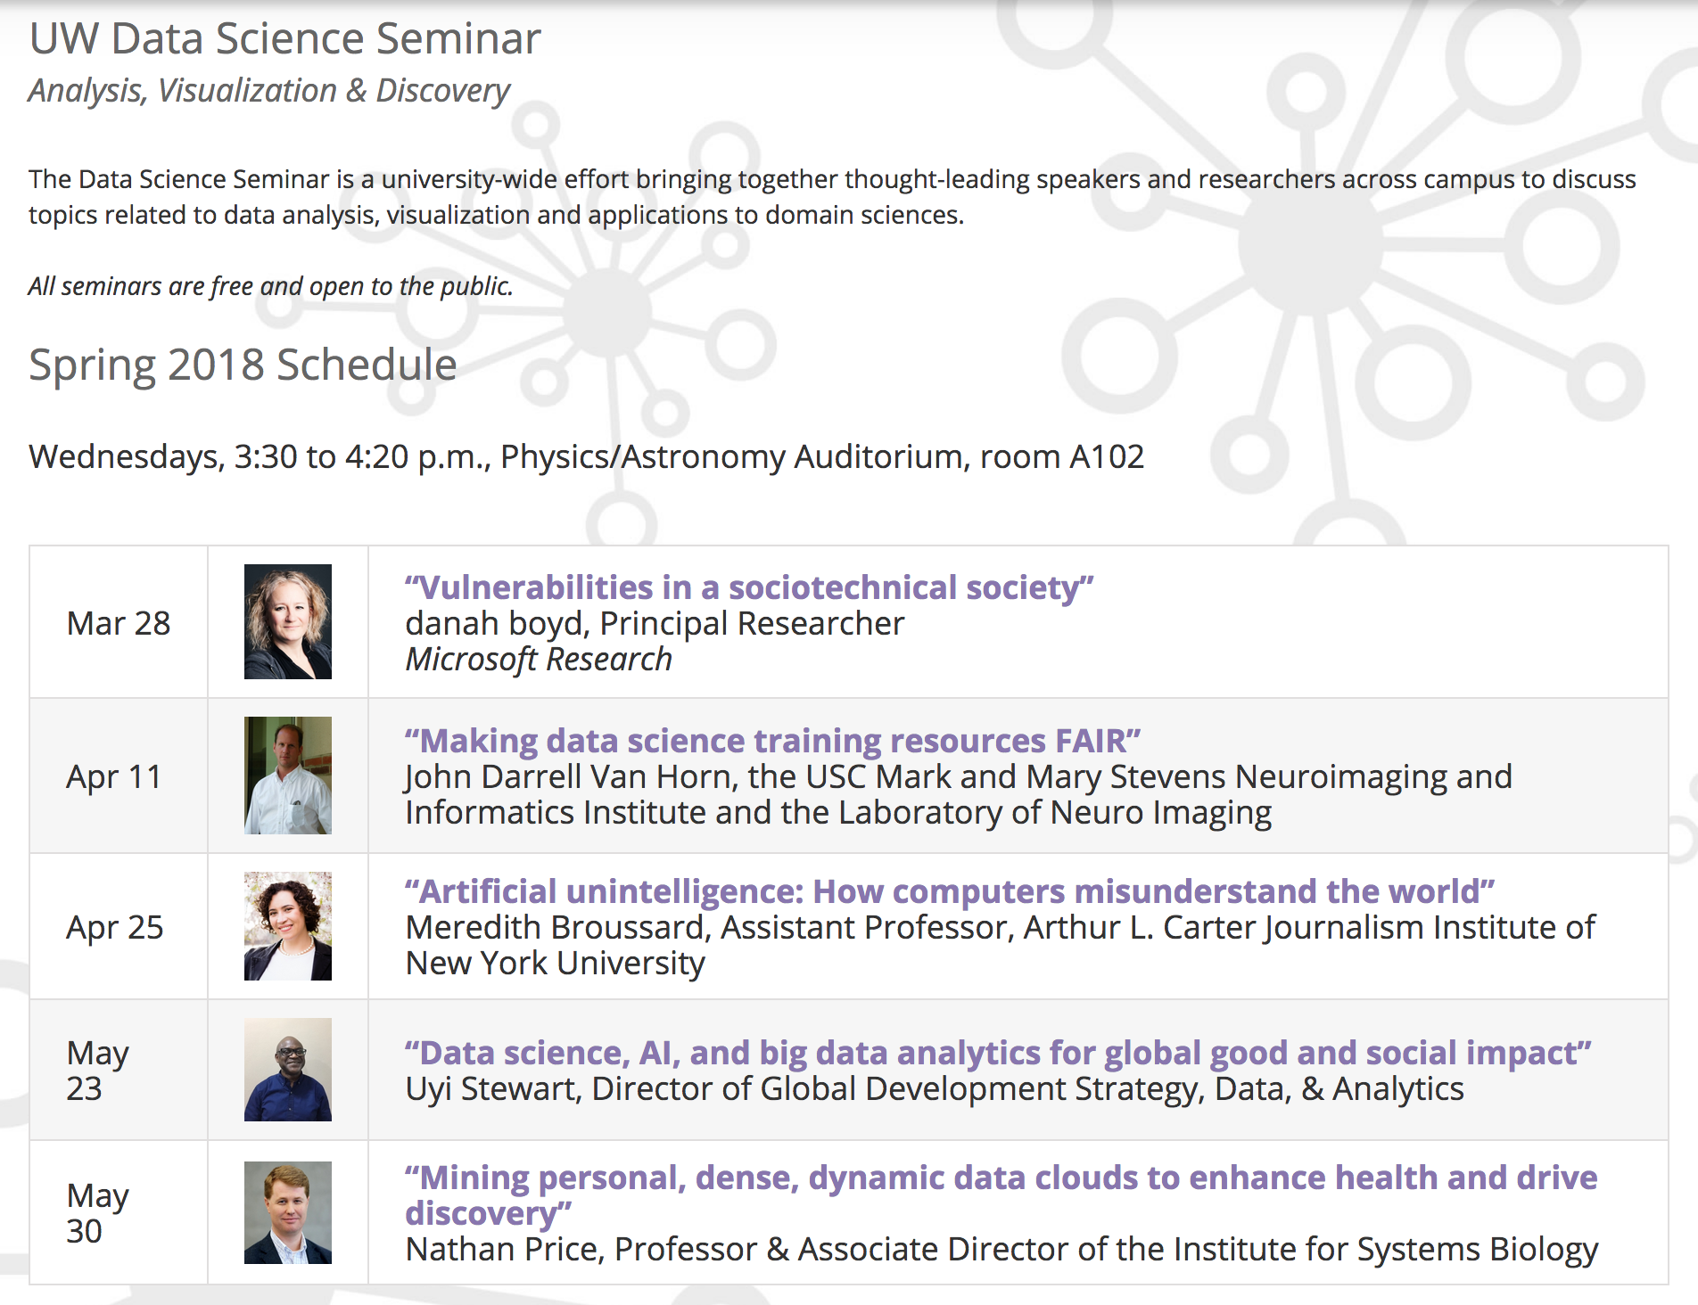
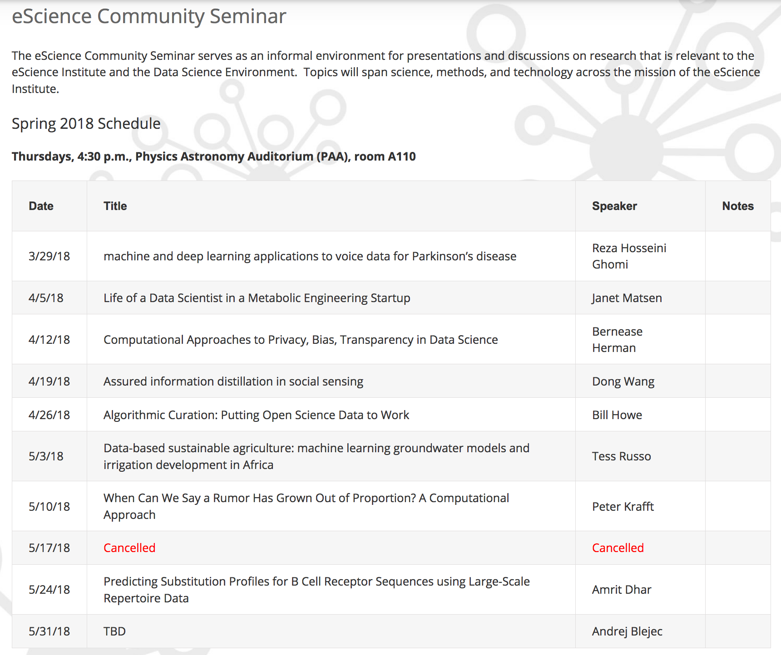
eScience Seminars
Weekly seminar * 3 quarters
Typically, approximately 40-45 attendees
Approximately 1000 attendee-hours
9 speakers in 2017-18 for a total of nearly 500 attendee-hours
Notes:
Rounded 486 to “nearly 500”. So average is 54 attendees / seminar

Slide 17
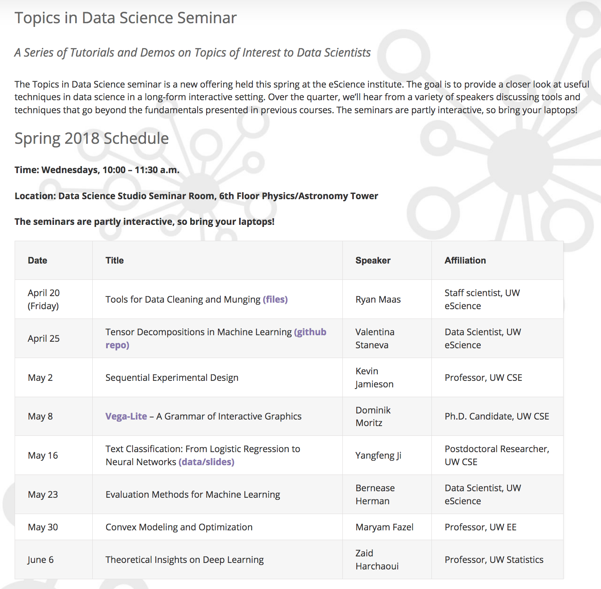
eScience Seminars
~15-25 attendees
each week in first offering

Slide 18
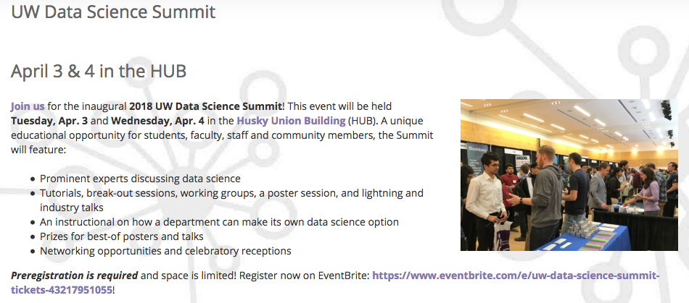
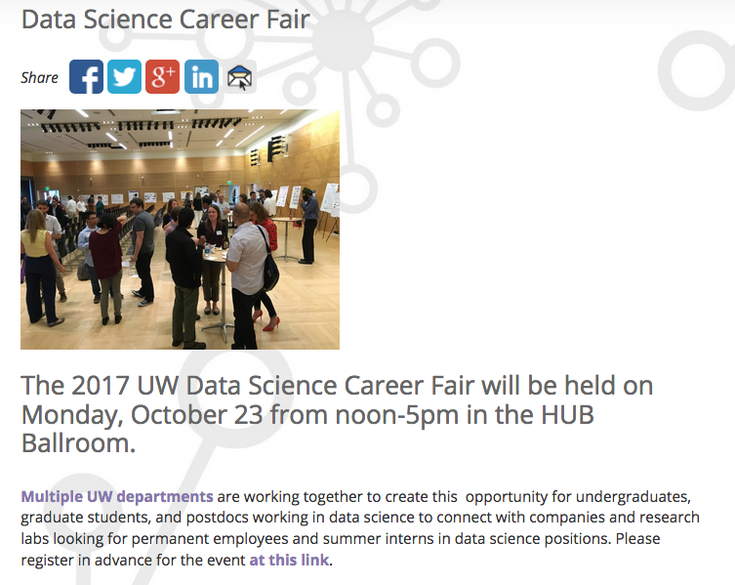
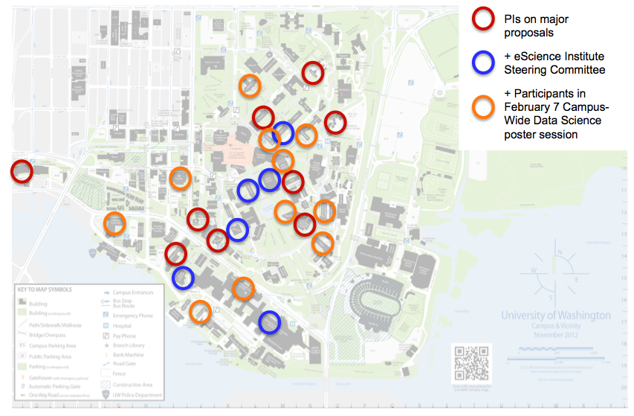
Career Building
255 attendees, although only 216 spots!
Nearly 900 students and 45 companies

Slide 19
Participating Departments
(many others pending approval)
Psychology
HCDE
ACMS
Genome Sciences
Math
Applied Math
iSchool
Statistics
Computer Sci & Eng
Chemical Eng.
Astronomy
Biology

Slide 20
Integration with eScience a Key to Success
Three eScience seminar series
eScience short courses & hack weeks
eScience social events
Interactions with eScience postdocs
Interactions with eScience research and data scientists
Use of Data Science Studio for activities
Natural & neutral hub for the program

Slide 21
Enrollments
PhD Options (10 units & growing)
  Between 2 and 27 students per unit, except for one
  Total of over 60 students
Undergraduate Options (5 units & growing)
  Over 200 students across three units (CSE ~82, iSchool ~74, ACMS ~45)
  HCDE and Stats recently joined and several others are working on joining
Professional Master’s:
  22 graduated this year & 44 new students enrolled
  110 students currently enrolled (or starting in September)
  Received 753 applications this year
Notes:
Master’s program:
This academic year, 22 students graduated from the program. This is approximately half of the first cohort of students, the others are enrolled part-time and most will graduate next year.
An additional 56 students will be continuing in the program next year.
In September, 44 new students will enroll in the program. There will be 110 students in the program during fall and winter quarters, many will graduate in March 2019.
This year we received 753 applications, up from 513 applications the previous year.
98 offers of admission were made, so the yield rate is about 44.9%
Is there any other information you would like?

Slide 22
“Data Science for ALL”
Formal Programs
Short Courses, Workshops, & Seminars
eScience Education Working Group

Slide 23
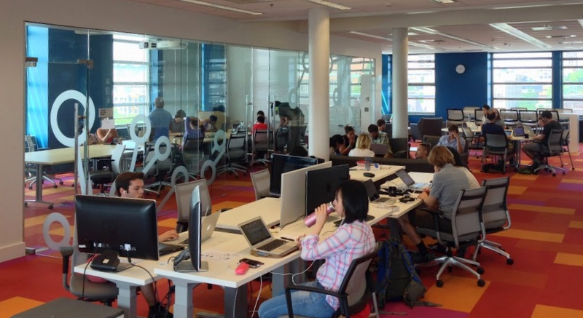
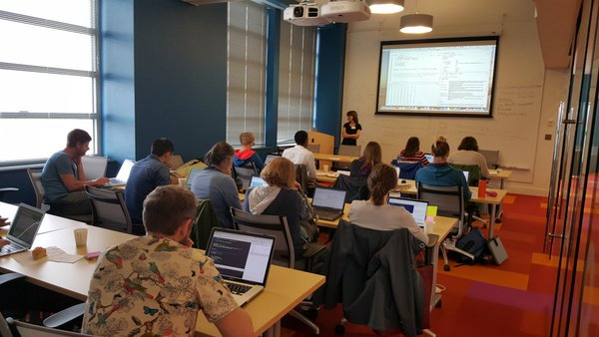
Informal Data Science Education
Open Office Hours
Seminars
Tutorials, workshops, and hack weeks
  Astrohack, neurohack, geohack, oceanhack,...
  Software & data carpentry
  Cloud 101
  …

Slide 24
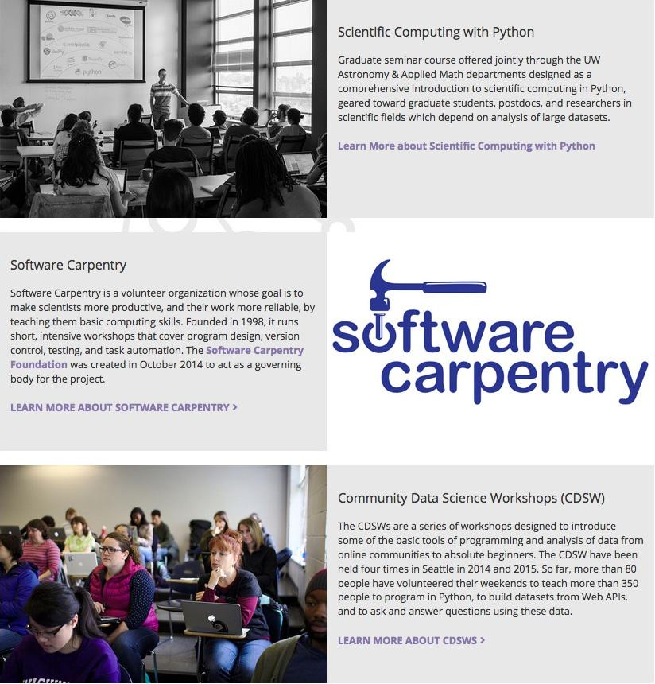
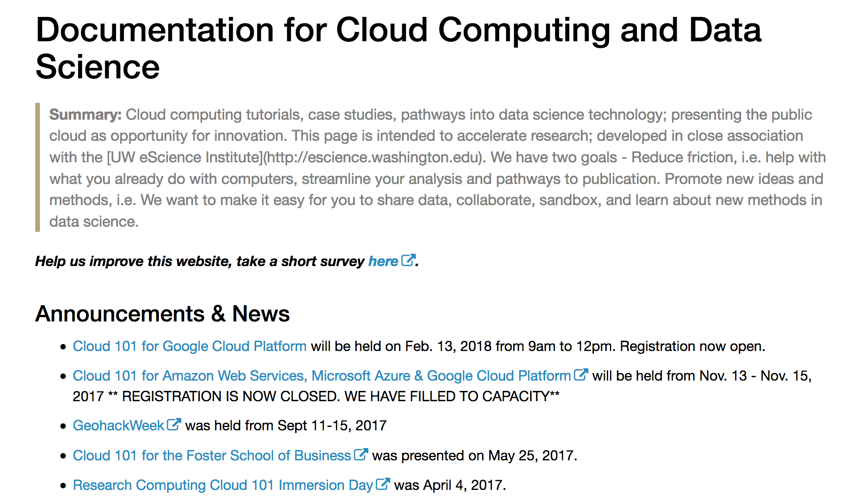
Various short courses and workshops
Courses are typically 10-60 people
Total for this academic year over 12 events and ~400 attendees
Notes:
1) Software Carpentry: 4*60 = 240
2) Software/Data Carpentry Instructor Training @ 40 people with 2 events
2.1) May 21st-22nd @ 17 participants
2.2) West Big Data Innovation Hub, Software/Data Carpentry Instructor Training (23 participants from six different areas around the Western USA) in March.
3) Data carpentry 1 event @ 25 people → Already counted in software carpentry
4) Cloud workshops: 4 events with > 50 people
Feb 13, 2018: Google Cloud Platform, Cloud 101 - approx. 20 people
Nov. 15, 2017: GCP Cloud 101 - 10 people
Nov. 14, 2017: Azure Cloud 101 - 6 people
Nov 13, 2017: AWS Cloud 101 - 15 people
5) Advanced Git workshop which had about 20 people
6) Intro to Git&Github (tutorial), Cabled Array Hackweek, Seattle, 2018 (~25)
7) Intermediate Git&Github (tutorial with Bernease), Winter, 2018 (~18)
Total:
13 workshops @ ~390 people.

Slide 25
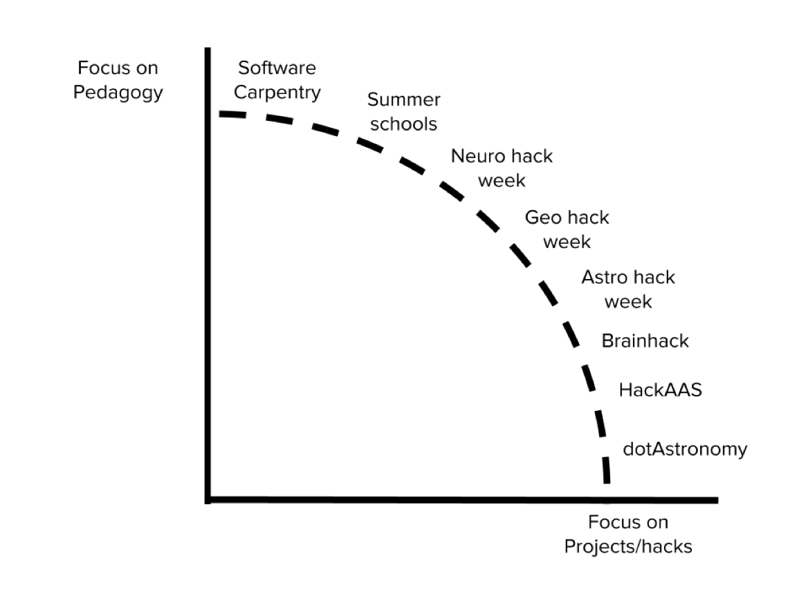
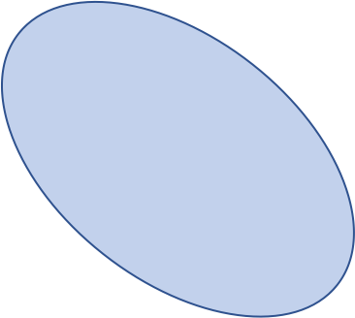
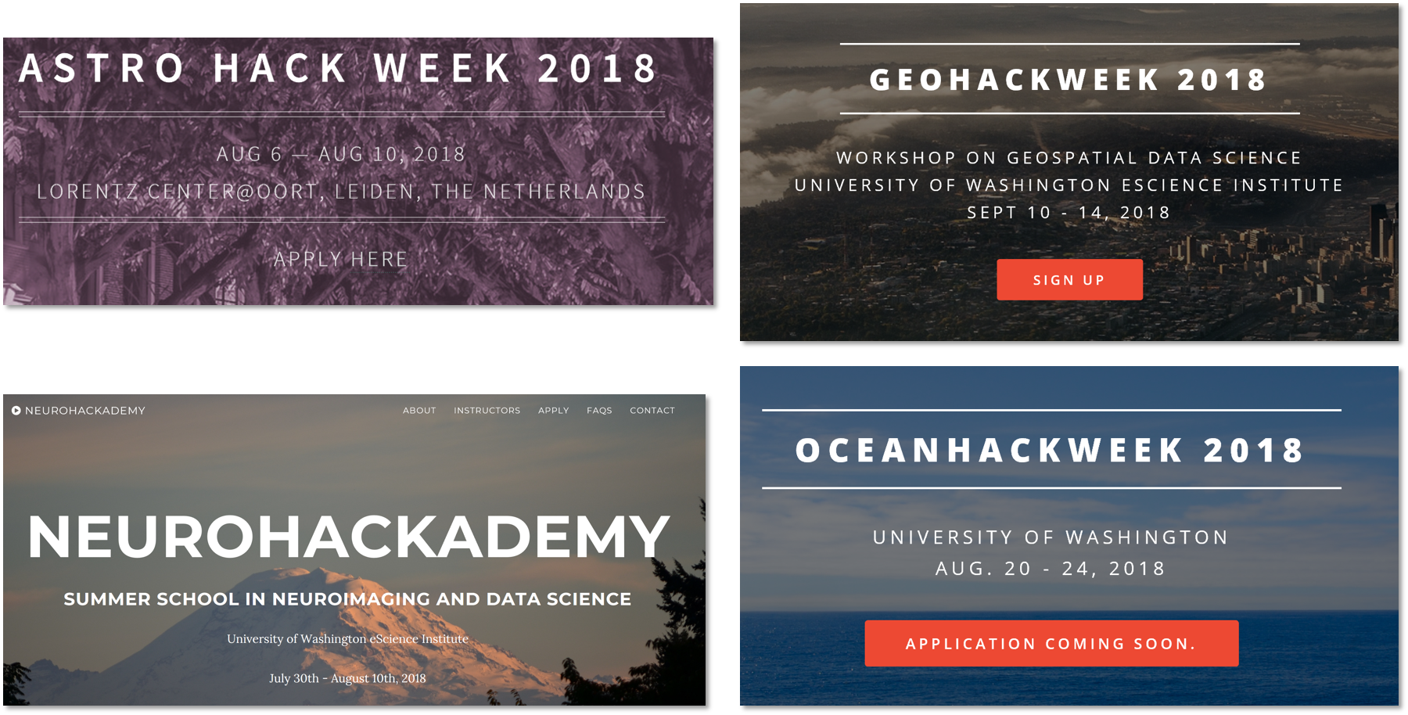
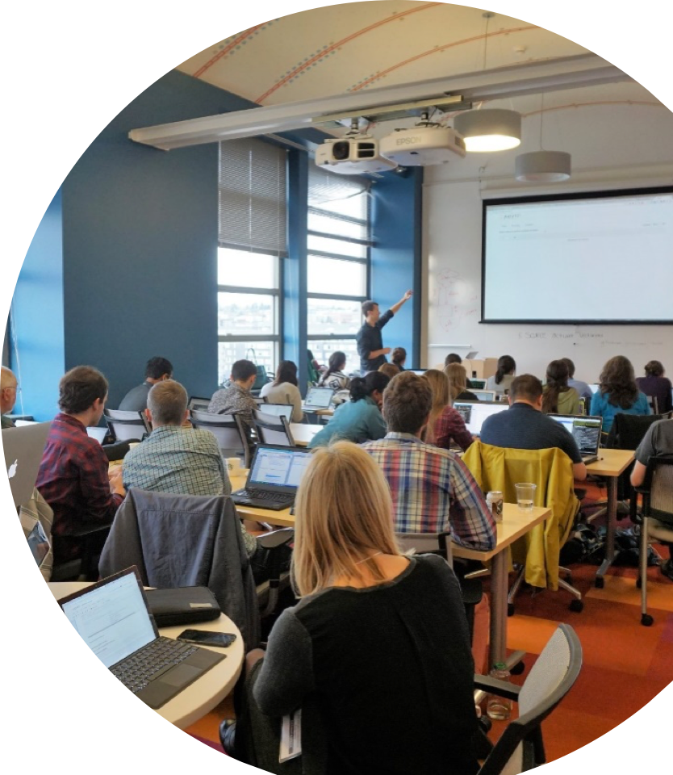
Hack Weeks
Notes:
Started with astro-hack, then neuro-hack, and most recently geo-hack week. Some will become two weeks.

Slide 26
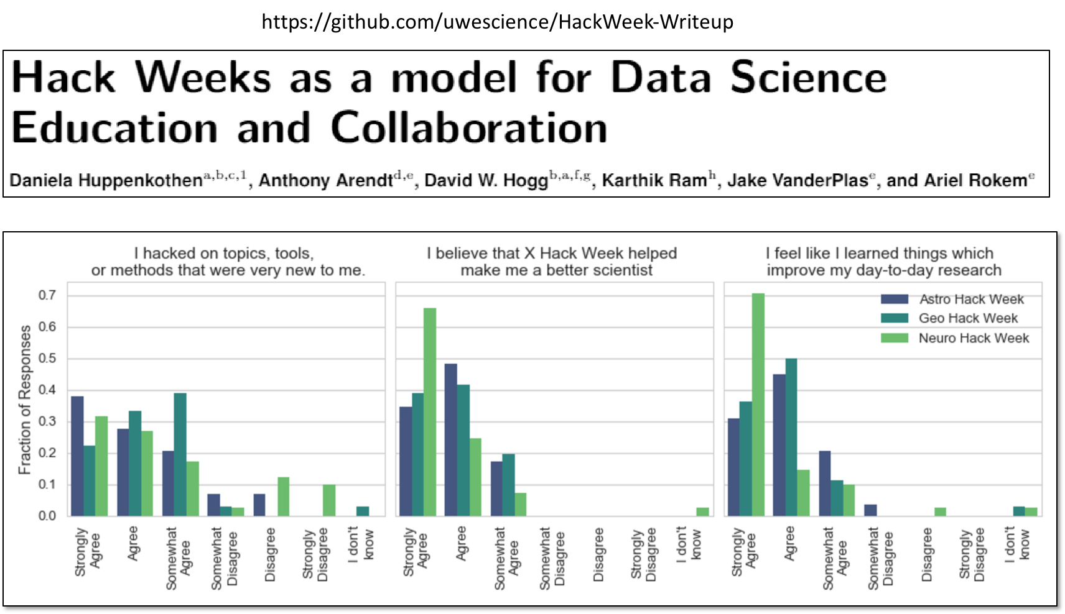
Hack Weeks
Participants
AstroHack: ~45
NeuroHack: ~50
GeoHack: ~50
OceanHack:
  Cabled-array hack: 25
Notes:
Started with astro-hack, then neuro-hack, and most recently geo-hack week. Some will become two weeks.

Slide 27
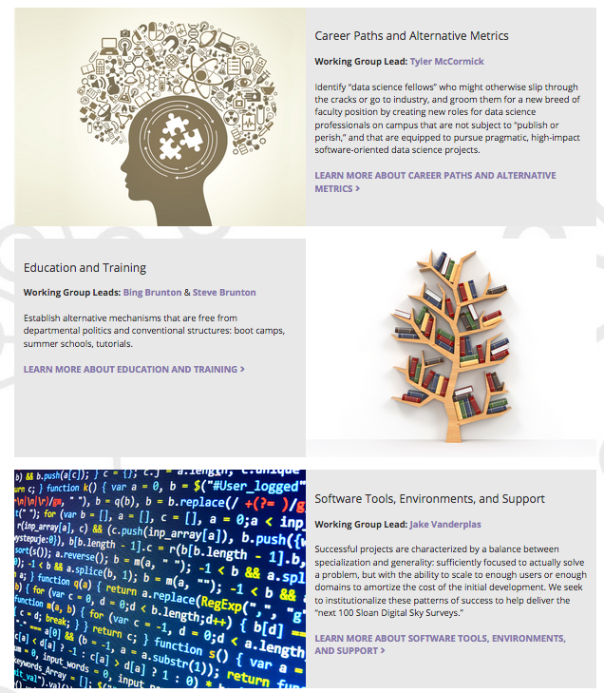
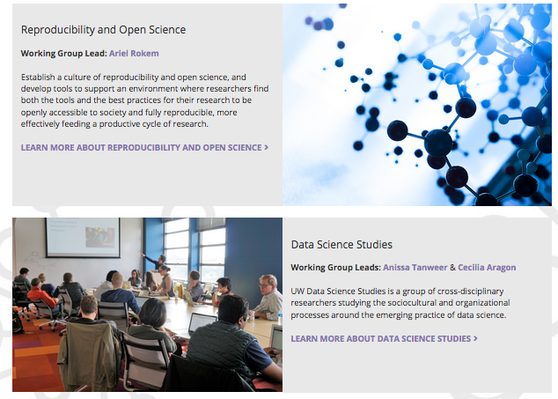

Working Groups

Slide 28
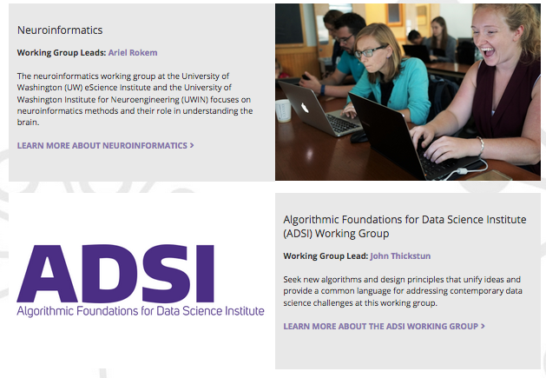
New Research-Themed Working Groups
NSF Tripods

Slide 29
Conclusion
Data science specializations
  To ensure “data science for all” goal
  Enables individual departments/schools to advertise
Formal education with extra activities
Focus on community, networking, and career
Data science institute, eScience, core of program
  eScience is natural home, core, and leader of program

