Slide 1
Data Science University of California Davis
Graduate Programs
Duncan Temple Lang Director, Data Science Initiative Professor, Statistics

Slide 2
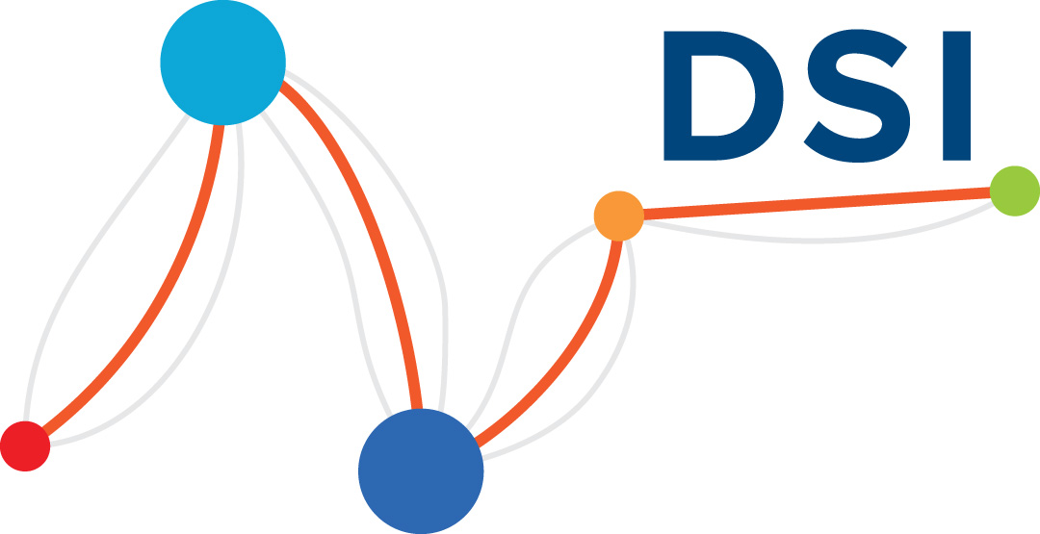
Data Science - Distinct Discipline
Data Science is a new, distinct academic discipline
Focus on process of data-enabled research
Breadth of entire data pipeline
Integrates Math, CS, Stat
Engage & Impact all disciplines
from Engineering to Religious Studies
“outward” & “inward” looking

Slide 3
Data Science Initiative
Provost-funded initiative to explore best structure for Data Science
Engage, enable and evangelize
Training, Consulting, Collaborative research, Community
Dedicated space in the Library to connect people with diverse backgrounds.

Slide 4
New Academic Unit
Create new Academic Unit for Data Science
Process in progress - complete 2018-19
4 new faculty positions
One in Data Studies, joint with Science and Technology Studies.
Opportunity for new perspective and culture in research and education.

Slide 5
Who’s Involved?
Multidisciplinary coalition of faculty from
Economics, Computer Science, English, Statistics
Anthropology, Engineering, Environmental Sciences, Biological Sciences, Medicine,
Business School, Veterinary Medicine, Physics,
Earth Sciences, Education, Political Science, …

Slide 6
Data Science for PhD Students
3 categories of PhD students
PhD in Data Science
PhD in pillar fields - CS, Stat, Math
PhD in domain disciplines
Increasing in size, by order of magnitude.
Immediate focus on 2 & 3

Slide 7
Developing Degree Options
2 UC-mechanisms for Graduate add-on degrees for PhD students
Designated Emphasis (DE)
Graduate Academic Certificate (GAC)
Available to students enrolled in other programs
Give student formal credentials in Data Science
Often already taking many courses for research in ad hoc path.
Notes:
We will develop a masters program as soon as the Academic Unit.

Slide 8
DE & GAC
Both involve 4 or 5 courses
Survey of Statistical Machine Learning
Data Technologies & Computational Reasoning
Elective course
Capstone/project - doing data science
DE involves additional components for thesis and exams.

Slide 9
Students & Careers
Attractive to students in both
Core disciplines to broaden their own degree (real data science problem experience)
Domain sciences
Provides credentials for non-academic career
Develop new type of professors to bring data science to disciplines.

Slide 10
Inclusive Graduate Groups
UC Davis is highly interdisciplinary
Has institutional structure to enable it
Faculty can advise in many different PhD programs
separate from their home department
Bidirectional
Can advise student in X doing data science & vice versa.

Slide 11
Why a Data Science PhD, if all PhDs use data to do Science?

Slide 12
Need for PhD in Data Science?
Existing PhD programs are already quite flexible
Data Science research in Stat, Math, CS programs
Are the degree requirements different for Data Science students? Or general foundational topics?
Need first-class home for critical mass of like-minded Data Science students that emphasizes multi-disciplinarity
Emphasize data science process and entire pipeline

Slide 13
Different Research Topics
How common are non-traditional topics relative to within-discipline topics?
Where is systematic research in
workflows,
framing data science problems,
computational environments for data analysis
Data visualization
Data sources and fusion
Reproducibility
Ethics

Slide 14
How will such scholars fit into traditional disciplines?

Slide 15
Future
Create new Academic Unit
Continue separate complementary Data Science Initiative
Develop
Major
DE & GAC
Minors with different focii
Masters
PhD

