Slide 1


NYU PhD Program in Data Science
Vasant Dhar
Professor
NYU Center for Data Science & Stern School of Business
@vasantdhar

Slide 2
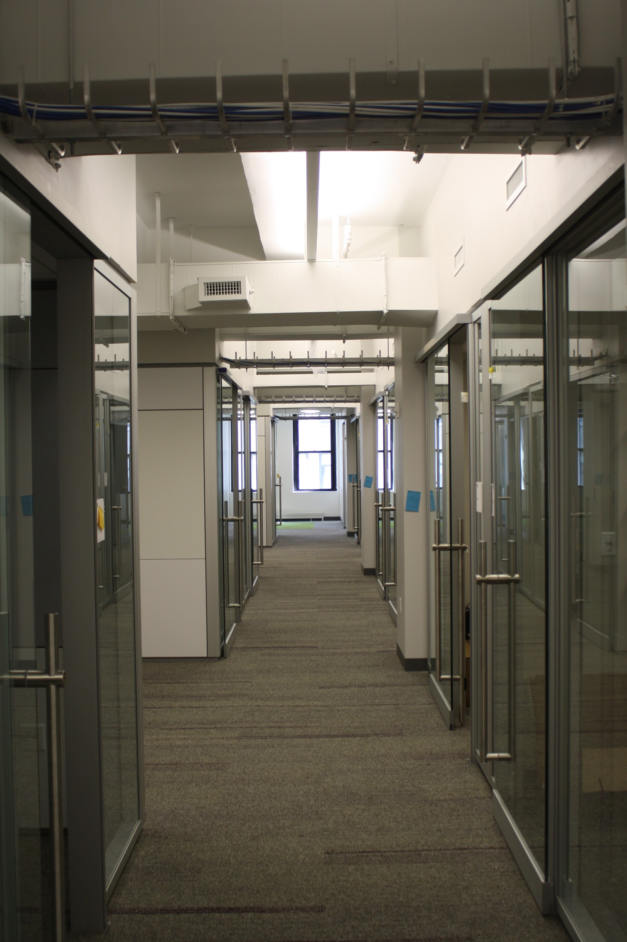

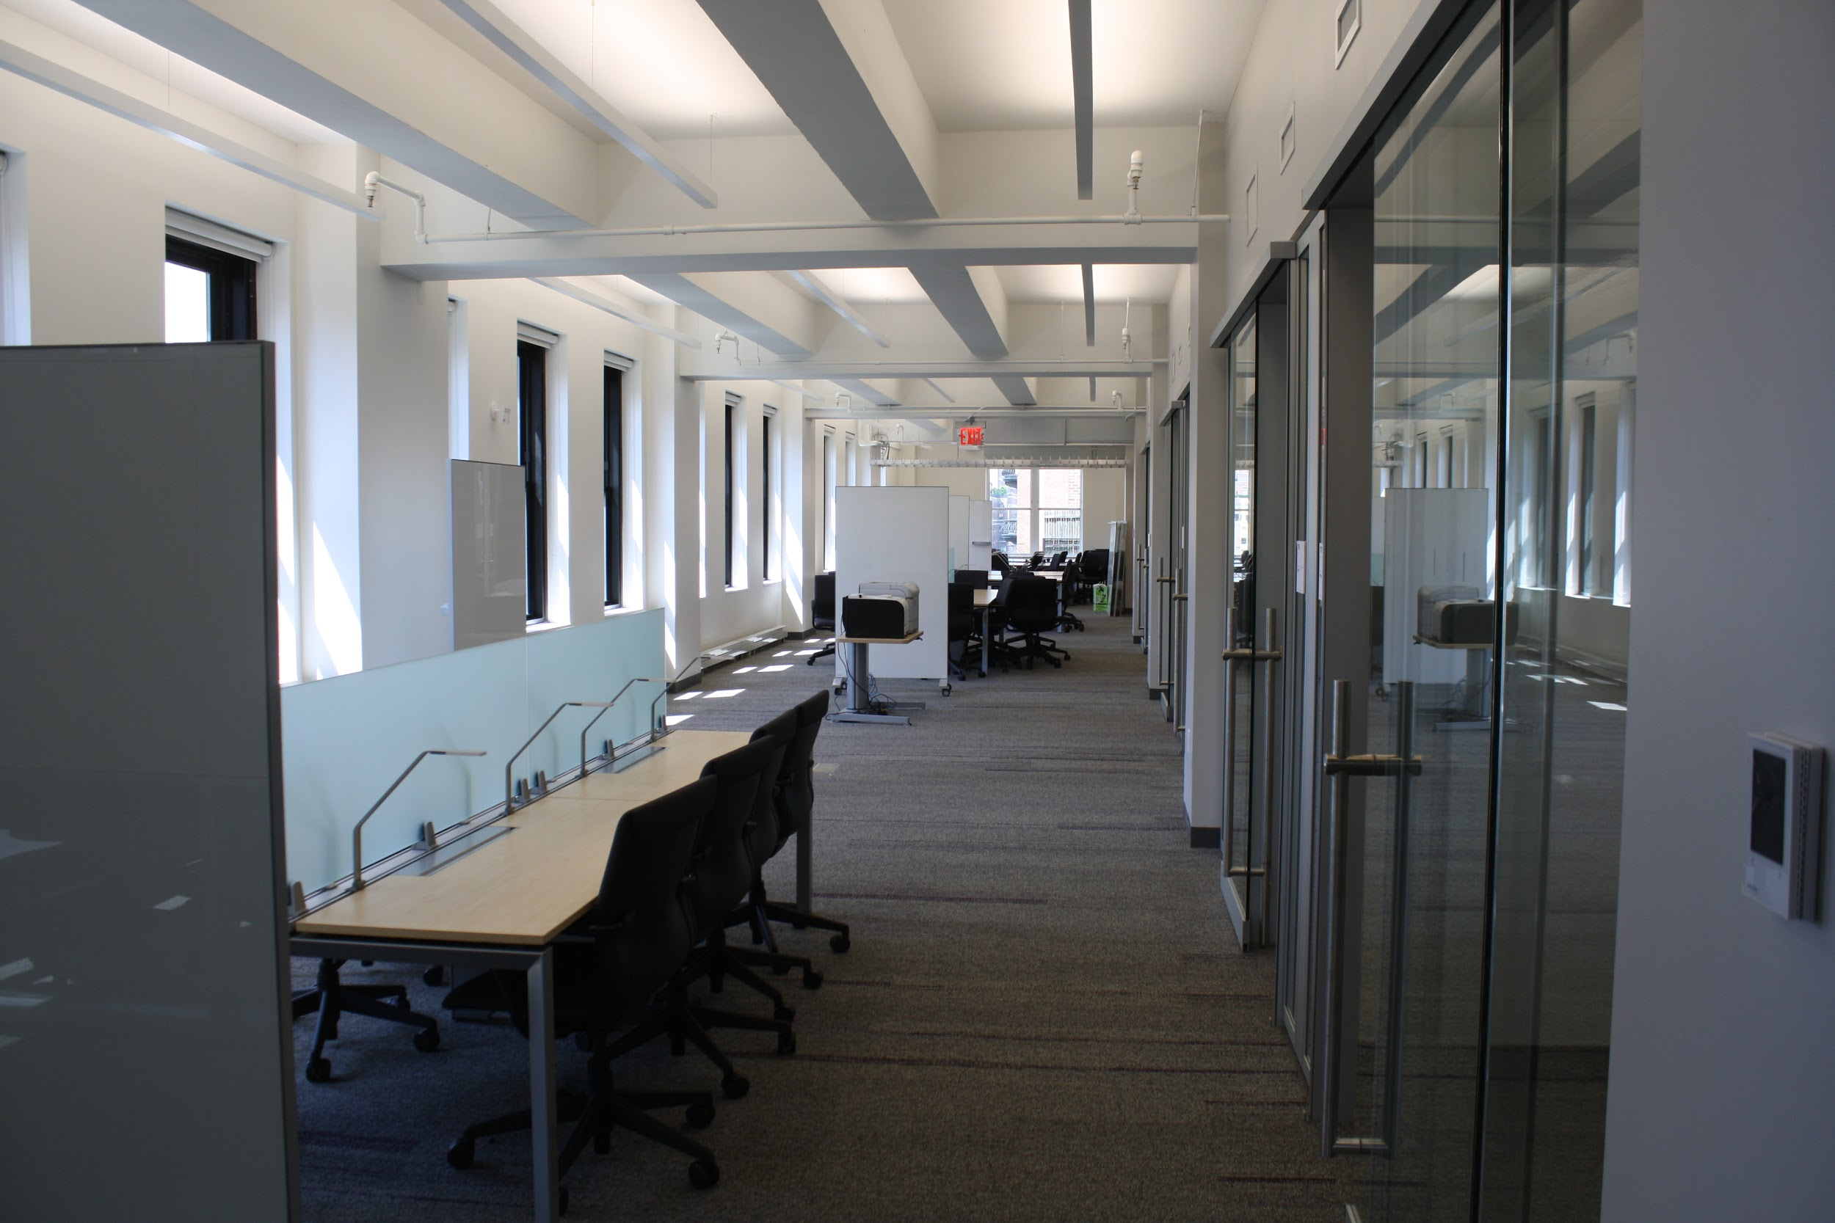
Why A Separate “Unit?”
Center for Data Science Space
*
Forbes Building
60 5th Avenue

Slide 3
Why A Separate “Unit?”
Data Science is perceived as its own area of study that cuts across disciplines
The act of creating a separate school is a clear signal from NYU about its commitment to Data Science
The goal is to “integrate” the data science element from across disciplines and create more than the sum of the parts
Dedicated space fosters integration
Faculty lines are currently split with other schools

Slide 4
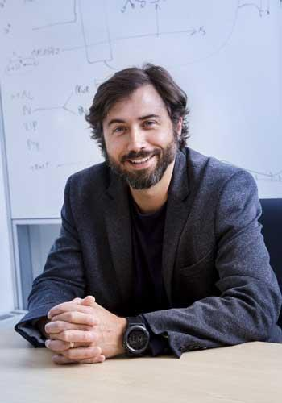
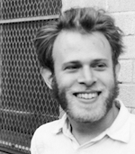
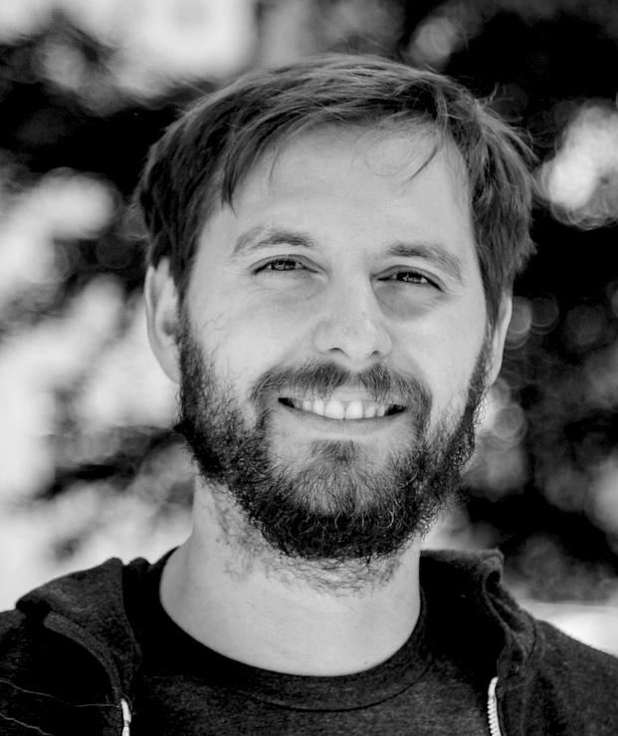
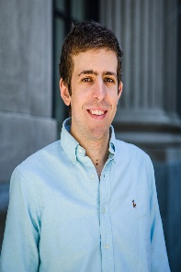
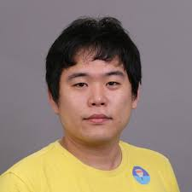
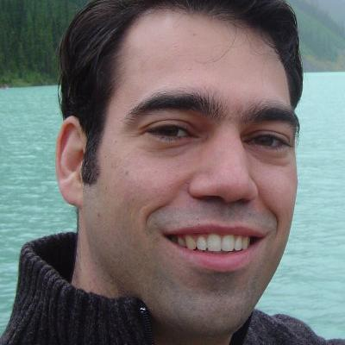
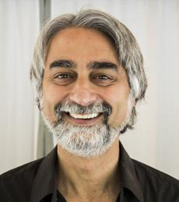
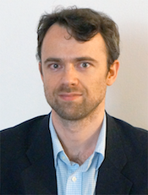
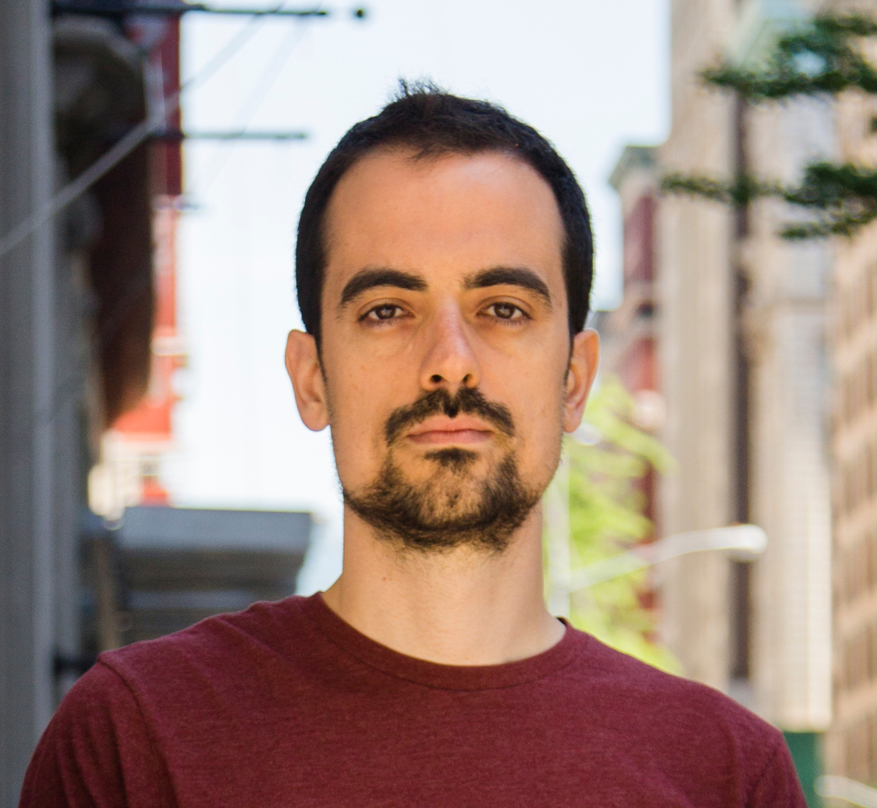
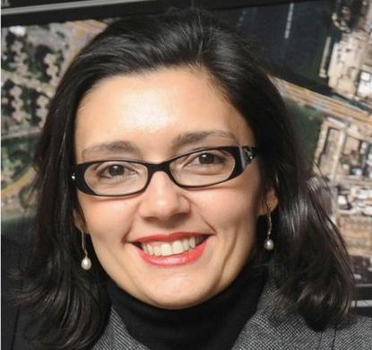
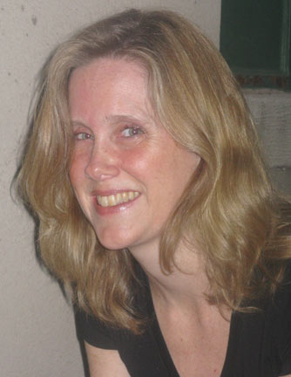
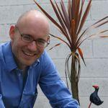
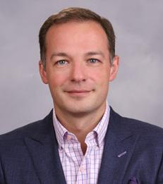
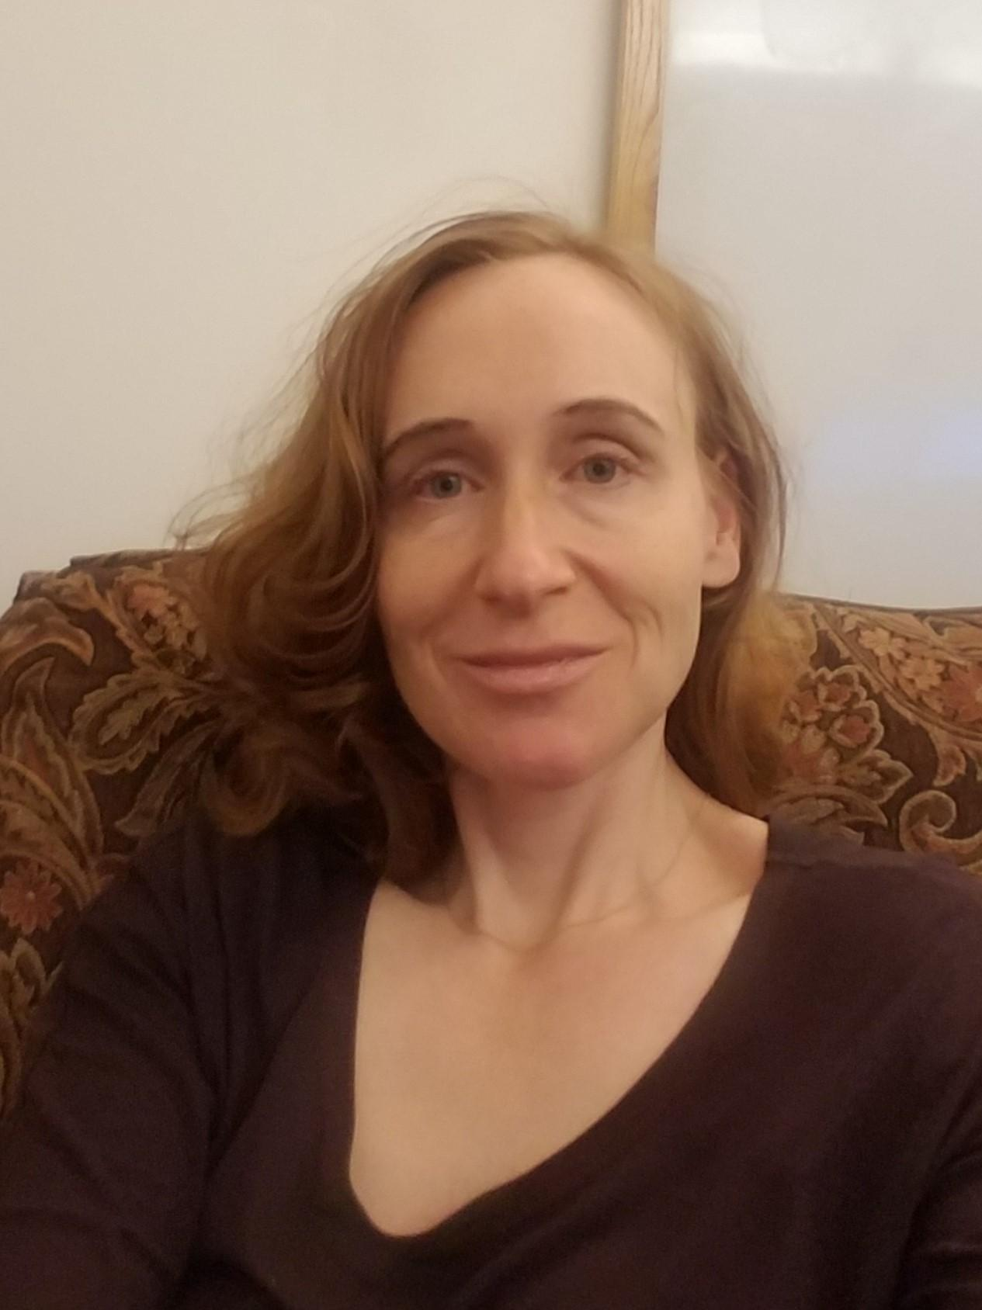
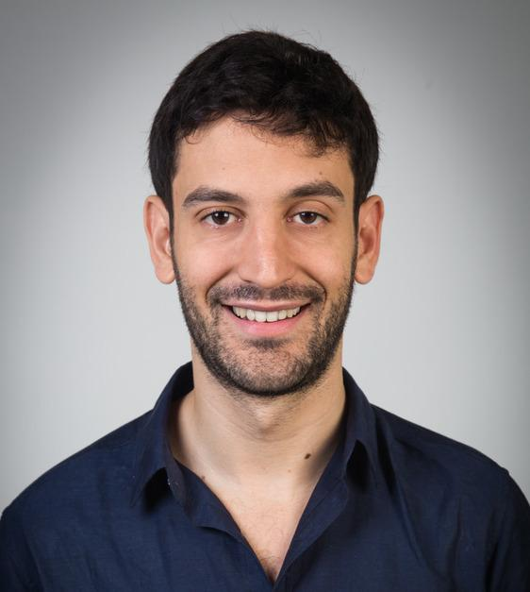
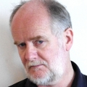
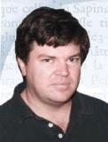
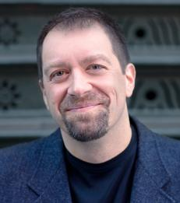
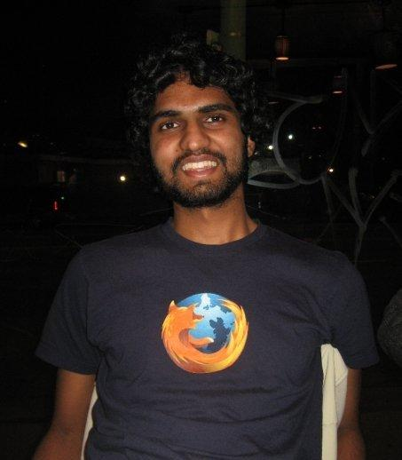
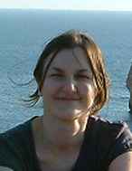
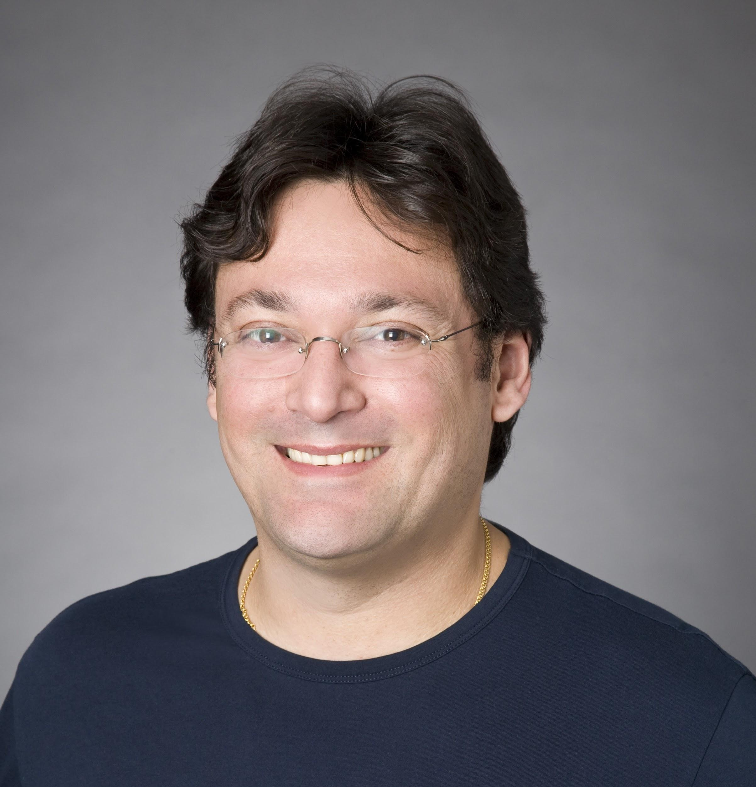
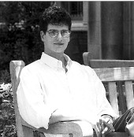

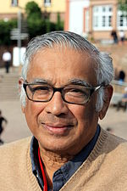
Afonso Bandeira - Mathematics and Data Science
Richard Bonneau - Biology and Computer Science
Sam Bowman - Linguistics and Data Science
Joan Bruna -
Computer Science and Data Science
Kyunghyun Cho -
Computer Science and Data Science
Kyle Cranmer -
Physics
Vasant Dhar -
Data Science and Information Systems
Rob Fergus - Computer Science
Carlos Fernandez-Granda - Mathematics and Data Science
Juliana Freire - Computer Science and Engineering & Data Science
Jennifer Hill - Applied Statistics and Data Science
David Hogg - Physics
Panos Ipeirotis - Information, Operations, and Management Sciences & Data Science
Julia Kempe - Incoming Director
Brenden Lake - Psychology and Data Science
Mik Laver - Politics and Data Science
Yann LeCun - Founding Director; Computer Science
Foster Provost -
Information Systems and Data Science
Rajesh Ranganath -
Computer Science
Cristina Savin -
Neural Science and Data Science
Claudio Silva -
Computer Science and Engineering & Data Science
*
Eero Simoncelli - Neural Science, Math, Data Science & Psychology
Arthur Spirling - Politics and Data Science
S.R. Srinavasa Varadhan - Mathematics and Data Science

Slide 5
Structure and Key Facts
The Center for Data Science is set up a Provostial Institute where the Director reports to the Provost
NYU CDS admitted its MSDS cohort in 2013
Admitted PhD first cohort in 2017, second cohort admissions completed in Feb 2018
Mix of engineering and social science flavors where students have some flexibility and time to develop a thesis topic and advisor
Funding: mix of university and grant funding

Slide 6
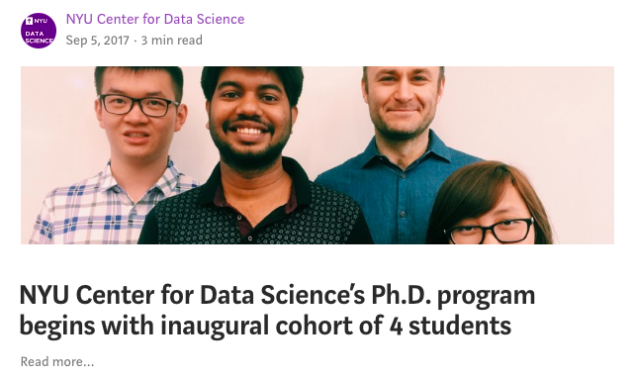
Curriculum Structure
2018 cohort: 15 students
  Courses: Set of “core” courses and electives in CDS and across the university
  Research “rotations:” students work on research projects with faculty from day 1 (counts towards credit and has formal requirements)
  Depth Qualifying exam, end of year 1
  Comprehensive exam, end of year 2
  Dissertation

Slide 7
Courses
PhD in Data Science Required Courses and Electives
15 Credits of CORE Courses -
  DS-GA 1001 Introduction to Data Science
  DS-GA 1002 Probability and Statistics for Data Science
  DS-GA 1003 Machine Learning
  DS-GA 1004 Big Data
  DS-GA 1005 Inference and Representation
57 Credits of ELECTIVES - Current CDS offerings (below) + approved courses from other NYU departments
  DS-GA 2001 Research Rotation
  DS-GA 1008 Deep Learning
  DS-GA 1011 NLP with Representation Learning
  DS-GA 1012 Natural Language Understanding and Computational Semantics
  DS-GA 1013 Optimization-based Data Analysis
  DS-GA 1014 Optimization and Computational Linear Algebra
  DS-GA 1015 Text as Data
  DS-GA 3001 Special Topics in Data Science
    Modeling Time Series
    Mathematics of Data Science: Graphs and Networks
    Causal Inference for Data Scientists
    Computational Cognitive Modeling

Slide 8
PhD Program Admissions
Admissions is an intensive effort requiring teamwork and coordination
  Two open houses during the academic year
  Intensive application review period in January-February (~400 applicants in last cohort)
  Each application is reviewed by two CDS faculty!
  One month turnaround
Campus visits/skype interviews for “acceptable” students that are part of the evaluation

Slide 9
Applicant/Admitted Pool Profile 2018

Slide 10
Admitable Pool Profile

Slide 11
Some “Startup” Experience
Research readiness varies considerably: some very smart students have no grounding in what it means to conduct inquiry
  What’s a good question
  A grounding in History/Philosophy of Science would help
Enforcement/Expectations
  Mechanisms/Processes are still developing

Slide 12
Change Management & Open Issues
We are keeping track of formal changes to the program we want to consider going forward
  i.e. Formal requirements for Ethics (which is currently a “soft” requirement)
Changes will be incorporated into the next version filed with the State in 2018-2019

Slide 13
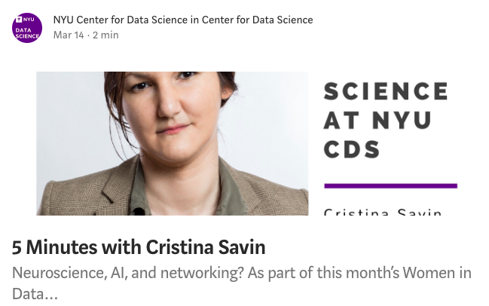
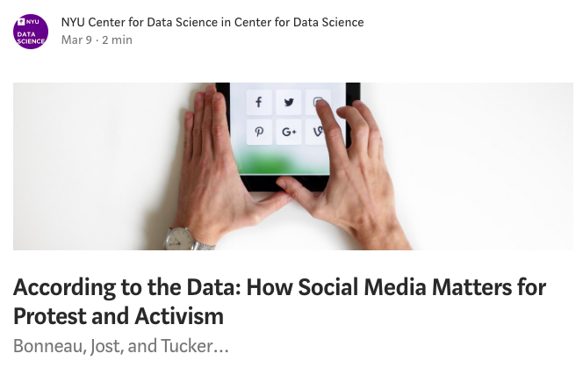
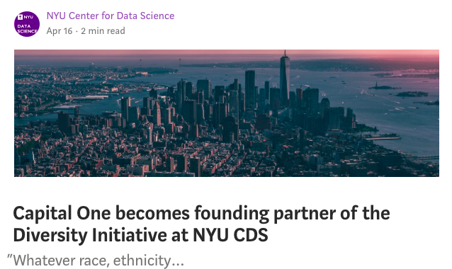
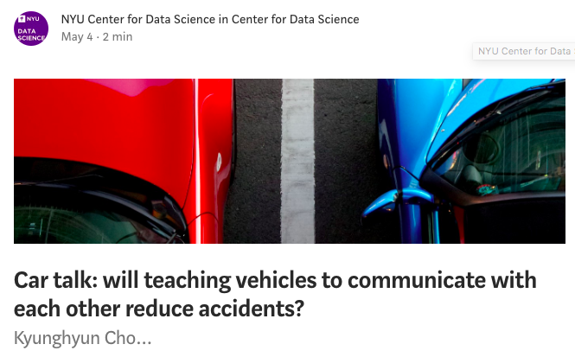
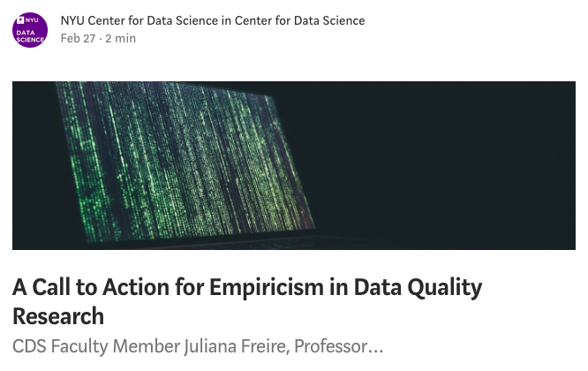
https://cds.nyu.edu/research/
Questions?

