Slide 1

NAS Presentation Fuel Economy Technology – 2025-2035
Ann Wilson
Motor & Equipment Manufacturers Association
National Academies of Sciences
July 16, 2018

Slide 2
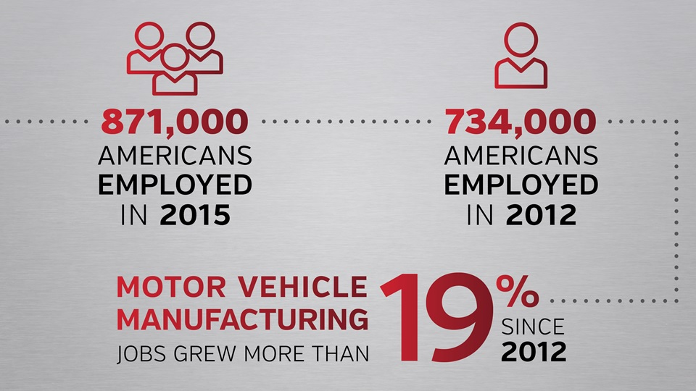
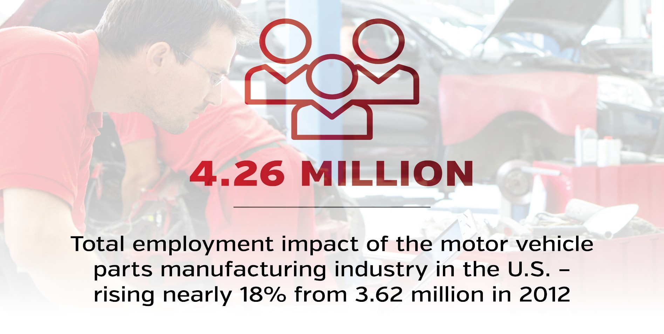

MOTOR VEHICLE PARTS SUPPLIERS ARE THE LARGEST SECTOR OF MANUFACTURING JOBS IN THE U.S.
All data from “The Employment and Economic Impact of the Vehicle Supplier Industry in the U.S.” based on research undertaken by IHS Markit on behalf of MEMA
Notes:
Largest manufacturing sector in U.S., 871,000 workers employed.
Suppliers have seen an employment growth rate that is three times that of any other major manufacturing sector in the U.S – an overall 19 percent increase in employment since 2012. The growth rate of employment for original equipment automotive suppliers since 2012 was even higher at 23 percent. Industry’s jump in employment can partly be attributed to these long-term investment decisions, which have led to advanced technology development because of the GHG and CAFE program standards set in 2012.
Supplier provide 77 percent of the value of a vehicle.

Slide 3
Future Fuel Efficiency Technology Uncertain
Uncertainty exists on the direction of technology investments for MY2025 and later:
Regulatory uncertainty with fluctuating fuel economy targets
Consumer fuel efficiency demand, often driven by fuel prices, can be unpredictable and volatile
Major R&D and capital investments are required; These could be stranded if OEM/consumer demand is lower than expected
Increased risk as advanced technologies are introduced rapidly
Source: LMC Automotive
Notes:
New, more advanced technologies will continue to become available. Technologies are often introduced at low levels then start moving up the curve applying across the fleet, now that those have been done, technologies need to be introduced quickly and may not be able to start out slowly.

Slide 4






Supplier Investment in Technology: Why Suppliers Take On Much of the Risks
Product R&D Investments ≈ 3-6 Years
Validation & Facility Investments ≈ 2-4 Years
Total Supplier Investments
≈ 5-10 Years
Product Concept Research
Engineering Development for Part or System
Design of Mfg Process
Customer Testing & Validation Prior to Production
Production Facility Updates & Retooling
Product Mfg & Deployed
Customer Purchase
Notes:
Suppliers have completed and have ongoing extensive investments in research and development to bring needed emissions-reducing technologies to fruition that enable OEMS to meet the standards. Suppliers take on the initial investments and the associated risks to develop technologies for their OEM customers. The roll-out of these technologies require major economic resources and significant lead-time. Suppliers’ product planning and investment costs include: product concept research; engineering development for the part or system; design of the manufacturing process; customer validation of part or system prior to production; production facility updates; and, finally, product production. Each of these stages can range anywhere from 1 year to 2 years, depending on many variables. These costs must be amortized over several years, so delaying a product deployment or shortening a product’s anticipated lifespan will jeopardize these carefully planned technology investments put in place several years in advance and would result in significant ramifications to the industry. Suppliers don’t get paid until the OEMs deploy the technology.

Slide 5
Low-Hanging Fruit Being Picked Quickly
Source: LMC Automotive
Notes:
Snap shot of how technology has been used and will be used going out to 2024. These are the 4 main technologies that have been in an increasing percentage of vehicles. So OEMs and suppliers will need to come up with more fuel efficiency technologies in the period from 2025 – 2035.
Engine boosting – downsizing the engine and turbocharging
12V Stop-Start – mild hybrid (off-cycle credit)
Direct Injection – instead of spraying fuel in the air before it goes into the engine, injects directly into the cylinder

Slide 6
Interim ICE Technologies (2018 – 2025)
Downsized engines with turbocharging or supercharging
Continuously variable valve duration
Cylinder de-activation – Ex: 3 cylinder to 2 cylinder
Twin charging – turbocharger with an electric supercharger
Hybrid electric versions of the above
Source: Mazda

Slide 7
Interim Electrification Technologies (2018 – 2025)
Dramatically increased use of start/stop systems
Significant, sustained increase in HEV sales – mostly mild hybrids
Gradual, but steady increase in BEV sales
Primarily for compliance - still not competitive with ICEs
Increasing BEV range
Source: LMC Automotive

Slide 8
HEV Sales are Projected to Increase Dramatically, While BEVs Slowly Increase
Source: LMC Automotive
Notes:
Hybrid electric vehicles has grown the most from 2015 – 2024. Hybrids can be done most affordably. BEVs have had slow steady growth but still low overall because of lack of consumer demand. (However, if CAFE standards are significantly weakened hybrids will suffer the most in production. Because it will not be necessary. BEV will still be partly driven by the ZEV mand
ate In CA and Sec 177 states. And the multiplier credit.)
This is in the U.S.

Slide 9
Global Vehicle Production by Propulsion System
Source: IHS-Markit
Notes:
Left scale is for the columns, right scale is for the lines.
Blue columns/bars, you can see that exclusive ICE will be declining out to 2030.
Orange bars you can see that ICE with Start-Stop will have a massive increase in near term then decline as hybrids take over.
Dark green bars you can see the mild hybrid increase dramatically.
Green bars also a big increase of full hybrids.
The blue line shows that the BEV/FCV share is near 0% production now and will increase to about 8% in 2030.
The green line shows the dramatic increase in the hybrid share out to 2030. the red line shows the combination of the two – general electrification share at 50% and 50% ICE
(Keep in mind this is global)

Slide 10
New Combustion Technologies Post-2025
Homogeneous Charge Compression Ignition (HCCI)
The goal is simultaneous combustion of the fuel-air mixture across the cylinder
Mazda Spark Controlled Compression Ignition (SPCCI)
Adds spark ignition to HCCI. An additional injection of fuel plus a spark is used to create a pressure wave that triggers compression ignition across the rest of the cylinder
20% improvement in fuel economy and 30% more torque
More responsive engine and better performance at high engine speeds
Source: Mazda

Slide 11
ICE Thermal Efficiency Comparison
Traditional gasoline ICE 30% - 35%
BIC production gasoline ICE 41%
Diesel ICE 45%
BIC large, low rpm ship diesel 50%
Mazda SkyActiv-X MY2020 Mazda 3 44%
Mazda SkyActiv-3 MY2023 56%
Hyundai and Toyota target 50%
Source: OEMs
Notes:
Mazda SkyActiv-X (uses HCCI) MY2020 Mazda 3 44%
Mazda SkyActiv-3 (uses SPCCI) MY2023
BIC – best in class

Slide 12
Other Post-2025 Technologies
Potential battery technologies for battery electric vehicles (BEVs)
Solid state
Nanowire
Sodium-ion
Graphene-based
Improved vehicle connectivity and safety technologies reduce congestion and improve safety
Dramatic lightweighting
Source: LMC Automotive
Notes:
If these Innovative technological improvements to batteries happen it could be game changing in post-2025 BEVs.
Solid state – not liquid, makes it much safer
Nanowire – crafted with nanowires to increase the surface area which dramatically increases the charge density of the battery (higher power battery with same mass)
Sodium-ion – cheap and abundant (lithium has more constraints)
Graphene –based – single layer carbon material (super thin sheet form, higher power)

Slide 13
Summary
The low-hanging fuel efficiency technology fruit is being picked rapidly; existing technologies will be deployed at increasing rates through 2025
Regulatory certainty improves investment in fuel efficiency technologies
Post-2025 technologies to watch include: solid state batteries and advanced high-efficiency ICEs
Source: LMC Automotive

