Slide 1
NAS Symposium:
Scientific Data for Evidence Based Policy and Decision making
September 24th, 2009
Vivek Kundra
Federal Chief Information Officer
www.whitehouse.gov

Slide 2

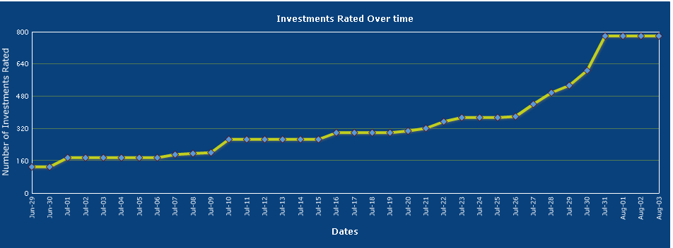
Effective Management:
IT Dashboard
“Executive departments and agencies should harness new technologies to put information about their operations and decisions online and readily available to
the public”
– President Obama, March 9, 2009
August: All investments rated by agency CIOs
July 17: VA announces suspension of 45 projects
Over 53M hits to date (as of 9/1/09)
All Major IT investments evaluated one month after launch
45 projects halted by the Department of Veterans Affairs (VA)
June 30: IT Dashboard Launched
CIO Rating progress

Slide 3



Open & Transparent Government: Data.Gov
Provides access to over 100,000 Federal datasets
Encourages innovative data-use
Launched May 21, 2009
Tapping into the Ingenuity of the American People

Slide 4
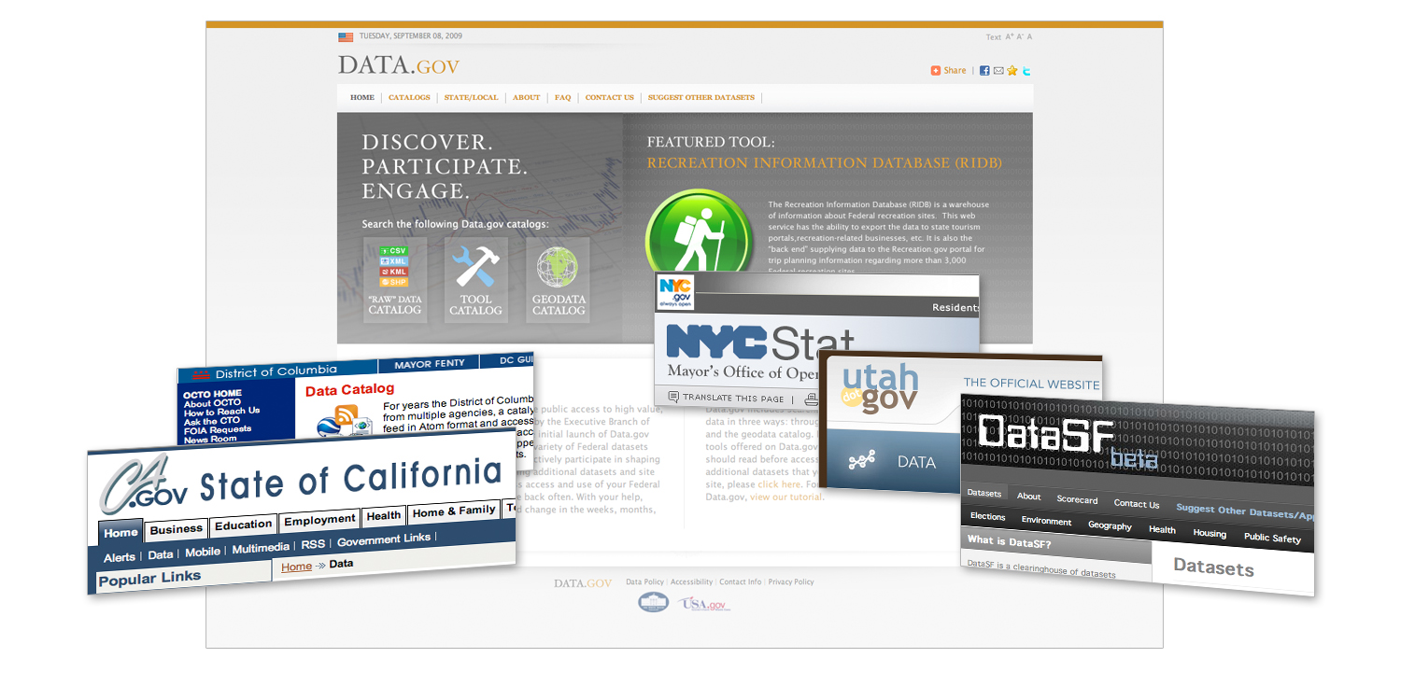
Open & Transparent Government:
State & Local Opportunities
Leading the way

