Slide 1
Understanding Ecosystems and Their Services
GEOSS Symposium: The Scientific Benefits of Data Sharing
16 November 2009
Anthony C. Janetos, Director
Joint Global Change Research Institute
Chair, GOFC-GOLD

Slide 2
Outline
The context of ecosystem services
The magnitude of the challenges
The magnitude of the challenge to come
Why is data sharing necessary?
Final thoughts

Slide 3
Context of Ecosystem Services

Slide 4
Ecosystems
Biological communities and their physical environment
Scale is a function of the intent of the analysis
People and infrastructure should be thought of as part of ecosystems, not apart from them

Slide 5
Ecosystem Services
Work, or functioning, that ecosystems do from which we benefit
Benefit can be direct or indirect
An unabashedly anthropocentric concept at its core
Originally articulated to point out that there are things that ecosystems provide that we depend on, but do not pay for (until we have to replace them)
This concept has grown to recognize that services can be either outside or inside of existing markets

Slide 6
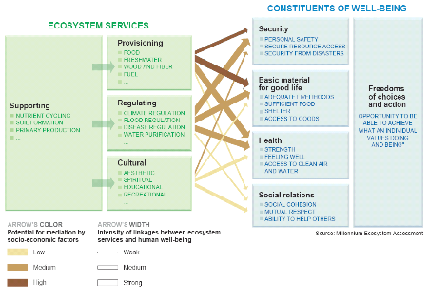
Millennium Assessment Focus: Ecosystem Services

Slide 7
Magnitude of the Challenges

Slide 8
MA Finding #1
Over the past 50 years, humans have changed ecosystems more rapidly and extensively than in any comparable period of time in human history
This has resulted in a substantial and largely irreversible loss in the diversity of life on Earth

Slide 9
Unprecedented change: Ecosystems
More land was converted to cropland since 1945 than in the 18th and 19th centuries combined
20% of the world’s coral reefs were lost and 20% degraded in the last several decades
35% of mangrove area has been lost in the last several decades
Amount of water in reservoirs quadrupled since 1960
Withdrawals from rivers and lakes doubled since 1960
Notes:
most water use (70% worldwide) is for agriculture.

Slide 10
MA Finding #2
The changes that have been made to ecosystems have contributed to substantial net gains in human well-being and economic development
Since 1960, while population doubled and economic activity increased 6-fold, food production increased 2 ½ times, food price has declined, water use doubled, wood harvest for pulp tripled, hydropower doubled.
But these gains have been achieved at growing costs that, unless addressed, will substantially diminish the benefits that future generations obtain from ecosystems

Slide 11
Degradation and unsustainable use of ecosystem services
Approximately 60% (15 out of 24) of the ecosystem services evaluated in this assessment are being degraded or used unsustainably
The degradation of ecosystem services often causes significant harm to human well-being and represents a loss of a natural asset or wealth of a country

Slide 12
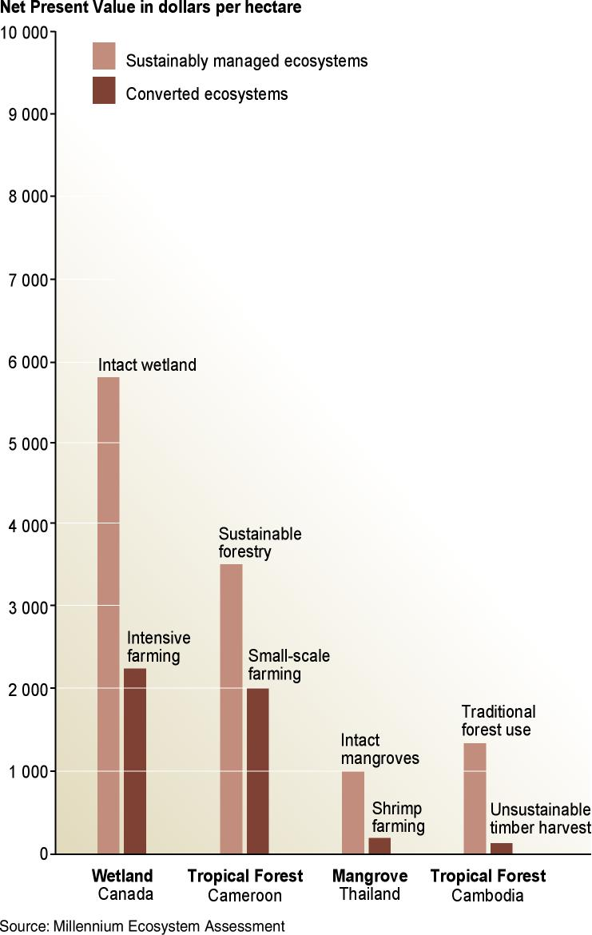
Degradation of ecosystem services often causes significant harm to human well-being
The total economic value associated with managing ecosystems more sustainably is often higher than the value associated with conversion
Conversion may still occur because private economic benefits are often greater for the converted system

Slide 13
The degradation of ecosystem services represents loss of a capital asset
Loss of wealth due to ecosystem degradation is not reflected in economic accounts
Ecosystem services, as well as resources such as mineral deposits, soil nutrients, and fossil fuels are capital assets
Traditional national accounts do not include measures of resource depletion or of the degradation of these resources
A country could cut its forests and deplete its fisheries, and this would show only as a positive gain in GDP without registering the corresponding decline in assets (wealth)
A number of countries that appeared to have positive growth in net savings (wealth) in 2001 actually experienced a loss in wealth when degradation of natural resources were factored into the accounts

Slide 14
Land-Cover and Land-Use Change
Perhaps the most consequential human-driven change of Earth’s important characteristics
About half of original forest area converted to agricultural production
Roughly doubled the amount of biologically available nitrogen
Increases in atmospheric concentrations of CO₂
Biggest contribution to loss of biological diversity

Slide 15
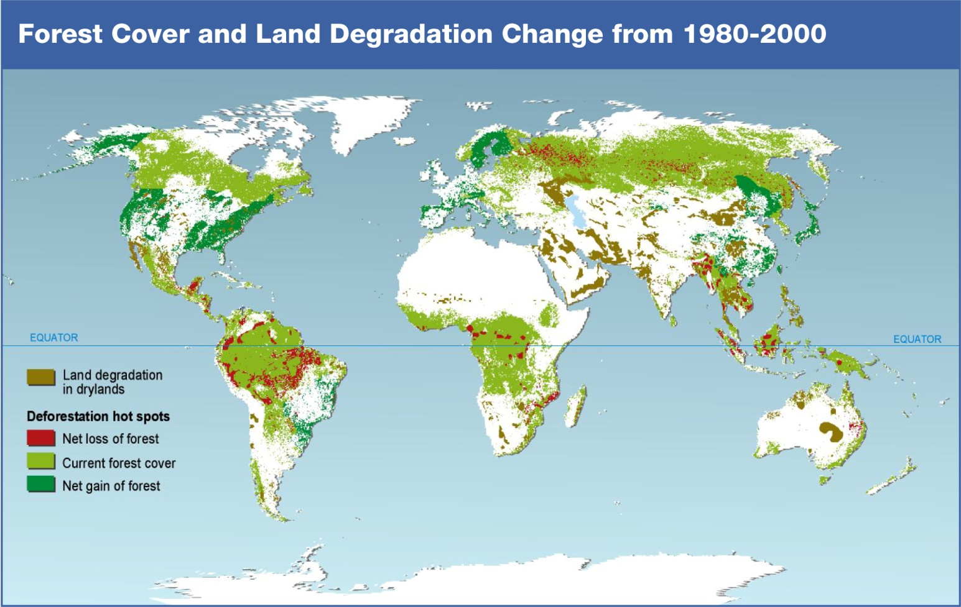

Slide 16
Implications
Original rationale emphasized documentation for purpose of understanding tradeoffs in services
This is possible for some tradeoffs:
Increase in timber production against carbon sequestration potential
Increase in agricultural output against a variety of other ecosystem services
Not possible for others because of lack of information on state, even though we understand processes

Slide 17
Change is the Thing
Can certainly document the big tradeoffs: agricultural productivity vs. carbon storage (globally)
Agricultural productivity vs. availability of fresh water for other uses
But documentation on smaller, more detailed scales is difficult, even when we are confident about underlying processes

Slide 18
Magnitude of the Challenge to Come

Slide 19
Global CO₂ Concentration
360
340
320
CO₂ concentration (ppm)
300
280
260
800
1000
1200
1400
1600
1800
2000
Notes:
3. Specifically with respect to climate, we know that:
- Human activity is rapidly changing the chemistry of the Atmosphere.
- Atmospheric chemistry is closely linked to climate, including temperature, but also a variety of temperature related mechanisms of enormous complexity.

Slide 20
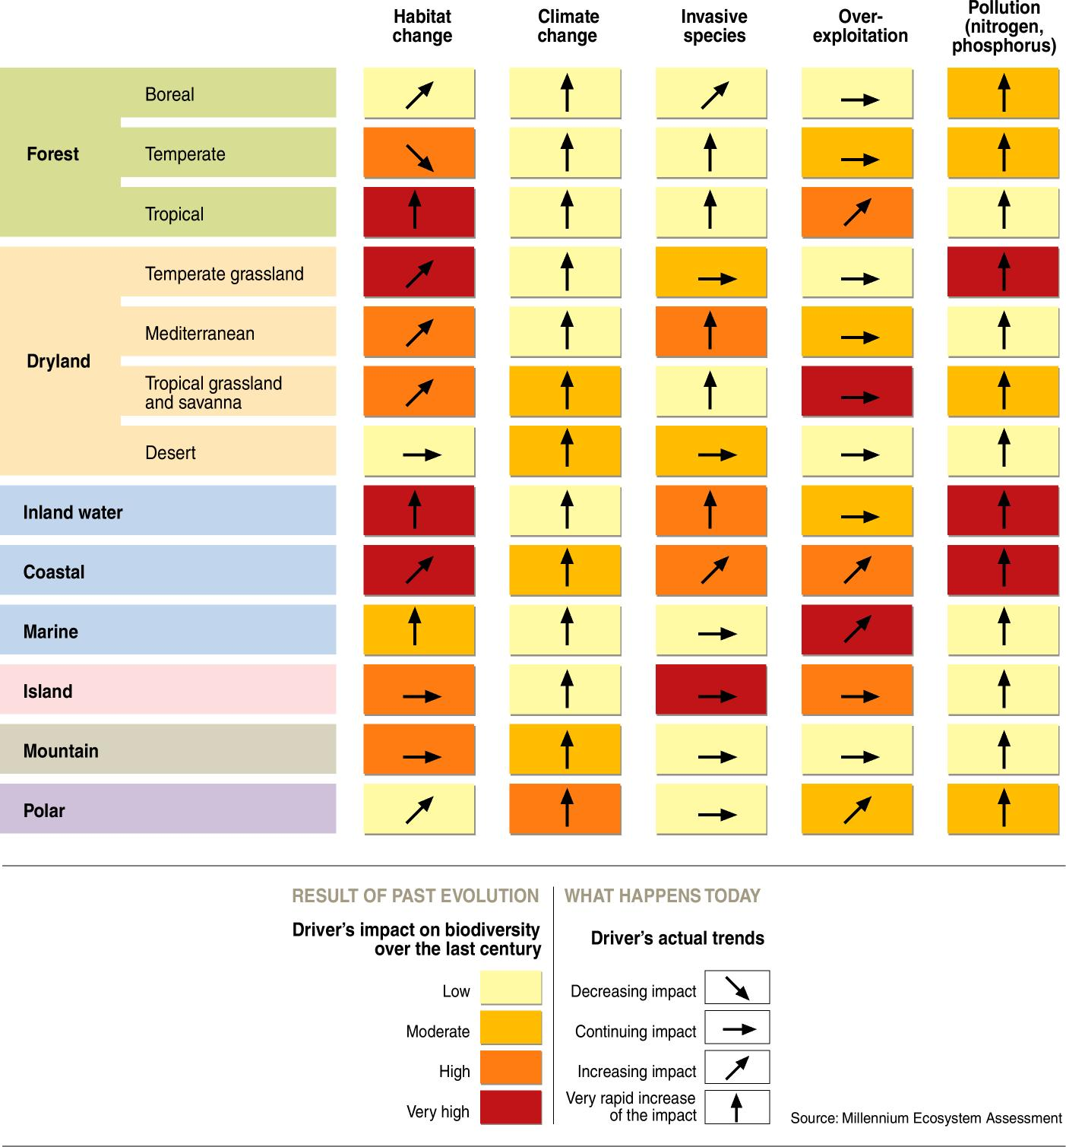
Direct drivers growing in intensity
Most direct drivers of degradation in ecosystem services remain constant or are growing in intensity in most ecosystems

Slide 21
2007 IPCC Conclusions
The observed change in the climate system over roughly the past century is virtually certain to be due in part to human influences.
The observed changes in climate are very likely to continue, and even accelerate during the current century.
There are now many observed, well-documented impacts of changes in natural resources, animal and plant species, and ecosystems in many regions of the world.
Impacts in the future are very likely to grow in both number and magnitude.
Climate change and its impacts present challenges for adaptation in both the developing world, and as well among developed countries.

Slide 22
Emerging Issues and Context
Ecological impacts are still emerging from the noise
Entirely new issues are also arising
Keep in mind that climate impacts must be viewed in a broader context of other environmental changes

Slide 23
Impacts, Vulnerabilities, Adaptation
Question is not whether we will see impacts, but how many are we seeing now, and what can we do about them?
Impacts now are larger, faster, more widespread than we had anticipated ten years ago
Attribution of climate trigger to human influence not especially relevant to some user communities

Slide 24
Ag/Land Use and Bioenergy

Slide 25
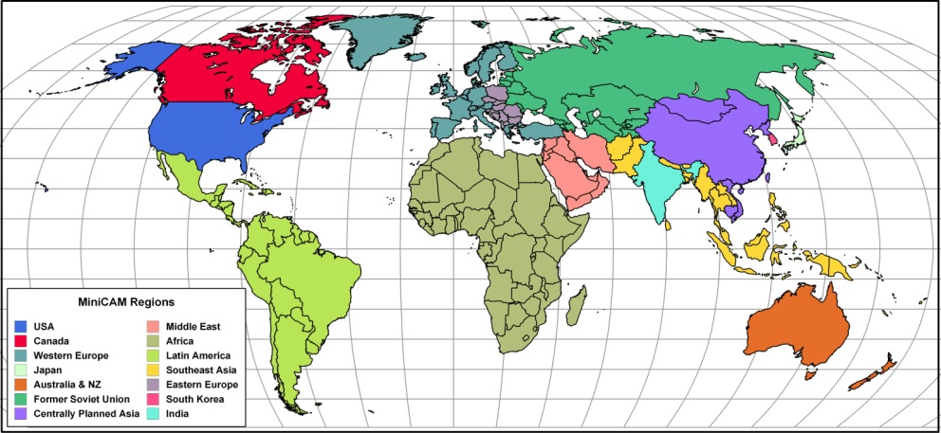
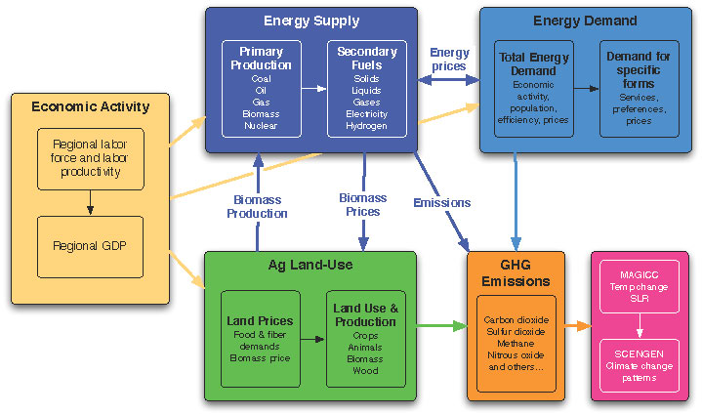

The PNNL Global Change Assessment Model (GCAM)
Energy-Agriculture-Economy Market Equilibrium
14 Global Regions – Fully Integrated
Explicit Energy Technologies – All Regions
Fully Integrated Agriculture and Land Use Model
15 Greenhouse Gases and Short-lived Species
Typically Runs to 2100 in 15-year time steps

Slide 26
Agriculture, Land-use and Energy in GCAM
Regional GDP
Demand
•
Crops
Commercial Biomass
Energy
•
Livestock
•
Forests products
Module
Regional
demographics
Production
•
Crops
Demand for
•
Livestock
Demand for Biomass
•
Forests products
Commercial
•
Biomass energy
Energy
Biomass
Markets
•
Land rent
Land Use
•
Crop prices
•
Crops
•
Livestock prices
•
Livestock
Technology
•
Forest product prices
•
Managed Forests
•
Biomass prices
•
Unmanaged
Supply
•
Crops
•
Livestock
BioCrops
•
Regional Land Categories and Characteristics
Forests products
Policies
•
Taxes
•
Subsidies
•
Regulation
Land Use Change
Emissions

Slide 27
The Land Use Implications of Stabilizing at 450 ppm When Terrestrial Carbon is Valued
450 ppm Stabilization Scenario When Terrestrial Carbon is NOT Valued (FFICT)
450 ppm Stabilization Scenario When ALL Carbon is Valued (UCT)

Slide 28

Conclusions
Failure to value terrestrial carbon storage could have disastrous consequences for forests and other unmanaged ecosystems.
Agriculture and forestry waste streams are an important bioenergy feedstock.
We find that relative to a reference scenario, a larger stock of forests is desirable
Terrestrial carbon storage provides a service whose value increases throughout the century….
Which raises land rents and crop prices…
And this effect is independent of whether or not bioenergy is a competing crop.
Improving crop yields has the potential to reduce land-use change emissions by hundreds of billions of tons of carbon over the 21st century.
Citation: M. Wise, K. Calvin, A. Thomson, L. Clarke, B. Bond-Lamberty, R. Sands, S. J. Smith, A. Janetos, J. Edmonds, “Implications of Limiting CO2 Concentrations on Land Use and Energy.” Science, May 29, 2009, DOI 10.1126/science.1168475.

Slide 29
Why is Data Sharing Necessary?

Slide 30
Reminders from Ecosystem Services
Stresses on ecosystems more than simply local
Benefits from services are also often more than local
Strategies for maintaining services from ecosystems will require cooperation among many different institutions
Must have common information base

Slide 31
Final Thoughts

Slide 32
Adaptation and Coping
Because changes occurring now, have both coping to current circumstances and questions about planning for future circumstances to consider
Requires information on current practices for coping and understanding of factors that control vulnerability
Requires ability to model effectiveness of adaptation strategies as part of integrated response portfolio
Requires free and open exchange of data for common understanding and appropriate strategies for response

