Slide 1
Institutional Design and Governance in Microbial Research Commons International Symposium on Designing the Microbial Research Commons National Academy of Sciences Washington, DC 8-9 October 2009 Charlotte Hess hess@syr.edu

Slide 2
What we are studying…
How people come together with incomplete information to make rules and decisions in order to effectively manage and sustain a resource.

Slide 3
The study of the Commons is NEW
Natural resources
Indigenous
Pre-existing
Tragedy of the commons
Enclosure
Interdisciplinary (Gordon and Scott)
Formal and informal property rights
Social dilemmas

Slide 4
Traditional Commons
Natural resources + indigenous regimes + homogenous communities + collective action =
Design principles
Group boundaries clearly defined
Rules governing the use of collective goods are well matched to local needs and conditions
Most individuals affected by these rules can participate in modifying the rules
The right of community members to devise their own rules is respected by external authorities
Monitoring mechanisms by community
Graduated sanctions

Slide 5
Design principles (in the knowledge commons might look something like:
Group boundaries clearly defined
Rules governing the use of collective goods are well matched to local needs and conditions
Most individuals affected by these rules can participate in modifying the rules
The right of community members to devise their own rules is respected by external authorities ??
Monitoring mechanisms
Graduated sanctions

Slide 6
The Study of New Commons is NEWER
Focus on evolution or building new types of commons
Increasing complexity
Much different scale, heterogeneity, and many unknowns
Extremely dynamic

Slide 7
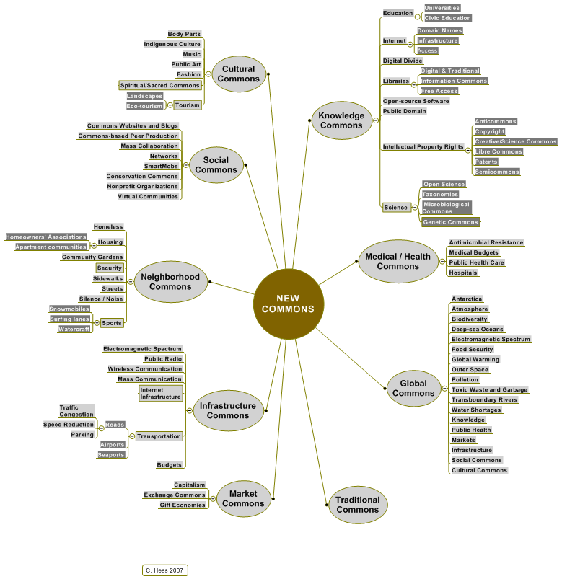

Slide 8
The way we think about commons is rapidly evolving
Common property (pre-1990)
→Common-pool resources (1990+)
→Commons (2000+)

Slide 9
Types of Goods

Slide 10
Definition of Commons
Resource(s) + people
Shared
Vulnerable to enclosure or other types of threats

Slide 11
New Commons
Characteristics of new commons
In the process of evolving
No clear rules
Heterogeneous community
Reacting to threats of enclosure or increasing rivalry
New forms of collaboration and collective action
We don’t know much about them
We know less about global commons**
**All global commons are also local

Slide 12
Characteristics of Commons
Self-governing
Participatory
Social dilemmas
Governance = hard work & requires ongoing attention, adjustment and adaption
Community members are “artisans” who “craft” appropriate institutions
Communication is essential to build trust and reciprocity

Slide 13
Diagnostic Tool 1: Institutional Analysis and Development (IAD) Framework
Bio
-
Physical
Characteristics
=
Ideas
ACTION
Artifacts
ARENA
Facilities
Attributes of the
Community
=
Action
Patterns of
Users
Situations
Interactions
Providers
Policymakers
Evaluative
Criteria
Rules
-
in
-
Use
=
Actors
Constitutional
Collective Choice
Operational
Outcomes

Slide 14
Diagnostic Tool 2: A Multi-tier Framework for Analyzing a Social-Ecological System
Resource Governance
System System
Resource Users
Units
Straight arrows represent direct causal links
Red, curved arrows represent feedbacks
WHAT IS THE RESOURCE?
Ostrom, E. 2007. “Sustainable social-Ecological Systems: An Impossibility?” http://www.indiana.edu/~workshop/publications/materials/conference_papers/W07-2_Ostrom_DLC.pdf
Interactions (I) → Outcomes (O)

Slide 15
Digital information
Anarchic
Exponential
Fragile
Centralized
Siloed
Unequal access

Slide 16
Scientific Information
The amount of scientific data is doubling every year.
Harder to collect, preserve, and steward
Many predict dramatic changes to the way science is done, and suspect that few traditional processes will survive in their current form by 2020
Szalay, A. and J. Gray. 2006 “2020 Computing: Science in an Exponential World.”
Nature 440, 413-414 (23 March 2006) | doi:10.1038/440413a

Slide 17
Microbial Commons in the Academy
University mission to create new knowledge
Responsibility to “disseminate” it
Libraries (historical stewards of the scholarly record)
Tradition of open science
University “owns” this knowledge
Increasing mandates to “monetize” it
Technology transfer offices
Tradition of tenure, secrecy, and competition

Slide 18
Lack of Incentives and HighTransaction Costs of Genomic Annotation (Welch and Welch)
Annotations in CIRs (collaborative information repository) need to
enhance academic credibility
move a researcher closer to a doctoral degree
Count toward tenure
Help lead to successful funding applications
There are substantial incentives not to share information until doing so will result in a publication.
(Evidence: geneticists and genomic researchers withholding data and materials with increasing frequency)
Welch, R. and Welch, L. 2009. “If you Build it, They might Come.” Nature Reviews Microbiology 7, 90 (February) | doi:10.1038/nrmicro2086

Slide 19
Open Source Communities as a model Schweik/English
Findings contradict classical theories of collective action
Tragedy of the anticommons rather than TOC
In environmental commons– norms, rules and governance structures – often help to overcome tragedies. This research suggests that too much governance structure and rules may get in the way of collaboration.
Schweik, C. and R. English. 2007. “Tragedy of the FOSS commons? Investigating the institutional designs of free/libre and open source software projects.” First Monday, 12: 2 (Feb) http://firstmonday.org/issues/issue12_2/schweik/index.html

Slide 20
Challenges of Scholarly Communication
Disciplinary incentives in an increasingly inter-disciplinary world
Long-standing mission of academic libraries—collect, organize, store, disseminate, preserve the culture and scholarly record
(Losing hold of this in the digital environment)

Slide 21
Suggestions for improving SC
Adapt pre-existing infrastructures: use libraries
Lib-department collaboration in funding OA
Build new collaborative institutional infrastructures
Build direct feeds and mandates
Universities need to be responsible for the long-term archiving and storage of scholarly and scientific data/datasets
Build OA into the tenure and promotion processes

Slide 22
Critical State of Academic Libraries
50,000+ academic journals
Bib dbs = $100,000+
Funding cuts—collections and staff
Paying millions for physical storage; buying our collections all over again
Out of touch with digital scholarship

Slide 23
What works?
PubMed/PubMedCentral/OS/wikipedia/libraries/open science
Networks & commons-based peer production (Benkler)
Global and Local (university mandates and supporting infrastructure
Outreach and awareness building at all levels (communication)
Persistent important measures:
Equity
Efficiency
Sustainability

Slide 24
Conclusions on Building MC
Use expertise of academic libraries to organize, disseminate, and archive/preserve**
** this is a huge assignment – libraries are desparately out of touch with the schoalrly- networked, non-commercial publishing arena
Document steps, lessons and share knowledge in building this global commons

Slide 25
Conclusions on Building MC 2
Build understandings of commons and OA
Translate importance of findings, projects, and initiatives to
Scientists
Librarians and information specialists
Non-scientific community

Slide 26
Conclusions on Building MC 3
Join IASC (International Association for the Study of the Commons) www.iascp.org
Present panel on MC at the January 2011 conference in Hyderabad, India

