Slide 1
Federal Demonstration Partnership (FDP) An activity convened by the Government-University-Industry Research Roundtable (GUIRR) of the National Academies of Sciences, Engineering and Medicine January 8, 2018
Larry Sutter
Co–Chair Membership Committee
Professor
Michigan Technological University
Department of Materials Science and Engineering

Slide 2
New Member Orientation
WIFI For the meeting rooms
SSID: HYATT-MEETING
Password: FDP@18

Slide 3
New Member Orientation
Welcome to the FDP!
A brief introduction to the FDP
Top 10 List
Additional information included at the end

Slide 4
New Member Orientation
Question #1 – Who are the key people?

Slide 5
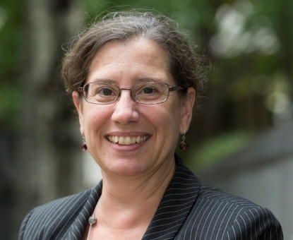
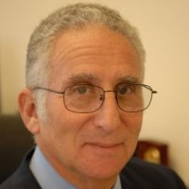
Key People: Leadership
Richard Seligman
Chair
Associate Vice President for
Research Administration
Caltech
Michele Masucci
Vice Chair
Professor, Department of Geography and Urban Studies
Vice President for Research
Temple University

Slide 6
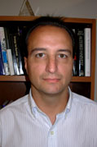
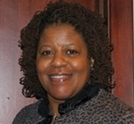
Key People: Executive Staff
David Wright
Executive Director
Claudette Baylor-Fleming
Administrative Coordinator

Slide 7
New Member Orientation
Question #2 – When and where do we meet?

Slide 8
When & Where
Question #2 – When and where do we meet?
Meet three (3) times a year: September, January, May
Some times Sunday – Tuesday… Sometimes Wednesday – Friday
Always in Washington DC
Future Dates:
2018: Jan 7-9, May 9-11, Sept 5-7 Hyatt Capital Hill
2019: Jan 23-25, May 19-21, Sept 22-24 Omni Shoreham

Slide 9
New Member Orientation
Question #3 – What is the FDP mission?

Slide 10
What is the FDP?
Question #3 – What is the FDP mission?
Researchers doing science, not administration
Association of federal agencies, academic and nonprofit research institutions, and research policy organizations that work together in a collaborative initiative to streamline the administration of federally sponsored research
Improving the productivity of research without compromising its stewardship
A unique forum for individuals from universities and nonprofits to work collaboratively with federal agency officials to improve the national research enterprise

Slide 11
New Member Orientation
Question #4 – What are FDP activities?

Slide 12
Activities
Question #4 – What are FDP activities?
At its regular meetings, faculty and administrators talk face-to-face with decision-makers from agencies that sponsor and regulate research.
Test new ways of doing things in the real world before putting them into effect.
DEMONSTRATIONS

Slide 13
Activities
Question #4 – What are FDP activities?
At its regular meetings, faculty and administrators talk face-to-face with decision-makers from agencies that sponsor and regulate research.
Test new ways of doing things in the real world before putting them into effect.
Information exchange – common practices shared.

Slide 14
New Member Orientation
Question #5 – Who are FDP members?

Slide 15
Membership
Question #5 – Who are FDP members?
154 institutional recipients of federal funds
Includes 38 new members (Phase VI)
Includes 26 Emerging Research Institutions
10 Federal Agencies
NSF, NIH, ONR, USDA, AFOSR, ARO, AMRMC, NASA, EPA and DHS

Slide 16
New Member Orientation
Question #6 – What are some examples of success?

Slide 17
History of Sucess
Expanded Authorities
FDP Subaward Agreement
Standard Government-wide Terms and Conditions
Faculty Burden Survey
FDP Clearinghouse for FCOI (now Expanded Clearinghouse)
ARRA Statistics
FDP as key sounding board for Research Business Models Subcommittee of the Committee on Science, grants.gov, research.gov, etc.
Congressional Testimony on Administrative Burdens

Slide 18
New Member Orientation
Question #7 – How is FDP organized?

Slide 19
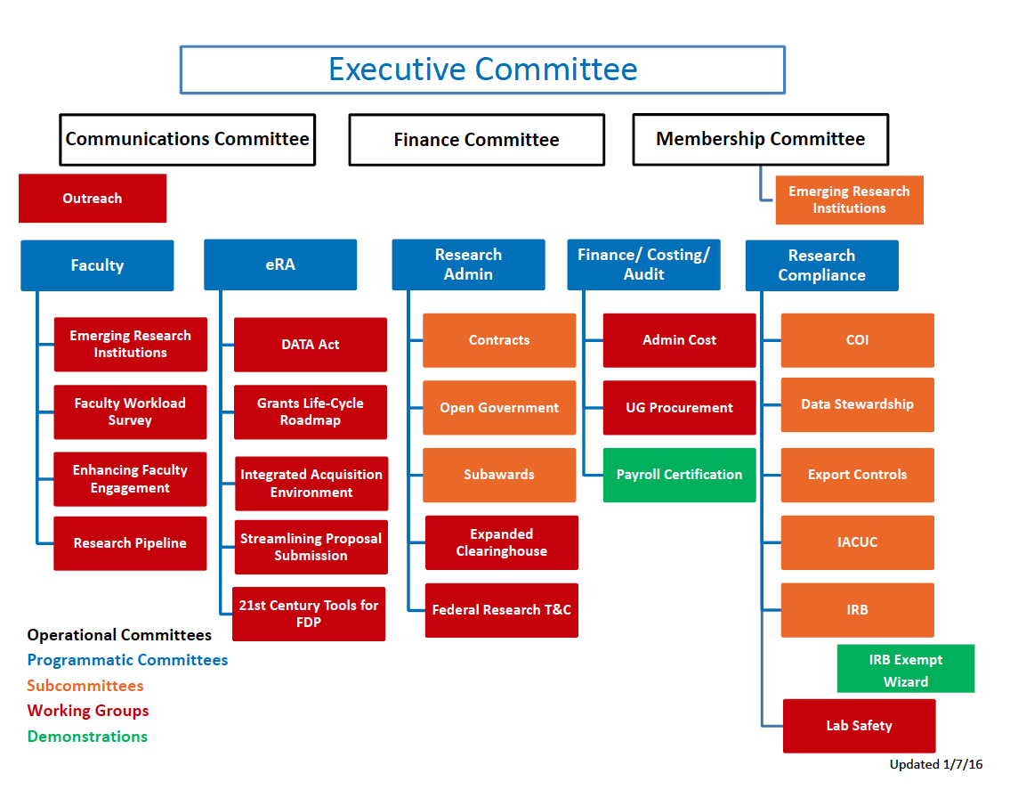
Organizational Structure

Slide 20
New Member Orientation
Question #8 – What is expected of my institution as a member?

Slide 21
Expectations of Members
Institutional representatives are expected to:
Attend regular FDP meetings
Participate on committees
Participate on working groups and task forces
Serve as advocates for their institutional colleagues
Expenses for attendance are borne by the institutions

Slide 22
Participation
ATTEND THE MEETINGS
Meeting formats vary to fit function
Broad plenary sessions
Break out sessions for committee, working groups, etc.
Networking opportunities
BE IN THE KNOW
Communication is facilitated through
FDP Website and Listservs (look for “Mailing Lists”)
Announcements at meetings
Meeting reports

Slide 23
New Member Orientation
Question #9 – How do I get more involved?

Slide 24
Getting Involved
Question #9 – How do I get more involved?
Identify key committee
Attend
Contribute
Volunteer

Slide 25
Some Current Activities
Conduct third Faculty Workload Survey
(FACT) Faculty-Admin Engagement
Expanded clearinghouse for sub-award information
Research Pipeline
Uniform Guidance issues
Smart IRB

Slide 26
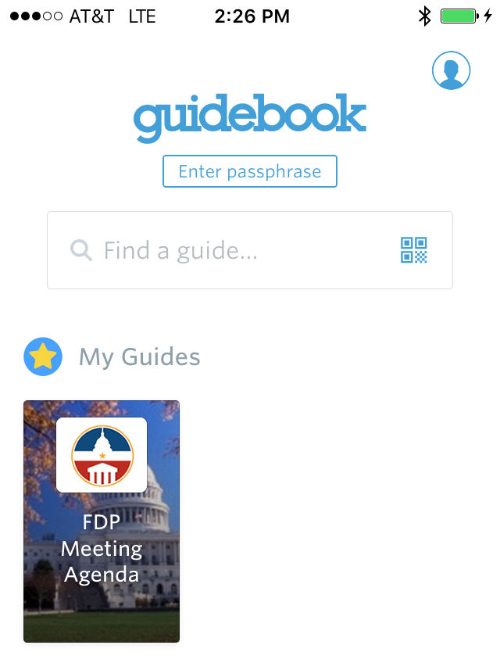
passcode -> fdpagenda

Slide 27
New Member Orientation
Question #10 – Anything else?

Slide 28
New Member Orientation
WIFI For the meeting rooms
SSID: HYATT-MEETING
Password: FDP@18

Slide 29
New Member Orientation
SEE ADDITIONAL INFORMATION APPENDED TO THIS PRESENTATION

Slide 30
Questions?
Membership Committee Co-Chairs
Larry Sutter Michigan Tech llsutter@mtu.edu | Katherine Kissmann Texas A&M University kkissmann@tamu.edu |  |  | Charisse Carney-Nunes NSF ccarney@nsf.gov
FDP Staff Contact
David Wright FDP Executive Director dwright@nas.edu |  |  | Claudette Baylor-Fleming FDP Administrative Coordinator cbaylor@nas.edu

Slide 31
HISTORY OF THE FDP
Phase VI: 2014-2020
Phase V: 2008-2014
Phase IV: 2002-2008
Phase III: 1996-2002
Phase II: 1988 Federal Demonstration Partnership
Phase I: 1986 Florida Demonstration Project
Pre-FDP: 1985 Hearing and Report by GUIRR

Slide 32
Organizational Structure

Slide 33
EXECUTIVE COMMITTEE
Provides general direction of FDP activities
Two (2) institutional members (one faculty, one research administrator)
The research administrator representative on the Executive Committee assumes the role of Chair for a three year period
Two (2) federal agency representatives (one program and one administrative)
One (1) representative from the National Academies Government-University-Industry Research Roundtable
The FDP Executive Director
One (1) senior federal science official (appointed by the Office of Science and Technology Policy)
Co-chairs from each of the FDP operational committees

Slide 34
MEMBERSHIP COMMITTEE
Responsible for Membership Issues Affecting FDP Activities
Conducts new attendee activities at meetings
Evaluates/recommends requests for additional affiliate membership
Encourages increased federal participation
Facilitates transition process for new FDP phases
Oversees nomination/election procedures
Supports ERI’s participation
Manages Annual Reporting process

Slide 35
FINANCE COMMITTEE
Responsible for FDP Financial Issues
Reviews annual budgets
Sets financial-related policies and procedures
Monitors the payment of dues

Slide 36
COMMUNICATIONS COMMITTEE
Responsible for the FDP Public Image
Approves FDP publications (printed or electronic)
Provides direction for the FDP web site
Oversees the FDP Biannual Report
Compiles/disseminates meeting proceedings
Develops/distributes outreach materials

Slide 37
FACULTY COMMITTEE
Serves as the forum for faculty representatives to discuss and develop faculty input on all FDP activities and FDP administration.
The Committee meetings are used to share information from other operational and programmatic committees.
Opportunity for faculty to incubate and develop new activity proposals.
As needed, the Faculty Committee develops surveys of faculty at member institutions to garner necessary information to direct proposed activities.

Slide 38
ERA COMMITTEE
Identifies opportunities to reduce administrative burden in areas of electronic processes and communications with federal agencies.
Informs the federal e-grants activities by providing institutional input.
Support the development of improved electronic interfaces between the government and the research community.
Provides IT consultation for demonstrations, pilots, and committees as requested.
Examines ways for FDP to function in the digital age.

Slide 39
ERA COMMITTEE
ERA Committee Activities
JAD Joint Application Design team with Grants.gov
SciENcv Science Experts Network Curriculum Vitae (Researcher Profile Portal)
Requirements for Research Management Systems
Survey on Applicant Investment in Grants.gov
Grant Reporting Information Project (GRIP)
Rich Media in Grant Applications

Slide 40
RESEARCH ADMINISTRATION COMMITTEE
Identifies opportunities to make the administrative requirements imposed by federal sponsors simpler and less costly without compromising accountability.
This includes contracting, proposal, award and subaward requirements and processes.
Concerned with general research administration areas not targeted for coverage by other standing committees.

Slide 41
FINANCIAL, AUDIT & COSTING POLICY COMMITTEE
This subcommittee explores opportunities to simplify financial, audit, or cost policies without compromising accountability.
Current initiatives
Administrative Cost Working Group
Project Certification
Procurement Standards Working Group
Notes:
I deleted Subrecipient Monitoring Demonstration and Federal Invoicing Initiative (exploratory)
I added Administrative Cost Working Group

Slide 42
RESEARCH COMPLIANCE COMMITTEE
Reviews existing and new requirements imposed by federal regulations related to:
Human research participant protections
Animal use and care
Conflicts of interest (individual and institutional)
Objectivity in research
Export controls
Efforts focus on
Identification and harmonization of requirements across federal agencies
Reduction of redundancies and unnecessary burdens
Identification of good practices for implementing the requirements

