Slide 1
NLM, EHR, HL7, SDO and other TLAs Standards for Local and Global Health Initiatives
James T. Case D.V.M, Ph.D.
Health Program Specialist for SNOMED CT
U.S. National Library of Medicine
National Institutes of Health, HHS
Bethesda, MD

Slide 2
Much ado about “Noting” The importance and value of EHR Adoption
1999 IOM Report on Medical Errors
44,000 to 98,000 deaths attributed to errors
Value of EHR recognized at the highest levels:
"Widespread adoption of interoperable health information technology is a cornerstone of creating a 21st Century Intelligent Health system.“ Newt Gingrich, Founder, The Center for Health Transformation; 2004
"We will make wider use of electronic records and other health information technology, to help control costs and reduce dangerous medical errors.“ President George W. Bush; 2006
"Our recovery plan will invest in electronic health records and new technology that will reduce errors, bring down costs, ensure privacy, and save lives.“ President Barack Obama; 2009

Slide 3
IOM Report on Medical Errors
“Synthesizing and interpreting the findings in the literature pertaining to errors in health care is complicated due to the absence of standardized nomenclature.”
“Efforts to assess the importance of various types of errors are currently hampered by the lack of a standard taxonomy for reporting adverse events, errors and risk factors .”
“Recommendation 5.1 A nationwide, mandatory reporting system should be established that provides for the collection of standardized information by state governments about adverse effects that result in death or serious harm.”
maintain a set of standards
require compliance with these standards
provide funds to update systems to support standards
To Err is Human – Building a safer health system – IOM, 1999

Slide 4
Areas of Medical Standards
Messaging - format and structure for data transfer between systems
Code Systems - medical concepts based on a standardized nomenclature
Identifiers - unique identification of patients, clients, institutions and care providers
Medical Record content and Structure - specific data elements and relationships in the medical record
Security, Confidentiality and Privacy
Notes:
7
6

Slide 5
Goals of Health Information Standards
Interoperability – the ability to exchange information between organizations
Comparability – the ability to ascertain the equivalence of data from different sources
Data quality – the measurement of completeness, accuracy and precision

Slide 6
Comparability
Meaning of the data is consistent when shared among different parties
e.g. - Erysipelas (human – Streptococcus A) vs. Erysipelas (animal – E. rhusiopathiae)
Common terminology required
Users should see familiar terms and phrases
Standards should work in the background
Not just words
Codes – uniquely identifies terms
Classification – groups related terms
Vocabulary – specialized, precise terms that remove ambiguity

Slide 7
Assessing Data Quality
What is “data quality”
Accessibility (can those that need it, get to it)
Validity and integrity (is it correct)
Accurate clinical content (does it mean what was meant?)
I know that you believe you understand what you thought I said, but I am not sure you realize that what you have heard is not what I meant. (Robert McCloskey)
Completeness (does it have all relevant information?)
Temporally reliable (does it support a consistent representation through time)
Timeliness (is it available when needed)

Slide 8
Evidence-Based Medicine Requires Evidence
There are massive clinical data bases in existence
In general, analytic value limited due to data quality issues
Statistical inference requires the ability to detect differences and identify associations
Either large differences or large populations of patients required
Prospective studies or clinical trials are limited
Focused data collection limits data
Cost of data collection – increases with number of elements and number of participants
Standards provide a mechanism to aggregate data

Slide 9
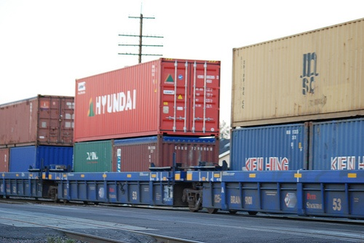
Health Level Seven (HL7) The “shipping container” for health data

Slide 10
What is HL7?
HL7 is a standard for exchanging information between medical applications and is an abbreviation of "Health Level Seven“...a protocol for data exchange. It defines the format and the content of the messages that applications must use when exchanging data with each another in various circumstances.
http://www.interfaceware.com/manual/what_is_hl7.html

Slide 11
Why a messaging standard?
N*(N-1)
N
72
9

Slide 12
HL7 Observation Result (ORU) Abstract Message Definition
Segment
MSH Message Header
{
[
PID Patient Identification
[PD1] Additional Demographics
[{NK1}] Next of Kin/Associated Parties
[{NTE}] Notes and Comments
[PV1 Patient Visit
[PV2]] Patient Visit - Additional Info
]
{
[ORC] Order common
OBR Observations Report ID
{[NTE]} Notes and comments
[CTD] Contact Data
{
[OBX] Observation/Result
{[NTE]} Notes and comments
}
[{FT1}] Financial Transaction
{[CTI]} Clinical Trial Identification
}
}
[DSC] Continuation Pointer
Segment Order
Optional Segment
Segment may repeat

Slide 13
NLM Terminologies The “Cargo”
NLM supports, distributes or develops clinical terminologies required for interoperability
SNOMED CT
LOINC
RxNorm
Provides distribution for over 100 clinical vocabulary standards through the UMLS Metathesaurus

Slide 14
When do you need a controlled nomenclature?
Aggregation of text-based content from multiple sources
Multiple individuals
Multiple institutions
Multiple disciplines
Any time you rely on a computer to manipulate language and “meaning” is critical.
Loss of non-verbal communication
Test lists (for comparability)

Slide 15
What is SNOMED?
SNOMED CT is a comprehensive clinical terminology that provides clinical content and expressivity for clinical documentation and reporting. It is a concept-based terminology, which means that each medical concept is uniquely identified and can have multiple descriptions.
SNOMED CT® Technical Reference Guide – July 2007 International Release

Slide 16
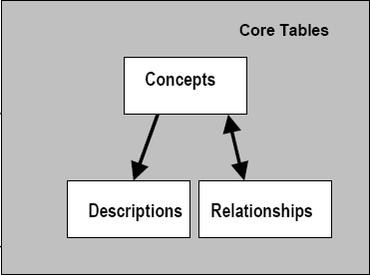
Core SNOMED Tables
SNOMED CT® Technical Reference Guide – July 2007 International Release

Slide 17
Single Concept - Alternate Representations
Fully specified name
Must be unique
Preferred name
Synonyms
Concept ID | Description ID | Term | Type
52702003 | 790741013 | chronic fatigue syndrome (disorder) | Fully Specified Name
52702003 | 87704019 | chronic fatigue syndrome | Preferred Term
52702003 | 496413011 | myalgic encephalomyelitis | Synonym
52702003 | 496412018 | postviral fatigue syndrome | Synonym
52702003 | 87703013 | benign myalgic encephalomyelitis | Synonym

Slide 18
Concept → Relationship e.g. Femur Fracture
SCT ID | Concept Name
71620000 | Fracture of Femur (disorder )
116676008 | Associated Morphology (attribute)
72704001 | Fracture (morphology)
363698007 | finding site (attribute)
421235005 | structure of femur (body structure)
ConceptID 1 | Relationship ID | ConceptID 2
71620000 | 116676008 | 72704001
71620000 | 363698007 | 421235005

Slide 19
NLM Activities with SNOMED CT
Licenses SNOMED from the International Health Terminology Standards Development Organization (IHTSDO)
Participates on a number of IHTSDO Committees
NLM distributes SNOMED through the Universal Medical Language System
Participates as the US representative to IHTSDO
Create subsets for specific use
CORE Problem list subset
Provides guidance in the use of SNOMED

Slide 20
Logical Observation Identifiers, Names and Codes (LOINC) http://www.loinc.org
“Within one laboratory, local jargon terms may be used which are usually well understood between colleagues, but would not be sufficiently widely known for communication with the outside world.”
U. Forsum et al., Pure Appl. Chem 72:555-745, 2000 Properties and Units in the Clinical Laboratory Sciences Part VII. Properties and Units in Clinical Microbiology

Slide 21
What is LOINC?
A 57,000+ record data base of universal names and codes for identifying discrete observations
Packages of those discrete observations as panels or survey instruments, e.g.
Glasgow Coma score
OASIS functional status
CBC

Slide 22
Where is LOINC required/used
Required by:
Federal health care systems (CHI, HITSP)
HEDIS – quality
Required in HHS accepted standard HL7 messages
Centers for Disease Control and Prevention (CDC)
Veterans Administration (VA)
Used by:
Large US laboratory services providers– e.g. Quest, LabCorp, ARUP
Used by major Payers (e.g. United Health)
Large research organizations - e.g. Partners, IU-Regenstrief, Intermountain, VA
Wide use internationally (more than 6 languages)

Slide 23
Anatomy of a LOINC Term
5193-8:Hepatitis B virus surface Ab:ACnc:Pt:Ser:Qn:EIA
5193-8
LOINC Code
Hepatitis B virus surface Ab
Component
ACnc
Property Measured
Pt
Timing
Ser
System
Qn
Scale
EIA
Method
There are six major LOINC axes
Notes:
LOINC Axes
What a Challenge Is.

Slide 24
Test comparisons
What you see in the order list
Lab A
Test Name: Lyme Disease Serology
Measures: B. burgdorferi Ab IgG
Method: ELISA
Scale: quantitative
e.g.: Titer 1:40
Lab B
Test Name: Lyme Disease Antibody
Measures: B. burgdorferi Ab IgM
Method: Immune blot
Scale: qualitative
e.g.: Positive
LOINC Code = 5062-5
LOINC Code = 6321-4

Slide 25
Using LOINC Things to Remember
Identifies the question, not the answer
The question (what am I measuring? e.g. Glucose) is not the answer (e.g. 90 mg/dl)
The thing ordered is not always the thing measured:
Blood Culture – live organism(s) identified
VDRL – Treponema pallidum Ab
Urinalysis – lots of different things
You must know the specifics of the component being tested for (what is this test actually measuring?)
Notes:
VDRL – Venereal disease research laboratory

Slide 26
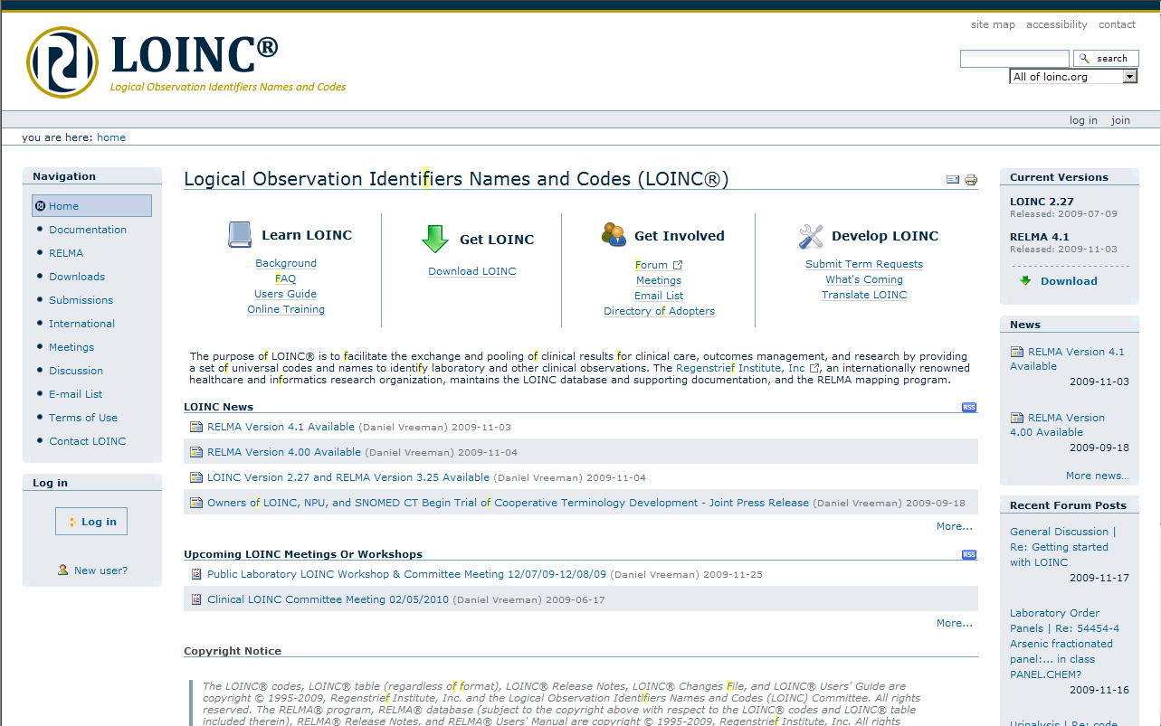
LOINC Web Site

Slide 27


Using LOINC and SNOMED Together in HL7

Slide 28
Example: blood count with standard codes and numeric results
Patient level PID|||0999999^6^M10||TEST^PATIENT^||19920225
|F||B|4050 SW WAYWARD BLVD |
Order/Request level
OBR|||H9759-0^REG_LAB|24358-4 ^Hemogram^LN
Discrete Results
OBX|2|NM|789- 8^RBC^LN||4.9|M/mm³|4.0-5.4||||F|
OBX|3|NM|718-7^HGB^LN||12.4|g/dL|12.0- 5.0||||F|
OBX|4|NM|20570-8^HCT^LN||50|%|35-49|H|||F|
OBX|5|NM|30428-7^MCV^LN||81|fL|80-94||||F|
LOINC Code
LOINC Term
UCUM Term
Standard Unit of Measure (UCUM)

Slide 29
Example: microbiology culture with standard codes (order and results)
Patient level
PID||| 6910828^Y^C8||Newman^Alfred^E||19720812|M||W|25 Centscheap Ave^^
Whatmeworry^UT^85201^^P||(555)777-6666|(444)677-7777||M|
Order Level
OBR||||634-6^Bacteria Aerobic Culture^LN|||199812292128||||||||119339001^Stool specimen^SCT|
Results
OBX||CE|634-6^Bacteria Aerobic Culture^LN|1|2547930011^Salmonella Typhimurium^SCT|
OBX||CE|634-6^Bacteria Aerobic Culture^LN|2|112283007^Escherichia coli^SCT|
LOINC Code
SNOMED CT Code
LOINC Term
SNOMED Term

Slide 30
RxNorm http://www.nlm.nih.gov/research/umls/rxnorm/docs/rxnormfiles.html
Standardized nomenclature for clinical drugs and drug delivery devices
Ingredients, strengths and dose forms
Quantity for delivery devices
Focus is U.S. prescription and non-prescription clinical drugs
Weekly and monthly updates available for most current additions
Demo Medication Order Entry Tool can be tested at: http://rxterms.nlm.nih.gov:8080/

Slide 31
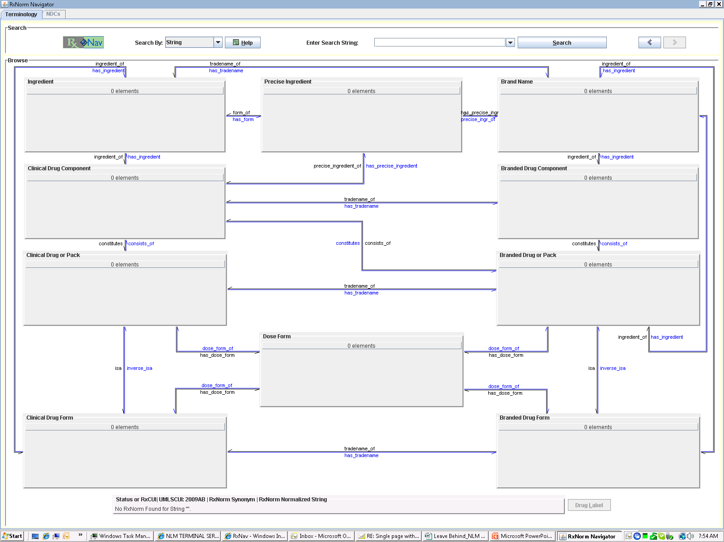
simvastatin

Slide 32
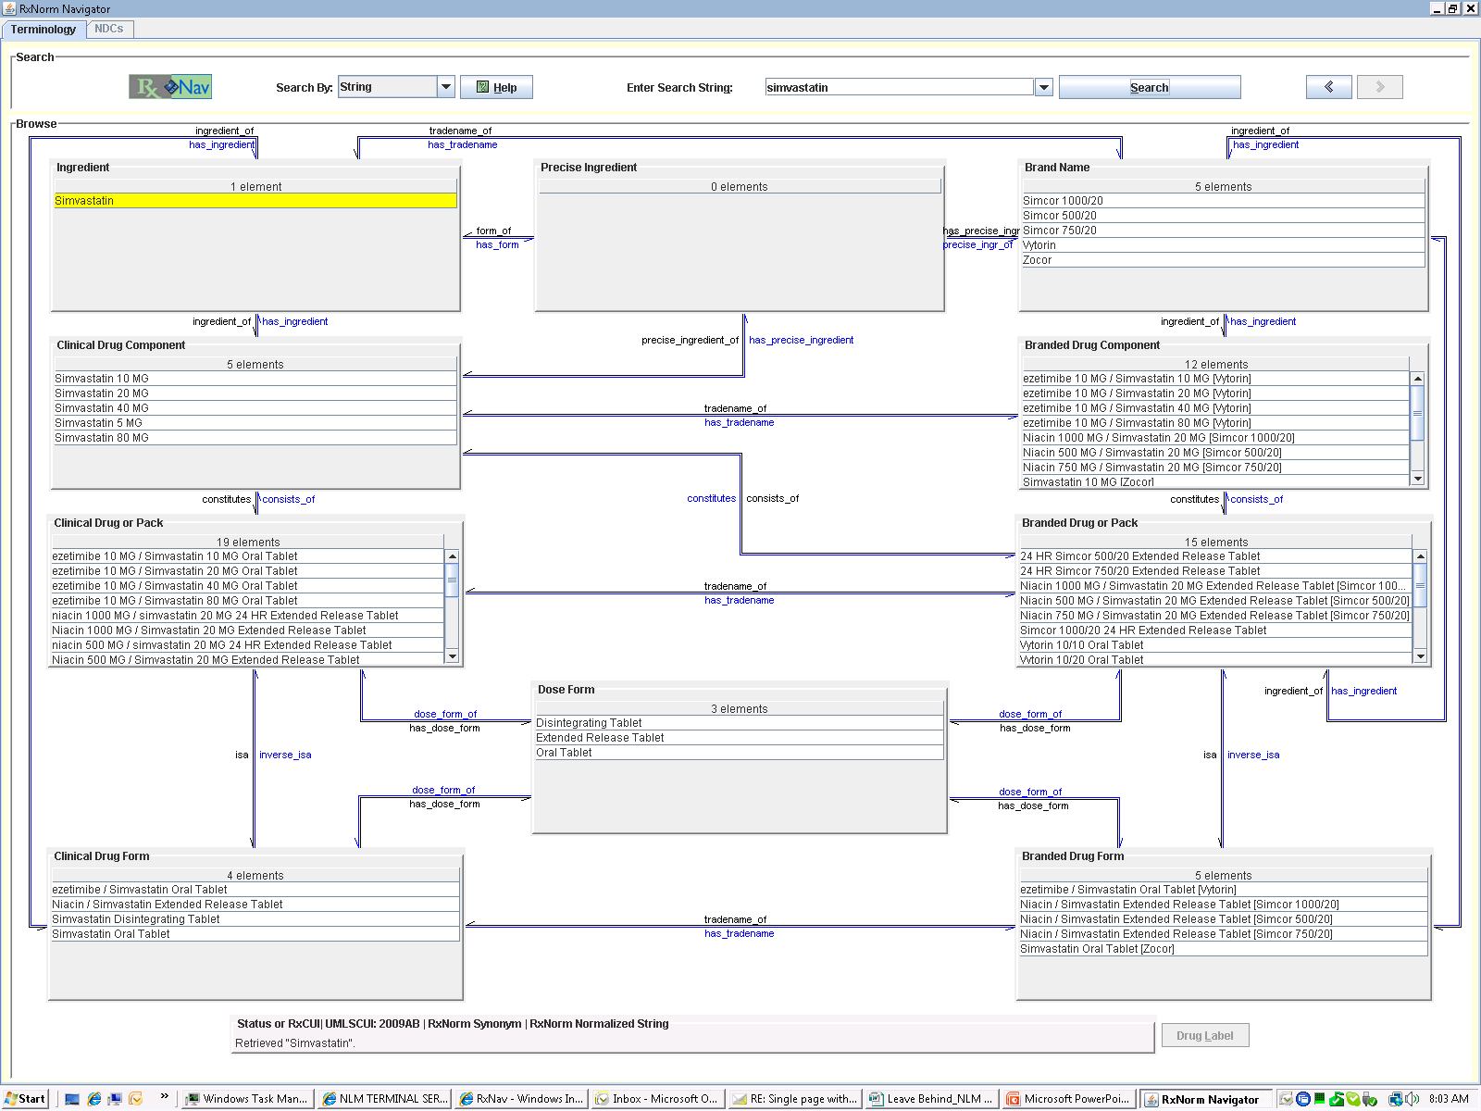

Slide 33
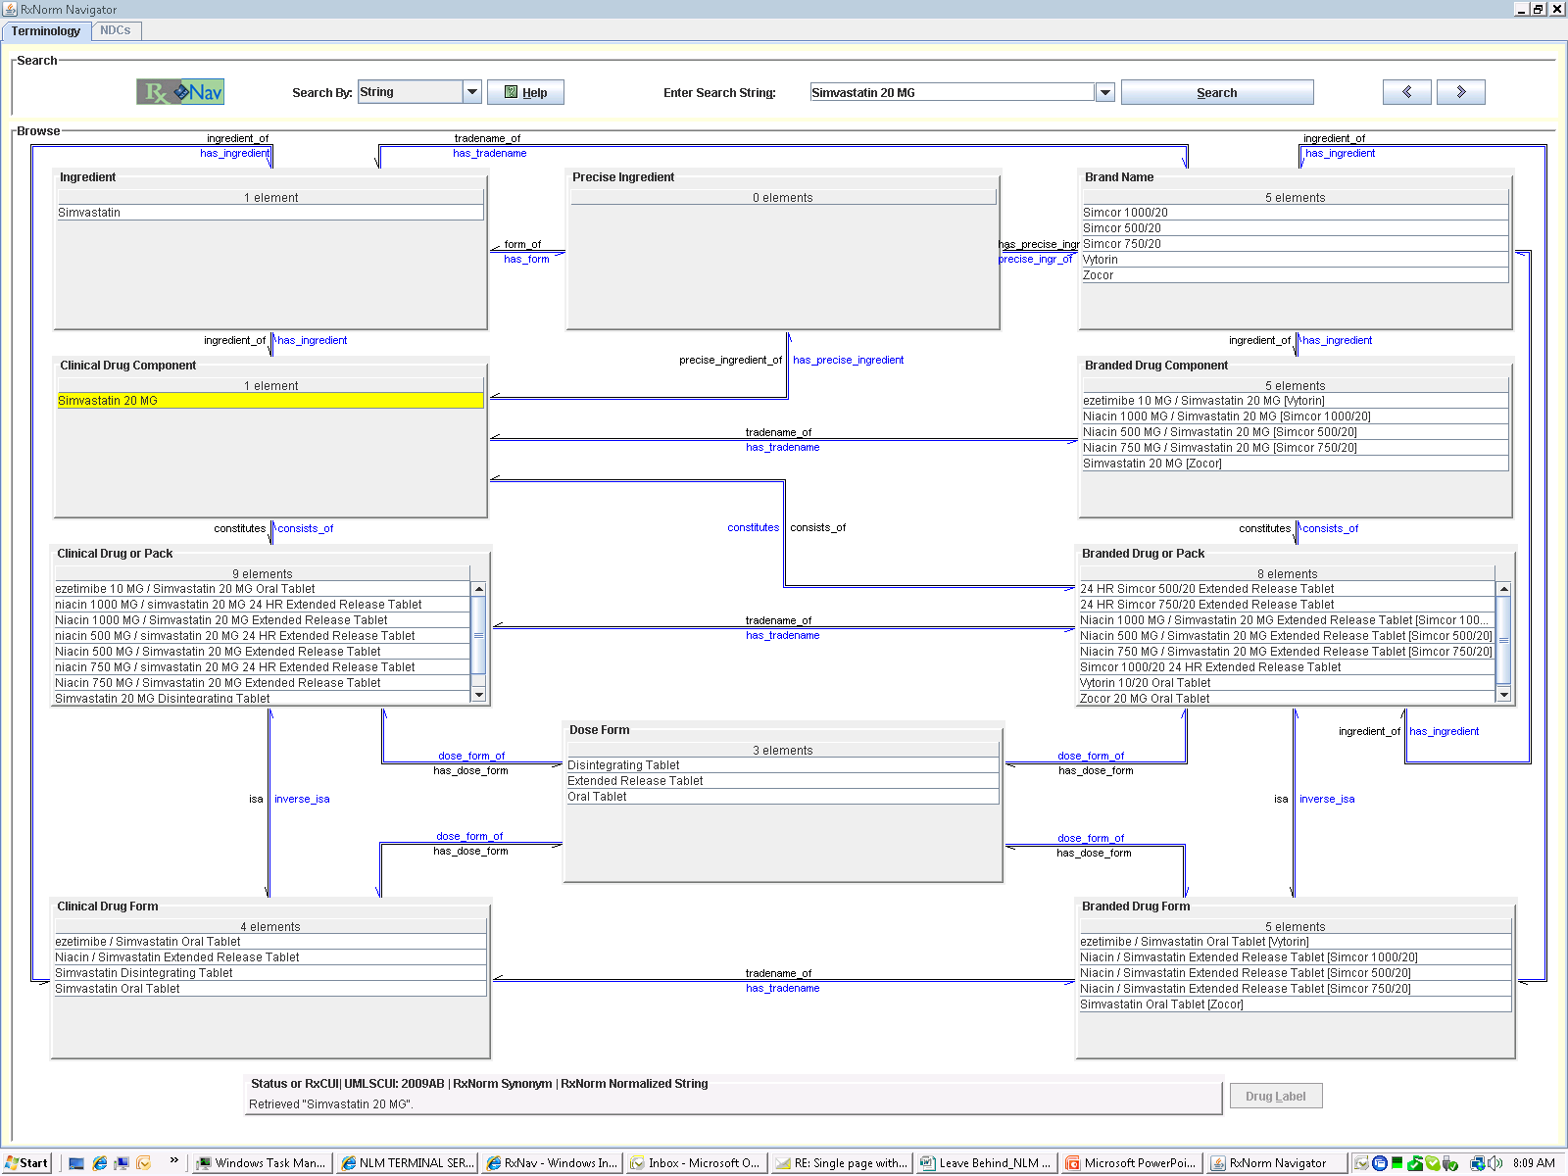

Slide 34
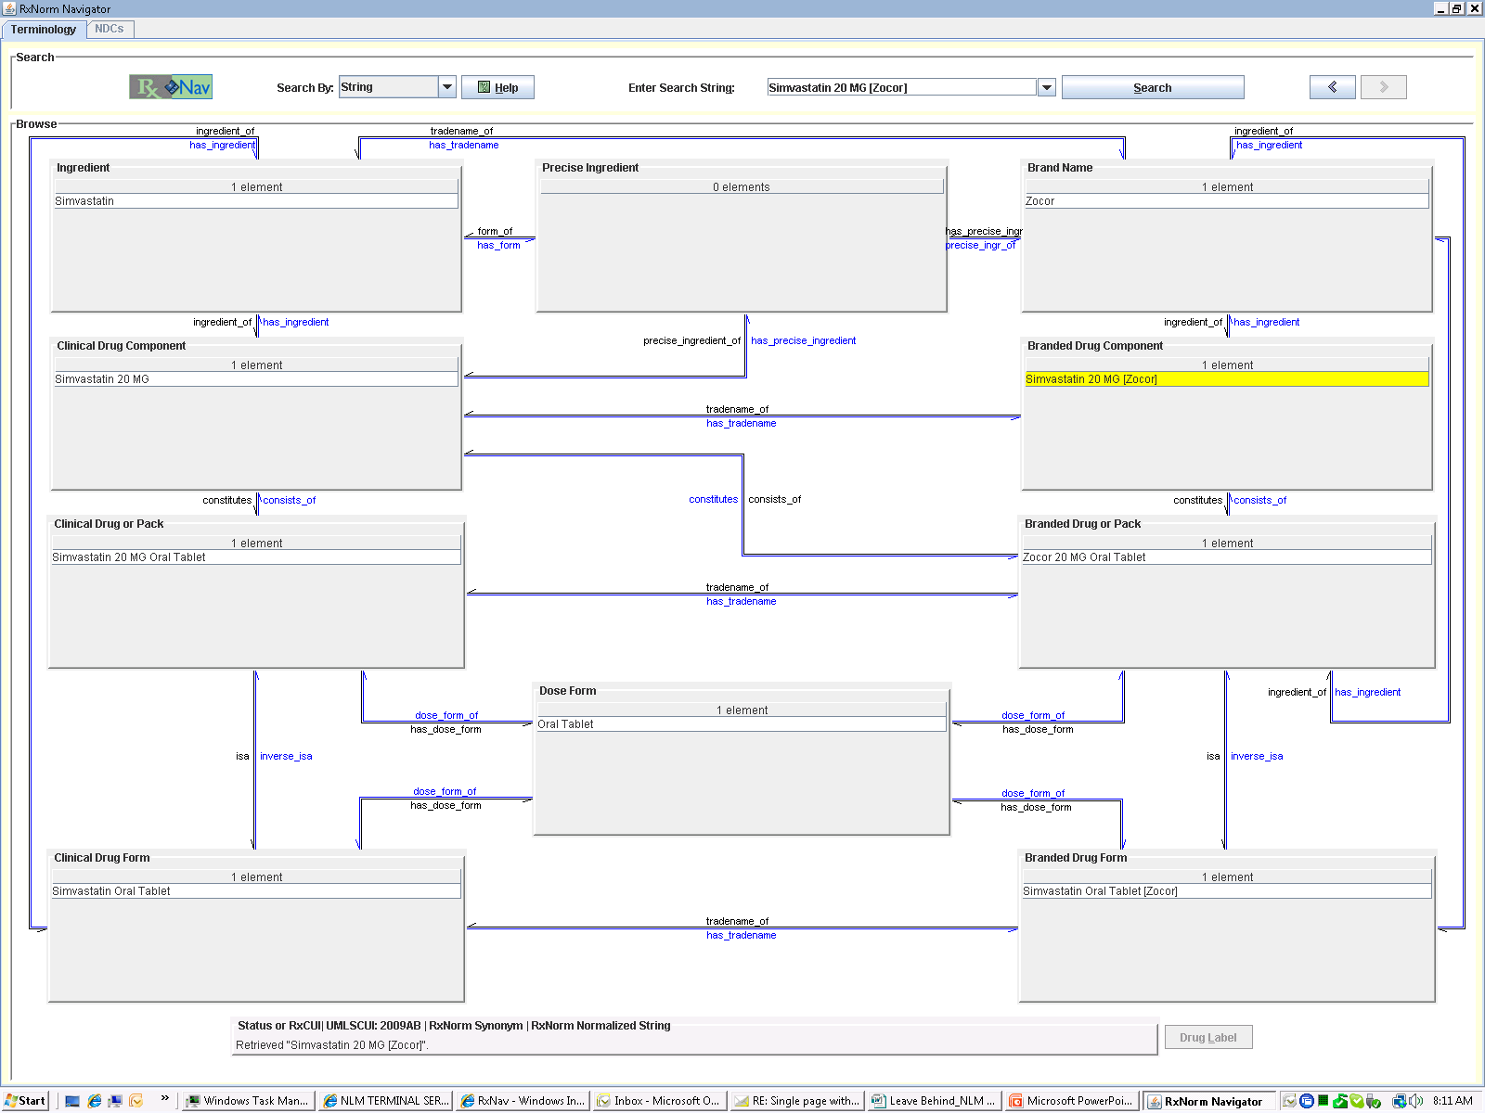

Slide 35
References
Health Level 7
http://www.hl7.org
SNOMED RT/ SNOMED CT:
http://www.snomed.org
LOINC
http://www.regenstrief.org/loinc/
RxNorm
http://www.nlm.nih.gov/research/umls/rxnorm/overview.html

Slide 36
Healthcare Information Technology Standards Panel (HITSP)
Purpose: Harmonize and integrate standards to meet clinical and business needs for sharing information among organizations and systems
Public and private sector participants
NLM is a participating agency
Provides interoperability specifications (IS) for 18 health related areas to meet specific needs
E.g. laboratory reporting, newborn screening, consumer empowerment, public health, clinical research

Slide 37
HITSP Specifications http://www.hitsp.org/
Work products guided by input from the American Health Information Community
Broad-based stakeholder input
Does not write or develop standards
Utilizes/recommends existing standards
Publishes guidance in the form of Implementation Specifications (IS), e.g.:
Lab results reporting
Biosurveillance
Medication management

Slide 38
Personal Health Records (PHR)
Provides personal access to medical data
Collates data from multiple providers
Does not replace provider (i.e. legal) medical records
May be accessible to providers
If internet enabled it is accessible from any location
May provide links to supplementary medical/health information
Allows personal control over access to health data

Slide 39
What is in a PHR?
Contact information
Emergency contacts
Provider information (primary care, specialists, etc.)
Insurance information
Medication list and doses
Allergies/immunizations
Significant health issues/procedures
Laboratory tests
Doctor visit notes
Additional health information as desired

Slide 40
PHRs - who is providing them
Everyone
Google Health- https://www.google.com/health/html/faq.html
Microsoft- Health Vault - http://www.healthvault.com
Intuit – Quicken Health - http://quickenhealth.intuit.com
U.S. Veterans Administration – My Health eVet - http://www.myhealth.va.gov/
MedScape

Slide 41
PHR providers – 2 of 3
Many health information software system vendors
Many care organizations
Cleveland Clinic’s MyChart - https://mychart.clevelandclinic.org/default.asp
MyHealth at Vanderbilt University Medical Center - http://www.vanderbilthealth.com/myhealth_help/
MyHealthManager at Kaiser Permanente - https://members.kaiserpermanente.org/kpweb/toc.do?theme=myhealthmanager_members
All these examples are “tethered” systems

Slide 42
PHR providers – 3 of 3
Medicare - My Medicare PHR Choice http://www.medicare.gov/PHR/PHRChoice.asp
Google Health (www.google.com/health)
HealthTrio (www.healthtrio.com/phr.html)
NoMoreClipboard.com (www.nomoreclipboard.com)
PassportMD (www.passportmd.com)
Some charge for certain services. The features described for some are quite impressive
www.medicare.gov/Publications/Pubs/pdf/Summary_Vendors_Medicare_PHR_Choice_Pilot_Table_2_16_10.pdf

Slide 43
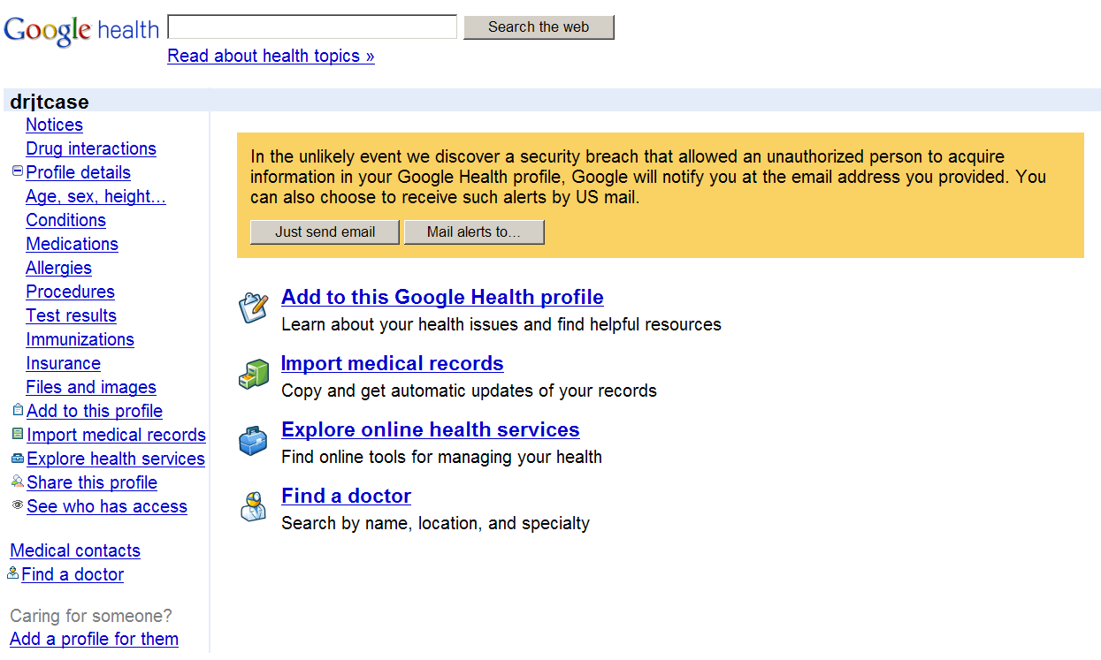
Google Health PHR

Slide 44
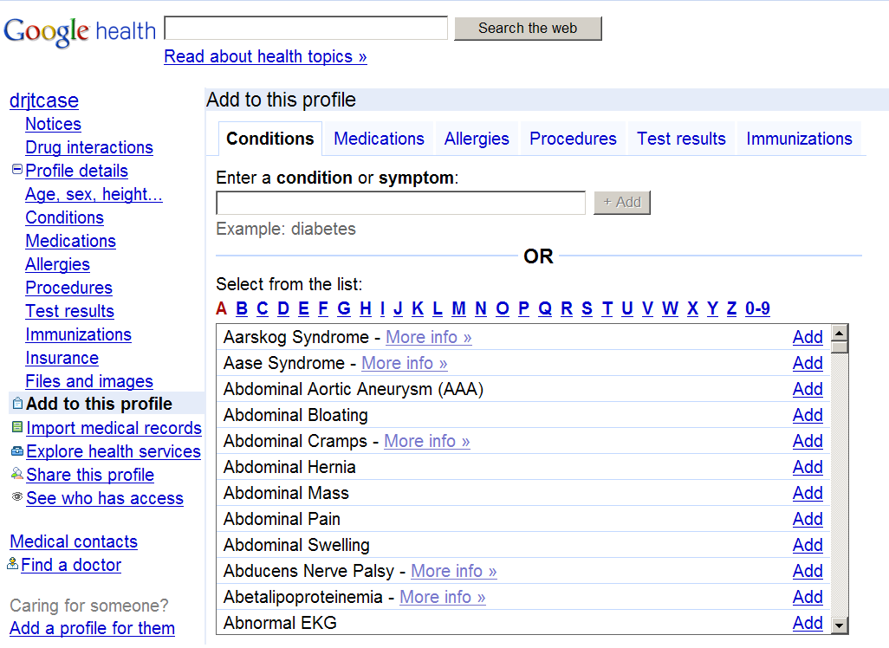
PHR Sections
Deep vein thrombosis

Slide 45
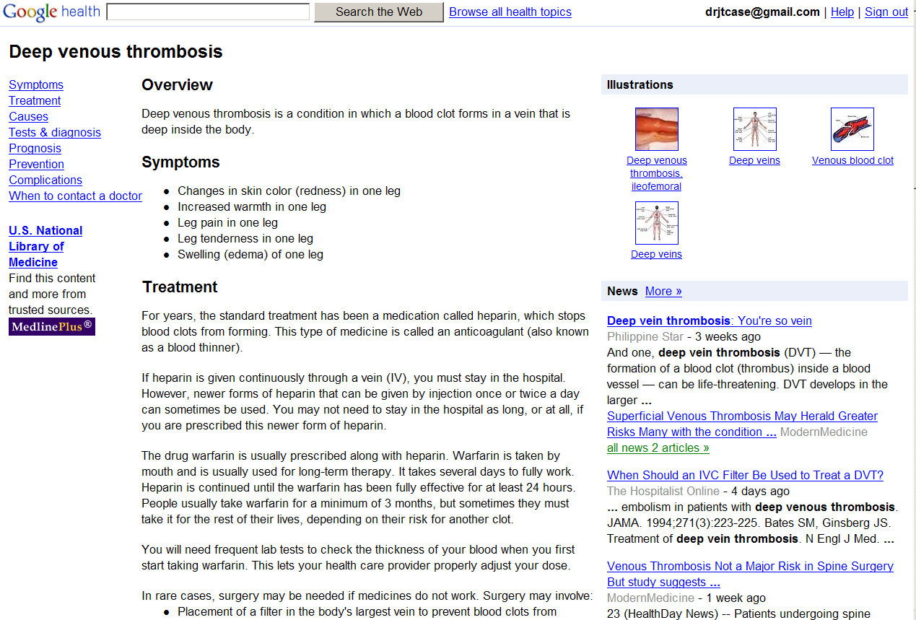
The NLM is the authoritative resource for medical conditions

Slide 46
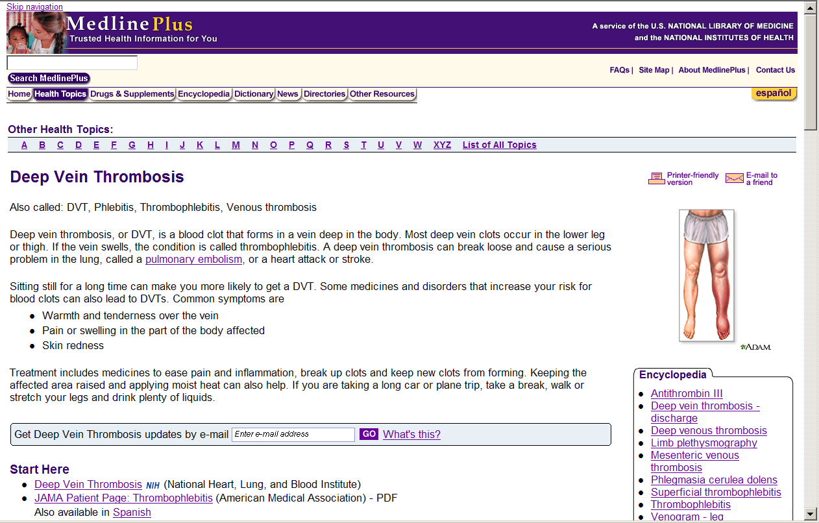
Details from the NLM

Slide 47
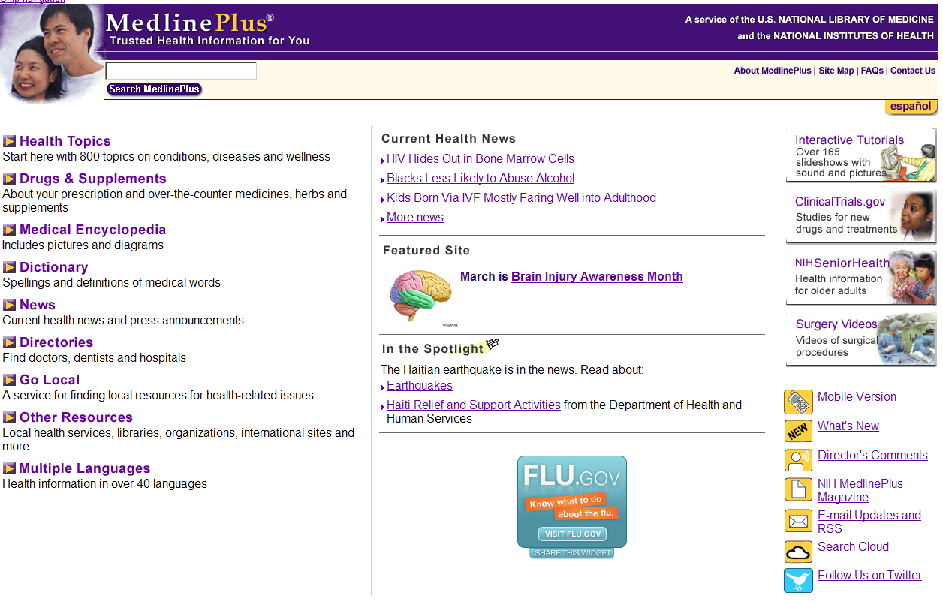
Medline Plus NLM Public Portal to Health Information

Slide 48
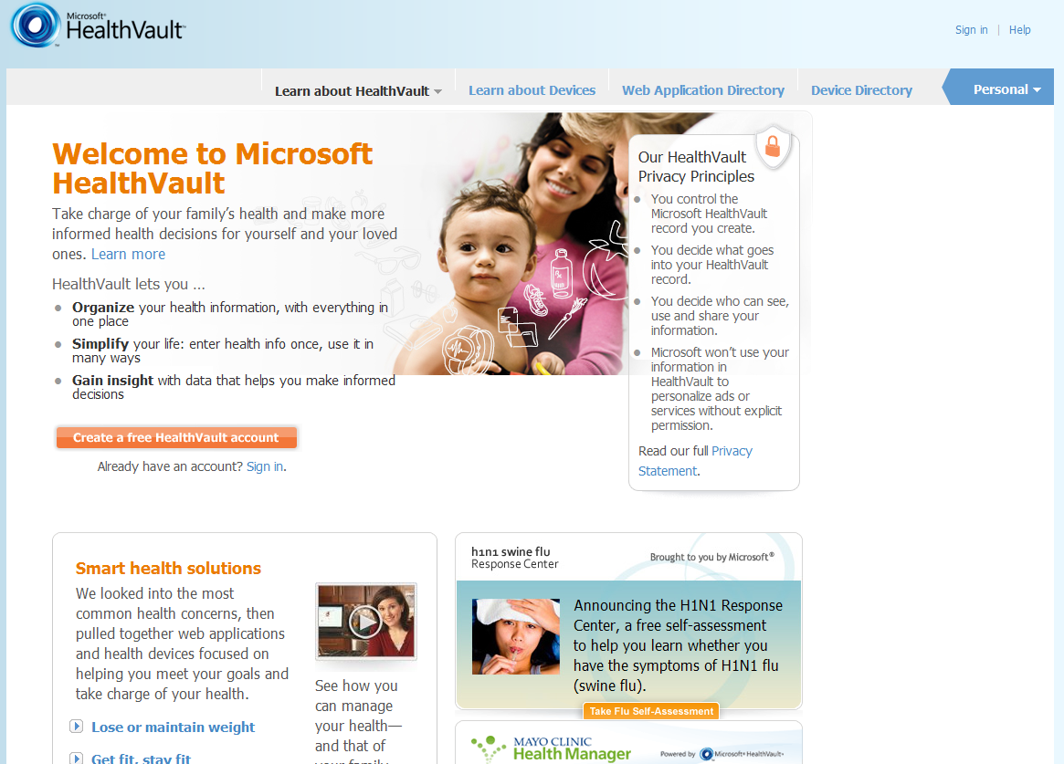

Slide 49
Overview of the NLM PHR
Aimed at the caregiver -- who oversees the care of their young children and/or frail elders
A stand-alone PHR – at present
Links to NLM’s information sources
Medline Plus http://medlineplus.gov/

Slide 50
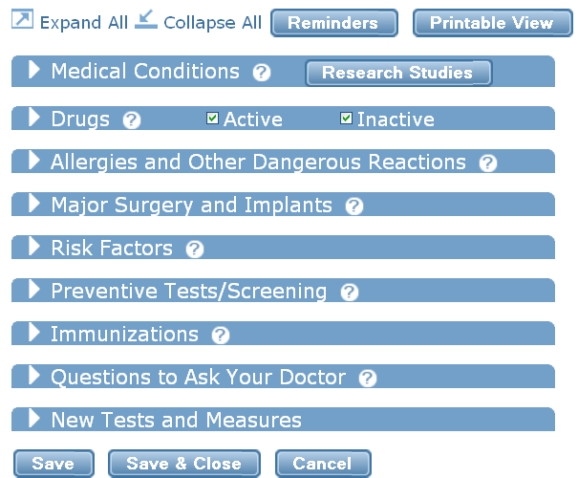
NLM PHR Content (“Collapse all” feature)

Slide 51
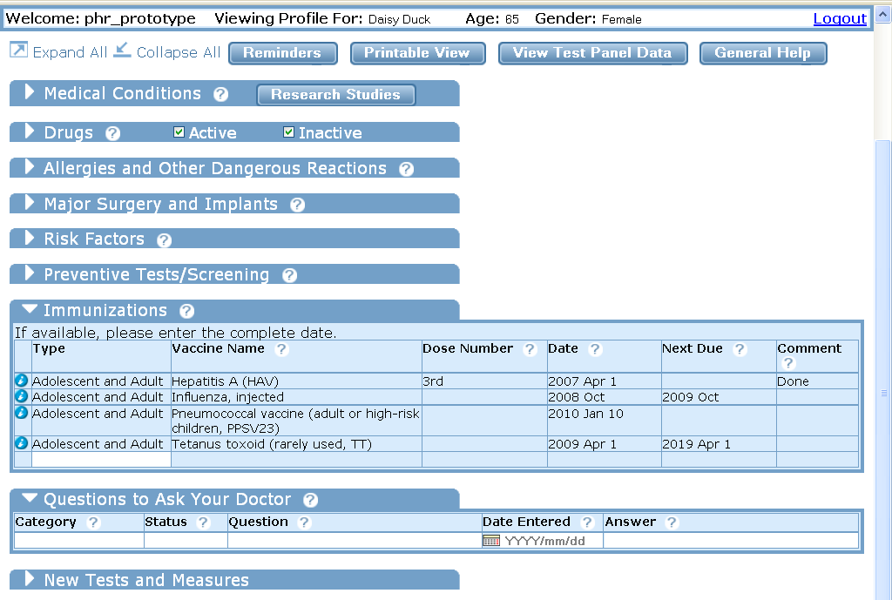
Click on triangle to expand one or more sections…

Slide 52
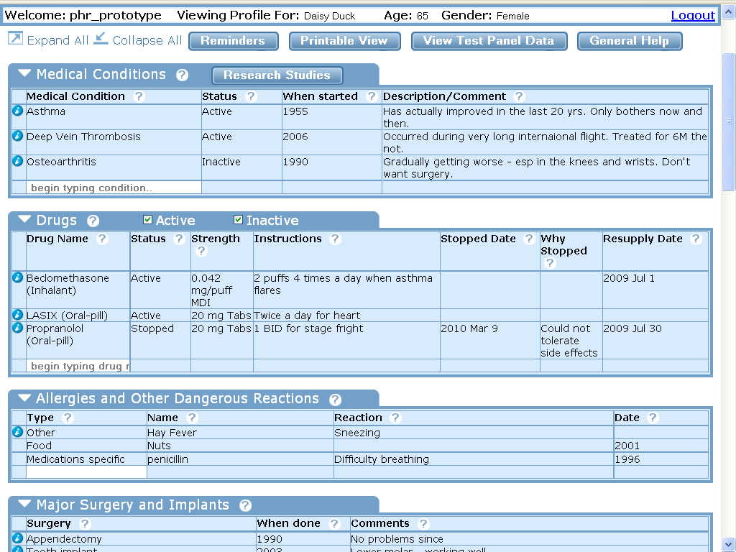
…Or click “Expand All” to show all sections with one click

Slide 53

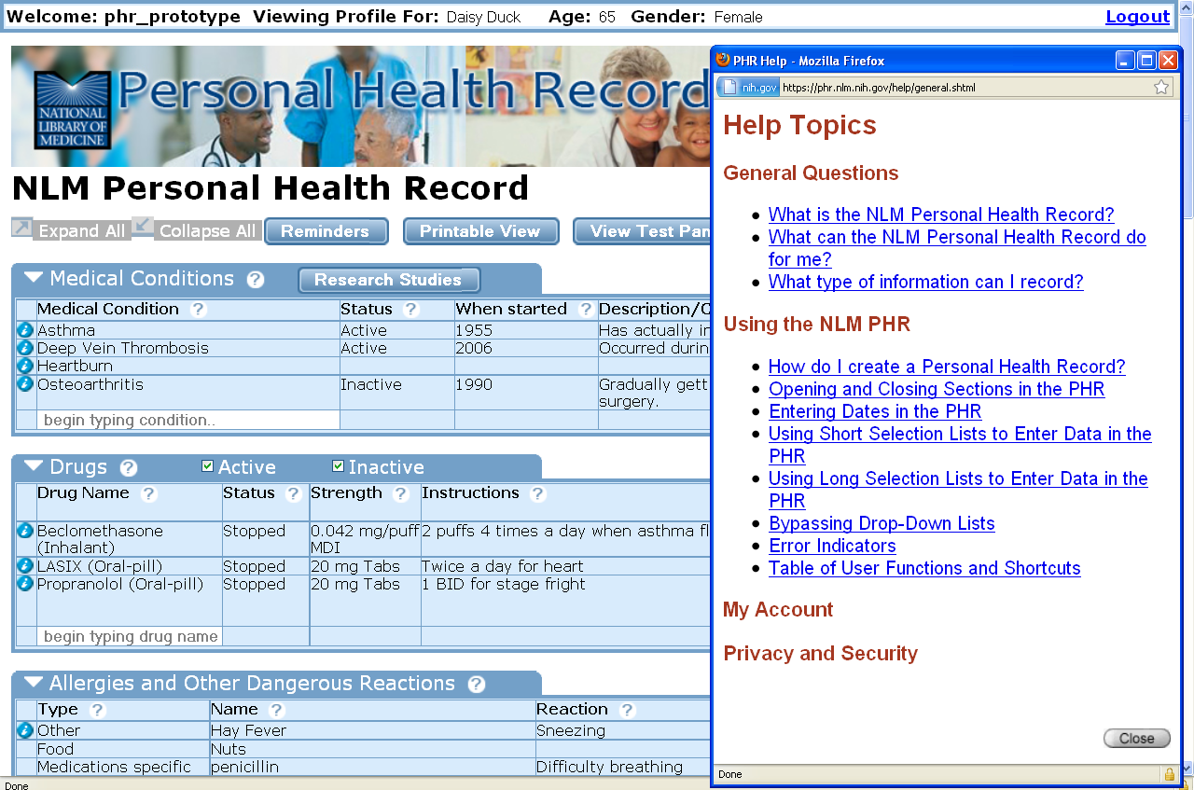
Help Topics pop-up window (click button)

Slide 54

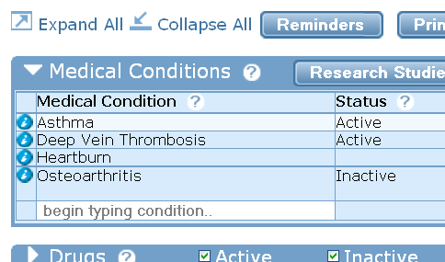
Info Button: Click on next to Asthma in Medical Conditions list…

Slide 55
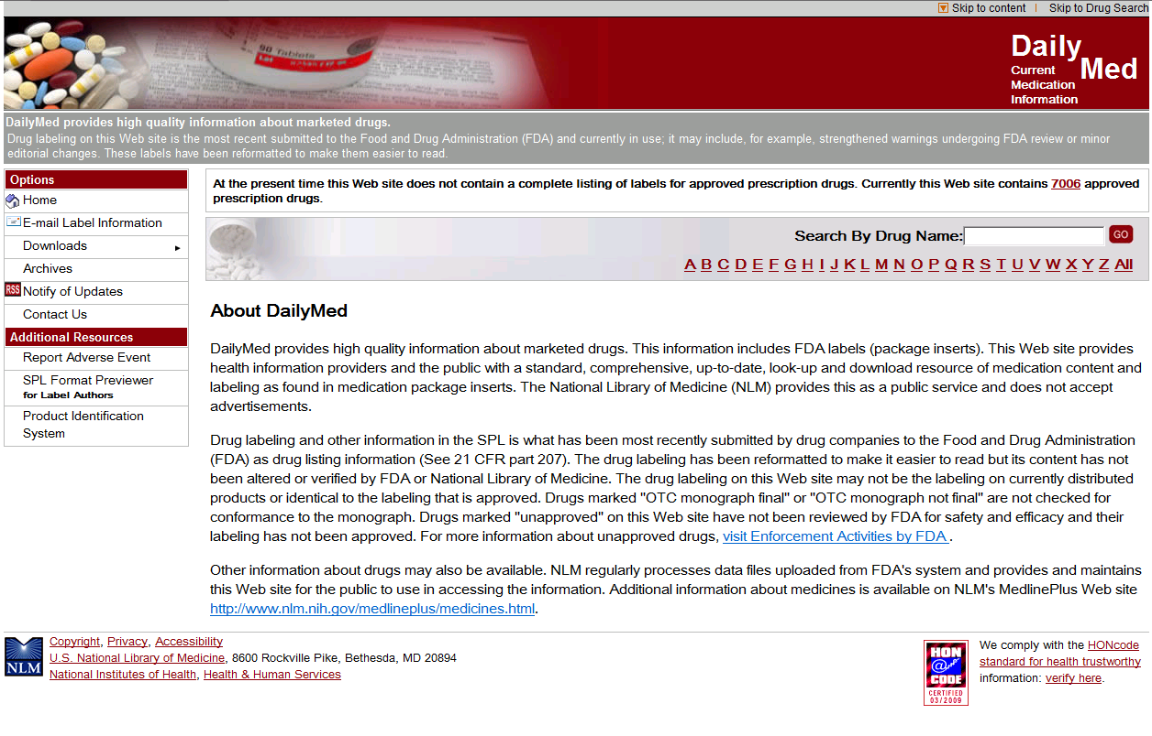
Consumer Drug Information DailyMed (http://dailymed.nlm.nih.gov/)

Slide 56
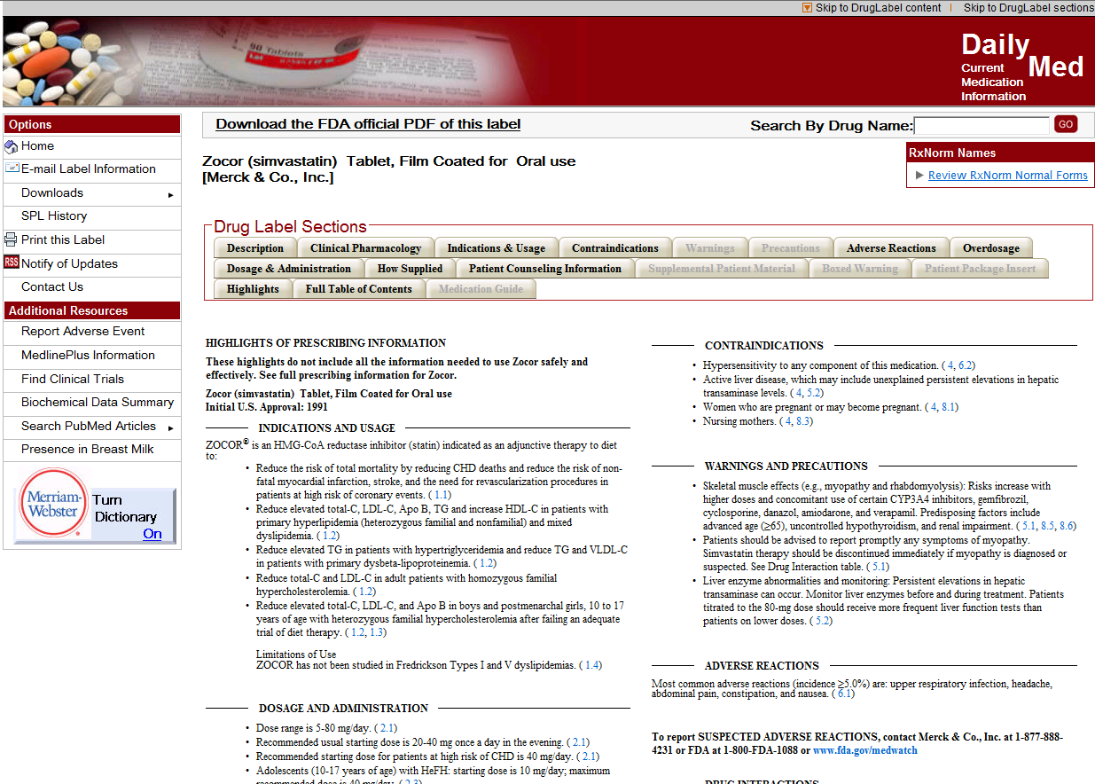
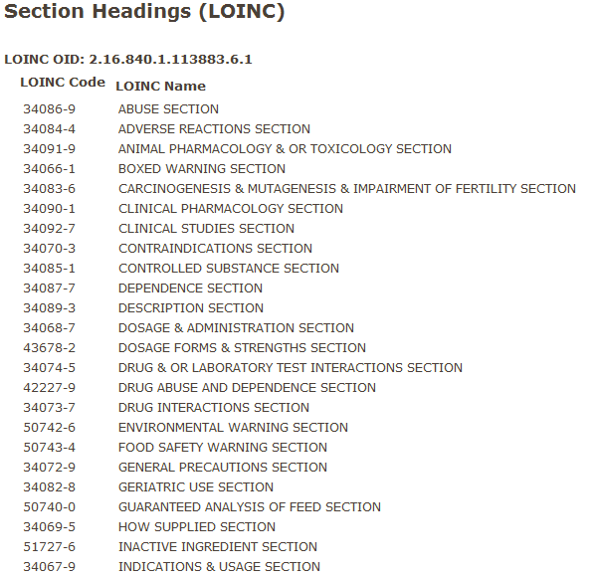

Slide 57
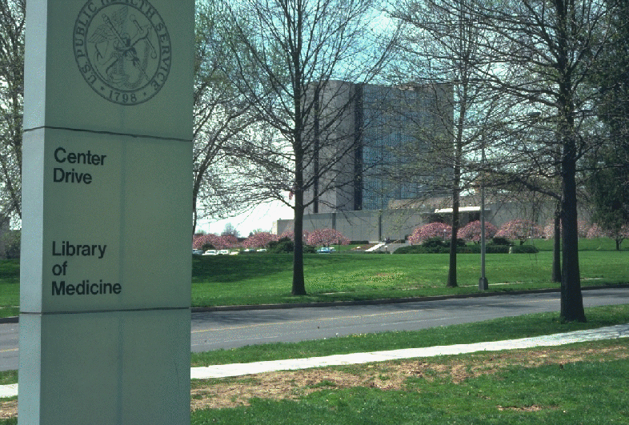
Thank you!

