Slide 1
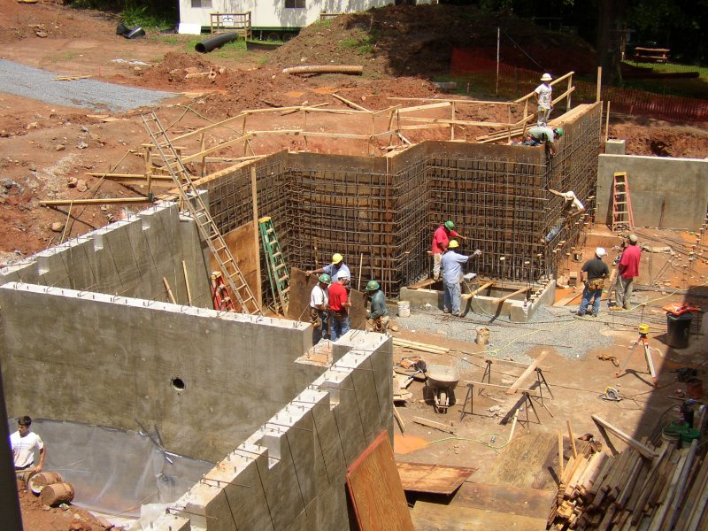
BUILDING AN Economically SUSTAINABLE FOUNDATION FOR THE INFORMATION AGE
Dr. Francine Berman
Vice President for Research, Rensselaer Polytechnic Institute
Co-Chair, Blue Ribbon Task Force on Sustainable Digital Preservation and Access

Slide 2
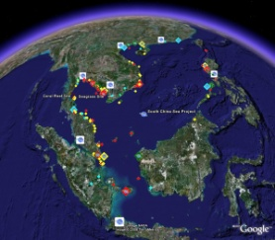



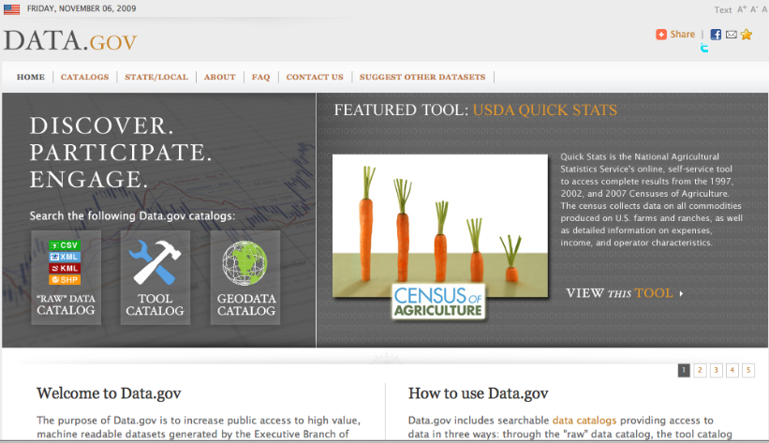
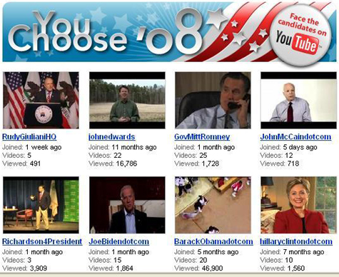

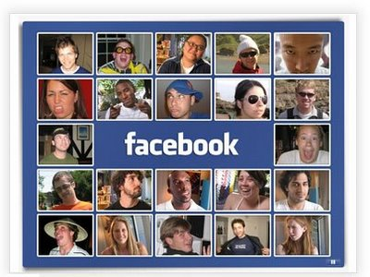





The Digital World
E-Government
E-Business
Research and Education
Digital Entertainment
Communication and Information

Slide 3

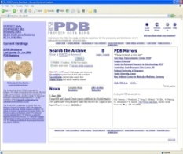
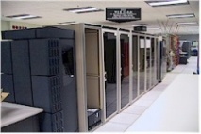
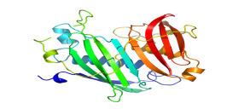


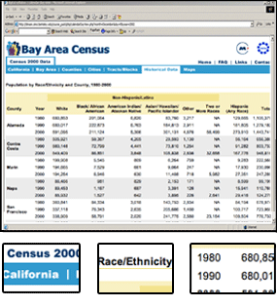
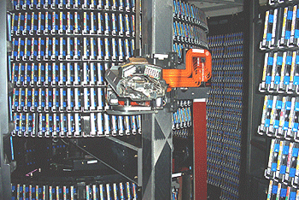



Information from birth to death/immortality: The Digital Data Life Cycle
Create
Edit
Use / Reuse
Preserve / Destroy
Publish
Data creation / capture / gathering from
laboratory experiments
fieldwork
surveys
devices
media
simulation output ...
Organize
Annotate
Clean
Filter ....
Analyze
Mine
Model
Derive additional data
Visualize
Input to instruments / computers / devices ….
Disseminate
Create portals / data collections / databases
Associate with literature ….
Store / preserve
Store / replicate / preserve
Store / ignore
Destroy ….
Information adapted from Chris Rusbridge and Liz Lyon

Slide 4
Supporting the Digital Data Life Cycle: A Multi-dimensional Problem
Multiple Challenges:
“How to ensure access to data over the long term”
standards and reliable SW and HW required to support data management, data preservation, data services
“Who is responsible for digital information?”
alignment between stakeholder groups and new regulation and policy concerning retention needed
“Who pays?”
Viable sustainable economic models needed
How to ensure long-term access?
Technical
Social, Policy, Regulatory
Economic
Economic
Who is responsible?
Who pays?

Slide 5
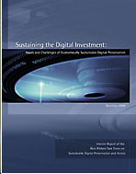
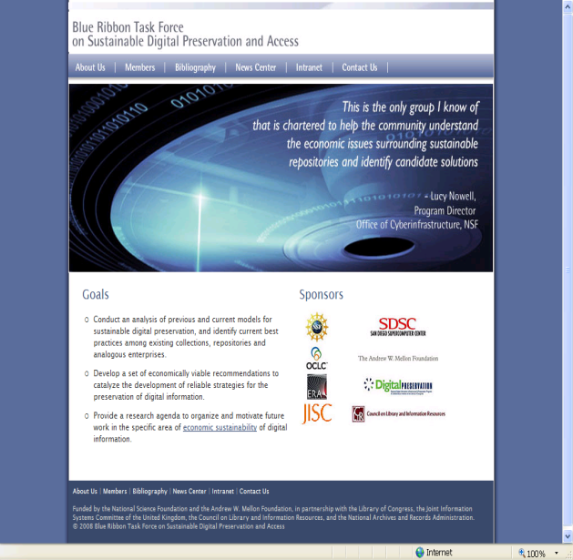

Focus on Economics: The Blue Ribbon Task Force on Sustainable Digital Preservation and Access
BRTF Charge:
Conduct a comprehensive analysis of sustainable digital preservation
Identify and evaluate best practices
Make specific recommendations for action
Articulate next steps for further work
BRTF Interim report
brtf.sdsc.edu
BRTF Final report

Slide 6

What is required to support digital information over the long term?
Economic sustainability for digital information* requires
Recognition of the benefits of long-term access and preservation
Incentives for decision-makers to act
Means of selecting “valued” information for long-term preservation
Mechanisms to support ongoing, efficient allocation of resources
Appropriate organization and governance of preservation and access activities
* From Blue Ribbon Task Force Interim Report

Slide 7


Who’s Paying the Bills?
The “free rider” non-solution: “Let X do it”
where X is:
The Government
The Libraries
The Archivists
Google, Microsoft, etc.
Data users
Data owners
Data creators, etc.

Slide 8
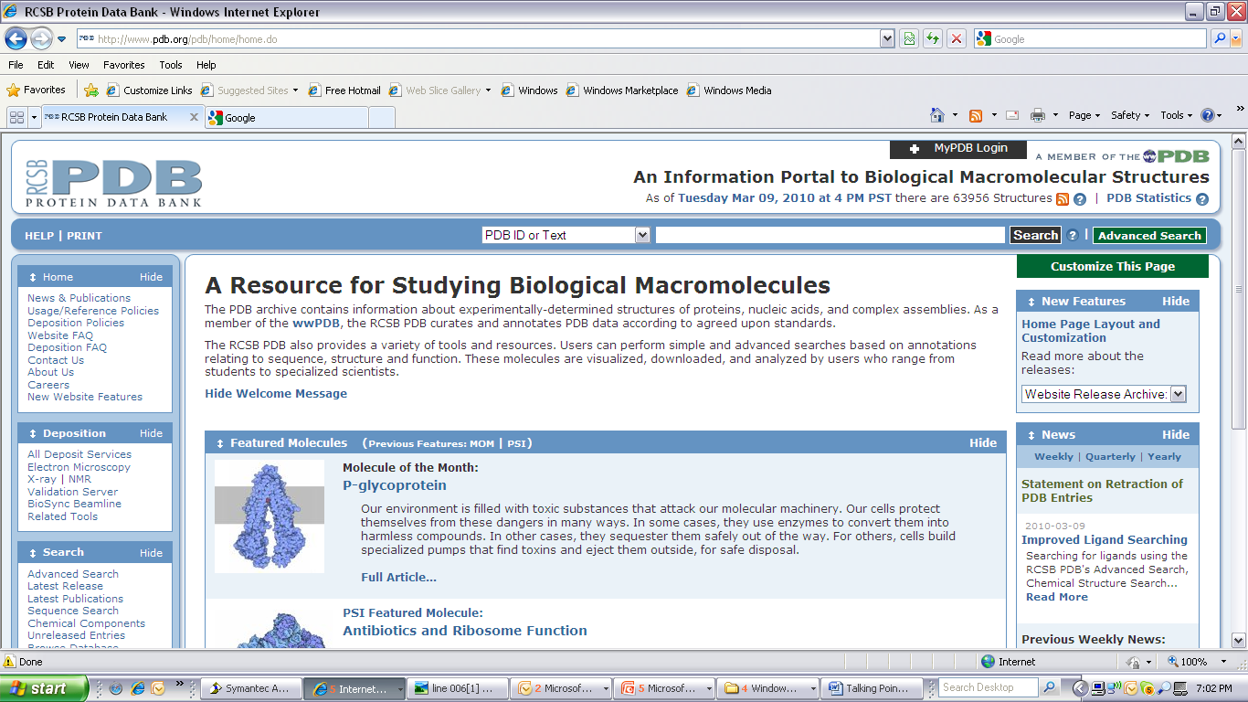


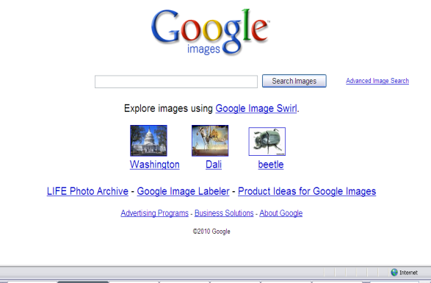

How do we currently support access to digital information?
Subscription
Federal grants
Advertisements
Pay per service
Donations, etc.

Slide 9
Who are the Stakeholders?
Many Stakeholders in digital preservation …
Stakeholders who benefit from use of the preserved asset
Stakeholders who select what to preserve
Stakeholders who own the asset
Stakeholders who preserve the asset
Stakeholders who pay
The greater the alignment between key stakeholder groups, the better the prospects for sustainable preservation
4 Common Stakeholder Scenarios
Research data
Scholarly discourse
Commercially-owned Cultural content
Collectively-produced web content
Findings from Blue Ribbon Task Force Final Report

Slide 10

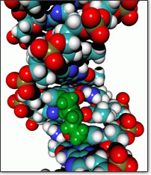

Research Data
Stakeholders who benefit: the greater research community
Stakeholders who select: Often the individuals who generate the data
Stakeholders who own: Often the data generators
Stakeholders who preserve: Often the data generators and their proxies
Stakeholders who pay: Federal agencies, institutions
Needed actions involve
the development of federal agency policies that mandate the stewardship of important research data
the identification of viable support options for third-party archives to host valuable research data
Findings from Blue Ribbon Task Force Final Report

Slide 11
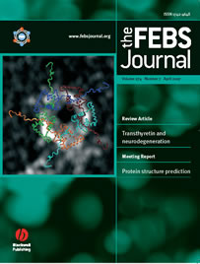

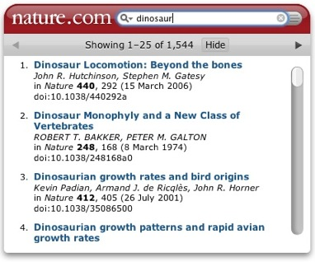
Scholarly Discourse
Stakeholders who benefit: the greater research and learning community
Stakeholders who select: Publishers, based on community review
Stakeholders who own: Publishers generally own IP rights
Stakeholders who preserve: Publishers and third-party entities
Stakeholders who pay: Publishers, libraries, and third-party entities
Needed actions involve
Clarification (with respect to licensing, ownership, rights, etc.) of the responsibilities of publishers, third-party archives, and scholars
Granting of non-excusive rights to content by scholars to enable decentralization of publishing and preservation.
Findings from Blue Ribbon Task Force Final Report

Slide 12

Commercially Owned Cultural Content
Stakeholders who benefit: the general public, cultural historians
Stakeholders who select: Studios, third-party organizations
Stakeholders who own: Studios, third-party organizations
Stakeholders who preserve: Institutional and individual repositories, third-party organizations, etc.
Stakeholders who pay: Studios, professional organizations, private owners, custodial organizations, etc.
Needed actions involve
Alignment of requirements for copyright deposit with the requirements of digital preservation and access
Development and involvement of organizations that can ensure secure handoffs of cultural materials from private owners to economically viable public preservers

Slide 13



Collectively-produced Web Content
Stakeholders who benefit: the general public, cultural historians, etc.
Stakeholders who select: Often the entities that preserve the data
Stakeholders who own: Often unclear
Stakeholders who preserve: Third parties interested in preservation of cultural assets
Stakeholders who pay: Third parties interested in the preservation of cultural assets
Needed actions involve
the development of appropriate licensing and regulations that permit third-parties to preserve web content
the development of incentives for host sites or third parties to preserve

Slide 14
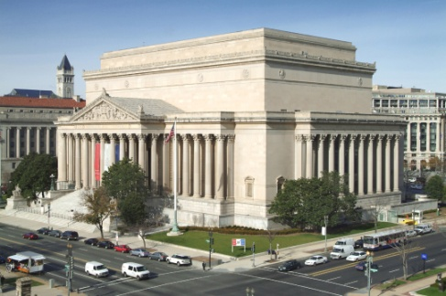
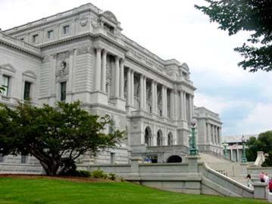

An Action Agenda for Trusted International, National and Public Institutions
Create mechanisms for public-private partnerships to align distinct groups: Convene stakeholders, sponsor cooperation and collaboration, etc.
Convene expert communities to address the selection and preservation needs of valuable materials for which there is no stewardship (Web materials, digital orphans).
Act expeditiously to reform national and international copyright legislation to address digital preservation needs.
Create financial incentives to encourage private entities to preserve digital materials on the public behalf.

Slide 15


An Action Agenda for Funders and Sponsors of Data Creation
Create preservation mandates when possible
Invest in building / seeding stewardship capacity throughout the system.
Fund the research into, modeling, and testing of domain-specific preservation strategies
Provide leadership in training and education for 21st century preservation, including domain expertise and core competencies in STEM. Promote digital preservation skills.
Findings from Blue Ribbon Task Force Final Report

Slide 16
An Action Agenda for Organizations and Individuals
Organizations
Fund internal preservation and access activities as core infrastructure.
Create economies of scope and economies of scale by partnering with related organizations and industry professional associations.
Develop preservation strategies that reflect technical, policy, and workforce best practices
Individuals
Provide nonexclusive rights to preserve and distribute created content.
Partner with preservation experts throughout your data’s lifecycle to ensure that data is ready to hand off in a form that will be useful over the long term.
Pro-actively participate in professional societies and relevant organizations to create stewardship best practices and selection priorities.
Findings from Blue Ribbon Task Force Final Report

Slide 17
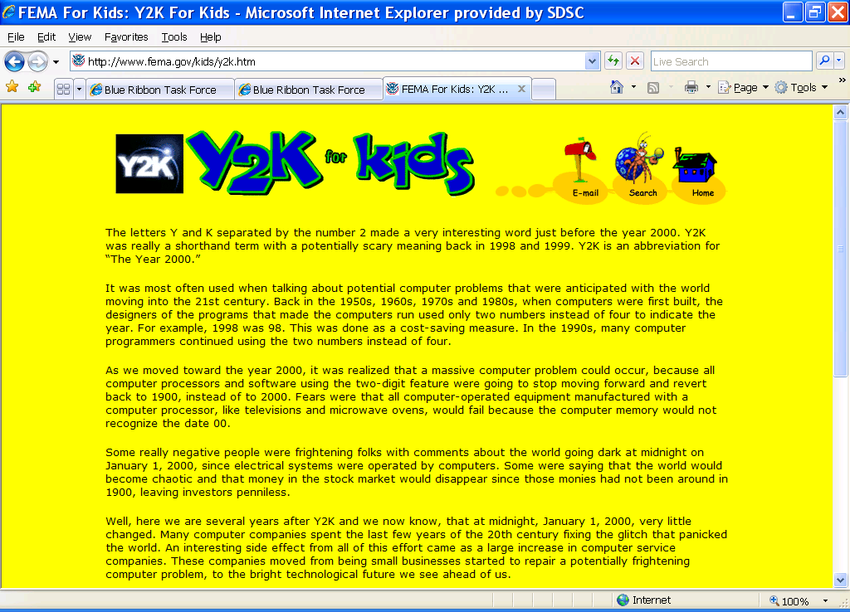
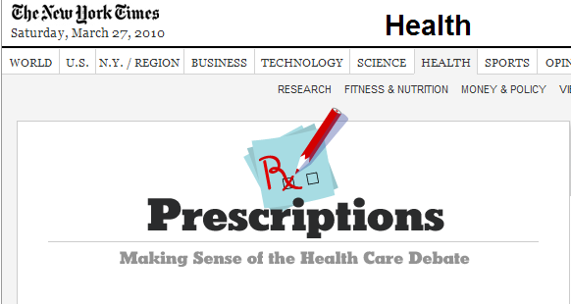

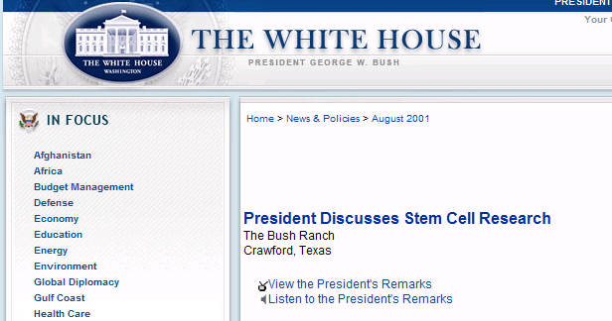
Our responsibility: Making the Case
To Decision Makers:
What are liabilities and the opportunity costs of not acting?
What specific actions need to be made a priority now?
To the General Public:
Does your dry cleaner know what digital preservation is?

Slide 18
Thank You
BRTF Interim report
brtf.sdsc.edu
BRTF Final report

