Slide 1
Libraries in the New Research Environment
Joyce Ray NAS/BRDI Symposium
Associate Deputy for Libraries June 3, 2010
Notes:
Thank you so much for inviting me to speak today
I am Rachel Frick, the senior program officer for the National Leadership grants for the Institute of Museum and Library Services.
Today, I am going to tell you a little about IMLS, our recent research activities, our preservation initiatives, some of our grant opportunities, and give you examples of projects we have funded that focus on sound recordings, preservation and format conversion efforts

Slide 2
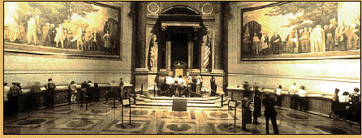
IMLS Mission
Primary source of federal support for the nation’s 123,000 libraries and 17,500 museums.
Create strong libraries and museums that connect people to information and ideas.
Help build the capacity of libraries and museums through grant-making, convenings, research and publications

Slide 3
Challenges of the Online Knowledge Universe
Build the content landscape
Address copyright barriers
Enhance discovery and create tools to support advanced research and re-use of content
Develop sustainable repositories - find the right economies of scale

Slide 4
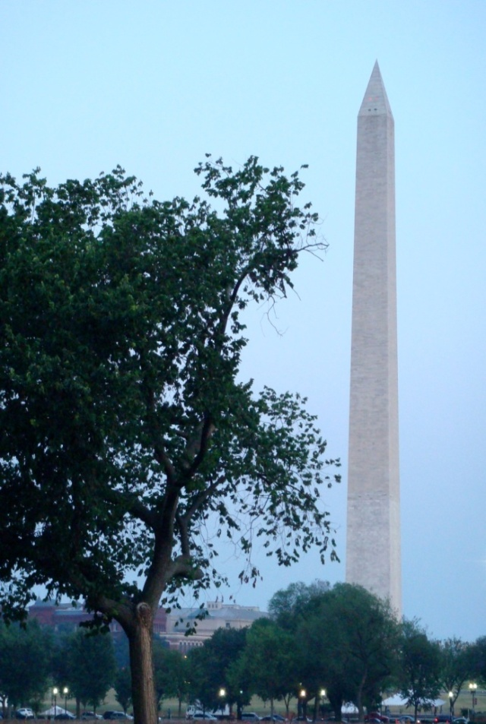
National Leadership Grants
Innovation, Impact and Collaboration
Advancing Digital Resources
Demonstration
Research
Library-Museum Collaboration
Planning

Slide 5
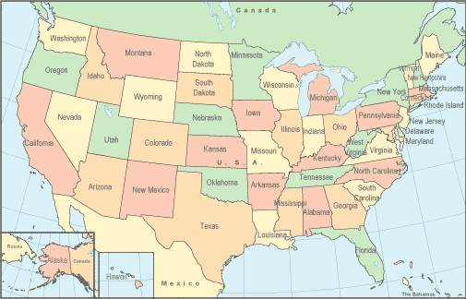
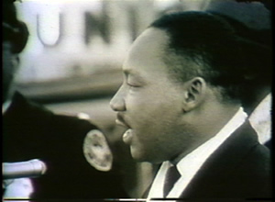
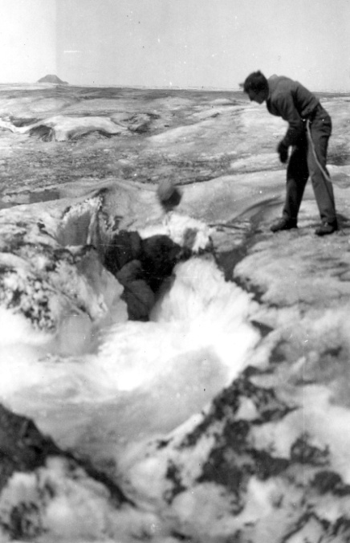
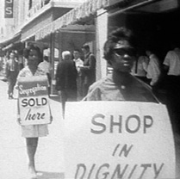
Collaborative Digital Programs
Statewide initiatives in over 40 States
Plus thematic collections
Notes:
Collaborative digital programs are now a recognized group that convenes under the auspices of the American Library Association’s Association of Specialized and Cooperative Library Agencies, InterLibrary cooperation and Networking Section,

Slide 6
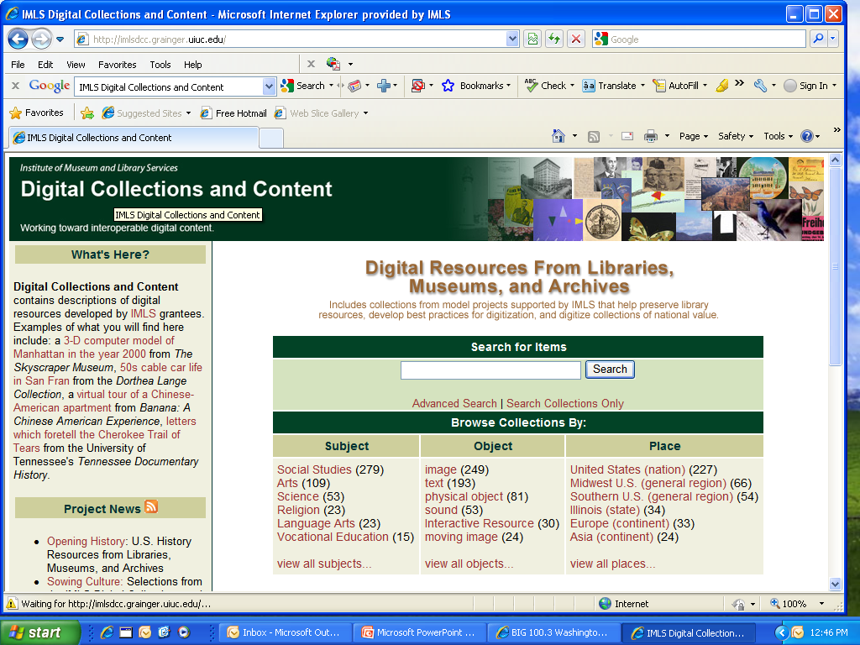
Large-Scale Aggregation
University of
Illinois Urbana-
Champaign
(2002, 2007)
IMLS Digital Collections and Content Registry
http://imlsdcc.grainger.uiuc.edu/
Notes:
This research project uses digital content created with IMLS funding as a testbed. Outcomes: 1) showed significance of collection-level descriptions to understanding item-level data; 2) developed a standardized format for collection descriptions: 3) conducting research on the impact of posting images from cultural heritage collections on Flickr Commons.

Slide 7

Best Practices for Digitization
Framework of Guidance for Building Good Digital Collections – IMLS supported, maintained by
http://framework.niso.org/
Federal Agencies Digitization Guidelines Interagency initiative led by Library of Congress

Slide 8

Address Copyright Barriers
University of Michigan (2008)
Copyright Review Management System
Collaborative resource for determining the copyright status of books published in the US between 1923 & 1963

Slide 9
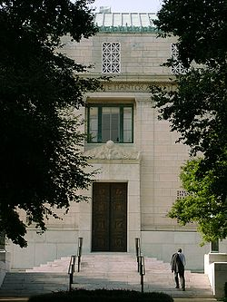

Address Copyright Barriers
The National Academies
Board on Science, Technology & Economic Policy
(2010)
Study on the Impact of Copyright on Innovation in a Digital Era

Slide 10
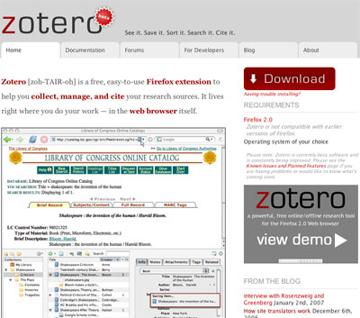
Discovery Tools
George Mason
University (2005)
Zotero - the scholar’s browser allows users to collect, manage, cite & share research resources…
Now in 14 languages
http://www.zotero.org/
Notes:
A free, easy-to-use Firefox extension to help collect, manage, and cite research sources; this tool has received additional funding from the Mellon Foundation and is now available in 30 languages. GMU recently was awarded a contract by NSF to provide a customized interface by expanding the software for internal use.

Slide 11
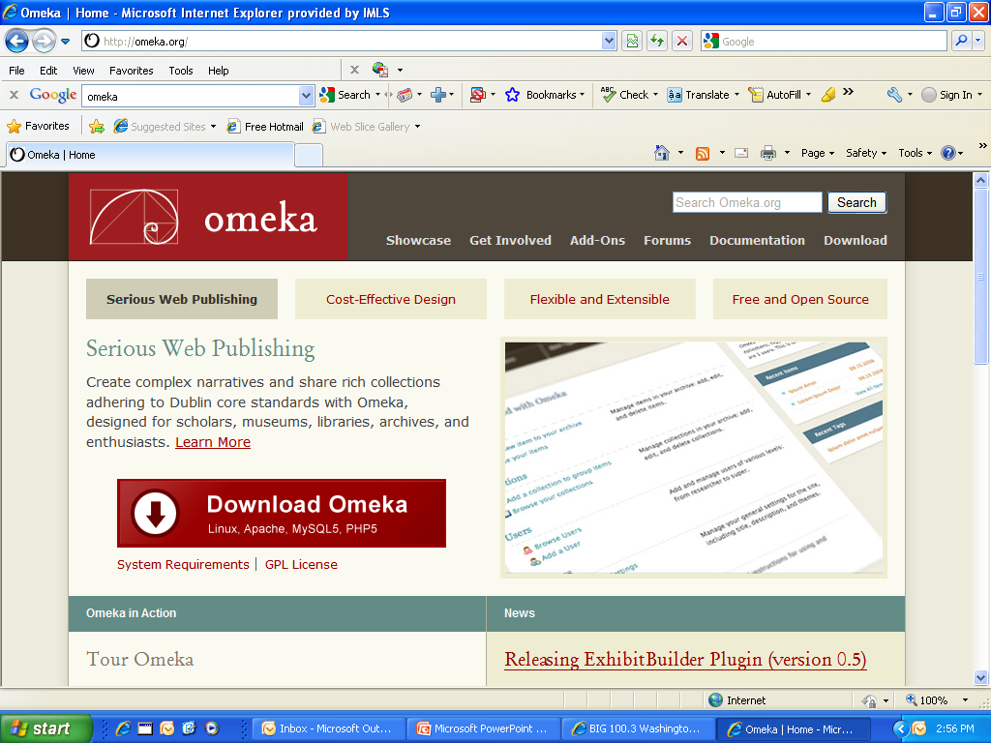
Presentation Tools
George Mason University (2007)
Omeka
“Serious web publishing”
For display of scholarly resources
http://omeka.org/
Notes:
A free and open-source web-based publishing platform for museums, libraries, archives, scholars and educators.

Slide 12
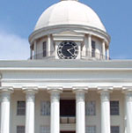
Sustainable Repositories
Alabama Commission on Higher Education (2006)
State-based networked repository based on the LOCKSS model for preserving digital content created by academic institutions, state agencies and cultural heritage organizations
http://www.lockss.org/lockss/Alabama_Digital_Preservation_Network

Slide 13

Sustainable Repositories
Rutgers
University
(2003)
William Patterson University (2007)
One-stop shop for New Jersey history and culture from the collections of libraries, archives, museums & historical societies; statewide repository for digital video
http://www.njdigitalhighway.org/index.php

Slide 14
Sustainable Repositories
Florida Center for Library Automation (2008)
TIPR (towards interoperable preservation repositories)
Partnership with Cornell and NYU to develop a common standards-based format and protocols for repository-to-repository transfers of data and metadata
http://fclaweb.fcla.edu/content/digital-preservation

Slide 15
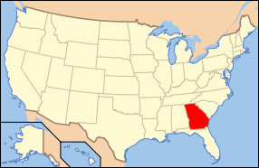
Sustainable Repositories
Georgia Institute of Technology
(2009)
GALILEO statewide institutional repository
9 regional repositories with central harvesting
http://www.library.gatech.edu/gkr/

Slide 16
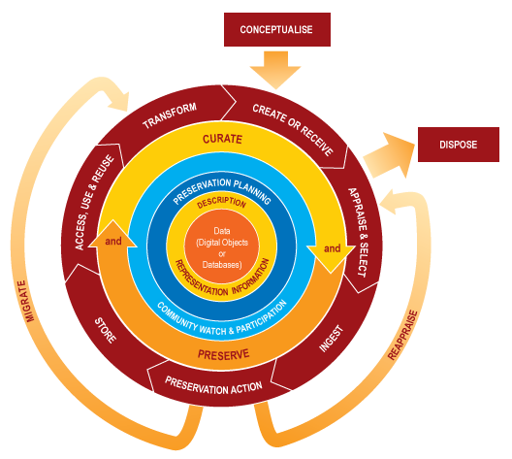
Digital Curation – The Life Cycle of Data
Credit: Digital Curation Centre

Slide 17
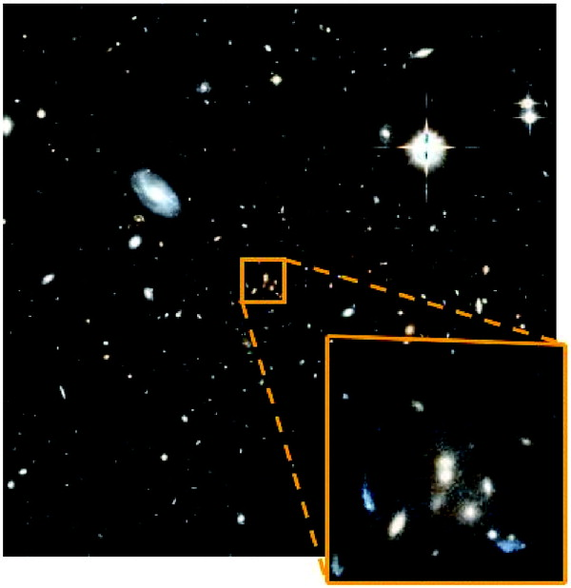

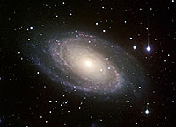
Digital Curation R&D
Johns Hopkins
University
(2006)
National Virtual Observatory
Dataset Preservation Repository
http://www.virtualobservatory.org/

Slide 18
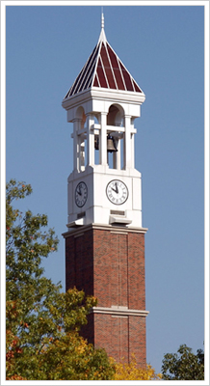
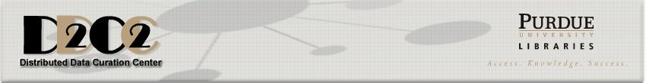
Data Curation R&D
Purdue University (2006)
Distributed Data Curation Center
[Partnership with UIUC]
Case studies of researcher data/metadata workflow, curation profiles across disciplines, system requirements for managing data in repositories
http://d2c2.lib.purdue.edu/

Slide 19
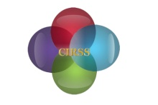


UIUC Data Curation Education Program (Credit: Carole Palmer)
Data from Big Science is … easier to handle, understand and archive. Small Science is horribly heterogeneous and far more vast. In time Small Science will generate 2-3 times more data than Big Science.
(‘Lost in a Sea of Science Data’ S.Carlson, The Chronicle of Higher Education, 23/06/2006.)
big science data
small science data
Notes:
In some disciplines, such as astronomy and high energy particle physics, work on data management and curatorial problems has been an integral part of the scientific endeavor for a number of years. In other domains, however, the concepts and methods that constitute data curation are still new and will require articulation and integration into daily practice. In the life sciences, for example, curation concerns have been addressed in a segmented fashion. Standards work has been carried out by various specialized groups in a “bottom-up” fashion, and querying techniques are largely addressed by database, data mining, and statistics experts

Slide 20
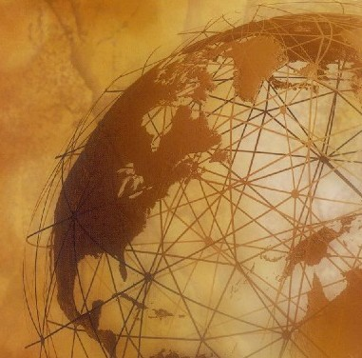
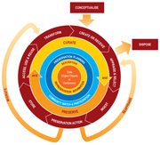
Digital Curation – Best Practices
University of North Carolina
Chapel Hill (2009)
with the Digital Curation Centre (UK) and other partners

Slide 21
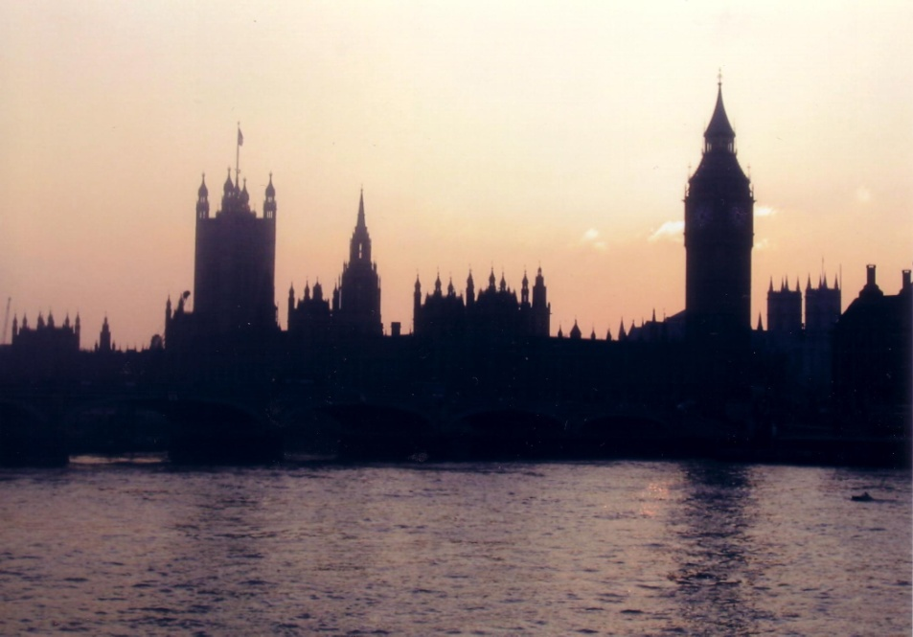

Digital Curation & E-Publishing
Bloomsbury E-Publishing Conference
June 24-25, 2010: London
Valued Resources:
Roles and Responsibilities
of Digital Curators
and Publishers
http://www.ucl.ac.uk/infostudies/e-publishing/

Slide 22
Challenges
Build the content landscape
Address copyright barriers
Enhance discovery and create tools to support advanced research and re-use of content
Develop sustainable repositories - find the right economies of scale, and . . .
Educate professionals to do this work

Slide 23
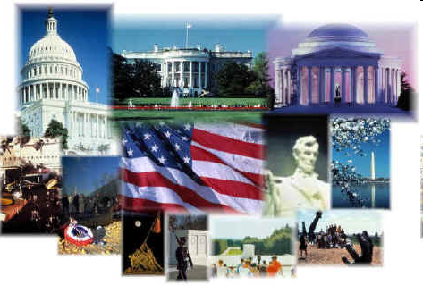
21st Century Librarian Program
Prepare LIS Educators & Workforce for the Next Century
Master’s Programs
Doctoral Programs
Programs to Build LIS Capacity
Continuing Education
Pre-professional Recruiting
Research
$130M+ In Grants Over Past 6 Years
~3500 Librarians, ~200 PhDs,
~1500 Pre-Professionals, ~26,500 CE
Notes:
23

Slide 24
More Information
Visit IMLS at
http://www.imls.gov
Joyce Ray
jray@imls.gov

