Slide 1
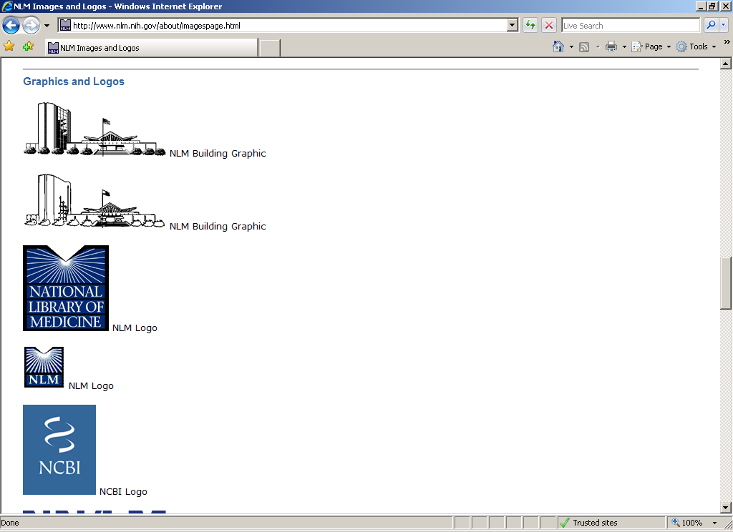
Board on Research Data and Information, National Research Council “Changing Roles of Libraries in Support of Scientific Data Activities” June 3, 2010 More Data, More Use, Less Lead Time: Scientific Data Activities at the National Library of Medicine
Betsy L. Humphreys
Deputy Director
National Library of Medicine
www.nlm.nih.gov

Slide 2
NLM & Scientific Data
Data categories
Substances
Sequences
Clinical Research
Taxonomies/Nomenclatures/Ontologies

Slide 3
NLM & Scientific Data
Challenges (aka Problems)
Much more data
Greater NIH/other investment in generating data
High throughput methods
New, unfunded mandate(s)
Much less lead time
Need to achieve standardization more rapidly

Slide 4
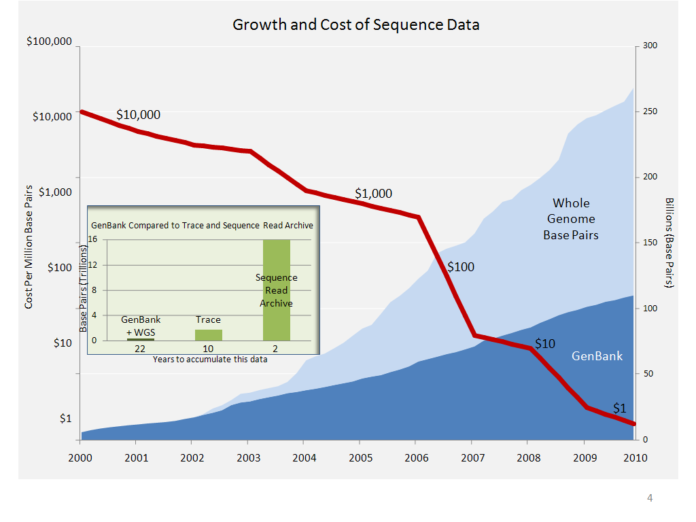

Slide 5
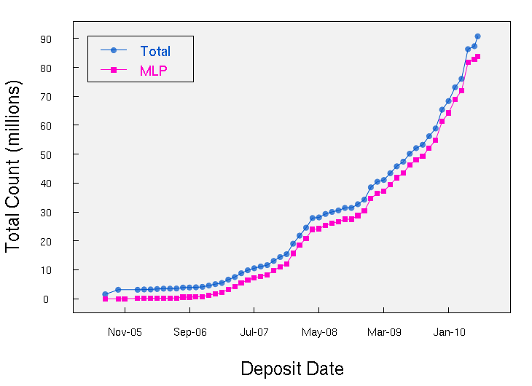
Growth In PubChem Tested Substances

Slide 6
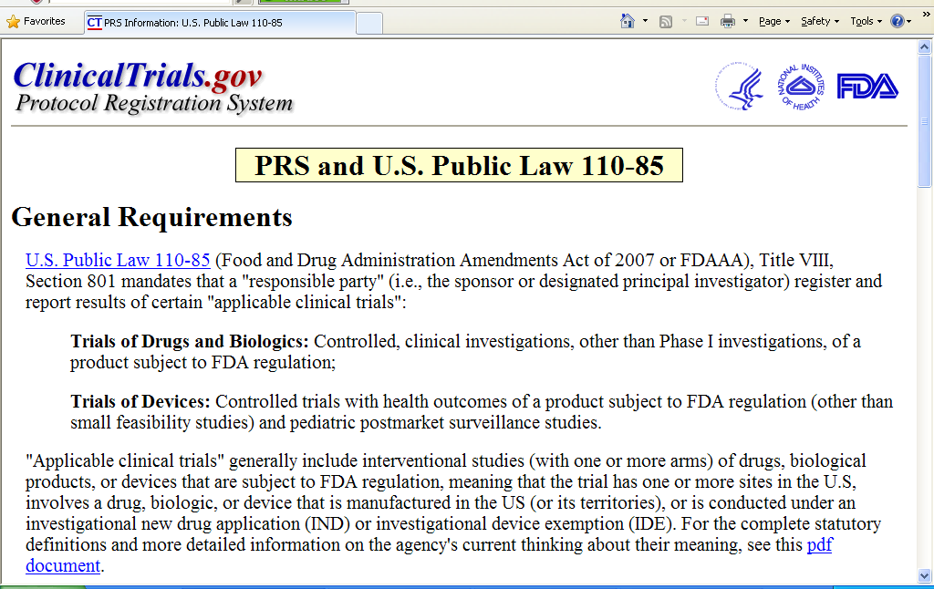

Slide 7
Number of Studies Registered at ClinicalTrials.gov since May 1, 2005
~320 / wk
~250 / wk
FDAAA 801
~25-30 / wk
ICMJE
2,317 Results Records submitted (Sept 2008 – March 2010)
About 30 new results records per week; 80 re-submissions per week
Anticipate increase in rate as rules become clear and outreach continues
7
Notes:
7

Slide 8
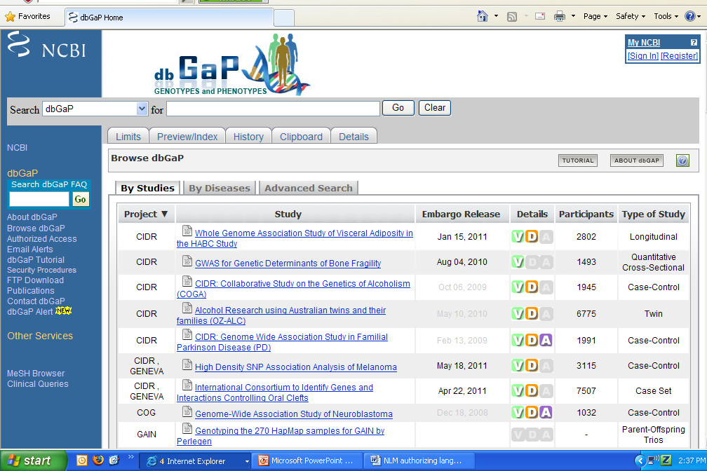

Slide 9
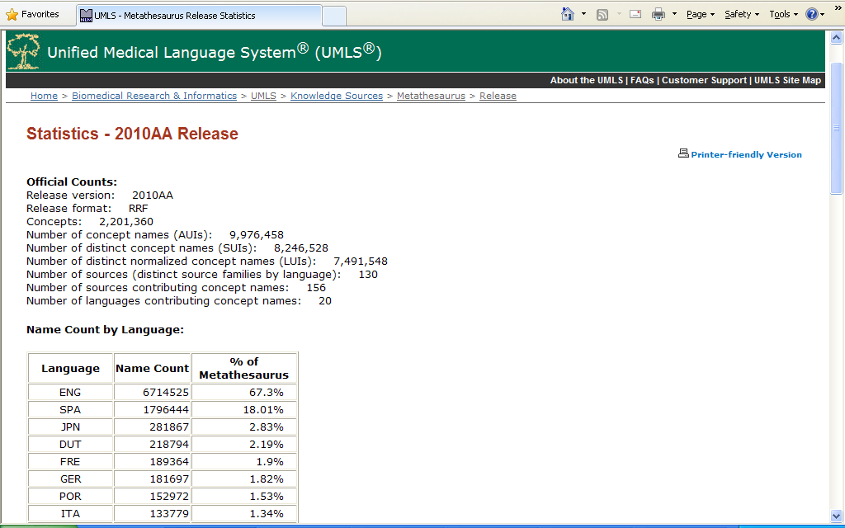
UMLS Metathesaurus – May 2010 version

Slide 10
NLM & Scientific Data
Strengths
Mission & Track Record
Curation, Storage, Permanent Access, Standards, R & D
Robust Infrastructure
Staff Expertise, Advisory Structure, Computing, Communications
Connections between different kinds of data, information
Strong US partnerships and international collaborations
Heavy use
Weaknesses
The “defects of our qualities”
Limited resources
Less user outreach/training than desirable

Slide 11
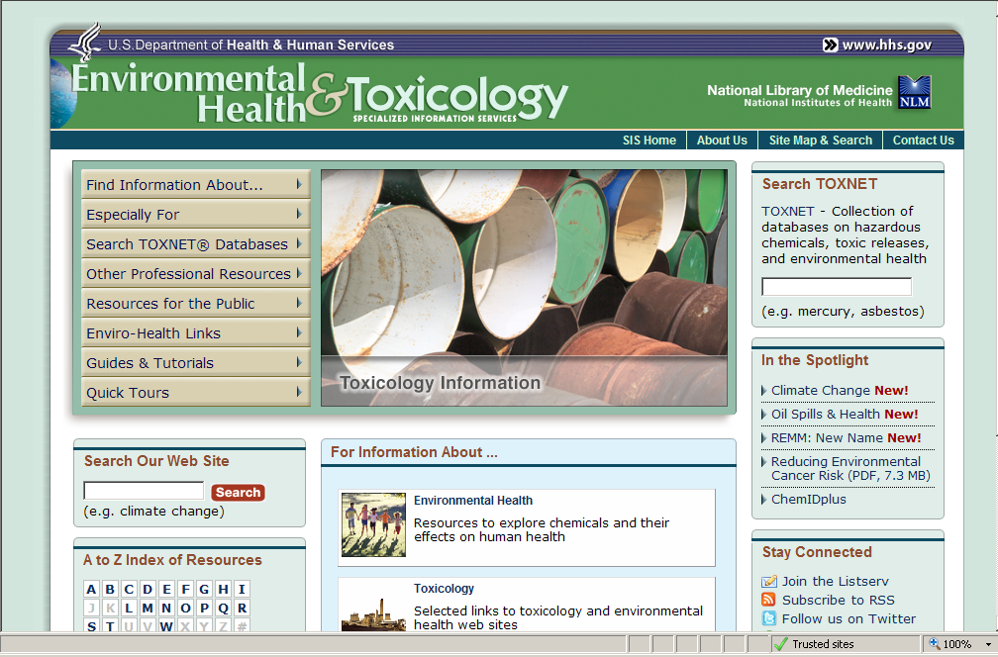

Slide 12
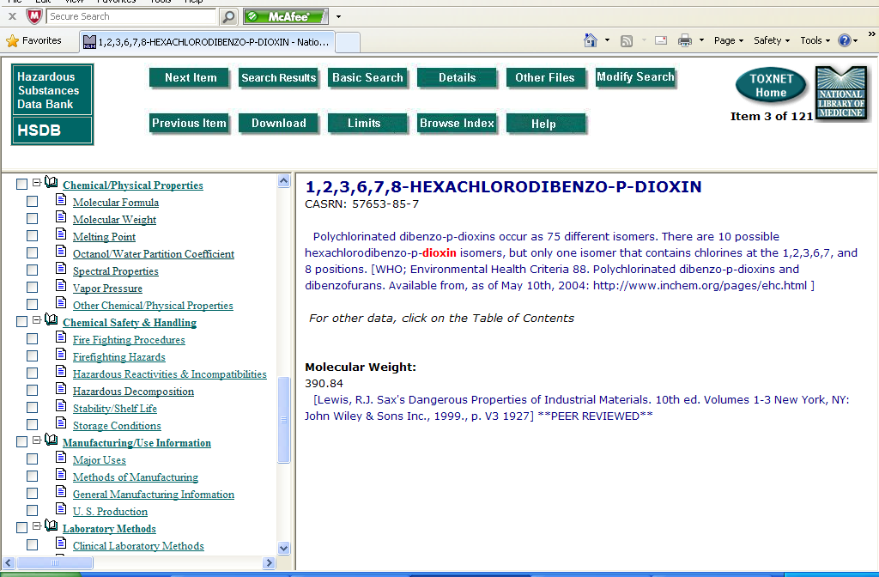
Hazardous Substances Data, 1978-

Slide 13
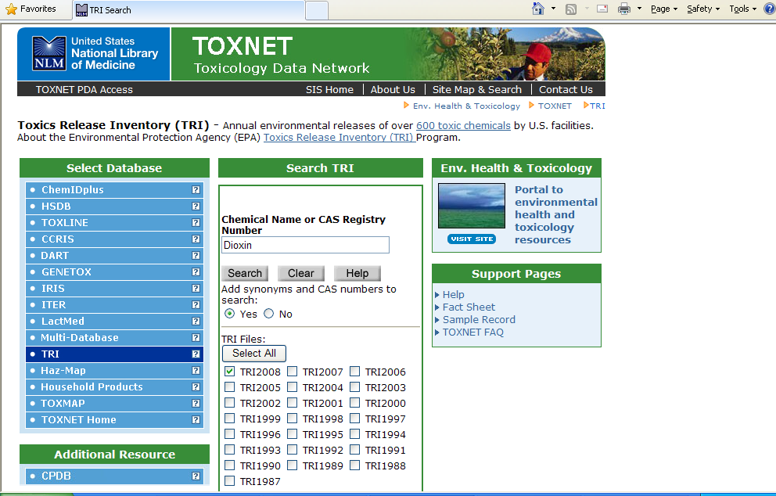
Toxic Release Inventory Data, 1987-

Slide 14
National Center for Biotechnology Information, 1988-
Design, develop, implement, and manage automated systems for collection, storage, retrieval, analysis, & dissemination of knowledge concerning molecular biology, biochemistry, & genetics
Perform research into advanced methods of computer-based information processing capable of representing and analyzing the vast number of biologically important molecules and compounds
Enable persons engaged in biotechnology research and medical care to use these systems & methods
Coordinate, as much as is practicable, efforts to gather biotechnology information on an international basis

Slide 15
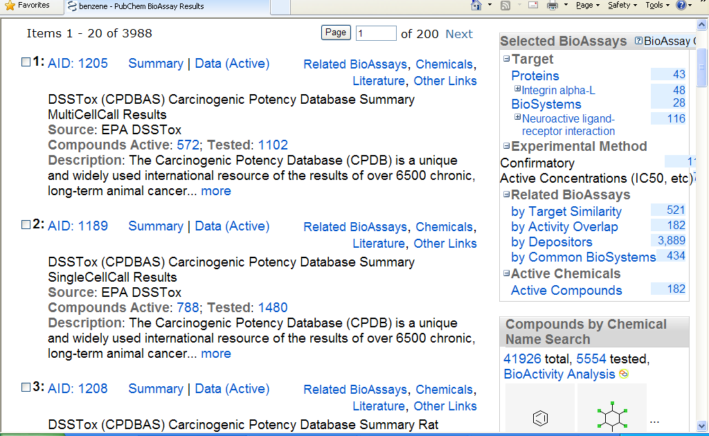
Benzene – PubChem Bioassay Results

Slide 16
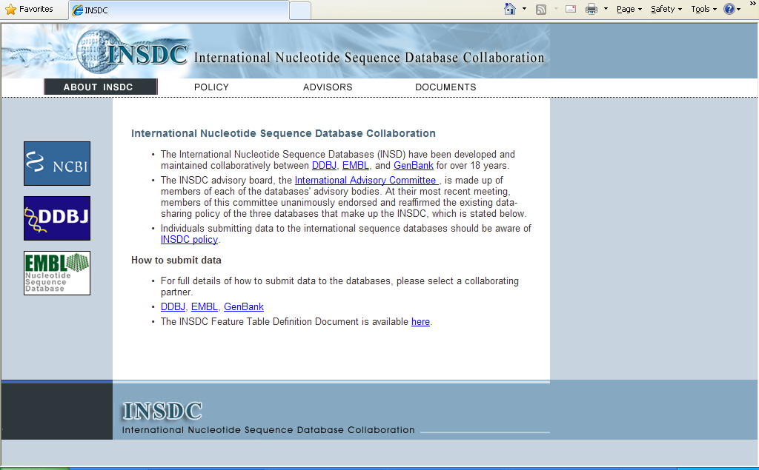

Slide 17

- ~2 million users a day
- 100 million hits a day
- 5 terabytes of data a day
- 3,500 web hits a second (peak)

Slide 18
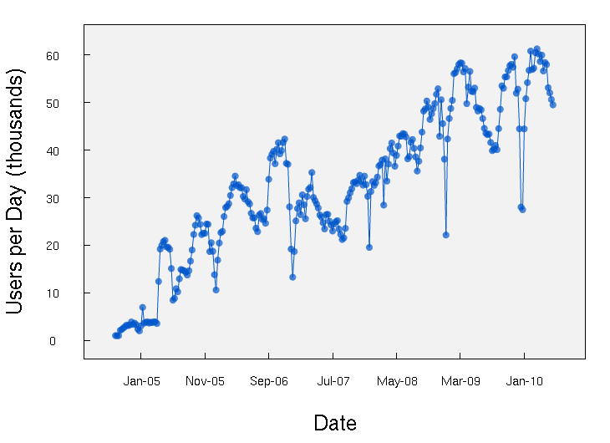
PubChem Users per Day

Slide 19
Current Activities/Future Plans
Continued emphasis on:
Improving the input
Tagging, standardization, explicit links (e.g., GenBank #s, NCT #s)
Increasing data curation efficiency
Use of “influentials” to promote standards, best practices
US Partnerships & International collaborations
Computer center efficiency, security
Better discovery, retrieval, display methods

Slide 20
